Slide 1
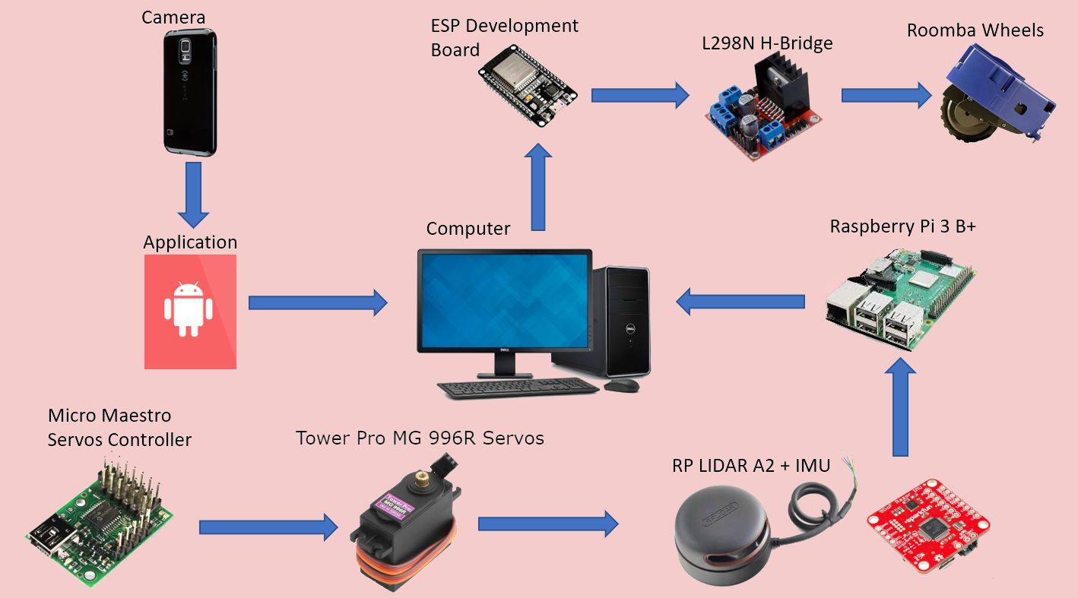
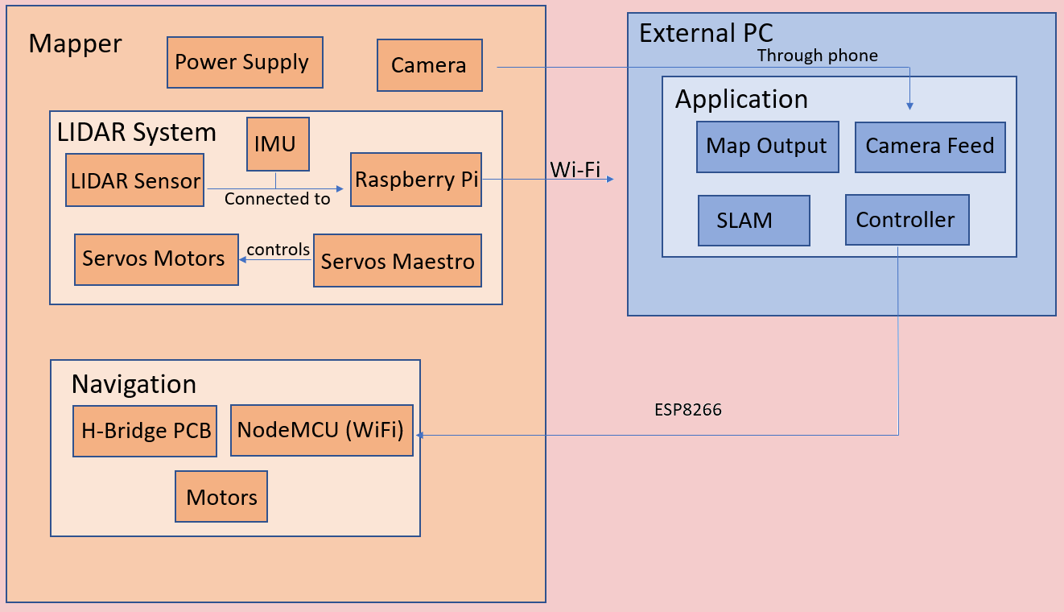
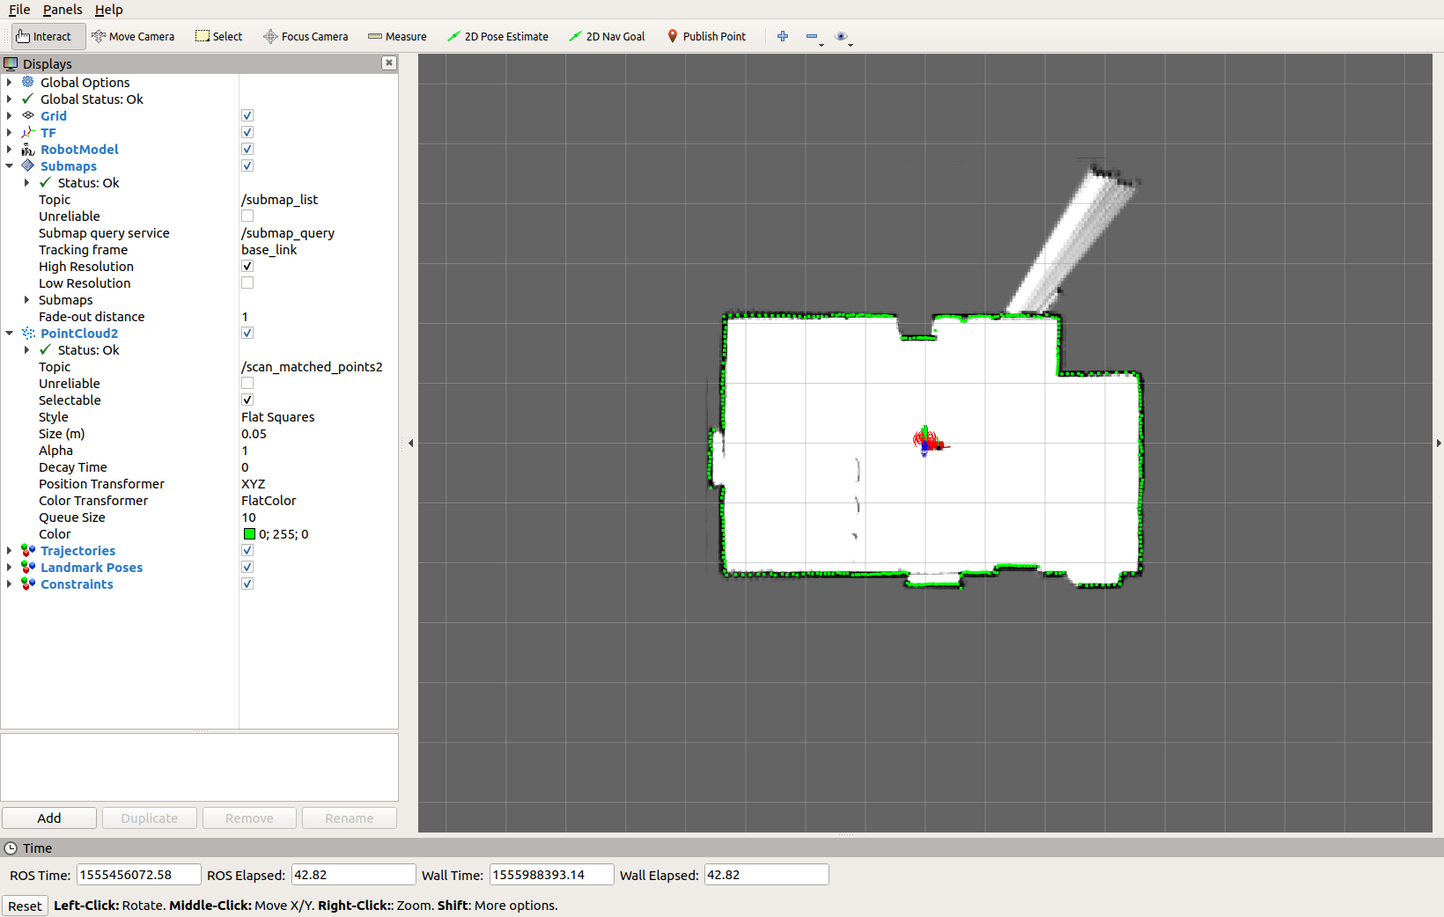
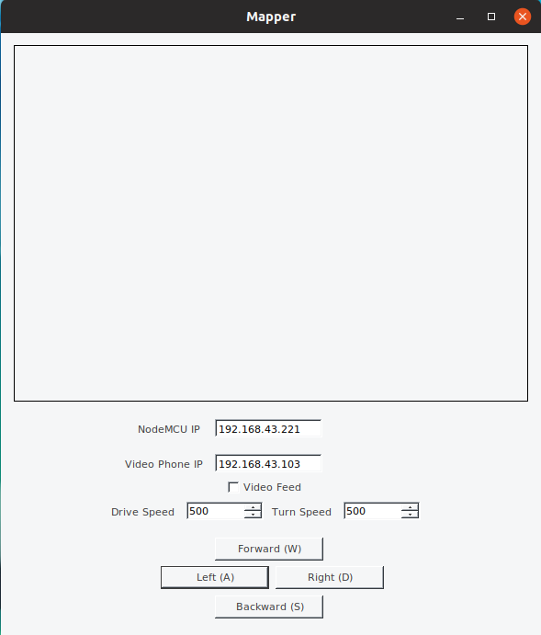
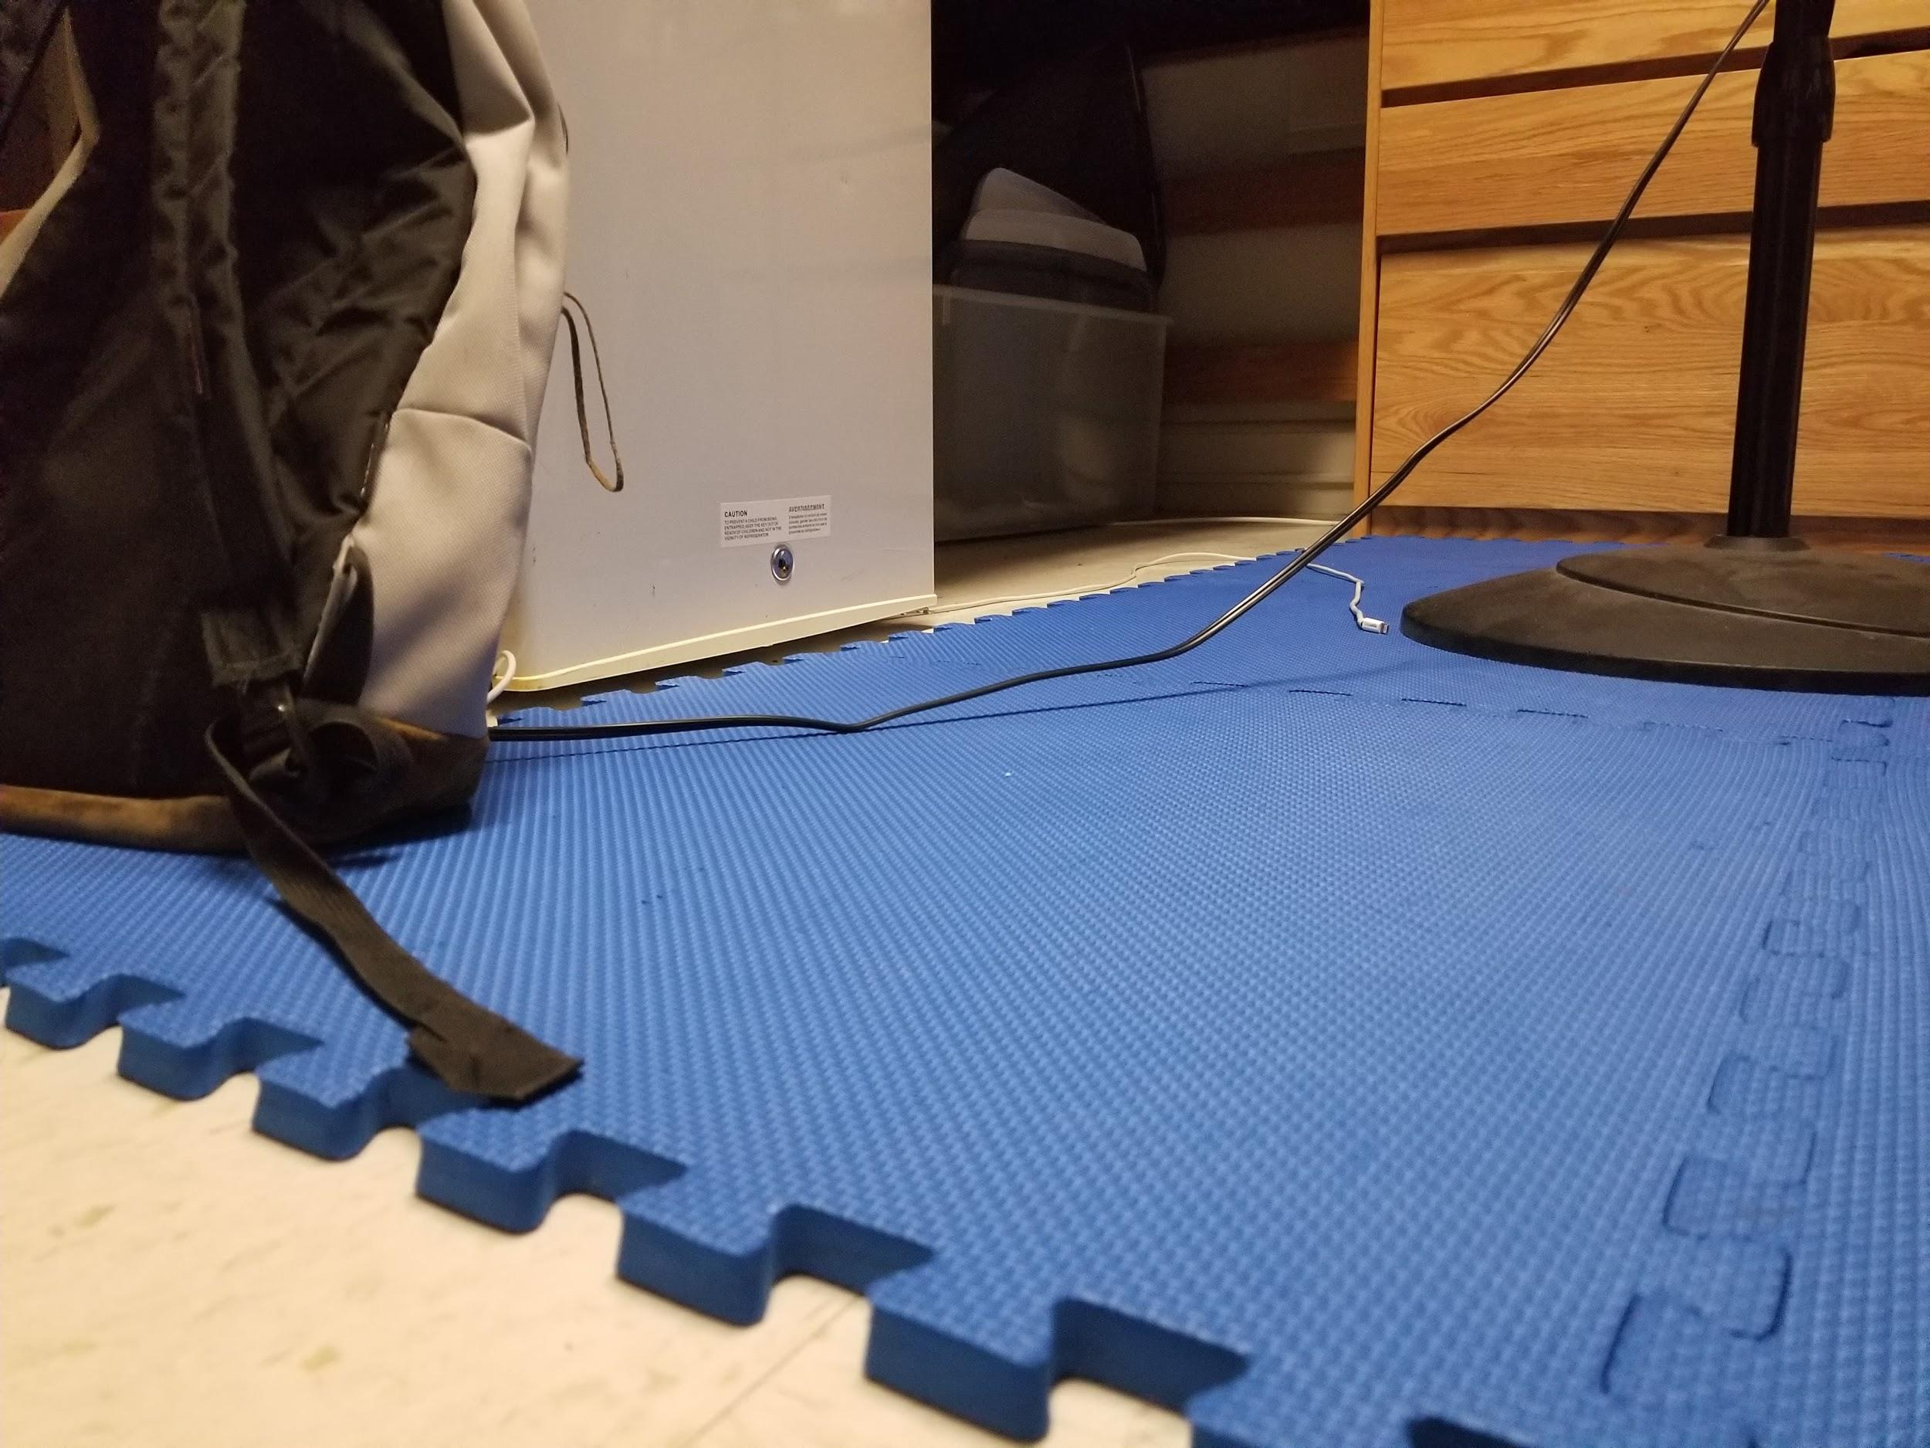
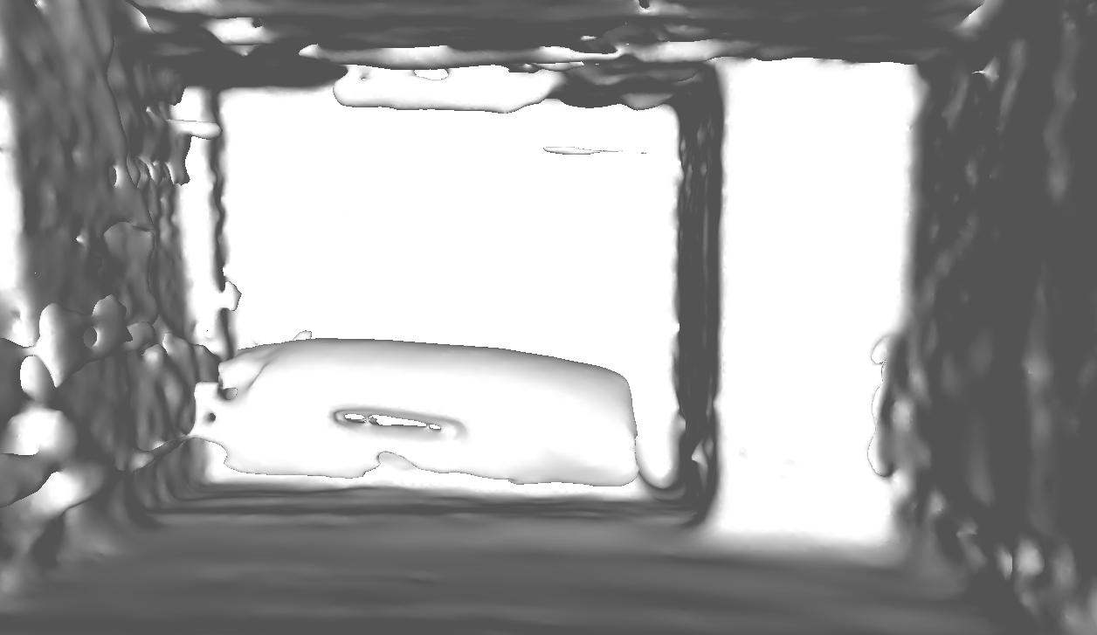
Mapper
Marcus Le, Kelvin Nguyen, Derek Sun, Bryan Martel
Faculty Advisor: Prof. Aura Ganz
Abstract
System Overview
To the average person, buying a house can be seen as a huge milestone. It’s a sense of accomplishment that is unlike anything else. But in today’s modern real estate, that process can be tedious, long, and often overwhelming. Our project, Mapper, provides users with a more convenient method of viewing houses for sale or rent. By using Simultaneous Localization and Mapping (SLAM) algorithms, our robot will feature the ability to map an entire floor in 3D for users to view, thus reducing the need to travel there in person to get an accurate visualization of their potential home. Using a LIDAR sensor and IMU mounted on a custom robot, Mapper will be able to send data through Wi-Fi to an external PC for the SLAM algorithm processing. The result will be a 3D mesh map of the building viewable on the external PC.
Block Diagram
Results
Specifications
Requirement | Specification | Actual
Navigate efficiently | Speed of up to 3 mph | 2.1 mph normal 3 mph max
Long range sensing | Effective detection range of 15 ft | 5 meters (16.4 feet)
Light-weight design | Approximately 12 pounds | < 10 pounds
Sufficient Battery Life | Approximately 2 hours of battery life | Approximately 3 hours 26 minutes
3D SLAM | LIDAR servos tilt system of 35 degrees | 45 degrees
Robust | Durable enough to withstand minor collisions | Durable enough to withstand minor collisions
User-Friendly | PC application for navigation commands and map display | Applications include: Mapper camera, map display, navigation control, speed control
Acknowledgement
Special thanks to:
Prof. Aura Ganz for being our advisor and guiding us through technical and non-technical aspects of our project
Shira Epstein for providing thoughtful insight regarding SLAM and possible problems to look out for
Prof. Jun Yao for his helpful evaluation and support
Dr. Chengbo Ai for his advice regarding LIDAR systems
Francis Caron for ordering the parts we needed and getting them to us as quickly as possible
Department of Electrical and Computer Engineering
ECE 415/ECE 416 – SENIOR DESIGN PROJECT 2019
College of Engineering - University of Massachusetts Amherst
SDP19

Slide 2
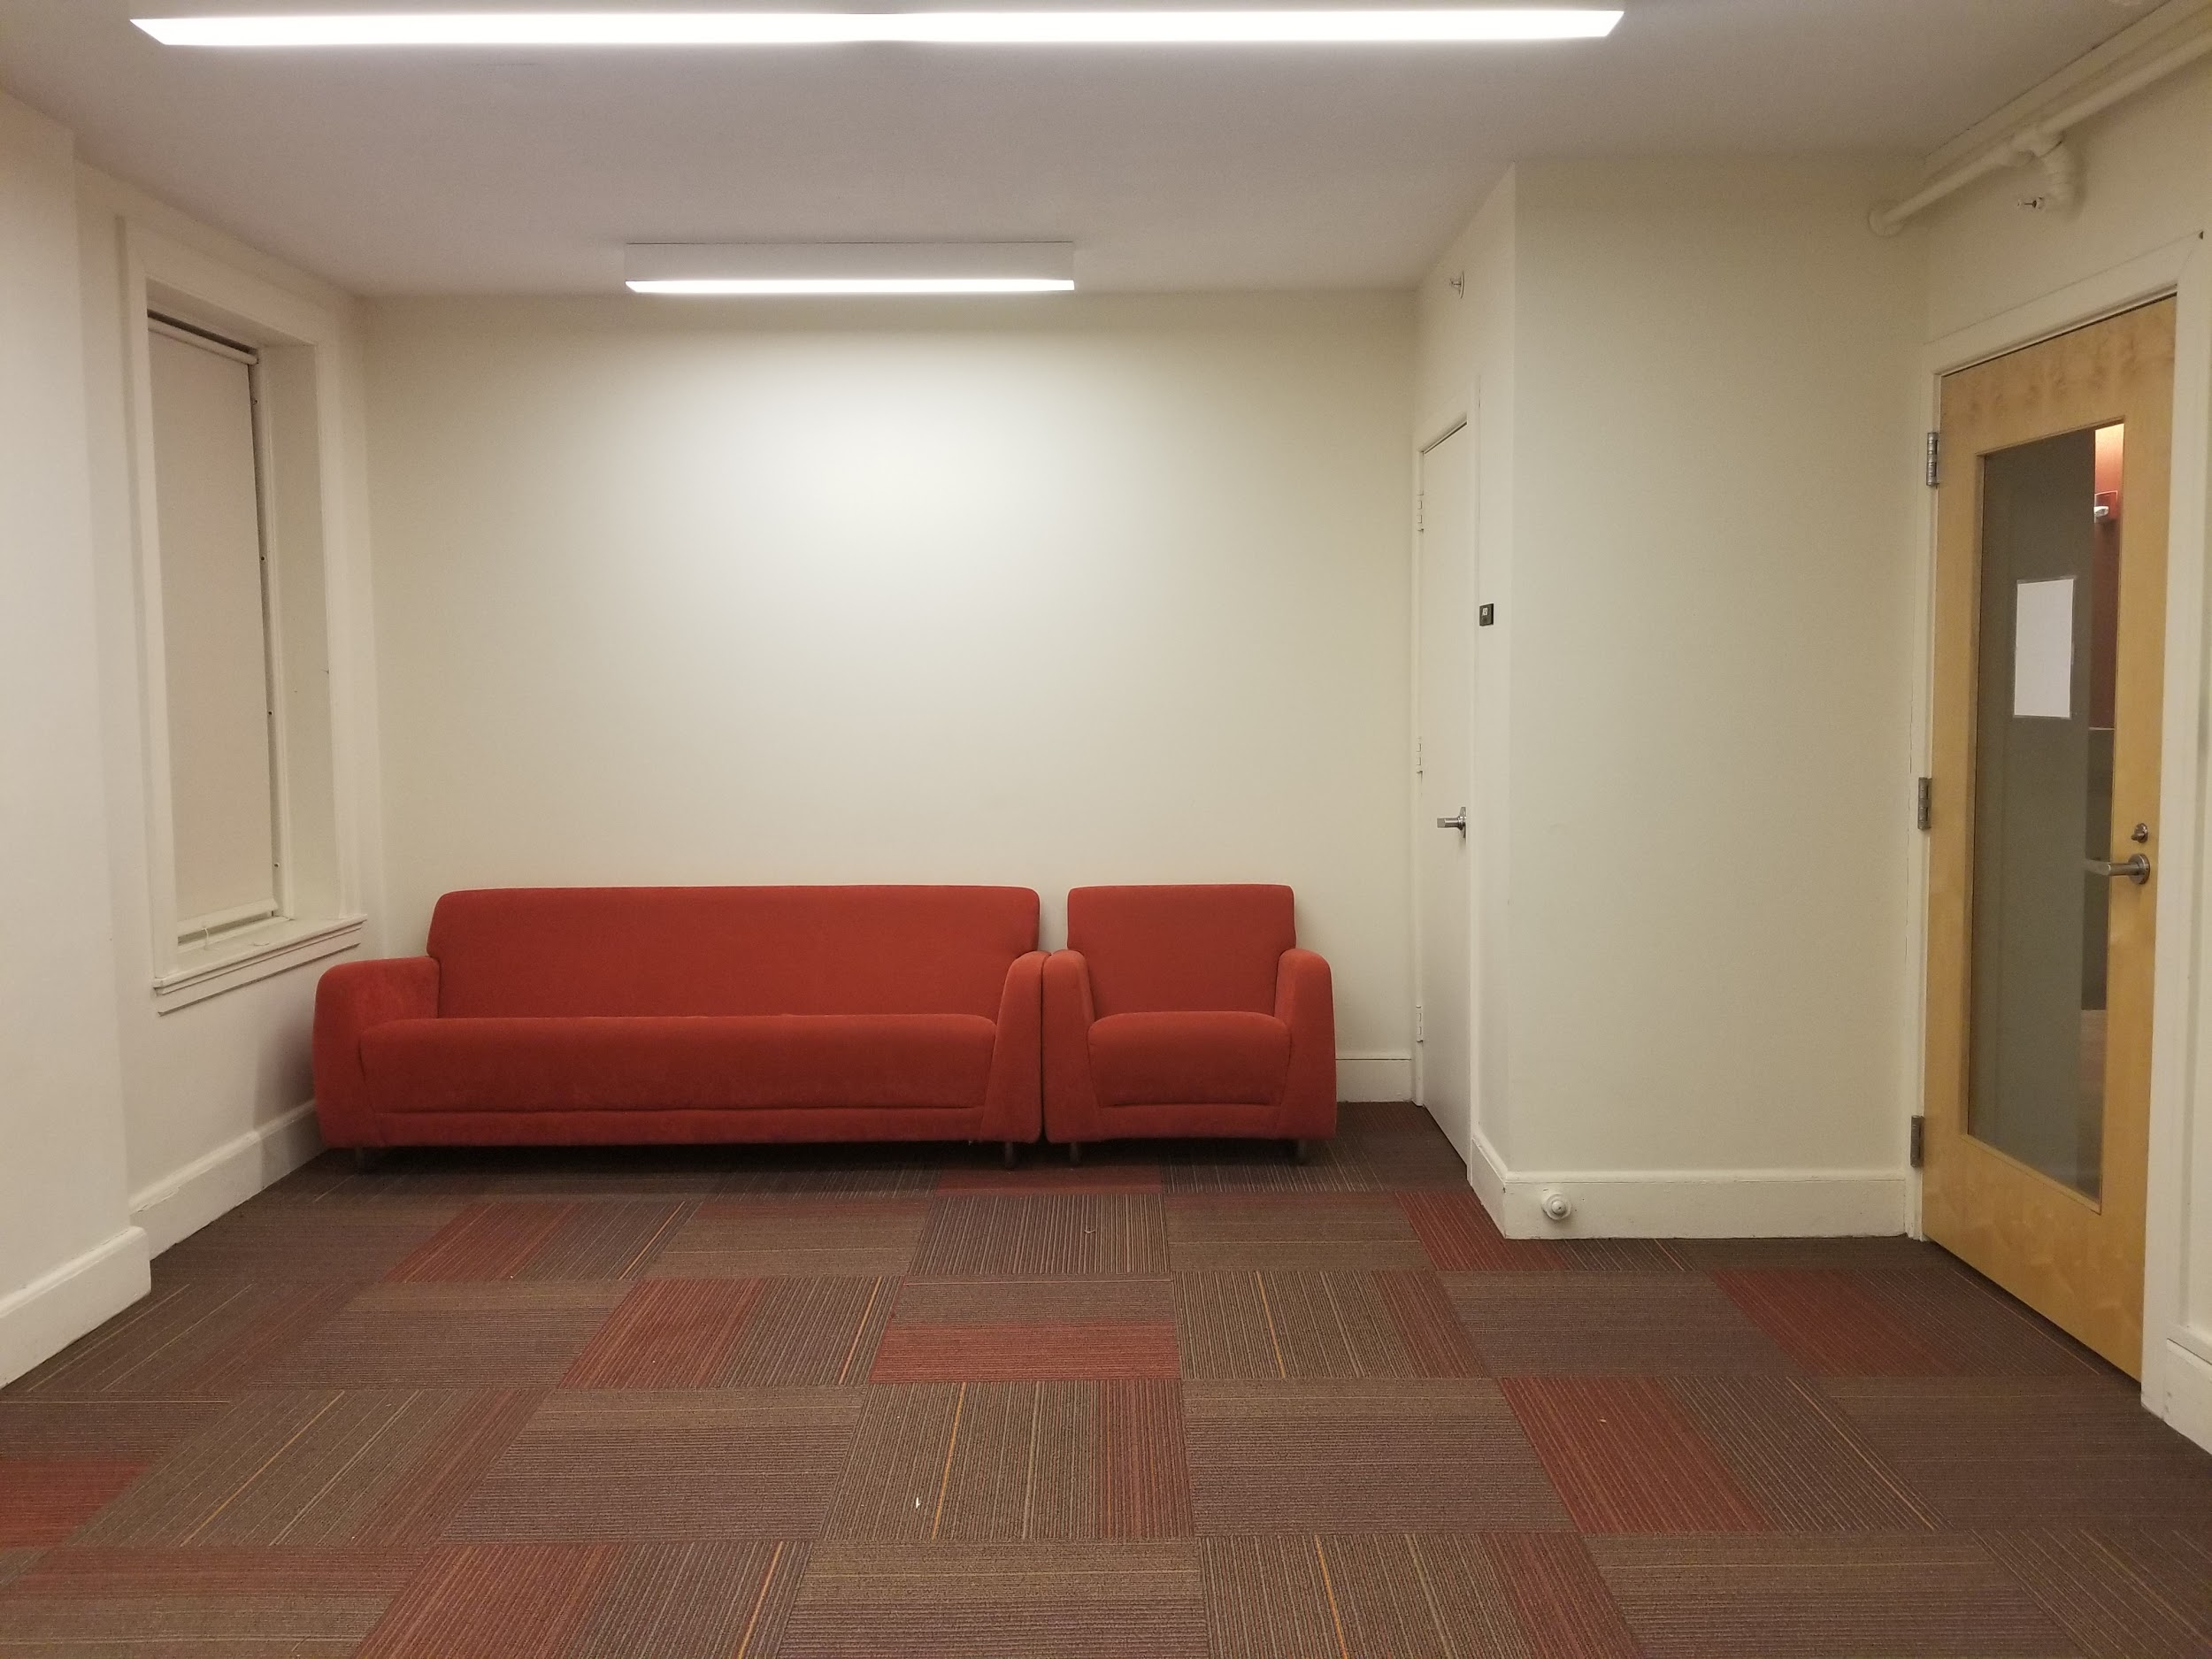
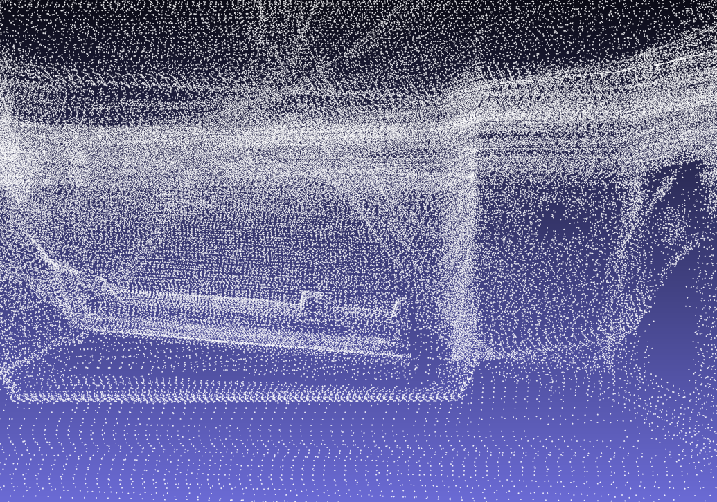
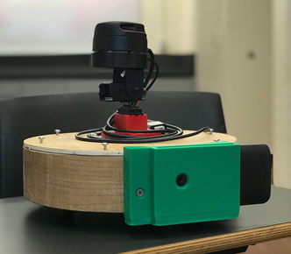
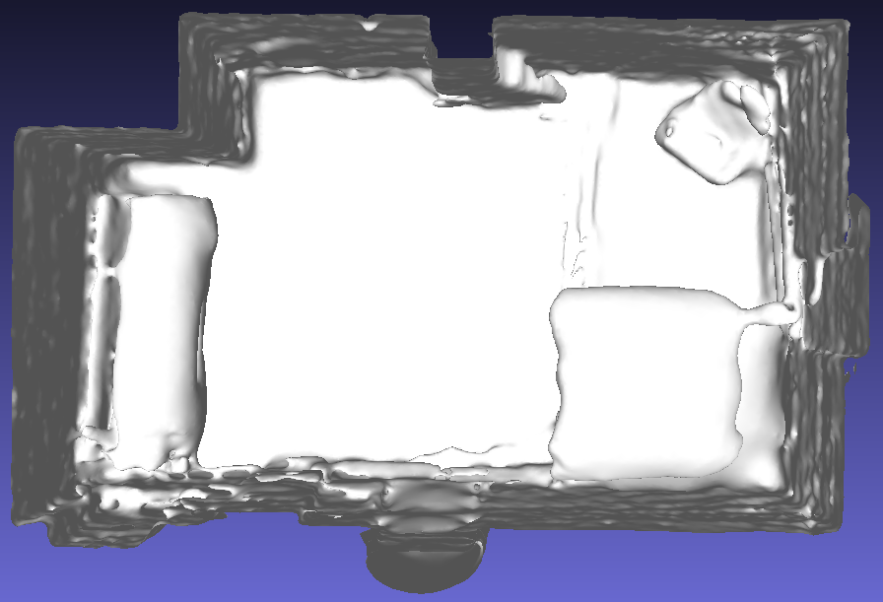
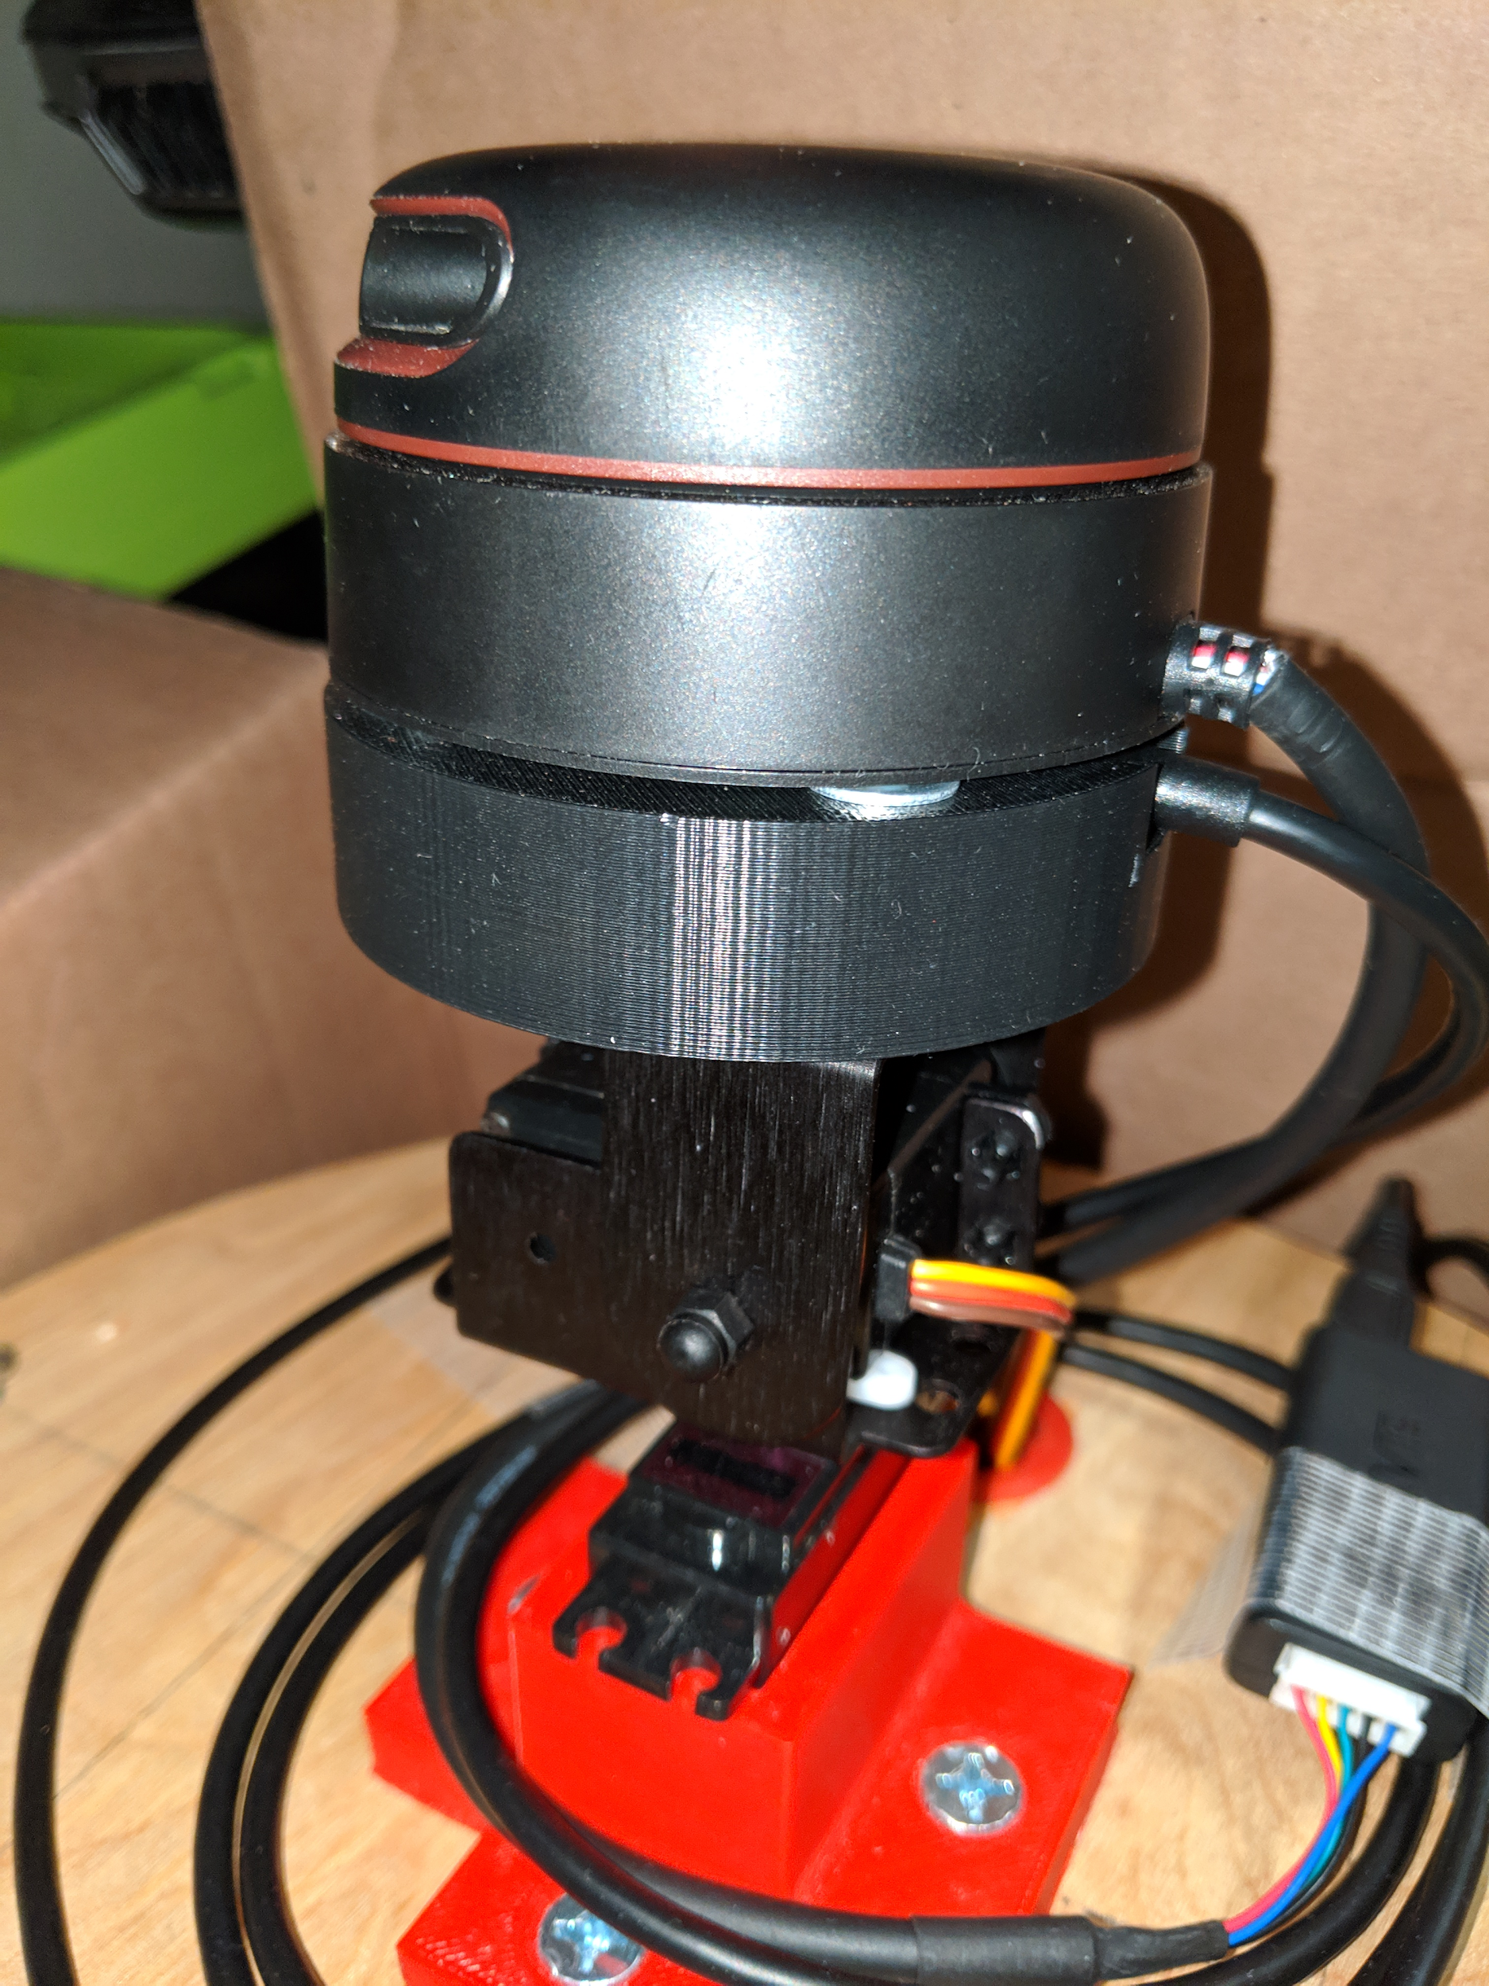
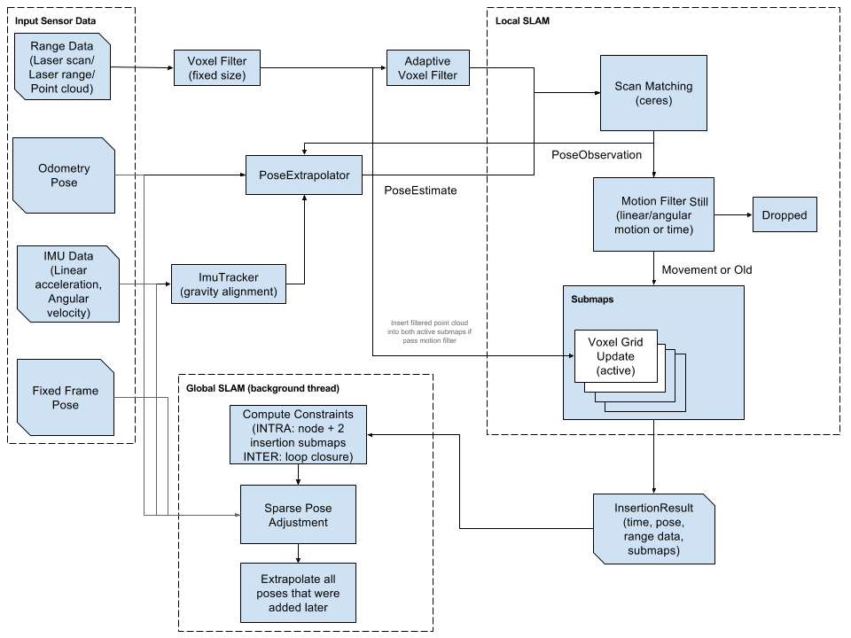
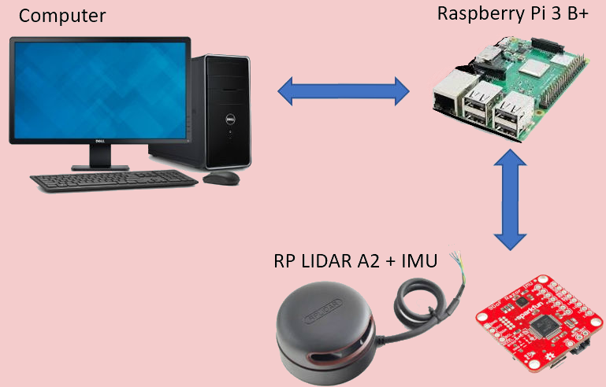
Example Scan
Robot
Original Room (Lewis Classroom)
Generated Point Cloud
11 inches in diameter
2.75 inches in height
L-shaped cutouts to house Roomba motors
Rectangular cutouts to house circuitry, batteries and wiring.
Lid included for mounting
Generated Mesh (top-down view)
LIDAR System
Simultaneous Localization and Mapping (SLAM)
The LIDAR system is comprised of the pan & tilt system, LIDAR mount, LIDAR, and IMU.
SLAM - using sensor data to estimate the pose of the robot and the map of the environment at the same time
Google Cartographer’s SLAM algorithm used to generate our 2D and 3D maps
LIDAR
Rotates at 600 RPM, providing us with constant distance measurements to be utilized in the SLAM algorithm.
IMU
Utilizes an accelerometer and gyroscope to determine the orientation of the LIDAR. This allows us to record three dimensional measurements.
LIDAR Mount
Connects our sensors to the pan & tilt system. The center of the mount is hollow to allow our IMU to fit snugly beneath the LIDAR.
Pan & Tilt System
Manipulates our sensor system to allow for angled measurements. The system rotates 360° and provides a maximum tilt of 45° in both directions.
Google Cartographer High Level System Overview
Assembled LIDAR System
LIDAR Mount
Cost
Development
Production
Part | Price ($)
RPLidar A2 | 319.95
IMU | 34.95
Chassis | 26.50
Servos controller | 19.95
NodeMCU | 8.39
PCB | 5.51
Raspberry Pi | 38.10
MicroSD | 11.99
Connector/wires/pins | 5.59
Wheel motors | 0 (M5)
Servos | 0 (M5)
Batteries | 10.80
Camera (Phone) | 0 (Owned)
Total | 481.73
Part | Price ($)
RPLidar A2 | 319.95
IMU | 30.56
Chassis | 13.25
Servos controller | 12.49
NodeMCU | 6.50
PCB | 2.18
Raspberry Pi | 35.00
MicroSD | 5.66
Connector/wires/pins | 3.78
Wheel motors | 59.98
Servos | 13.80
Batteries | 3.29
Camera Module | 22.51
Total | 528.95
Robot Operating System (ROS)
ROS - set of software libraries and tools to help in building robot applications
LIDAR and IMU integrated into ROS to be compatible with Cartographer ROS package
Raspberry Pi running Ubuntu Server with ROS
taking advantage of ROS’ distributed computing environment to remotely launch sensors and publish sensor data over Wi-Fi
Mapper’s ROS System Overview

