Slide 1
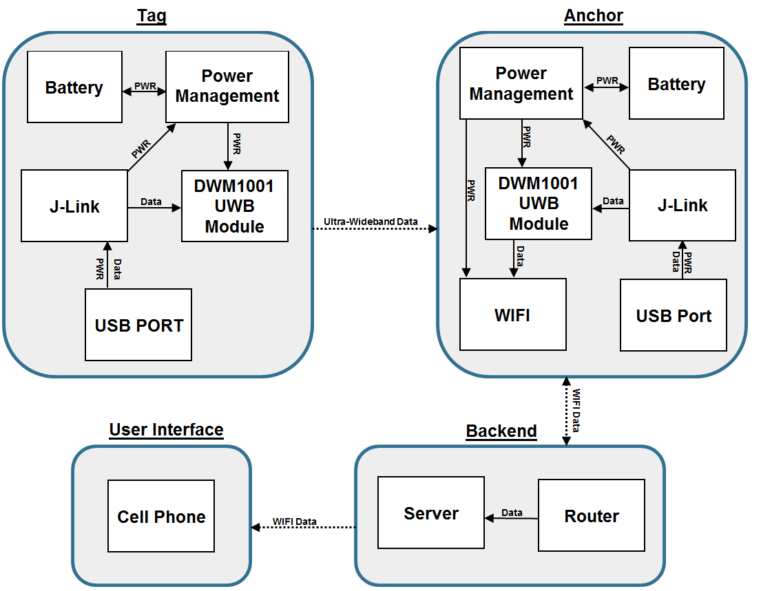
positIN
Isaac Nelson, Chris Nagy, Aric Pennington, Yaowei Xie
Faculty Advisor: Prof. Neal Anderson
Abstract
System Overview
Indoor positioning systems tend to lack accuracy and transmitter power efficiency. In instances where personal safety or protection of property is an issue, accuracy of these real-time location systems (RTLS) is critical. Several technologies and algorithms were considered, but the commonly used existing technologies only offered a positioning accuracy as good as 1 meter. To achieve both efficiency and accuracy. a low power algorithm was used with ultra-wide band (UWB) technology.
To solve the issue of inaccurate indoor positioning, positIN built a 2-dimensional indoor real time location system (RTLS) that is based on ultra-wideband (UWB) technology. The design incorporates time difference of arrival (TDoA) geolocation, which is a low power method in locating a signal emitting tag. Other technologies considered consisted of GPS repeaters, WiFi and BLE RSSI, and passive RFID. Collectively, these technologies only offer a positioning accuracy as good as 1 meter. UWB technology was chosen because of the superior accuracy and range over other positioning technologies.
positIN is a 2-dimensional indoor positioning system consisting of 3 fixed position anchors, 1 mobile tag, a server, and an Android application. The tag communicates information to the anchors using ultra wideband technology. The anchors then forward arrival timestamp data via WiFi to the server. The server calculates the location of the tag and then forwards this position via WiFi to the application on an Android mobile device. On the mobile device the user is able to see where the tag is located.
Block Diagram
Results
The system is able to locate the tag within the 30cm accuracy specification continuously, while inside of the 60m range area. Incorporating a power saving mode utilizing an onboard 3-axis accelerometer, the tag device is easily able to operate for the 12 hours specified operational battery life. This mode stops the tag from transmitting when the device is not moving. Depending on anchor configuration results have been measured with less than 5cm of accuracy error.
Specifications
Requirement | Specification | Value
Location with minimal error | Two Dimensional Device Arrangement | 1 tag, 3 Anchors
 | Tag Position Accuracy | 30cm
 | Line of sight anchor range | 60m
Transmitter Power Efficiency | Tag operational battery life | 12 hours
 | Tag standby battery life | 16 years
User Convenience | Visual Interface | Location displayed on mobile device screen
Acknowledgement
Special thanks to our advisor, Prof. Neal Anderson, and our evaluators, Prof. Xia and Prof. Moritz, for their time, advice, and their patience. We would like to thank Shira Epstein and the M5 staff for critical help with the build. We would also like to thank Prof. Hollot and Prof. Soules for their guidance and suggestions.
Department of Electrical and Computer Engineering
ECE 415/ECE 416 – SENIOR DESIGN PROJECT 2019
College of Engineering - University of Massachusetts Amherst
SDP19

Slide 2
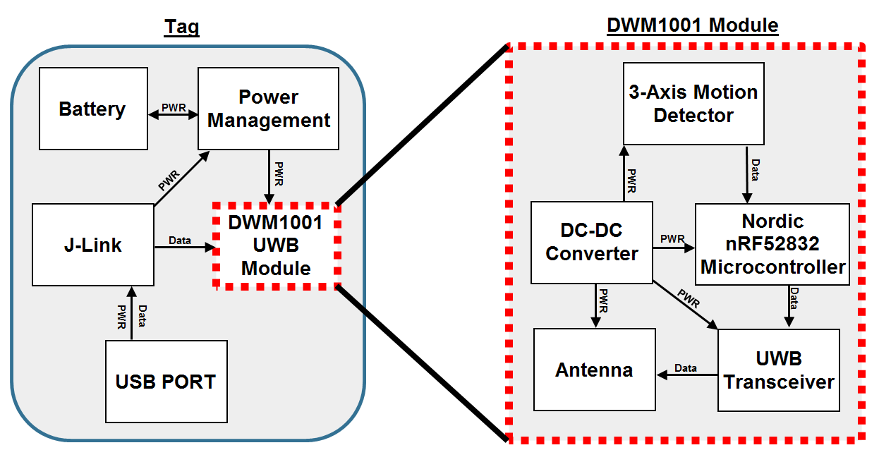
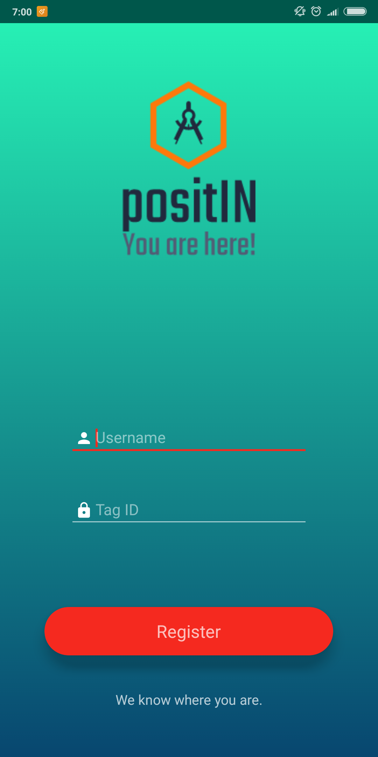
Tag
Backend
The tag is a component that enlaces the users for the purpose of localization. The tag will be operated in two different modes, active and battery saving mode. This piece of hardware pings out an ultra-wideband signal to the anchors at the systems designated frequency. As the person moves the tag pings will take different amounts of time to reach each anchor, thus allowing the positioning to be calculated. This device communicates only one way to the anchors to minimize power consumption, while also utilizing a 3 axis accelerometer to halt pings when the tag is not moving. Each tag has a unique ID which allows many to be running on a single system setup.
The backend consists of a localization engine, a multi-threaded server, and a router acting as an access point thus creating a wireless local area network (WLAN). The WLAN consists of a set of anchors, user devices, and the server. Anchors send tag’s UWB information via Wi-Fi through a router to the server. The router receives packets from the anchors and forwards them to the correct port on the server. Per each anchor and user device connection to the server, the server spawns off an anchor thread and device thread, respectively, to service them. The localization engine also runs concurrently as a thread on the server.
User Interface
The user interface is an application on the user’s mobile phone which allows he/she to modify the features, content and functions of the system. Additionally, the application will receive and display the calculated position data from the Backend. In other word, it is an Indoor GPS. The user can track their real-time position in the room, while they are walking with the tag. When logging into the app the user must identify which tag ID they want to receive positioning for.
Anchor
The anchor block of our project makes up the data acquisition portion of the system. The anchor is the component responsible for sensing the ping sent out by the tag, timestamping it with relation to other anchors, and sending this time value to the server for localization calculations. The hardware is almost identical to the tag design, with the inclusion of the ESP2866 WiFi chip which allows it to forward these timestamps to the server. To implement two dimensional positioning a three anchor setup will be necessary. Since each anchor is running on their own clock and they are not synchronized by the server, the anchors communicate between themselves through UWB to get differences in time stamps, which the server can then interpret as TDOA values.
Scalability
TDoA allows for positIN to scale to multiple tags and keep a high refresh rate. Each tag embeds its’ ID in a transmission message sent to the anchors. The anchors also forward this ID along with their own to the server in a timestamp message. The server uses the tag ID along with the corresponding anchor ID to align timestamp messages. This ensures that timestamp messages are not out of phase even when they are received out of phase. The end user uses the android application to register its’ tag ID to the server. The server will discard any received timestamp messages that its’ corresponding tag ID has not been registered. The server is multi-threaded which takes advantage of parallel processing. The performance of the server is greatly improved when executed on a multi-core processor.
Cost
Development
Production
Part | Price ($)
PCB | 2.00
Dev Board | 35.99
Battery | 13.53
UART WiFi | 6.95
BMS | 5.76
Total | 64.23
Part | Price ($)
PCB | 0.14
Dev Board | 23.32
Battery | 13.53
UART WiFi | 6.95
BMS | 2.49
Total | 46.43

