Slide 1
SDP 18: EfficienSeat
Preliminary Design Review
18 October 2017
Team 26
Advised by Professor Tilman Wolf
Kristina Georgadarellis, Matthew Donnelly, Dennis Donoghue, Aarsh Jain
Notes:
Presentation by Kristina

Slide 2
Background Information
Dining halls have inefficient “first come, first served” seating - problem during busy times
Patrons must commit and pay for entry before knowing state of seating
Leads to congested walkways with patrons spending unnecessary time searching for seats
Wastes patron’s time and lowers efficiency of dining hall staff that need to use walkways
Notes:
Presentation by Dennis

Slide 3
Assess Needs
Patron Needs
Be able to efficiently locate seating at dining halls
Be able to know seating status of entire dining hall at a glance
Dining Hall Needs
Adaptation to system should be simple and painless
Be able to implement a cost effective, easy to maintain system
Notes:
Presentation by Dennis

Slide 4
Our Solution: An Overview
Three main components
Camera system with imaging and thermal sensing mounted on ceiling
Small interactive unit on the table with which patrons interact
Phone app
Three clients to keep in mind
Patrons who use our app (referred to as Users)
Patrons who do not (referred to as Non-Users)
Dining hall staff
Notes:
Presentation by Matt
Explain these relative to the needs (previous slide) - talk a tad more in depth

Slide 5
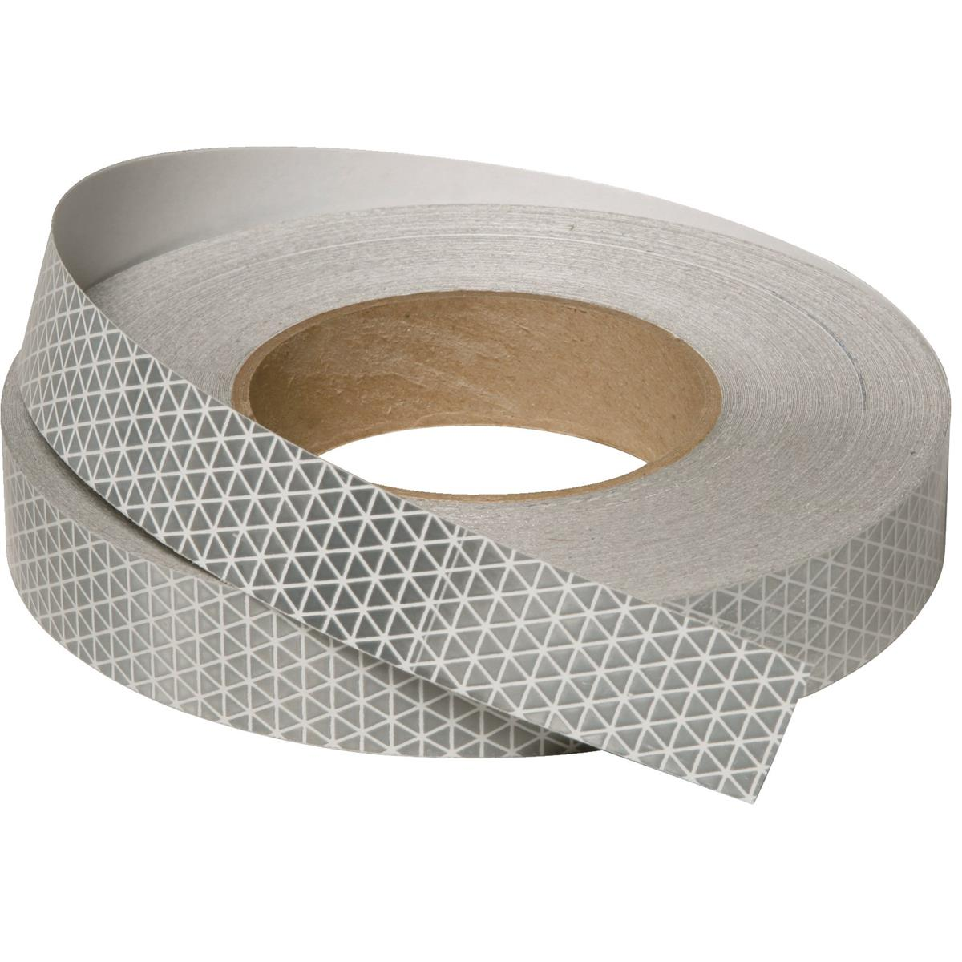
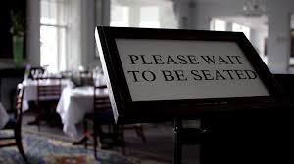
Our Solution: Alternatives
Passive indicators to replace the table unit like IR reflector strips
Different options for the camera like infrared, live imaging
Restaurant reservation system
Sensing sections of the dining hall rather than seats
App access from home
Notes:
Presentation by Matt
Discuss why these wouldn’t work, relate to why we chose corresponding points for our system solution

Slide 6
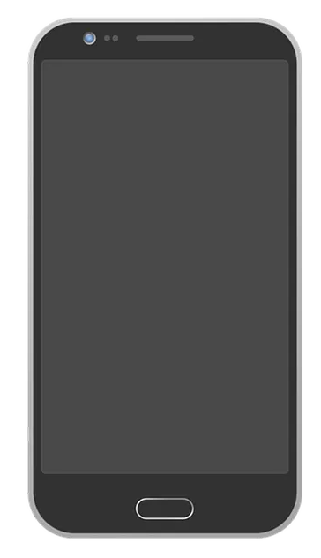
Our Solution: Scenarios
Let’s walk through a scenario
Four friends want to go to dinner
Open the app and select the dining hall
Select your dining hall
Berkshire
Hampshire
Worcester
Franklin
Notes:
Presentation by Aarsh

Slide 7
Our Solution: Scenarios
Let’s walk through a scenario
Four friends want to go to dinner
Open the app and select the dining hall
At the Dining Hall
Users can find seats based on party size
Camera keeps track of empty seats
Button system on table assists Users and Non-Users
Swipe to select your party number
2
1
3
find available seats
Notes:
Presentation by Aarsh

Slide 8
Our Solution: Scenarios
Getting Seated
App finds list of available seats and tables according to party size
Once selected, the seats are reserved for 2 minutes
Go to the seat and press the button to claim
If no seats are available
Prompted to add request to queue
A notification pops up when seats ready
Claim your seats
4
5
2
3
1
Notes:
Presentation by Aarsh

Slide 9
Our Solution: Scenarios
Seating Priority System
Two types of table claiming: Full and Partial
Big parties have full table priority over single sitters
Non-users alter table priority
Reporting Errors
Available seat or table was actually taken
Non-User Interaction
LED on table unit indicates table status
Only sit at tables that indicate “available”
Encouraged to push button to claim table
Claim your seats
4
Partial Table Claim
5
2
3
Full Table Claim
1
Notes:
Presentation by Aarsh

Slide 10
System Specifications
Allows Users to search for available seats by party size through app
Users will receive response from app within 2 seconds
For parties up to the size of the largest table, achieve 90% success in finding seats correctly if available
Function in dining rooms of several hundred seats
Table unit is spill-proof and low maintenance
System accommodates Non-Users
Notes:
Presentation by Kristina

Slide 11
Block Diagram
Server
Database
Sky Unit
User Interface
Camera
Data Processing
GUI
Seating Info Feedback
Search Functionality
Dining Hall Map
Transmitter/
Receiver
Power Supply
Microprocessor
Table Unit
Table Status Indicator
Power Supply
Microprocessor
Transmitter/
Receiver
Button
Notes:
Presentation by Kristina
Server is the hub.
Table unit sends data to the sky unit when button is pushed
LED is controlled by server (through sky unit)
Sky unit processes data from the camera system, sends it to server for more processing
The server is also database for the user interface. Through the server. The user interface interacts with the table unit (seat selected - light flashes)

Slide 12
Subsystems: Table Unit
Requirements
Must be low power
Accommodate both Users and Non-Users
Communicate with sky unit
“Dining Hall” resistant
Implementation
LED push button to indicate table status
Solar/Rechargeable battery for power supply
RF receiver and transmitter
Table Unit
Table Status Indicator
Power Supply
Transmitter/
Receiver
Button
Notes:
Presentation by Kristina
LED push button - three states: ON - claimed, OFF - available, BLINK - someone on the way
Solar powered rechargeable battery - self sustaining, many units - low maintenance.

Slide 13
Subsystems: Sky Unit
Requirements
Encompass ~100 seats
Easy to install in dining hall
Accurately identify empty seats
Communication with table unit/server
Pre-process camera data
Implementation
Visual and thermal cameras
Uses wall power
RF and WiFi communication
Microprocessor
Sky Unit
Camera
Thermal Sensor
Transmitter/
Receiver
Power Supply
Data Processing
Microprocessor
Notes:
Presentation by Matt

Slide 14
Subsystems: Server
Requirements
Capable of storing data and handling App requests
Handle 100+ concurrent requests
Assist in processing of Sky Unit data
Implementation
Implemented on scalable rented Amazon Servers
Possible to split into a database and application server
Server
Database
Data Processing
Notes:
Presentation by Dennis

Slide 15
Subsystems: User Interface
Requirements
Takes less than 2 seconds to load or refresh
Quick response time
Minimalistic layout for ease of use
Implementation
Android platform
Android Studio
Java
User Interface
GUI
Seating Info Feedback
Search Functionality
Dining Hall Map
Notes:
Presentation by Dennis

Slide 16
MDR Deliverables
Table Unit Power Supply
Demonstrate a power supply that can support the table unit over the course of its daily operation
User Interface
Demonstrate that the app can run a table search and display results
Empty Seat Analysis
Demonstrate that the camera system can detect seated patrons and objects
Table Unit
Demonstrate that the table unit can cycle through all states
Notes:
Presentation by Dennis
Talk more in depth

Slide 17
Team Responsibilities
Dennis
App, Server, search algorithm, and sky unit data processing
Aarsh
Hardware for table unit (LED button, power supply)
Matt
Hardware for camera unit (Visual camera, thermal camera, microprocessor)
Kristina
Sky unit data processing
Notes:
Presentation by Everyone

Slide 18
Extra Slides

Slide 19
State Machine - User Search
Update Database
Database
Sky Unit
Poll
Database Query
Seating Information
Poll, Update
User selects seat
User Search
Table Unit

