Slide 1





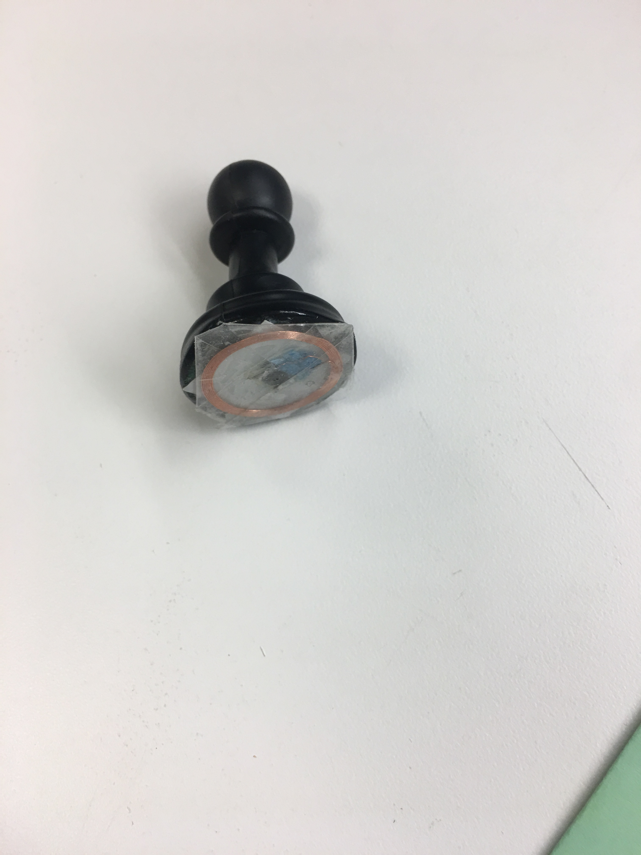
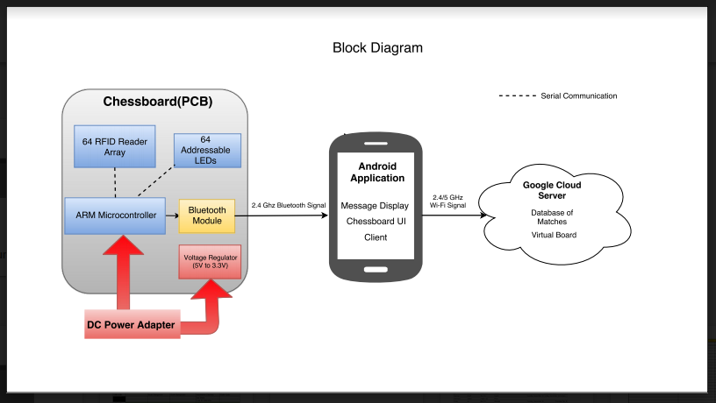
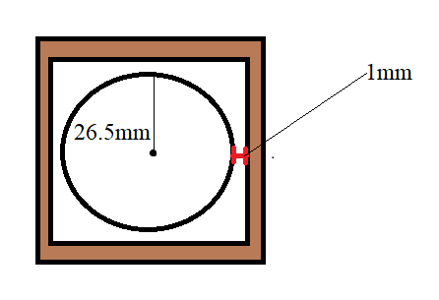
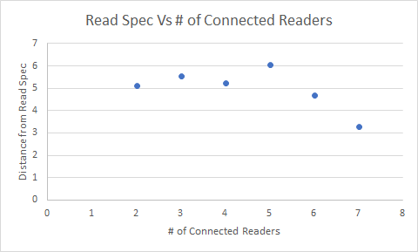
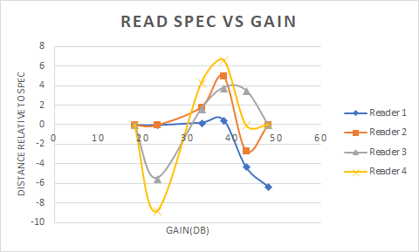

Smart Chess
David Nguyen, Shashwat Patel, Battsooj Bayarsaikhan
Faculty Advisor: Prof. David McLaughlin
Abstract
System Overview
A continued area of weakness for digitalized chess is its failure to replicate the experience of a physical set. Our solution is a chessboard that bridges the gap between the physical and virtual world. Smart Chess allows users to play across internet using two physical chess boards. It utilizes RFID technology to detect the type and movement of pieces which is then communicated to the opponent’s board through LED indicators.
The system consists of multiple designs of chess board, android phones for each board and the server. Android cellphone used to set up games, connect to the server through WiFi , and to stablish communication with the board through Bluetooth. The board design consists of subsystems of a LED array and a RFID reader array. Chess pieces are equipped with RFID tags.
Specifications
The design and size of the board follows Tournament Sizing Standards set by the U.S. Chess Federation [1]. Color specification of matched set (matched piece and square color) can be satisfied in the manufacturing process.
Square Size: 2 – 2 ½ inch (5.08 – 6.35 cm)
Visibility of each square lighting is a specification that is satisfied as to be recognizable in normal indoor lighting. Transmission time of a detected move is to be under 2.5 sec to cause a natural game follow, therefore, to create more holistic user experience.
Realistic user experience of chess board design demands the specification of detecting a piece in anywhere within a square. Each RFID reader tested and verified to meet this requirement. Varying quality of received RFID-RC522 readers caused some readers to be inadequate for the design.
Graph:
Pawn equipped with a tag.
Block Diagram
Results
Proposed exact specification is set to detect a piece within a circle 1mm away from each side. There are 6 different gain settings for the readers
A design of chess board was built, meeting the requirement. Each square consists of two addressable LEDs, RC522, vellum for light dispersion and PlexiGlass for the top of board. To create an interactive experience for the reviewers, we implemented an UI that is connected to the server. The goal of the project can be understood by imagining two of the designs functioning together.
Acknowledgement
Number of parallel connected readers affects the reading range, from the graph above. As the purpose of project, the chess board is designated to be placed in indoors, powered by a wall plug. Even though there is no power constraint, we optimized the power consumption to be low.
We would like to thank our advisor, Professor David McLaughlin, for his expertise and guidance throughout our project’s development and our evaluators, Professors Soules and Taneja, for their helpful feedback at our design reviews.
Department of Electrical and Computer Engineering
ECE 415/ECE 416 – SENIOR DESIGN PROJECT 2018
College of Engineering - University of Massachusetts Amherst
SDP18

Slide 2
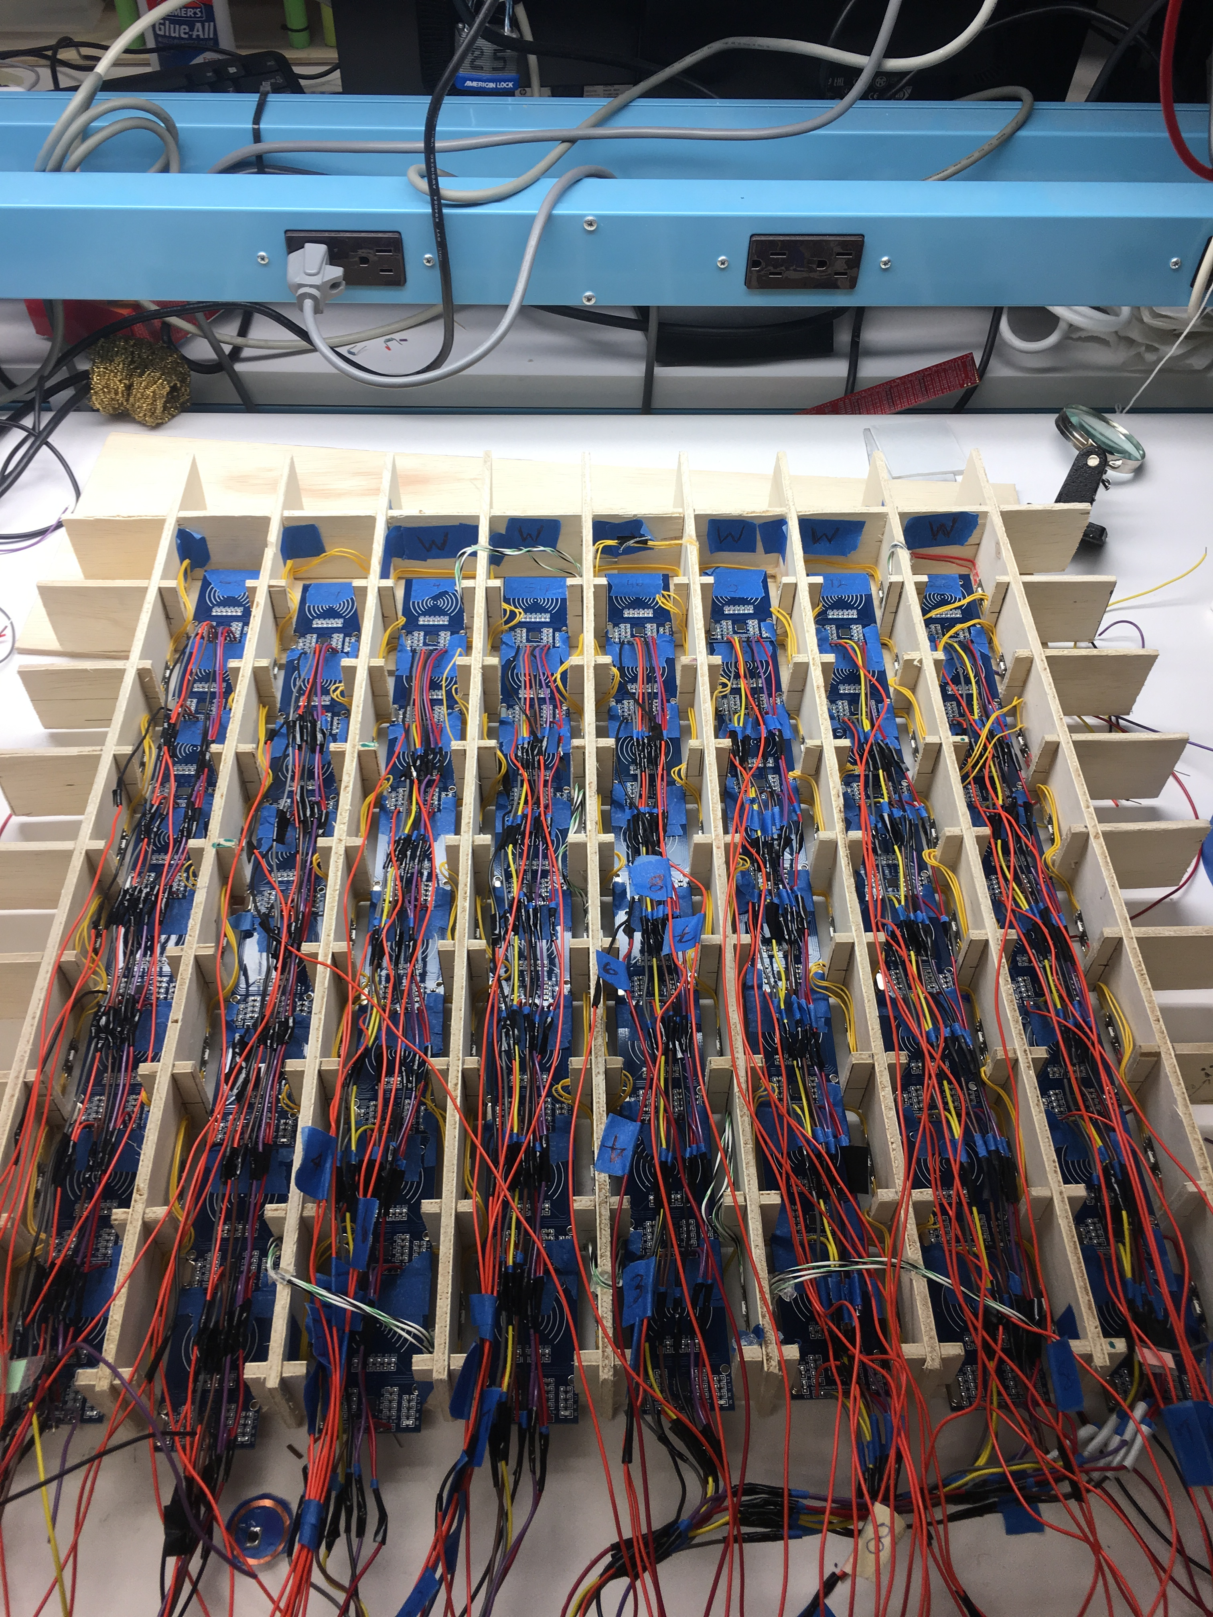

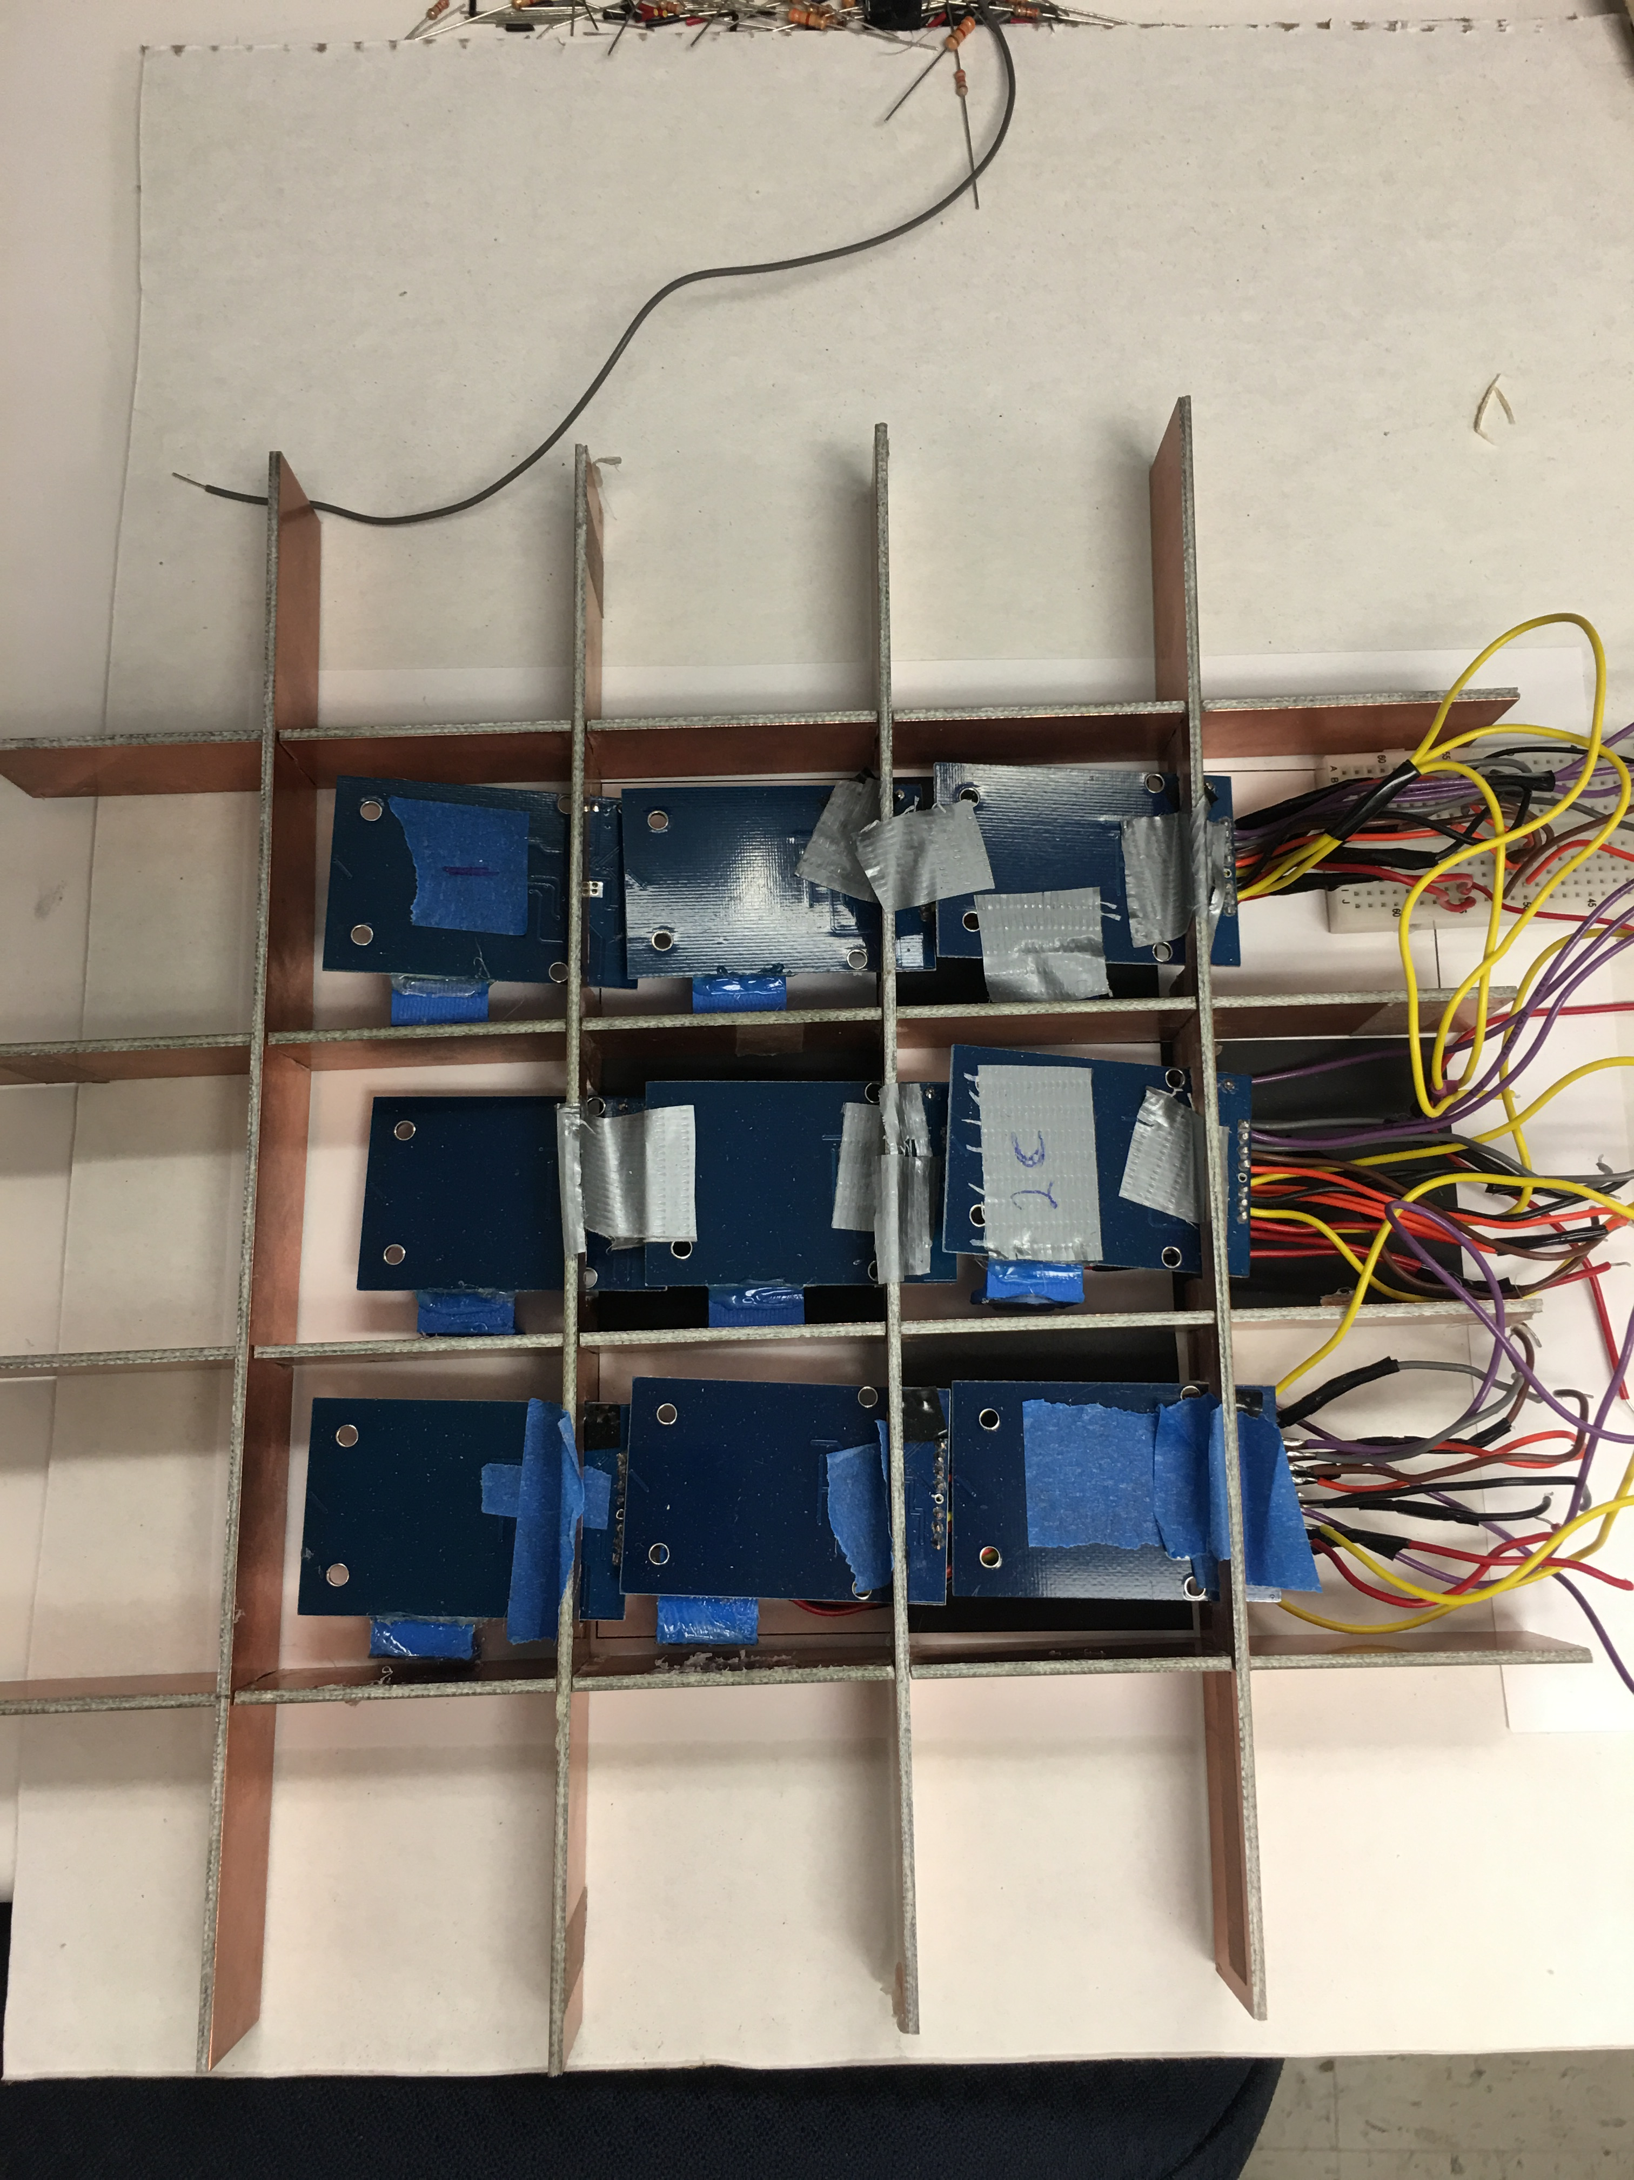
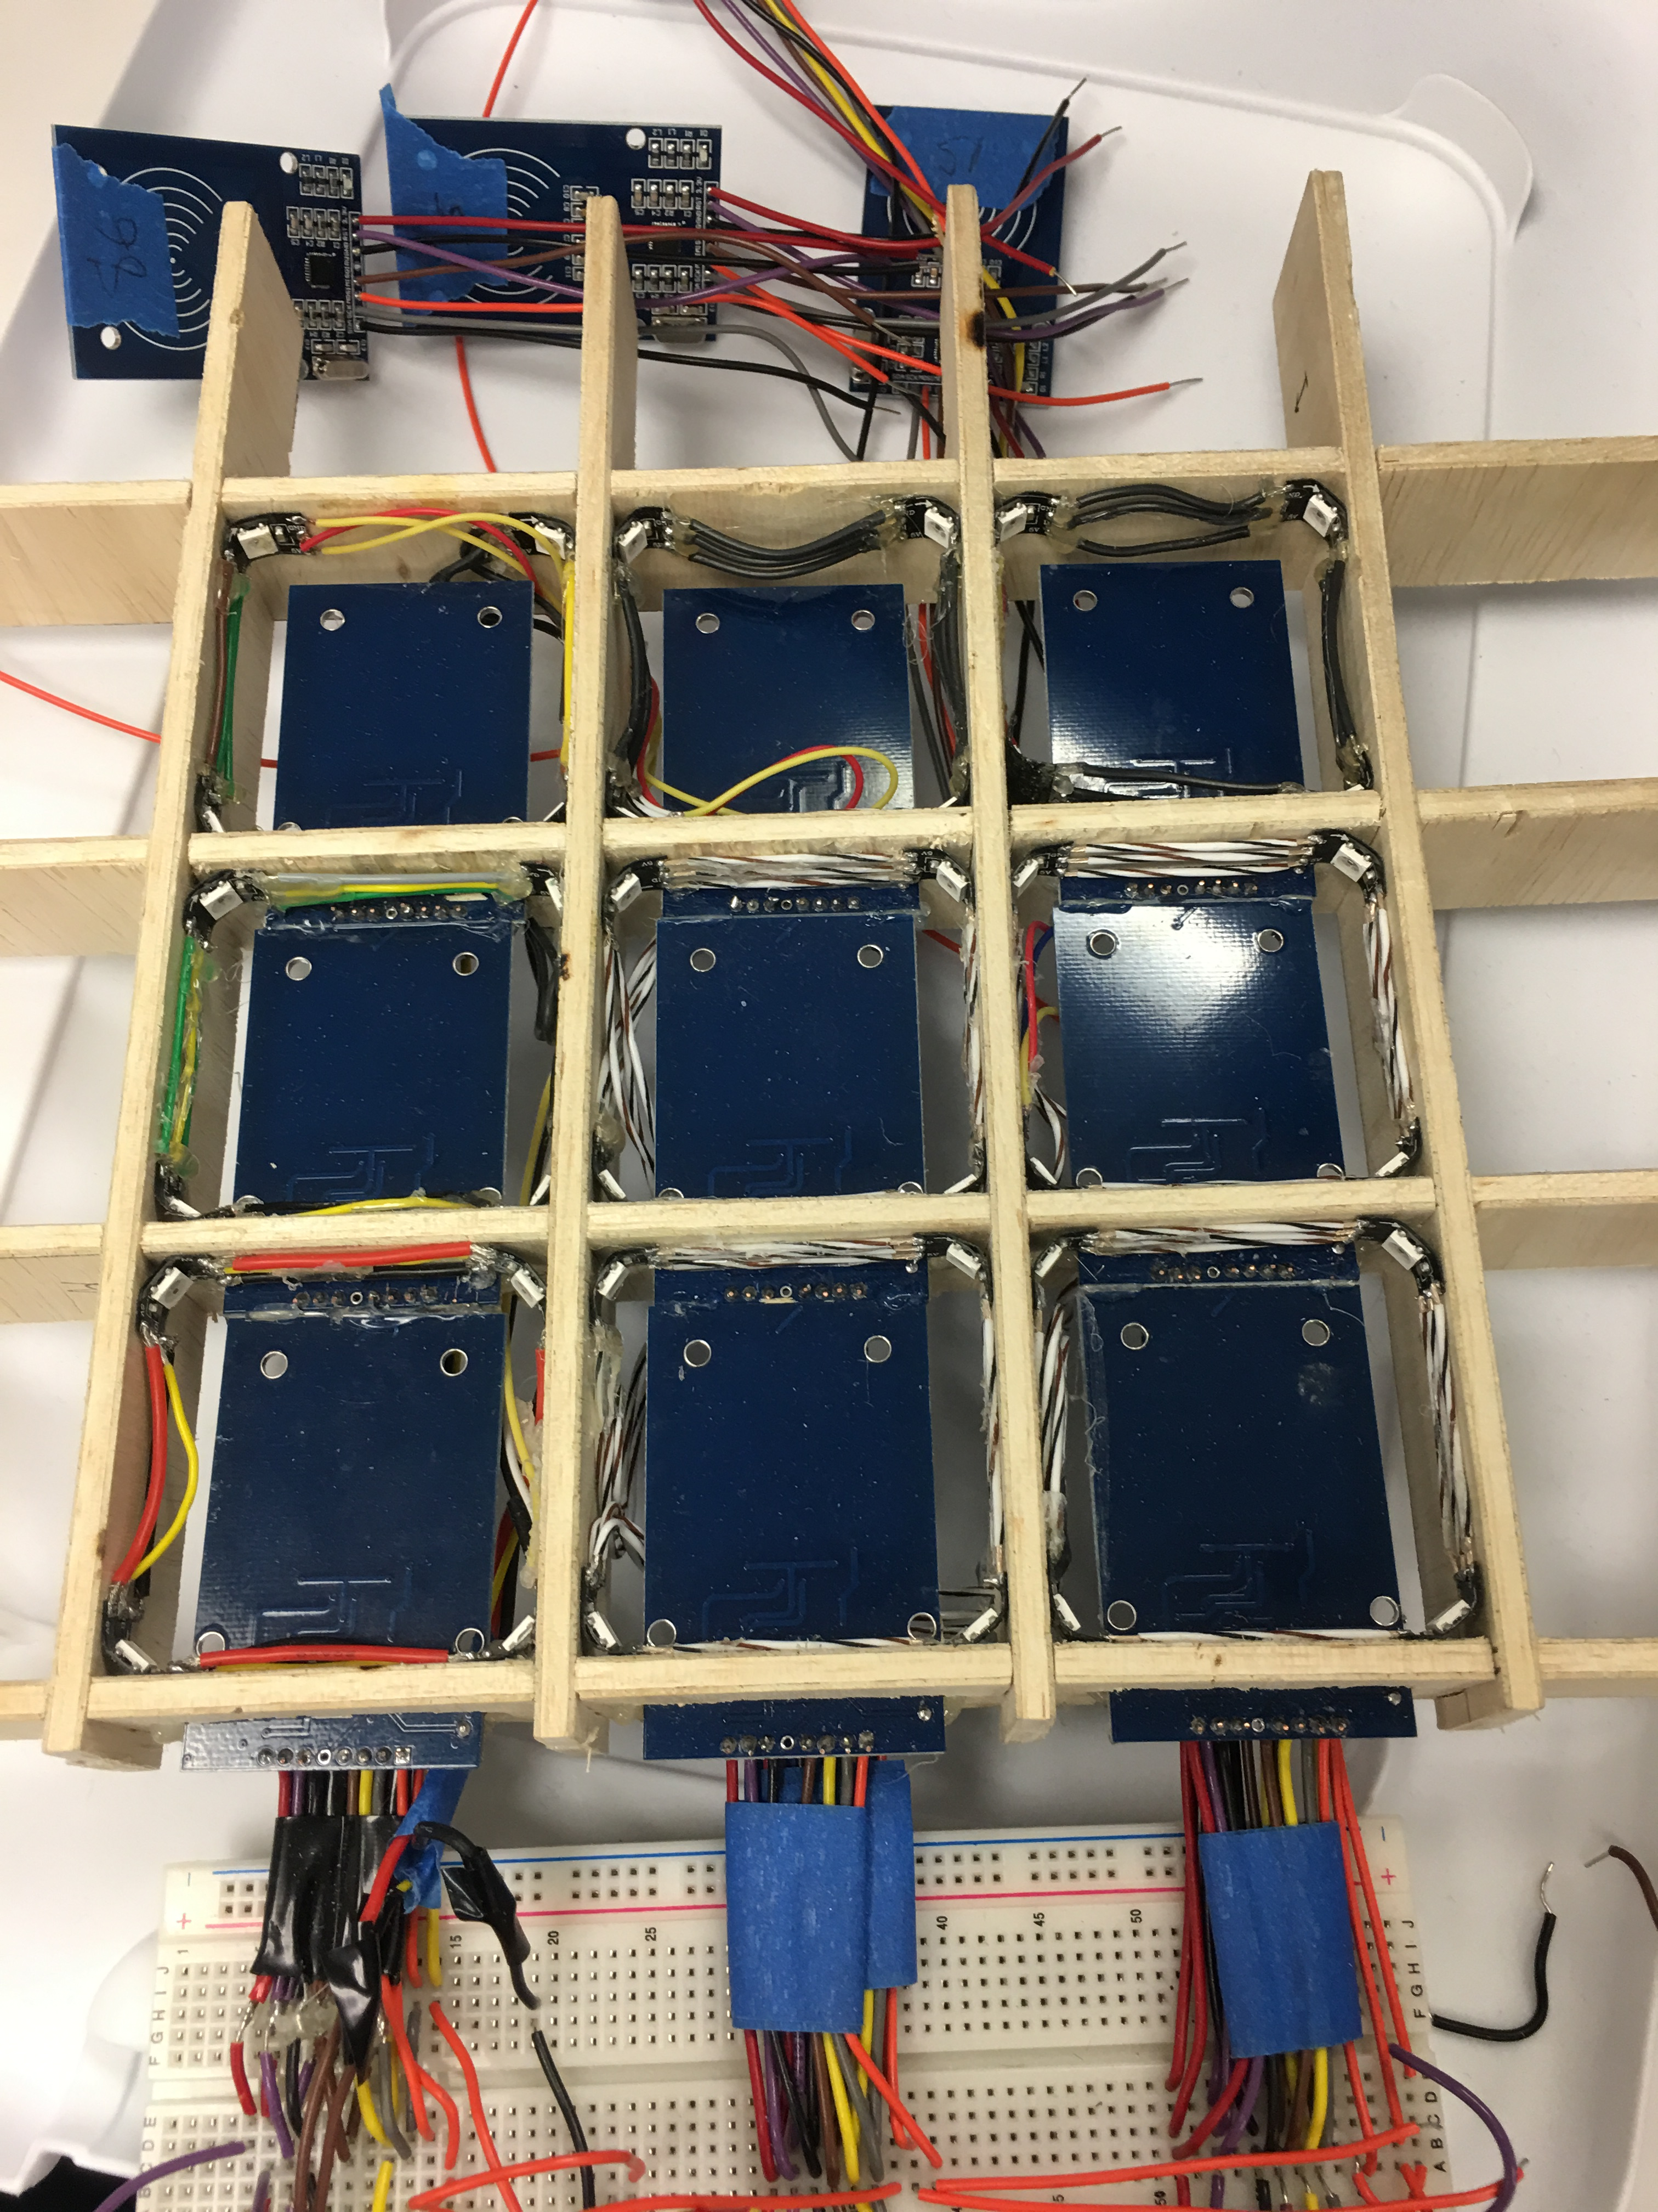
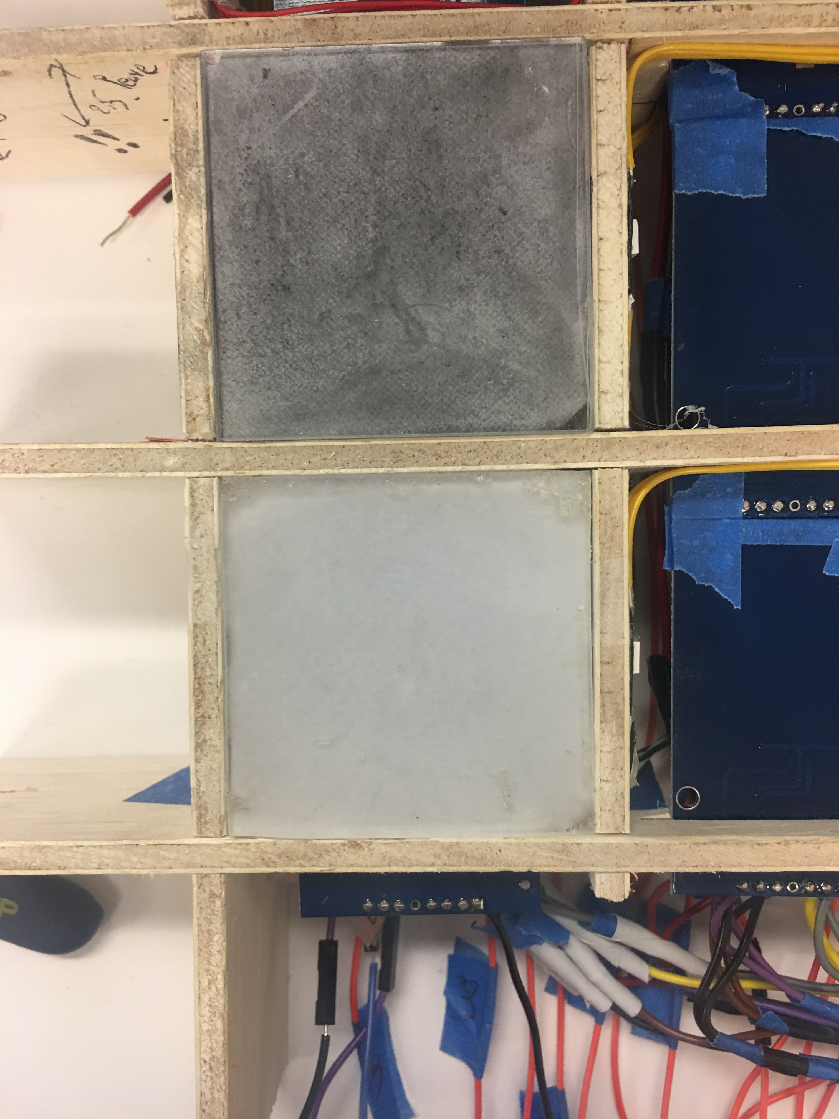
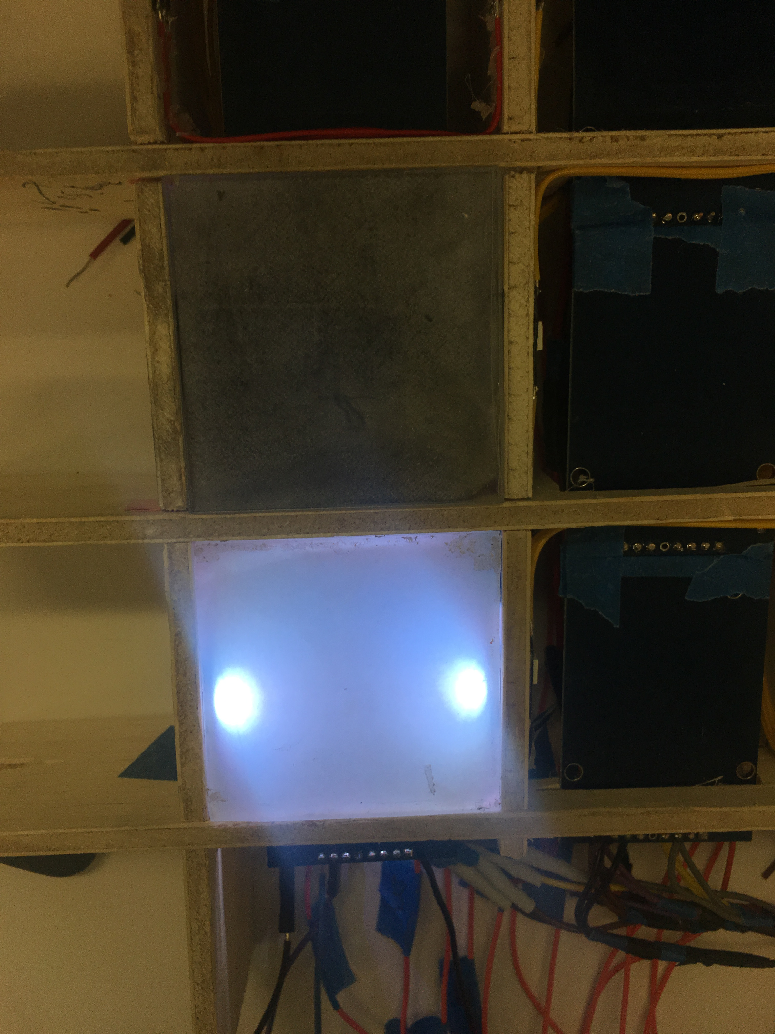
Challenges
RF Interference
The major challenge we were faced during the development process was caused mainly by high device density and volume. With having so many components (e.g. 128 LEDs, 64 readers, 8 MUXx etc), connection issues were considerable on over 800 soldering points. Another issue we faced was to realize the varying quality of the components which resulted us a lot of time. Moreover, timing issue in serial SPI protocols used in both RFID readers and LEDs rose with increasing number of components and traveling paths.
With limited spacing and sizing of antennas in RC522, we discovered that closely placed readers malfunctions, and this issue can be resolved with shielding. Also it is expected to cause a failure when an electromagnetic field source is placed nearby the board. With one microprocessor in the design, wiring paths underneath each reader is placed as far as possible from the reader’s antenna.
Communication
As the purpose of this project is to replace digitized chess game, we wanted to have a minimal use of smartphone in the game flow.
The android application, programmed in Java, will serve as an intermediary between the board and the server. The application will display a visual chessboard, a notification system when a move has been made and also a missing piece notification to alert the user when a piece has been removed from the board.
The server is hosted by Google Cloud Platform, a suite of cloud computing services.
Optimization of transmission time of a detected move is possible through more sophisticated circuitry of electric design. Aside from finding cheaper and more suitable raw materials for the frame and top of the squares, the design could be improved with a customized lighting system to result more uniform lighting of squares.
Electromagnetic shielding is one of aspect of the design that can be improved as a further development. Testing with a tinfoil wrap around the frame seem to result improved reading range and accuracy.
Integration of the board to the web chess play systems of ICC (Internet Chess Club), like Chess.com, ChessCube, GameKnot, etc., is essential to commercial use of this project since there are more than 100 million active chess players on these sites.
Prototype
During development process of the design, we built three different 3x3 board with different material and path designs. Once an adequate prototype is built, scaling the design was next step.
Further Work
Cost
Part Name | Development Cost ($) | Production ($) Cost
64 pcs - RC522 | 200 | 128
PlexiGlass | 28 | 10
NeoPixel LED Roll | 50 | 35
AC/DC Adapter | 15 | 15
Frame | --- | 7
Wiring | --- | 2.5
8 pcs - MUX | --- | 10
Arduino Mega | 15 | 15
Bluethoot Module | 5 | 2
Total | 318 | 224.5

