Slide 1
FPR
Team 24
“Remote Chess”
March 21, 2018
Notes:
‹#›
‹#›
‹#›

Slide 2
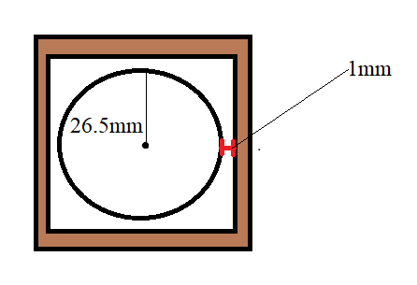
Range Spec Redefined
Chess Square Spec
5 - 6cm
Final Chess Square size = 5.5cm
Range <= 1mm

Slide 3
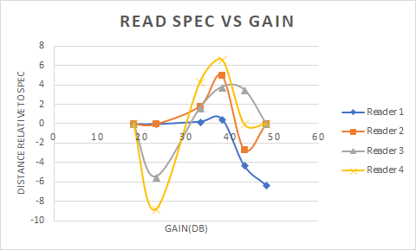

Slide 4
