Slide 1
CDR
Team 24
“Remote Chess”
March 21, 2018
Notes:
‹#›
‹#›
‹#›

Slide 2
Team Introduction
Battsooj Bayarsaikhan
Shashwat Patel
David Nguyen

Slide 3
Content
Project Overview
System Specifications
Proposed CDR Deliverables
Block Diagram
Demo
CDR Deliverables
Project Timeline/Gantt Chart

Slide 4
System Specifications
An ideal system/solution must possess the following characteristics:
Detect every move/changes on the board accurately
Identify different types of pieces
Verify eligibility of recorded move
Indicate illegal moves
Fast response time (<2s)
Standard sized (5cm-6cm squares) (3.75in king height)
Reflect opponent’s move clearly

Slide 5
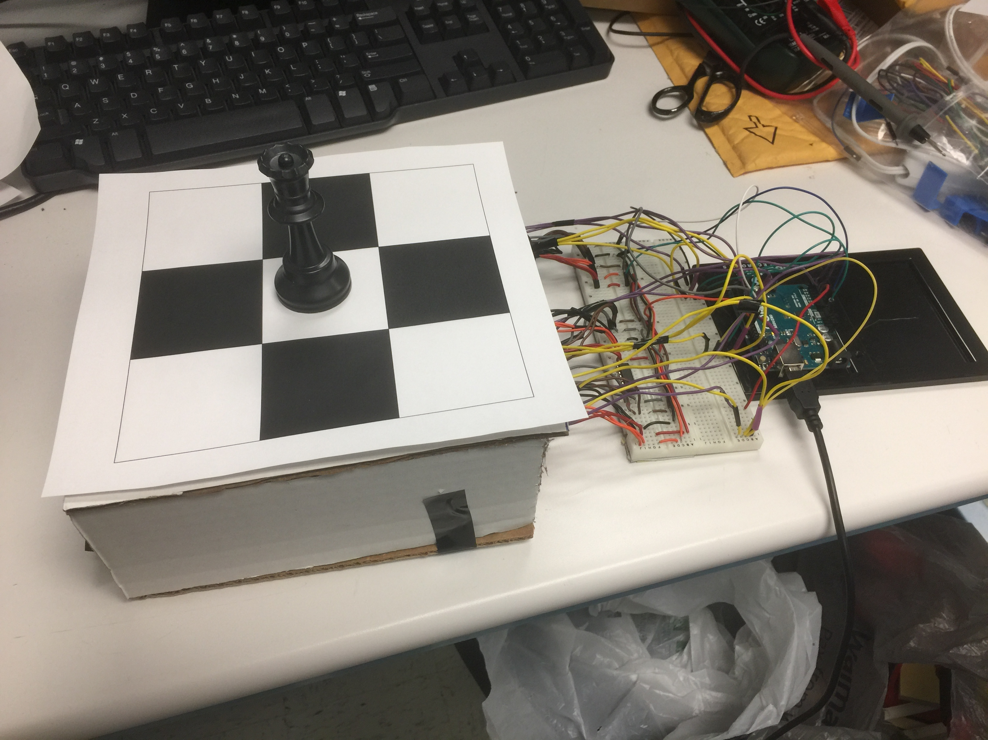
MDR Recap
Read only 1 piece
Some Readers not working
Basic Bluetooth to Server Connectivity

Slide 6
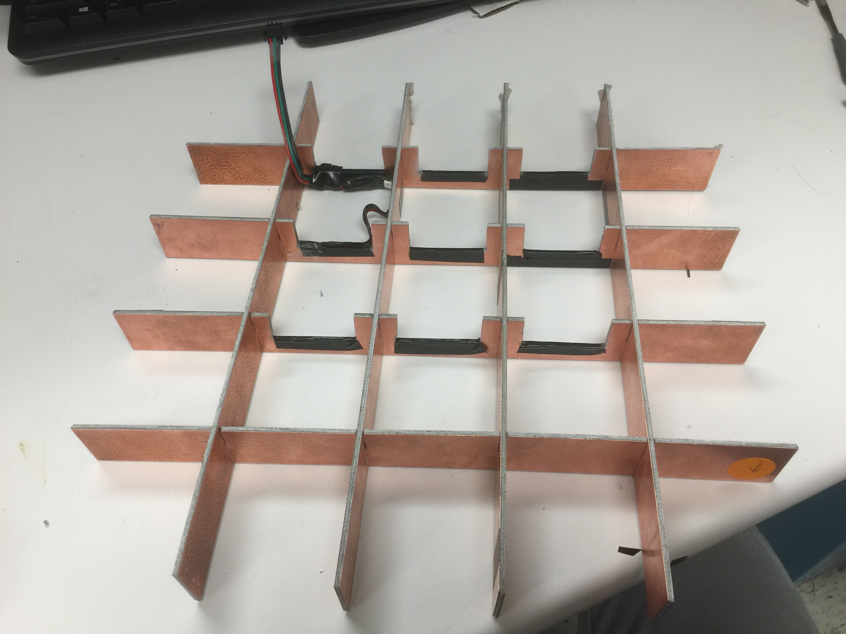
Frame
Copper Cladded FR4
Sturdy
Lightweight
RF Shield

Slide 7
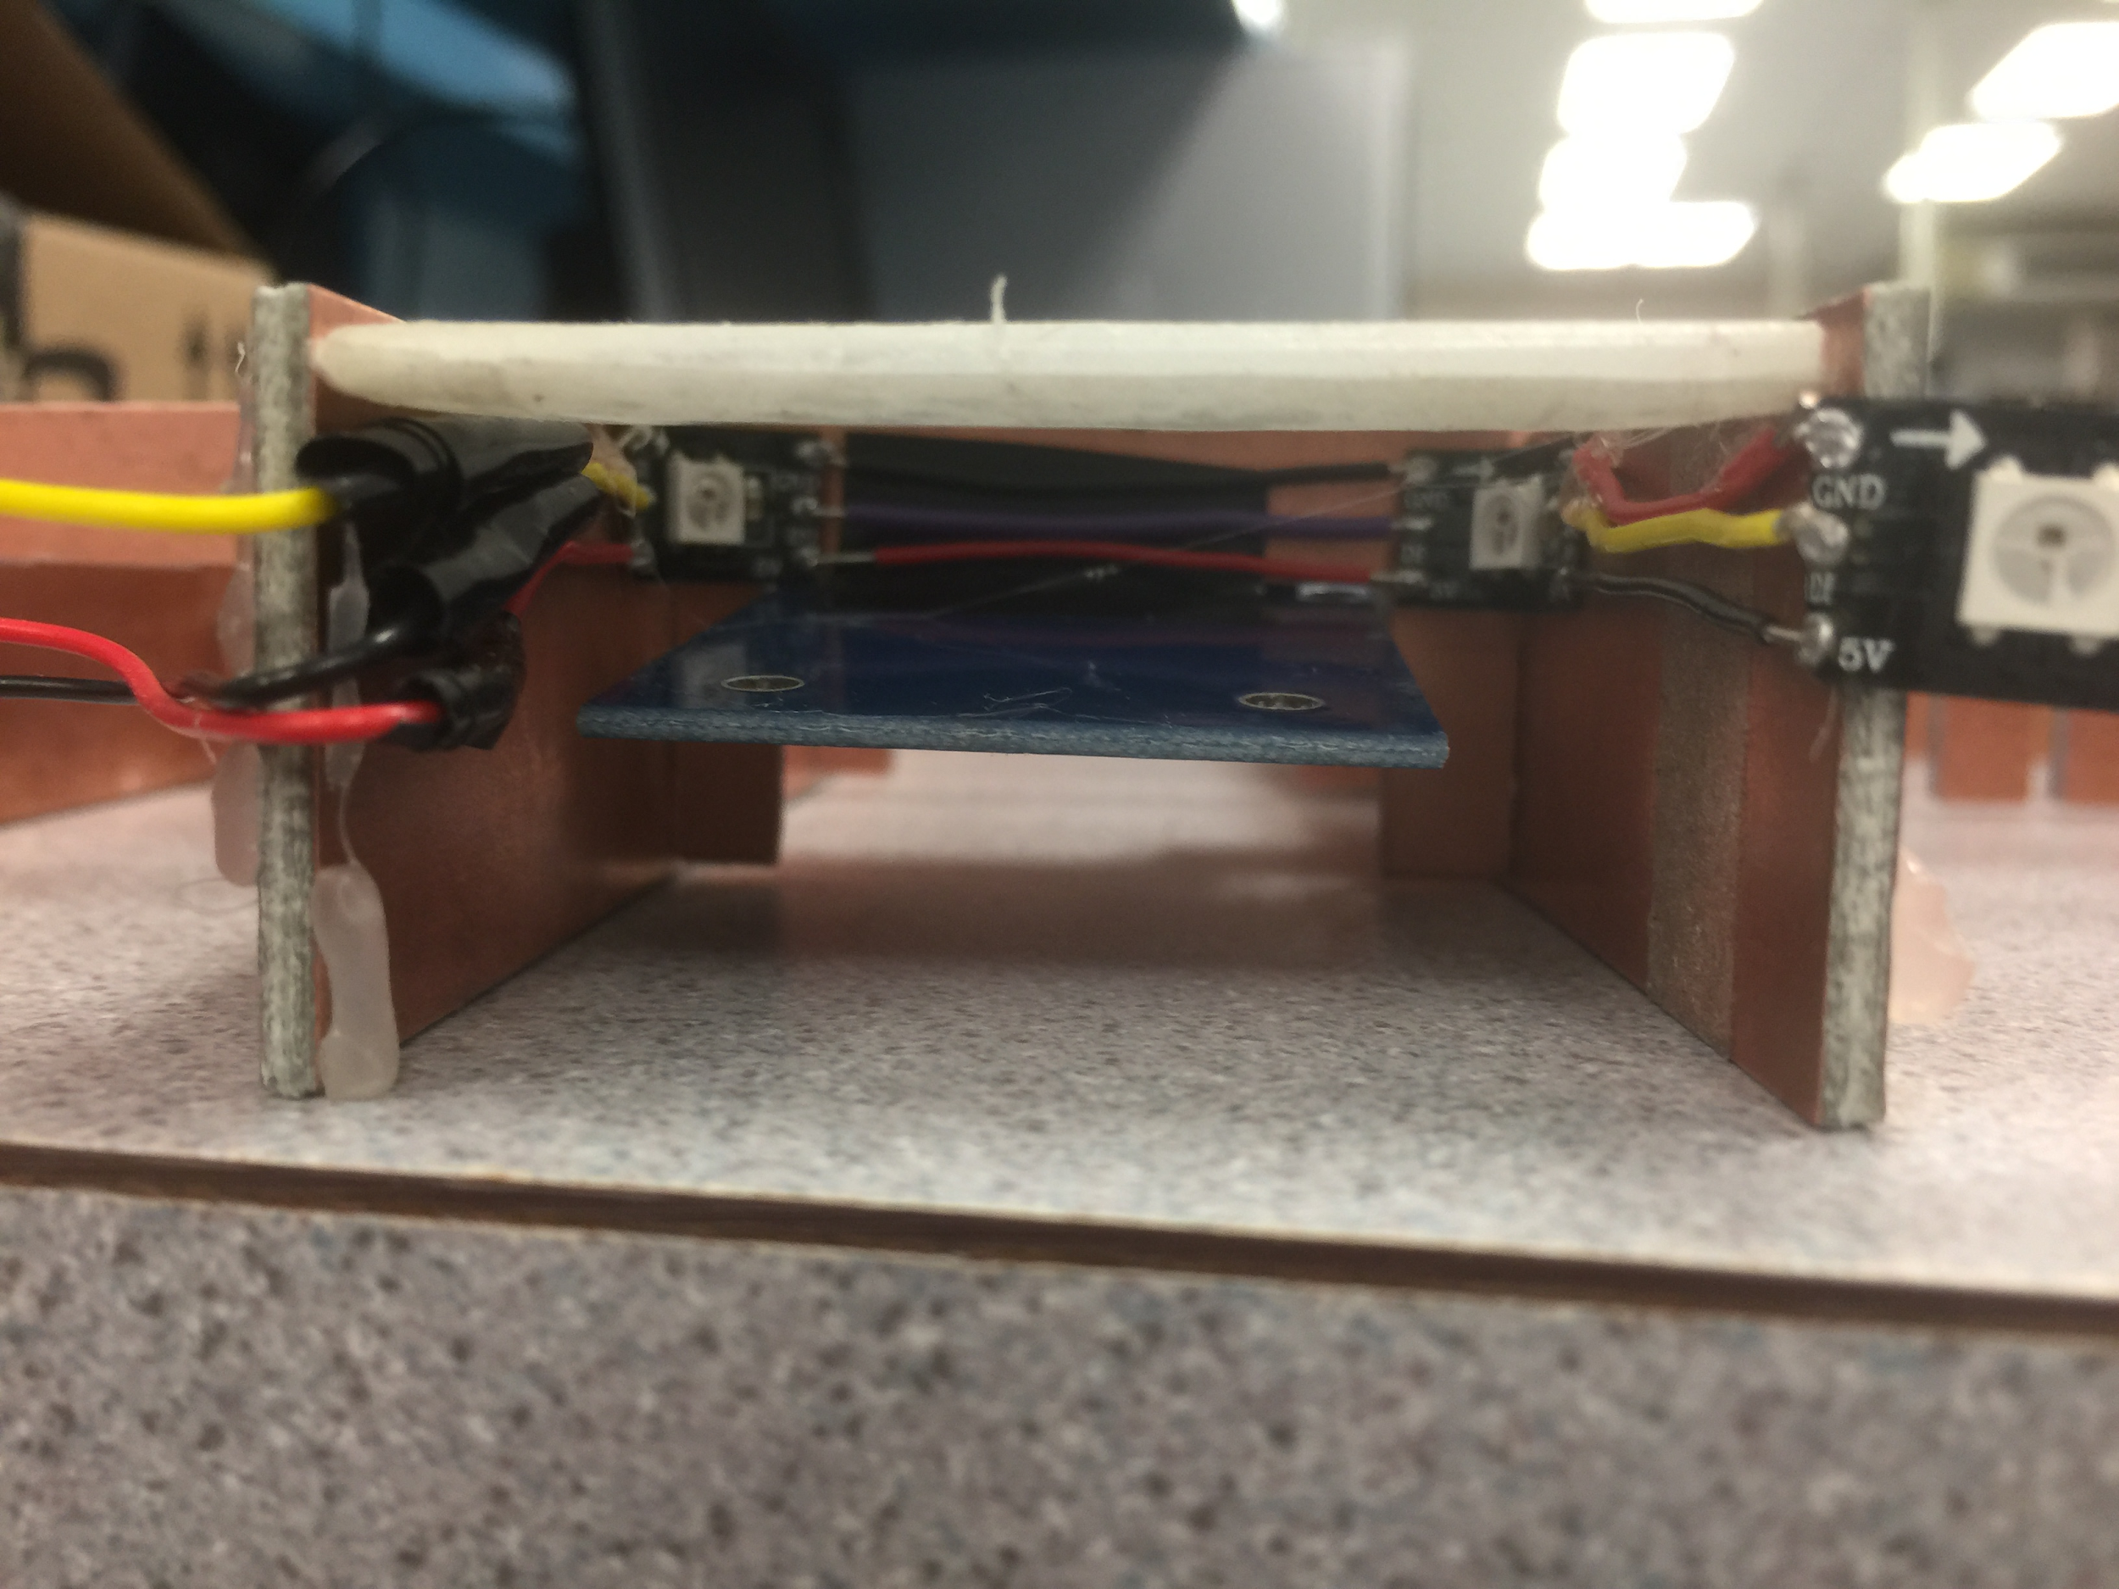
Unit Cell

Slide 8
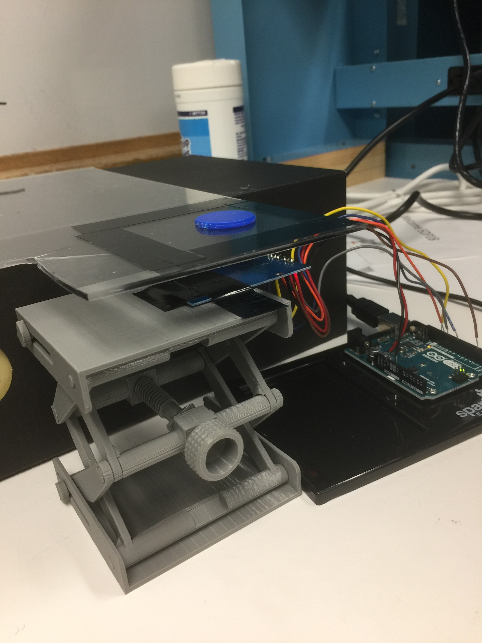
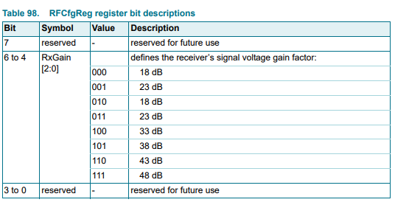
Reader Range Test
Distance between reader and chess surface
6 Gain Settings

Slide 9
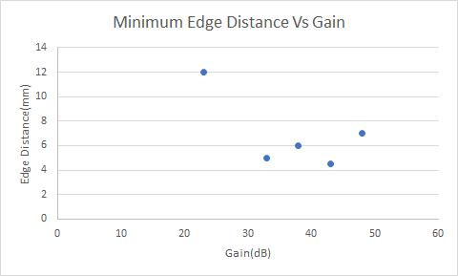
Read Range at 1cm

Slide 10
Android App and Server
Merged Bluetooth App and Server Connection App
Included more transferrable functionality for FDR
- Multiple Client connection to Server
- Addition of Incorrect Move Check by player
- Additional Feature Inclusion Game Clock

Slide 11
Detailed Game Progression
1.Players begin by connecting to chessboard and server through SmartChess Android App
2.Microcontroller Checks for Correct Piece Positioning upon setup
3.Players Choose White or Black
4.Timers will begin upon either sides first move(Working on this feature)
5.A button will be used to stop the timer and begin reading through RFIDs for changes on the board
6.After finding changes to the board it is sent to the Google Cloud Server, recorded, and sent to Client 2
7. Steps repeated until Game Over

Slide 13
Project Timeline
Week of | 12/9 | Winter Break 12/20-1/23 | 1/23 | 1/28 | 2/4 | 2/11 | 2/18 | 2/25
Website | D/B
LED Research and Interference Testing |  | B/S | B/S | B/S
App Completion/2nd Board Functionality | S
Integrating ARM processor/ Order the RFID readers |  | S/D | S/D
PCB Design and Order LEDs |  |  |  | D/S
Build Chassis and PCB testing |  |  |  |  | B/D/S | (PCB)
PCB Adjustments/ 2nd Round PCB Order |  |  |  |  |  | D/S
Full Chessboard (with PCB 1) and App integration |  |  |  |  |  | B/D/S | B/D/S
2nd PCB Testing |  |  |  |  |  |  | D/S/B

Slide 14
Questions

