Slide 1
Shush!
SDP Group 14:
Ryan Coleman
Christos Lemonias
Tim Reardon
Shaaz Salim
Notes:
Ryan: Just intro

Slide 2
Problem Statement
Difficulty sleeping when your roommate's alarm goes off
Feeling bad when you keep your roommate awake
Enjoy listening to white noise before bed
Alarm that wake you up without waking anyone else
Robust and easy to use system which enhances the users experience
Notes:
Ryan: “I’m sure we have all shared a room with someone at some point. Us being engineers we usually have to wake up pretty early and could easily wake someone else up.

Slide 3
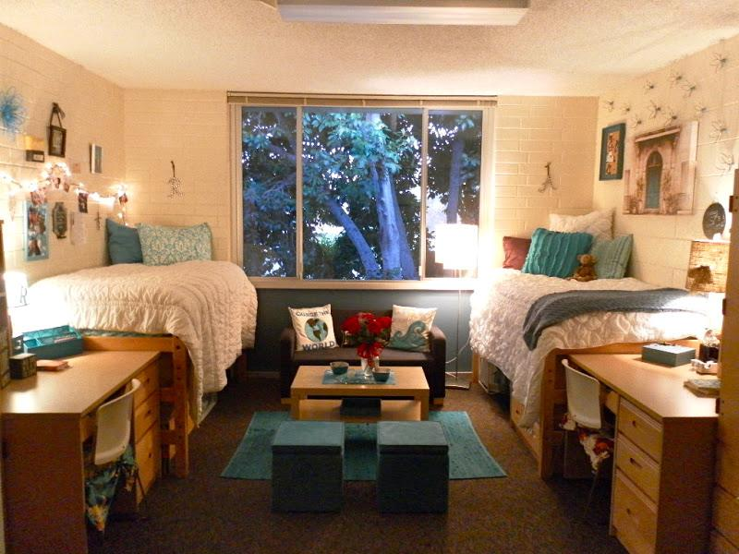
Our Solution

Slide 4
Specifications (Hardware)
Array
  Works properly within a meter from pillow
  Has it’s own dedicated Bluetooth link
  Sound covers approximate size of pillow (20x28 in)
  Volume at pillow between 70 and 90 dB
Alarm box
  No bigger than .25x.125x.125 meters
  Works within 5 meters of the array
Notes:
Christos Separate array from brain box

Slide 5
Specifications (Software)
Mobile application contains full user interface for complete control over the Shush! Device
Battery life of array will be displayed on app for convenience
The app will be designed and available for android
Functions such as snooze, alarm time, and tone select
Intuitive and easy to operate
Notes:
Shaaz: important to have entire system accessible via mobile; android allows us great flexibility; user should ideally have shush control their entire sleeping experience; ux/ui experience

Slide 6
Parametric Array
Block Diagram
Battery
Transducers
Bluetooth
App
Alarm Box
Bluetooth
Bluetooth
Interface
Micro Controller
Display
Phone Systems
Accelero- meter
Speaker
Memory
Parametric Circuitry
Memory
Power

Slide 7
Subsystem (Alarm Box)
Must enclose both microcontroller and parametric circuitry
Powered by wall outlet
Must communicate effectively with other systems
Has a build in digital display
Must meet size requirements
Alarm Box
Bluetooth
Micro Controller
Display
Parametric Circuitry
Memory
Power
Notes:
Ryan “We have taken to also referring to this system as the brain of our project.

Slide 8
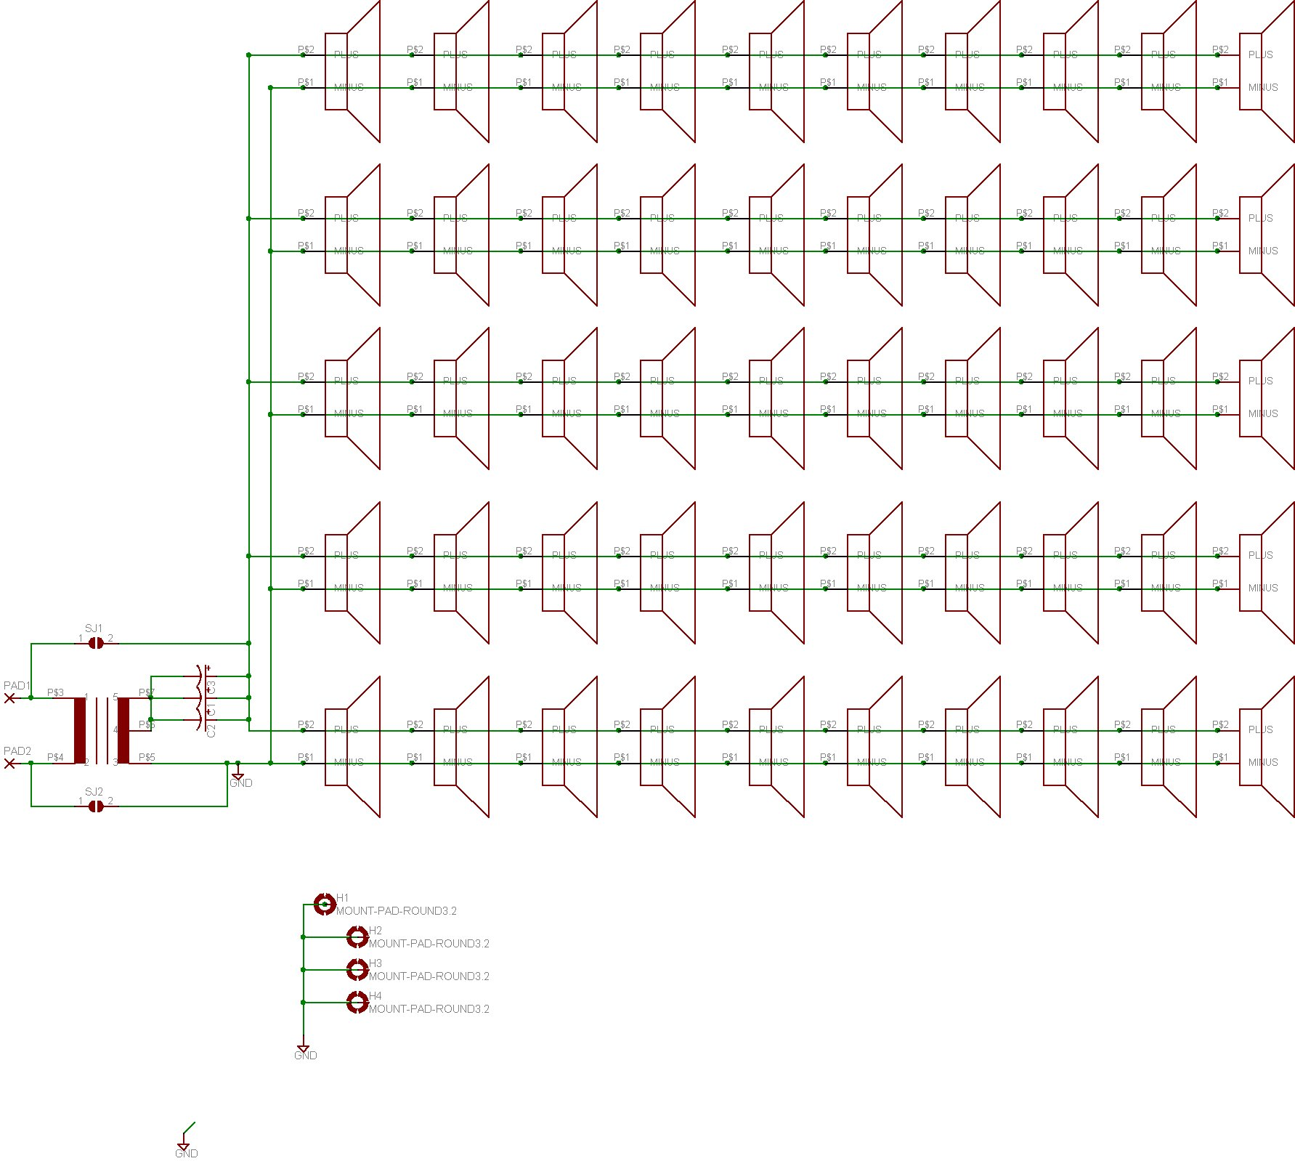
Subsystem (Transducer Array)
Mountable on wall
Lightweight
Long battery life
Bluetooth functionality
Parametric Array
Battery
Transducers
Bluetooth
Notes:
Chris

Slide 9
Subsystem (Mobile App)
Easy to use interface
Has access to systems within the phone
Communicates well with alarm box through bluetooth
Low processing power
User input functionality
App
Bluetooth
Interface
Phone Systems
Accelero-meter
Speaker
Memory
Notes:
Shaaz: app will have permissions to access storage bluetooth and speaker; does not occupy too much CPU to keep user exp of rest of phone high;

Slide 10
Additional Features
Time permitted add-ons
Laser light for aligning array
Standalone box that works without app
Back up Alarm in case array dies
When to wake app functionality
Array recharging through plug or induction
Notes:
Tim
be sure to mention TIME PERMITTED

Slide 11
Design Alternatives
Using earbud speakers instead of parametric circuit
Locating alarm recipient automatically
Adjusting array through app only
Wifi connected as opposed to bluetooth
Found similar product on Kickstarter
  has not seen production lines yet
Notes:
Chris

Slide 12
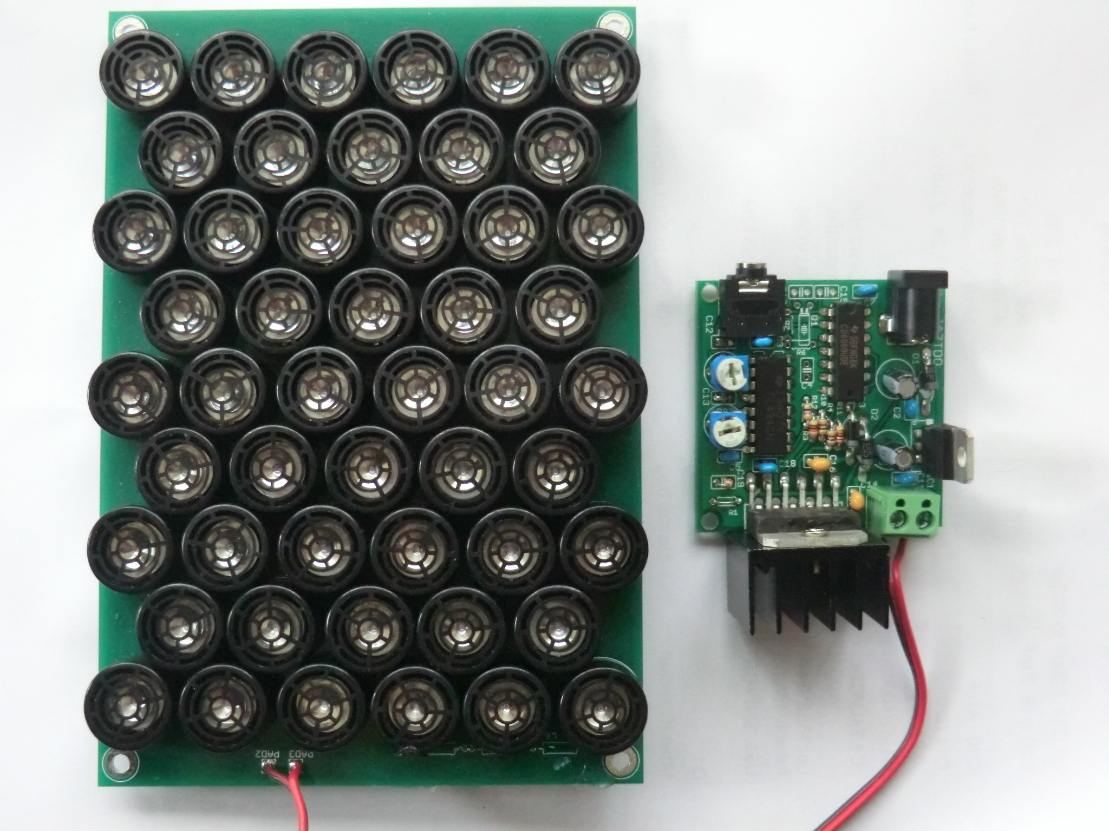
MDR Deliverable
Working Parametric Speaker with Array
  Ryan Coleman
  Christos Lemonias
App Framework
  Shaaz Salim
  Tim Reardon
Notes:
Tim
We have 2 MDR deliverables: a functional parametric speaker with array set up that we can start testing with and the framework for the app. With these deliverables we will be able to start testing and focusing the parametric speaker to sound clear at the 1 meter distance we set previously. We will also have the app design set up so that we have an idea how we hope that the user will interface with Shush

Slide 13
Questions?
Notes:
comparable Processors? Limited processing in the box, mostly non continuous
Estimate battery life? power usage of bluetooth and transducer

Slide 14
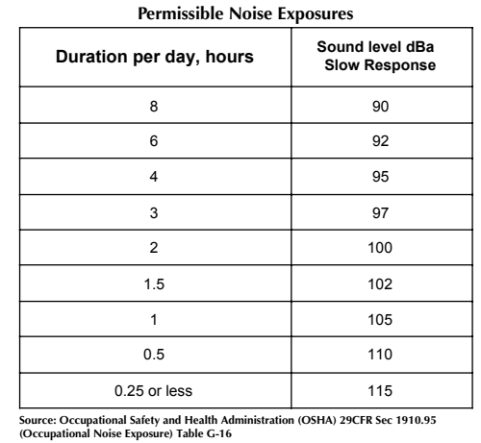
Health Risks?
Possible symptoms may include:
  nausea, dizziness, fatigue
Only occurs:
  at dB levels over 100
  at frequency just above our hearing

Slide 15
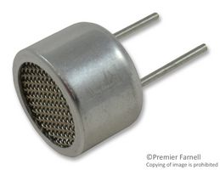
Array Power Consumption
One 40KHz piezo transducer dissipates .21 microW
  We will need roughly 100

