Slide 1
Shush!
SDP Group 14:
Ryan Coleman
Christos Lemonias
Tim Reardon
Shaaz Salim
Notes:
Ryan: Just intro

Slide 2




This is Shush!
Christos Lemonias
Ryan Coleman
Tim Reardon
Shaaz Salim
Notes:
Ryan

Slide 3
Problem Statement
Difficulty sleeping when your roommate's alarm goes off
Feeling bad when you keep your roommate awake
Enjoy listening to white noise before bed
Alarm that wake you up without waking anyone else
Robust and easy to use system which enhances the user's experience
Notes:
Ryan

Slide 4
Specifications
Array
  Works properly within a meter from pillow
  Has it’s own dedicated Bluetooth link
  Sound covers approximate size of pillow (20x28 in)
  Volume at pillow between 70 and 90 dB
App
  The app will be designed and available for android
  Functions such as snooze, alarm time, and tone select
Notes:
Christos

Slide 5
Cost Analysis
Past | QTY | Unit Price | Description | Total
 | 1 | $31.25 | Teensy 3.5 | $31.25
 | 10 | $4.46 | Ultrasonic Transducer | $44.60
 | 2 | $0.96 | Logic Output | $1.92
 | 4 | $1.30 | Half Bridge Driver | $5.20
 | 2 | $0.95 | Voltage Regulator | $1.90
 | 4 | $0.92 | MOSFET PT8N | $3.68
 | 1 | $8.50 | HC-05 Bluetooth Serial Module | $8.50
 | 2 | $8 | Shipping | $16
 |  |  | Total | $113.05
Future | 1 | $8.00 | MicroSd and Adapter | $8.00
 | 1 | $22.00 | Audio Shield | $22.00
 | 1 | $17.45 | WALL MOUNT ADAPTER 24V 24W | $17.45
Notes:
Tim

Slide 6
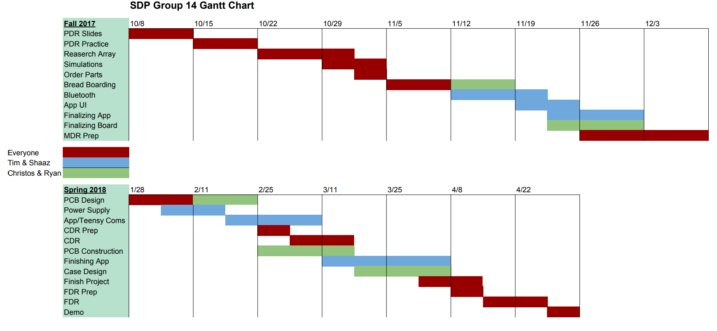
Gantt Chart
Notes:
Shaaz

Slide 7
Parametric Array
Block Diagram (Original)
Battery
Transducers
Bluetooth
App
Alarm Box
Bluetooth
Bluetooth
Interface
Micro Controller
Display
Phone Systems
Accelero- meter
Speaker
Memory
Parametric Circuitry
Memory
Power
Notes:
Tim

Slide 8
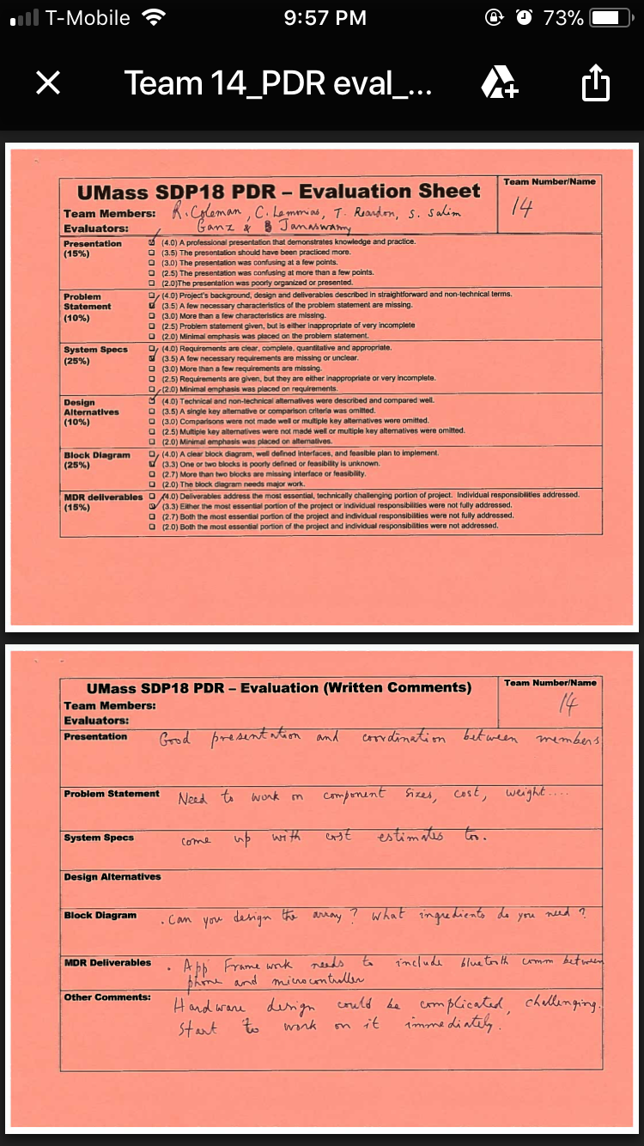
PDR Recommendations (1)
Simplify Design/Combine array with alarm box
  Keeps design from getting too complicated
  Less spots for errors to occur
  Only need one Bluetooth connection as opposed to two
  Gets rid of battery
We took this into account moving forward and...
Notes:
Tim

Slide 9
Block Diagram (Updated)
Parametric Array
Parametric Circuitry
Transducers
App
Interface
Micro Controller
Phone Systems
Memory
Accelero- meter
Speaker
Memory
Power
Bluetooth
Bluetooth
Notes:
Tim

Slide 10
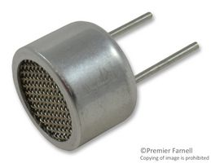
Transducers
16mm piezoelectric transducers
  Parallel honeycomb setup
  Current setup uses 10
Not currently at optimal distances
  Breadboard pin spacing isn’t great
  Future PCD design needed
Parametric Array
Parametric Circuitry
Transducers
App
Interface
Phone Systems
Micro Controller
Memory
Accelero- meter
Speaker
Memory
Power
Bluetooth
Bluetooth
Notes:
Ryan

Slide 11
Parametric Circuitry
Opto isolator
  protects our microcontroller from harmful currents
H-bridge Amplifier
  Microcontroller outputs 3.3V but transducers need 20V
Parametric Array
Parametric Circuitry
Transducers
App
Interface
Phone Systems
Micro Controller
Memory
Accelero- meter
Speaker
Memory
Power
Bluetooth
Bluetooth
Notes:
Ryan

Slide 12
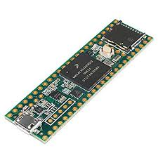
Microcontroller
Teensy 3.5
  Up to 120 MHz ARM® Cortex
Supply voltage: 3.3V
SPI communication pins (for SDHC external memory interface)
PWM capabilities
  many PWM output pin options
Parametric Array
Parametric Circuitry
Transducers
App
Interface
Phone Systems
Micro Controller
Memory
Accelero- meter
Speaker
Memory
Power
Bluetooth
Bluetooth
Notes:
Christos

Slide 13
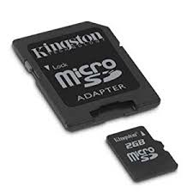
Memory
External memory card will be used
  SanDisk microSDHC card
  16 GB of space
What is being stored?
  WAV files for music/tones
  Alarm clock settings
Parametric Array
Parametric Circuitry
Transducers
App
Interface
Phone Systems
Micro Controller
Memory
Accelero- meter
Speaker
Memory
Power
Bluetooth
Bluetooth
Notes:
Shaaz

Slide 14
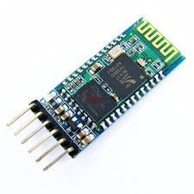
Bluetooth
HC-05
  Maintains connection up to 30 feet
  Voltage levels line up with Teensy
Software will allow for easy manipulation of received information
Parametric Array
Parametric Circuitry
Transducers
App
Interface
Phone Systems
Micro Controller
Memory
Accelero- meter
Speaker
Memory
Power
Bluetooth
Bluetooth
Notes:
Shaaz

Slide 15
Voltage Supply
Parametric circuitry needs a 20V supply
Teensy needs 3.3V
24V wall adapter will be used
  Voltage regulator circuits to provide both voltage supplies
Parametric Array
Parametric Circuitry
Transducers
App
Interface
Phone Systems
Micro Controller
Memory
Accelero- meter
Speaker
Memory
Power
Bluetooth
Bluetooth
Notes:
Christos

Slide 16

App
Developed in Android Studio for Android Apps
User controls
  Pick time and day of alarms
  Choose repeating alarms
  Choose alarm tones
Will send all information to the Teensy
Parametric Array
Parametric Circuitry
Transducers
App
Interface
Phone Systems
Micro Controller
Memory
Accelero- meter
Speaker
Memory
Power
Bluetooth
Bluetooth
Notes:
Tim

Slide 17
PDR Recommendations (2)
Add Bluetooth connection between microcontroller and phone to MDR Deliverables
  Important for the eventual combination of our deliverables
  Didn’t want to leave this for later and possibly delay ourselves
We took this into account moving forward and...
Notes:
Shaaz

Slide 18
MDR Deliverables
Bluetooth Connectivity Demonstration
  Developed By Shaaz Salim
App Framework Presentation
  Developed by Timothy Reardon
Parametric Circuitry with Array
  Developed by Ryan Coleman and Christos Lemonias
Notes:
Shaaz

Slide 19
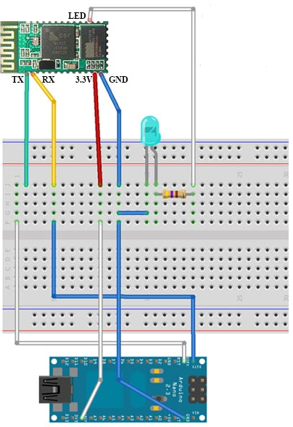
Bluetooth Presentation
Mobile app code sends ‘high’ signal
while button is pressed.
Teensy constantly checks for change
in signal from Bluetooth.
Notes:
Shaaz

Slide 20
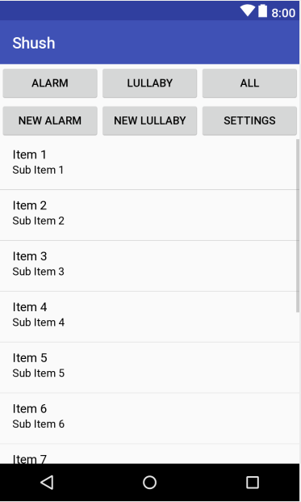
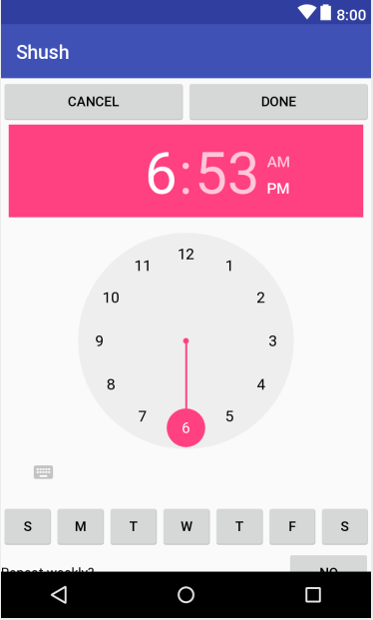
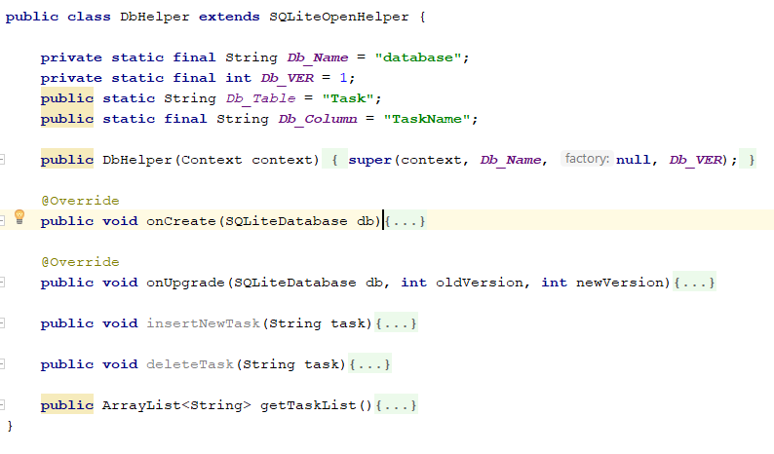
Framework Presentation
Notes:
Tim

Slide 21
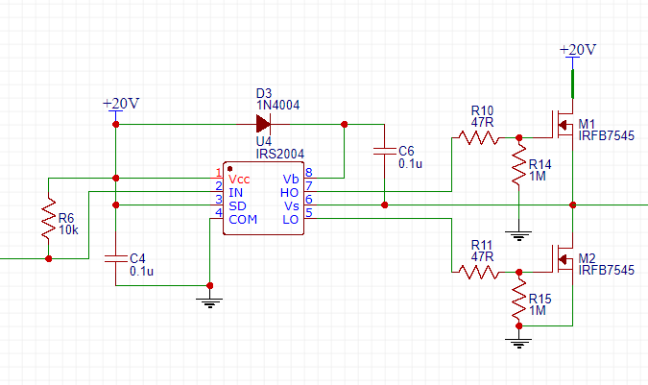
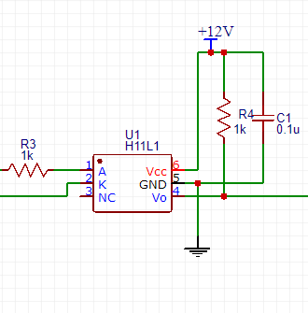
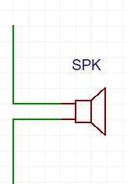

Parametric Schematic
Optoisolator 1
Optoisolator 2
H-bridge
Speaker
Notes:
Ryan

Slide 22
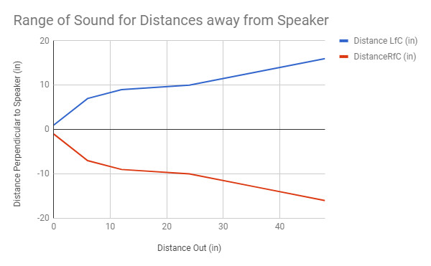
Parametric Array Spread
Notes:
Christos

Slide 23
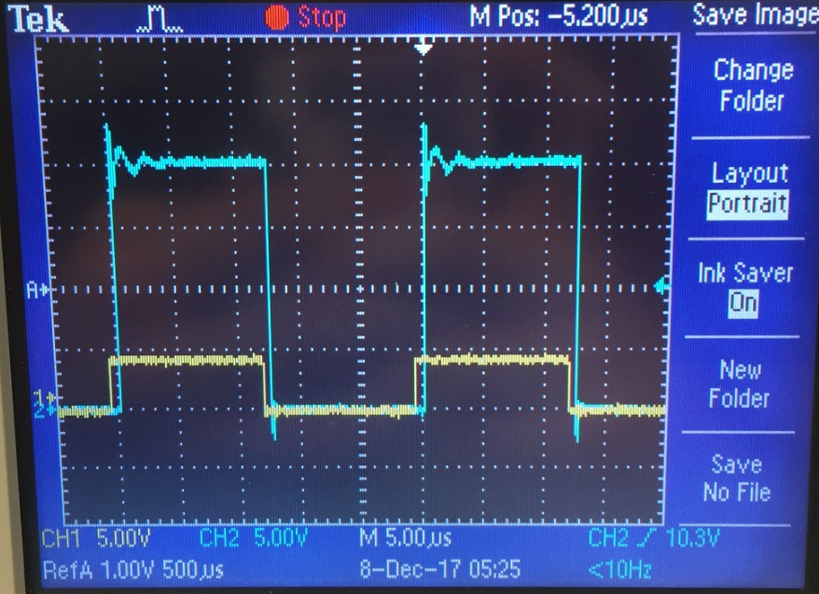
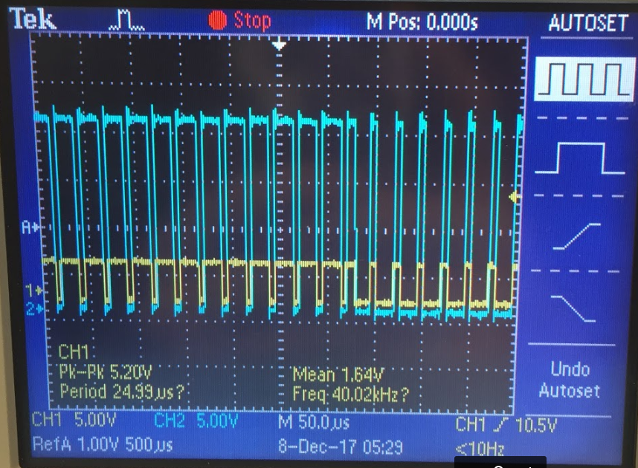
Parametric Presentation
Notes:
Ryan “We have taken to also referring to this system as the brain of our project.

Slide 24
CDR Deliverables
Functional prototype (All Members)
  Fully functional App
  System control via App
Power supply / regulation implementation (Tim and Shaaz)
PCB design (Ryan and Christos)
Notes:
Ryan

Slide 25
Questions?
Notes:
comparable Processors? Limited processing in the box, mostly non continuous
Estimate battery life? power usage of bluetooth and transducer

Slide 26
Weight
Current Speaker/board set up is only 0.28lbs
Future PCB weight should be similar to our breadboard
Components should not add much to the overall weight
Notes:
comparable Processors? Limited processing in the box, mostly non continuous
Estimate battery life? power usage of bluetooth and transducer

Slide 27
Power Consumption
Teensy MC: maximum of .33W at operating voltage of 3.3 V
  Output high current total for all ports: 100mA
  Output high voltage: 3.3V
  relatively low power; regulated by power supply
Transducers: 2.1 uW of power at 20V
  Each 40KHz piezo transducer dissipates .21 uW
  10 piezo transducers

