Slide 1
Shush!
SDP Group 14:
Ryan Coleman
Christos Lemonias
Tim Reardon
Shaaz Salim
Notes:
Ryan: Just intro

Slide 2


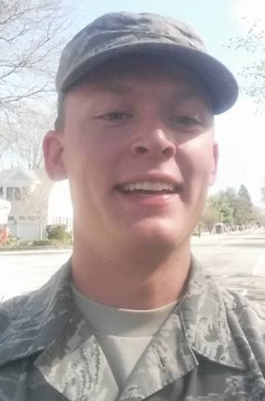

This is Shush!
Christos Lemonias
Ryan Coleman
Tim Reardon
Shaaz Salim
Notes:
Ryan

Slide 3
Problem Statement
Difficulty sleeping when your roommate's alarm goes off
Feeling bad when you keep your roommate awake
Enjoy listening to white noise before bed
Alarm that wake you up without waking anyone else
Robust and easy to use system which enhances the user's experience
Notes:
Ryan

Slide 4
Design
Phone
Hardware
Transducer Array
APP
Driving Circuit
Power Supply
Notes:
Christos

Slide 5
Specifications
Hardware
Works properly within a meter from pillow
Weight of less than 2 lbs
Sound covers approximate size of pillow (20x28 in)
Volume at pillow between 70 and 90 dB
App
The app will be designed and available for android
Functions such as snooze, alarm time, and tone select
Notes:
Christos

Slide 6
Block Diagram
Parametric Array
Parametric Circuitry
Transducers
App
App
Interface
Interface
Micro Controller
Phone Systems
Phone Systems
Memory
Memory
Display
Memory
Display
Power
Wireless
Bluetooth
Bluetooth
Bluetooth
Bluetooth
Notes:
Tim

Slide 7
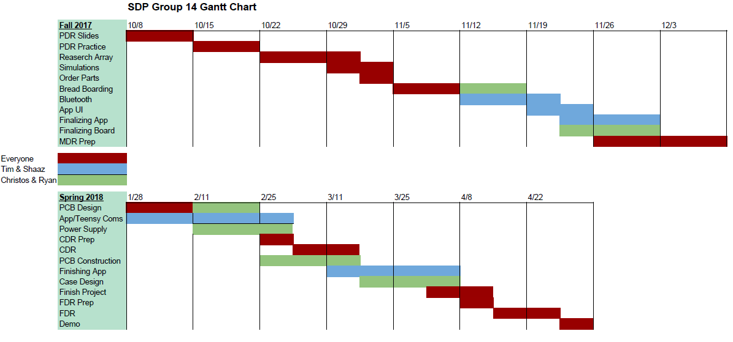
Gantt Chart
Notes:
Shaaz

Slide 8
Cost Analysis
Past | QTY | Unit Price | Description | Total
 | 1 | $31.25 | Teensy 3.5 | $31.25
 | 20 | $4.46 | Ultrasonic Transducer | $89.20
 | 2 | $0.96 | Logic Output | $1.92
 | 4 | $1.30 | Half Bridge Driver | $5.20
 | 2 | $0.95 | Voltage Regulator | $1.90
 | 4 | $0.92 | MOSFET PT8N | $3.68
 | 1 | $8.50 | HC-05 Bluetooth Serial Module | $8.50
 | 1 | $8.73 | 24V 1A AC/DC Power Supply | $8.73
 | 4 | $8 | Shipping | $32
 |  |  | Total | $182.38
Notes:
Tim

Slide 9
CDR Deliverables
Functional prototype (Tim & Shaaz)
Fully functional App
System control via App
Power supply / regulation implementation (Ryan & Christoss)
PCB design (Ryan & Christoss)
Notes:
Shaaz

Slide 10
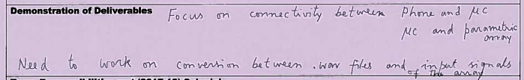
CDR Recommendations
Took these recommendations into consideration
Influenced our CDR Deliverables
Made sure to focus on communication between parts
Between App and Teensy
Between Teensy and Speaker
Notes:
Tim

Slide 11
CDR Deliverables (updated)
Functional prototype (Tim & Shaaz)
Fully functional App
App to teensy communication
Teensy to parametric circuitry communication
Using .wav files
Power supply / regulation implementation (Ryan & Christos)
PCB design (Ryan & Christos)
Notes:
Shaaz

Slide 12
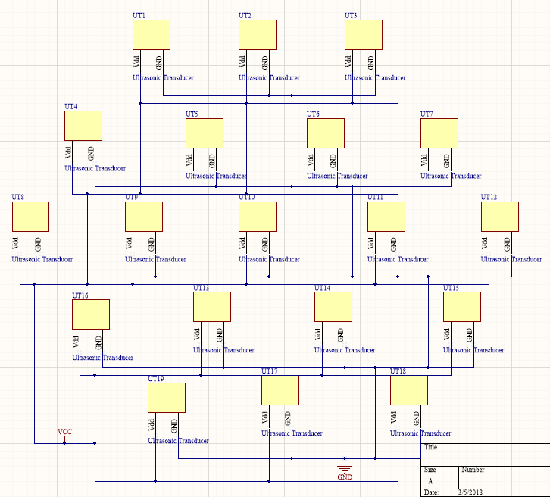
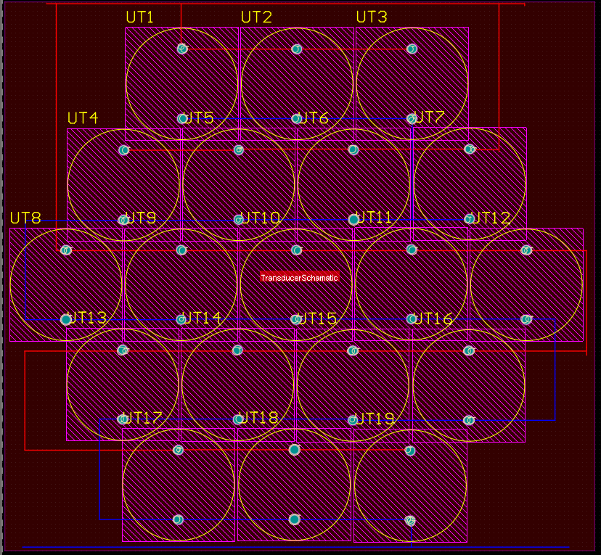
PCB Design (Array)
Had to design transducer model manually

Slide 13
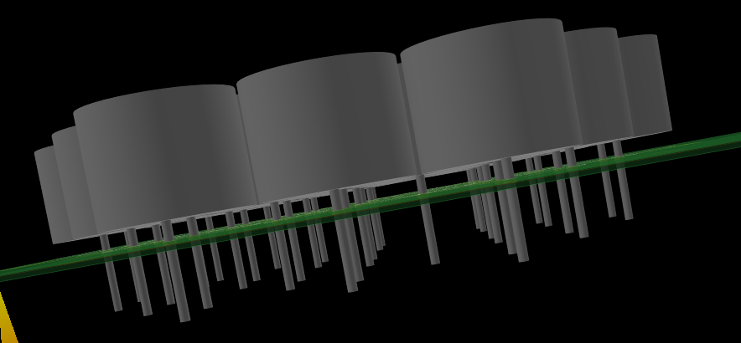
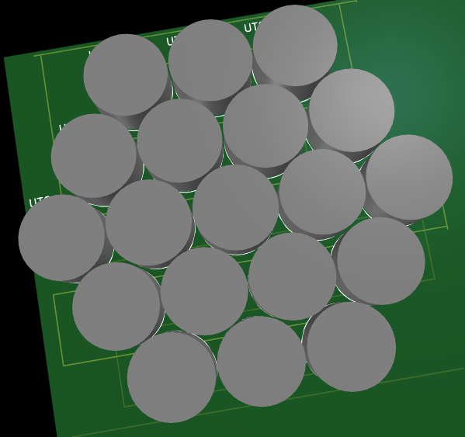
PCB Design (Array)

Slide 14
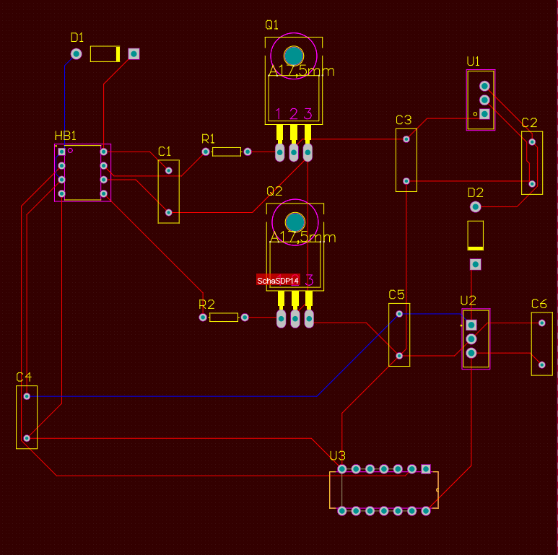

Slide 15
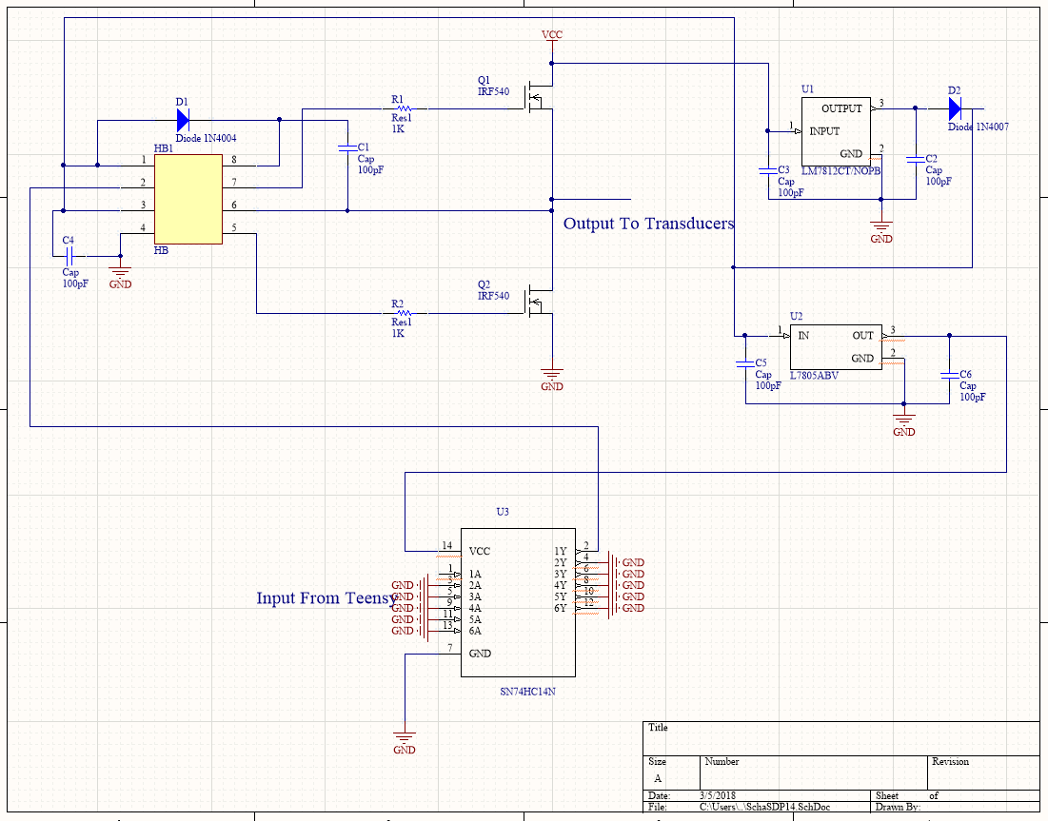
PCB Design (Parametric Circuitry and Power)

Slide 16
Voltage Supply
The System needs a 24V supply
Also need 12V and 5V
While running we draw 21mA at 24V ~~ .5W
24V 1A wall adapter used
Voltage regulator circuits to provide different voltage supplies
Notes:
Christos

Slide 17
Power Supply Distribution
Voltage
Regulator
1
12V source
Voltage
Regulator
2
Power Supply
24V
5V source
Transducers
Parametric Circuity
Teensy
Notes:
Christos

Slide 18
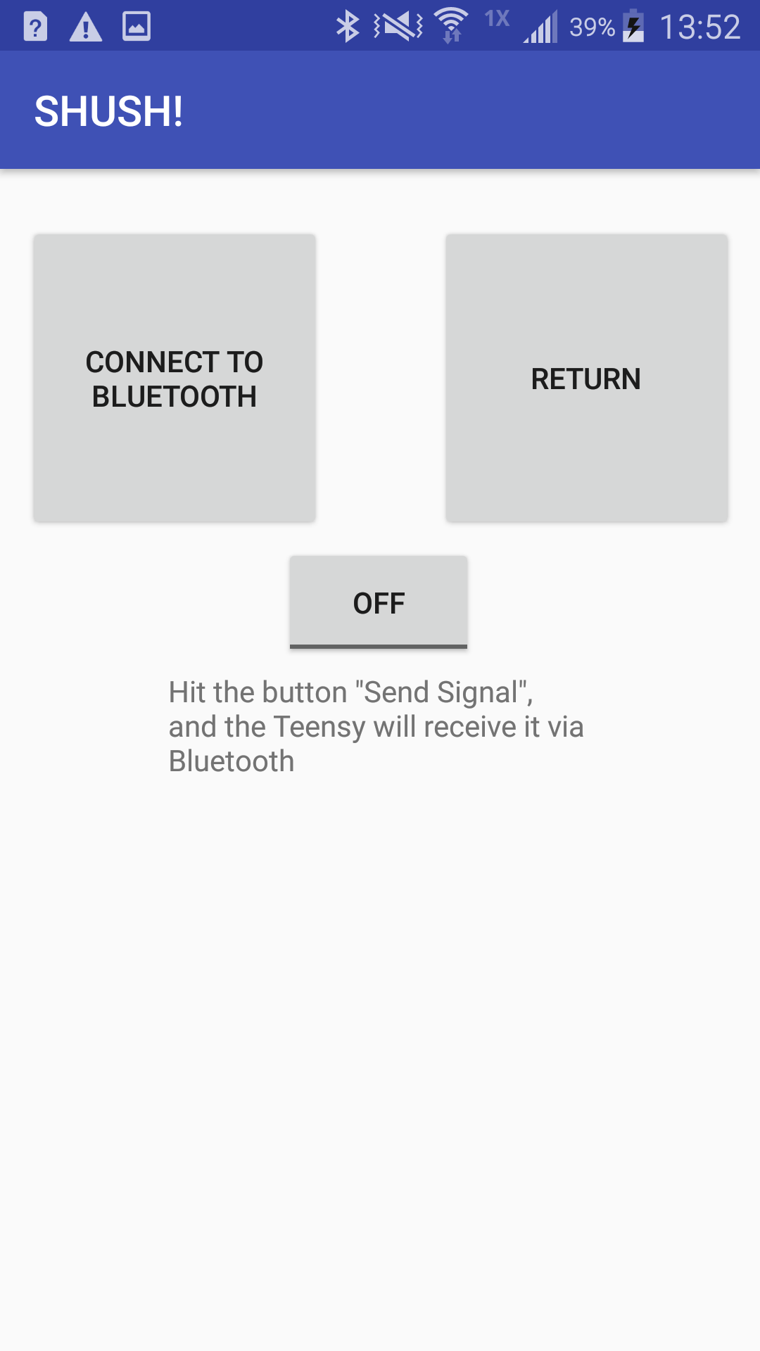
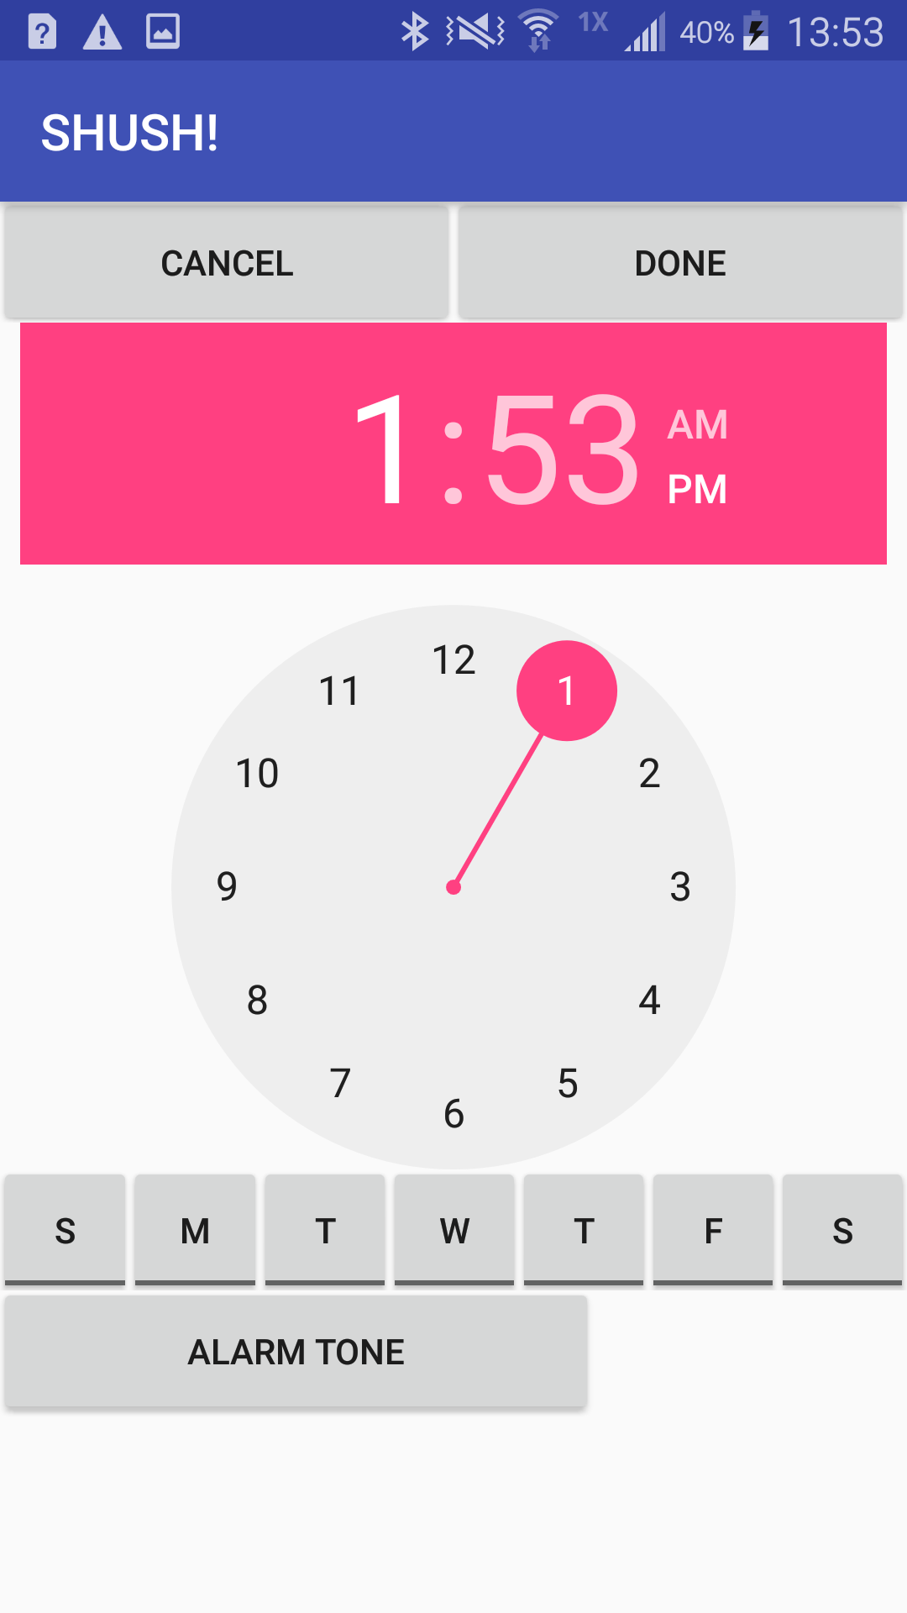
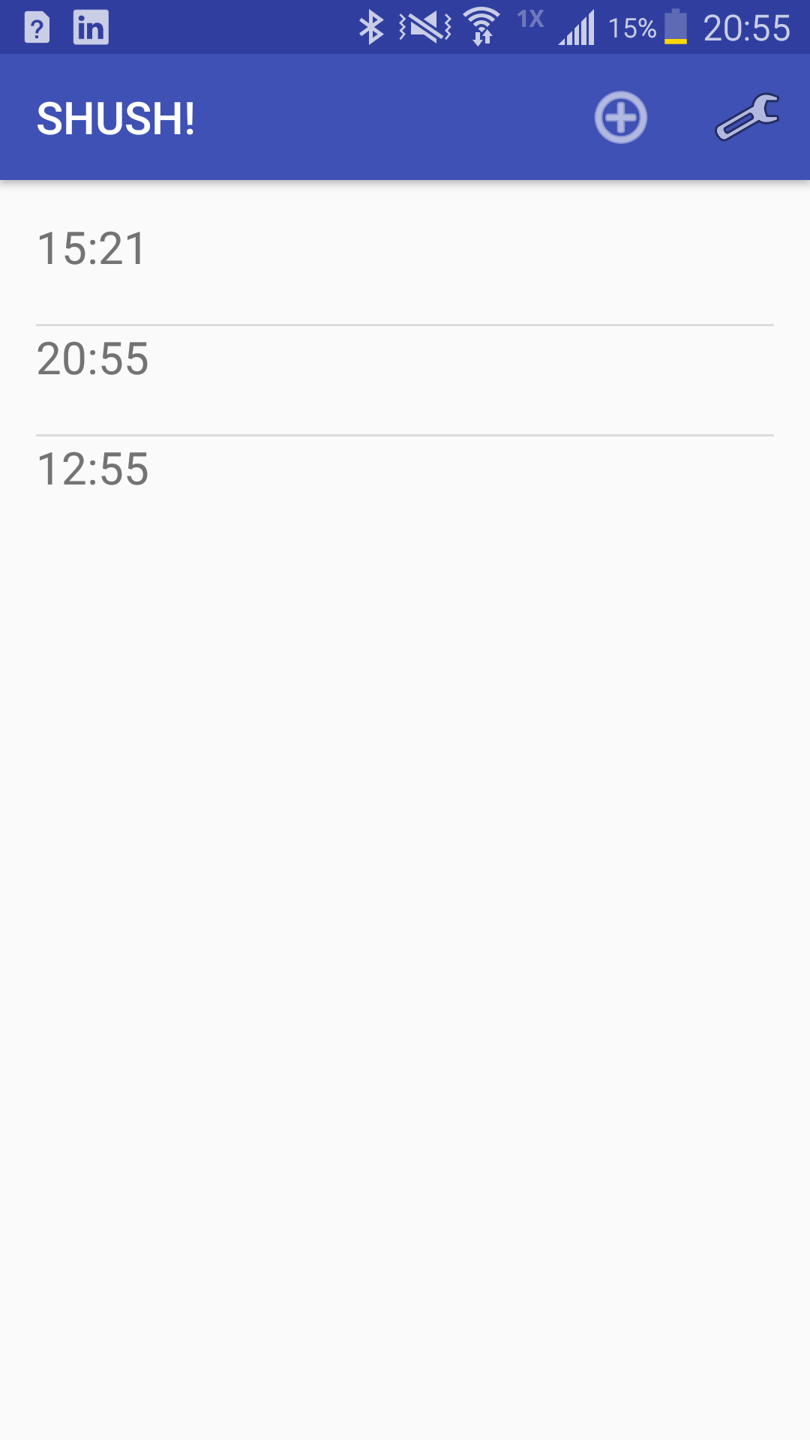
App

Slide 19
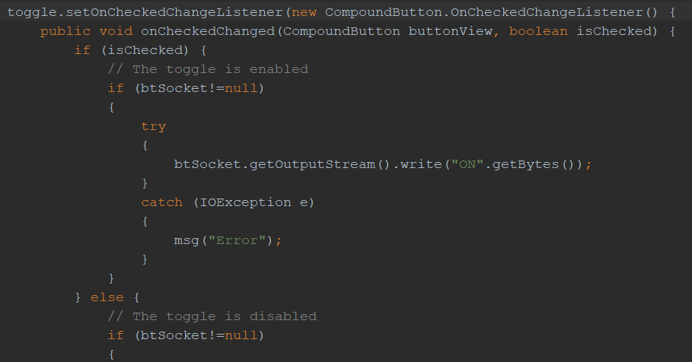
Bluetooth Communication

Slide 20
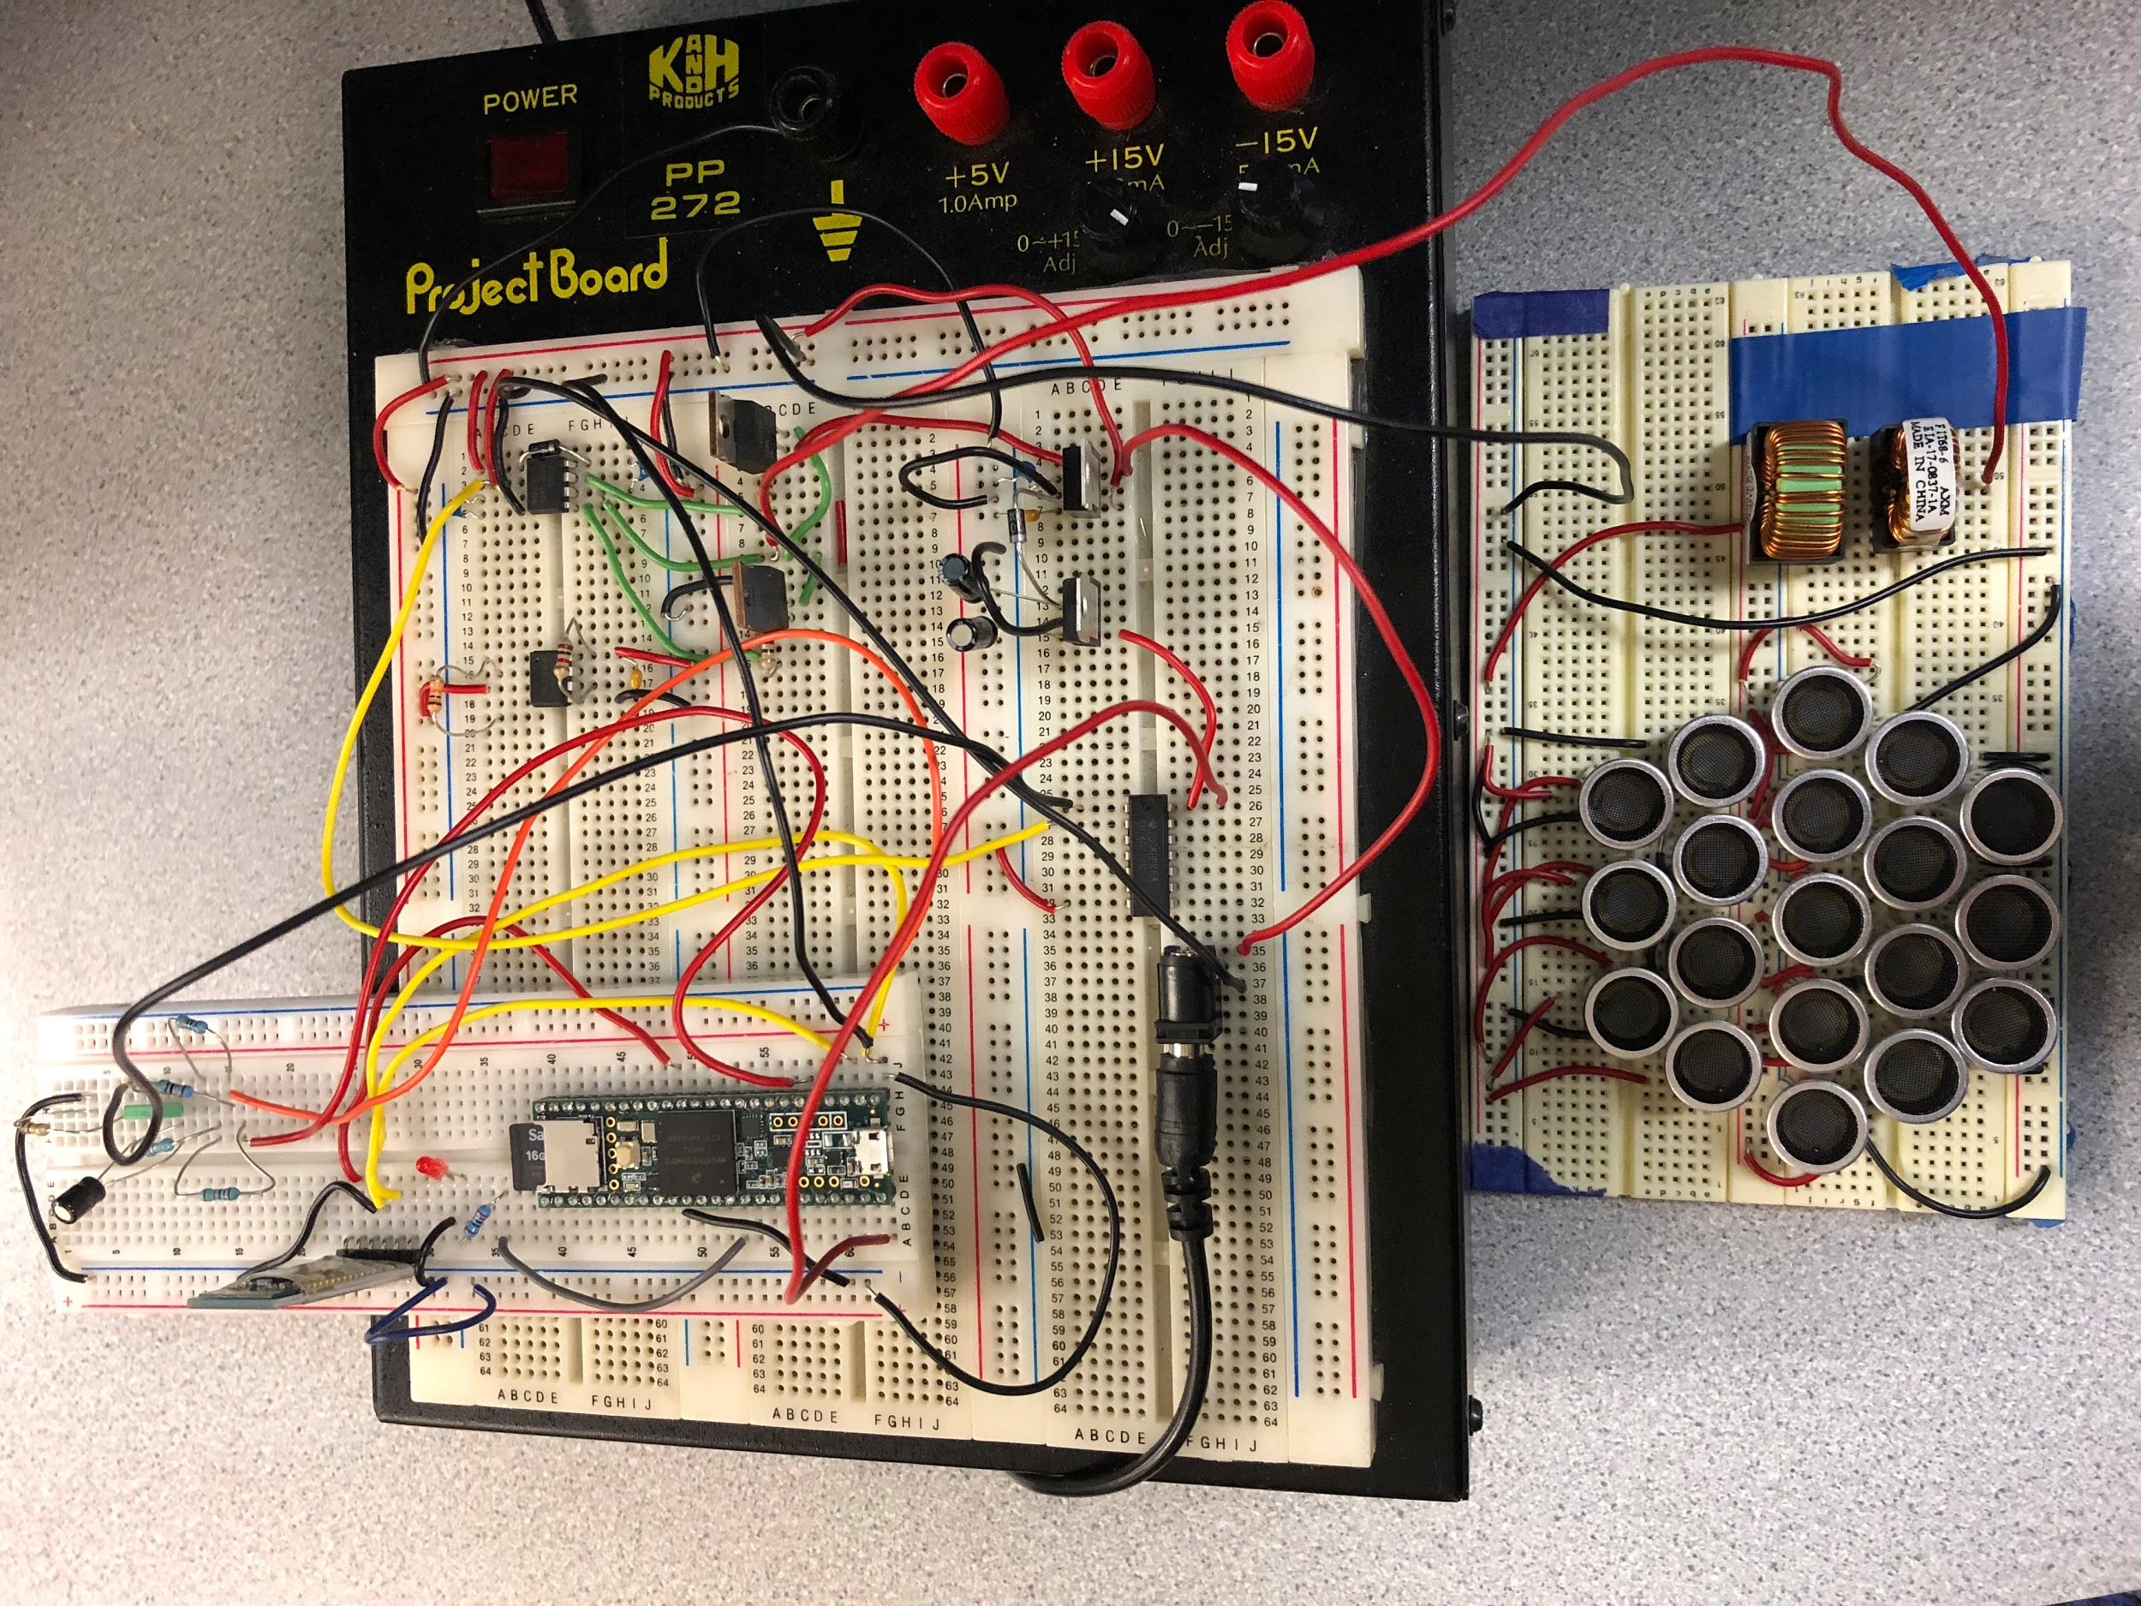
Functional Prototype
Parametric Array
Parametric Circuitry
Transducers
App
Interface
Phone Systems
Micro Controller
Memory
Display
Memory
Power
Bluetooth
Bluetooth

Slide 21
FPR Deliverables
Mobile App Release Candidate
Tim and Shaaz
Working Parametric Speaker (meets specifications)
Ryan and Christos
Fully Constructed Shush! Prototype
Everyone
Demo:
Demonstrate directivity specs
Show well designed and functional app
Notes:
Ryan

Slide 22
Questions?
Notes:
comparable Processors? Limited processing in the box, mostly non continuous
Estimate battery life? power usage of bluetooth and transducer

Slide 23
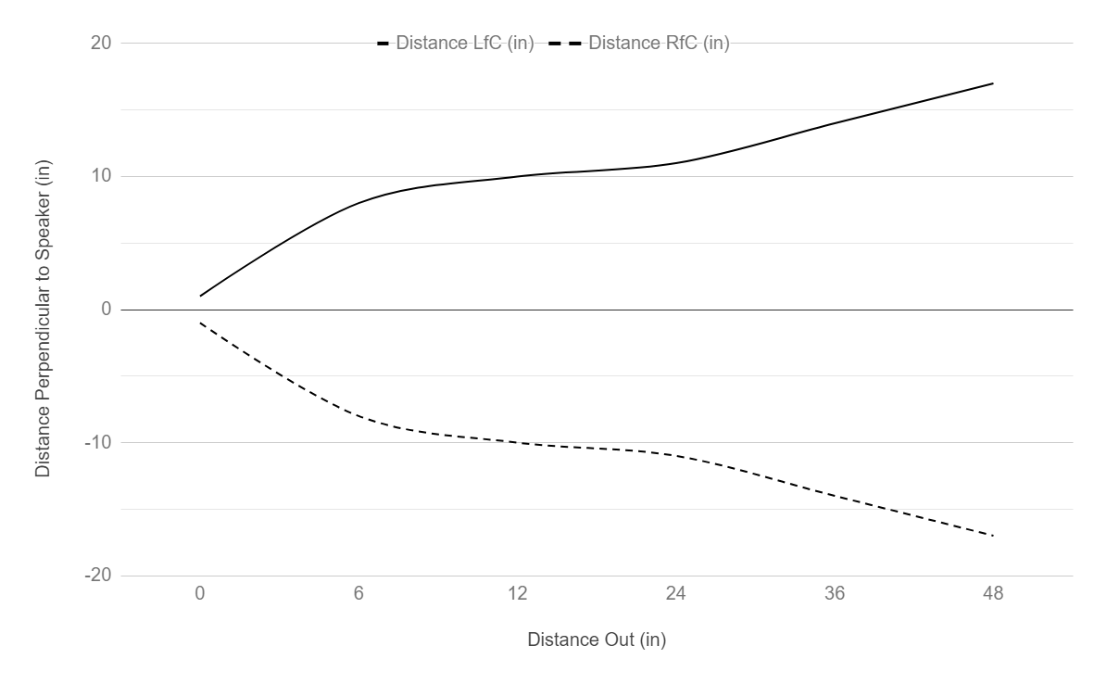
Volume
Experimented with increasing the volume
Effective changes
Array Inductors
Decreases in Noise
Ineffective changes
More Transducers
High Voltage
Notes:
comparable Processors? Limited processing in the box, mostly non continuous
Estimate battery life? power usage of bluetooth and transducer

Slide 24
Weight
Current Speaker/board set up is only 0.28lbs
Future PCB weight should be similar to our breadboard
Components should not add much to the overall weight
Notes:
comparable Processors? Limited processing in the box, mostly non continuous
Estimate battery life? power usage of bluetooth and transducer

Slide 25
Power Consumption
Teensy MC: maximum of .33W at operating voltage of 3.3 V
Output high current total for all ports: 100mA
Output high voltage: 3.3V
relatively low power; regulated by power supply
Transducers: 4.2 uW of power at 20V
Each 40KHz piezo transducer dissipates .21 uW
20 piezo transducers

