Slide 1
R.A.W.
Remote Armwrestling
SDP Team 12
Tyler Costa, Steve Lucey, Zach Matthews, Steve McGrath
Notes:
Steve L.

Slide 2
Problem Statement and Product
A game that connects the physical and virtual world
Physical competition between distant friends
More intimate than phone call
Could motivate individual to exercise (strength training)
Our Solution….
Remote ArmWrestling game against other users in real-time
Two robotic arms connected over the internet
Each arm replicates the force and strength of the opposite user
The results of the matches would get submitted into a database which would rank users based on their performances
Information accessible through phone application
Notes:
Steve L.
If friends plan to meet at bar with RAW at end of week, more likely to work out that week.
https://www.google.com/url?sa=i&rct=j&q=&esrc=s&source=images&cd=&cad=rja&uact=8&ved=0ahUKEwi3xfTA5PbWAhWLPCYKHbgsCiMQjRwIBw&url=https%3A%2F%2Fwww.pinterest.com%2Fpin%2F164381455119064701%2F&psig=AOvVaw0vlvB1OXIHQGuxyQWCiMzB&ust=1508299652782709

Slide 3
System Requirements
A sturdy robotic arm
Average forearm and length being 0.3 meters
Reliable power supply for each component
Sensors to detect end of the match
High speed connection for communicating between arms
Operates with non-perceivable delay
An application for creating an account and monitoring results
Notes:
Zach

Slide 4
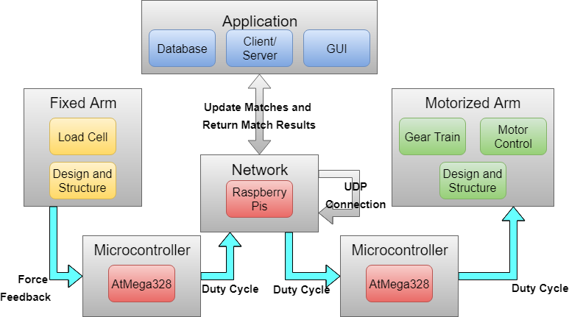
Block
Diagram
Zach - Blue
Steve L. - Red
Tyler - Green
Steve M. - Yellow
Notes:
Tyler

Slide 5
CDR Deliverables
1 Motorized Arm and 1 Fixed Arm:
Motorized Arm will start in arm wrestling position
Will attach weight to that arm
User will apply force to Fixed Arm
Force applied will be converted to a duty cycle
Then sent over the network connection to drive motorized arm
Application
Added integration to AWS RDS, and reconstructed match creation/join interfaces
Notes:
Steve M.

Slide 6
Each Member's Contribution for FPR
Tyler Costa: Built Arm enclosure, built laser/photoresistor setup, designed and built new pulley, and created hard stop on losing arm side
Steve Lucey: Start/End game signal across system, real-time graph of force, ad-hoc RPi network and network for server connection
Zach Matthews: Start/end game signal across system, laser implementation, GUI/Server/Database for match login
Steve McGrath: Built enclosure for fixed arm, created a more sturdy set up for fixed arm, and designed and fabricated PCBs
Notes:
Steve M

Slide 7
FPR Deliverables
1 Motorized Arm and 1 Fixed Arm:
Motorized Arm will start in arm wrestling position
Will attach weight to that arm via a pulley
User will apply force to Fixed Arm
Force applied will be converted to a duty cycle then sent over the network connection to drive motorized arm
Lasers will indicate a win/loss signal to the system
Application/Match Login
Create match via phone application
Login and start match on fixed arm
Notes:
Steve M.

Slide 8
DEMO

Slide 9
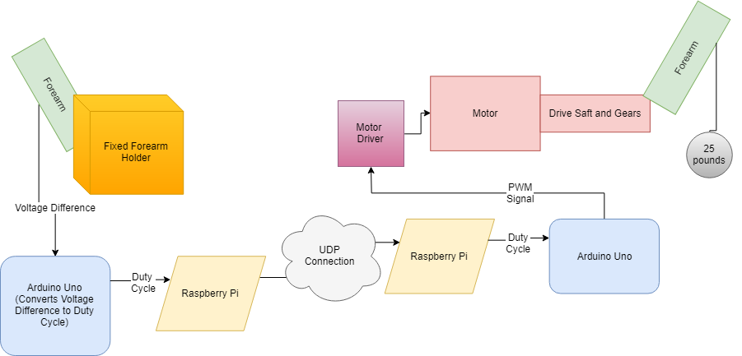
Communication Line

Slide 10
Questions?

