Slide 1
R.A.W.
Remote Armwrestling
SDP Team 12
Tyler Costa, Steve Lucey, Zach Matthews, Steve McGrath
Notes:
Steve L.

Slide 2
Problem Statement and Product
A game that connects the physical and virtual world
Physical competition between distant friends
More intimate than phone call
Could motivate individual to exercise (strength training)
Our Solution….
Remote ArmWrestling game against other users in real-time
Two robotic arms connected over the internet
Each arm replicates the force and strength of the opposite user
The results of the matches would get submitted into a database which would rank users based on their performances
Information accessible through phone application
Notes:
Steve L.
If friends plan to meet at bar with RAW at end of week, more likely to work out that week.
https://www.google.com/url?sa=i&rct=j&q=&esrc=s&source=images&cd=&cad=rja&uact=8&ved=0ahUKEwi3xfTA5PbWAhWLPCYKHbgsCiMQjRwIBw&url=https%3A%2F%2Fwww.pinterest.com%2Fpin%2F164381455119064701%2F&psig=AOvVaw0vlvB1OXIHQGuxyQWCiMzB&ust=1508299652782709

Slide 3
System Requirements
A sturdy robotic arm
Average forearm and length being 0.3 meters
Reliable power supply for each component
Sensors to detect end of the match
High speed connection for communicating between arms
Operates with non-perceivable delay
An application for creating an account and monitoring results
Notes:
Zach

Slide 4
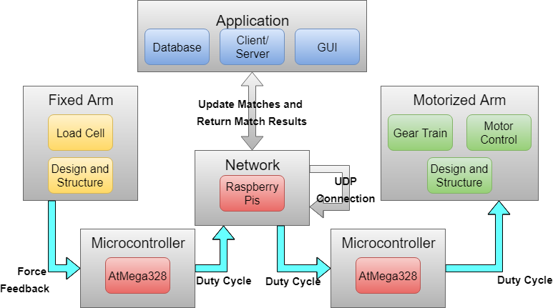
Block
Diagram
Zach - Blue
Steve L. - Red
Tyler - Green
Steve M. - Yellow
Notes:
Tyler

Slide 5
MDR Deliverables
1 Arm with Basic Movement Capabilities:
Starts in armwrestling position
Arm begins to lose to given amount of weight
Arm then stalls and stops losing to the given amount of weight
Finally, arm starts beating given amount of weight
Not networked
Application:
Android application
Local SQLite database
Notes:
Tyler

Slide 6
Each Member's Contribution for CDR
Tyler Costa: Conversion of force applied into appropriate duty cycle, Added sturdiness to design of motorized arm
Steve Lucey: Set-up of Raspberry Pis, Python scripts for UDP connection, Arduino IDE, Connections between Arduino and Raspberry Pis
Zach Matthews: AWS RDS SQL Server (cloud database), Improved functionality for creation of matches and user connection, Connections between Arduino and Raspberry Pis
Steve McGrath: Attached load cell (gauges) to second arm, Amplified measured signal from load cell, Mounted second arm to sturdy bearings
Notes:
Steve M

Slide 7
CDR Deliverables
1 Motorized Arm and 1 Fixed Arm:
Motorized Arm will start in arm wrestling position
Will attach weight to that arm
User will apply force to Fixed Arm
Force applied will be converted to a duty cycle
Then sent over the network connection to drive motorized arm
Application
Added integration to AWS RDS, and reconstructed match creation/join interfaces
Notes:
Steve M.

Slide 8
Application
Created AWS RDS
Microsoft SQL Server
Microsoft SQL Server Management Studio
Creation of database for system
Tables consist of:
Profiles
Connection
Matches
SQLConnection Class in Visual Studio
Establish connection from app to database
Notes:
Zach

Slide 9
DEMO

Slide 10
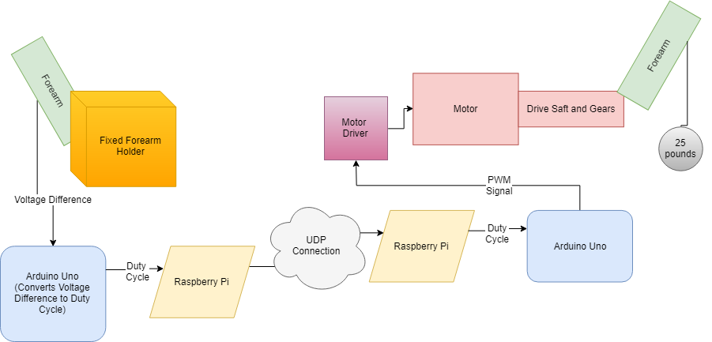
Communication Line

Slide 11
Deliverables for FDR and Demo Day
FDR:
Clear encasement and upgraded pulley system for motorized arm and upgraded design for fixed arm
Fully functional PCB design
Win/Loss condition sensors along with hard stops
Application linked to arms via server
Demo Day:
One fixed arm to be given user input in order to control the motorized arm
Fixed amount of weight (15-20lbs) to be moved by the user
Limited motor capabilities to ensure safety of spectators
Notes:
Tyler

Slide 12
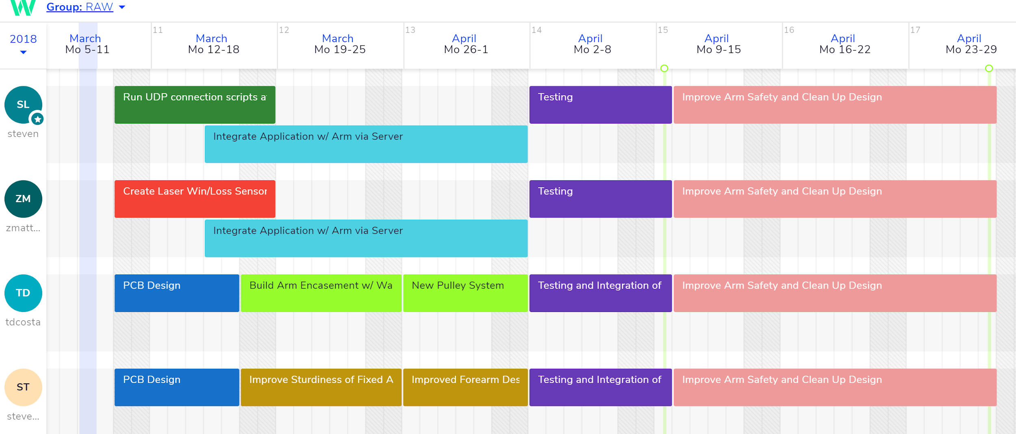
Gannt Chart

Slide 13
Questions?

