Slide 1
Team Tactile
October 19, 2017
Advisor: Professor Kelly

Slide 2
Team Members
Alex Bonstrom
CSE
Connor McLaughlin
ECE
Austin Fernalld
CSE
Alex Smith
CSE

Slide 3
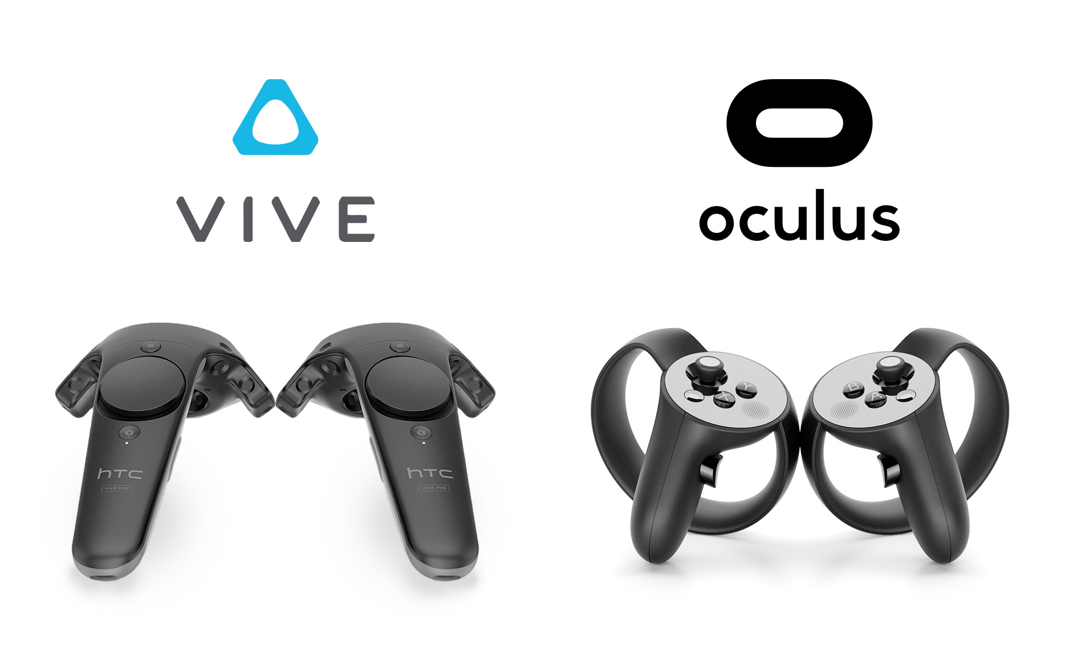
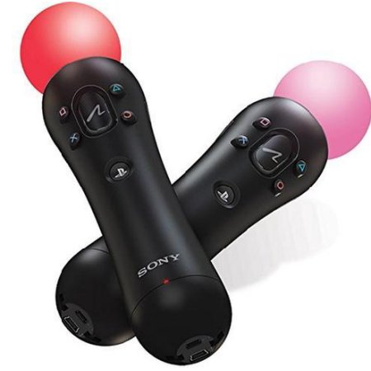
VR Controller Designs - Market Available
Rigid Construction
Doesn’t allow complex motions with the hand
Only records orientation and button presses
Can’t recognize realistic hand motions
Games based off finger movements hard to implement
Only feedback offered is vibration
VR controllers currently only produce vibrations as feedback
Notes:
Bonnie
The technology behind Virtual Reality has grown significantly in the past few years, and the VR gaming industry has been growing with it. Companies like Sony, Microsoft, and Oculus have been creating VR games and VR controllers to interface with the games.
Currently, these controllers are very rigid and can’t account for hand movements that the controller is not expecting. They only receive signals from the buttons, joysticks, and proprioceptive signals

Slide 4
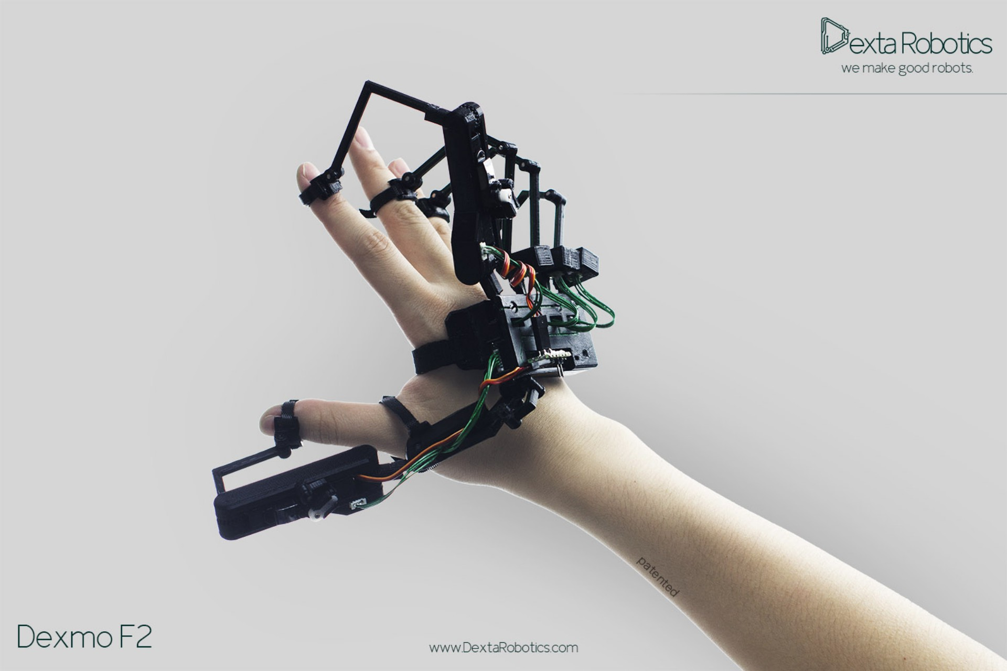
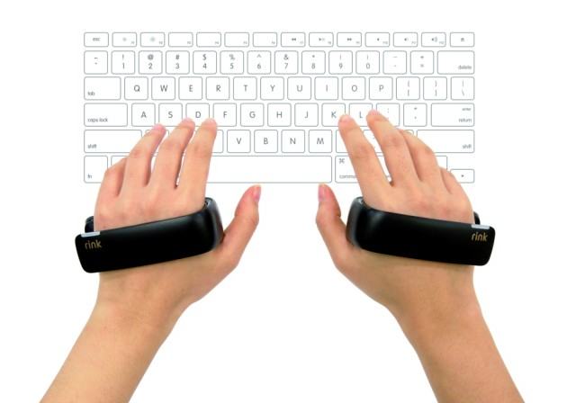
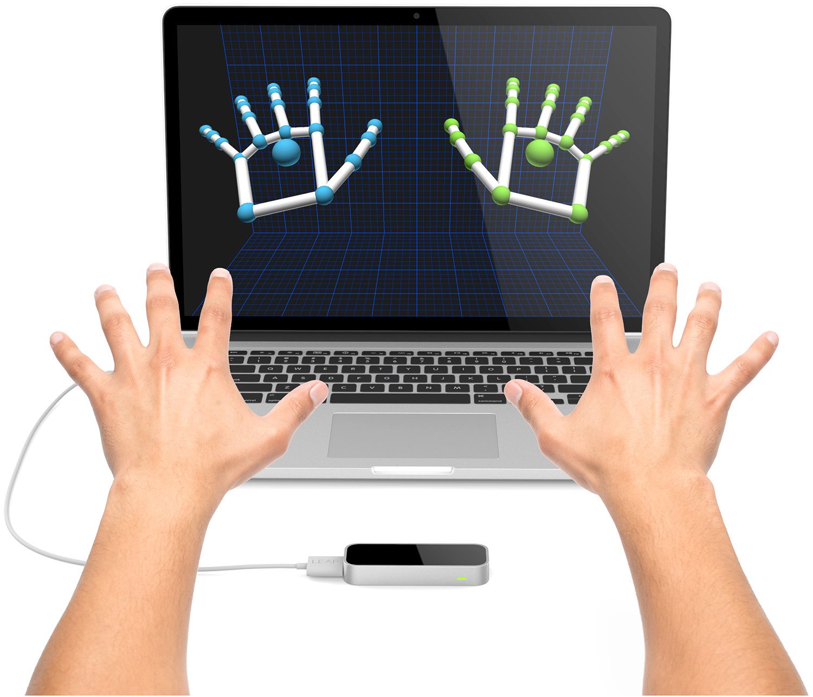
VR Controller Designs - In Development
Exoskeleton/Glove
Provides haptic feedback with the ability to feel objects on the screen
Main competitors
Dexmo F2
VRgluv
Sensor Tech
Both the Rink and Leap Motion sense the hand and fingers with no haptic feedback
Rink by Samsung
Leap Motion
Notes:
Smith

Slide 5
Problem Statement
Current mainstream controllers cannot properly interact with the virtual environment.
In development, controllers either have not been proven yet or have no physical interaction with fingers.
Solution: Design a VR controller that mimics the feel of real-life objects using a design that puts the weight and conception underneath to provide a better “feel” to the users.
Notes:
Smack. Incorporates force of the fingers.

Slide 6
Requirements Analysis: System Specifications
Read in finger compression data
Track hand location
Translate hand position into Unity VR coordinates
Provide resistance for each finger
Maximum latency of 80ms
Less than 3 lbs
Notes:
Austin
Quanatative Specifications? can I check this off?

Slide 7
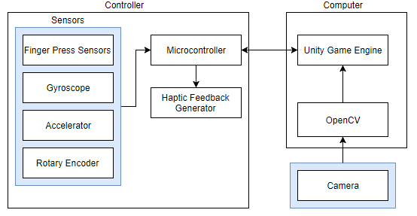
Design System (with Block Diagram)
Enclosure
IR-LED Sensors
Piston
Piston
Piston
Piston
VR Console/Computer
USB Port
Data Input
Microcontroller
USB Port
Unity
USB Port
Gyroscope
Webcam
USB Port
Notes:
Smith

Slide 8
General Controller Layout
rotary encoder
Finger Sensor (Pressure Shown)
Spring Hinge
Sensor Rail
MCU
Actuator
Palm Rest
USB
Notes:
.670 in = 17mm
.880 in = 22.3 mm
.21 in = 5.3mm

Slide 9
Sensing Finger Distance (3 Options)
Pressure Sensor
Plunger
Enclosed Tube
Spring
Pressure Sensor
Measurable pressure in tube
Adjustable pressure levels by finger
Airtight seal hard to maintain
Infrared Emitting Diode (IR-LED)
Plunger
Side Guides
IR-LED
Springs
Measures distance using reflections of LED
Range of 2cm-15cm
16.5 ms measuring cycle
Expensive current draw when measuring
Micro-Servo
Articulating Arm
Micro Servo
Sense finger by servo movement
Easy to provide feedback
Data might be hard to parse
Notes:
Smith
There are 3 options that might work for this application. The first would be using a pressure sensor. Go over pros and cons and then

Slide 10
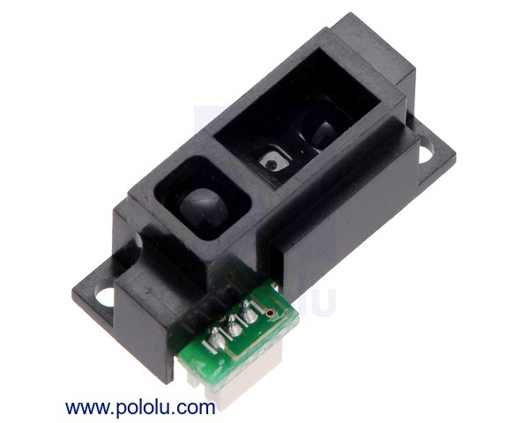
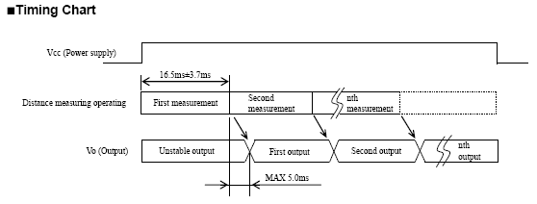
IR-LED
Quantity | Unit Price (USD)
1 | 7.95
5 | 7.16
25 | 6.36
100 | 5.56
Allows more flexible finger movement
Possible room for finger stopping mechanism
Measurements latency ≅ 30ms
Will stagger measurements to reduce power draw
Manufacturer: Sharp
Manufacturer Part Number: GP2Y0A51SK0F
Description: Shortest range distance sensor by Sharp
Detection Range: 2cm- 15cm
Output Voltage: Analog .4V-2.2V
Sensitivity: ≅ .2V/cm
Notes:
Smith
https://www.pololu.com/product/2450
2cm = .8” 15cm = 6”

Slide 11
Micro Servo
Built In feedback
Higher mechanical difficulty
Servo “holds” on no signal
additional sensors may be needed
Further research is needed
Description: MG90s High Torque Micro Servo Metal Gear
Torque: 1.56 lb-in. - 1.9 lb-in.
Voltage: 4.8V-6V DC
Weight: .45 oz
Speed: .1 sec/60°
Quantity | Unit Price (USD)
1 | 9.95
10 | 8.96
100 | 7.96
Notes:
https://www.adafruit.com/product/1143

Slide 12
Pressure Sensor
.670 in.
Cost:
.880 in.
Quantity | Unit Price (USD)
1 | 12.01
5 | 10.53
25 | 9.47
50 | 8.43
100 | 6.74
300 | 5.93
.21 in.
Manufacturer: NXP USA Inc
Manufacturer Part Number: MPXHZ6250AC6T1
Description: SENSOR PRESSURE ABS AXIAL 8-SSOP
Operating Pressure: 2.9 PSI - 36.26 PSI
Maximum Pressure: 145.04 PSI
Output Voltage: 0.3V - 4.9V
Sensitivity: 137mV/PSI
Notes:
Smith

Slide 13
MCU Specifications:
16 bit
Min speed: 1MHz
Max speed: 25MHz
Min I/O pins: 20
Min ADC pins: 8
Min Timer/Counter pins: 2
PWM Operator for MicroServo
Operating Voltage Range: 2V-6V
SPI Serial Port

Slide 14
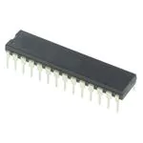
Possible Solutions
Atmega328P
23 general purpose I/O lines
three flexible timer/counters with compare modes
SPI serial port
6-channel 10-bit A/D converter
20 MHz

Slide 15
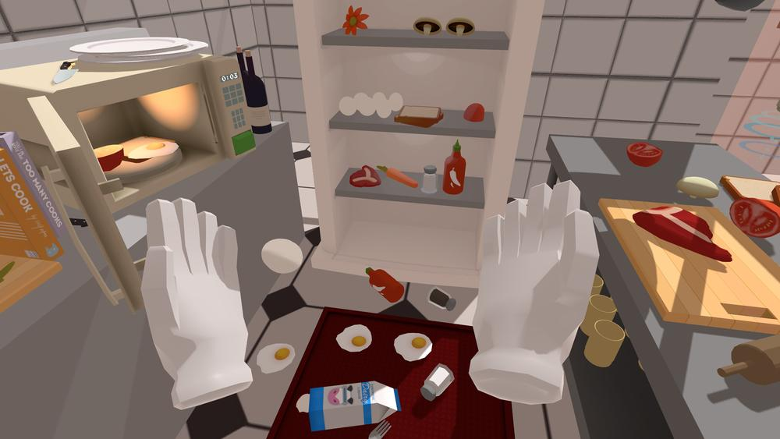
Virtual Reality Engine
Unity Game Engine
VR Environment:
User controlled hand
Objects to “pick up”
Demonstrate hand can interact with object
Receive feedback and send to controller
Possibilities:
Sword fighting
Creating recognizable hand gestures
Non-standard inputs require custom plugin
Notes:
Bonnie
To realize our virtual reality environment, we will be using the Unity game engine, the most popular game engine on the market. With it, we will create a virtual reality environment that contains a user controlled hand object and several objects of different sizes for the hand to pick up.

Slide 16
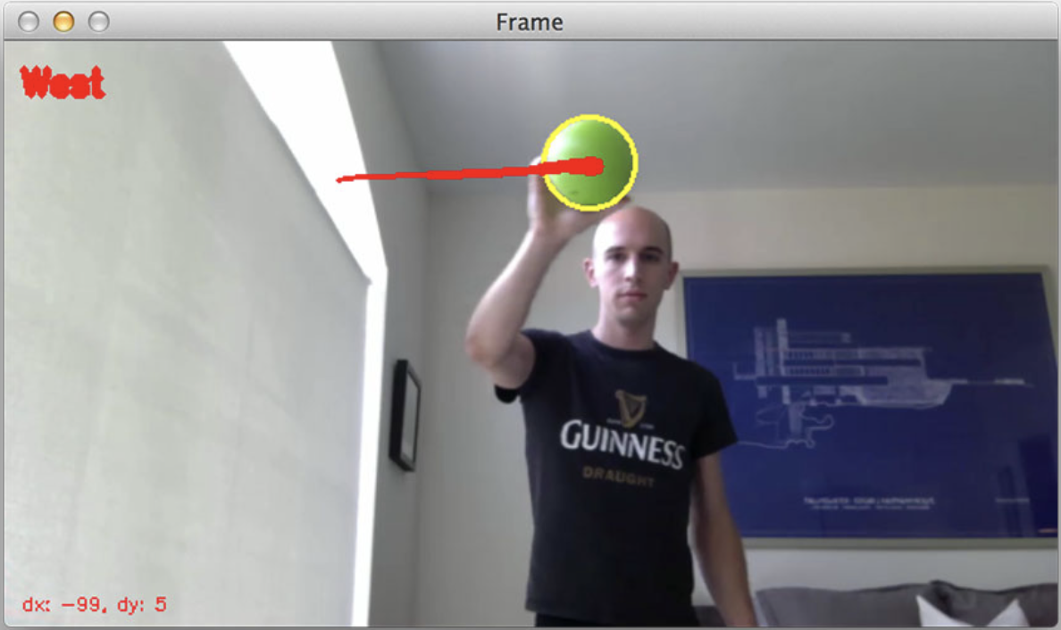
Controller Triangulation
Implement OpenCV for movement
Tracking API interfaced with C++
Translate to VR coordinates
Use gyroscope & accelerometer data for rotation about axes
Notes:
Austin
Accelerometer for Z axis (front and back)

Slide 17
Budgetary Analysis
Enclosure: $100
Microprocessor: $1.32
HD Webcam: $94.64
Finger Sensing: $35.80
Power Supply: $25.00
-----------------------
Total: $256.76
Notes:
Austin
50% Budget Leeway
{
Pressure Sensors: $52.50
Micro Servos: $49.75
IR Leds: $35.80

Slide 18
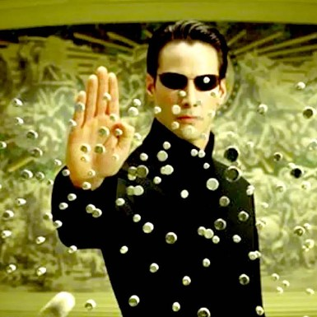
Future Functionality Possibilities
Wireless Functionality
Integrated Power Supply
Shape to Additional Forms
Synchronized L / R
Notes:
Austin

Slide 19
Proposed MDR Deliverables
Demonstrate Finger Sensing
IRLED or Micro Servo
Demonstration of VR Finger Interactions
Using fabricated data
Fingers move dynamically and individually
Able to pick up virtual object
Notes:
Bonnie

Slide 20
Team Member Roles
Alex Smith
Team Leader
Mechanical Design Lead
Alex Bonstrom
Software Development Lead
Document Co-Lead
Connor McLaughlin
Sensor Implementation Lead
Power Disbursement
Austin Fernalld
Triangulation/Positioning Lead
Document Co-Lead

Slide 21
Thank you
Questions?

