Slide 1
FIVR
December 7, 2017
Advisor: Professor Kelly

Slide 2
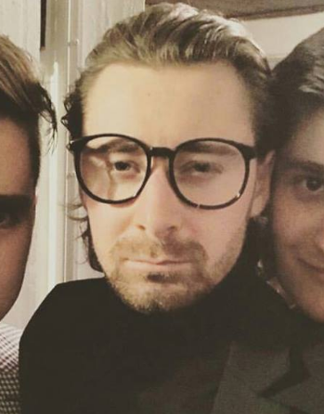
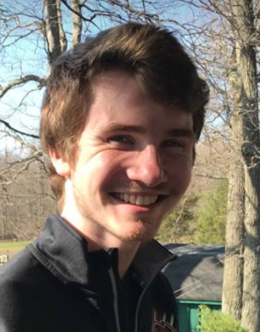
Team Members
Alex Bonstrom
Unity / Documentation
Connor McLaughlin
Servo / Feedback Implementation
Austin Fernalld
Triangulation / Positioning
Alex Smith
Finger Distance / Mechanical Design

Slide 3
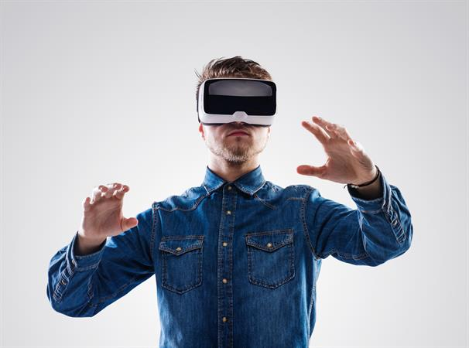
Problem Statement
Commercial Virtual Reality controllers neglect the sense of touch in video games
For an authentic VR experience a user must feel, touch and lift as though they are in the environment
Notes:
Bonnie

Slide 4
Solution
Design a VR controller that records hand movement, finger movement while providing feedback (resistance) when the user grips an object in the virtual environment
Inherent Challenges:
Recording the distance a finger moves in free space
Accurate hand positioning
Mechanical design
Allowing independent movement of fingers
Stopping hand from squeezing
Notes:
Smack

Slide 5
System Specifications
Measure finger position accurate to +/- 5mm
Track hand location
(x,y,z) coordinates within +/- 7.5 cm
Resist finger compression
Resistance at minimum of 10 locations
Allow independent finger movement
Maximum latency of 100 ms
Average latency from input to result in PS4 gaming
Less than 1.8 lbs, the weight of three XBOX controllers
Notes:
Austin
Computer 8 feet away, screen at 130 degree angle
X width: 236.22cm -> 1000 points -> .236 cm/pixel
Y height: 171.45cm -> 750 points -> .229 cm/pixel
Almost 1:1 in (X,Y) movement

Slide 6
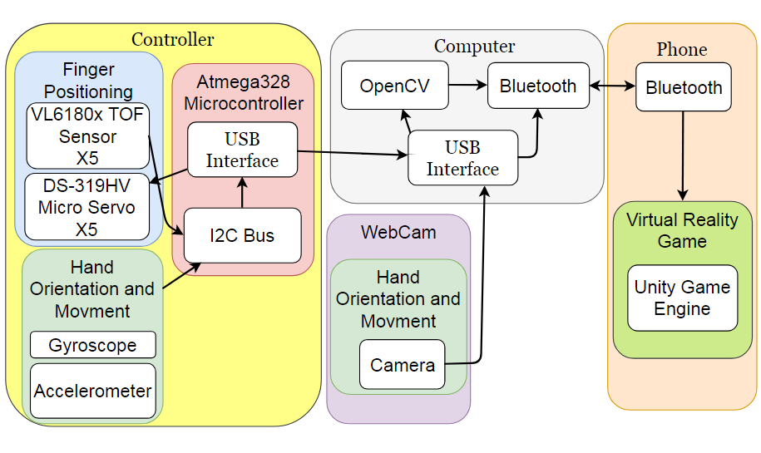
Design System (with Block Diagram)
Notes:
Smith

Slide 7
Proposed MDR Deliverables (From PDR)
Demonstrate Finger Sensing
IRL or Micro Servo
Demonstration of VR Finger Interactions
Using fabricated data
Fingers move dynamically and individually
Able to pick up virtual object
Notes:
Bonnie

Slide 8
MDR Revised Deliverables
Take distance measurements from 4 fingers
Transmit distance measurements from microcontroller to PC
(X,Y) coordinates of object via webcam and OpenCV-Python
Servo movement
Demonstration of VR Finger Interactions
Using fabricated data
Fingers move dynamically and individually
Notes:
Bonnie

Slide 9
General Controller Layout
Finger Lever
Compression Spring
Finger Stopper
Hinge
VL6180x
PCB
Servo
Notes:
Alex

Slide 10
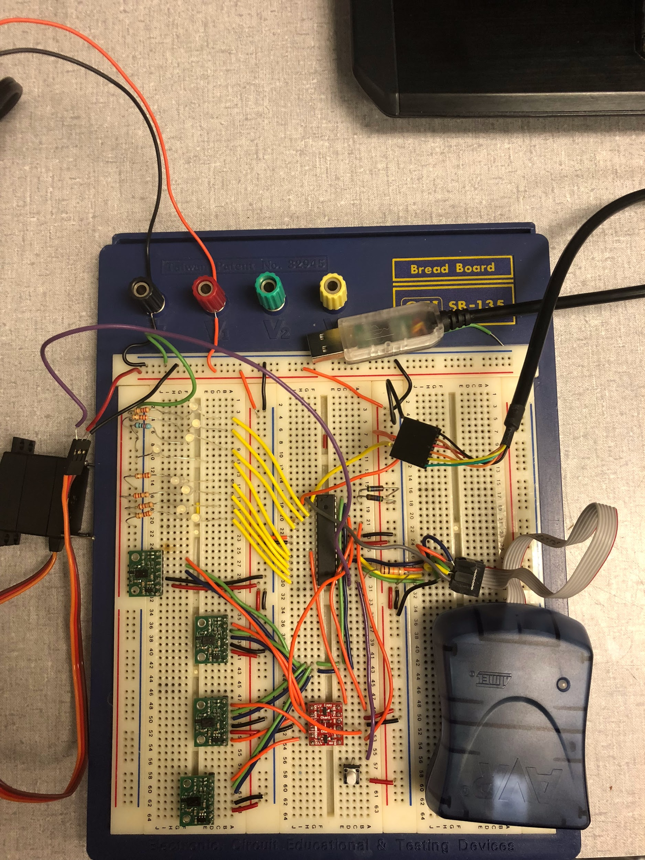
Our Breadboard
8 LEDs
USB
Servo
Atmega328
I2C
VL6180x TOF
Sensors
AVRisp Programmer
Voltage
Level
Shifter
Button
Notes:
Alex

Slide 11
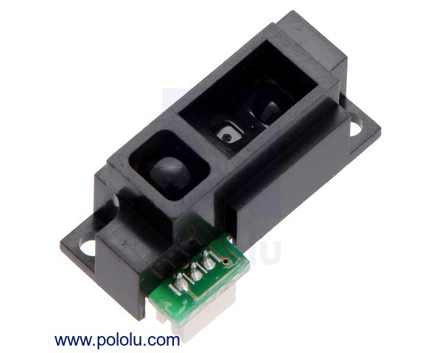
Sensing Finger Distance - Requirements
Requirements
Measure distance within 15cm
Small dimensions
Thin profile
Sampling rate > 60Hz
Low power usage
preferably digital output
Original Idea-IRLED
Range of 2-15cm
Measurement latency = 30ms
1in x .3in x .3in
Analog output
5v, 22mA for 16ms read
5V*22mA*16ms*60Hz*60sec/min*60min/hour= 380.16AH per sensor
Notes:
Alex

Slide 12
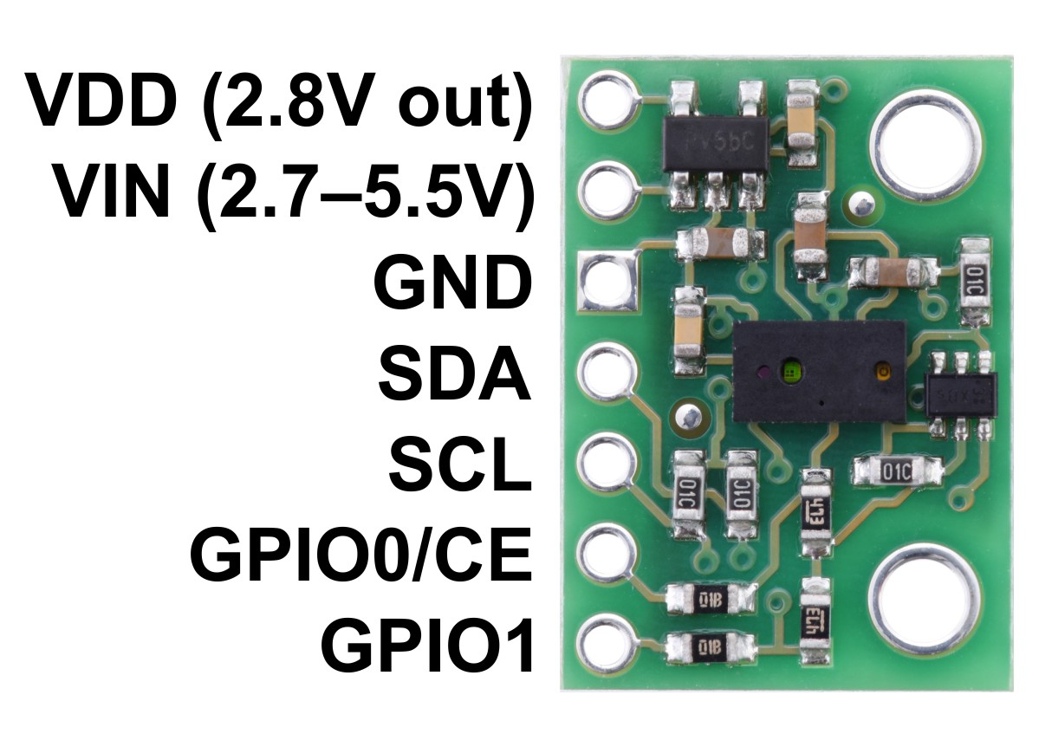
Sensing Finger Distance - Solution
VL6180x Time of Flight(TOF) Sensor
Measures up to 20cm
1mm resolution
Sampling Period of 4.4ms
Default Readout rate = 227Hz
Not dependent on reflectance of target
Uses I2C bus
default address = 0x29
2.7V*5mA*4.4ms*60Hz*60sec/min*60min/hour = 12.8AH per sensor
.75‘
.5’
⅛’ thick
Notes:
Alex

Slide 13
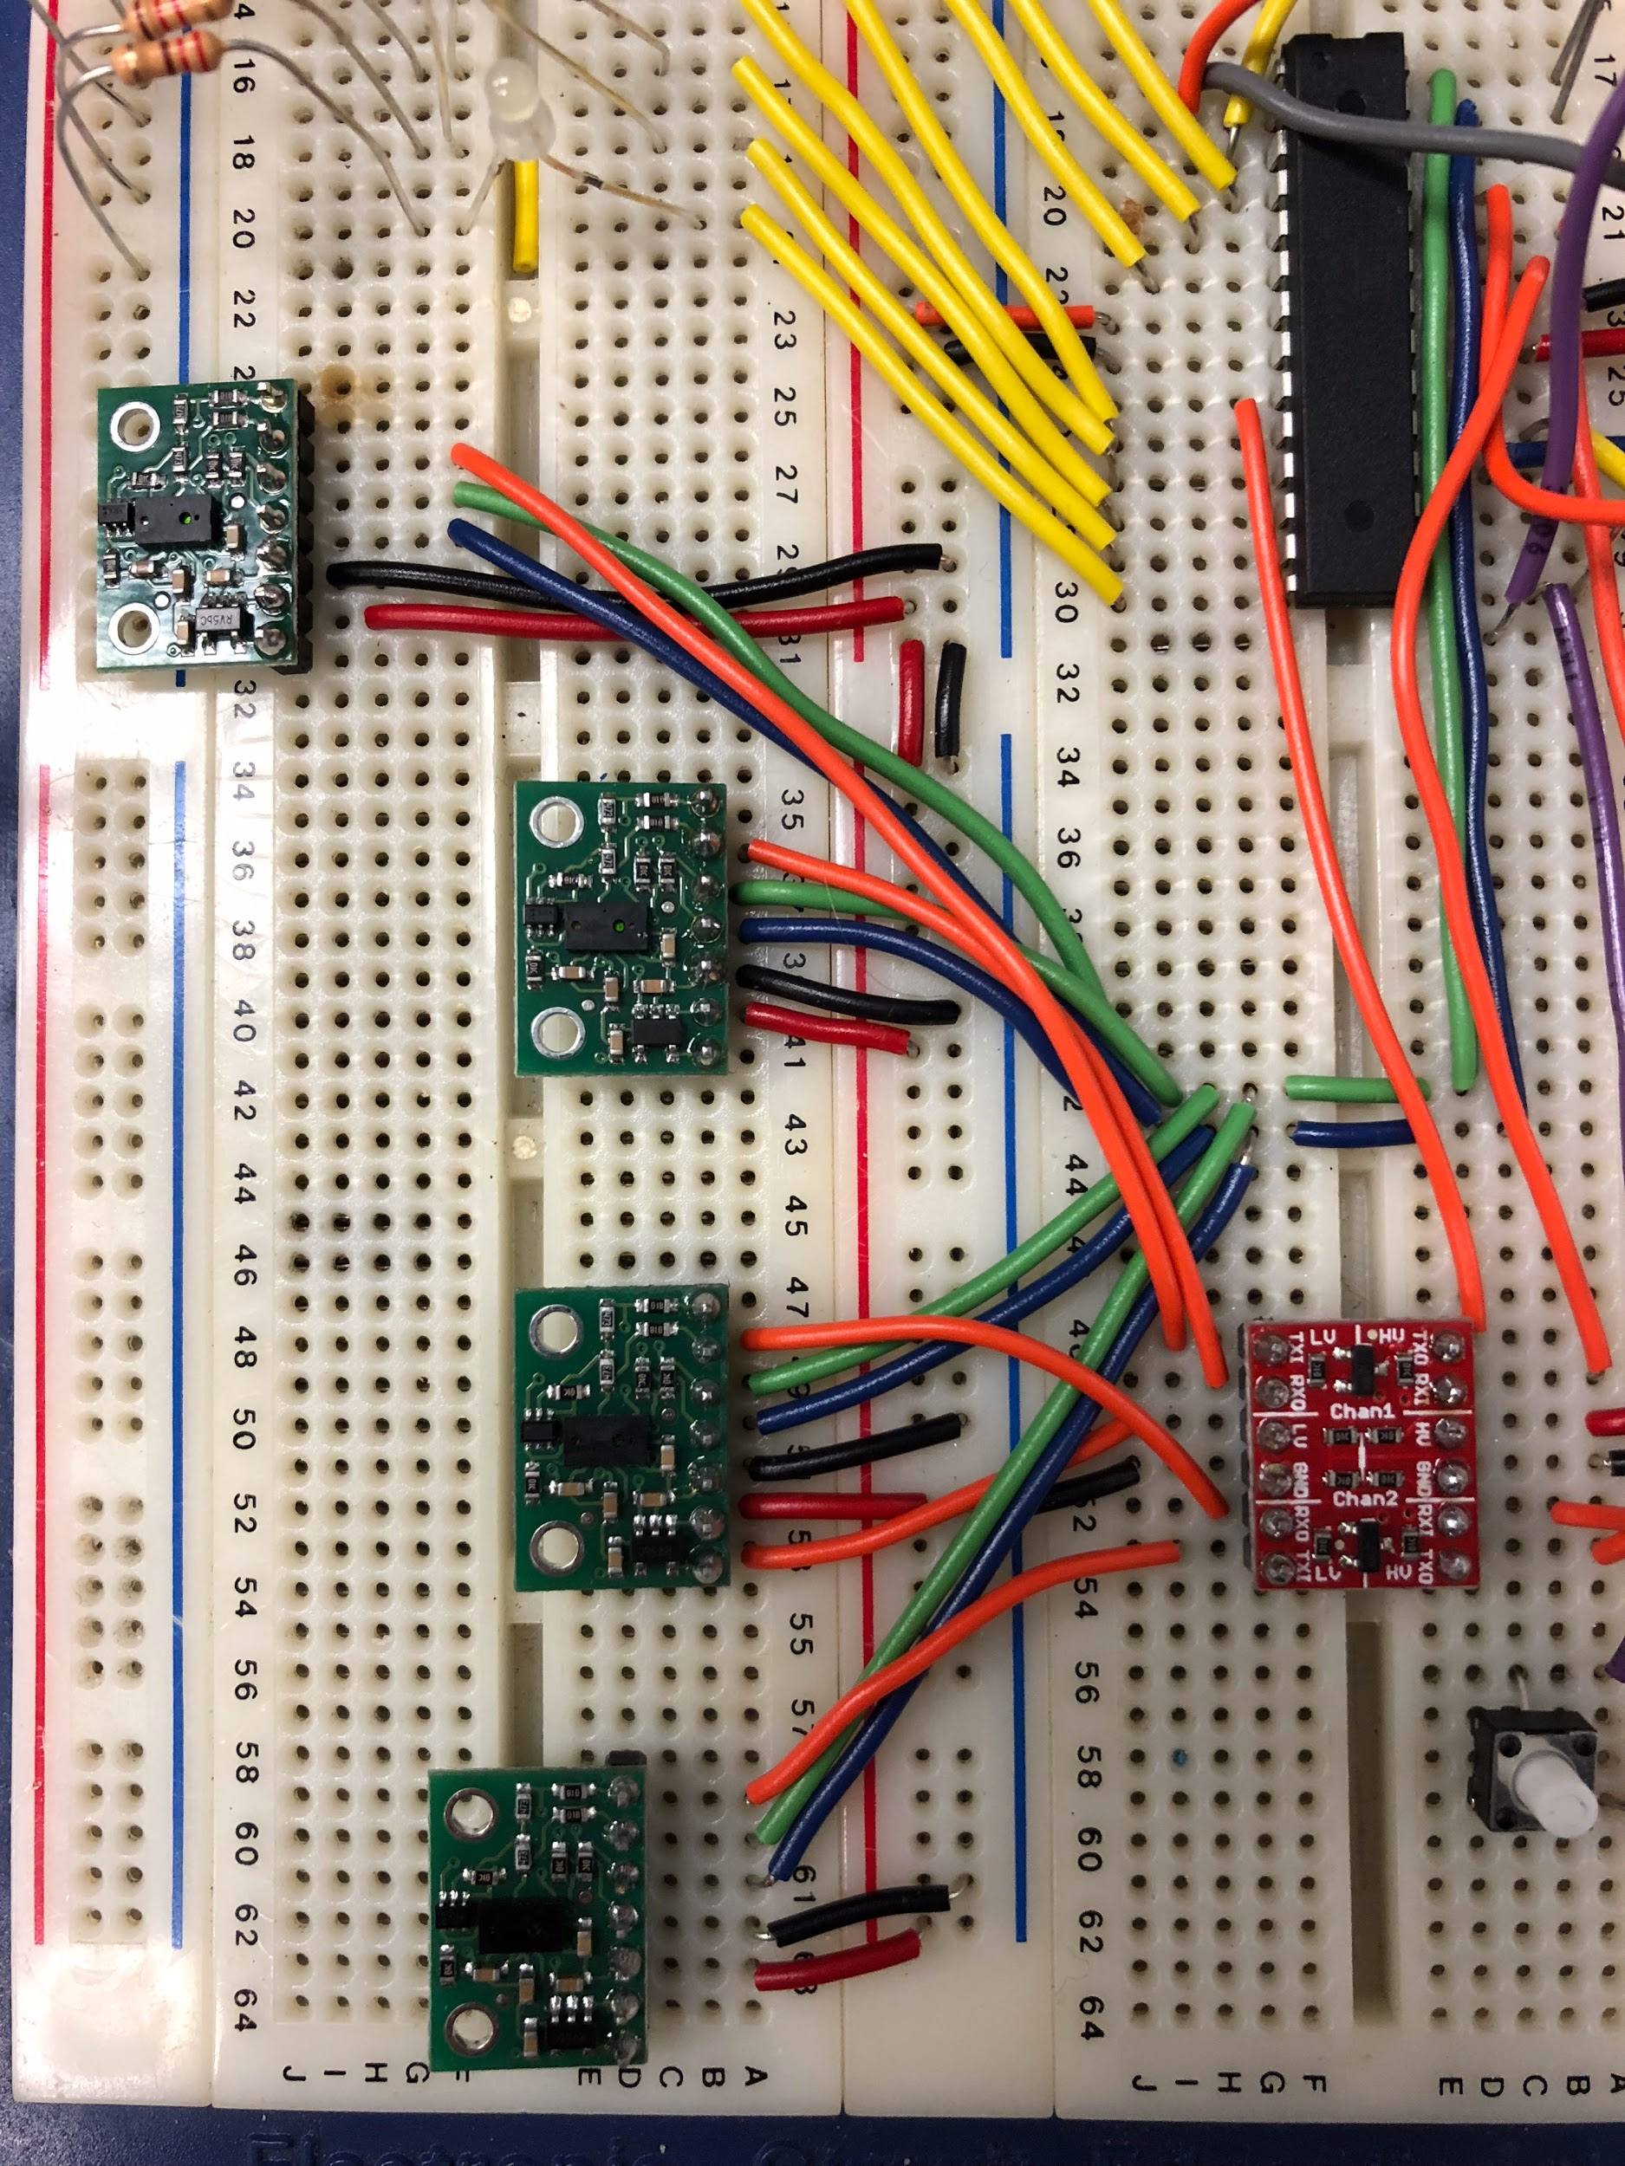
VL6180x Problem
On startup all TOF sensors use device address 0x29 on I2C bus
Solution
Put TOF sensors in standby mode
Reactivate one by one and change address
Required voltage level shifter
Wire = activate
Wire = I2C data
Wire = I2C clock
Notes:
Alex

Slide 14
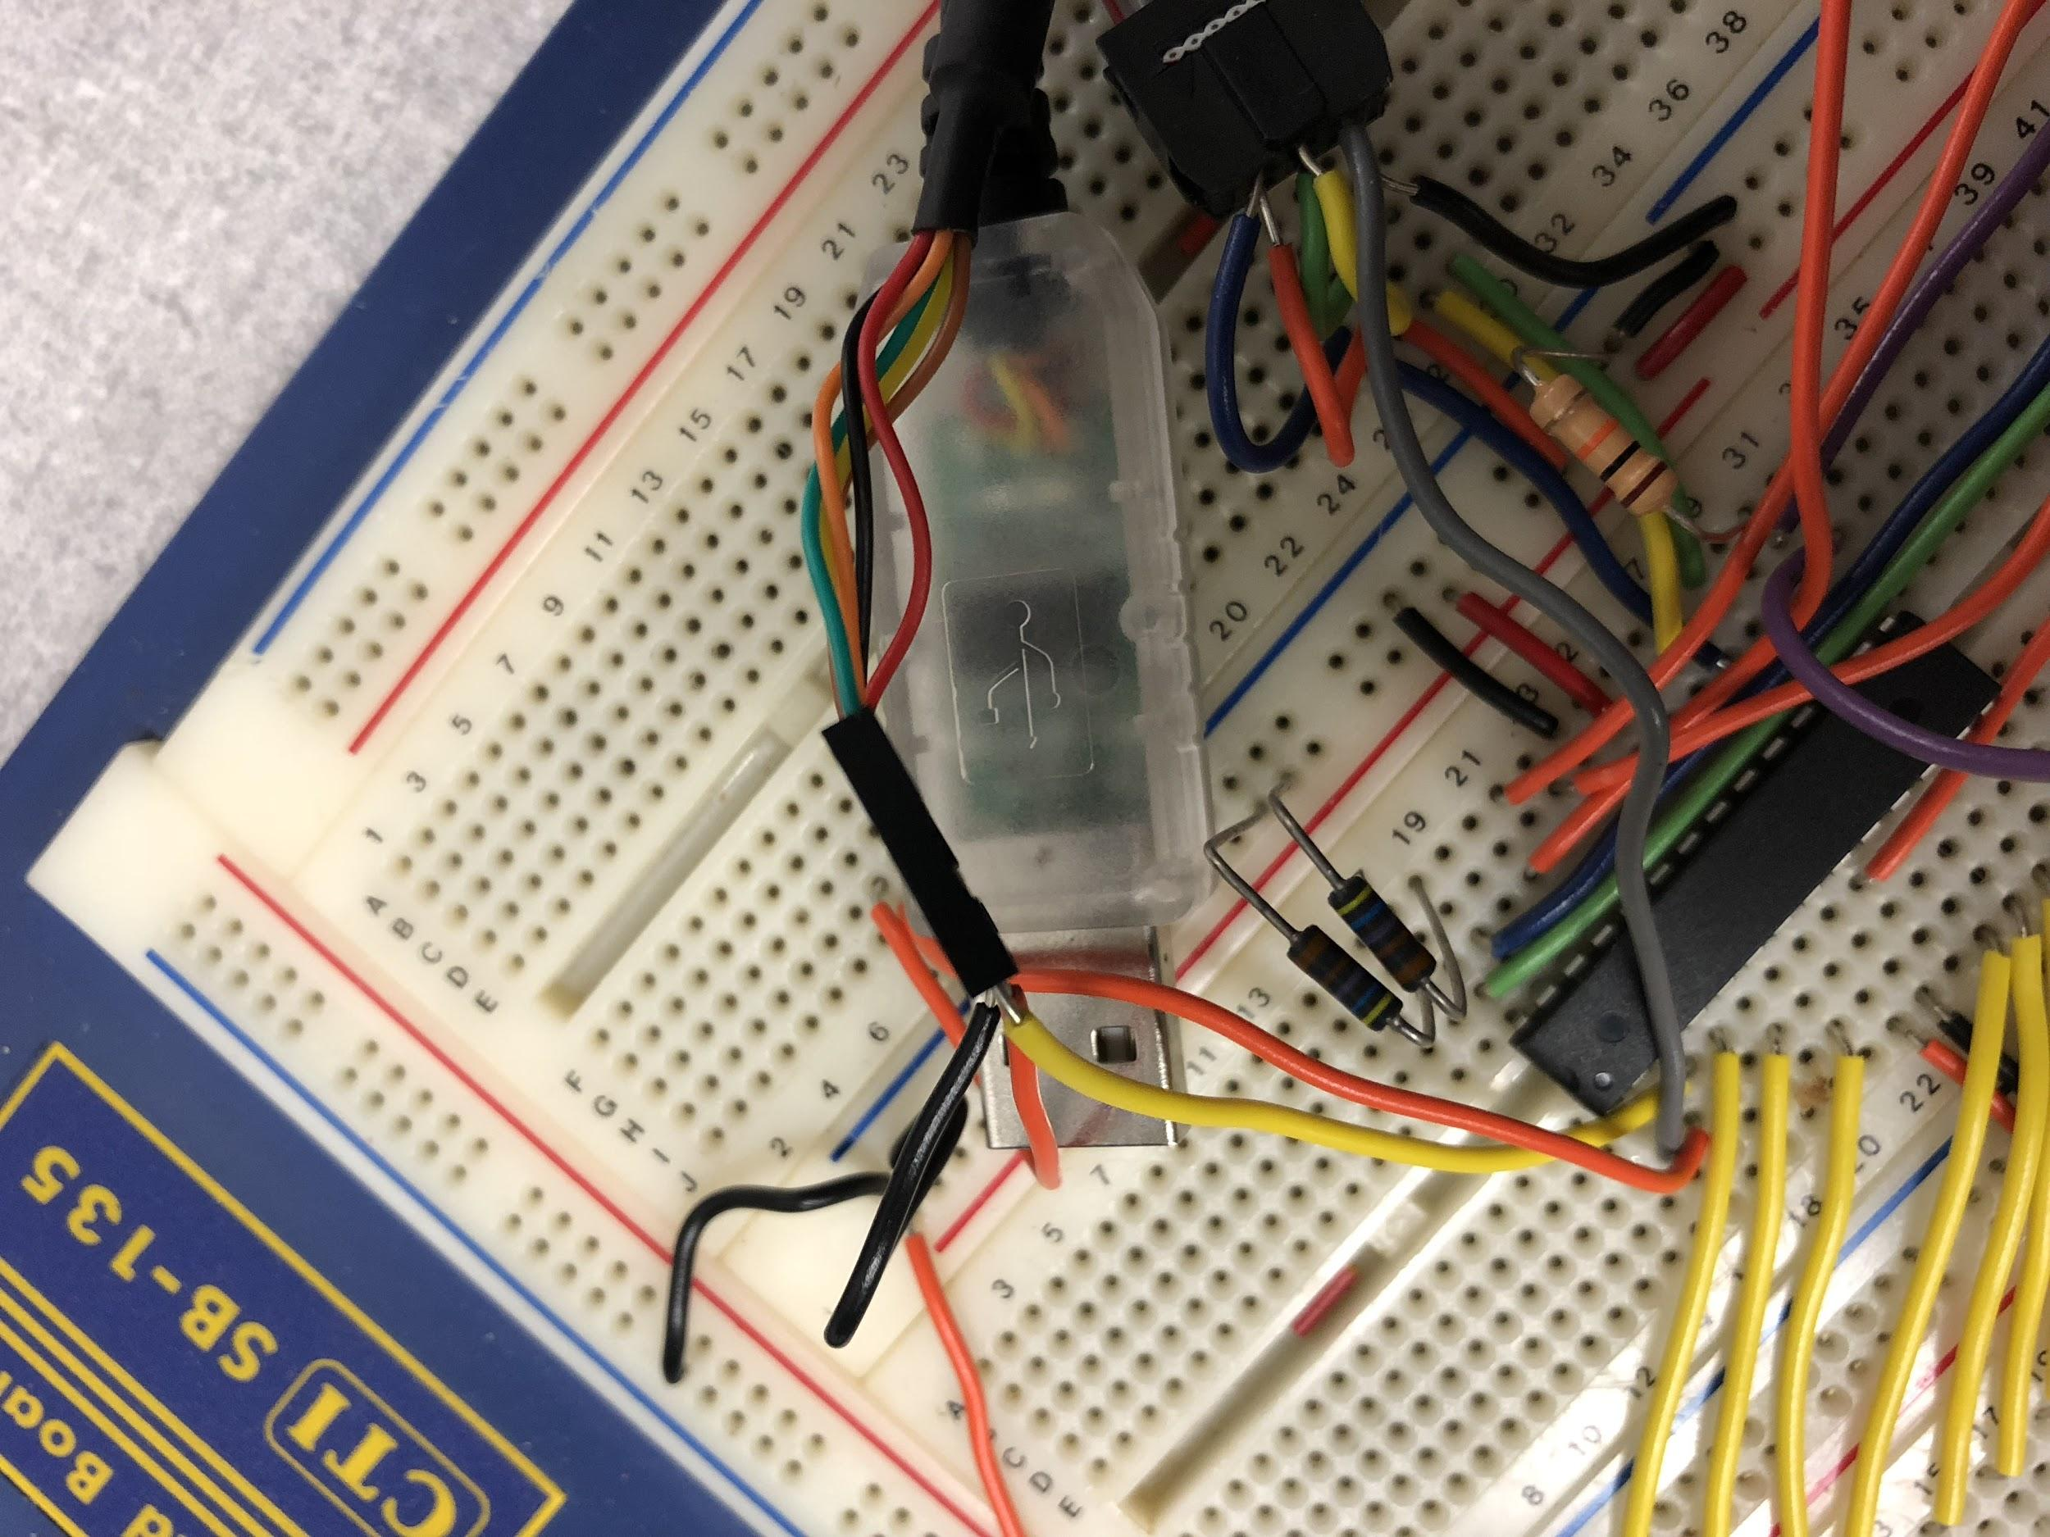
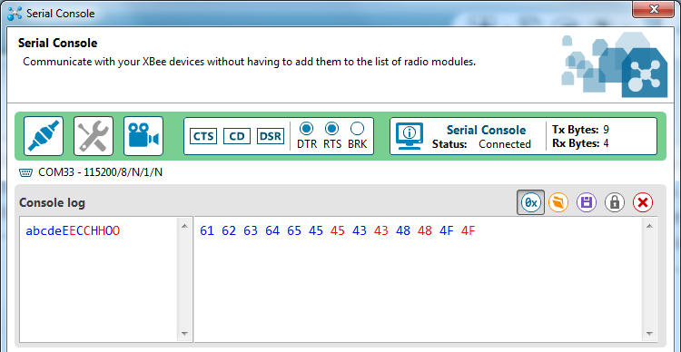
Communication with Computer
Used FTDI USB-rs232 converter cable
Connects to USART
38400 Baud Rate
8 data bits, 1 stop bit, no parity
38400bps/(9bits*5 sensors) = 853 finger readings per second
X-CTU to read serial port
Notes:
Alex

Slide 15
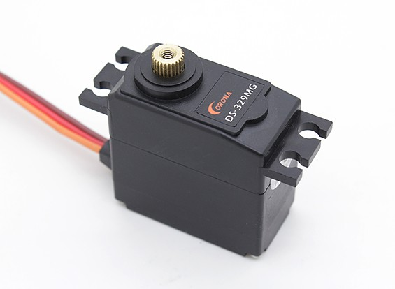
DS-319HV MicroServo X5
Requirements:
Light-weight, durable
Sample Period of 20ms(50Hz)
Locking mechanisms for every position
Feedback control
Low power
Description: MG90s High Torque Micro Servo Metal Gear
Torque: 1.56 lb-in. - 1.9 lb-in.
Voltage: 4.8V-6V DC
Weight: .45 oz
Speed: .1 sec/60°
Quantity | Unit Price (USD)
1 | 9.95
10 | 8.96
100 | 7.96
Notes:
Smack
https://www.adafruit.com/product/1143

Slide 16
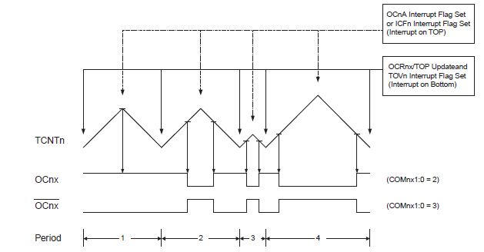
MicroServo Implementation
Micro Servo operates in relation to the duty cycle of the PWM
Manipulating the duty cycle will lock the servo in a set position.
Notes:
Smack

Slide 17
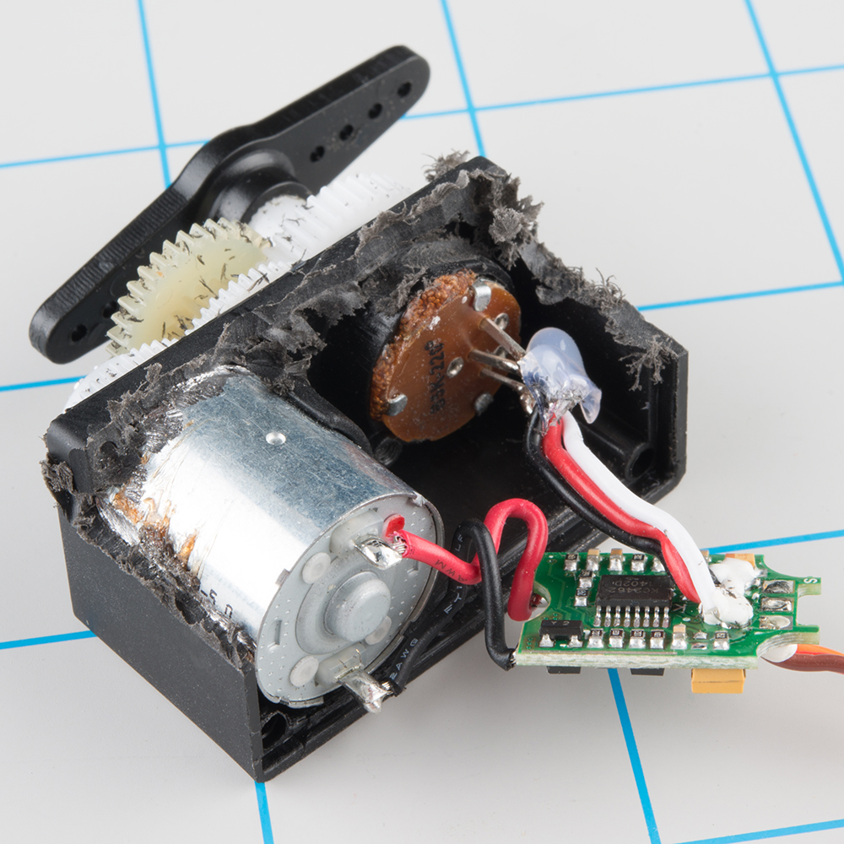
MicroServo Problems
No proper feedback provided with servo.
Solution:
Unscrew the servo and solder a line from the potentiometer to accurately provide the system with the servos exact position
Notes:
Smack

Slide 18
Why use the Servo this way?
Used as feedback within the controller when the VR environment detects object in grip path
Feedback involves locking the servo into a certain position to represent accurate dimensions of the VR object.
Notes:
Smack

Slide 19
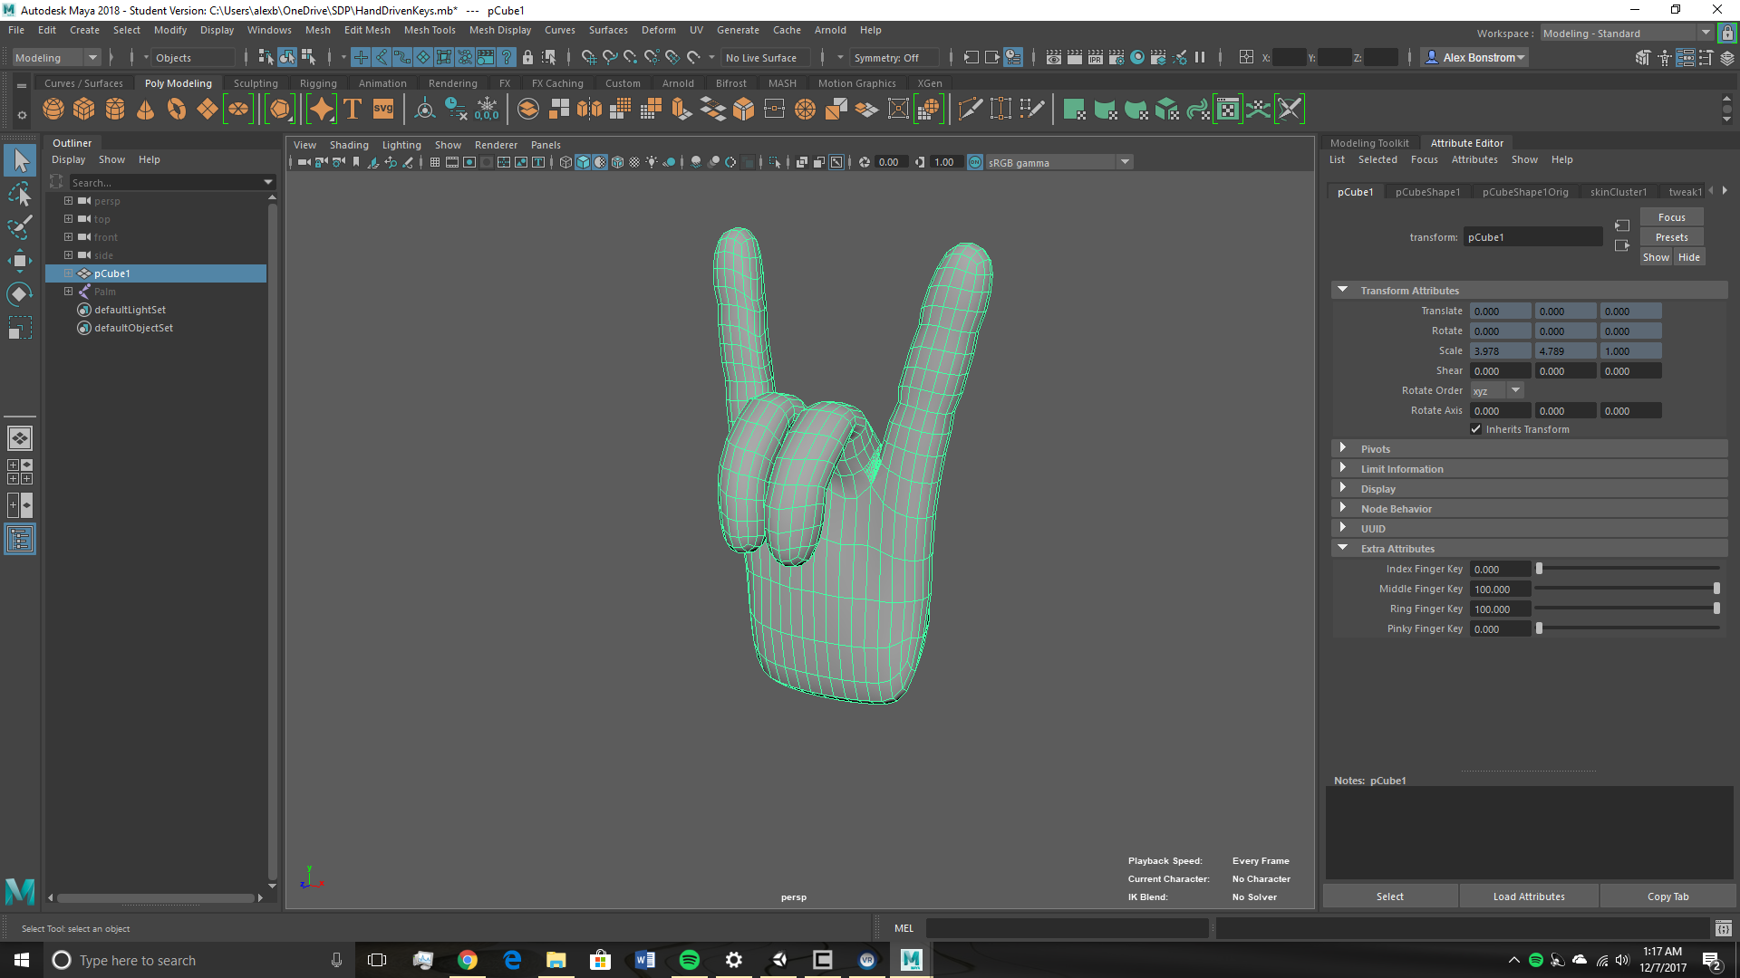
Modeling the Hand/Other Game Objects
Autodesk Maya
Most common modeling application for Unity integration
Used to model GameObjects for Unity
Unity accepts standard Maya binary files as input
Not good for variable animations
Driven Keys don’t work in Unity
Notes:
Bonnie
To realize our virtual reality environment, we will be using the Unity game engine, the most popular game engine on the market. With it, we will create a virtual reality environment that contains a user controlled hand object and several objects of different sizes for the hand to pick up.

Slide 20
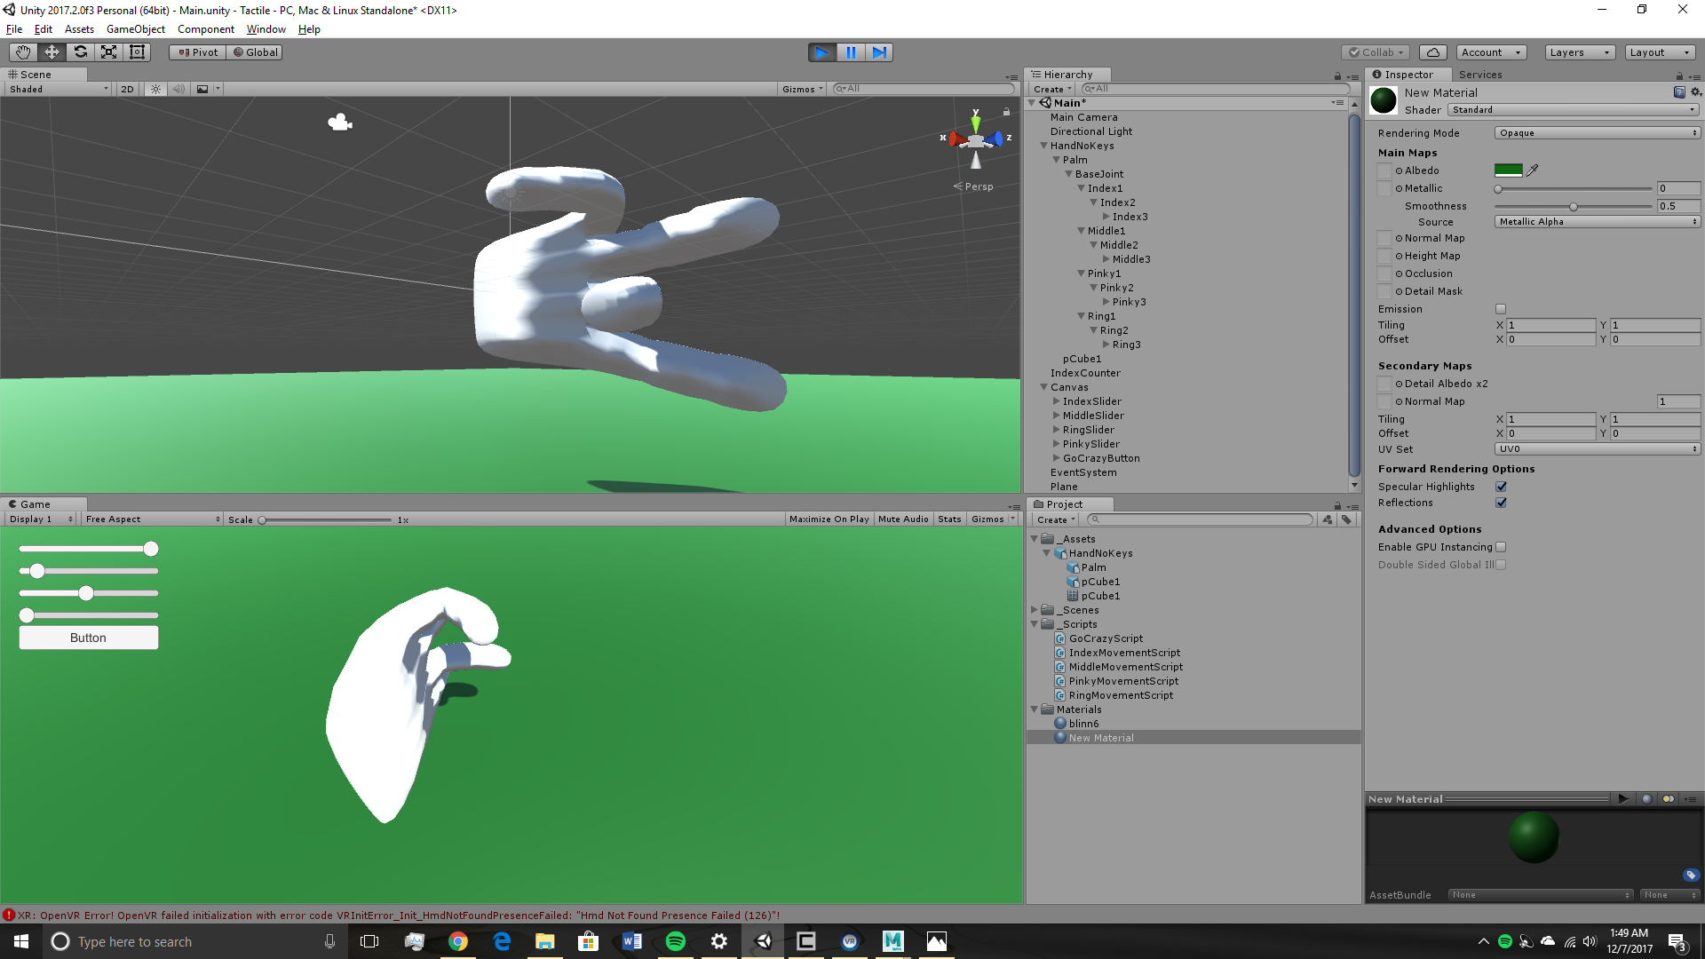
Unity
Virtual Reality Engine
All objects used will be made in Maya
Animations will be made in Unity
Unity offers standard VR packages
We will use UnityEngine.VR
Has everything needed for mobile VR game development

Slide 21
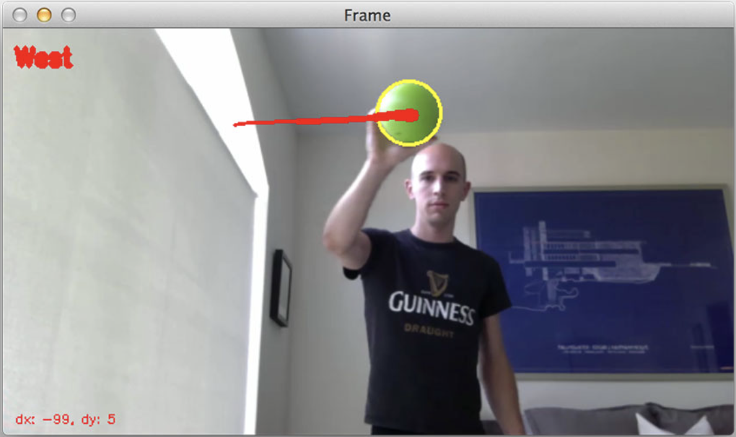
Controller Triangulation
Calculate HSV of ball
Implement OpenCV-Python script to track
(X,Y,Z) from center and size of radius
Rotation using gyroscope data
Translate to VR coordinates
Notes:
Austin
Accelerometer for Z axis (front and back)

Slide 22
Budgetary Analysis
Component | Singular Unit Price ($) | Mass Unit Price (1000 Unit Price / 1000) [$]
Enclosure | $50 | $10
Finger Sensing Technology | $54.75 | $46.25 ($14.50 DIY)
Micro Servo | $50.00 | $50.00
Power Supply | $15.50 | $15.50
Microprocessor | $2.00 | $1.66
Accelerometer | $0.59 | $0.53
Gyroscope | $3.42 | $1.67
Aero-Strike Softball | $6.49 | $1.08
 | Total: $182.75 | Total per Unit: $126.69 ($94.94)
Revenue Per Unit (Sale Price) with ~50% COGS: $249
Notes:
How much will it cost in mass production?
Austin
50% Budget Leeway
{
Pressure Sensors: $52.50
Micro Servos: $49.75
IR Leds: $35.80

Slide 23
Proposed CDR Deliverables
5 TOF sensors operating simultaneously
Unity hand model mimics controller finger movement
Demonstrate that virtual objects can be picked up by a virtual hand
Micro servos move to position when near Unity object
Demonstrate (X,Y,Z) tracking with webcam, accelerometer and gyroscope
Initial mechanical design
Notes:
Bonnie

Slide 24
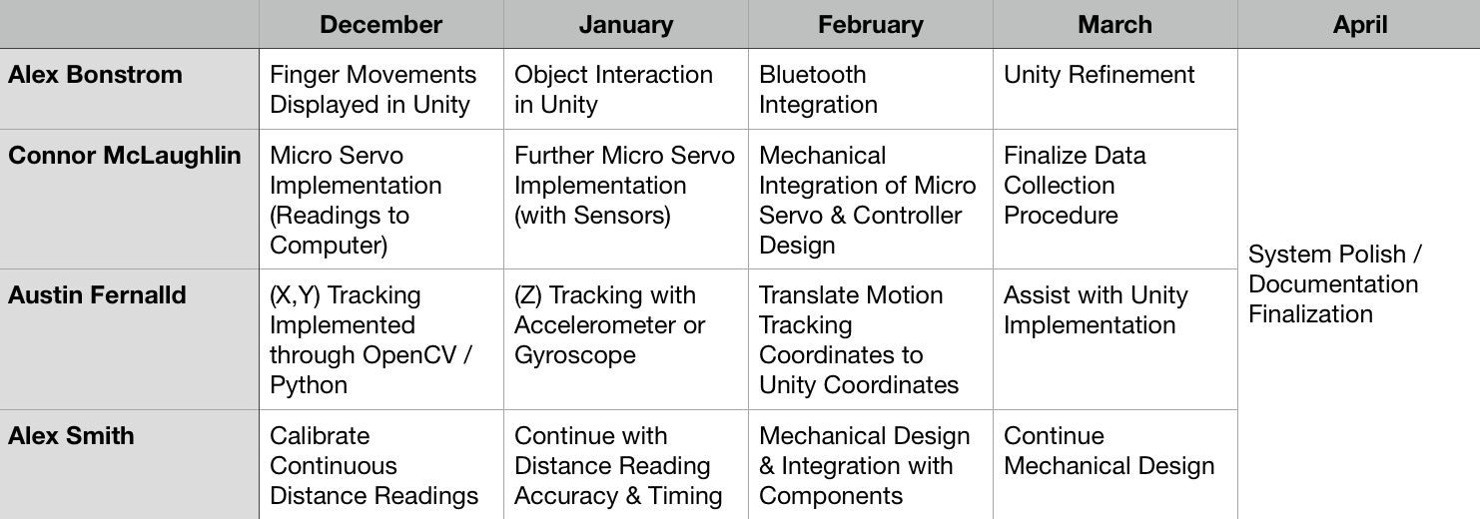
Team Responsibilities & Scheduling
Notes:
Go one by one
prepare public demo for april. be prepared to answer what it will look like

Slide 25
Demo
Notes:
Alex
Smack
Austin
Bonnie

Slide 26
Questions?

Slide 27
Thank You

