Slide 1
FIVR
Finger Interaction Virtual Reality
April 19, 2018

Slide 2
Team Members
Alex Bonstrom
Unity / Documentation / Positioning
Connor McLaughlin
Finger Control Feedback / Mechanical Design
Austin Fernalld
PCB Designer
Alex Smith
Finger Distance / Breadboard / Controller Orientation / Mechanical Design

Slide 3
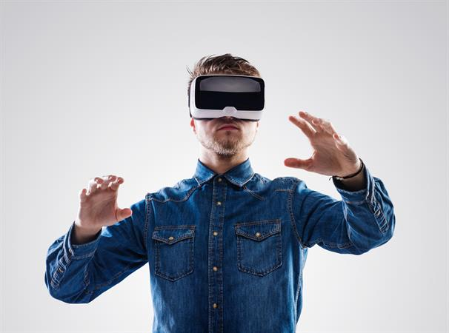
Problem Statement
Commercial Virtual Reality controllers neglect the sense of touch in video games
For an authentic VR experience a user must feel, touch and lift as though they are in the environment
Notes:
Bonnie

Slide 4
Introduction
FIVR
Virtual Reality Controller
Commercial Virtual Reality controllers neglect the sense of touch in video games.
For an authentic VR experience a user must feel, touch and lift as though they are in the environment.

Slide 5
Solution
Design a VR controller that records hand movement, finger movement while providing feedback (resistance) when the user grips an object in the virtual environment
Inherent Challenges:
Recording the distance a finger moves in free space
Accurate hand positioning
Mechanical design
Allowing independent movement of fingers
Stopping hand from squeezing
Notes:
Smack

Slide 6
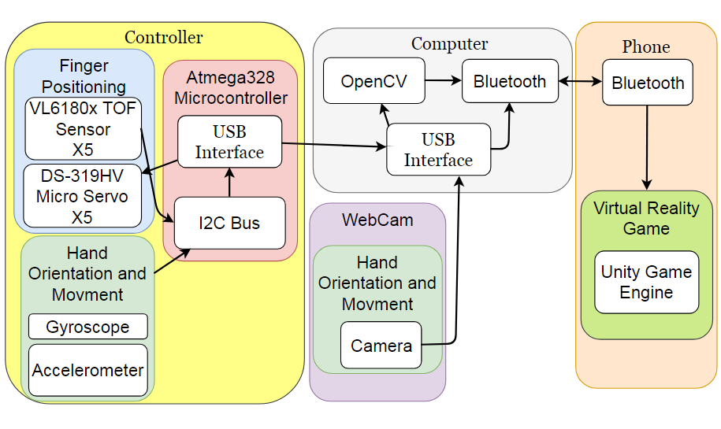
Design System (with Block Diagram)
X 3
Notes:
flip the servo and TOF sensor

Slide 7
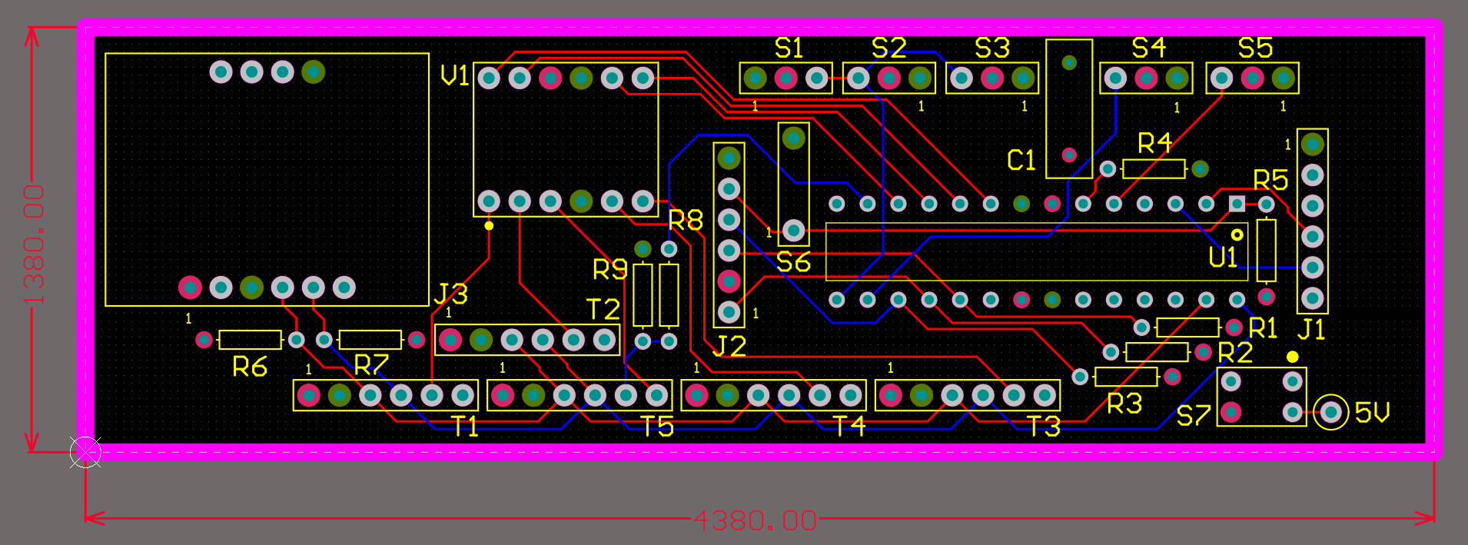
PCB Design
Using Altium Designer

Slide 8
Controller Communication
Data Output = 33.47ms = 29.9Hz

Slide 9
Unity Communication
2 Sources of Input
OpenCV (Using C# wrapper EmguCV)
Data: X, Y coordinates
Transferred using UDP to Unity
Microcontroller Communication
Data: Finger readings, orientation data
Reads input from Unity using TCP
Reads and writes to Microcontroller using C# SerialPort class
Sends data to Unity using UDP
2 C# Projects = 1 Visual Studio Solution

Slide 10
System Specifications
Measure finger position accurate to +/- 5mm
Track hand location
(x,y,z) coordinates within +/- 7.5 cm
Resist finger compression
Resistance at minimum of 10 locations
Allow independent finger movement
Maximum latency of 100 ms
Average latency from input to result in PS4 gaming
Less than 1.8 lbs, the weight of three XBOX controllers
Notes:
Austin
Computer 8 feet away, screen at 130 degree angle
X width: 236.22cm -> 1000 points -> .236 cm/pixel
Y height: 171.45cm -> 750 points -> .229 cm/pixel
Almost 1:1 in (X,Y) movement

Slide 11
Proposed FDR Deliverables
5 TOF sensors operating simultaneously
Unity hand model mimics controller finger movement
Demonstrate that virtual objects can be picked up by a virtual hand
Micro servos move to position when near Unity object
Demonstrate (X,Y,Z) tracking with webcam, accelerometer and gyroscope
Notes:
Bonnie

Slide 12
Budgetary Analysis
Component | Singular Unit Price ($) | Mass Unit Price (1000 Unit Price / 1000) [$]
Enclosure | $30 | $10
Finger Sensing Technology | $54.75 | $46.25
Micro Servos | $51.45 | $51.45
Power Supply | $15.50 | $15.50
Microprocessor | $2.00 | $1.66
Adafruit BNO055 Breakout | $34.77 | $34.77
Aero-Strike Softball | $6.49 | $1.08
PCB Fabrication | $33 | $23.78
 | Total: $227.96 | Total per Unit: $184.49
Revenue Per Unit (Sale Price) with ~50% COGS: $299
Notes:
How much will it cost in mass production?
Austin
50% Budget Leeway
{
Pressure Sensors: $52.50
Micro Servos: $49.75
IR Leds: $35.80

Slide 13
Demo

Slide 14
Thank you!

Slide 15
Questions?
?

