Slide 1
FIVR
CDR Presentation
March 7, 2018
Advisor: Professor Kelly

Slide 2
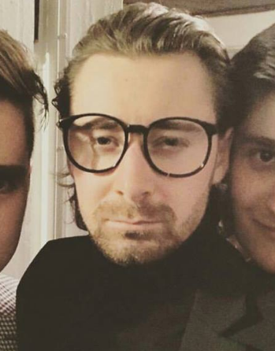
Team Members
Alex Bonstrom
Unity / Documentation
Connor McLaughlin
Servo / Feedback Implementation
Austin Fernalld
Triangulation & Positioning / PCB Designer
Alex Smith
Finger Distance / Mechanical Design

Slide 3
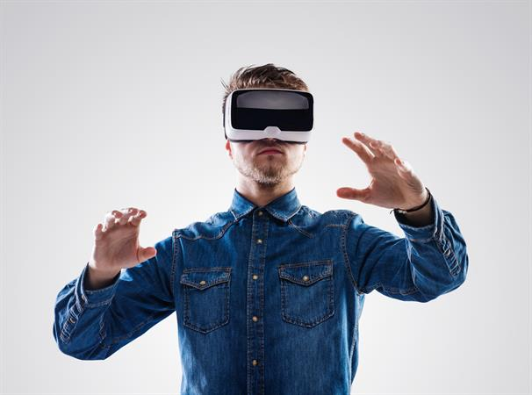
Problem Statement
Commercial Virtual Reality controllers neglect the sense of touch in video games
For an authentic VR experience a user must feel, touch and lift as though they are in the environment
Notes:
Bonnie

Slide 4
Solution
Design a VR controller that records hand movement, finger movement while providing feedback (resistance) when the user grips an object in the virtual environment
Inherent Challenges:
Recording the distance a finger moves in free space
Accurate hand positioning
Mechanical design
Allowing independent movement of fingers
Stopping hand from squeezing
Notes:
Smack

Slide 5
System Specifications
Measure finger position accurate to +/- 5mm
Sample rate = 60Hz
Track hand location
(x,y,z) coordinates within +/- 7.5 cm
Resist finger compression
Resistance at minimum of 10 locations
Allow independent finger movement
Maximum latency of 100 ms
Average latency from input to result in PS4 gaming
Less than 1.8 lbs, the weight of three XBOX controllers
Notes:
Austin
Computer 8 feet away, screen at 130 degree angle
X width: 236.22cm -> 1000 points -> .236 cm/pixel
Y height: 171.45cm -> 750 points -> .229 cm/pixel
Almost 1:1 in (X,Y) movement

Slide 6
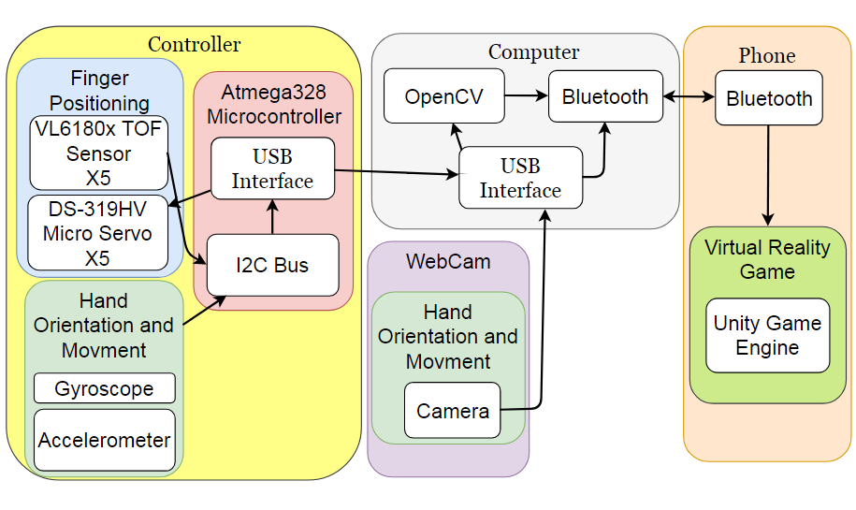
Design System (with Block Diagram)
Notes:
flip the servo and TOF sensor

Slide 7
General Controller Layout
Finger Lever
Compression Spring
Finger Stopper
Hinge
VL6180x
PCB
Servo
Notes:
Alex

Slide 8
Hardware

Slide 9
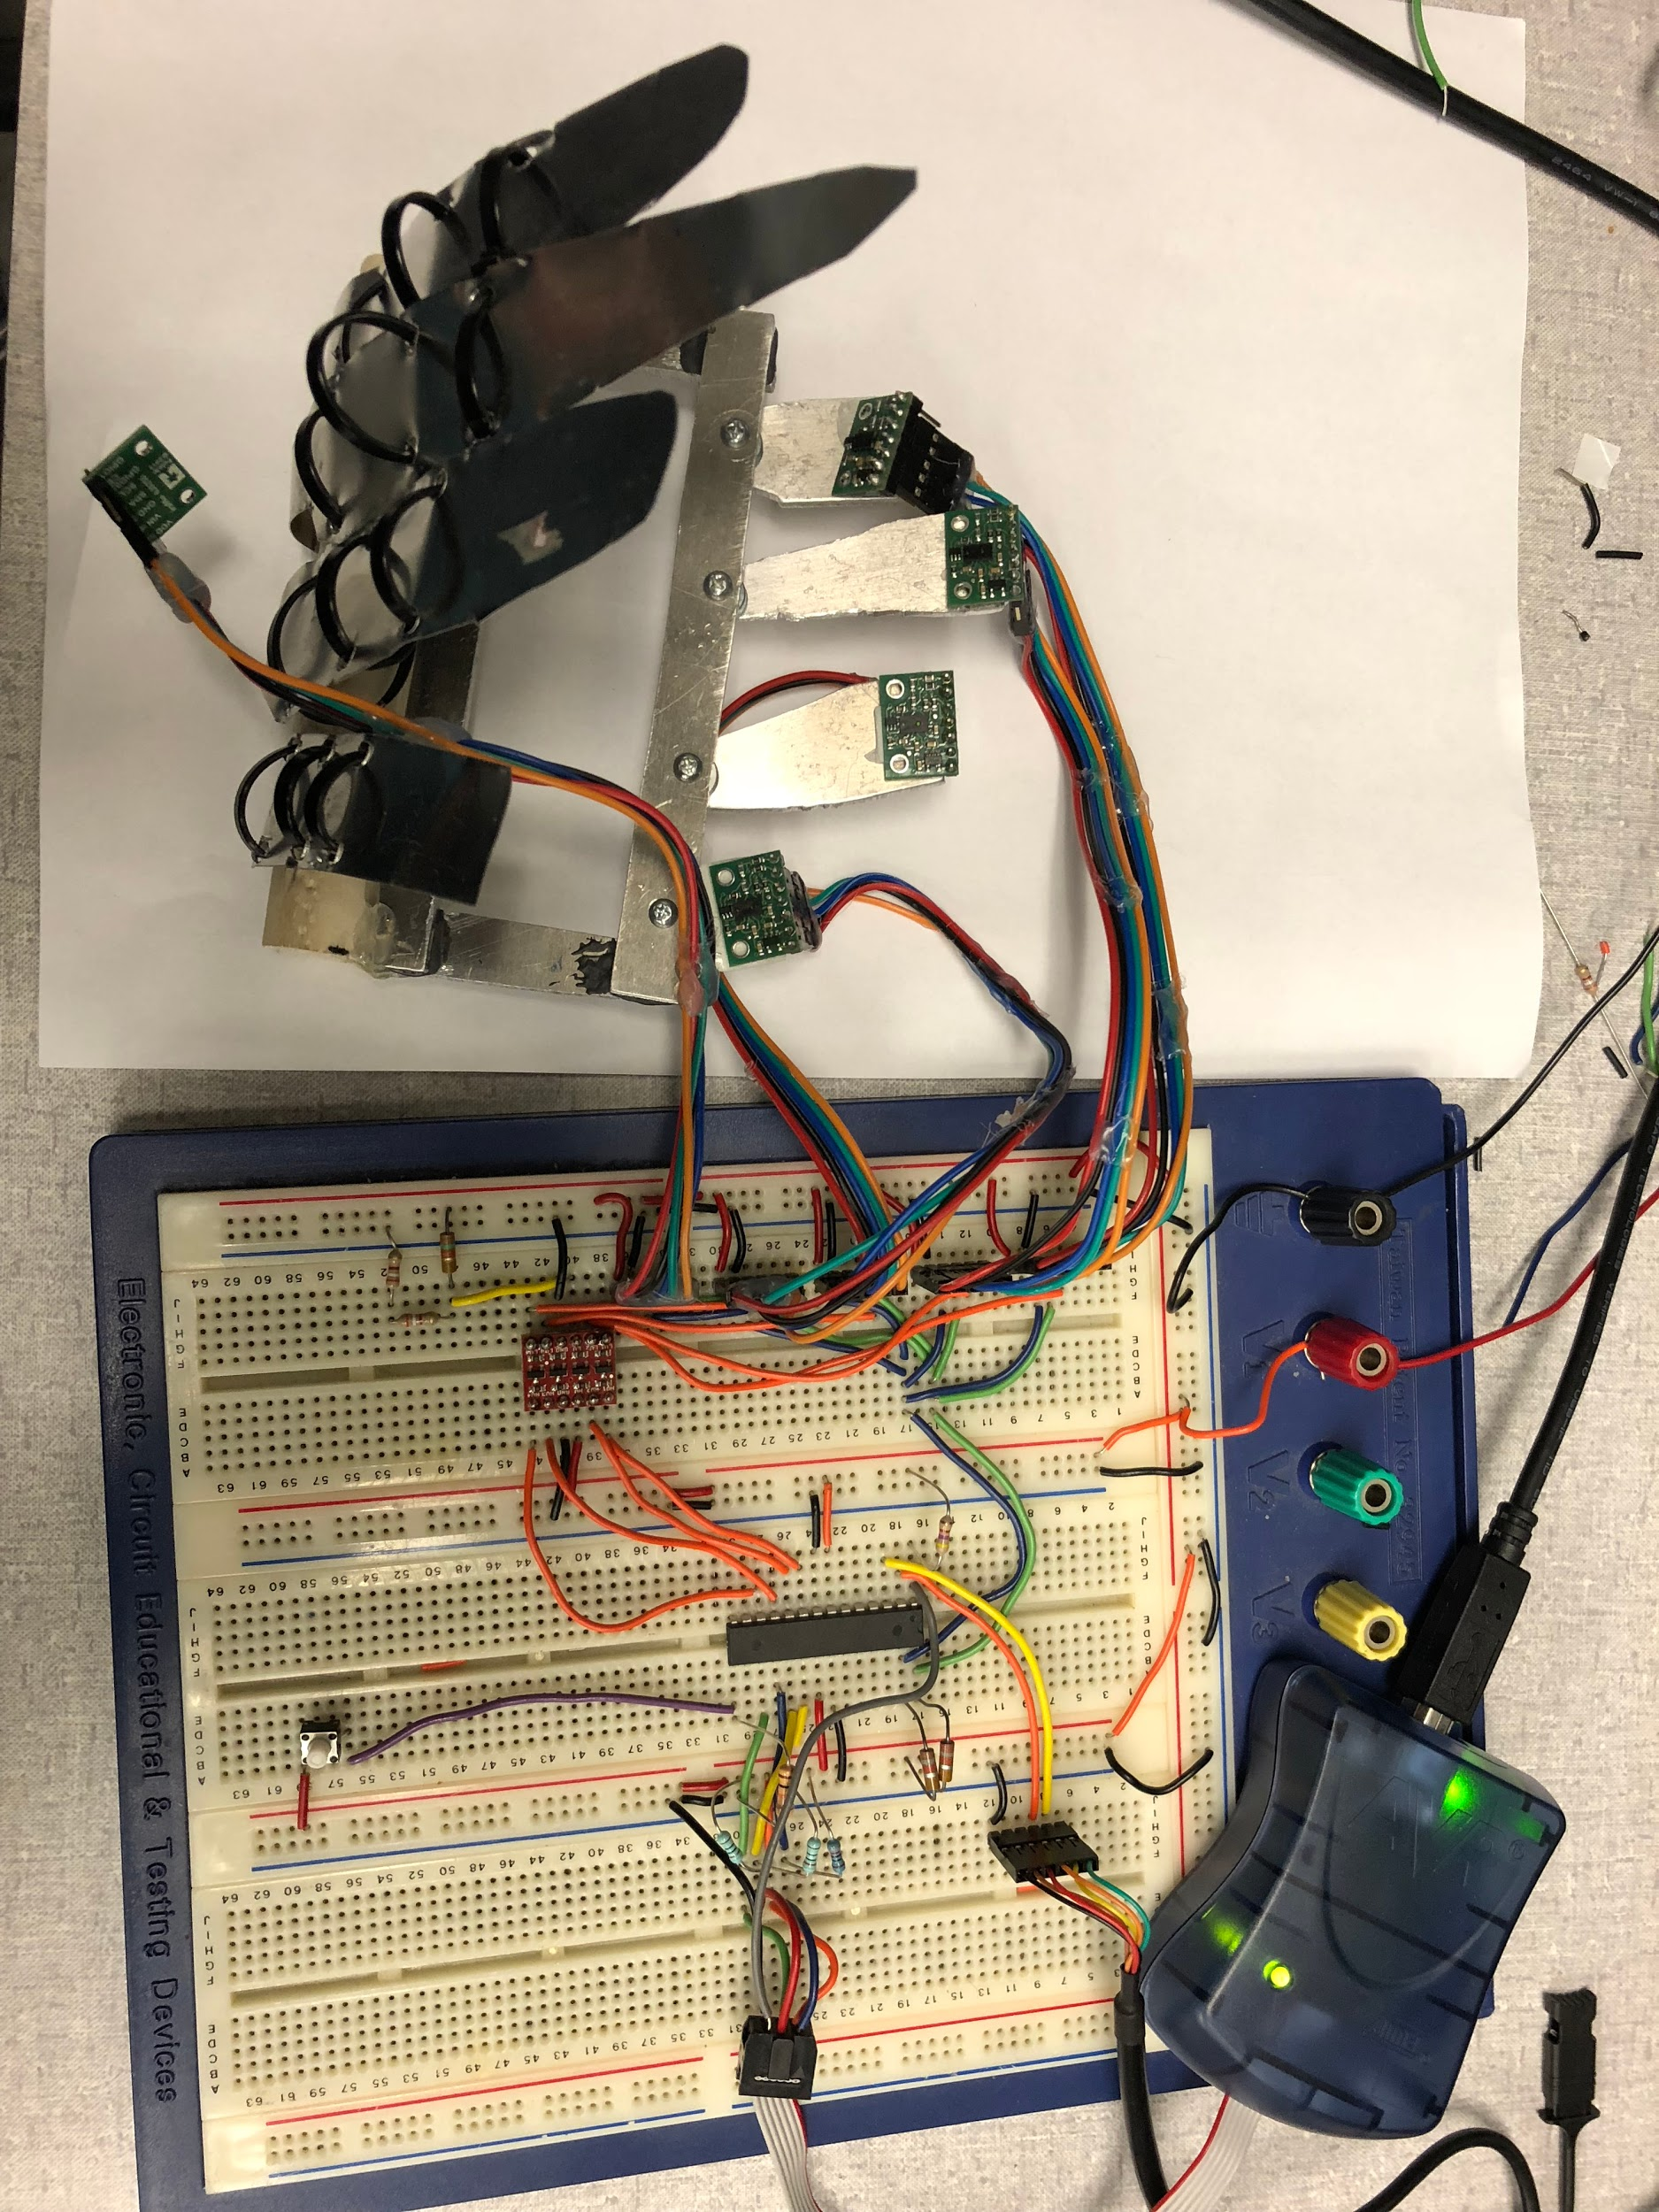
Our Breadboard
AVRisp Programmer
VL6180x TOF
Sensors
Atmega328
USB
I2C Bus
Voltage
Level
Shifter
Button
Notes:
Alex

Slide 10
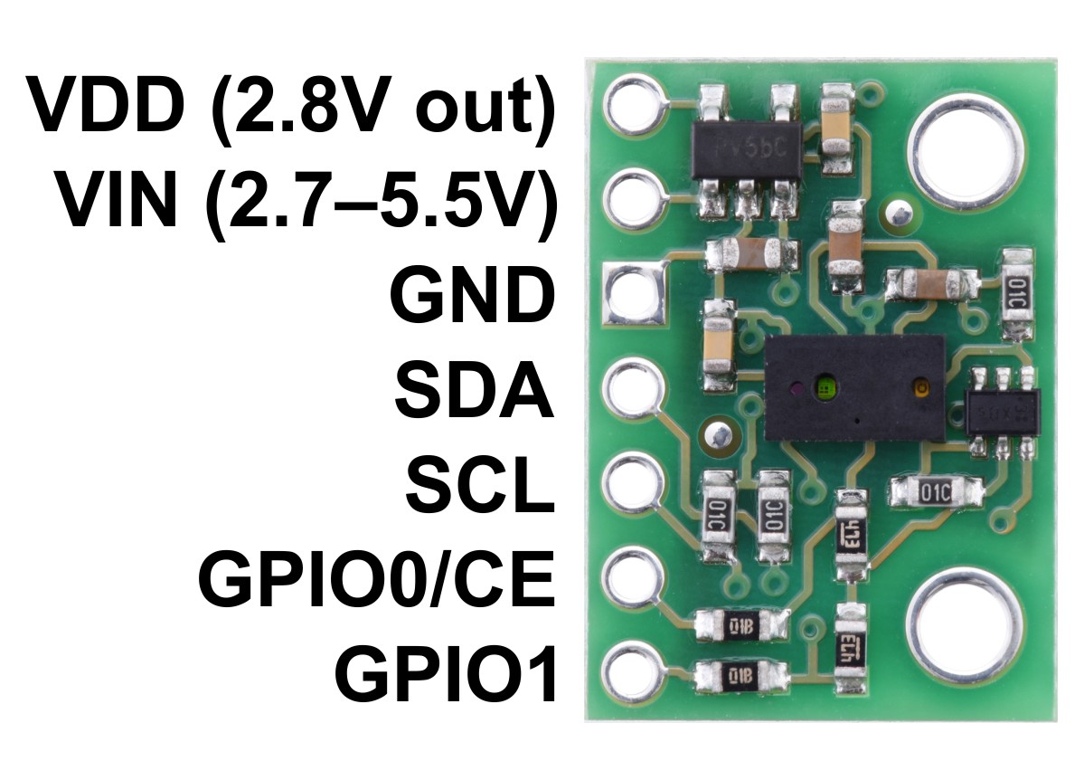
Sensing Finger Distance
VL6180x Time of Flight(TOF) Sensor
Measures up to 20cm
1mm resolution
Theoretical sampling period of 11.5ms = 87Hz
Achieved 36Hz
Not dependent on reflectance of target
Field of view = 12.5°
Uses I2C bus
default address = 0x29
Level Shifter
.75‘
.5’
⅛’ thick
Notes:
Alex

Slide 11
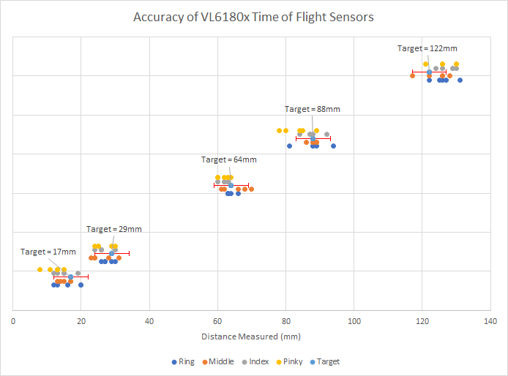
VL6180X Accuracy (within +-5mm from target)
Overall accuracy = 79.7%
17mm = 87.5%
29mm = 87.5%
64mm = 93.7%
88mm = 81.3%
122mm = 62.5%

Slide 12
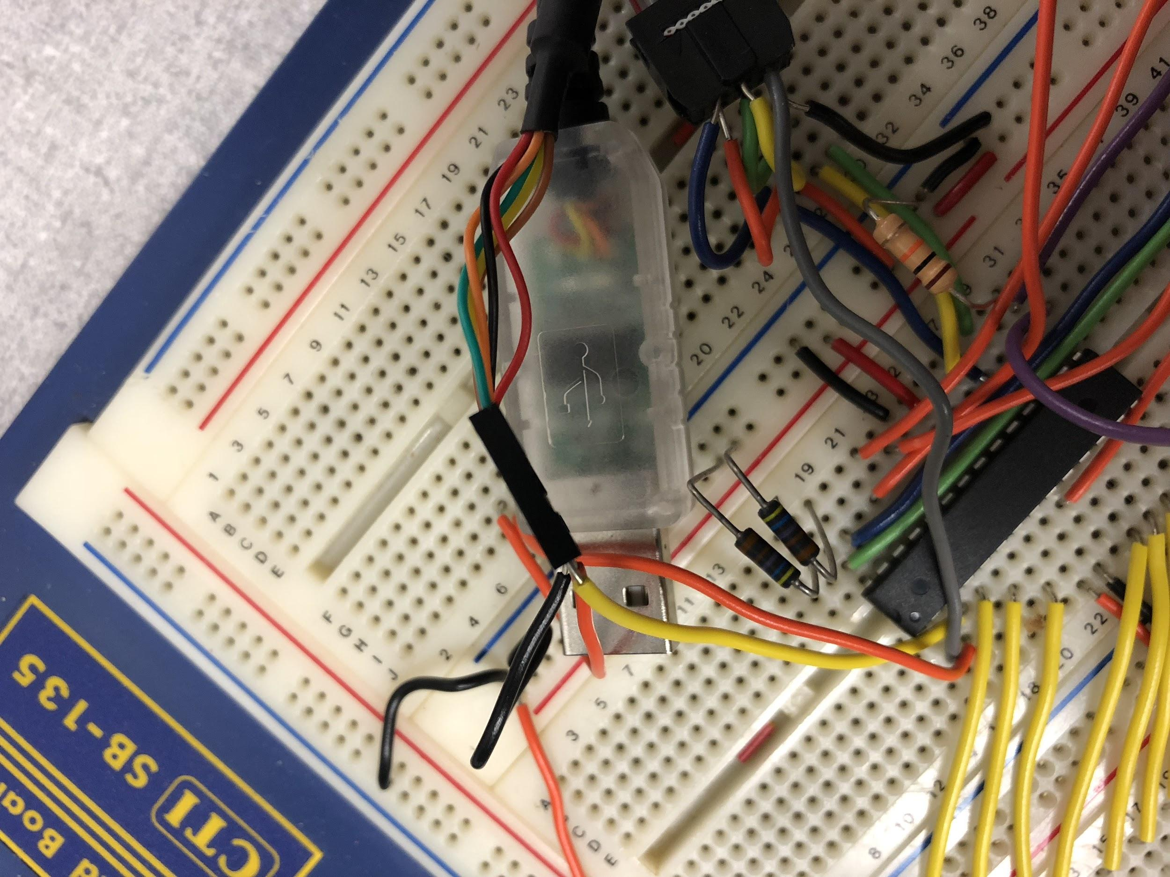
Communication with Computer
Used FTDI USB-rs232 converter cable
Connects to USART
38400 Baud Rate
8 data bits, 1 stop bit, no parity
38400bps/(9bits*5 sensors) = 853 finger readings per second
Notes:
Alex

Slide 13
I2C and Usart
I2C baud rate = 200KHz
5 transmissions per range measurement
Effective range baud rate = 200000/5 = 40000Hz
Usart baud rate = 38400Hz
1 transmission per range measurement
Only 1600 cycles unutilized per second
.04 seconds

Slide 14
Unity -> MicroServo Integration
Unity
Detects player hand in collision box
Sends servo position via usart
Atmega328
Check receive buffer every 10 range measurements
≅ 3 times per second
Updates servo position
Unity Game Engine
int count = 0;
if(usart_getchar()){
while(!(PINB & (1<<PINB1))){
while(count < 10){
VL6180X_Single_Range();
count++;
}
if(usart_check_received()){
moveServo(usart_getchar_quick());
}
count = 0;
}}

Slide 15
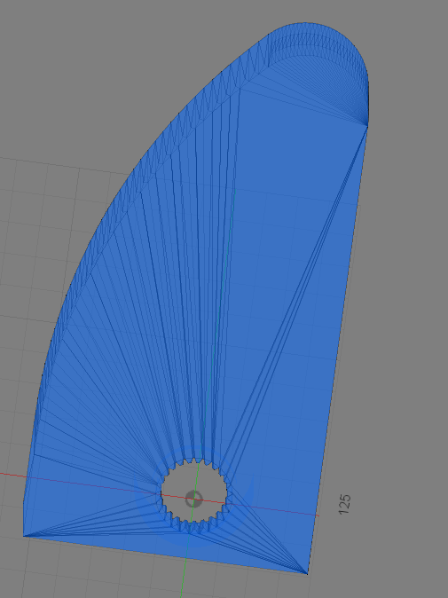
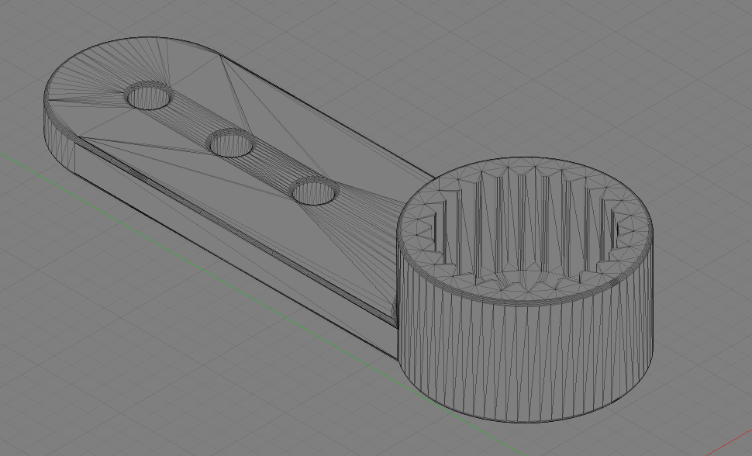
Designing Finger Prototypes in Fusion 360
Dimensions needed: no longer than 50 mm, a width of 20mm(average width of finger), a smooth curve for each finger to rest on, and an opening to fit a 25T Servo spline. First design
Design Flaws: Even though first design was optimal, the 3D printer was unable to cut the fine dimensions of the servo spline.
Solution: Use previous design but mold to attach with a premade attachable servo head.

Slide 16
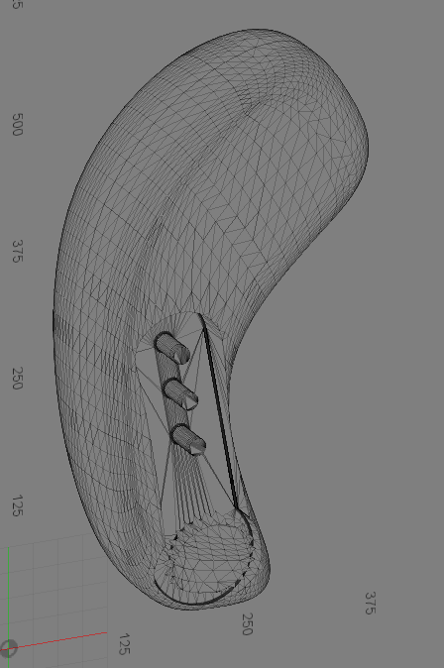
Final Prototype
By accounting for the servo horn being attached to the design I altered the design. By sanding the outer edges to fit the horn and screw it in directly to the model.

Slide 17
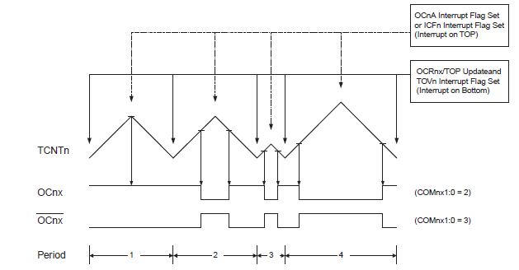
MicroServo Implementation
Micro Servo operates in relation to the duty cycle of the PWM
Manipulating the duty cycle will lock the servo in a set position.
Servo
Servo
Servo
Notes:
Smack

Slide 18
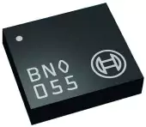
Hand Orientation with Bosch BNO055
9DOF sensor
Fused gyroscope, accelerometer & magnetometer data
Outputs Euler angles or Quaternion units
Provides absolute orientation
Fused output at 100Hz
Communication over I2C

Slide 19
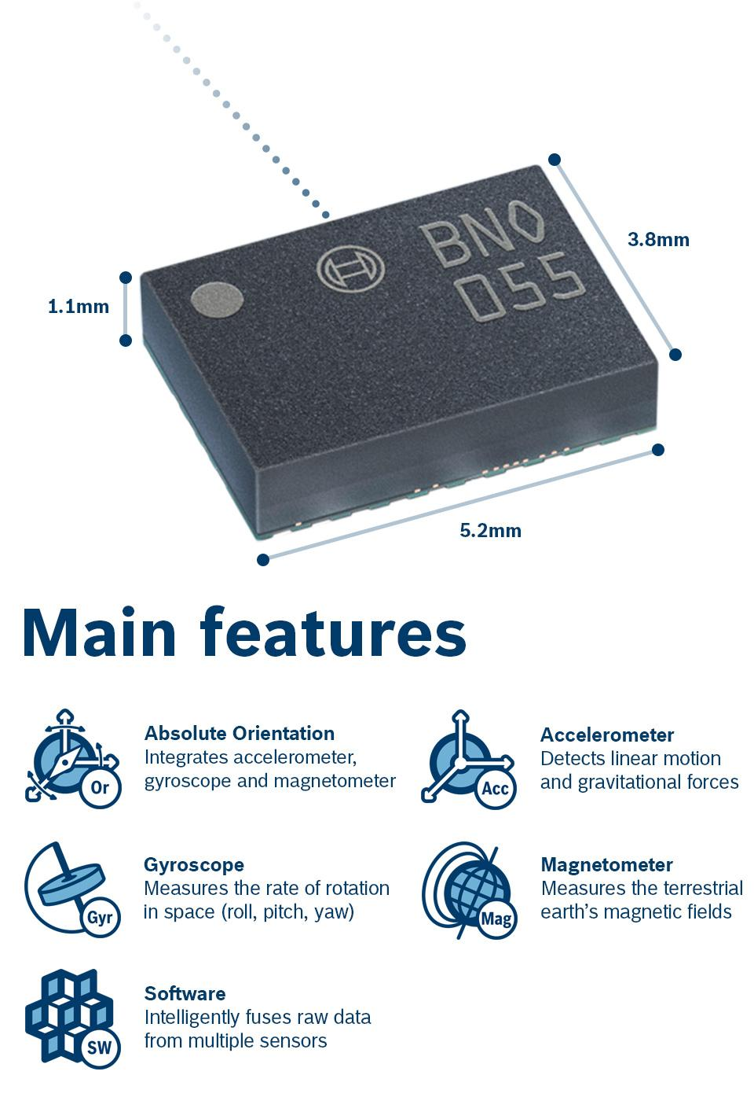
Bosch BNO055 Specifications
Triaxial 14-bit accelerometer
Triaxial 16-bit gyroscope
32-bit microcontroller
5.2 x 3.8 x 1.1mm

Slide 20
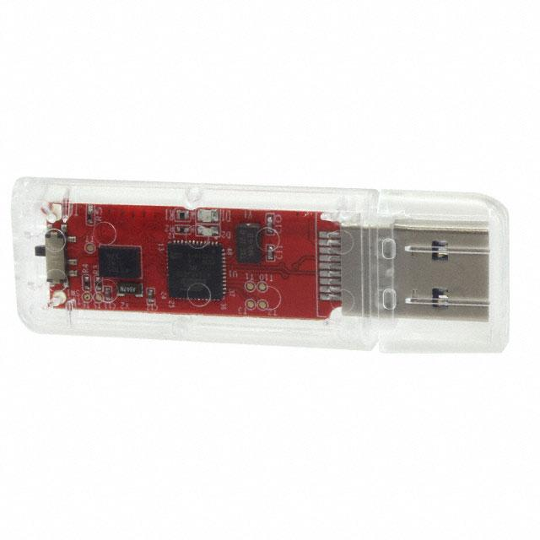
Temporary Solution: Bosch BNO055 on USB
Can’t integrate standalone unit until PCB design finished
On-board Cortex M0+
Need to integrate provided library / driver into program: difficult

Slide 21
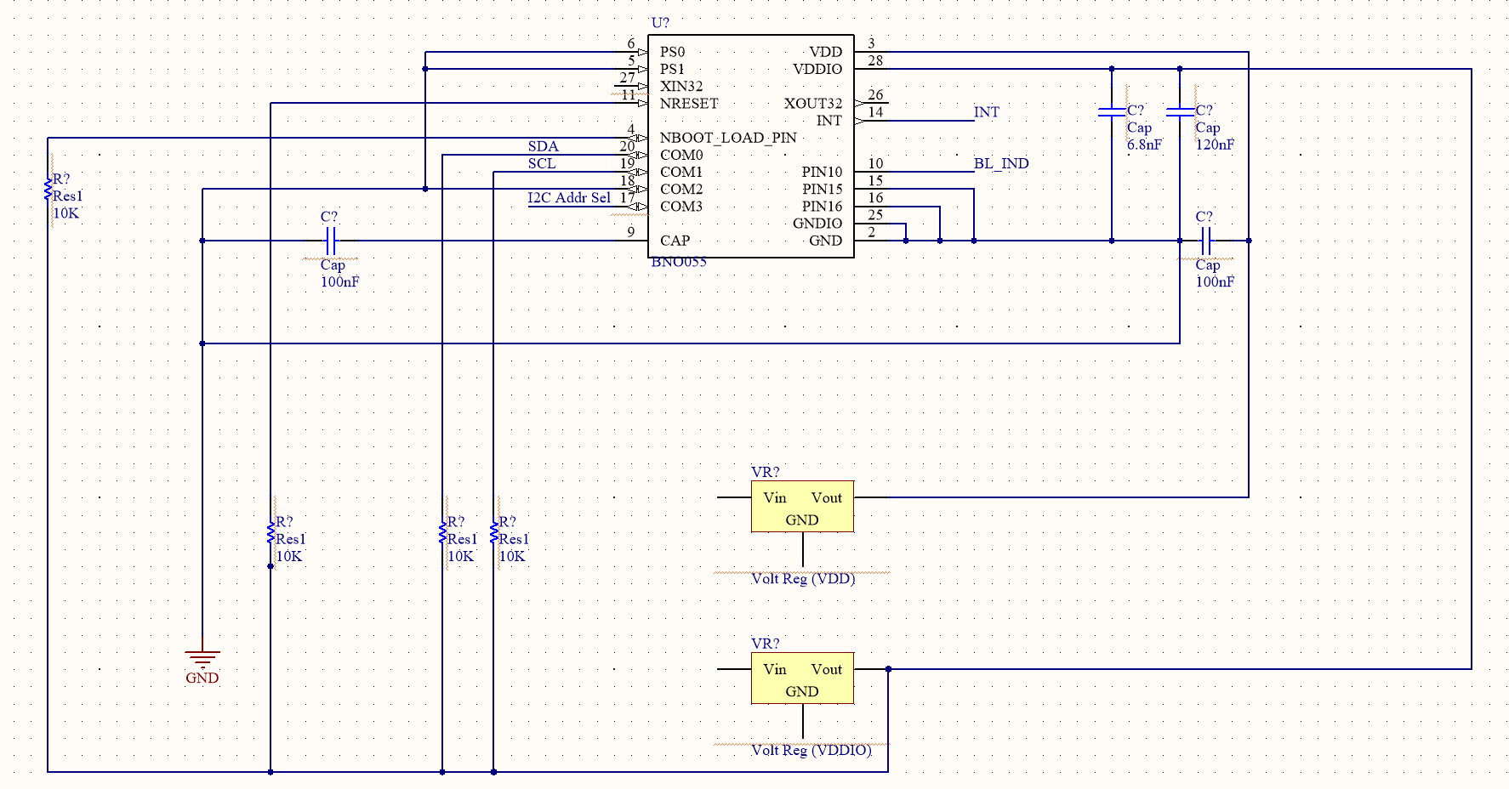
PCB Design
Learning Atmel Designer
Bosch schematic completed
Atmega328 schematic once res./cap. finalized

Slide 22
Software

Slide 23
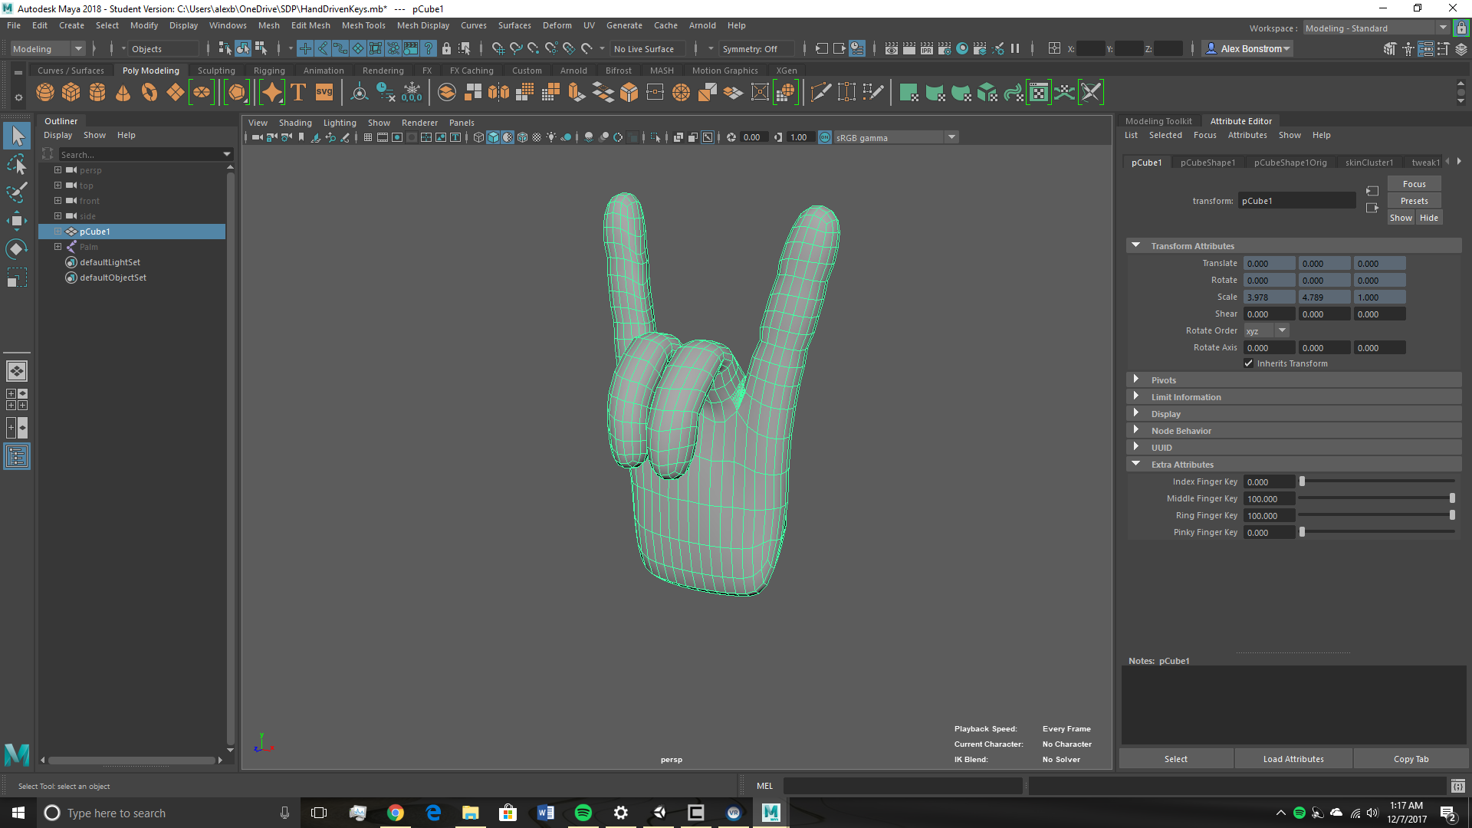
Modeling the Hand/Other Game Objects
Autodesk Maya
Most common modeling application for Unity integration
Used to model GameObjects for Unity
Unity accepts standard Maya binary files as input
Not good for variable animations
Notes:
Bonnie
To realize our virtual reality environment, we will be using the Unity game engine, the most popular game engine on the market. With it, we will create a virtual reality environment that contains a user controlled hand object and several objects of different sizes for the hand to pick up.

Slide 24
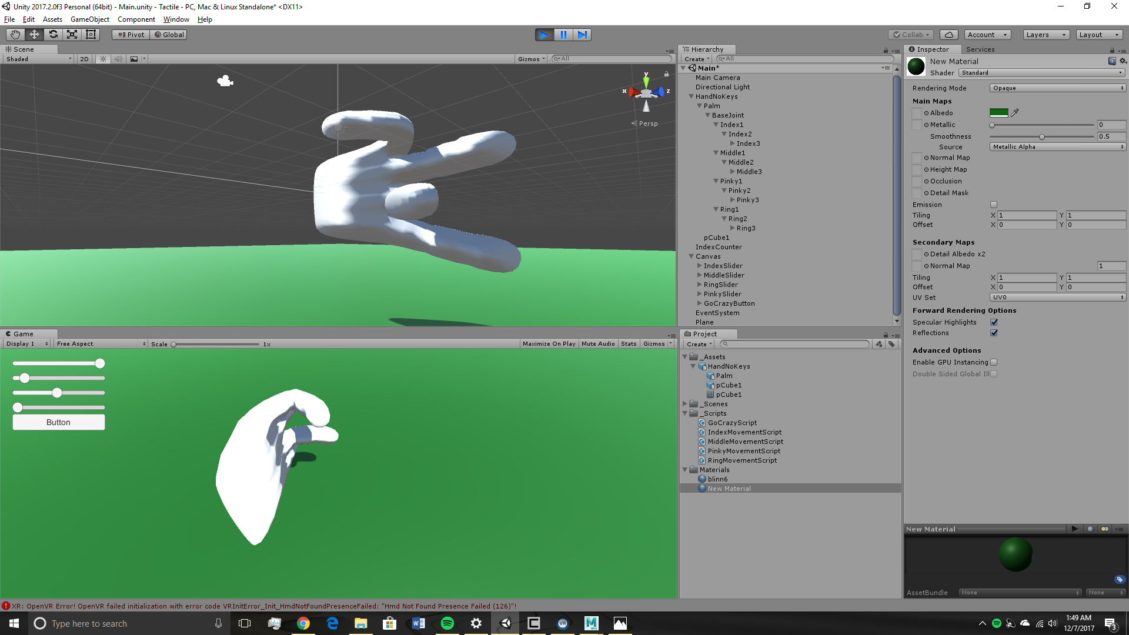
Unity
Virtual Reality Engine
Industry Standard
Unity offers standard VR packages
All development will be in C#
Unity uses Mono .NET based development platform

Slide 25
Unity <-> Microprocessor Integration
Microprocessor - I2C/COM
I2C protocol communicates serially to the computer through COM port
Unity - C#/Mono
C# has SerialPort library for this
SerialDataReceivedEventHandler
Unity’s Mono platform can’t handle many SerialPort functions:
SerialPort.BytesToRead -- Not necessary but useful
SerialDataReceivedEventHandler -- Necessary
Cannot connect Unity directly to COM port

Slide 26
Unity <-> Microprocessor Integration Solution
Unity - Create TCP Server to service requests
SendMessage()
ListenForData()
Separate C# .exe application
Connects to Unity through TCP client/server connection
Connects to COM port through C# SerialPort

Slide 27
Controller Triangulation
Calculate HSV of ball strapped to wrist
Implement OpenCV-Python script to track
(X,Y,Z) from center and size of radius
Translate to VR coordinates
Notes:
Austin
Accelerometer for Z axis (front and back)

Slide 28
Budgetary Analysis
Component | Singular Unit Price ($) | Mass Unit Price (1000 Unit Price / 1000) [$]
Enclosure | $50 | $10
Time of Flight Sensors | $42.45 | $33.05
Micro Servo | $50.00 | $50.00
Power Supply | $15.50 | $15.50
Atmega 328-PU | $2.01 | $1.67
Bosch BNO055 | $12.07 | $5.93
Temporary Bosch USB Stick | $31.25 | $31.25
Aero-Strike Softball | $6.49 | $1.67
 | Total: $209.77 | Total per Unit: $149.07
Revenue Per Unit (Sale Price) with ~50% COGS: $299
Notes:
How much will it cost in mass production?
Austin
50% Budget Leeway
{
Pressure Sensors: $52.50
Micro Servos: $49.75
IR Leds: $35.80

Slide 29
Proposed CDR Deliverables
5 TOF sensors operating simultaneously ✔
Unity hand model mimics controller finger movement ✔
Demonstrate that virtual objects can be picked up by a virtual hand ✔
Micro servos move to position when near Unity object ✔
Demonstrate (X,Y,Z) tracking with webcam, accelerometer and gyroscope ✔
Initial mechanical design ✔
Notes:
Bonnie

Slide 30
Team Responsibilities & Scheduling
 | March | Early-Mid April | Late April / Early May
Alex Bonstrom | Finish/Polish Microcontroller + Unity Communication | Finish/Polish Unity Game Environment + Functionality | System Polish Final Documentation Public Demonstration Graduation
Austin Fernalld | Finish PCB Design | Assist with Unity implementation
Connor McLaughlin | Integrating Servos into Unity through Microcontroller | Assemble Finished Prototype
Alex Smith | Complete Mechanical Design | Assemble Finished Prototype
Notes:
Go one by one
prepare public demo for april. be prepared to answer what it will look like

Slide 31
FPR Proposed Deliverables
Completed PCB Design
Finalized Mechanical Design
Movement of hand position and orientation in Unity
Servo feedback provided from real data
Able to pick up object in unity with feedback

Slide 32
Demo
Notes:
Alex
Smack
Austin
Bonnie

Slide 33
Questions?

Slide 34
Thank You

