Slide 1
Preliminary Design Report
Team RoMo
October 18, 2017
Notes:
Justify design choices
Use independent wheel control
Interference with signals
Use DR as backup

Slide 2
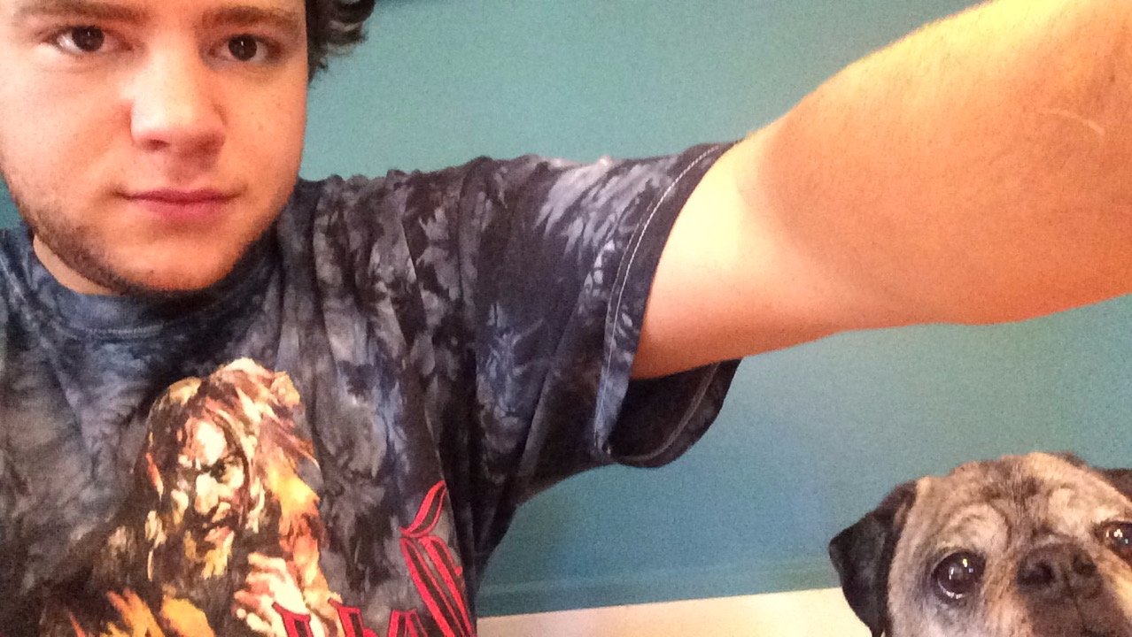
Meet team Romo
Kevin Moriarty
CSE ‘18
Hampden, MA
Collin Timmerman
EE ‘18
Westwood, MA
Aaron Stam
EE ‘18
Holden, MA
Leonardo Luchetti
EE ‘18
East Bridgewater, MA

Slide 3
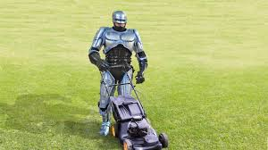
RoMo - An autonomous robotic lawn mower
Notes:
Our project is RoMo, the autonomous lawn mower. Our goal is to remove the human from the equation of this mind numbing chore. We plan to do this by modifying an older lawn mower with new technology to allow it to mow a lawn with minimal amount of help or setup.

Slide 4
Our idea
Mowed
Lawn
Unmowed
Lawn
RoMo

Slide 5
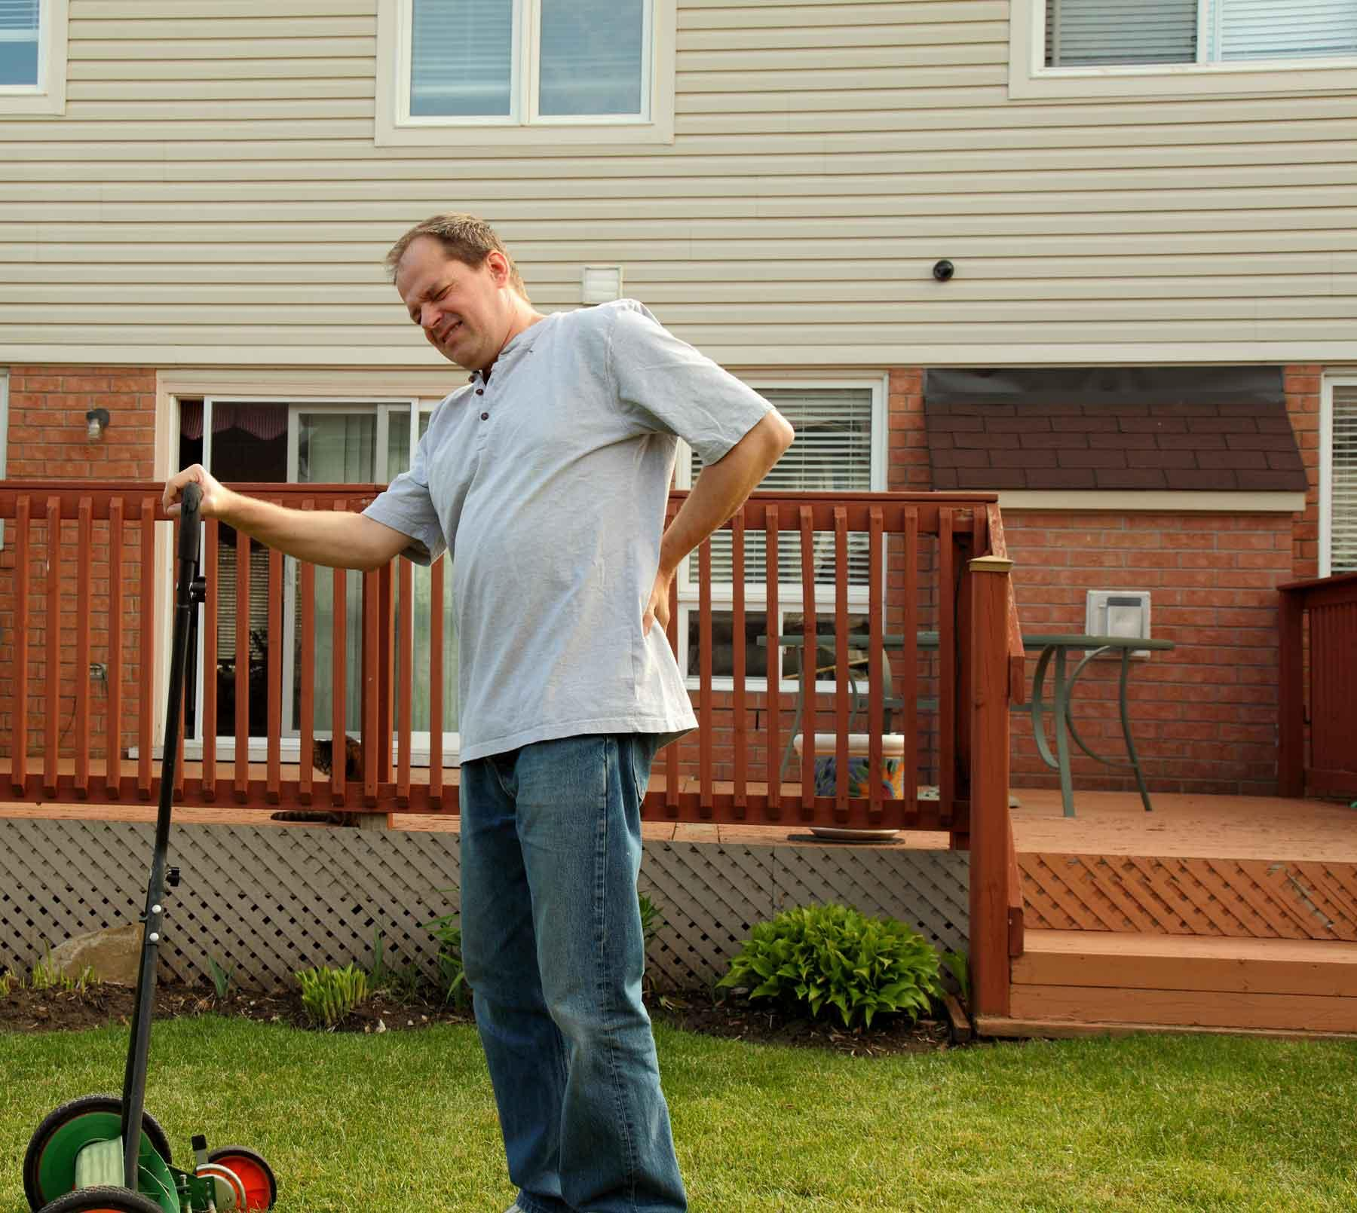
Assessing Needs
Mowing the lawn takes time
Physically demanding
Expensive
Notes:
For Obvious reasons people don’t like to mow their own lawn
It takes up free time that you could spend doing things you enjoy or need to do
The average american spends 70 hr/yr
It requires a certain degree of physical ability to be able to do
If you aren’t able to do it on your own it requires you to pay someone else to do it
It costs the average american $150/yr to maintain their lawn

Slide 6
Requirement Analysis: Specifications
Lawn Mower
Mows the 1500 sq. ft lawn on one 24V batteries charge
Moves at 3.5 MPH +/- 1 MPH
5cm Positioning Accuracy
Lawn
Rectangular
Level
Obstacle free
Known starting position

Slide 7
Design Alternatives (Existing Products)
Products do exist on the market
They cost $1500+
Require a lot of set up
Pre-mapping of entire yard
Poor Battery performance
Other Solutions
Use of light nodes and IR sensors to define lawn
Use sensors to detect change in grass to find end of line

Slide 8
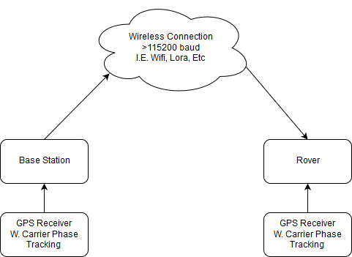
Overall System Block Diagram

Slide 9
Operation: Base Station
No User Input
User Inputs L&W of Lawn
Ping Rover
Rover Indicates Not Ready
Startup
Standby
Rover Indicates Job Complete
Rover Indicates Ready
Start Kinematic GPS
Rover Indicates Job Not Complete

Slide 10
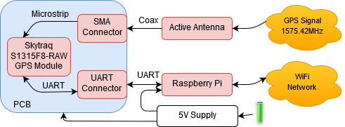
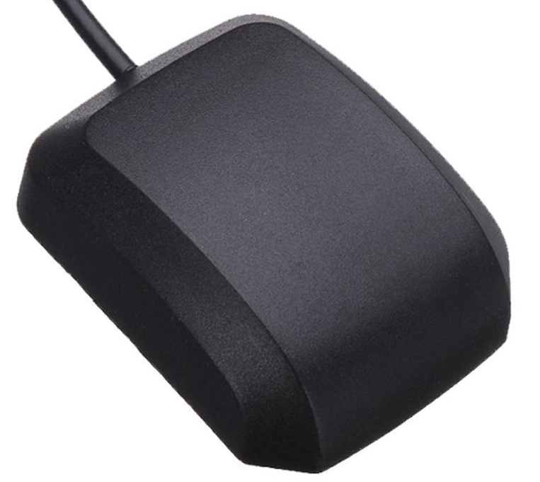
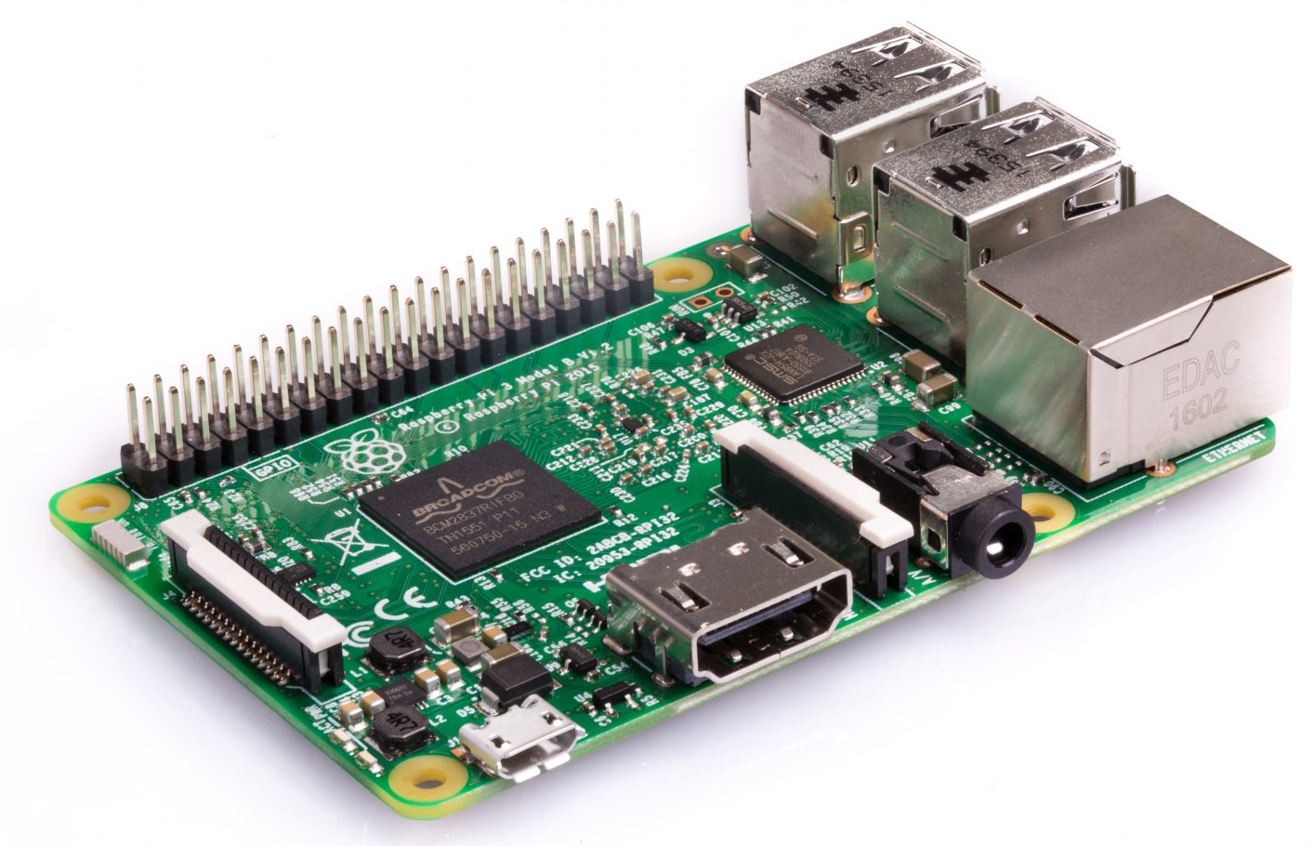
Base Station System Block Diagram

Slide 11
Operation: Rover
Ready Switch Off
Base Transmitting GPS
Ready Switch On
Ping Base Ready
Start Kinematic GPS
Start
Standby
Base Not Transmitting GPS
Full Stop
Distance Left = 0
Mow Forward
Map path
Decelerate/Turn
Turns remaining = yes

Slide 12
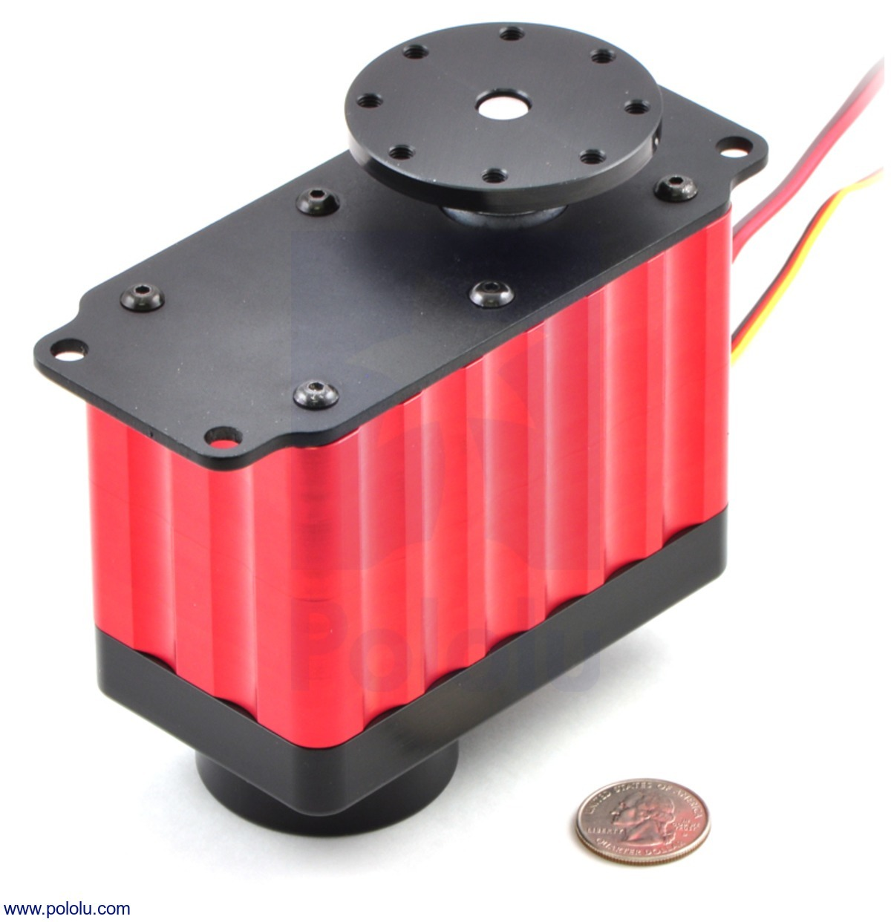
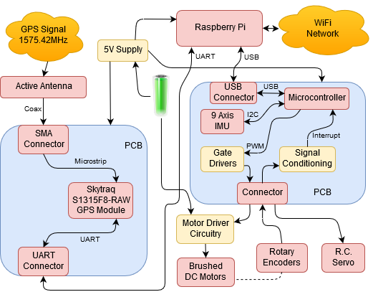
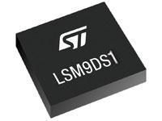
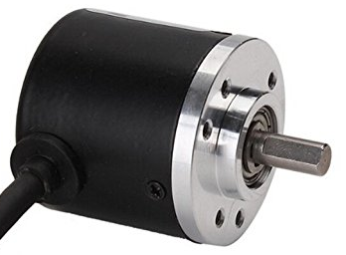
Rover System Block Diagram

Slide 13
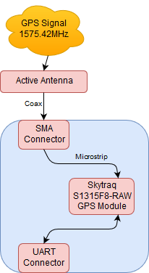
Subsystem: Real Time Kinematic GPS
Differential Positioning
Existing user base
Mature ecosystem
RTKLIB
Skytraq S1315

Slide 14
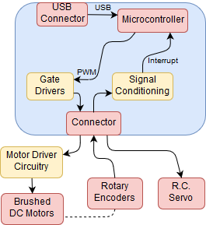
Subsystem: Motion Control
Motion referenced to center of mower blade
Two motors drive rear wheels
Motors driven by a single PWM signal
Control of speed
Wheel speed measured by rotary encoders
Output a pulse every 0.6°
Output speeds averaged to get linear speed
Single servo (R.C. style) angling front wheel
Servo position directly proportional to pulse width

Slide 15
Subsystem: Motion Control (Alternative)
Motion referenced to center of mower blade
Two motors driving rear wheels
Turning is accomplished by differential speed of the wheels
Motor driven by independent PWM signals
Wheel speed measured by rotary encoders
Output a pulse every 0.6°
Two freely rotating casters on front of mower

Slide 16
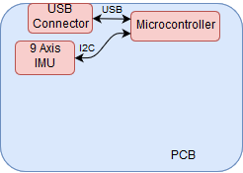
Subsystem: Dead Reckoning (extension)
Limited GPS update rate
IMU - Inertial Measurement Unit
Update Position Faster

Slide 17
Requirement Analysis: Inputs and Outputs
Inputs
Base GPS signal
Rover GPS signal
Dimensions of lawn
Start mow command
Outputs
Differential position of rover
Wheel Motor Control
Stop mow command

Slide 18
Software Stack Summary
Base Station
RTKLIB
Rover
Raspberry Pi
RTKLIB
Path Calculation
Dead Reckoning
Microcontroller
Motion Control
Signal Generation

Slide 19
Subsystem: Power Supply
24 V battery pack
Capacity to power two brushed DC motors over flat ground
Control circuitry power negligible compared to power for locomotion
Lithium Iron Phosphate batteries chosen based on cost
Charging input
Female connection mounted in case
Designed for 24 and 36 V power supplies
Swappable power supply
Designing subsystem to allow for use of 36 V battery pack
Enables use on uneven terrain or extended run time

Slide 20
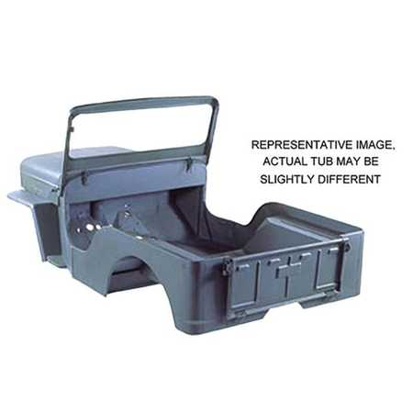
Chassis Design
2 feet long x1.5 feet wide
Raspberry Pi, GPS, and Motor Control PCB mounted inside
Aluminum frame with polymer cover
Grass shield on right side of chassis
Approximately 25 lbs

Slide 21
Subsystems: Risks
Kinematic GPS
Loss of signal to either base or rover
Failure of differential calculations
WiFi
Loss of communication between base and rover
Interference/Noise in signal
Power Supply
Inadequate charge at start of mowing operation
Motion Control
Loss of synchronization/communication between wheels/motors
Motor slippage

Slide 22
Preliminary Design Report
Item | Quantity | Cost/Unit | Total Cost
Gps Receivers | 2 | 25 | 50
Rasberry Pi | 2 | 35 | 70
Brushed DC motors | 2 | 15 | 30
USB-UART IC | 2 | 2 | 4
Microcontroller | 1 | 6 | 6
IMU IC | 1 | 6.36 | 6.36
Circuit Board - GPS | 2 | 1 | 2
Circuit Board - Rover | 1 | 2 | 2
Rotary Encoder | 2 | 16 | 32
Battery (LiFePO4, 36V, 84Wh) | 1 | 100 | 100
Total (excluding shipping) | ~ | ~ | 302.36
Left over for misc. Bits (electrical, mechanical) | ~ | ~ | 197.64

Slide 23
Preliminary Design Report: MDR Deliverables
Finalize System Design (with specific PNs)
Get Boards Designed (preferably produced)
Complete Preliminary Software
Build Chassis Frame

Slide 24
Planning Ahead
Plan for FPR
Plan for Demo Day
Test in parking lot
Backup location Totman gym
Oral presentation w/ handouts
Q&A session
Prototype on display
Video of successful test
Poster presentation
Q&A panel

Slide 25
Questions
Questions?

