Slide 1
Midway Design Report
Team RoMo
December 6th, 2017
Notes:
Justify design choices
Use independent wheel control
Interference with signals
Use DR as backup

Slide 2
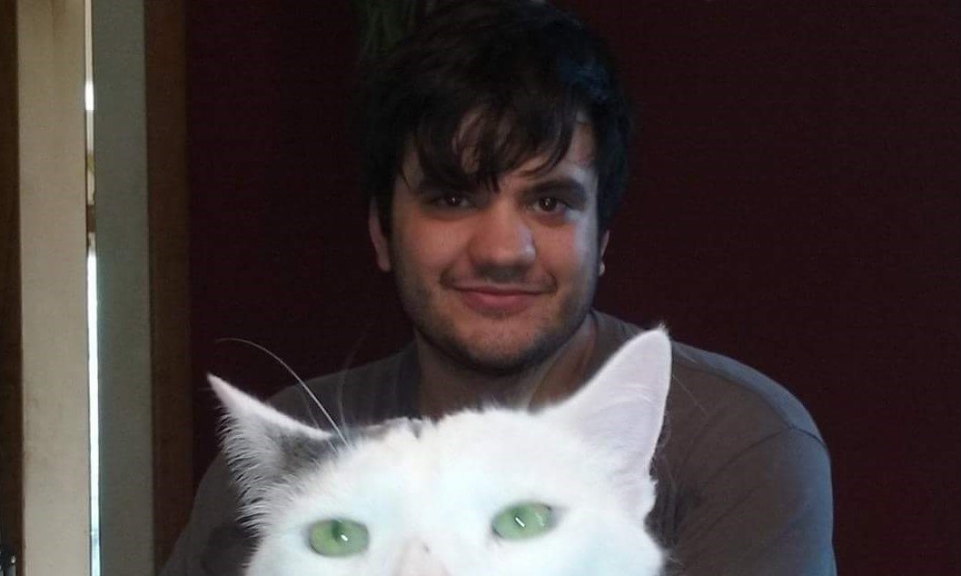
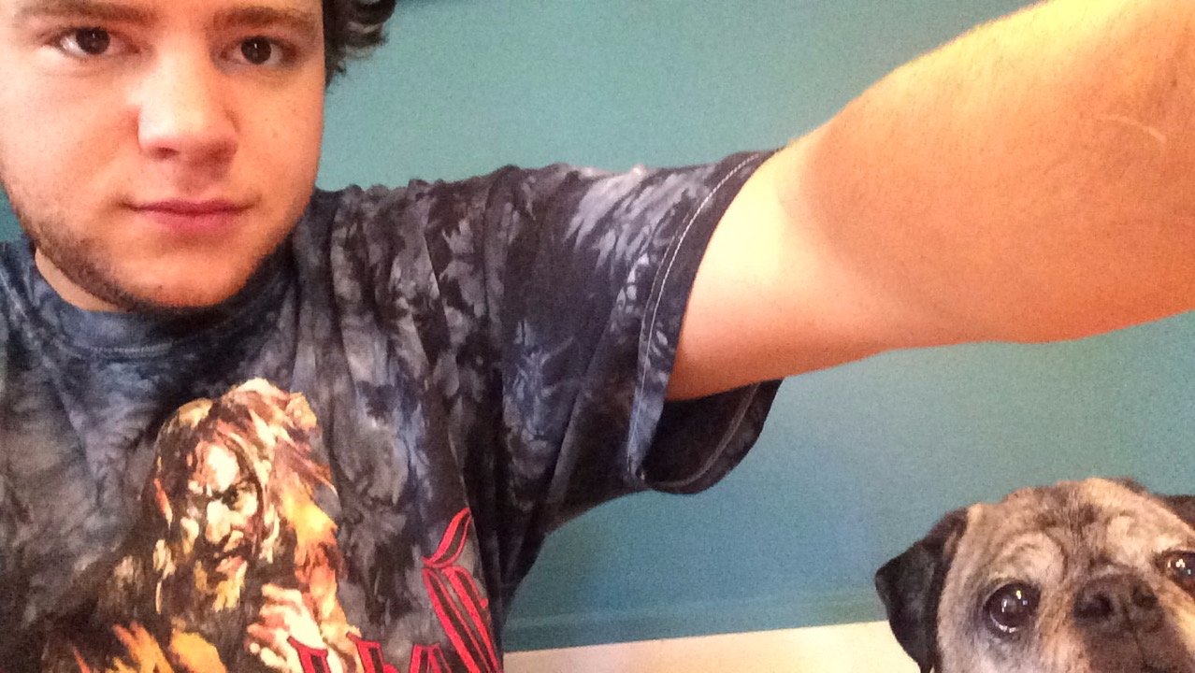
Meet team Romo
Kevin Moriarty
CSE ‘18
Hampden, MA
Collin Timmerman
EE ‘18
Westwood, MA
Aaron Stam
EE ‘18
Holden, MA
Leonardo Luchetti
EE ‘18
East Bridgewater, MA

Slide 3
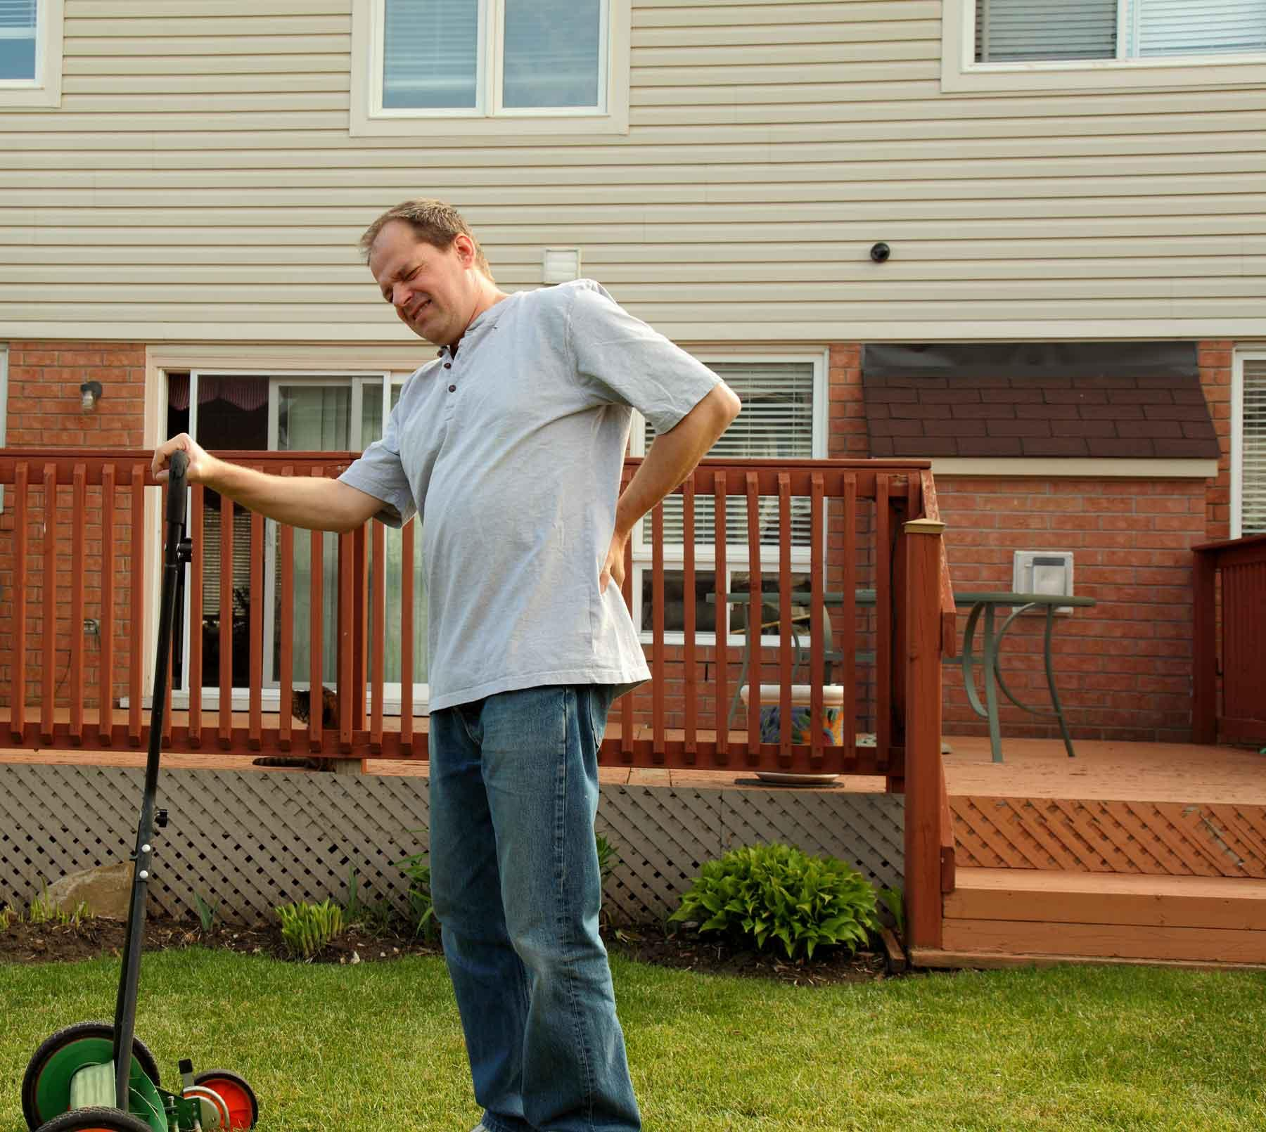
Assessing Needs
Mowing the lawn takes time
Physically demanding
Expensive
Notes:
For Obvious reasons people don’t like to mow their own lawn
It takes up free time that you could spend doing things you enjoy or need to do
The average american spends 70 hr/yr
It requires a certain degree of physical ability to be able to do
If you aren’t able to do it on your own it requires you to pay someone else to do it
It costs the average american $150/yr to maintain their lawn

Slide 4
Requirement Analysis: Specifications
Lawn Mower
Mows the 1500 sq. ft lawn on one 24V battery charge
Moves at 3.5 MPH +/- 1 MPH
Lawn
Rectangular
Level
Obstacle free
Known starting position

Slide 5
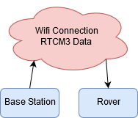
Updated System Block Diagram

Slide 6
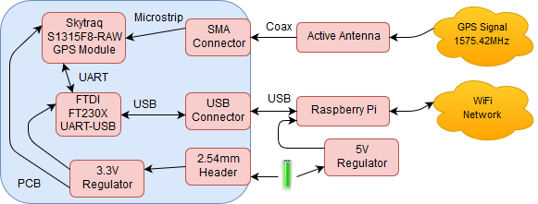
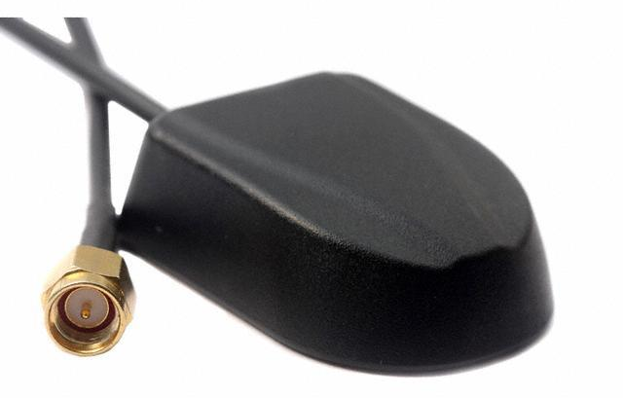
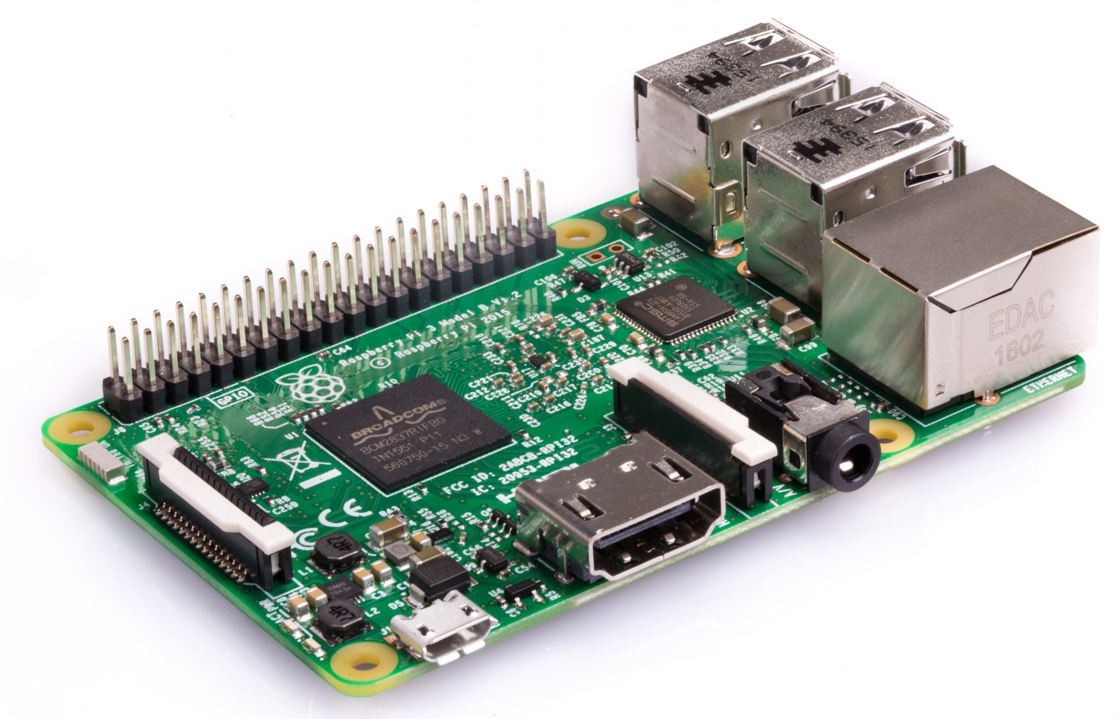
Updated Base Station System Block Diagram

Slide 7
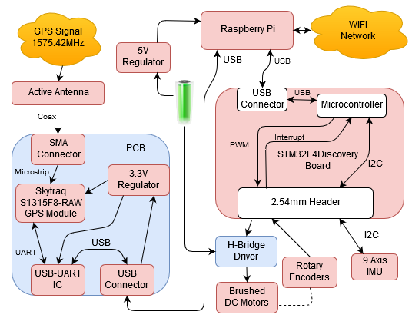
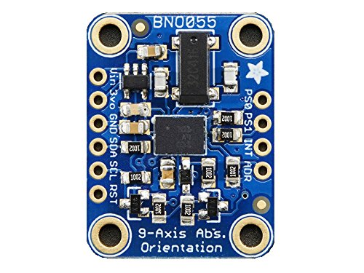
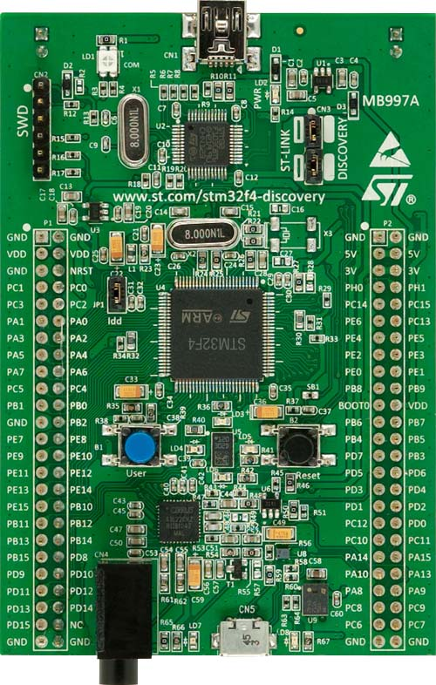
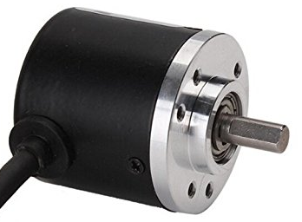
Updated Rover System Block Diagram

Slide 8
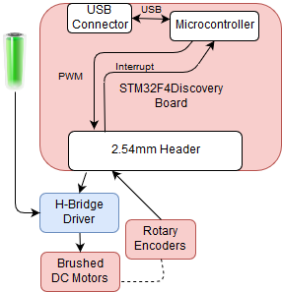
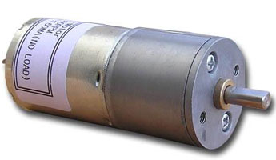
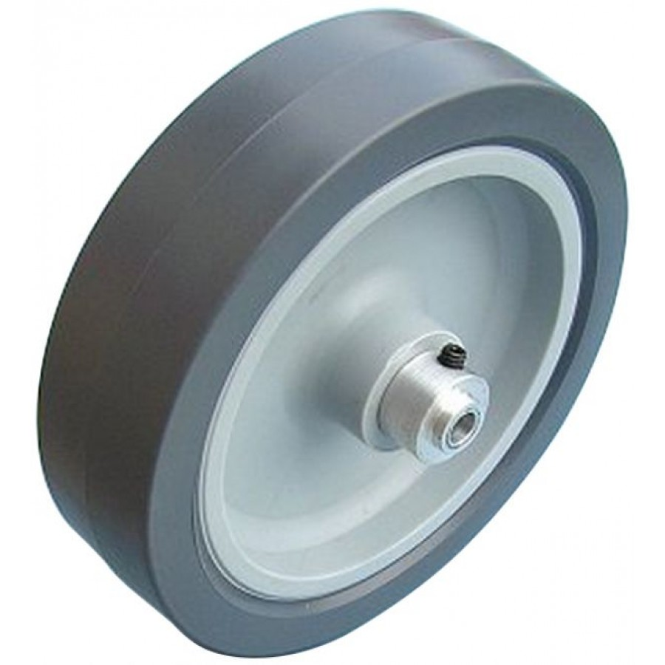
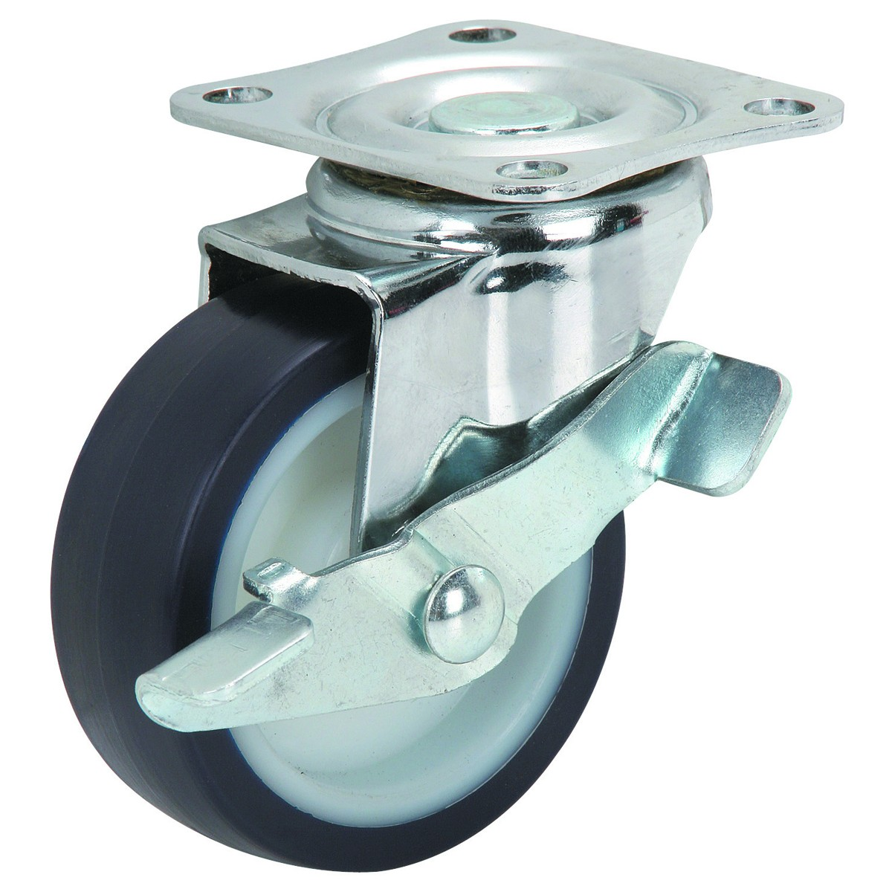
Wheels and Motors
DC Wheel Motors: High torque DC Geared Motors
24VDC, 300rpm
PN: MT-24V300
Qauick DC-5 24V Rotary Encoder
PN: 4696639
DC Blade Motor
24VDC, 20k rpm
PN: RS-385PH-2465
Might Gear Down RPM
100 mm Diameter Wheels
76mm Swivel Caster

Slide 9
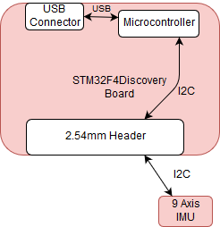
Subsystem: Dead Reckoning (extension)
9 Axis IMU
Adafruit 9-DOF IMU Breakout
PN: ADA2472
Uses BOSCH BNO055
Generates
Absolute Orientation Vector
Angular Velocity Vector
Acceleration Vector
Compute Change in Position

Slide 10
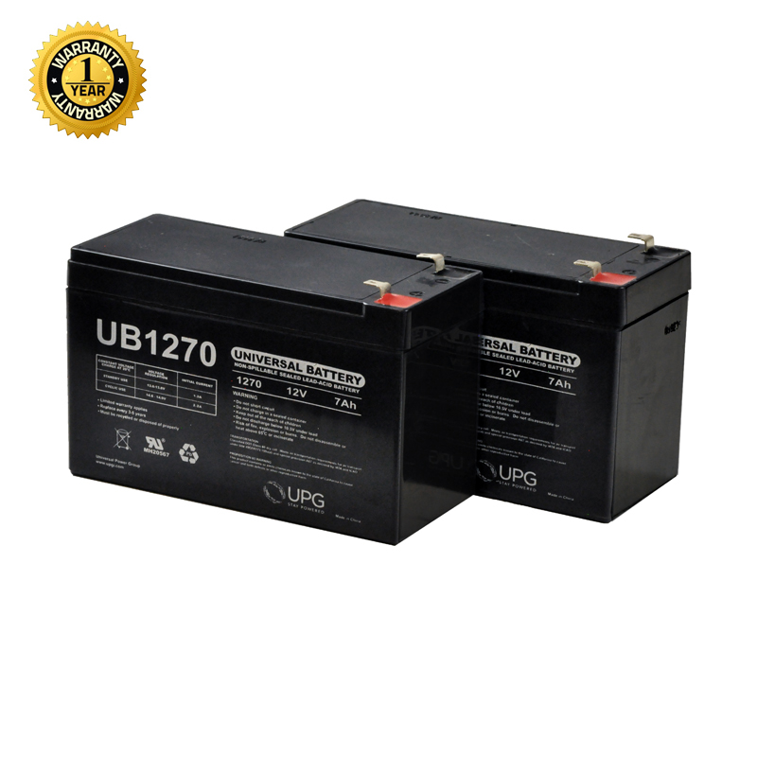
Subsystem: Power Supply
24 V battery pack
2x UB1270 AGM 7AH
Assume 1Hr Run Time
400 mAH for Wheel Motors
Around 200 mAH to run other circuitry
2AH for Mower Motor
Leaves around 50 % battery life
5V Regulator (24V - 5V)
ASIN: B01GJ0SC2C

Slide 11
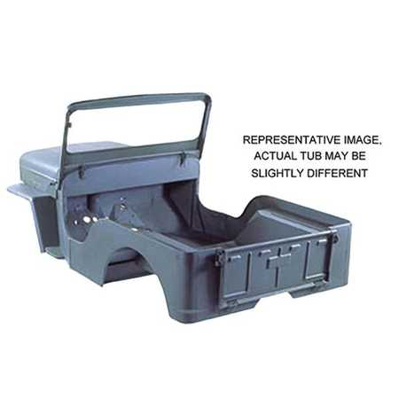
Chassis Design
2 feet long x 1.5 feet wide
Raspberry Pi, GPS PCB, and Motor Control Subsystem mounted inside
Aluminum frame with polymer cover
Assembly pending updated materials
Less than 25 lbs

Slide 12
MDR Delivirables: Finalize System Design
System Designed
All necessary parts ordered
Other parts in shipping or ready to order
Wheels and casters
Batteries
Raspberry Pi
Motors

Slide 13
Design & Manufacture GPS Boards
Requirements:
Antenna to USB solution
GPS module with phase measurement
Power Supply
UART to USB ic

Slide 14
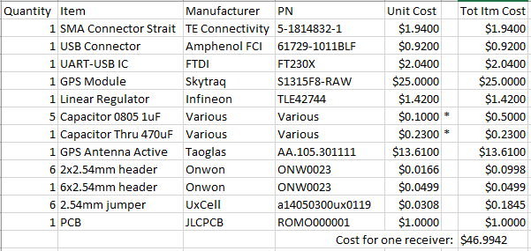
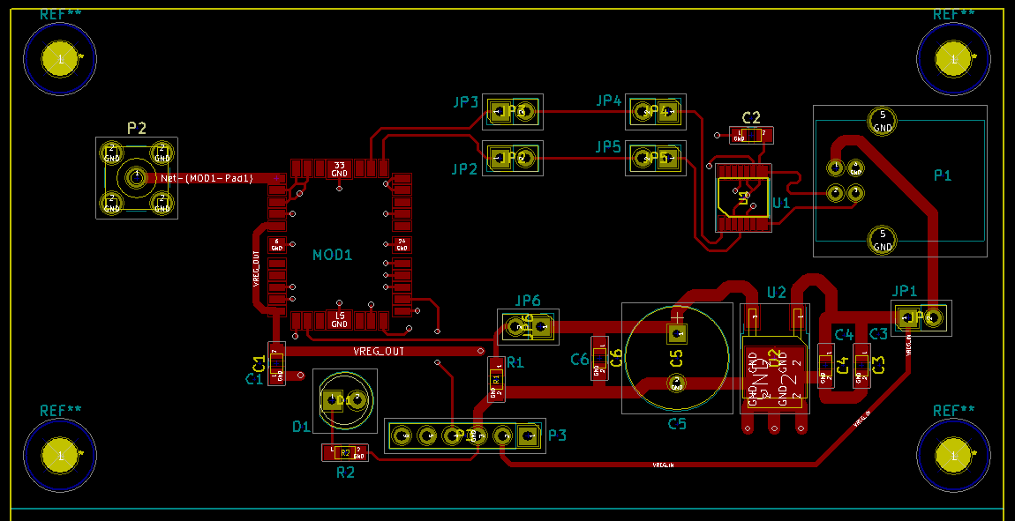
Design & Manufacture GPS Boards
Solution:
Single double sided 0.6mm PCB
Mimimize width of 50Ω trace

Slide 15
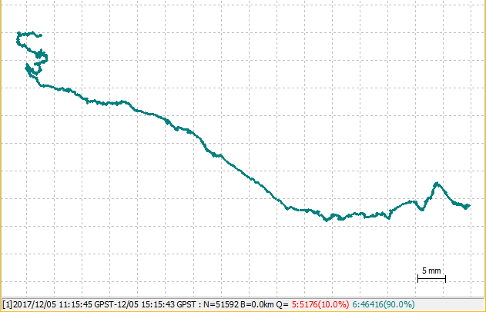
GPS Board Preliminary Testing
Static Precise Point Positioning
Shows:
Drift over last 4 hours
Given:
Total Run Time of 08:09:18
(hh:mm:ss)

Slide 16
GPS Board Continued Testing
Whats Next:
Setup network to stream measurement data
Test Kinematic Solutions (differential positing)
If required: alternate antennas

Slide 17
MDR Deliverables: Complete Preliminary Software
Software for GPS Tracking complete
Motor Control Software written
Quadrature Encoder Decoding: Done
Motor Speed Control Algorithm: Done
PWM Generation: Done
Only parameter changes for different encoders, motors required
Alternate Support for Speed control of mower blades
Timer to measure frequency of encoder

Slide 18
MDR Deliverables: Build Chassis Frame
Aluminum Bar Ordered
Need to be taken to machine shop now
Chassis construction will be delayed further
Design decision to rework with T-slotted aluminum frame pieces
Removes the need for welding and most machining
Frame can be adjusted if slight problems with level or balance are found
Parts are easier to mount on removable frame parts instead of assembled chassis

Slide 19
Planning Ahead: CDR Deliverables
Rover Built and Functioning
Kinematic GPS Position Functioning
If not, some other positioning system set-up
Have Motor Control and Positioning system Integrated
Power Components all wired, power requirement met

Slide 20
Planning Ahead: Path to FPR

Slide 21
Planning Ahead: Path to FPR
Task | Start Date | End Date | Duration
Finish testing/troubleshooting GPS (Aaron) | 6-Dec-17 | 24-Dec-17 | 18
Setup and Test GPS with Two Receivers (Aaron & Kevin) | 6-Dec-17 | 20-Dec-18 | 379
Port GPS Software to Raspberry Pi (Aaron & Kevin) | 20-Dec-17 | 20-Jan-18 | 31
Complete chassis frame (Leo) | 20-Dec-17 | 20-Jan-18 | 31
Mount Power Supply to Chassis (Collin) | 28-Dec-17 | 2-Jan-18 | 5
Power Distribution (Collin) | 2-Jan-18 | 5-Jan-18 | 3
Mount Motor Control Subsystem to chassis (Leo) | 28-Dec-17 | 5-Jan-18 | 8
Test Motor Control and Chassis Functionality (Leo & Kevin) | 5-Jan-18 | 12-Jan-18 | 7
Assembly of Dead Reckoning Subsystem (Collin and Leo) | 12-Jan-18 | 19-Jan-18 | 7
Integrate Dead Reckoning into Software (Aaron & Kevin) | 12-Jan-18 | 19-Jan-18 | 7
Testing of Dead Reckoning Subsystem (All) | 19-Jan-18 | 26-Jan-18 | 7
Integrate GPS and motor control (Aaron & Kevin) | 26-Jan-18 | 2-Feb-18 | 7
Testing to meet system requirements (All) | 2-Feb-18 | 2-Mar-18 | 28
Final Integration and Testing (All) | 2-Mar-18 | 11-April-18 | 40
Prepare for FPR (All) | 11-Apr-18 | 20-April-18 | 9

Slide 22
Questions
Questions?

