Slide 1
Instrumented Beehive
Team 1:
CSE: Max Aukshunas, Manali Palwankar
MIE: Virginia Ng, Amy Morin, Phuoc Truong, Benjamin Palazzi

Slide 2
Problem Statement
Bees must live in a healthy colony in order to thrive
Very hard to maintain healthy colony when little is known about what goes on in hive
Beekeepers must perform manual inspections to assess colony health
Time and labor consuming
Can only be done at certain times/days of year
Disturbs bees
Varies in accuracy

Slide 3
How significant is the problem?
Around 100 million beehives kept globally
Total value of pollination services in US: $10b-$15b annually
Heavily reliant on bees to pollinate our plants
Massive increase in number of bees dying because of:
Climate change
Pesticides
Diseases
Poor nutrition

Slide 4
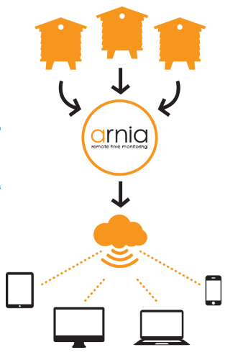
Existing Products
Arnia Remote Hive Monitoring
Measures temperature, humidity, weight, acoustics
No power/wifi needed at the hive
Data transmitted wirelessly from multiple hives to one gateway
Gateway transmits to Arnia Servers using cellular data
Gateway is battery powered

Slide 5
System Specifications
Temperature, humidity, and motion sensors integrated into a standard 10-frame hive
Sensor readings collected every 10 minutes and stored locally
Sensor readings are date and time stamped
Sensor readings are uploaded to a remote monitoring site at least once a day
Hive is located within range of Wi-Fi
Required power is locally generated (solar) and stored in a rechargeable battery
Hive is exposed to and operates in all weather conditions, all day, every day

Slide 6
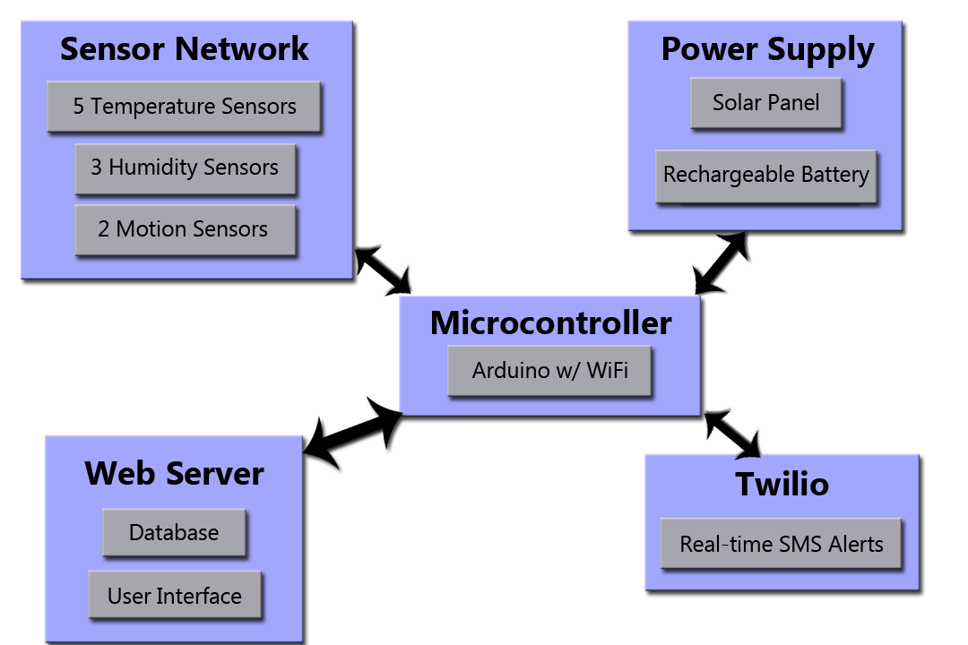
Our Solution: Block Diagram

Slide 7
Subsystem: Microcontroller
Arduino Uno R3 with ESP8266 WiFi module for WiFi access
Collects readings from sensors every 10 minutes
Time stamps readings and stores data temporarily
Arduino Uno has 35 KB of storage
Uploads data to server every day
Sends SMS alerts to users phone based off readings
Must use low power
Attached to outside of hive

Slide 8
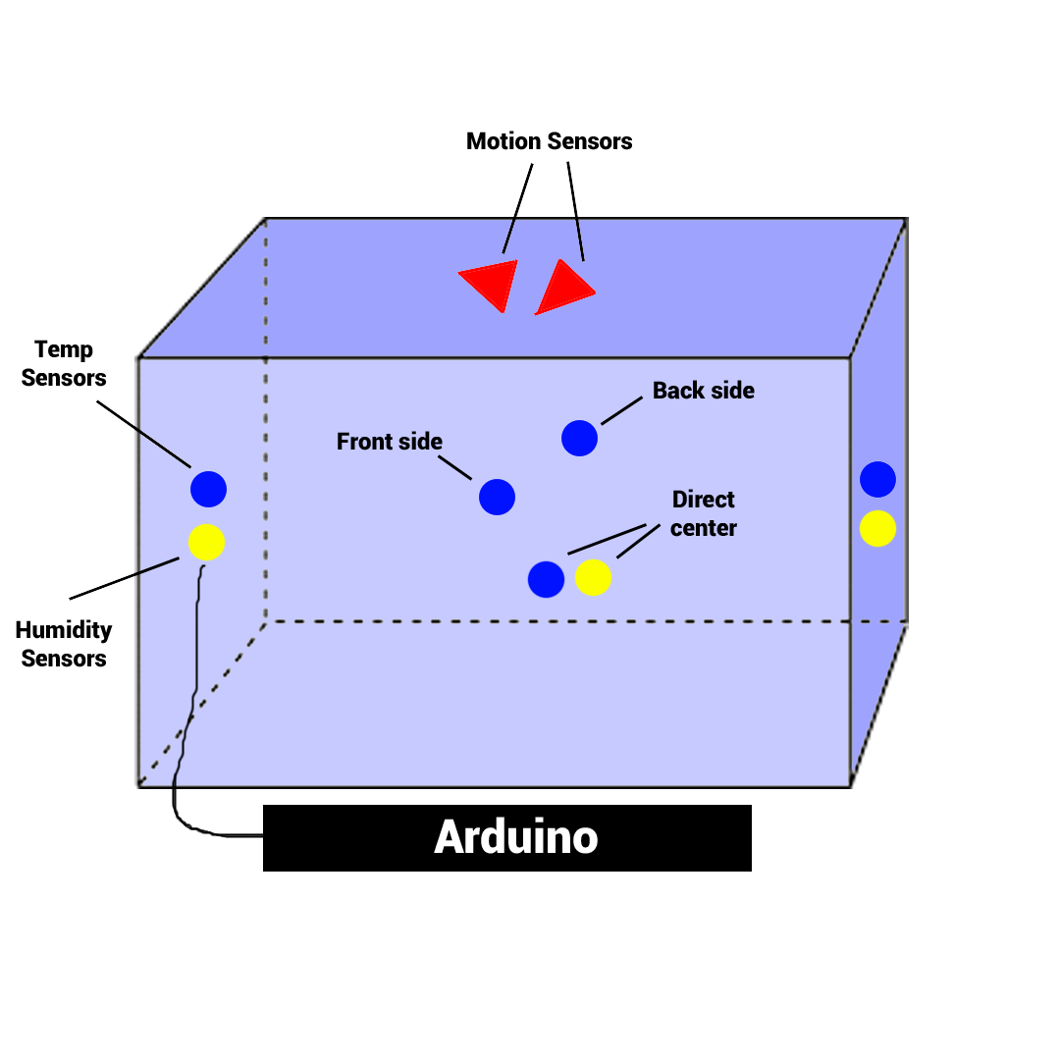
Subsystem: Sensor Network
5 waterproof temperature sensors
3 humidity sensors
2 IR motion sensors on top
Sensors must be accurate
All sensors wired to Arduino
Mean of sensor readings at a location considered for accurate measurements

Slide 9
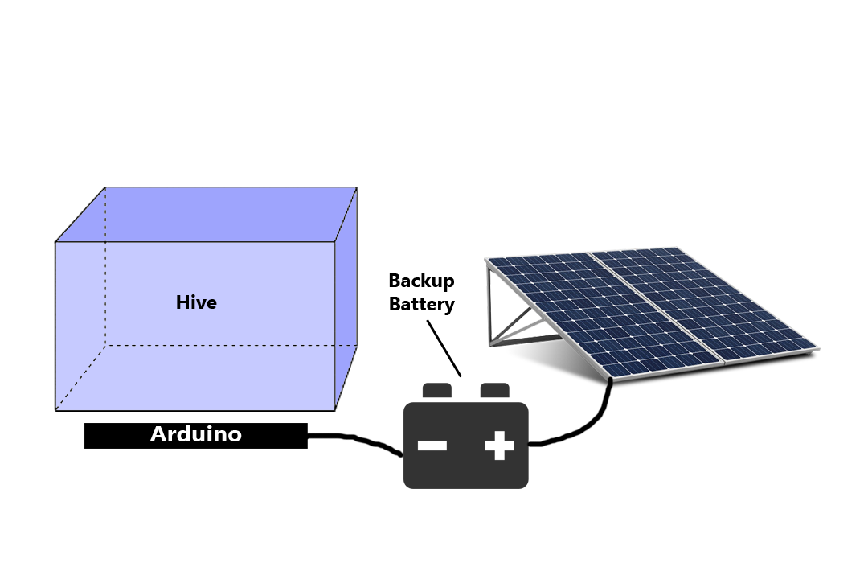
Subsystem: Power Supply
Solar panels will power Arduino
Backup battery for when there’s no sunlight
Must operate at 5 V
Must be constantly powering Arduino
Notes:
Need to calculate how much power the Arduino will draw in order to find right solar panel/battery size

Slide 10
Data Processing and Storage
Arduino Uno has:
32 KB Flash Memory
2 KB SRAM
1 KB EEPROM
ESP8266 WiFi Module also has 1 MB Flash Memory
All sensors come with libraries to work with
Data for each individual sensor is date/time stamped and stored
Data constantly being checked for conditions
Motion of large object detected
Irregular temperature/humidity over long enough period of time

Slide 11
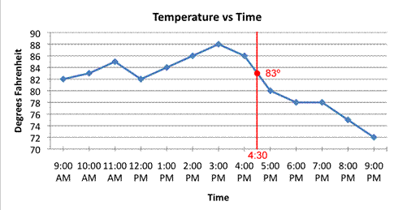
Data Analysis & Alerts
Twilio service used to send real-time SMS alerts
Intruder/security alerts
Irregularities in temperature/humidity
Create a web server using hosting site (HostWinds, HostGator)
Use ESP8266 libraries to upload data to server via WiFi
Data will be uploaded at the end of every day
Create graphs to help visualize data

Slide 12
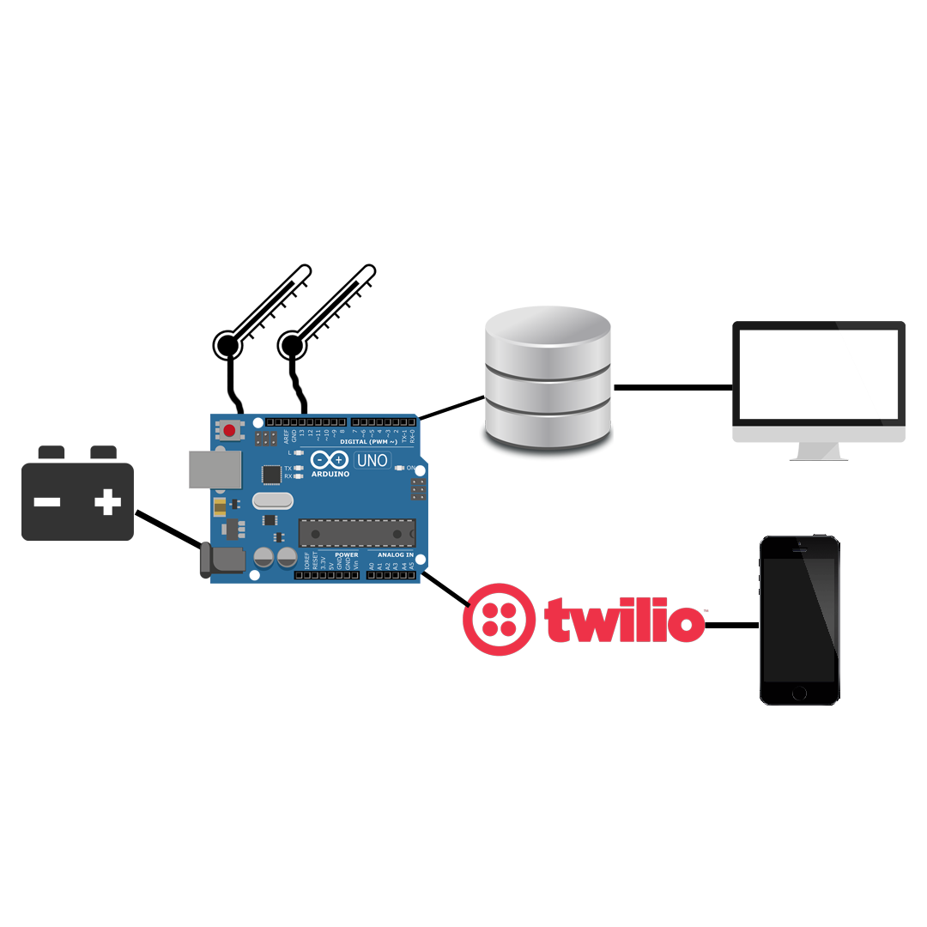
Proposed MDR Deliverables
2 temperature sensors taking readings every 10 minutes, time/date stamped, data then stored on Arduino
Data is able to be uploaded to server and seen on UI
Real-time sms alert caused by increase/decrease in temperature
Prototype of power supply

Slide 13
What We’ll Present At Demo Day
10-frame beehive with sensor network and Arduino
Solar panel with battery pack is powering Arduino
We are able to take temperature and humidity readings, upload them to the web server with WiFi and display graphs of readings over time
Significant changes to temperature/humidity will trigger sms alerts sent to one’s phone
When movement from a large object is sensed, sms alert is triggered

Slide 14
Team Member Responsibilities
Max Aukshunas: Using Twilio API to send SMS alerts, create a web server, upload/manipulate data
Manali Palwankar: Collect data from all sensors, store them in an organized way on Arduino, ready data for transfer
Benjamin Palazzi: Designing/implementing sensor network
Amy Morin: Designing/implementing sensor network
Phuoc Truong: Fabrication lead/connecting power supply
Virginia Ng: Team lead/integrating components

Slide 15
Questions?

