Slide 1
Instrumented Beehive
Team 1:
CSE: Max Aukshunas, Manali Palwankar
MIE: Virginia Ng, Amy Morin, Phuoc Truong, Benjamin Palazzi

Slide 2
Problem Statement
Bees must live in a healthy colony in order to thrive
Very hard to maintain healthy colony when little is known about what goes on in hive
Beekeepers must perform manual inspections to assess colony health
Time and labor consuming
Can only be done at certain times/days of year
Disturbs bees
Varies in accuracy
Replacing 100 million hives is infeasible

Slide 3
Previous System Specifications
Temperature, humidity, and motion sensors integrated into a standard 10-frame hive
Sensor readings collected every 10 minutes and stored locally
Sensor readings are date and time stamped
Sensor readings are uploaded to a remote monitoring site at least once a day
Hive is located within range of Wi-Fi
Required power is locally generated (solar) and stored in a rechargeable battery
Hive is exposed to and operates in all weather conditions, all day, every day

Slide 4
Updated System Specifications
Temperature and humidity sensors can easily be moved within the hive and hive-to-hive
Sensor readings collected every 15 minutes and stored locally
Sensor readings are date and time stamped
Sensor readings are uploaded to a remote monitoring site at least once a day
Hive is located within range of Wi-Fi
Required power is locally generated (solar) and stored in a rechargeable battery
Hive is exposed to and operates in all weather conditions, all day, every day

Slide 5
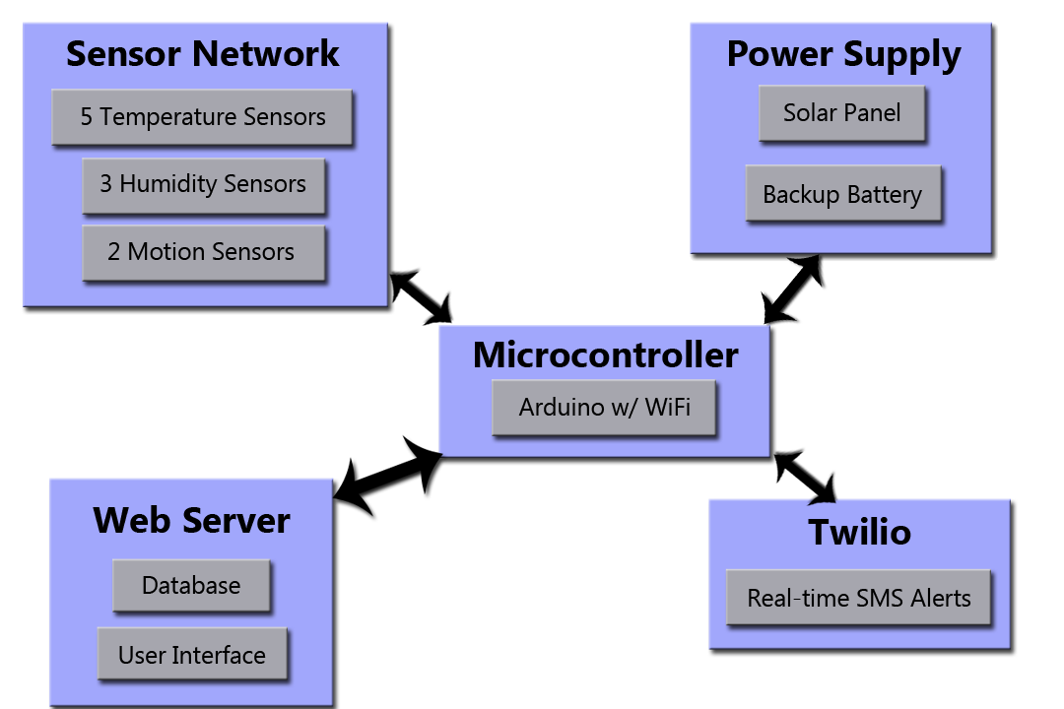
Our Previous Solution:Block Diagram

Slide 6
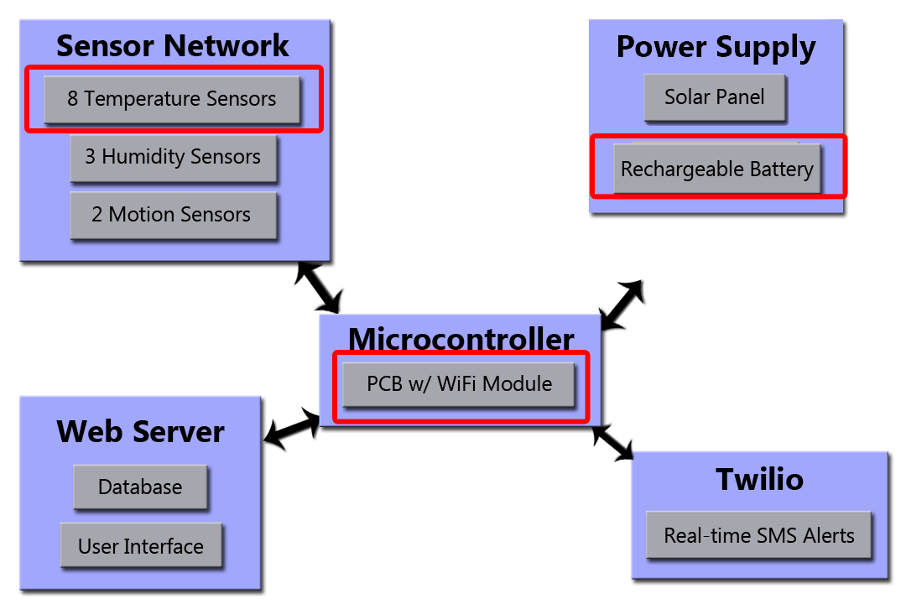
Our Updated Solution: Block Diagram

Slide 7
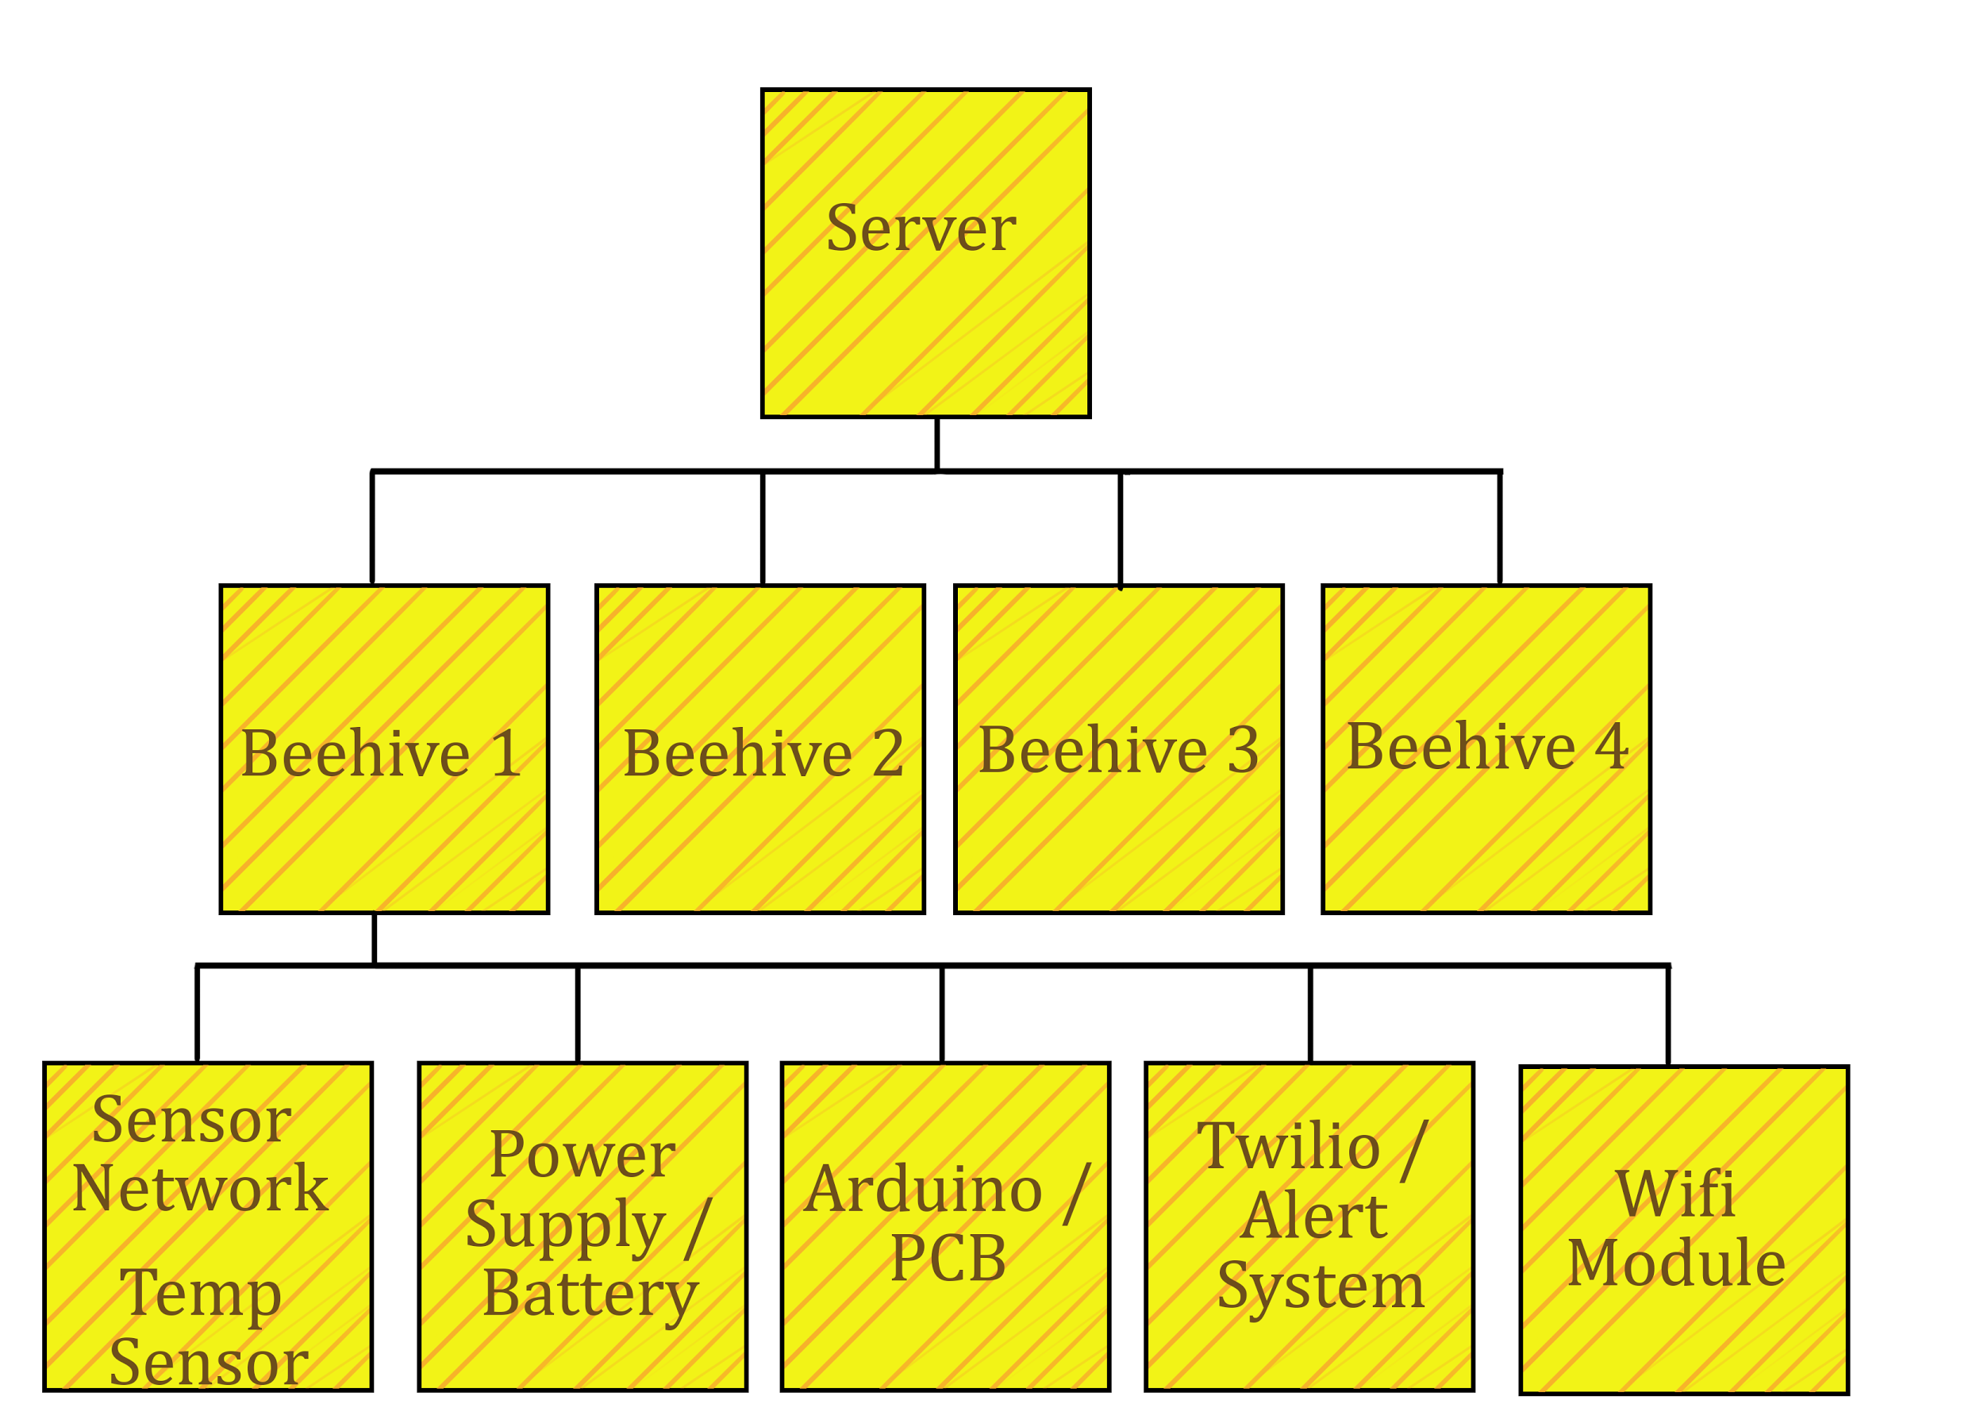
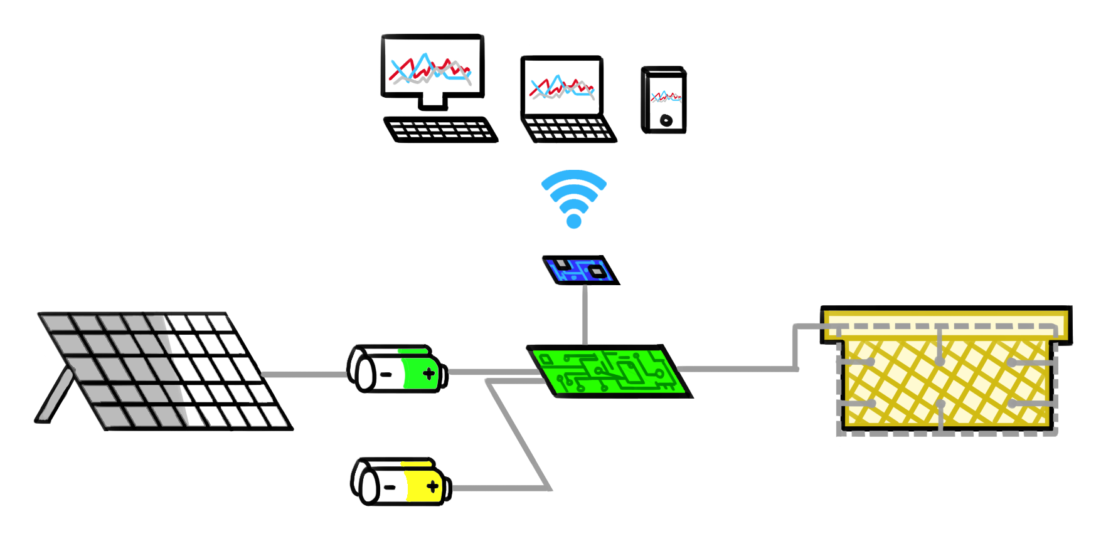
Overview of System

Slide 8
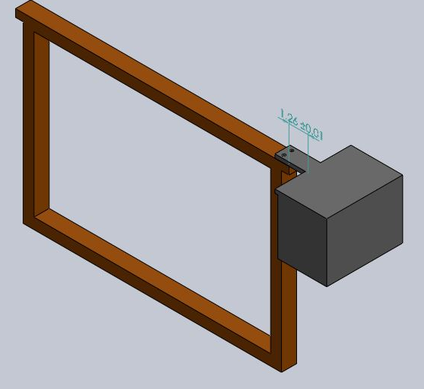
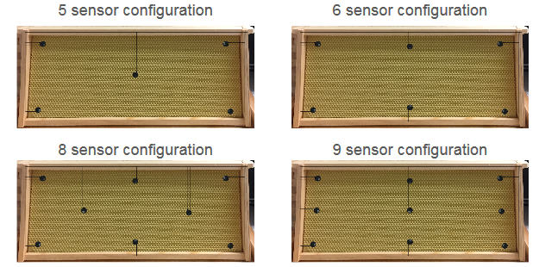
Selected Design Solution
Sensors in empty frame with plastic encasing
Protects sensors from bees
Frame can easily be moved in the hive
Easy to integrate into existing hives
Much cheaper than buying entire new hive

Slide 9
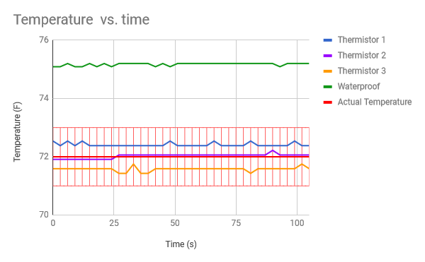
Sensor Tests
Sensor Type
-Thermistor (RTD 1.0K OHM 2SIP)
-Waterproof
-Temperature and Humidity
-Thermistor (RioRand)
Final Decision Sensor
-Thermistor (RTD 1.0K OHM 2SIP)

Slide 10
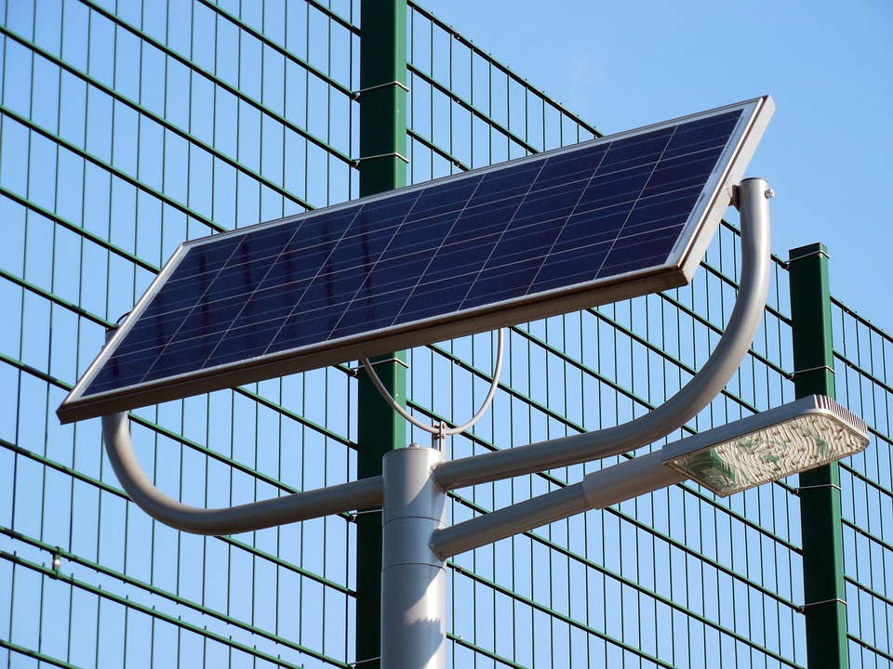

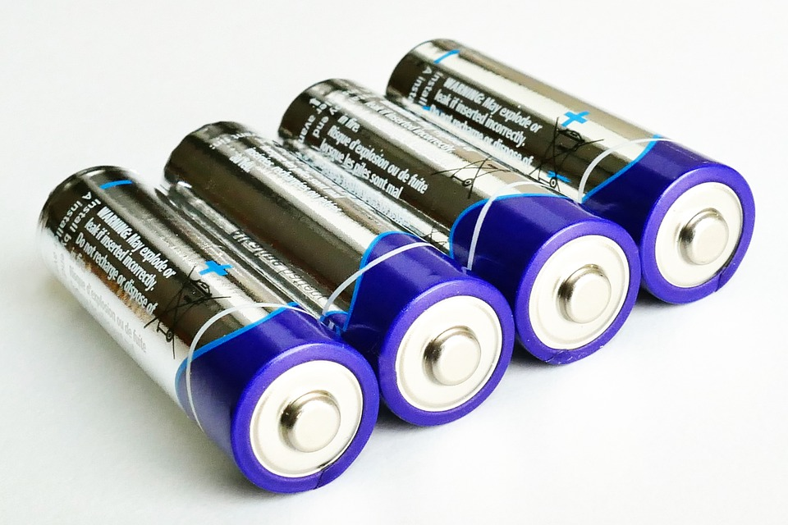
Power Supply and Charging the Battery
Rechargeable battery charged by a 5W rated solar panel
Battery will provide power to the Arduino board
Using a Buck converter to step down unregulated Voltage above 5V to a 5V and 3.3V for Wifi Module
12-15V to 5V Step down conversion
5V rechargeable batteries

Slide 11
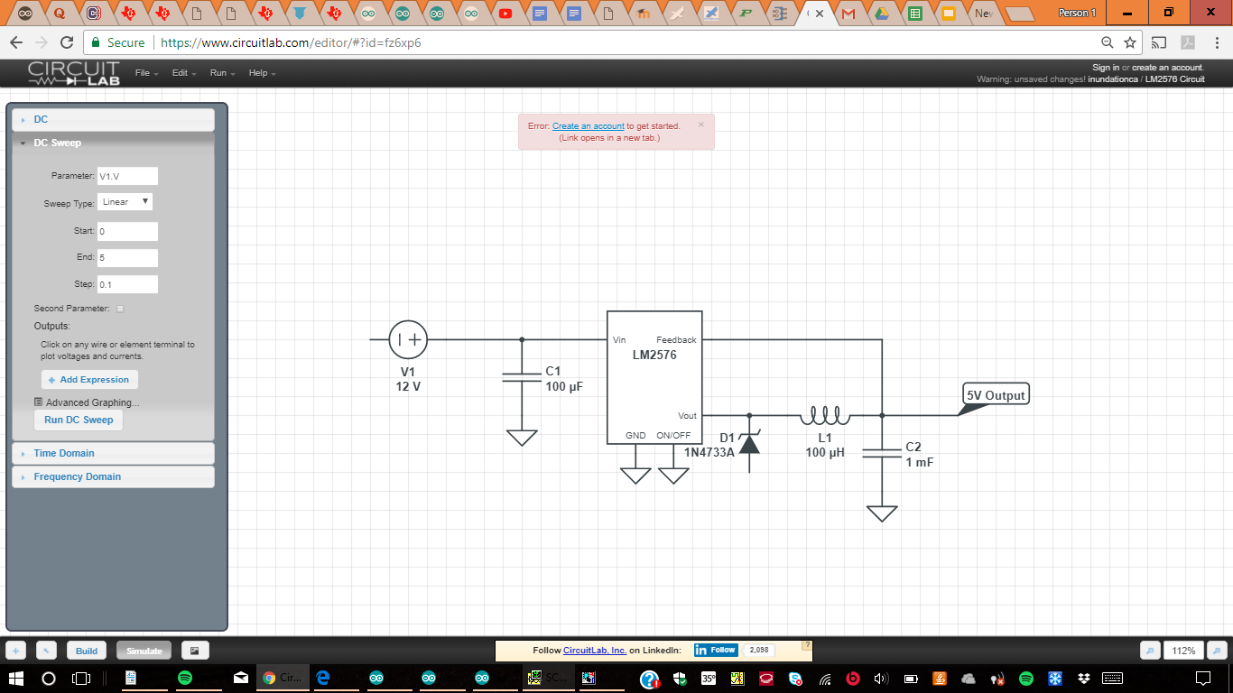
Solar panel and power calculations
LM2576 Buck converter circuit design for voltage regulation
Adjusting the Output voltage from Solar Panel to charge the 5V rechargeable Battery and regulation down to 3.3V for WiFi module
ATMega328 chip draws 25mA current running at 5V, hence it consumes 125mW Power(Max) and WiFi
Draws 320mA at peak
The circuit outputs between
0.7mA up to 3A current
Efficiency of the converter
Is up to 80%

Slide 12
Data Analysis and Alerts
Accomplished:
Website live at http://instrumentedbeehive.website/
Twilio sms alerts can be sent on command
Data can be uploaded, seen in tables
Features to be added:
Accounts
Configure alerts
Customized charts

Slide 13
Team responsibilities
Max Aukshunas: Using Twilio API to send SMS alerts, create a web server, upload/manipulate data
Manali Palwankar:To collect and store data from all sensors,ready data for transfer and Voltage regulation for the power supply
Benjamin Palazzi: Designing/implementing sensor network
Amy Morin: Designing/implementing sensor network
Phuoc Truong: Fabrication lead/connecting power supply
Virginia Ng: Team lead/integrating components

Slide 14
Proposed MDR Deliverables
2 temperature sensors taking readings every 10 minutes, time/date stamped, data then stored on Arduino
Data is able to be uploaded to server and seen on UI
Real-time sms alert caused by increase/decrease in temperature
Prototype of power supply

Slide 15
Proposed CDR Deliverables
Circuit finalized and PCB ordered
Sensor layout finalized and assembled
Rechargeable battery powering Arduino and testing
Backend of website fully functional

Slide 16
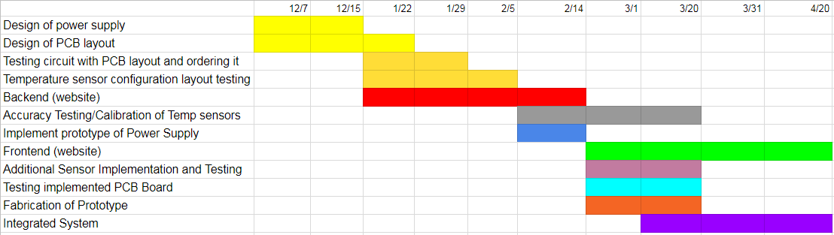
Gantt Chart

Slide 17
Questions?

