Slide 1
Instrumented Beehive
Team 1:
CSE: Max Aukshunas, Manali Palwankar
MIE: Virginia Ng, Amy Morin, Phuoc Truong, Benjamin Palazzi

Slide 2
Problem Statement
Bees must live in a healthy colony in order to thrive
Very hard to maintain healthy colony when little is known about what goes on in hive
Beekeepers must perform manual inspections to assess colony health
Time and labor consuming
Can only be done at certain times/days of year
Disturbs bees
Varies in accuracy
Replacing 100 million hives is infeasible

Slide 3
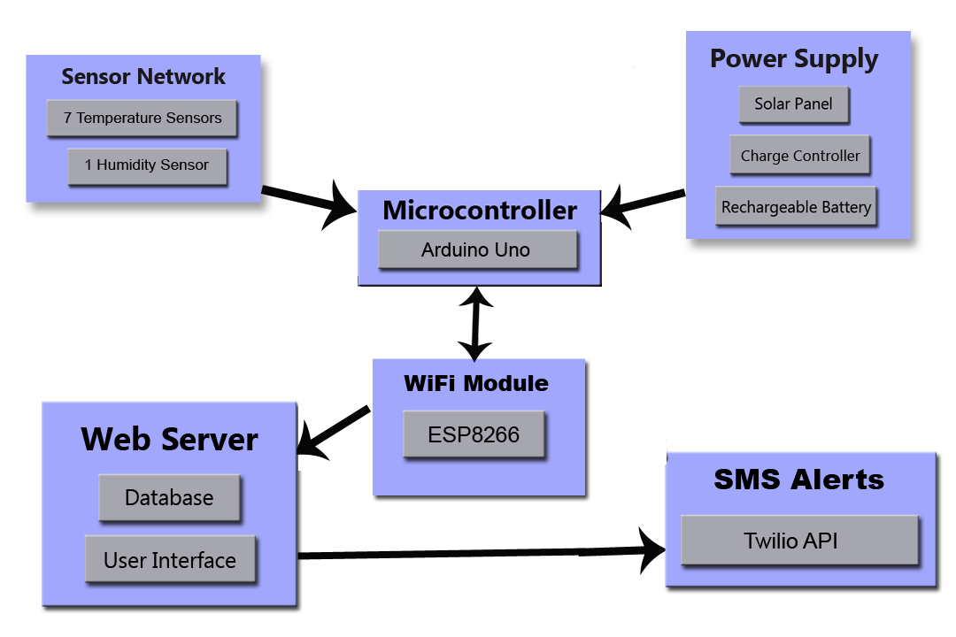
Block Diagram

Slide 4
Final Specifications
Temperature and humidity sensors can easily be moved within the hive and hive-to-hive
Sensor readings collected every 15 minutes
Sensor readings are date and time stamped
Sensor readings are uploaded to a remote monitoring site at least once a day
Hive is located within range of WiFi
Required power is locally generated (solar) and stored in a rechargeable battery
Hive is exposed to and operates in all weather conditions, all day, every day and can run without sunlight for up to 13 days

Slide 5
Software Functionality
Alerts
Moving average, trending, battery level
All customizable (values/status)
Customization
Phone number
Delay
Features
Current levels (battery/sensors)
Time period graphs
Individual points and metrics

Slide 6
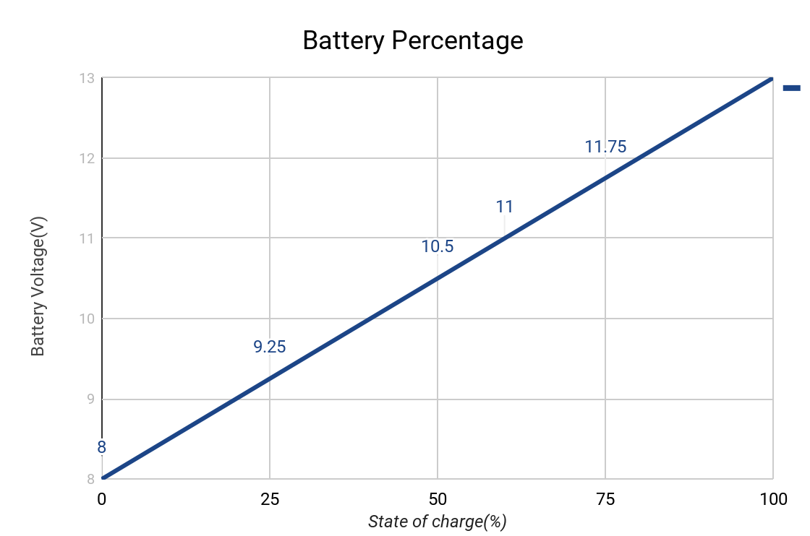
Battery Percentage
Battery is at 100% when it outputs 13V
Minimum threshold is 8V where charge controller stops outputting current
System sends alert when Battery percentage is 25%, i.e. 9.25V

Slide 7
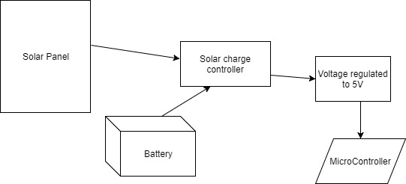
Final Power Supply Design and analysis
Lead acid Battery 13V
Solar Panel at 12V-22V output voltage
Solar Charge controller-PWM prevents overcharging and monitors charge of the battery
Current system can run for 13 days without power
As soon as Solar panel outputs enough power, Battery will charge and system will resume

Slide 8
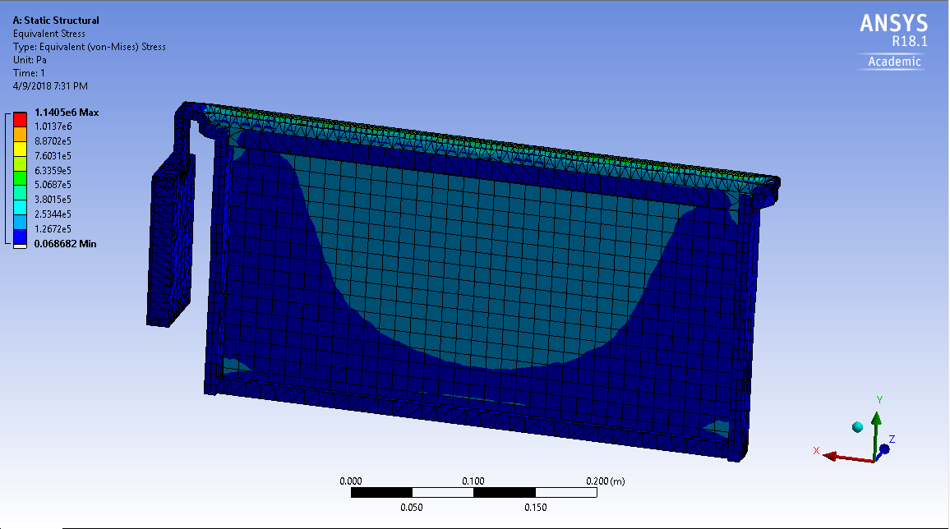
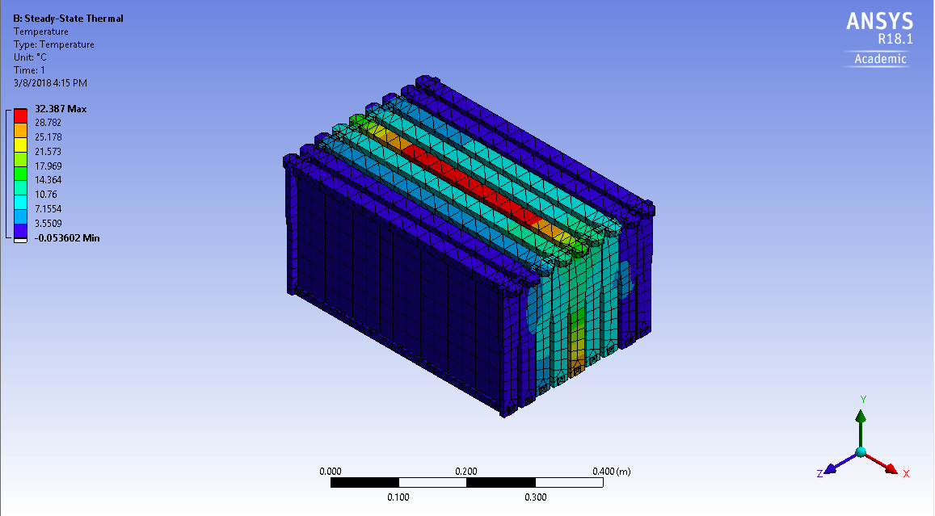
Structural and Thermal Analysis
Structural
Thermal
Static structural analysis with the applied weight of another beehive onto only the hinge shows the stress is much below the yield stress of ABS 3D printing material
Steady-state thermal analysis done at different outside temperatures, including bee heat generation in brood, to confirm the theoretical distribution in previous bee research
Notes:
ANSYS deets: structural- fixed support constraints on top, bottom, and sides of panel, with a 222N force applied across the hinge because that is the weight of a 50lb beehive (if it was stacked) and it is 22x below the yield stress of the ABS
Thermal: changed outside temperatures while inserting a constant heat generation from the bees (only occurs in winter/ below 18degC) to check the distribution of the generation around the brood. Here the brood was simulated as the middle panel as opposed to a ball in the middle just for modeling purposes, same concept, same amount of bee wattage and distribution

Slide 9
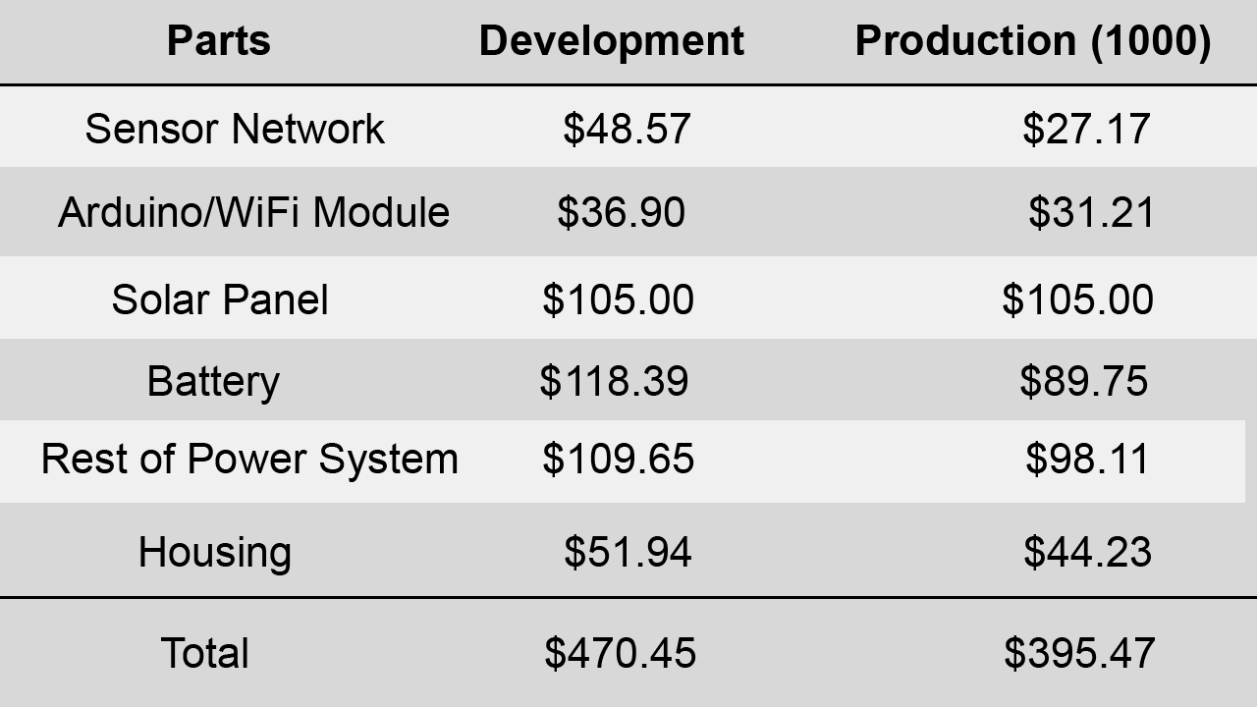
Cost Analysis

Slide 10
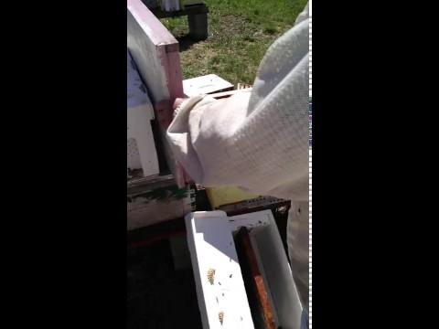
Field Test

Slide 11
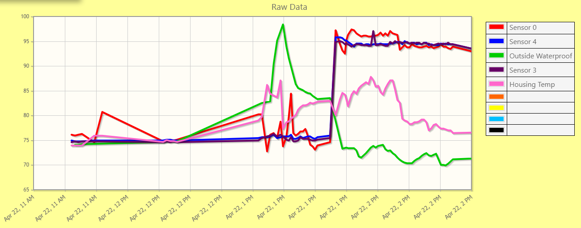
Field Test Results

Slide 12
Team Responsibilities
Max Aukshunas: Data collection/upload/manipulation, developing website, alert system
Manali Palwankar: Power analysis and assembly, Voltage regulation, Battery percentage, PCB design
Benjamin Palazzi: Designing/implementing sensor network, 3D modeling and printing
Amy Morin: Designing and implementing sensors, ANSYS modeling, circuitry work
Phuoc Truong: Fabrication lead/connecting power supply
Virginia Ng: Team lead/integrating components, PCB design

Slide 13
FPR Deliverables
Local storage in case of upload failures
Alerts regarding battery percentage ✔
Website backend is error-free ✔
Appealing user interface ✔
Arduino replaced with PCB
Entire power system working ✔
Sensors on frame of hive ✔

Slide 14
Demo

Slide 15
Questions?

