Slide 1
Instrumented Beehive
Team 1:
CSE: Max Aukshunas, Manali Palwankar
MIE: Virginia Ng, Amy Morin, Phuoc Truong, Benjamin Palazzi

Slide 2
Problem Statement
Bees must live in a healthy colony in order to thrive
Very hard to maintain healthy colony when little is known about what goes on in hive
Beekeepers must perform manual inspections to assess colony health
Time and labor consuming
Can only be done at certain times/days of year
Disturbs bees
Varies in accuracy
Replacing 100 million hives is infeasible

Slide 3
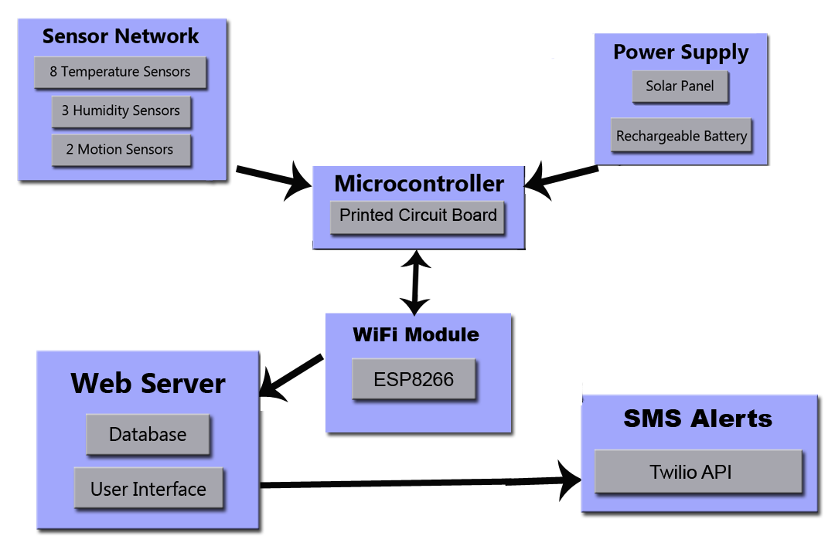
Block Diagram

Slide 4
System Specifications
Temperature and humidity sensors can easily be moved within the hive and hive-to-hive
Sensor readings collected every 15 minutes and stored locally
Sensor readings are date and time stamped
Sensor readings are uploaded to a remote monitoring site at least once a day
Hive is located within range of Wi-Fi
Required power is locally generated (solar) and stored in a rechargeable battery
Hive is exposed to and operates in all weather conditions, all day, every day and can run without sunlight for upto a week

Slide 5
Power Analysis
We plan to keep the system running for 7 days without a solar panel charging the battery
ATMega 2560 and Arduino would use maximum current about 0.3A
Total Energy needed, (24x7)hx0.3A-->49Ah
Our Battery provides 13V of output voltage
We used LM340 voltage regulator to limit the current upto maximum 1A and provide an output voltage of 5V to the board but a serial voltage regulator has limitations and power loss is (Vout-Vin)*1A=(12-5)V*1A=7W

Slide 6
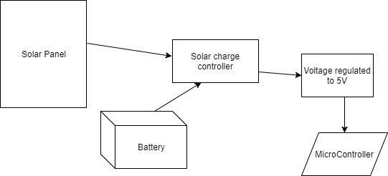
Solar Power Supply Prototype
Lead Acid Battery 55AH, 13V
Solar Panel at 12V output voltage
Solar Charge controller-PWM prevents overcharging and monitors charge of the battery
Microcontroller-Arduino Uno or PCB board using ATMEGA2560

Slide 7
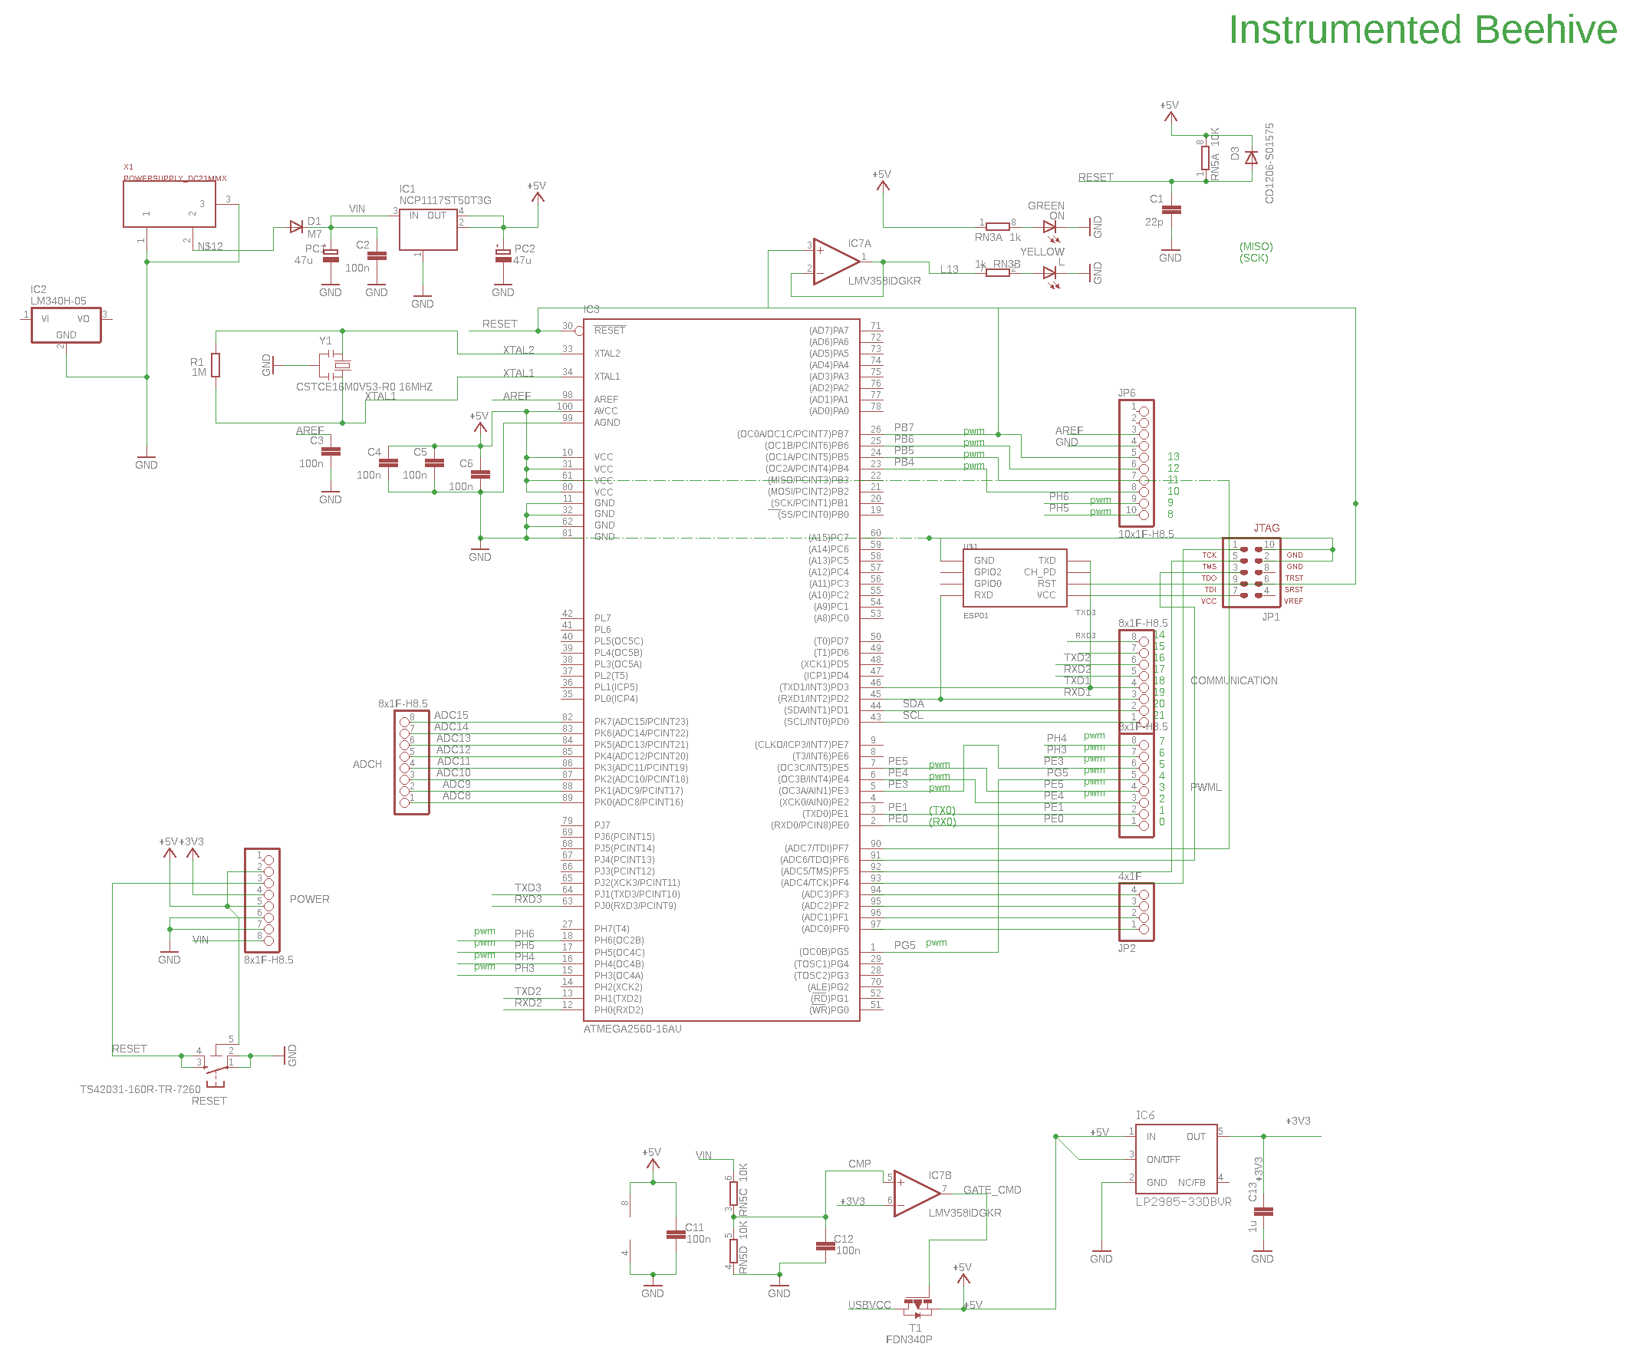
PCB Design and SPICE simulations
Schematic customized
by adding WiFi module,
JTAG header and
voltage regulation
Original Schematic provided by Arduino included USB to serial converter
Decision to switch to a
Switching regulator due
to power loss and
heat dissipation

Slide 8
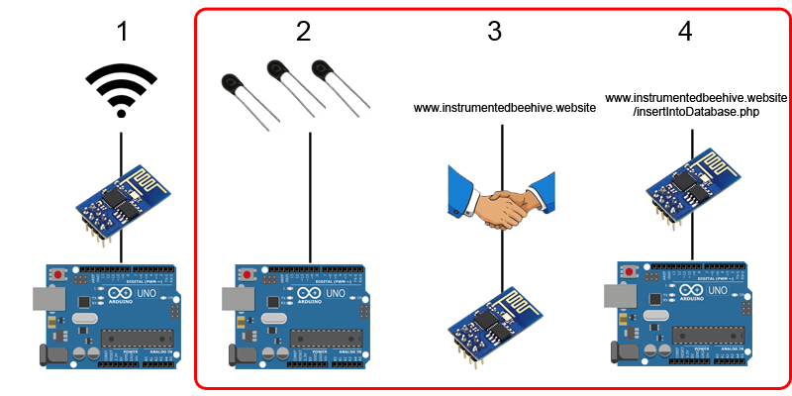
Data Recording & Upload
9 sensors
Readings every 15 minutes
Data sent immediately

Slide 9
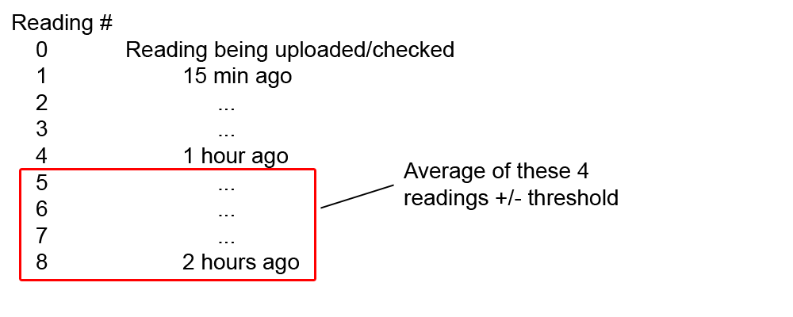
Twilio Alerts
Currently 1 alert set up (moving average)
Checked during upload
Can be customized

Slide 10
Data Manipulation & Analysis
Current temperature
Graphs of any sensor during any time period
All data points during chosen time period
Sensor metrics for each sensor

Slide 11
CDR Deliverables
Circuit finalized and PCB ordered
Sensor layout finalized and assembled
Rechargeable battery powering Arduino and testing
Backend of website fully functional

Slide 12
Demo

Slide 13
Team Responsibilities
Max Aukshunas: Use Twilio API to send SMS alerts, create a web server, upload/manipulate data
Manali Palwankar: Collect data, analyze power requirements and Assembling Power Supply, regulate input voltage to PCB, PCB design
Benjamin Palazzi: Designing/implementing sensor network
Amy Morin: Designing/implementing sensors, thermo modeling
Phuoc Truong: Fabrication lead/connecting power supply
Virginia Ng: Team lead/integrating components

Slide 14
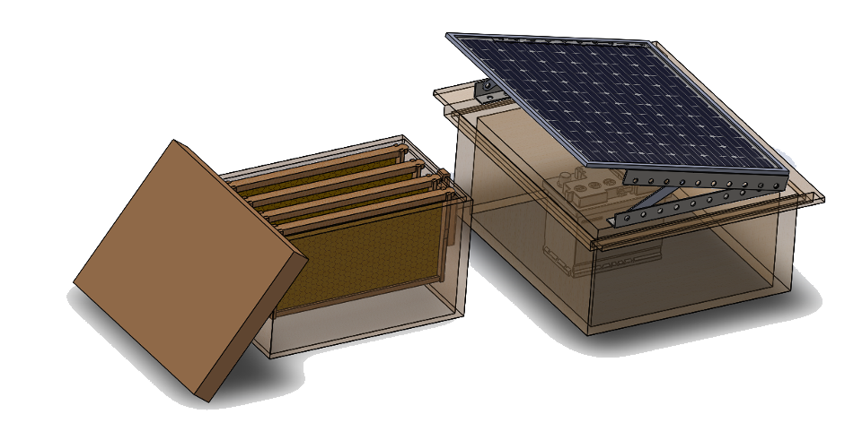
Proposed FDR deliverables
Local storage in case of upload failure
Website backend is error-free
Appealing user interface
Arduino replaced with PCB
Entire power system working
Sensors on frame of hive

Slide 15
Questions?

