Slide 1







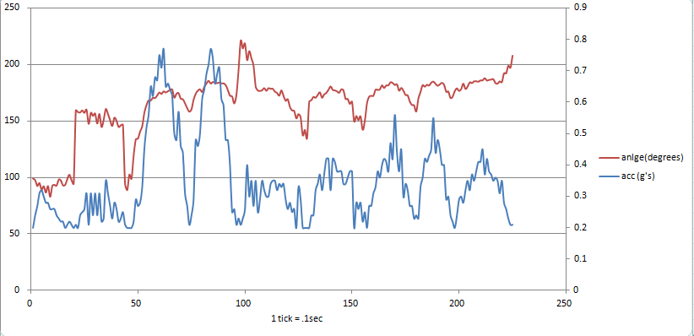

SmartWheel
Yaroslav Burdin, Jack Tam, Bingjun Wang, Bingze Li
Faculty Advisor: Prof. Lixin Gao
Abstract
System Overview
SmartWheel is primarily a parent automobile control system which allows you to monitor and record your child’s driving habits based on the acceleration of the vehicle. The driving records are available both through the local web server and the smartphone application. It provides information such as a car’s speed, acceleration, and location history. Moreover, in case of a potential emergency, the system grants a real time alert through mobile text messaging.
The overall system includes two main subsystems: SmartWheel Box and Home Box. SmartWheel Box is a device that is located in the child’s car, and is used to obtain the driving behavior based on the car’s speed and acceleration. If acceleration exceeds certain threshold, the SmartWheel Box automatically sends the text message alert to the parent. The Home Box is a local data server that automatically collects the data obtained by the SmartWheel Box when the car is in the radius of the server. The driving history of the child is available through the website and the smartphone application.
Results
Block Diagram
The high resolution 3-axis accelerometer allowed to compute the car’s acceleration vector, that is used to obtain the car’s nature of motion: rapid acceleration, rapid deceleration, possible car collision. The SmartWheel system provides the device’s misposition detection, which sends a notification message if the SmartWheel Box is not fixed in the steady state. Moreover, the SmartWheel Box is able to detect couple types of dangerous turns: sharp turns on the low speed, gradual turns on the high speed.
SmartWheel Box: Accelerometer and GPS module detect acceleration, speed, and location in real time. Sends text message in real-time to SmartPhone. Writes history data in text file and sends to server when it connects to the internet.
Home Box (Server): Store history data, hold Website User interface and communicate with SmartPhone application.
SmartPhone (Application): Plot the points from text message and data server in map.
The graph of the rough data of the acceleration vector components: magnitude (acceleration) and direction (angle, i.e. 90 degrees: forward acceleration)
Specifications
Acknowledgement
Specification | Value
Dimensions | 11.5x8.5x4.5 cm^3
Weight | 340 grams
Battery Life | 16 hours
Unit Price | <$120
Text Message Alert Delay | < 10 seconds
Storage Capacity | 14 days of driving
Server Connection Radius | >70 meters in open area; > 32.5 meters with a wall in between.
The SmartWheel was supported by Professor Lixin Gao who provided insight and expertise that greatly assisted the project.We would also like to show our gratitude to Professor Maciej Ciesielski and Professor William Leonard for feedback that greatly improved the SmartWheel.
We are also immensely grateful to Jesse Cafarelli, Sergio Cunha, Benjamin Miller and Ray Paradis for sharing their ideas and wisdom with us during the course of this project.
Department of Electrical and Computer Engineering
ECE 415/ECE 416 – SENIOR DESIGN PROJECT 2017
College of Engineering - University of Massachusetts Amherst
SDP17

Slide 2
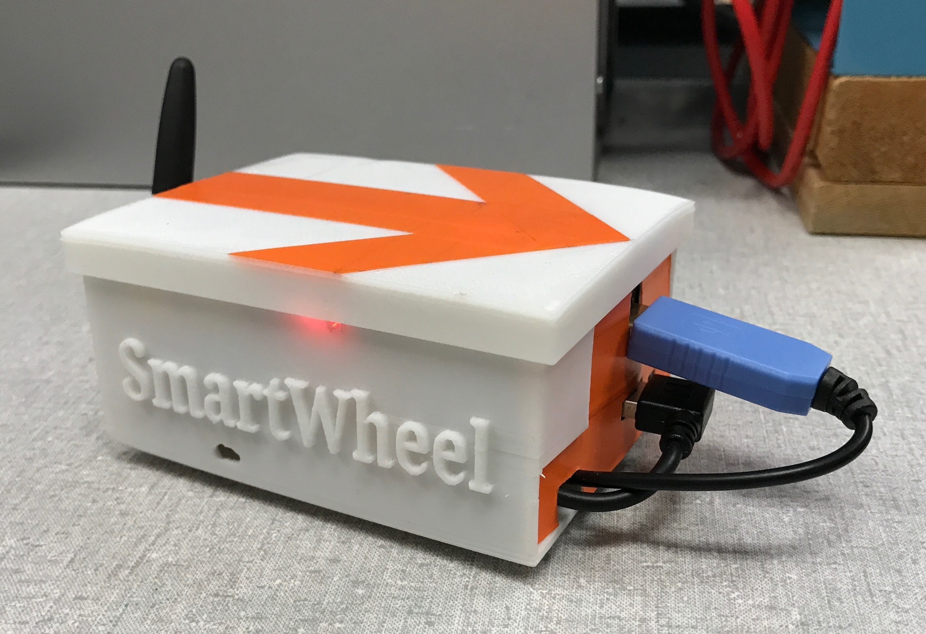
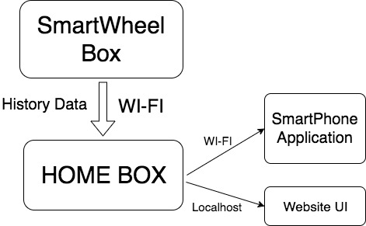
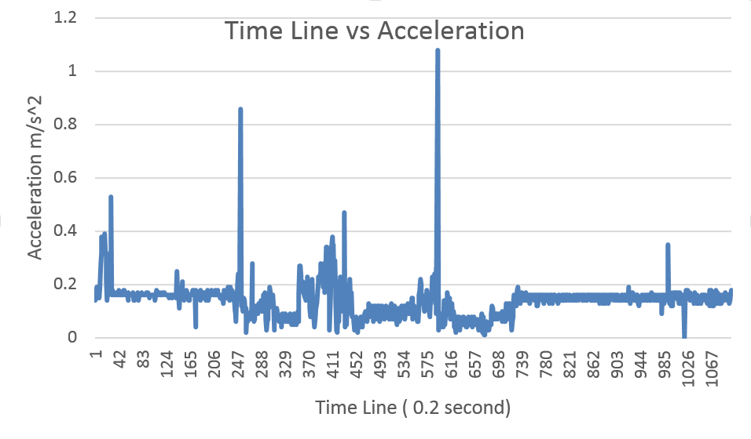
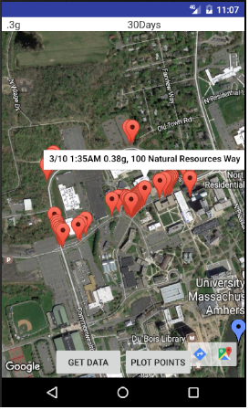
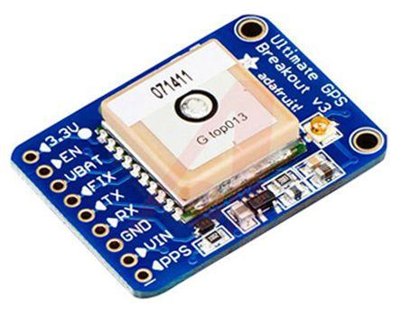
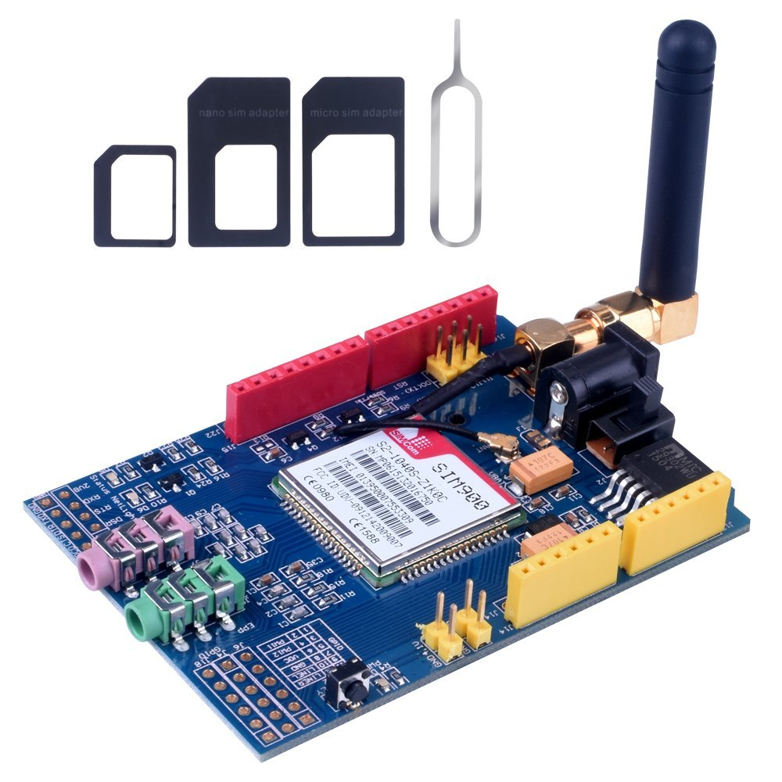
SmartWheel Box
Home Box:
Home Box is a local data server that runs on home laptops or PCs
History data transferred as text file format to Server with WI-FI connection.
Phone app could read data from server with WI-FI connection
A simple Website User Interface could plot the History Data
Microprocessor record data from two sensors (Accelerometer and GPS Sensor), store data and send text message through GSM Module.
Accelerometer:
Sample graph plotted on the Website
ADXL345 is 3-axis accelerometer chosen for the project due to its low power consumption, extended industrial temperature range (-55°C to +105°C), and small dimensions. It is used to measure the dynamic acceleration resulted from car’s motion. Since accelerometer is an important component of the system, it provides high resolution, allowing to compute car’s acceleration vector.
SmartPhone Application
Automatically plots point from last message received from car box, shown in blue
Get data button collects and processes data from servers
Two drop down menus to choose maximum acceleration and time frame
Plot points button plot all points above the acceleration chosen and within the selected number of days in red.
Each point shows the date, time, acceleration, and address at that point.
GPS Sensor
The GPS sensor that we are using is from Adafruit. It requires a 5V DC input voltage and only draws 20mA current which saves a lot of power. The chip has a maximum of 10 Hz for data updating. It provides the coordinates and speed parameter that we need in our project.
Experiment
GSM Module
To test the system, we fixed the SmartWheel box in the car so that it doesn’t move around. We found relatively empty parking lots and roads and drove around normally at first. We then experimented with the text alert system by purposefully accelerating, decelerating, and turning too fast. If the acceleration was higher than a set limit, a designated phone number should receive a text message.
Once the message is received on the phone, the phone application is used to automatically plot the points on the map. We then compare the location of the plotted points to where we were when the message was sent. To make sure the information is correct, we had a laptop in the car that was monitoring the latitude, longitude, and acceleration sampled from the box the entire time.
Afterwards, the SmartWheel Box is moved within the range of the router and automatically connected to the server in order to transfer collected data. We would then open up the application and use the data to plot the points on the map. After tracing the path we took and compared it with the points plotted in the application, in order to make sure that the data gathered by the SmartWheel box is correct
Data immediately accessible
Reliable data sent to cell phone from SmartWheel
Communication Between SmartWheel and cell phone
Private communication
Cost
Development
Production
Part | Price
Accelerometer | 1.19
GPS sensor | 35.95
Raspberry Pi 3 | 35
GSM | 13.78
Cable | 16.94
Battery | 16.99
Total | 119.85
Part | Price
Accelerometer | 0.89
GPS sensor | 15.95
Microprocessor | 3.05
GSM | 13.78
Battery | 7.95
PCB | 11.95
Transistors | 8
Total | 60.12

