Slide 1
Preliminary Design Review
Flying Universal Gripper
October 18, 2016
Advisor: Weibo Gong
Notes:
‹#›
‹#›
‹#›
‹#›

Slide 2



Flying Universal Gripper
Timothy MacMannis
CSE
Peter May
CSE
Noah Smith
EE
Zachary Roy
EE
Advisor: Weibo Gong
Notes:
‹#›
‹#›
‹#›
‹#›

Slide 3

The Problem: Buried In Trash
Effects of litter across the globe are reaching detrimental levels
Decomposing trash threatens the integrity of soil and drinking water
Estimated that 18 percent of litter eventually makes its way into streams, rivers and oceans
Advisor: Weibo Gong
Notes:
‹#›
‹#›
‹#›
‹#›
http://environment.about.com/od/pollution/a/litter.htm
https://www.reference.com/science/litter-problem-827544dc4b7db4a6#
https://scienceleadership.org/blog/littering_and_its_effect_on_the_environment

Slide 4
The Problem (Continued)
Trash not only hurts the environment but also poses as a serious safety hazard
It is estimated that 25,000 car accidents each year are a result of litter on roads
Litter is also extremely dangerous to animals who can accidently swallow pieces of plastic and other trash materials
Advisor: Weibo Gong
Notes:
‹#›
‹#›
‹#›
‹#›

Slide 5
Effect on Groups/Individuals
Areas like river coast lines, are common places where bottles from boaters constantly get discarded, ruining part of the outdoor experience.
Promotes more people to litter when they already see trash on the ground.
Advisor: Weibo Gong
Notes:
Mantis drone claw cannot release gathered objects
Waste disposals teams are expensive, tought to find resources of people

Slide 6
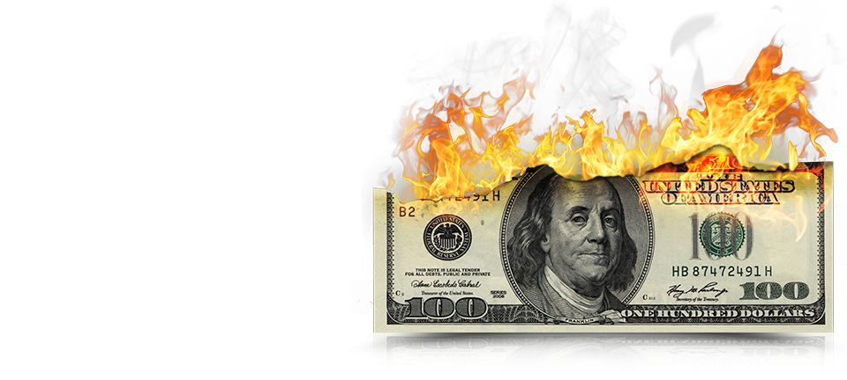
The Problem (Continued)
The United States spends an estimated 11.5 billion dollars on litter cleanup every year.
Advisor: Weibo Gong
Notes:
‹#›
‹#›
‹#›
‹#›

Slide 7
Problem Requirements
A litter collecting entity
Ability to operate in inaccessible places
Easy to deploy
Low Cost
Outputs
A cleaner safer environment
Happier population

Slide 8
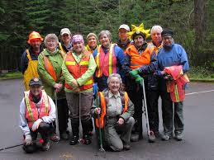
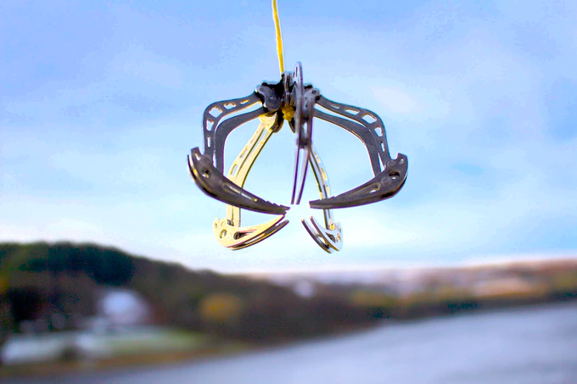
Design Alternatives
Waste Disposal team
Community cleaning gatherings
MANTIS Drone Claw
Advisor: Weibo Gong
Notes:
Mantis drone claw cannot release gathered objects
Waste disposals teams are expensive, tought to find resources of people

Slide 9
Our Solution: Flying Universal Gripper!
Use a drone to quickly and easily access hard to reach areas.
Employ granular jamming to pick up objects of different shapes and orientations
Can automatically navigate to objects on the ground using advanced sensor and software techniques
Advisor: Weibo Gong

Slide 10
Project Specifications
Find and fly to objects autonomously
Pick up complex shapes
Able to lift up to 5lbs
20 minute flight time
Durable frame
Less than $500
Advisor: Weibo Gong
Notes:
6 min

Slide 11
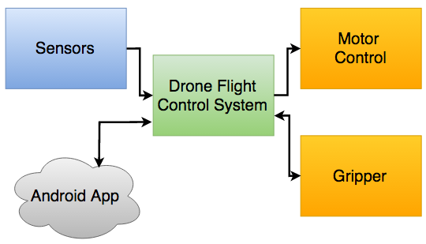
High Level Block Diagram
Advisor: Weibo Gong
Notes:
Jim

Slide 12
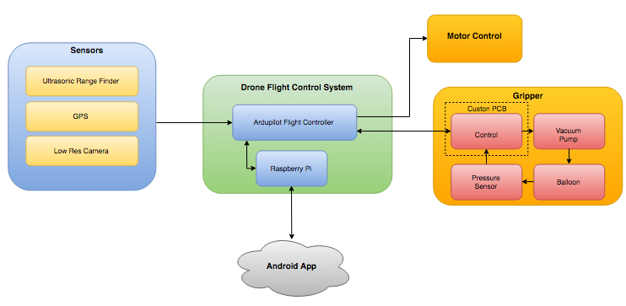
Detailed Level Block Diagram
Advisor: Weibo Gong
Notes:
Tim

Slide 13
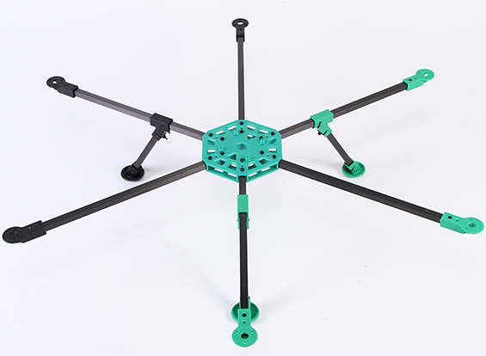
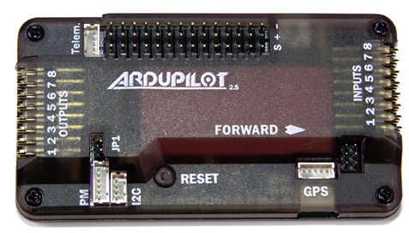
The Drone
Frame
Lightweight and modular
Easily mount all electronics and the gripping device
6 motors for increased stability and safety
Ardupilot Programmable Flight Controller
Based on Arduino Mega Architecture
Image Processing
GPS enabled
Autonomous flight paths with external sensors and inputs
Advisor: Weibo Gong
Notes:
Tim

Slide 14
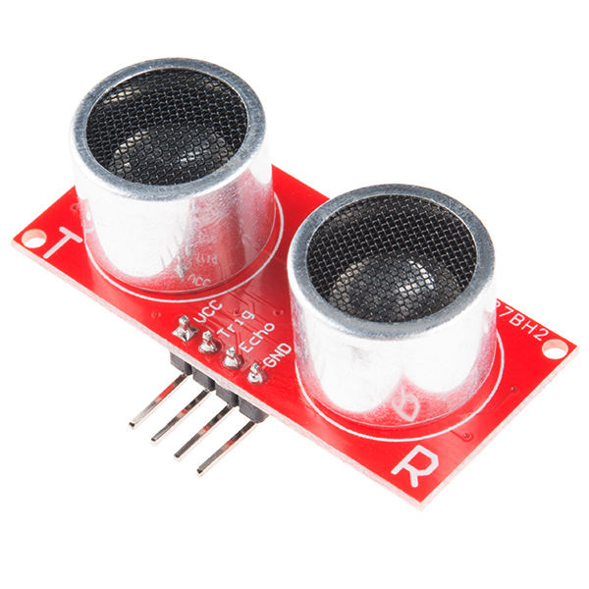
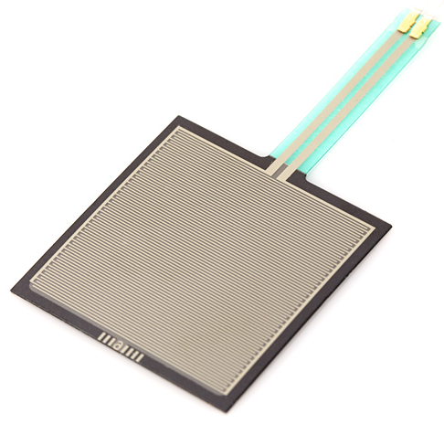
Sensors
Ultrasonic Range Finder
  Altitude Control
  Obstacle Avoidance
Gripper Pressure Sensor
  PSI monitor for gripper
  Detect Object in gripper
GPS module
Low Res Camera
Advisor: Weibo Gong
Notes:
Tim

Slide 15
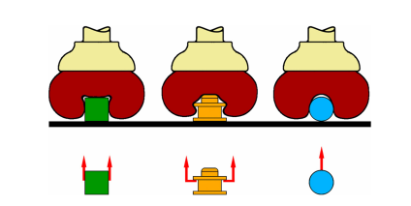
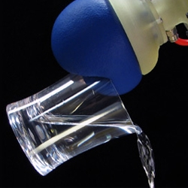
Granular Jamming
How Does it Work?
Granular material (coffee grounds)
Elastic membrane (balloon)
Vacuum used to modulate jamming transition
3 types of gripping results
  Friction
  Constraining
  Vacuum suction
Advantages over other grippers:
Passive vs. Active
Low cost
https://www.eng.yale.edu/brown/ABRJL12.pdf
Advisor: Weibo Gong

Slide 16
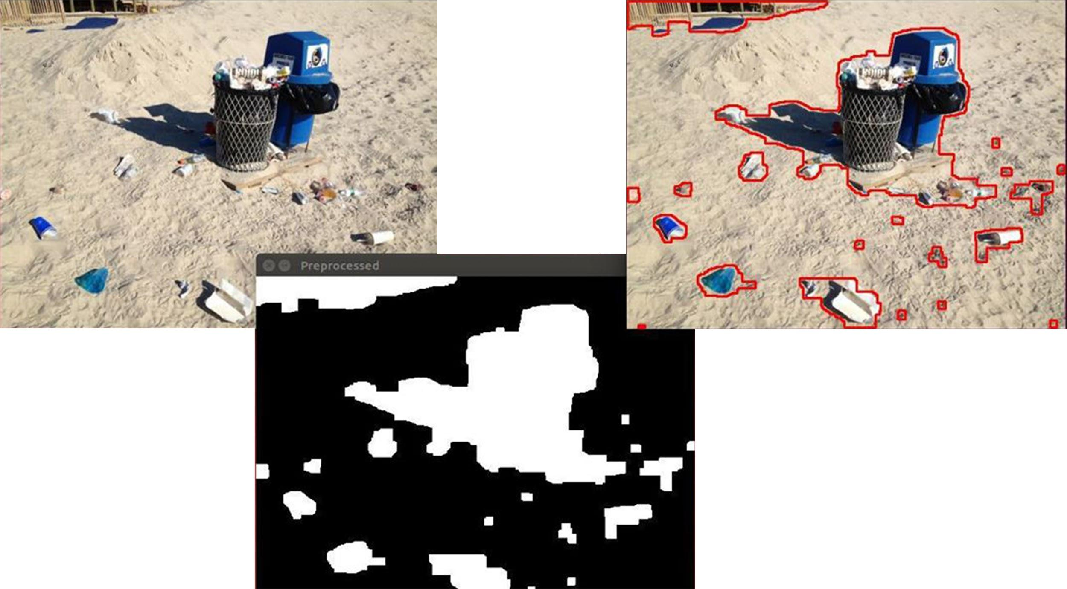
Computer Vision
Identify objects while hovering over them
Guide the drone to objects on the ground
Guide gripper to object after landing
Advisor: Weibo Gong

Slide 17
Computer Vision (Continued)
Drone Tracking Algorithms
OpenCV
Template Matching
Color Detection
Stereo vision
Advisor: Weibo Gong

Slide 18

Android App
Inputs From User
Set start coordinates
Set search radius
Set search pattern
Launch drone
Manual release
Return home
Outputs From Drone
Altitude
Ground speed
Battery life
Current coordinates
Advisor: Weibo Gong

Slide 19
Parts and Estimated Cost List
Drone
  Body: $30
  Electronics/sensors: $200 - $300
  Flight controller: $50
Gripper: $30
Vacuum Pump: $20
Raspberry Pi: $27
PCB: $50
Total: $407 - $507
Advisor: Weibo Gong

Slide 20
MDR Deliverables
Drone assembled and tested
Functional gripper built and tested
Integrated drone and gripper prototype
Demonstration of picking up object remotely
Create beta app
Advisor: Weibo Gong

Slide 21
Questions or Comments?
Advisor: Weibo Gong

