Slide 1
Midway Design Review
Flying Universal Gripper
December 6th, 2016
Advisor: Weibo Gong
Notes:
‹#›
‹#›
‹#›
‹#›

Slide 2



Flying Universal Gripper
Timothy MacMannis
CSE
Peter May
CSE
Noah Smith
EE
Zachary Roy
EE
Advisor: Weibo Gong
Notes:
‹#›
‹#›
‹#›
‹#›

Slide 3
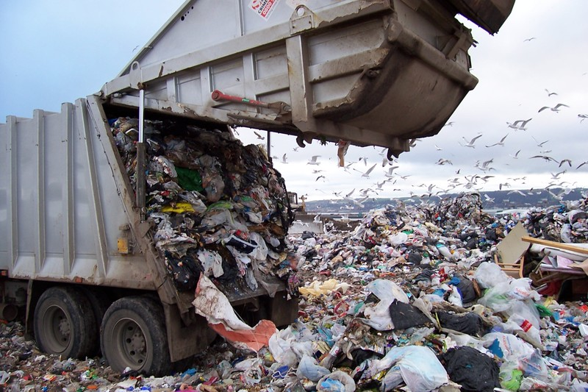
The Problem
Trash accumulates over time if not picked up and disposed of
It can be near impossible to pick up trash in hard to reach or hazardous areas.
Advisor: Weibo Gong
Notes:
Zach

Slide 4
The Project
Use a drone to quickly and easily access hard to reach areas.
Employ granular jamming to pick up objects of different shapes and orientations
Can automatically navigate to objects on the ground using advanced sensor and software techniques
Advisor: Weibo Gong
Notes:
Zach

Slide 5
The Project Specifications
Find and fly to objects autonomously
Pick up various complex shapes
Able to lift up to 5lbs
20 minute flight time
Durable frame
Less than $500
Advisor: Weibo Gong
Notes:
Zach

Slide 6
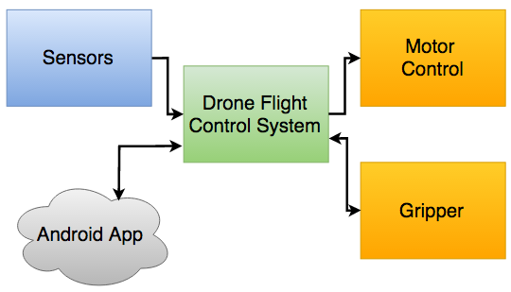
High Level Block Diagram
Advisor: Weibo Gong
Notes:
Pete

Slide 7
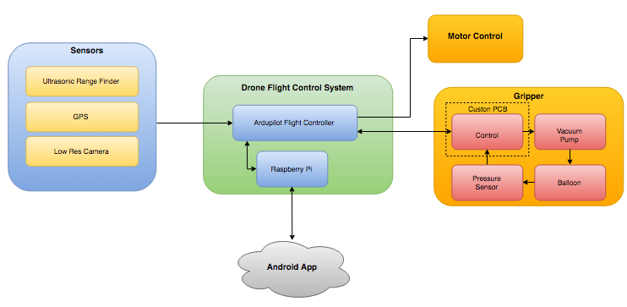
Detailed Block Diagram
Advisor: Weibo Gong
Notes:
Pete

Slide 8
Detailed Block Diagram
Notes:
Pete

Slide 9
Proposed MDR Deliverables
Drone assembled and tested
-Tim and Peter
Functional gripper built and tested
-Noah and Zach
Integrated drone and gripper prototype
-All
Demonstration of picking up object remotely
-All
Design beta app
Advisor: Weibo Gong
Notes:
Pete

Slide 10
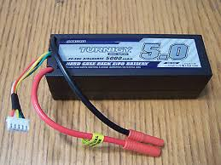
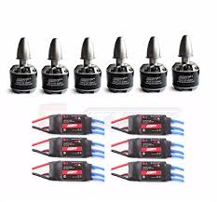
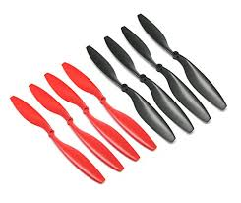
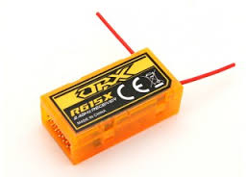
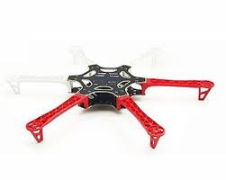
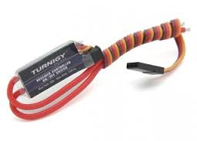
Drone Parts
Advisor: Weibo Gong
Notes:
Tim

Slide 11
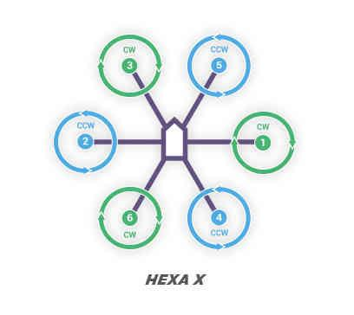
The Drone-Motor Configuration
Advisor: Weibo Gong
Notes:
Tim

Slide 12
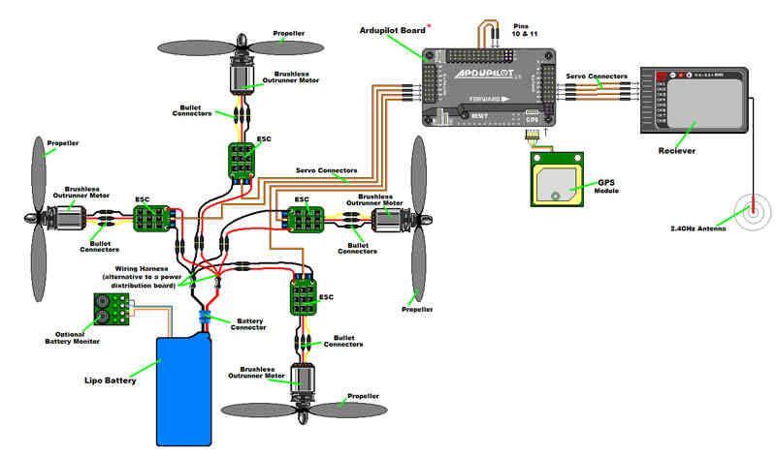
The Drone-Wiring
Advisor: Weibo Gong
Notes:
Tim

Slide 13
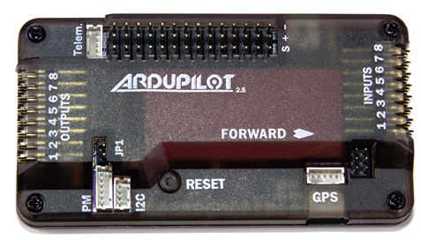
Drone Flight
The flight controller allows for a steady and controlled flight.
  Goal of the project is to have a slow and stable craft that can accurately navigate
Each motor provides 850g of thrust
Total thrust is 5100g
Total weight of drone without gripper system 1500g with gripper 2100g
Ideal thrust to weight ratio is 2:1
Advisor: Weibo Gong
Notes:
Tim

Slide 14
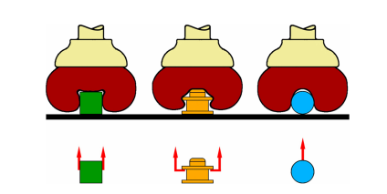
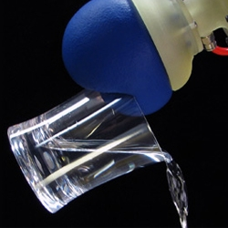
Granular Jamming
How Does it Work?
Granular material (coffee grounds)
Elastic membrane (balloon)
Vacuum used to modulate jamming transition
3 types of gripping results
  Friction
  Constraining
  Vacuum suction
Advantages over other grippers:
Passive vs. Active
Low cost
https://www.eng.yale.edu/brown/ABRJL12.pdf
Advisor: Weibo Gong
Notes:
Noah

Slide 15
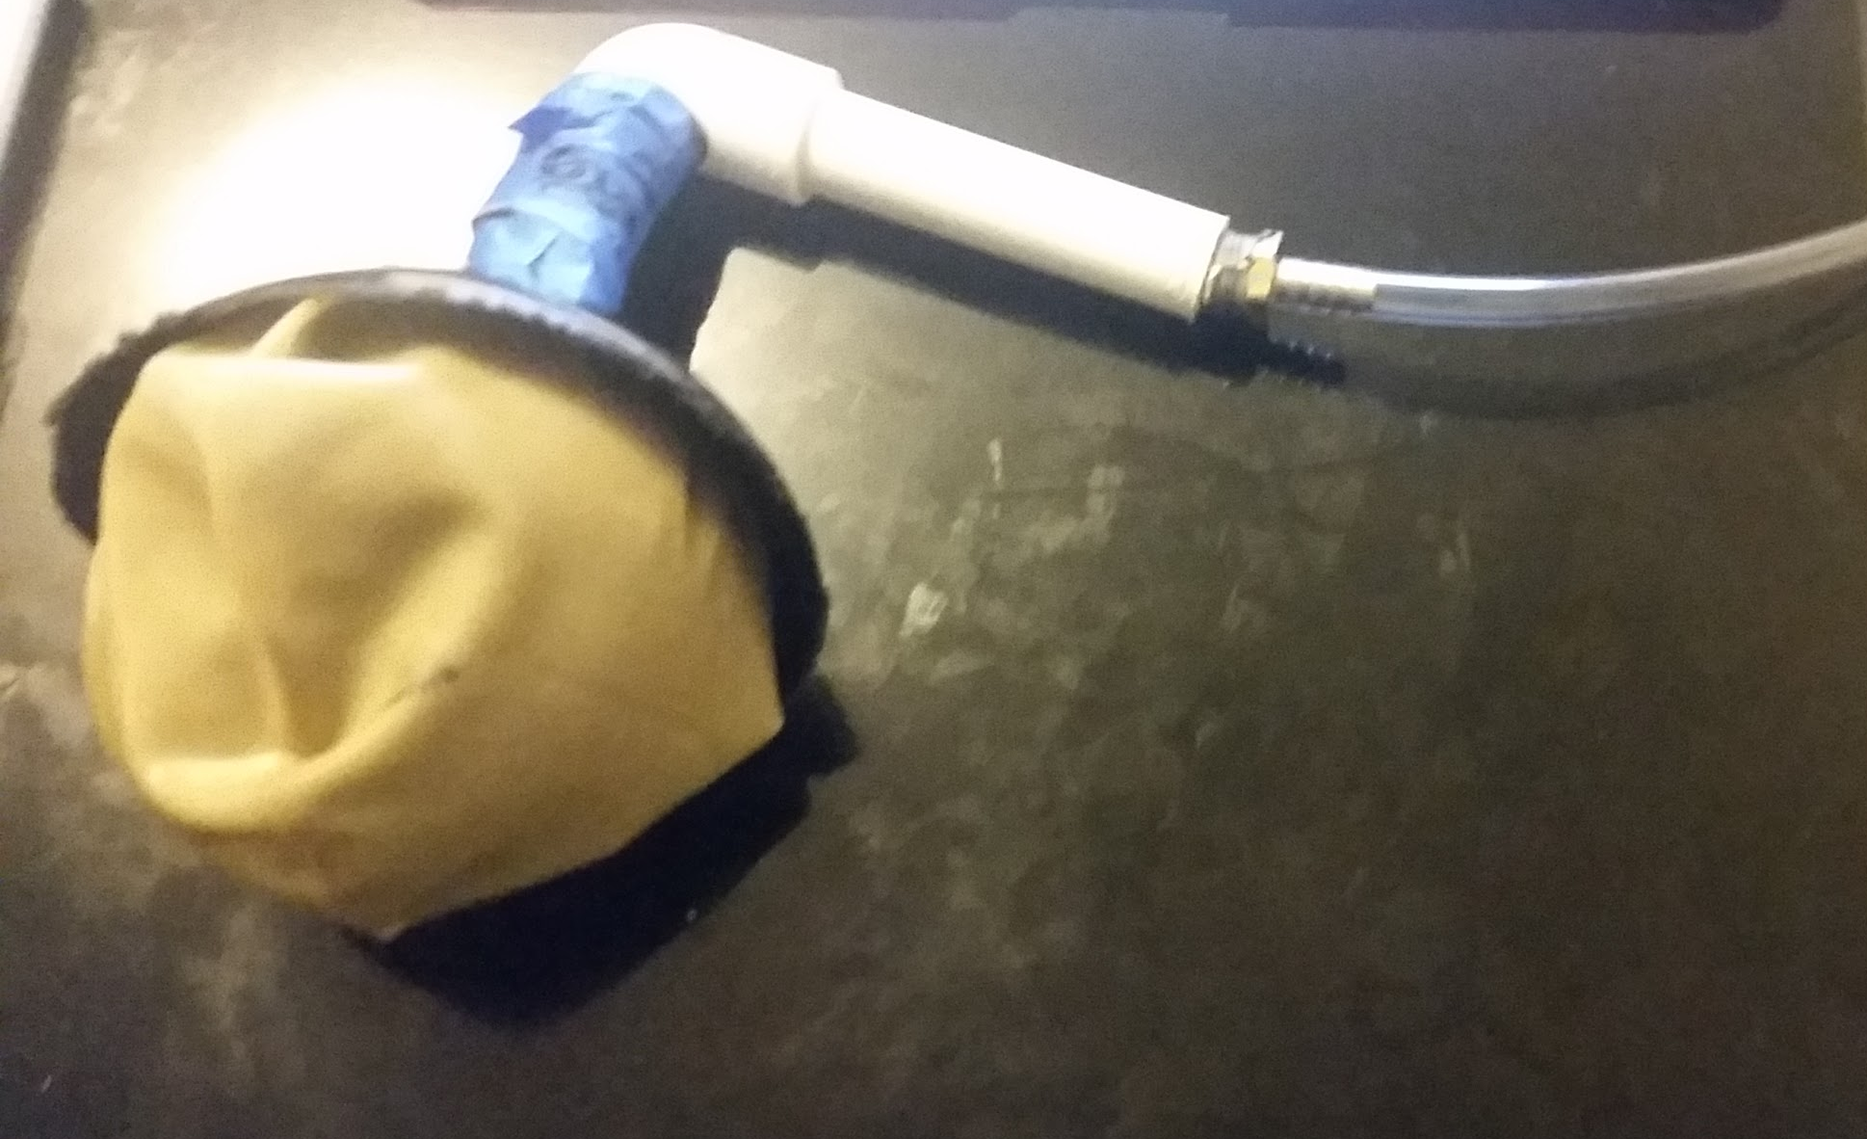

Our Gripper
Used a Large Funnel
18 inch balloon
Fine coffee grains to fill balloon
PVC tubing
Metal connectors
Flexible ⅛” tubing
12V Vacuum
Advisor: Weibo Gong
Notes:
Noah

Slide 16
Our Gripper-Mount
Mount 300g 12V vacuum on top of drone
Attach Remote Relay Switch to Vacuum that is triggered by controller
Use reducing coupler to increase size of tubing
PVC elbow to angle gripper perpendicular to drone
Attach Latex balloon filled with coffee to plastic collar
Collar attached to larger PVC piping
Bolted the Gripper system to bottom of drone frame
Advisor: Weibo Gong
Notes:
Noah

Slide 17
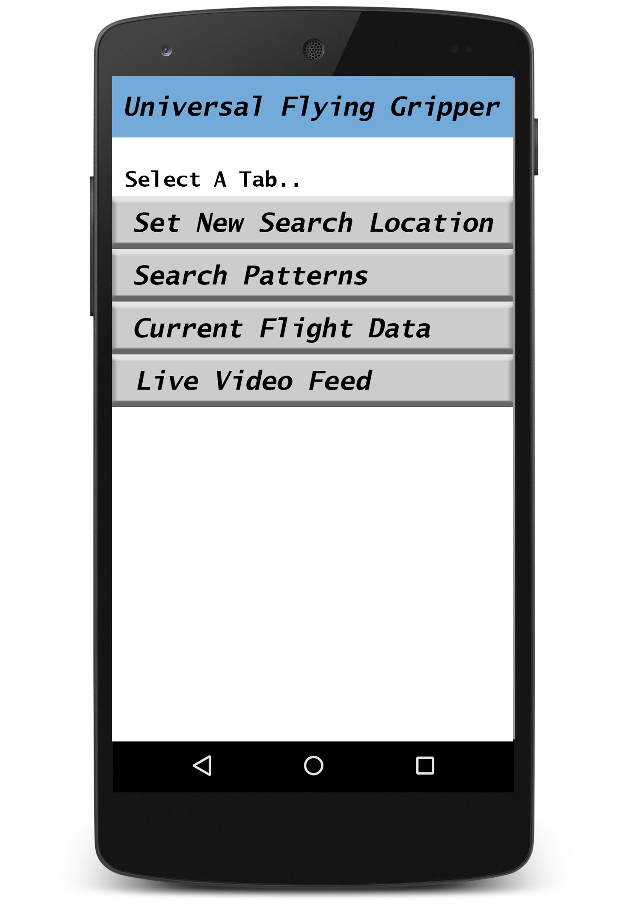

Android App
Advisor: Weibo Gong
Notes:
Zach

Slide 18
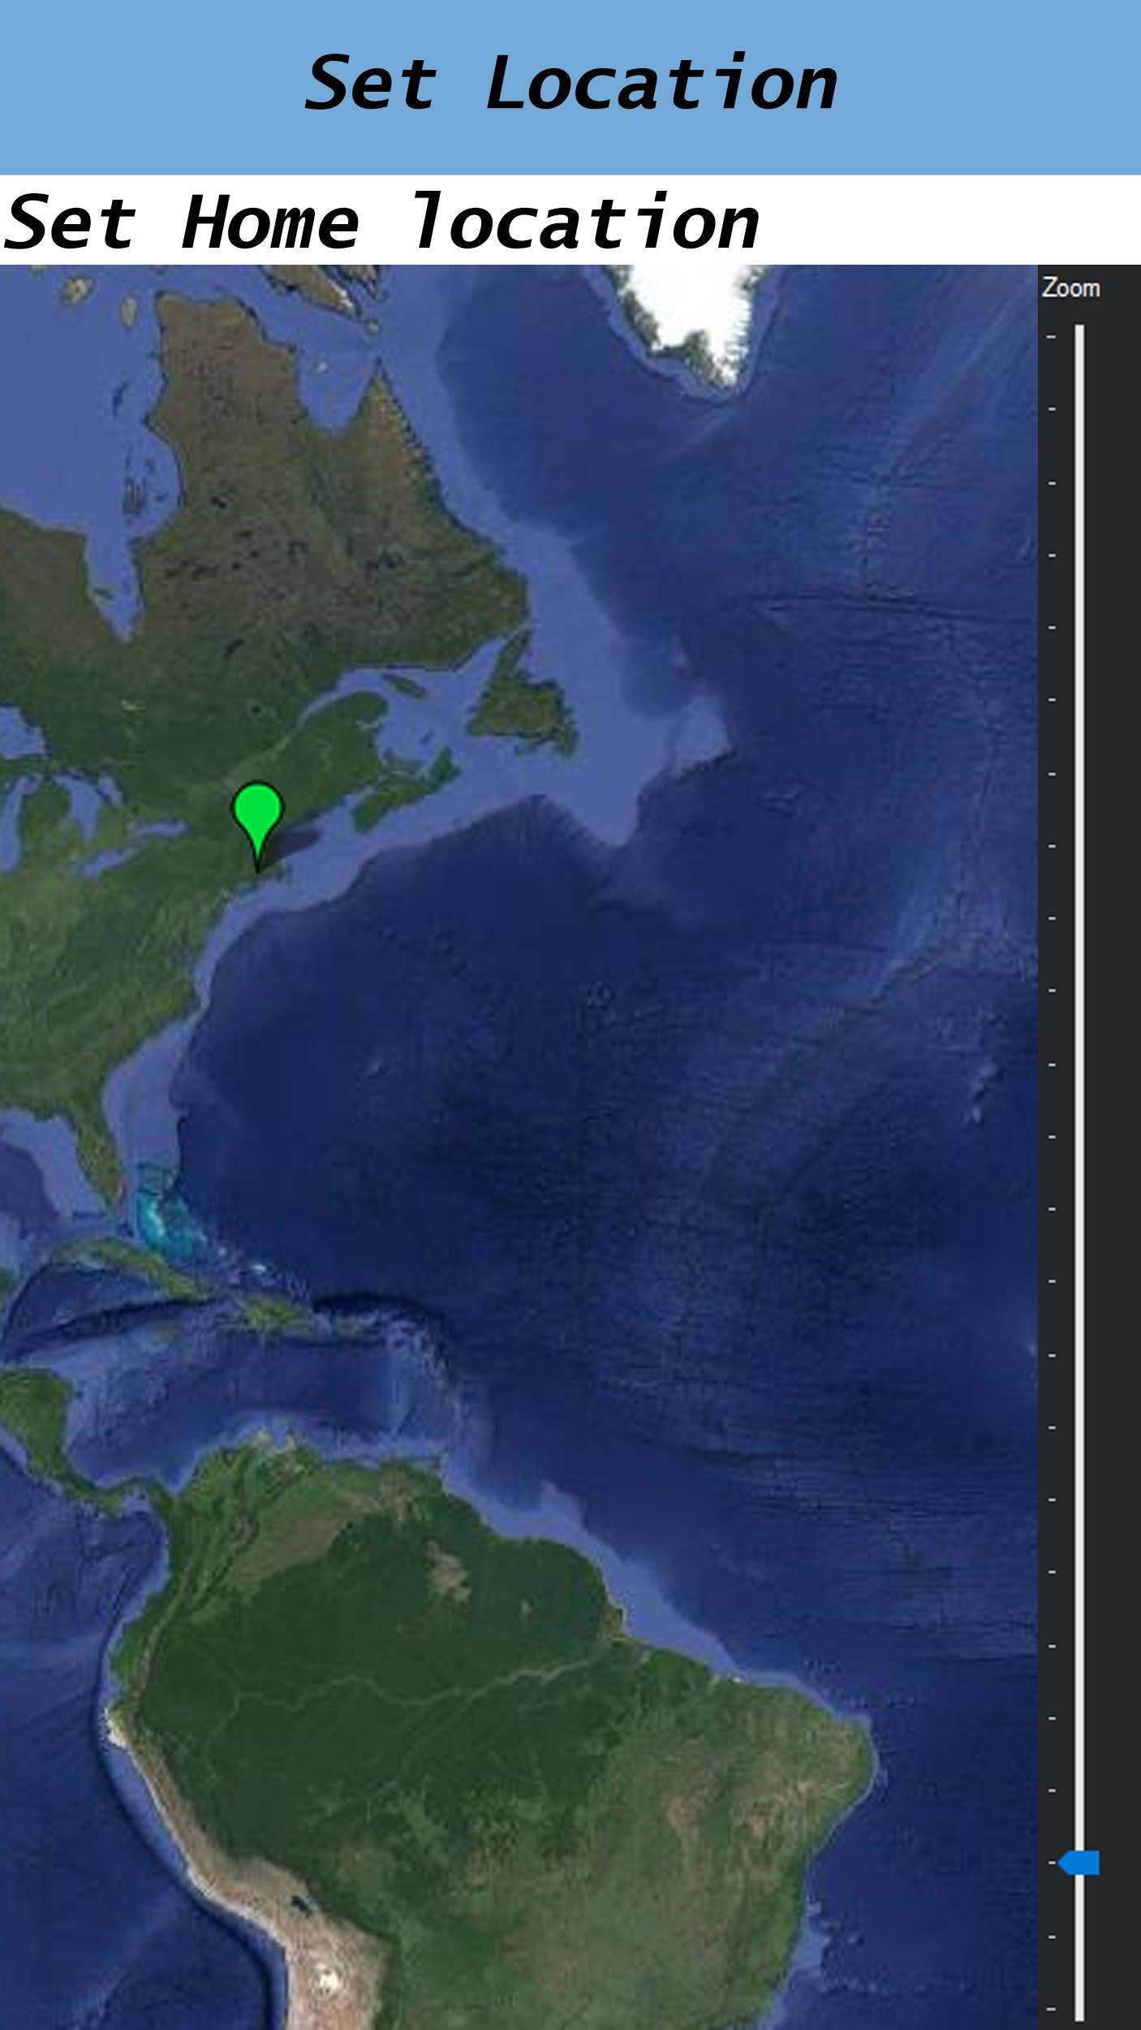
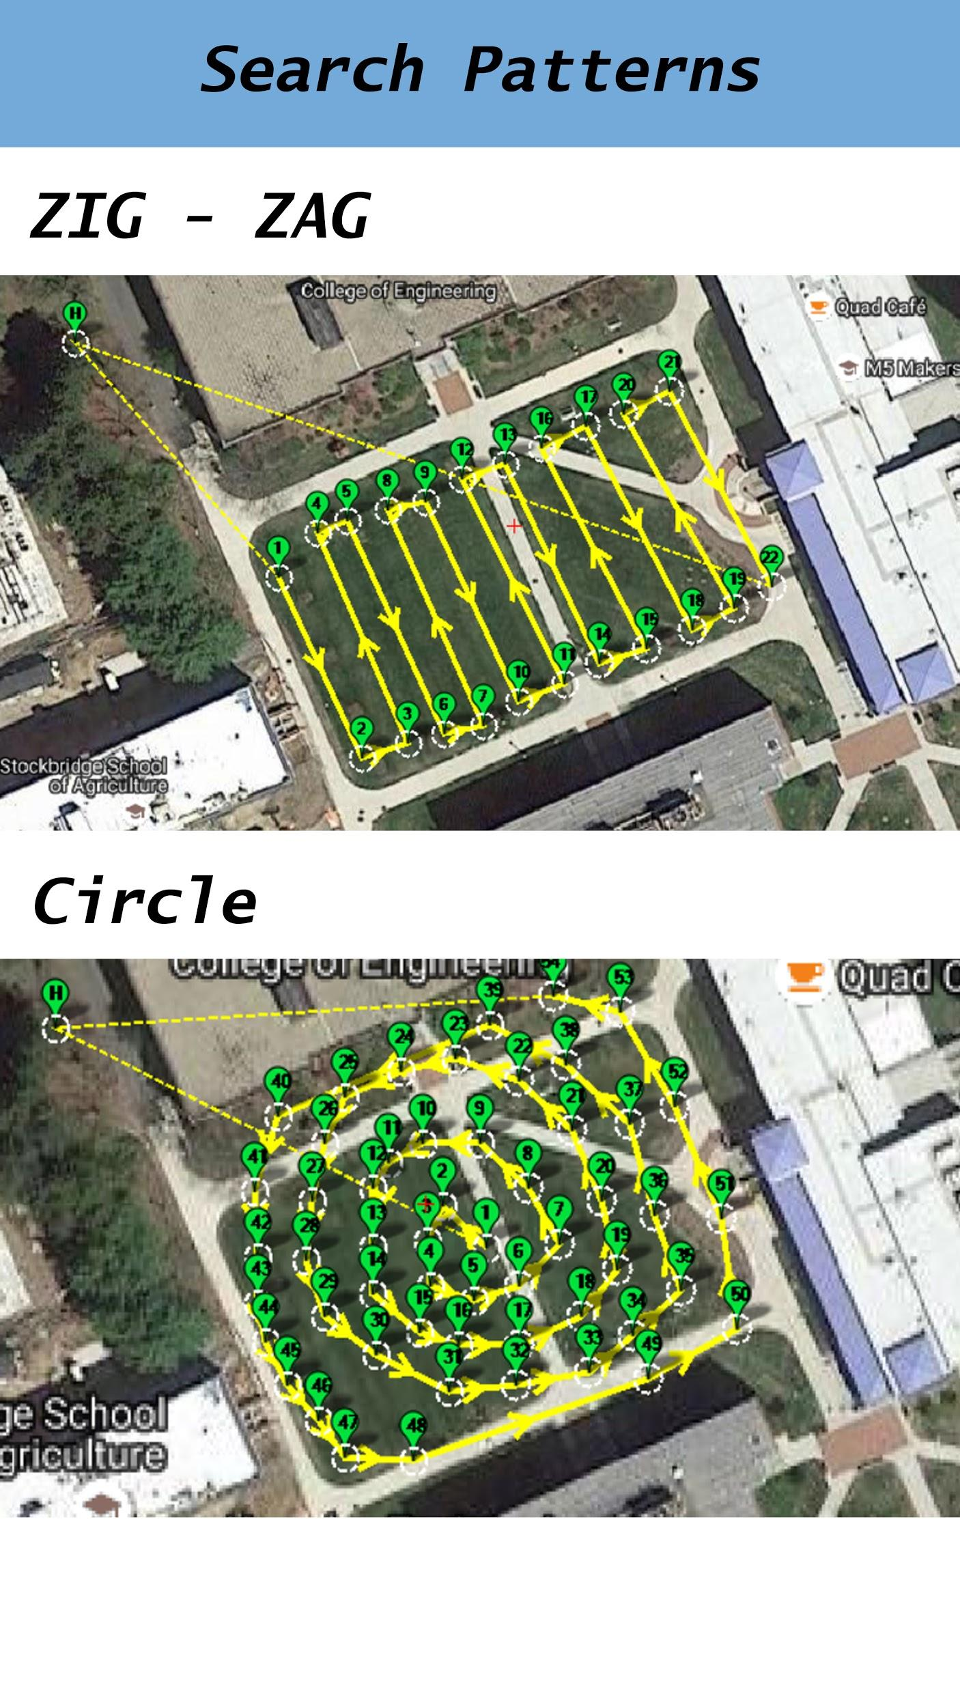
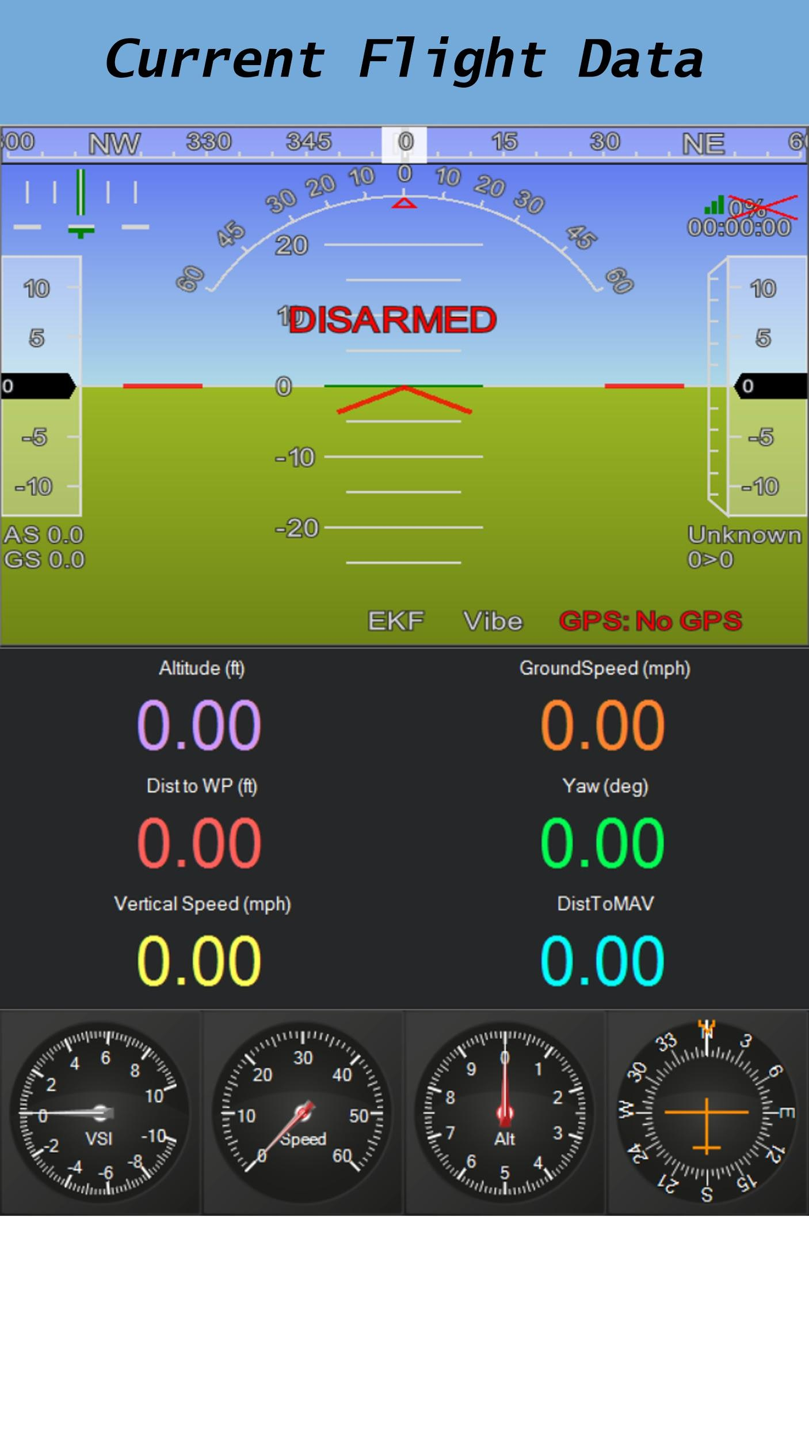
Android App
Advisor: Weibo Gong
Notes:
Zach

Slide 19
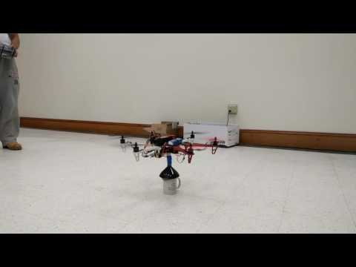
Demonstration
Notes:
Zach

Slide 20
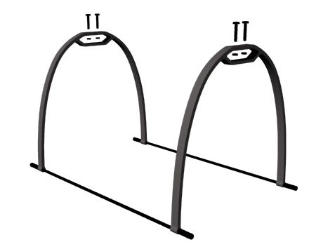
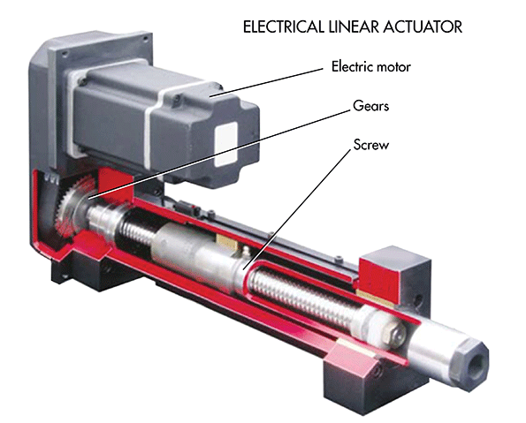
Design Alternative
Drone will land before attempting to pick up an object
Gripper will be lowered down directly on top of object
Allows for granular jammer to properly set around object
Landing Gear Needed
Lowering Mechanism
Notes:
Tim

Slide 21
Camera Tracking
Low resolution Camera
Shape recognition
Color detection
Open CV
Objectives
Center drone above object
Land on object
Notes:
Pete

Slide 22
CDR Deliverables
Zach and Noah
Mechanical system to lower gripper
Implement pressure sensor
Implement PCB to control gripper
Peter and Timothy
Use camera tracking to detect object
Sensor Integration
Raspberry Pi
Advisor: Weibo Gong
Notes:
Pete

Slide 23
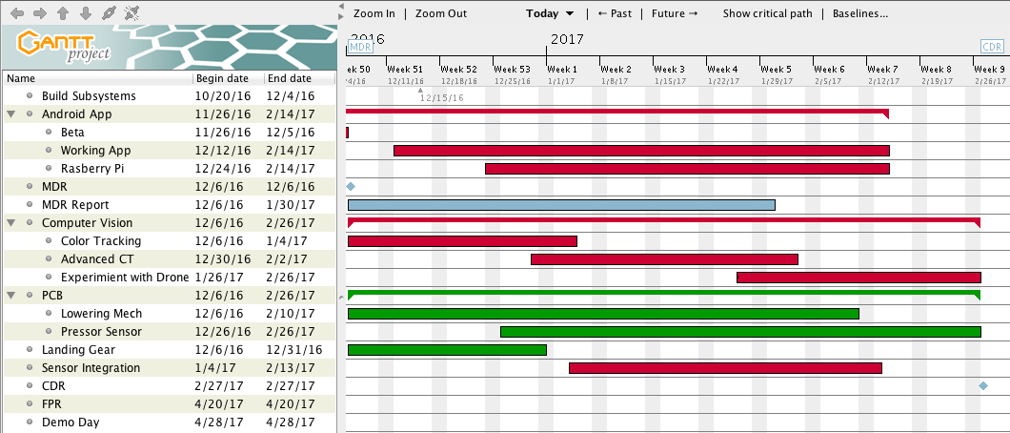
Schedule
Peter and Tim … . Zach and Noah …...
Advisor: Weibo Gong
Notes:
Noah

Slide 24

Questions or Comments?
Advisor: Weibo Gong

