Slide 1
Preliminary Design Review
Team Breadcrumb
October 21, 2016
Notes:
++ competing products
++ alternatives we didn’t like
++ different types of feedback
== add commonsense flow to presentation

Slide 2




Team Members
Patrick Rauker
EE
George Younes
CSE
Marion Meirlaen
CSE
Rimannu Saad
CSE

Slide 3
Navigation for the Visually Impaired
Current Navigation for the visually impaired includes…
Using their other senses to navigate (smell/sound)
Help of family, friends, assistants
Cane/dog for avoiding obstacles

Slide 4
How Significant is this Problem?
285 million people worldwide visually impaired
39 million blind
Around 90% live in low-income settings
Unable to get jobs because of dependence

Slide 5

Hardships
Currents ways of navigating make it difficult to:
explore new areas
get home safely without proper training
Can be disorienting without assistance from another person
Notes:
Outside of memorized home areas, the current ways of navigating around makes it very difficult for a visually impaired person to travel without depending on another person. It’s even more difficult when this person is in an area where everything smells and sounds the same. In fact, it’s similar to being lost at sea or in the woods, where we lose all sense of direction. For the visually impaired, examples include, the beach, where everything smells like the sea. Large parks, where everything smells like grass.

Slide 6
Product Proposal
An affordable navigation system that does not require vision from the user
Small system that can attach to a cane or fit in the pocket of the visually impaired
Track user’s path
Direct user back to starting location
Use audio feedback to provide navigation
For use in a traffic free zone (non-moving obstacles)

Slide 7
Societal Impact
Improves independence of visually-impaired individuals
Improves quality of life
Provides peace of mind to care givers

Slide 8
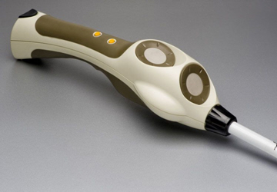
Design Alternatives
Radar incorporated Cane
Uses a radar sensor in the bottom of the cane (or handle) to provide extended sensing capabilities
Locates obstacles in user’s vicinity
Uses two vibrating buttons
Haptic feedback instead of audio

Slide 9
Operation Procedure
User turns on device, once gps satellites acquired, user alerted
User can turn on tracking mode
When user decides to return, he/she can press a button to begin the navigation
Cane guides person through turns with audio feedback
If person goes off track, device alerts person with an audio signal to get them back on track
Alert the user to pause if gps signal is dropped
Notes:
“Basic Use Case” move to front

Slide 10
Device Requirements
With an optimal GPS connection…
Turns within 5 meters of original point
Record and direct user through turns of 90 degrees in any direction with at least 10 paces between turns
Alert and redirect user that is more than 10 meters off course and redirect them to proper path using magnetometer
Has a battery life of ~8 hours (record/playback)
Turn-around notification

Slide 11
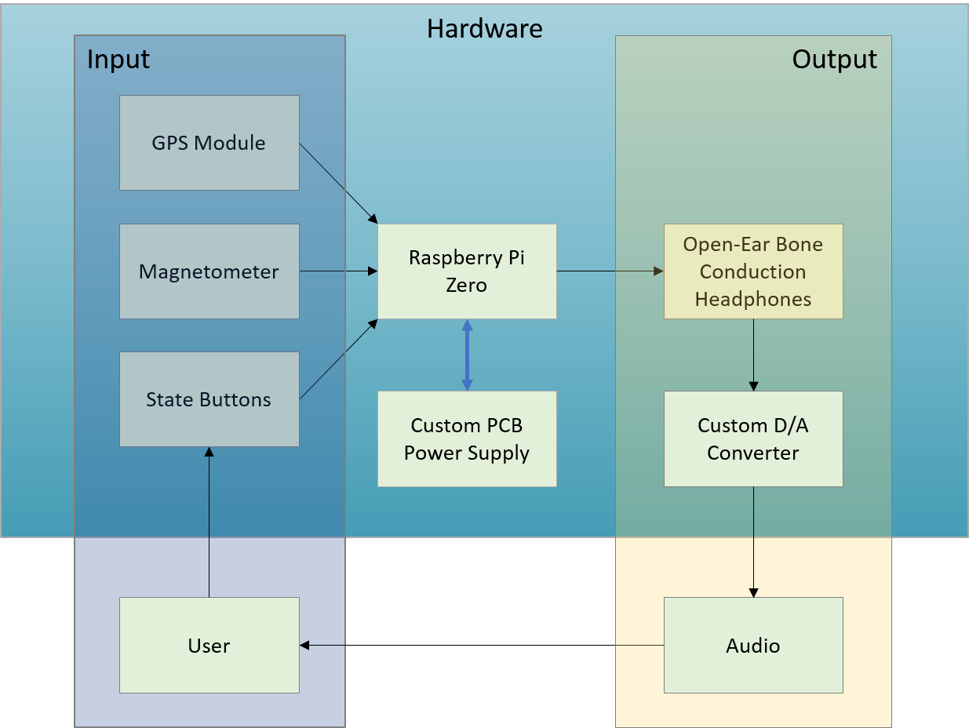
Block Diagram
Hardware
Raspberry Pi
Magnetometer
GSP cone
Haptic feedback motors
Software
GPS Marking Algorithm
Following Breadcrumbs (BC) Algorithm
User Interaction
Power
PCB logic to power hardware
Li-Io battery
Charging Circuit for Li-Io battery
User Input/Feedback
Haptic Feedback
Depression Button(s)
For power/record and
playback of GPS breadcrumbs
Notes:
Move this block diagram, give hardware block diagram

Slide 13
Proposed Hardware
Raspberry Pi Zero
Adafruit GPS
Magnetometer/Accelerometer
PCB Power Supply
Li-Ion Battery
Open Ear Conduction Headphones
Custom D/A converter
User Interaction Hardware (Buttons, LED’s, etc.)

Slide 14
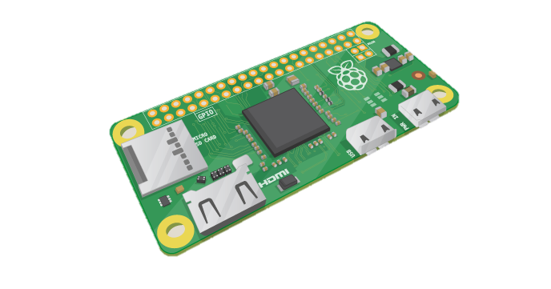
Raspberry Pi Zero
Processor
1GHz Broadcom BCM2835
Memory
512MB LPDDR2 SDRAM
Mini USB data/power out
Mini USB power in
Power consumption
5V @ ~80mA (idle)
~ 0.4W
40 pin in/out array
Micro SD slot

Slide 15
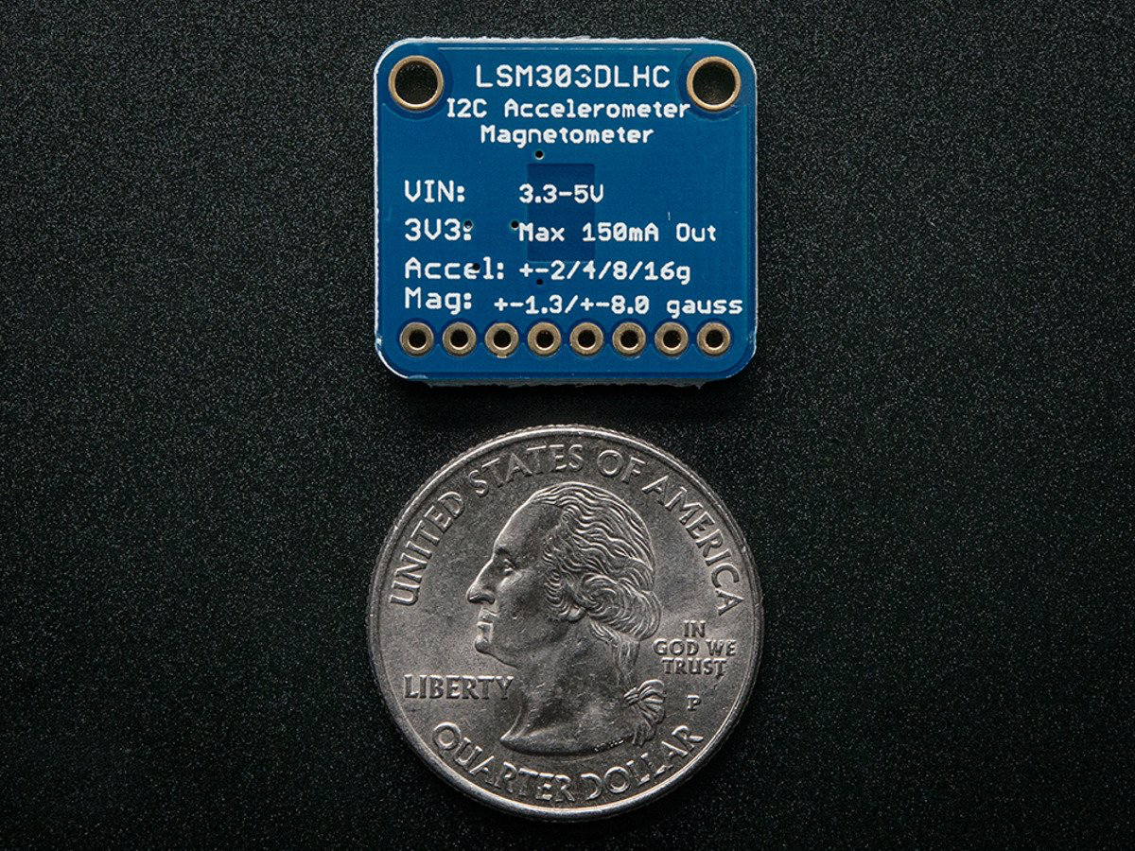
Magnetometer/Accelerometer Head
Allow for precise turning when navigating
Compass will determine correct angles to turn at
Ensures user will not lose direction while navigating back
Allows for possible future use of dead reckoning
If user loses GPS signal, dead reckoning algorithm and Magnetometer/Accelerometer will assume direction until signal is reestablished

Slide 16
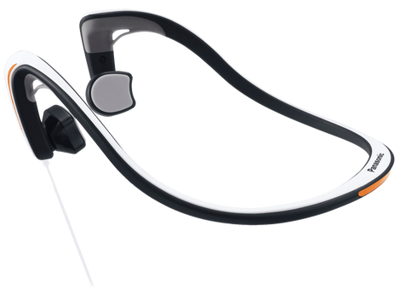
Open Ear Conduction Headphones
Bone conduction sends musical signals from the cheek bones to the inner ear
Allows the user to hear his/her surroundings during navigation instructions.

Slide 17
Power Requirements
Raspberry Pi (w/ accessories) = 350-230 mA (peak)
GPS module = 110 mA
Audio Feedback Motors = 110 mA (intermittent)
---------------------------------------------------------------------
= 460-570 mA (5 V)
4 Li-Ion Batteries (2 series, in parallel) deliver 6800 mAh @ 7.4 V

Slide 19
Software
Requirements
Operating System: Raspbian (Official OS for Raspberry Pi)
Storage: 1 recording per second = ~300kB
Efficiency of algorithm is a concern
GPS waypoint algorithm
Navigation backtrack algorithm

Slide 20
Finite State Machine

Slide 22
Input/Output
Input
Subject movement
Power switch
Record/Playback switch
Output
Navigation
Audio response

Slide 23
MDR Deliverables
A device which…
Shows basic end-to-end functionality
Can plot a GPS waypoint
Provide proof of meaningful location data
Can provide audio feedback
Will ultimately display feasibility

Slide 24
Thank you!
Questions?

