Slide 1
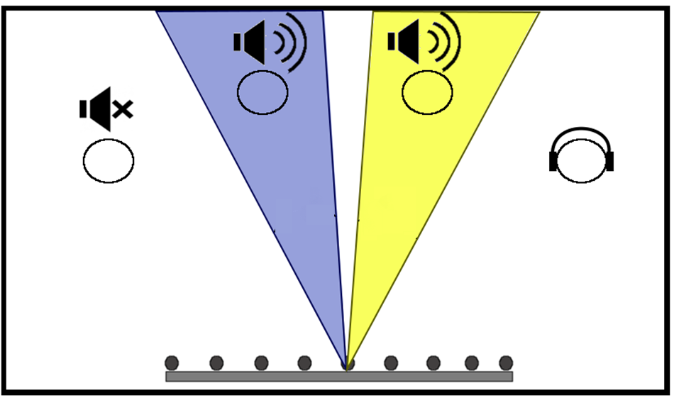
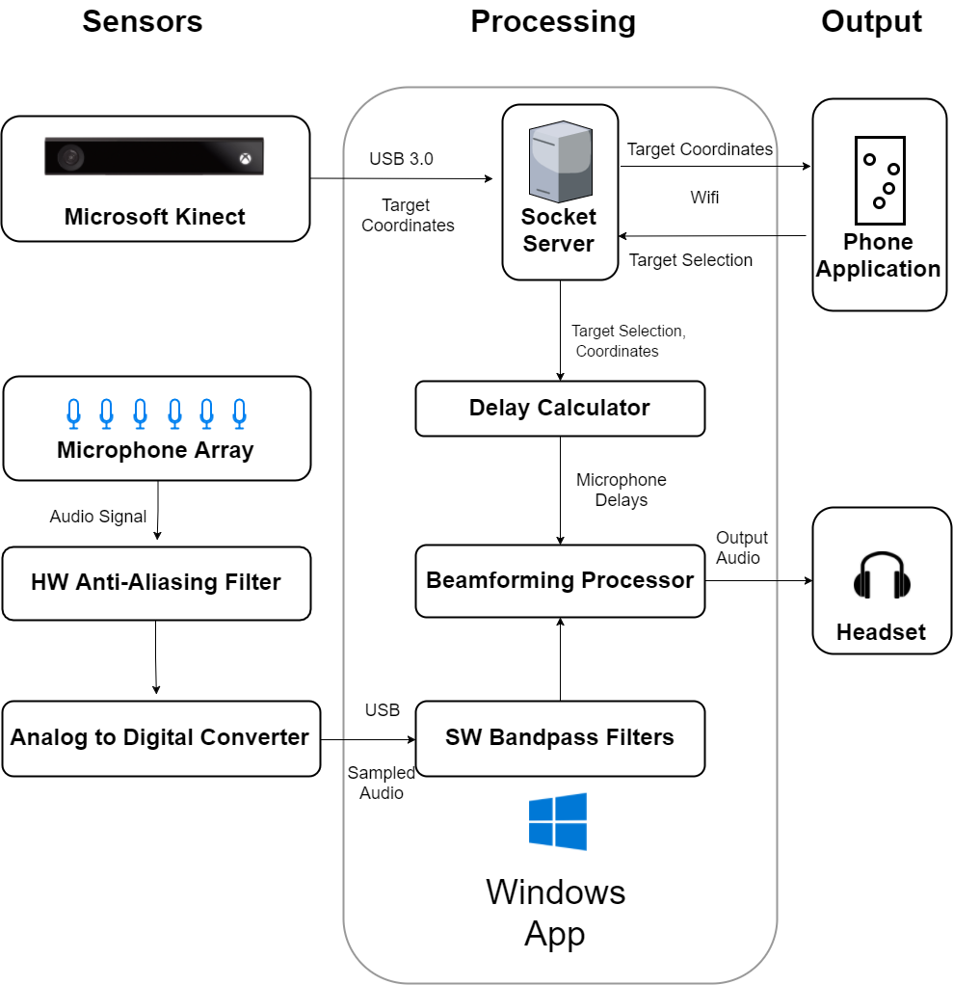
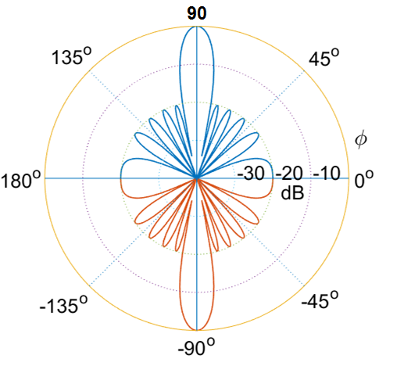
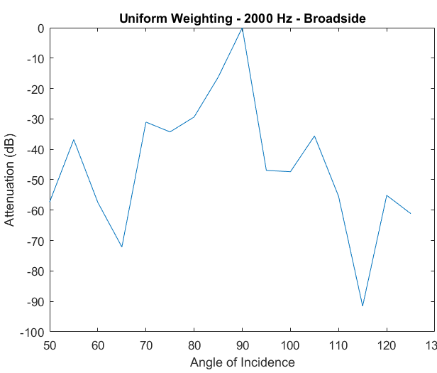
Earbeamer
Aaron Lucia, Matteo Puzella,
Nathan Dunn, Niket Gupta
Faculty Advisor: Prof. Mario Parente
Abstract
Beamforming
Earbeamer is a stationary, wall-mounted hearing aid system targeted at the senior citizen population that allows users precise control over the audio output of particular individuals within the room. By applying beamforming in parallel over a microphone array, the audio of each identified individual is isolated, and may be attenuated or amplified. Through an Xbox Kinect, the movements of each individual are tracked, ensuring that a conversation is unimpeded regardless of movement within the room.
ϕ₁
ϕ₂
Block Diagram
For a target standing at an angle ϕ from the axis of an array of M microphones with uniform spacing d, the difference in arrival times of sound waves at each microphone may be accounted for:
$$y\left[n\right]= \sum_{m=0}^{M −1}{x[n −\frac{md\cos{φ}}{v}]}$$
Results
Beamwidth of the main lobe is dependent upon the targeted angle, as well as the ratio of the microphone distance to the wavelength of a targeted frequency
Best and Worst Case Array Responses
Mic Distance | Steering Angle | Calculated Beamwidth
λ/2 | 90 | 10.0
 | 150 | 18.5
λ/4 | 90 | 18.5
 | 150 | 36.9
Specifications
Dolph-Chebyshev Response to 2000 Hz - Broadside
Uniform Weighted Response to 2000 Hz - Broadside
Specification | MDR Report | Final
Array Size | < 2m | 0.914m
Target Identification Range | > 20 feet | 18 feet
Angle of Operation | 30º to 150º | 30º to 150º
Maximum Targets | 4 | 4
3dB Beamwidth (Broadside) | 15º | 9.3º (best case) 18.5º (worst case)
Operating Range | 1000 - 4000 Hz | 1000 - 4000 Hz
Delay | < 300 ms | 250 ms
Amplification Pattern of Beamformer as determined
mathematically (left) and experimentally (right).
Acknowledgement
Special thanks to our advisor Professor Mario Parente and our evaluators Professors Kelly and Yang for giving us helpful feedback . Thanks to Fran Caron and Terry Bernard for ordering the equipment for the Beamformer.
Department of Electrical and Computer Engineering
ECE 415/ECE 416 – SENIOR DESIGN PROJECT 2017
College of Engineering - University of Massachusetts Amherst
SDP17

Slide 2
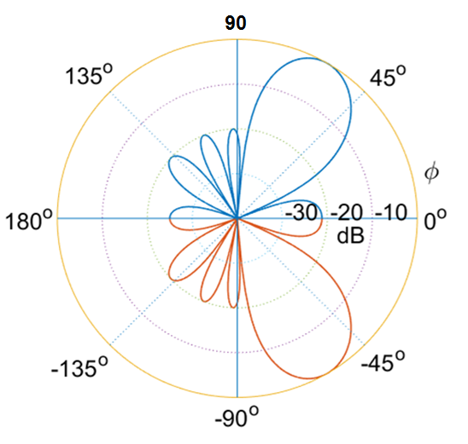
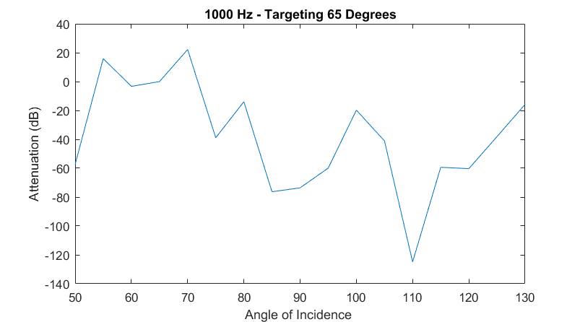
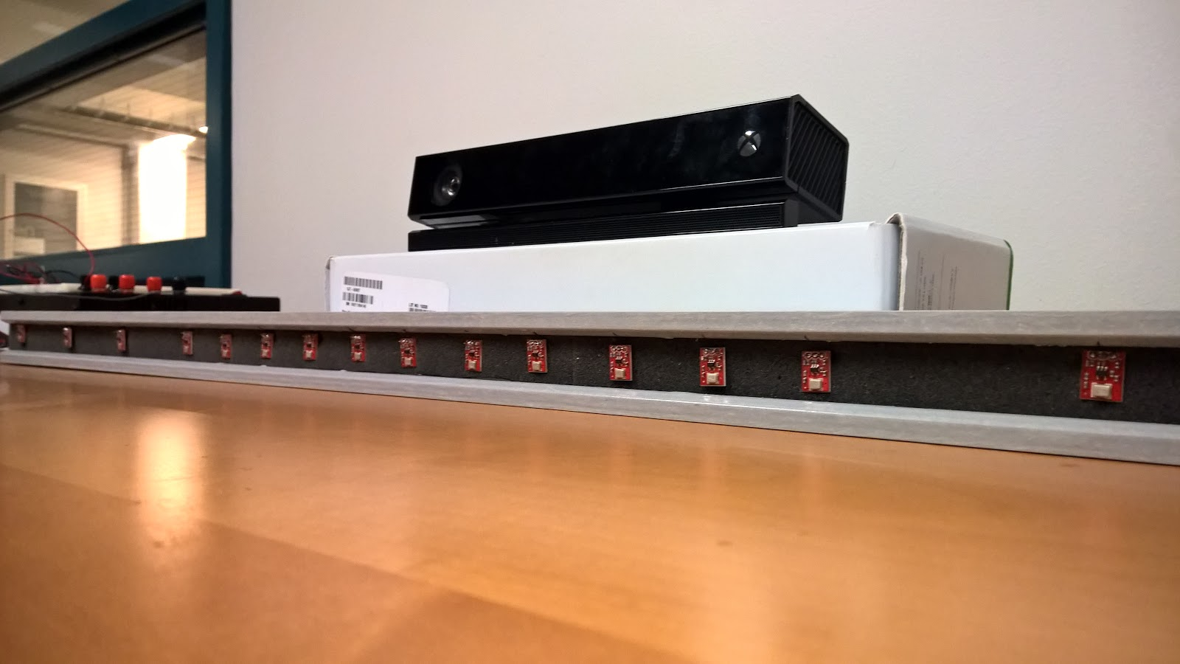
Microphone Array
User Interface
1000 – 2000 Hz
Mobile Application
iOS (Swift)
Wireless connection
WebSockets protocol
Targets speakers displayed proportionally in relation to system and environment
Tap to mute/unmute targets
2000 – 4000 Hz
A total of 16 microphones were allocated across two subarrays, targeting two successive octaves
Lower Frequency Spacing: 8.6 cm
Higher Frequency Spacing: 4.3 cm
Dolph-Chebyshev Weights were applied to enforce side-lobe attenuation of –20 dB
Dolph Chebyshev Response to 1000 Hz,
Steered to 65º
PCB
Experimental results (below) confirmed that Chebyshev Weights successfully controlled sidelobe attenuation. Both the graph at right and below demonstrate response to a 1000 Hz signal, steered to 65º
The Printed Circuit Board (PCB), as shown in the figure above, was designed to fit inside the array housing. The PCB contains:
A power jack connector which connects to the barrel plug
16 low pass filters that are made up of resistors and capacitors
A ribbon cable that connects to the Analog to Digital Converter (ADC)
Unit Housing
Spatial Aliasing
The Nyquist theorem also applies to beamforming. If the spacing between microphones exceeds half the wavelength of a targeted frequency, a form of aliasing occurs - a lobe equal in magnitude to the main lobe amplifies an unwanted direction.
In the figure at left, the microphone distance is 3/4 the wavelength of the signal – despite being aimed at 150º , another lobe appears at 60
Cost
Production | 1 unit | 1000 units
Printed Circuit Board | $ 59.33 | $ 16.04
Microphones | $ 9.95 | $ 8.46
Kinect Sensor | $ 139.98 | $ 139.98
ADC | $ 700.00 | $ 700.00
Housing | $ 30.70 | $ 6.20
Unit cost | $1,090.29 | $ 997.94
FIR Filters were designed to limit the frequencies handled by a particular subarray to those meeting the Nyquist criterion

