Slide 1
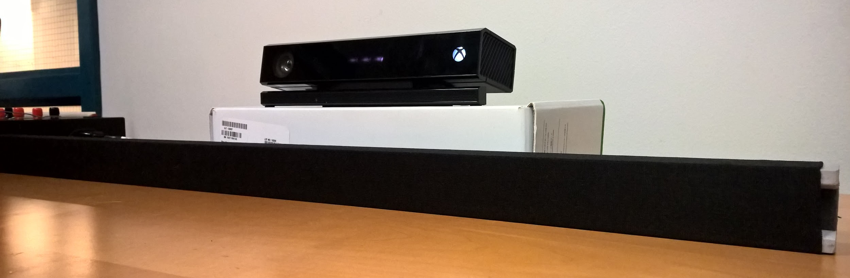
Ear Beamer FPR
  Aaron Lucia, Niket Gupta, Matteo Puzella, Nathan Dunn

Slide 2
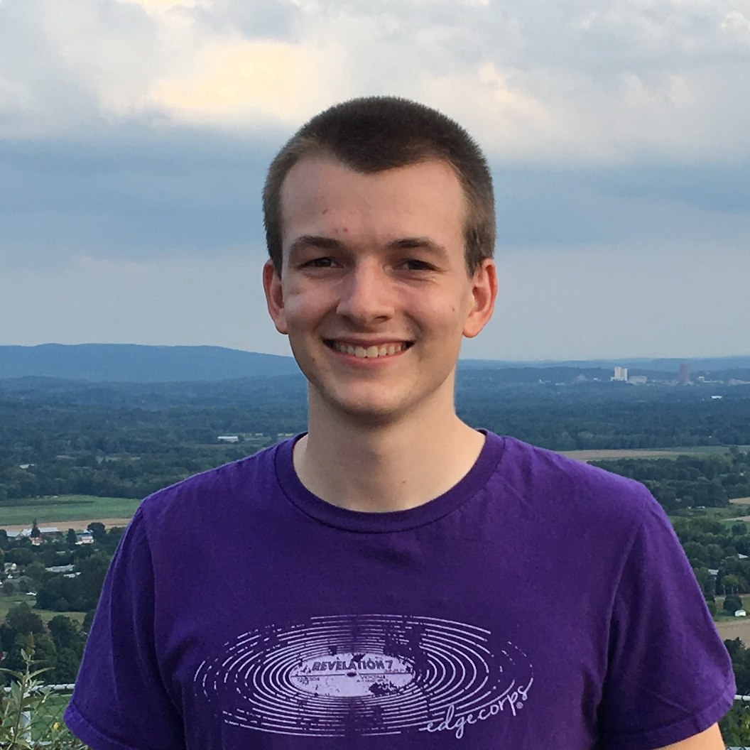
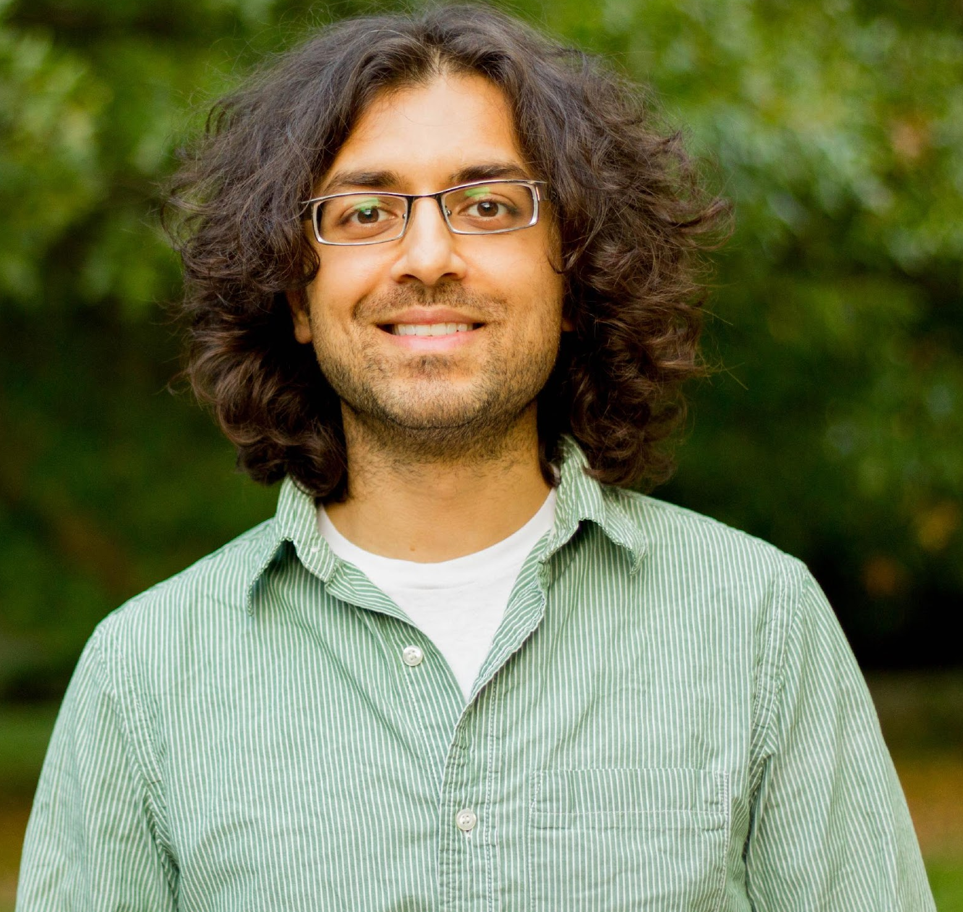
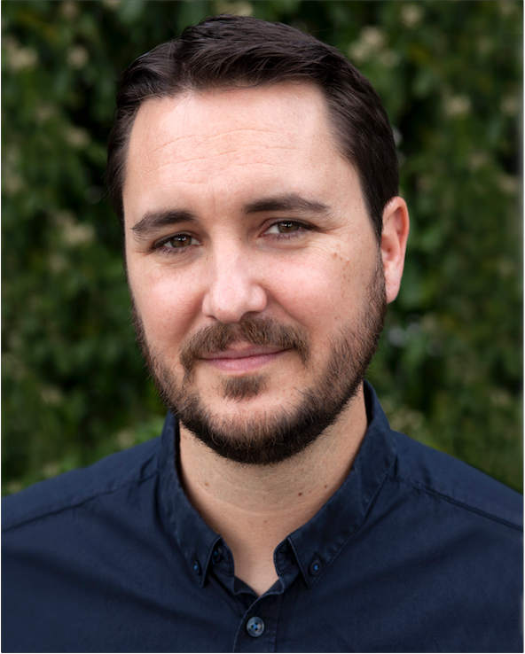
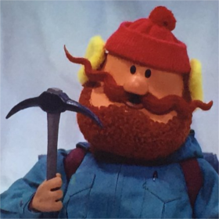
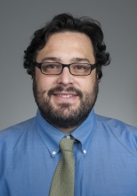
The Team
Aaron Lucia
CSE
Niket Gupta
CSE
Matteo Puzella
EE
Nathan Dunn
CSE
Advisor: Prof. Mario Parente

Slide 3
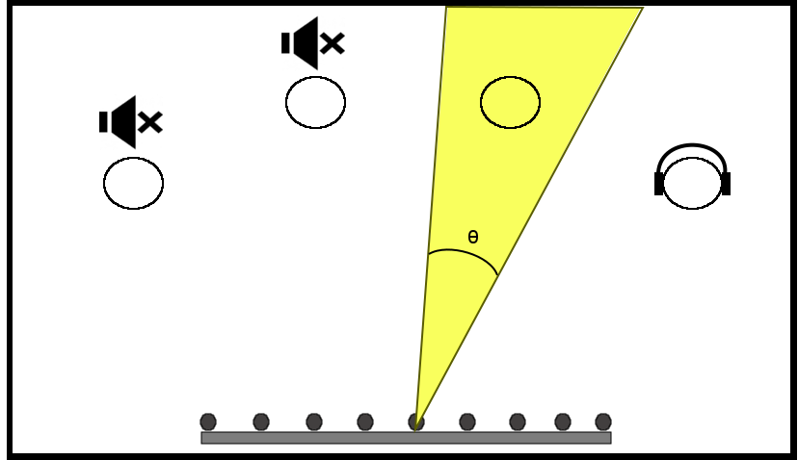
Outlining the System
Our Goal:
Develop a hearing aid system that gives user ability to individually amplify multiple targets of his/her choice and attenuate unwanted targets, independent of body or head position of the user

Slide 4
Block Diagram

Slide 5
FDR Goals from CDR:
Hardware:
Printed PCB for anti-aliasing filters
Design and print PCB for power supply
Reducing Noise and Improving Performance
Implement Chebyshev Weighting for microphones
Design scenarios to determine experimental performance of beamforming and compare with theoretical MATLAB simulations
Usability
Improve design and user interface of iPhone application
Improve User interface for Windows Application
Additional Recommendations from Evaluation:
Investigate audio normalization
Improve acoustic isolation of user from speakers

Slide 6
Specifications
Specification | MDR Report | Achieved by FPR
Array Size | < 2m | 0.914m
Target Identification Range | > 20 feet
Angle of Operation | 30º to 150º | 30º to 150º (60 to 120 when Kinect directly behind array)
Maximum Number of Targets | 4 | 4
3dB Beamwidth | 15º (broadside) | Theoretical Broadside: 9.3º (best case) 18.5º (worst case) Experimental Broadside: < 10 º (best case) < 20 º (worst case)
Operating Frequency Range | 600 - 2400 Hz | 1000 - 4000 Hz
Delay | < 300 ms | 250 ms

Slide 7
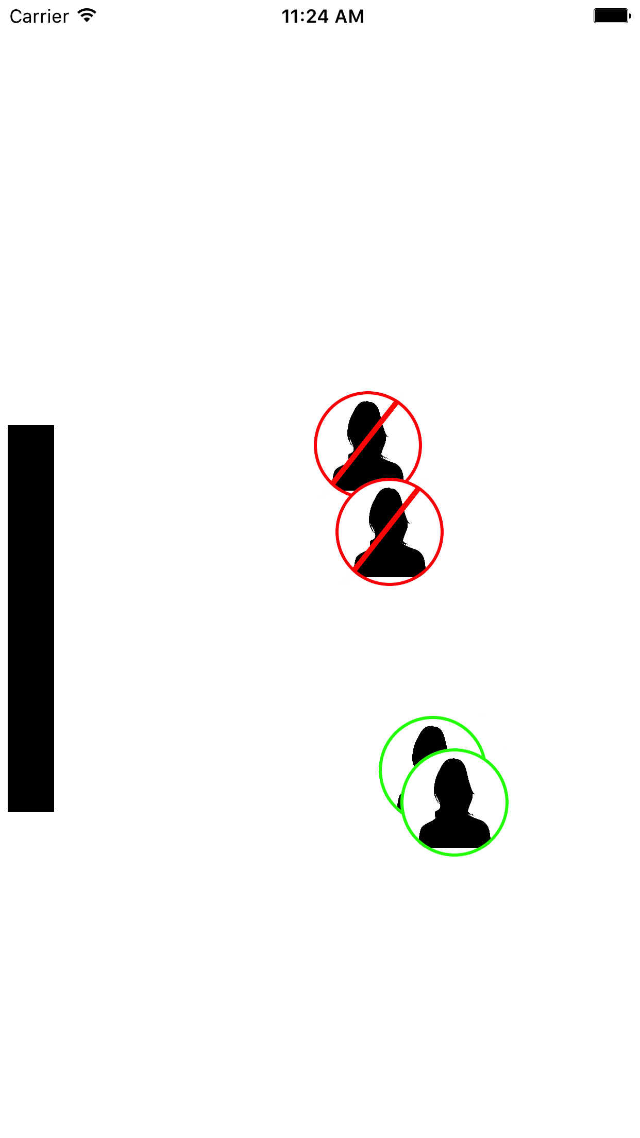
iPhone Application
Wireless Communication
Live updates (every second)
More Intuitive design
Targets mapped to room

Slide 8
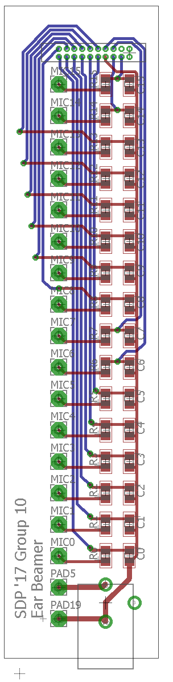
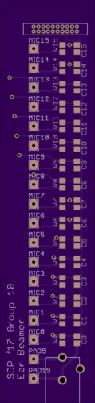
PCB Layout

Slide 9
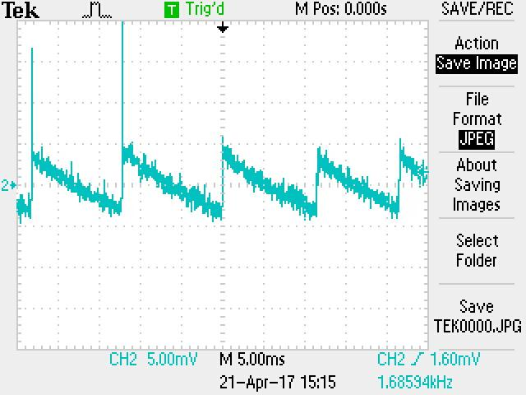
Power Supply
-Switching AC/DC wall mount adapter produces triangle wave that can be heard in audio
-Using the breadboard as our power supply for now

Slide 10
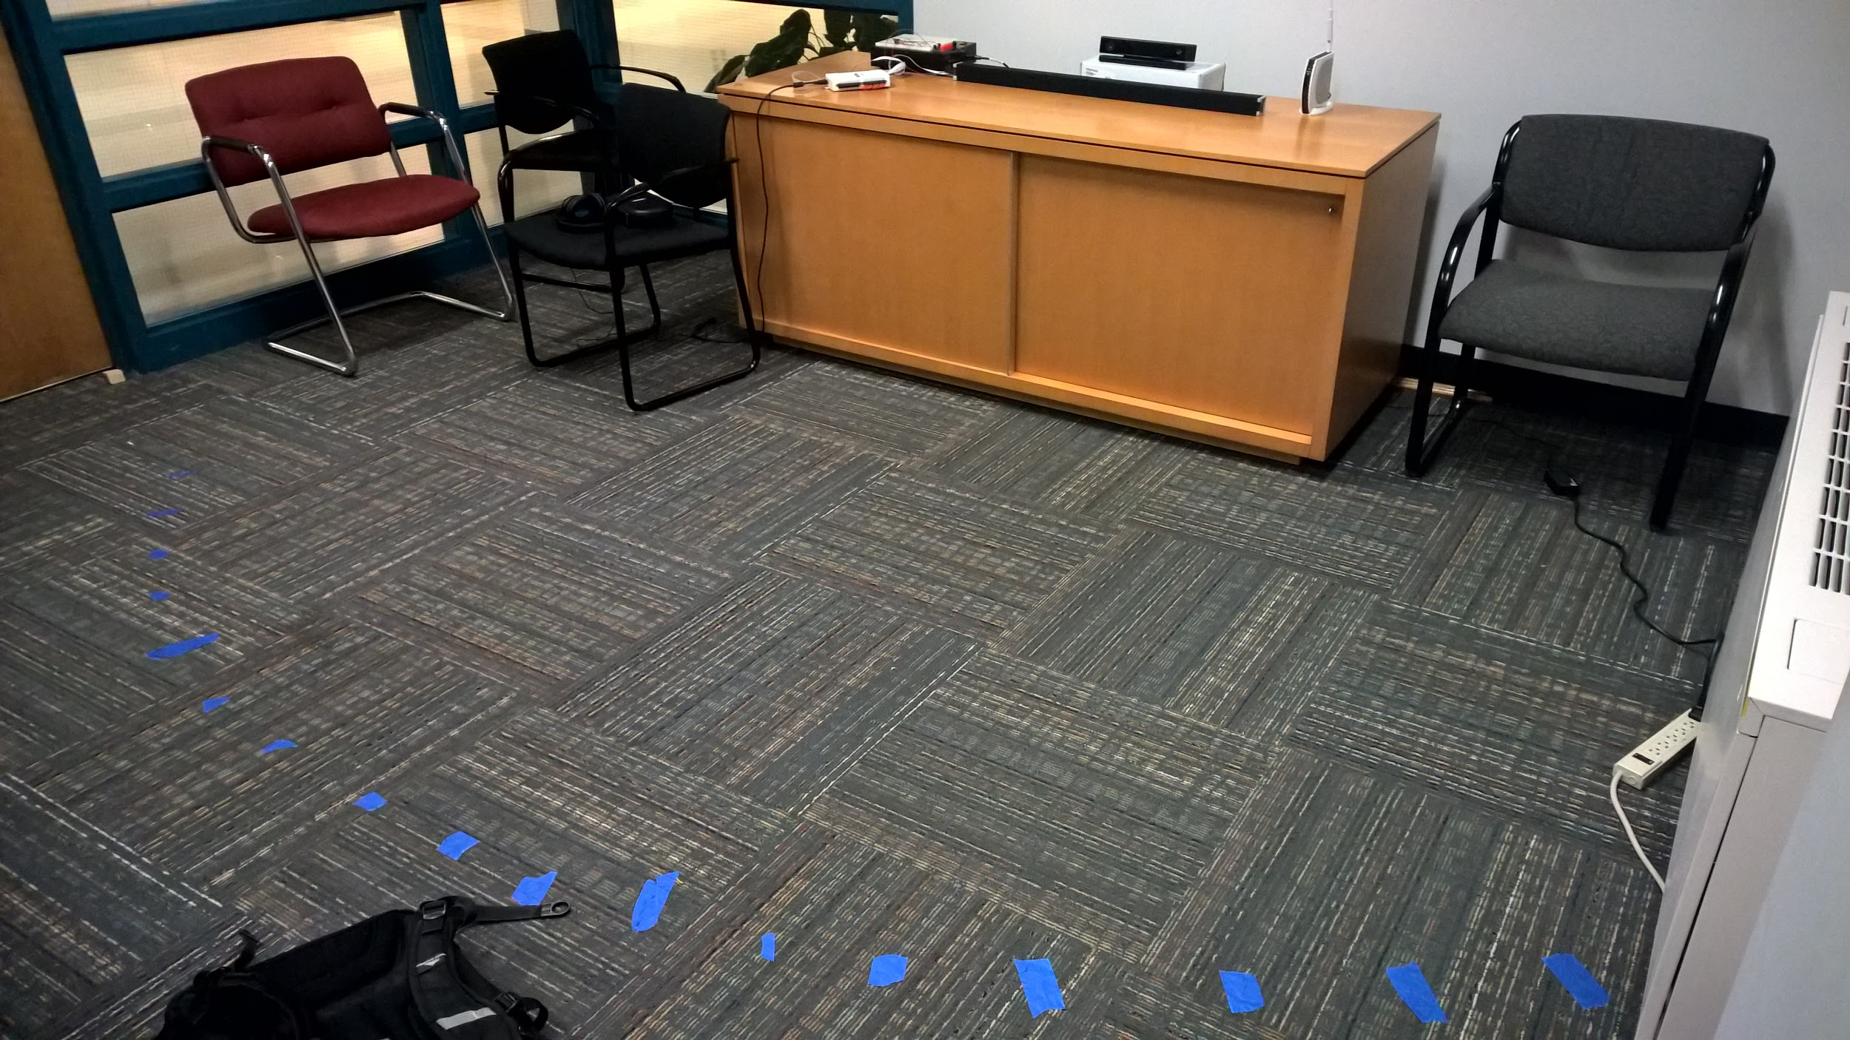
Verifying Beamwidth
Marked off locations 8’ from array, spaced 5º apart

Slide 11
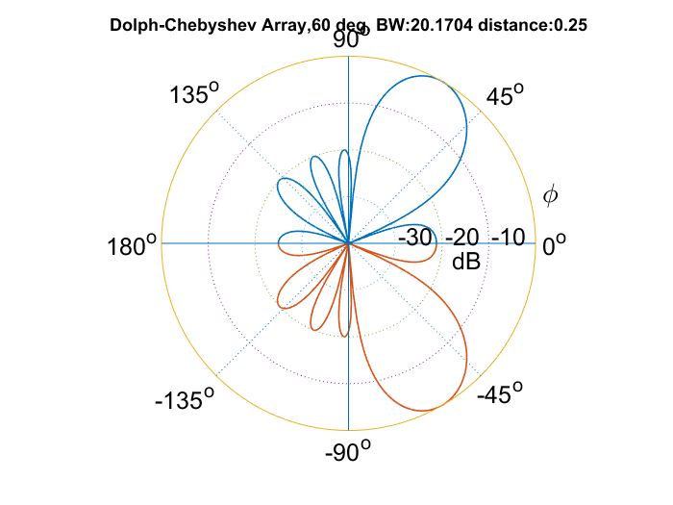
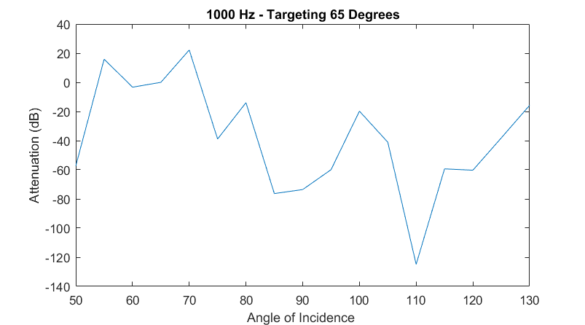
Verifying Beamwidth - Worst Case
Theoretical Performance
Experimental Performance

Slide 12
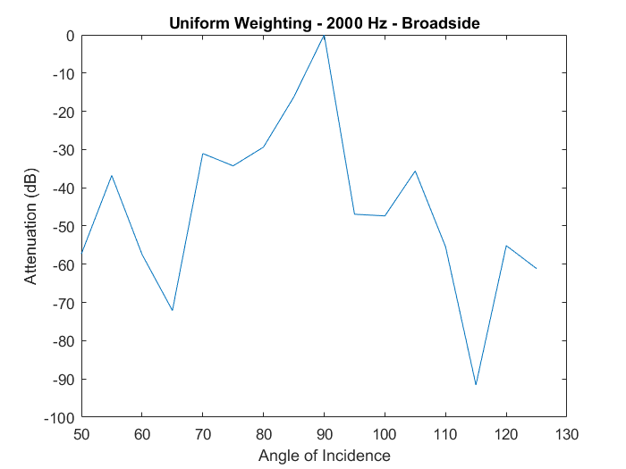
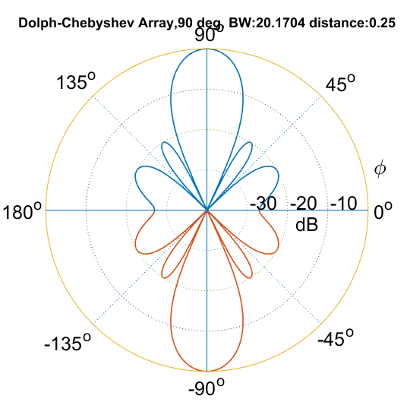
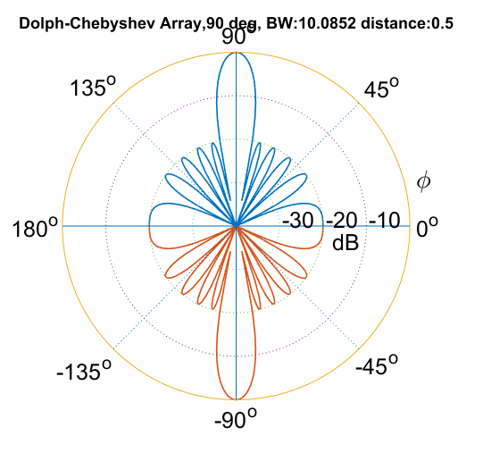
Verifying Beamwidth - Average Case*

Slide 13
Changed frequency bands
Old frequency range 600Hz - 2400Hz
New frequency range 1000Hz - 4000Hz
Results in shorter microphone array

Slide 14
Audio leveling
Normalize the audio levels of each beam
Allows people who are quieter or farther away to be heard at the same volume

Slide 15
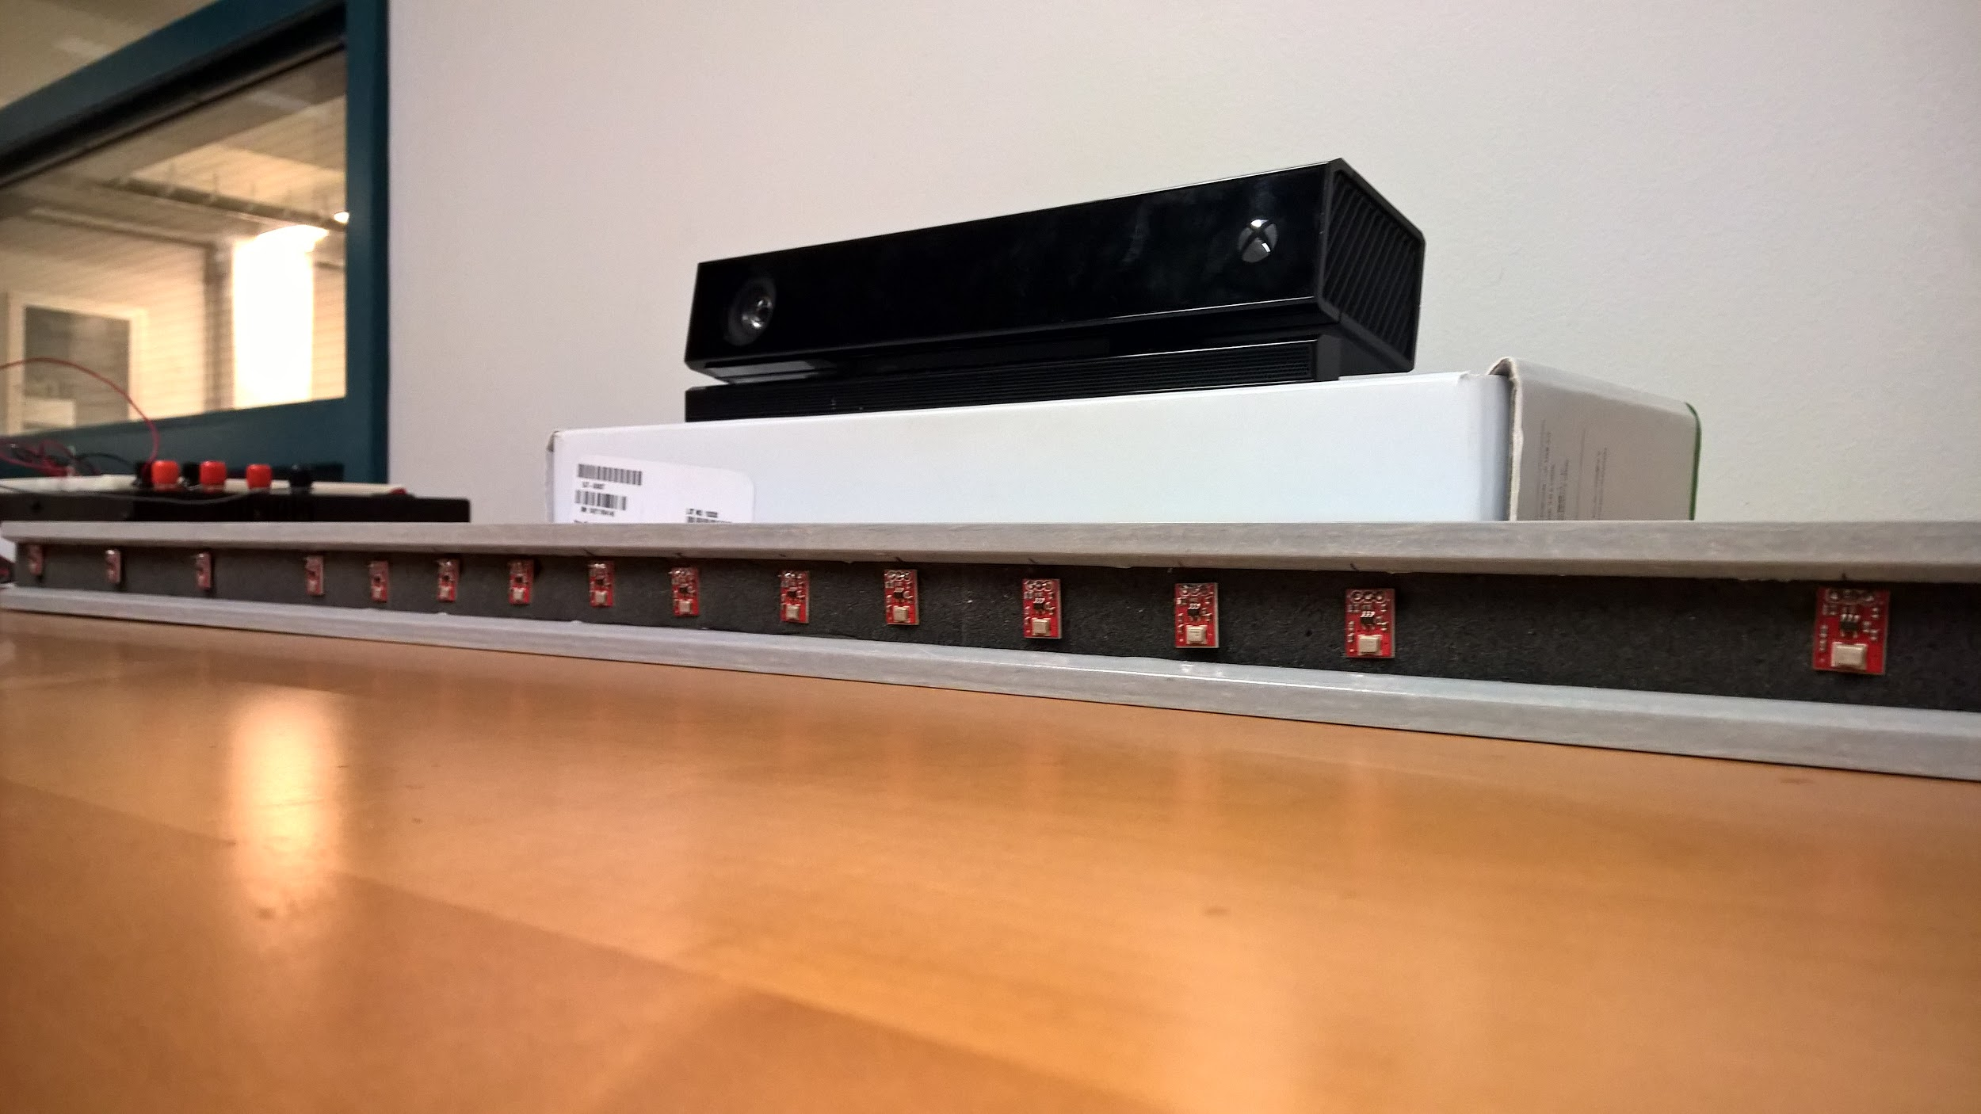
Final Assembly

Slide 16
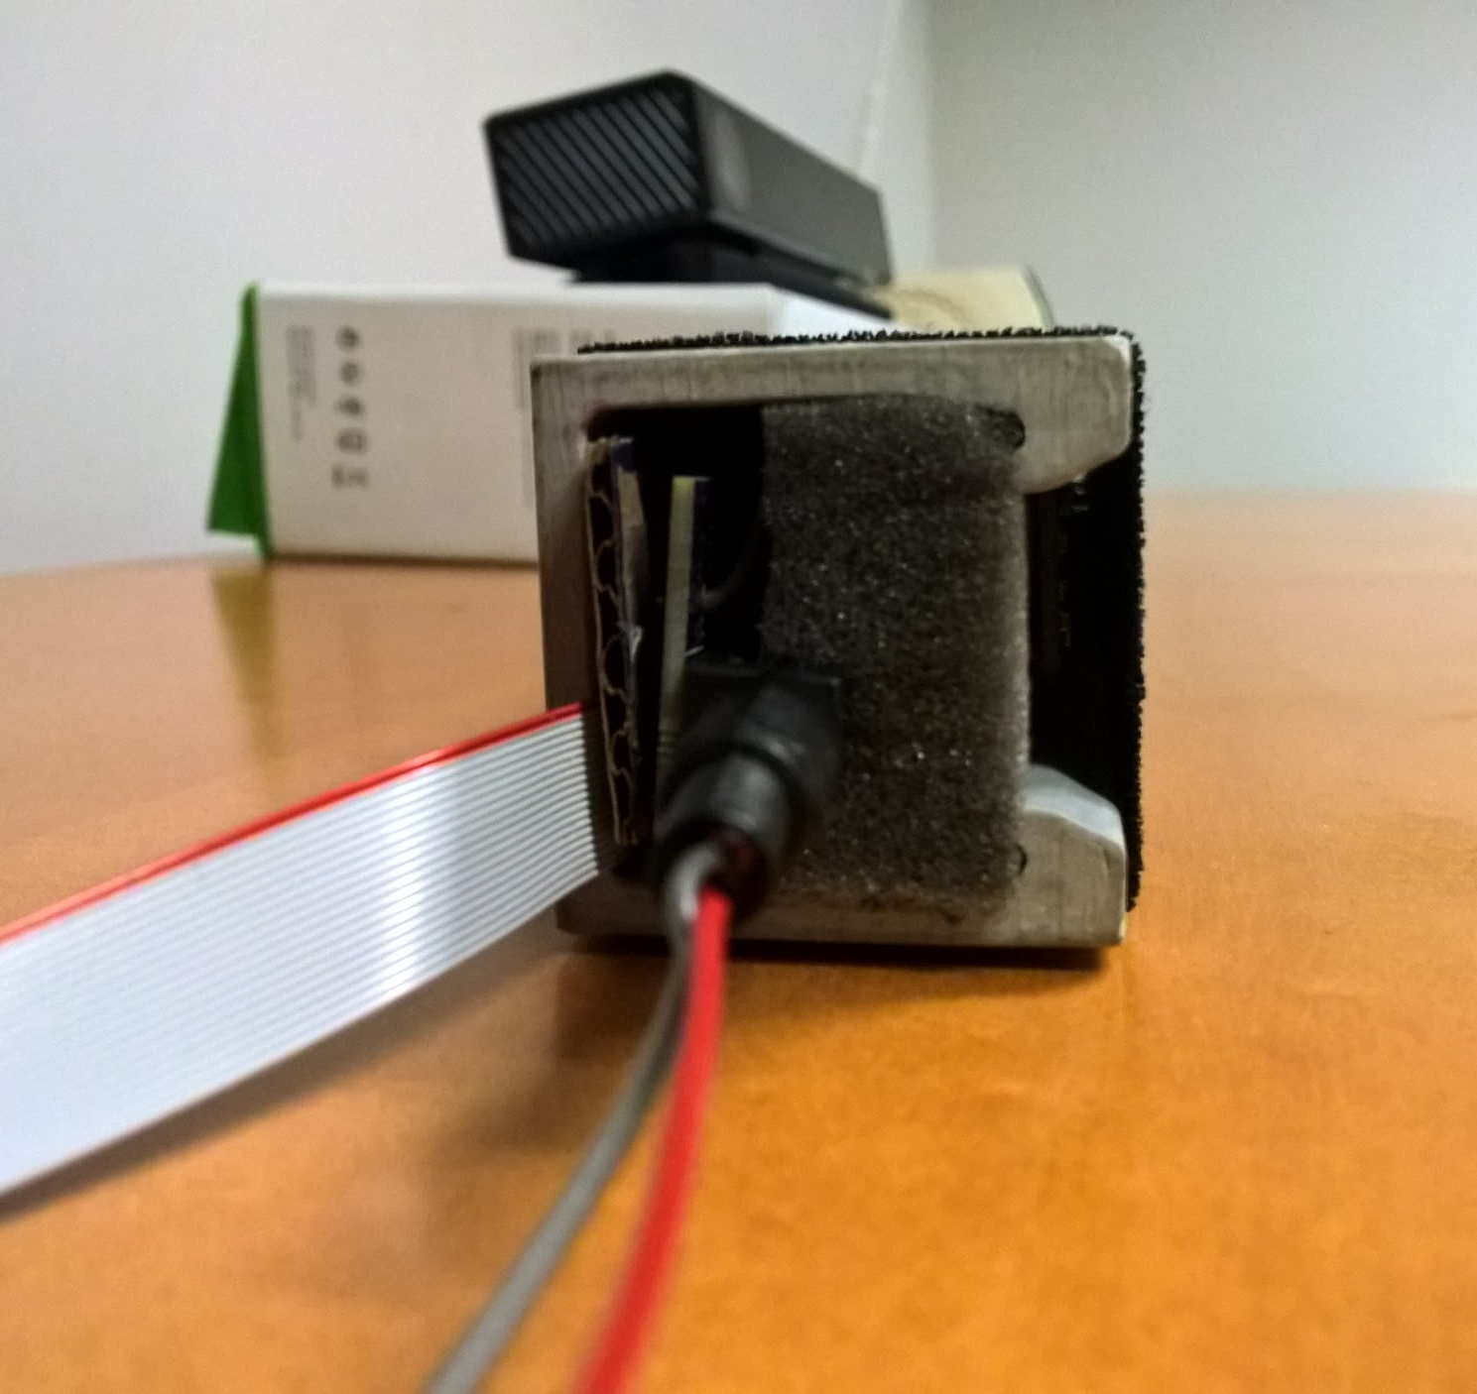
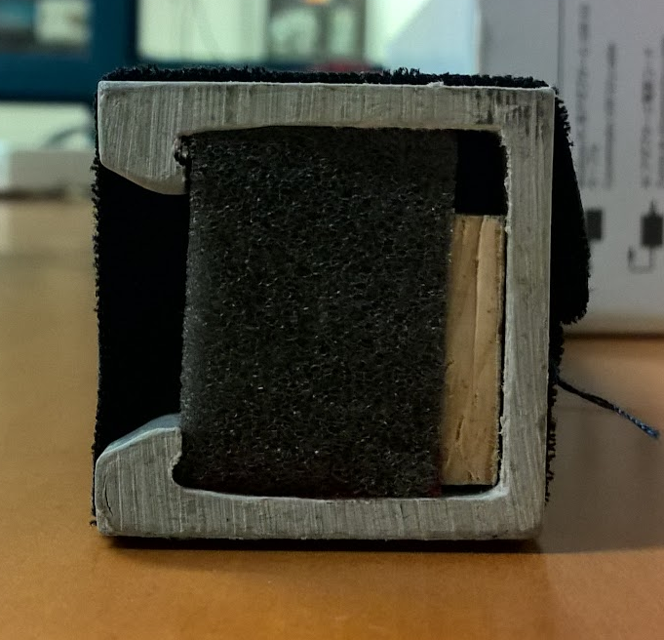
Array Construction

Slide 18
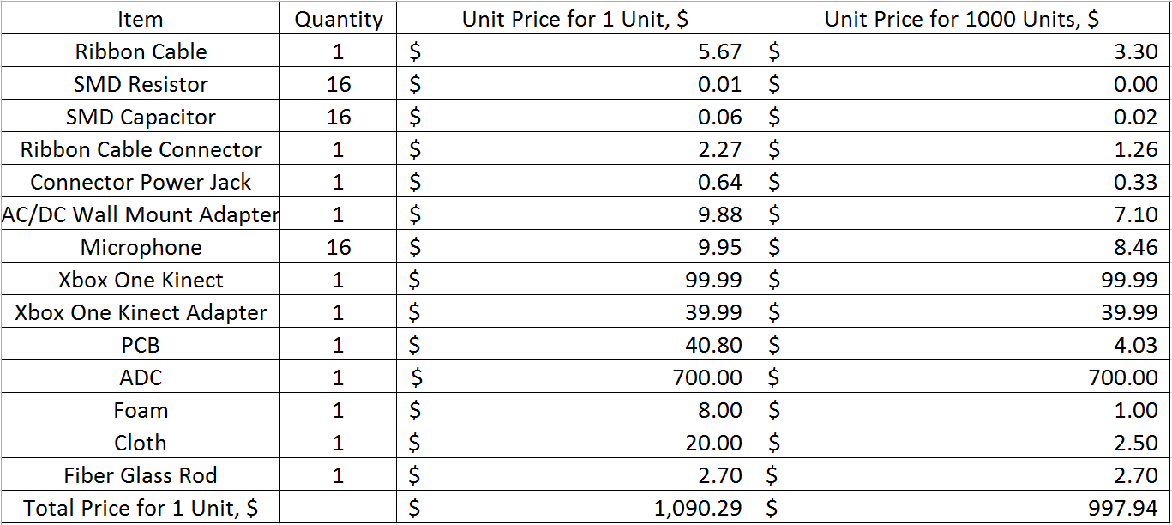
Cost Analysis

Slide 19
Future possibilities
Hardware (FPGA) solution for ADC and processing
  Minimize delay even further
    Parallel DSP in hardware
  More microphone input channels
    Better audio quality (higher frequency ranges)
    Reduced beamwidth

Slide 20
Demo
Two people standing separately have isolated audio
Listener will be sitting outside kinect’s range with app in hand

Slide 21
Demonstration

Slide 22
Questions?

Slide 23
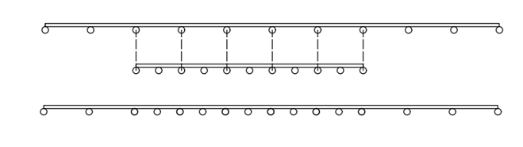
Software Filtering
Subarrays within array target sub-bands of human speech frequencies
14cm
600 - 1200 Hz Octave
1200 - 2400 Hz Octave
Aliasing occurs in beamforming if the microphone distance exceeds λ/2
To avoid, microphones can only process data in given subband

Slide 24
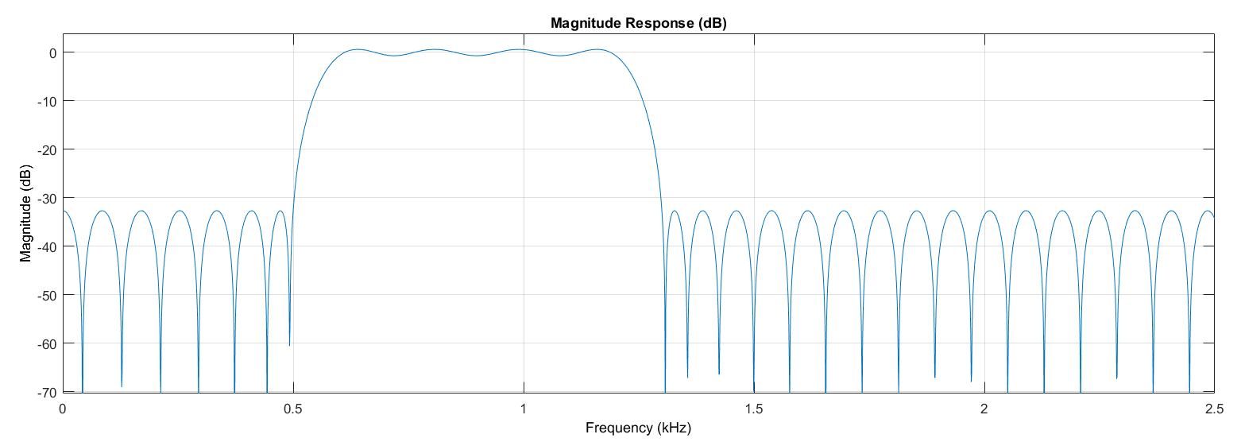
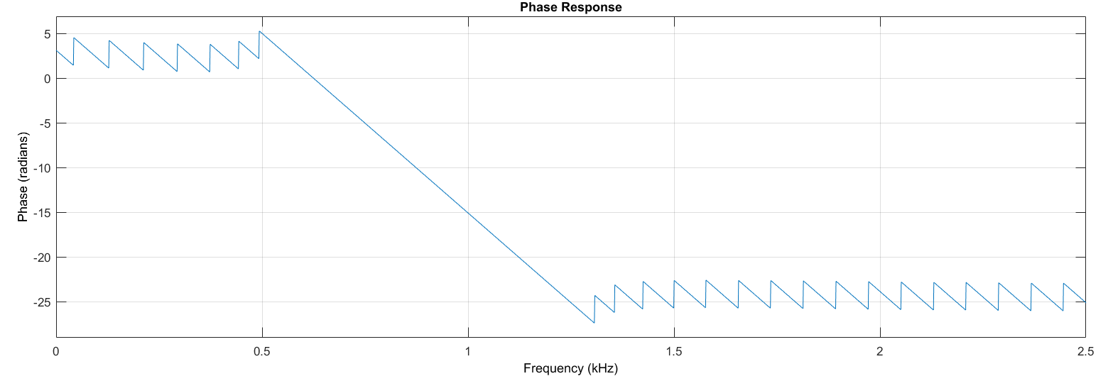
Software Filtering
 | Low Octave | High Octave
Stopband Low | 500 Hz | 1100 Hz
Passband Low | 600 Hz | 1200 Hz
Passband High | 1200 Hz | 2400 Hz
Stopband High | 1300 Hz | 2500 Hz
Transition Bandwidth | 100 Hz | 100 Hz
Filter Order | 200 | 200
Stopband Attenuation | 35 db | 35 db
Requires 120us to process 65 ms of audio

Slide 25
Integration: Audio Datapath

Slide 26
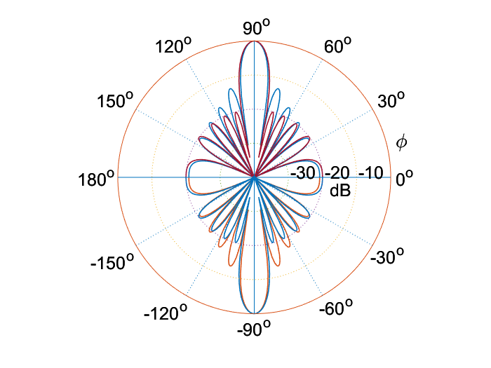
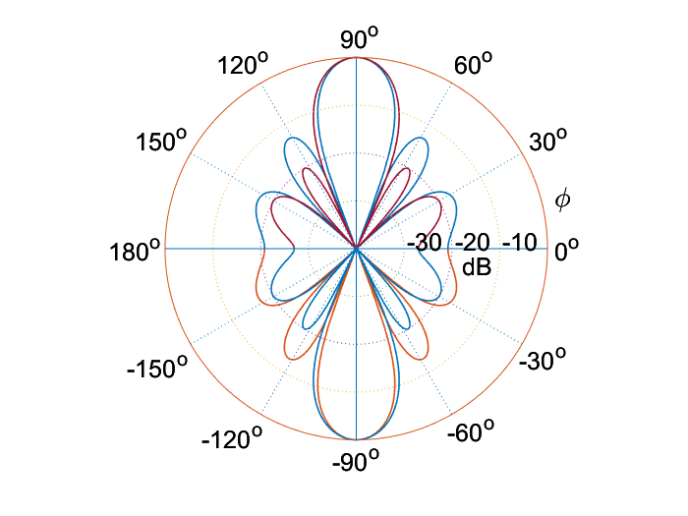
Why do I still hear the other guy? - Side lobes and Microphone Weights
With sound, a 10dB decrease represents a halving of volume
Sidelobes can reach close to -10dB attenuation when mics are uniformly weighted
Can reduce sidelobes, at the cost of beamwidth, using Chebyshev weights
Worst case for our Array, d= 0.25ƛ
Best case for our Array, d= 0.5ƛ

Slide 27
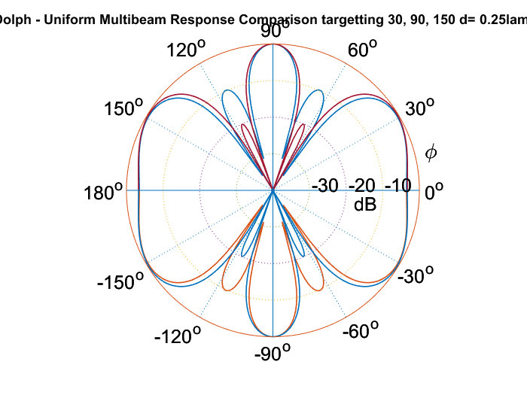
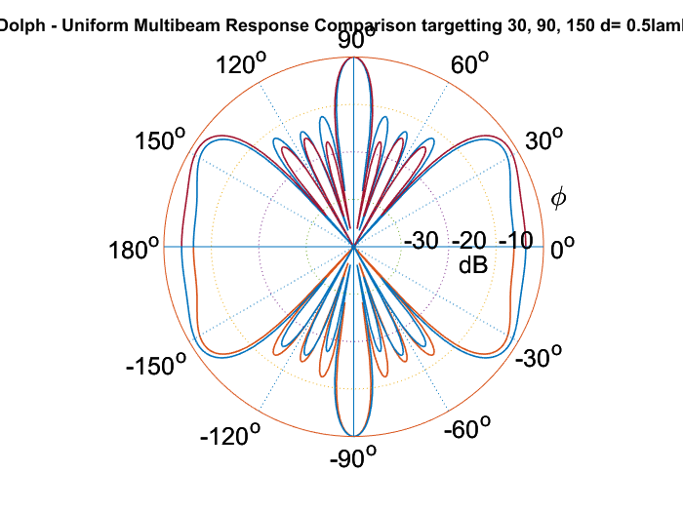
Why do I still hear the other guy? - Side lobes and Microphone Weights
Sidelobes get worse when beamforming is done in parallel
Worst case for our Array, d= 0.25ƛ
Best case for our Array, d= 0.5ƛ

