Slide 1
Ear Beamer CDR
  Aaron Lucia, Niket Gupta, Matteo Puzella, Nathan Dunn

Slide 2
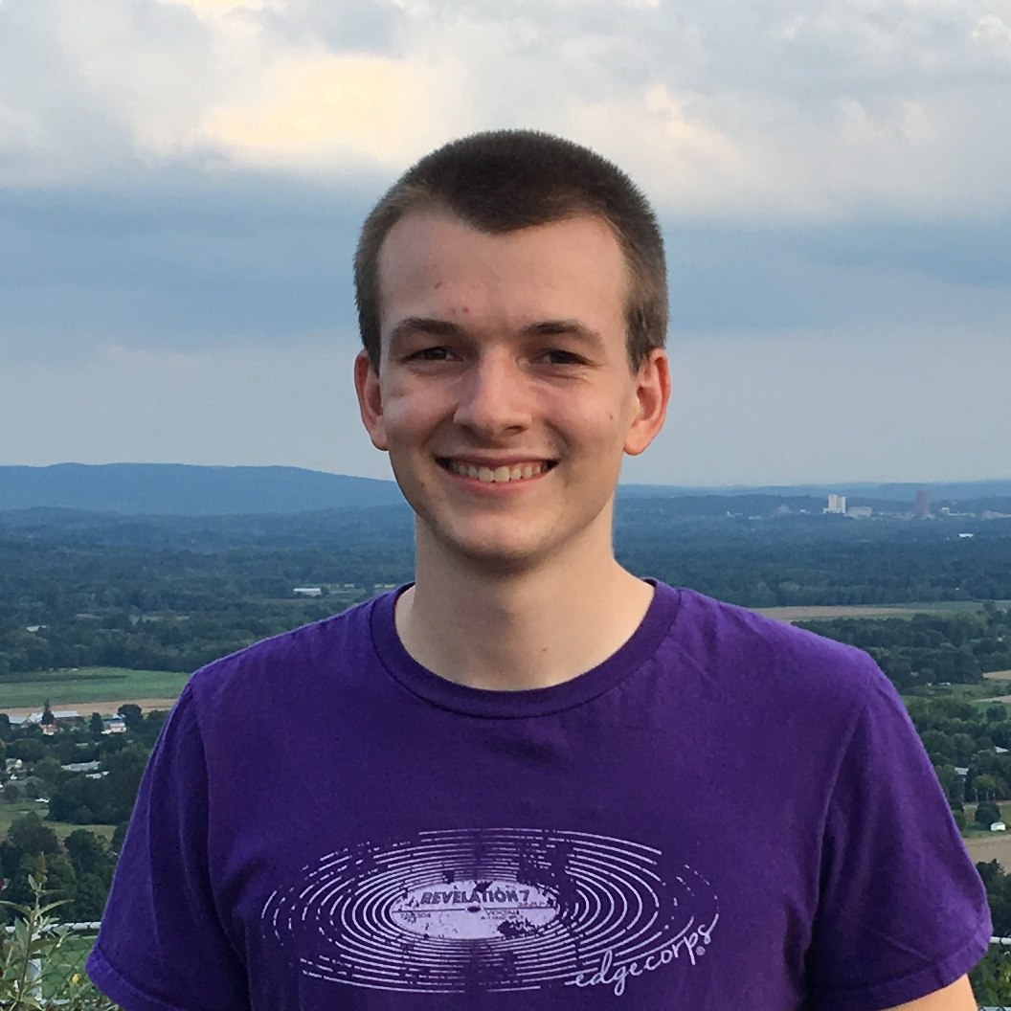
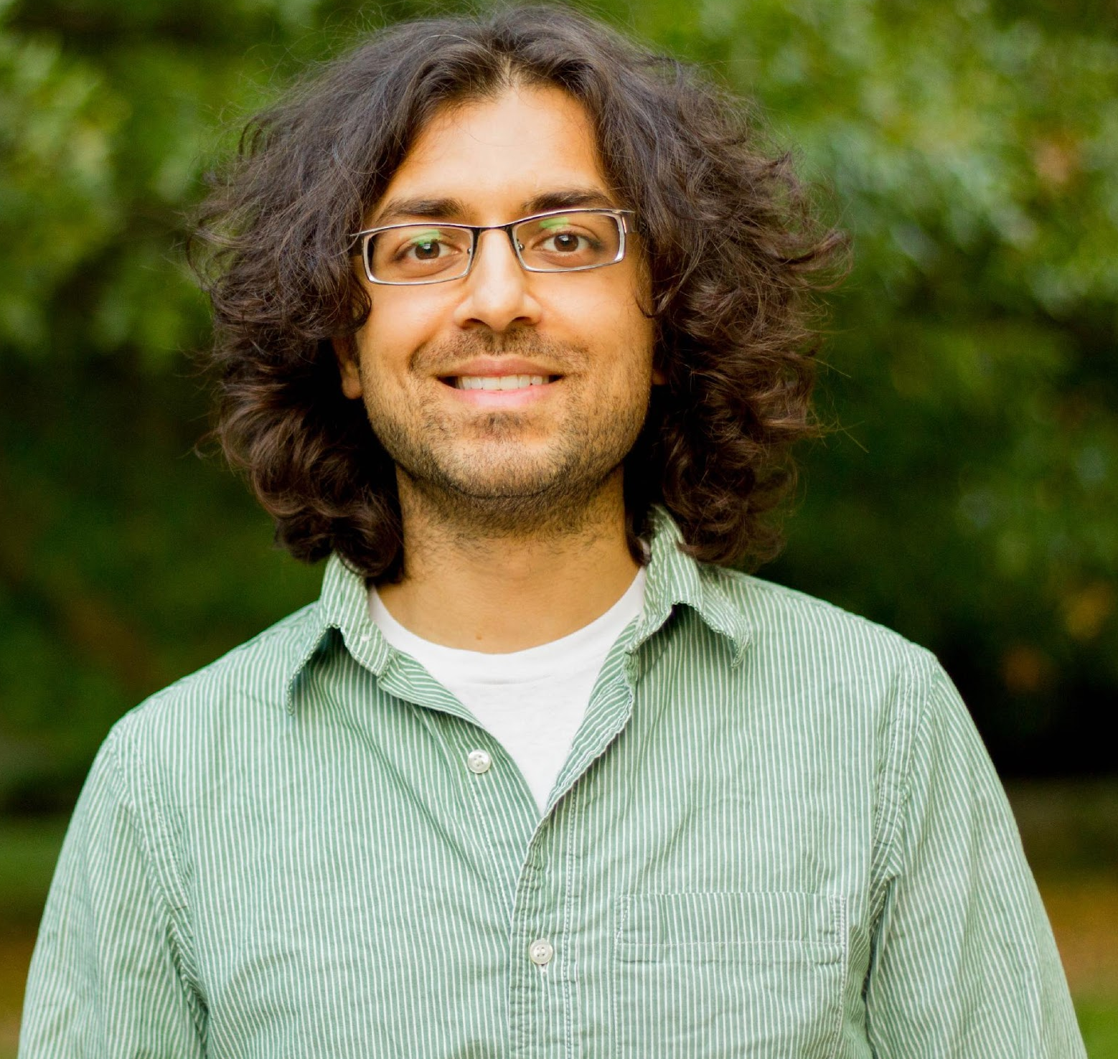
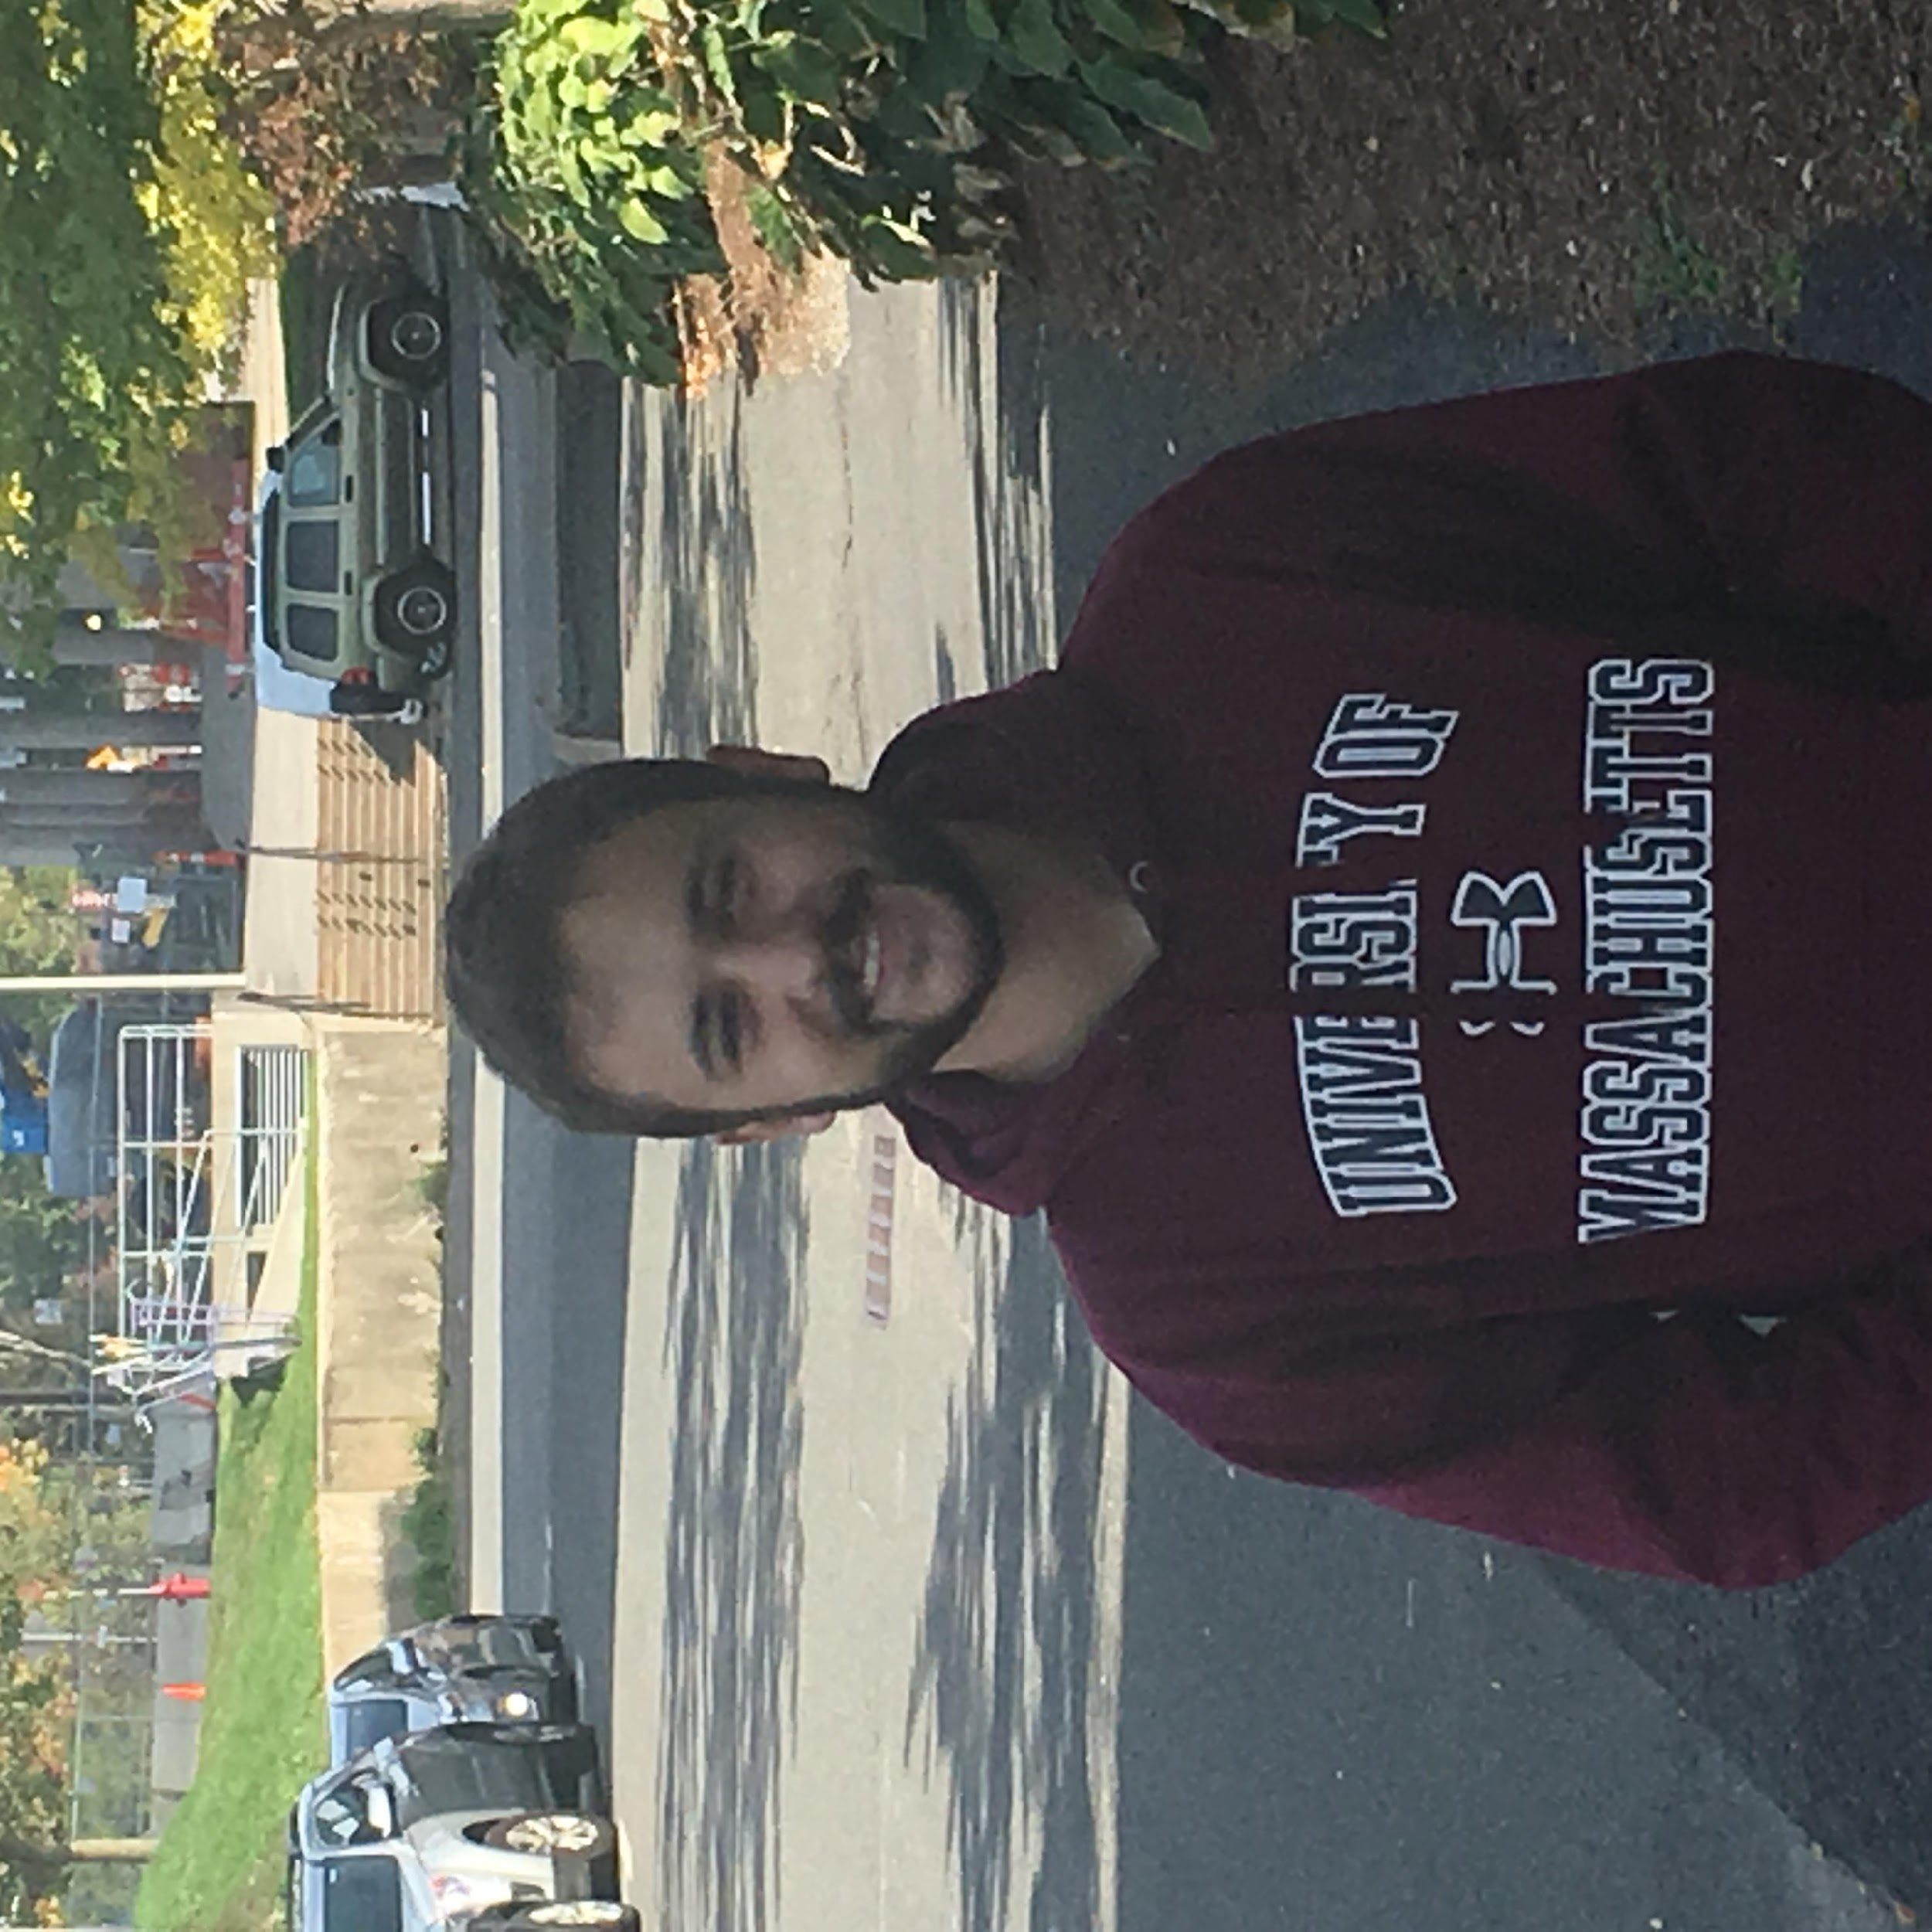
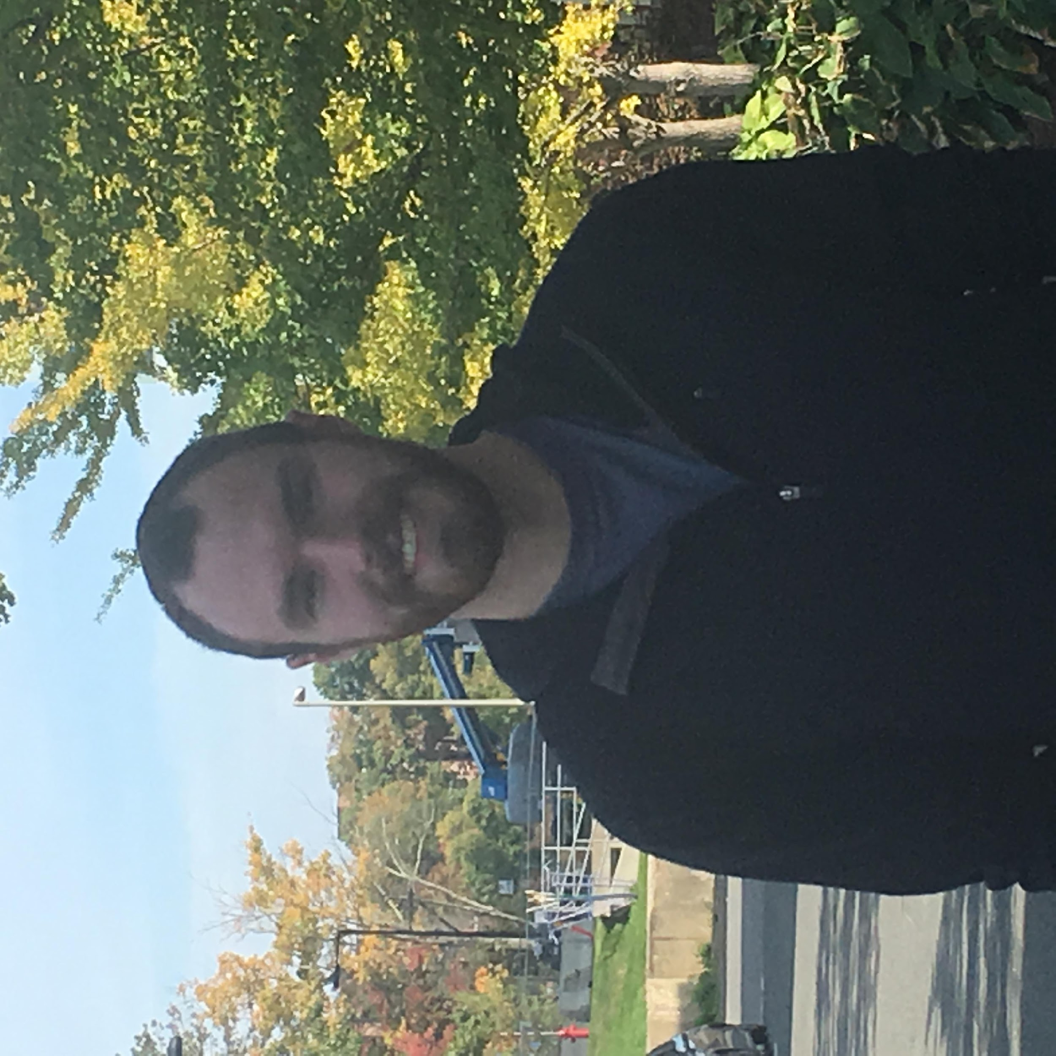
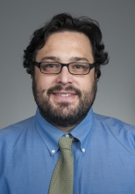
The Team
Aaron Lucia
CSE
Niket Gupta
CSE
Matteo Puzella
EE
Nathan Dunn
CSE
Advisor: Prof. Mario Parente

Slide 3
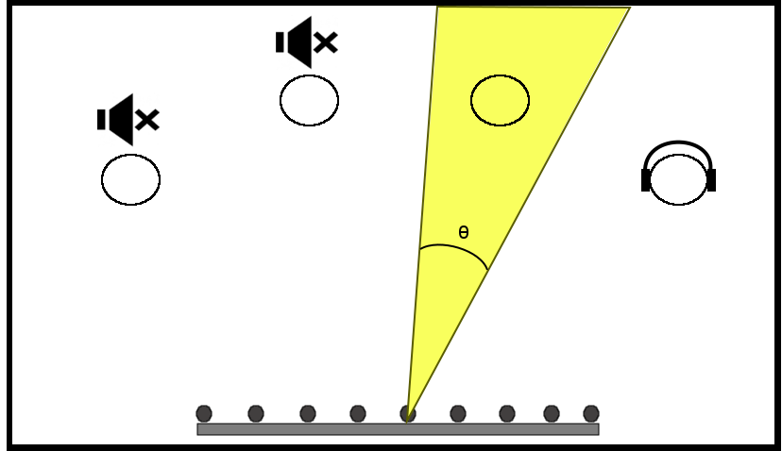
Outlining the System
Our Goal:
Develop a hearing aid system that gives user ability to individually amplify multiple targets of his/her choice and attenuate unwanted targets, independent of body or head position of the user

Slide 4
Block Diagram

Slide 5
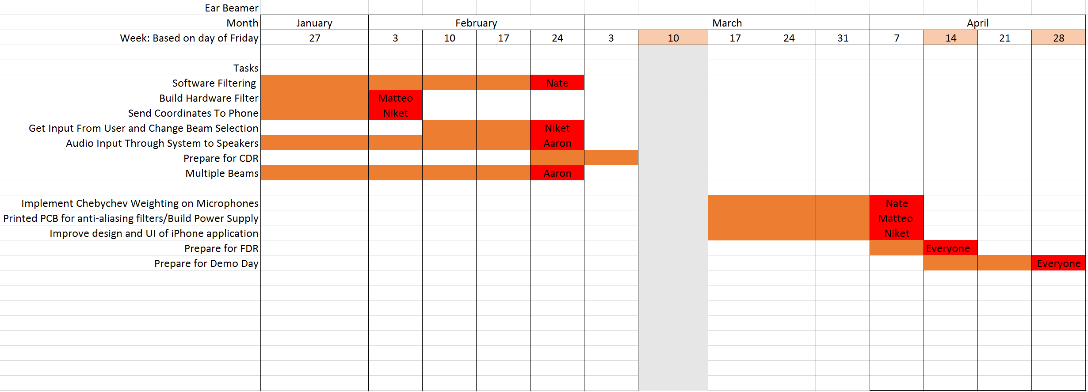
2017 SDP Scheduling
WE ARE HERE

Slide 6
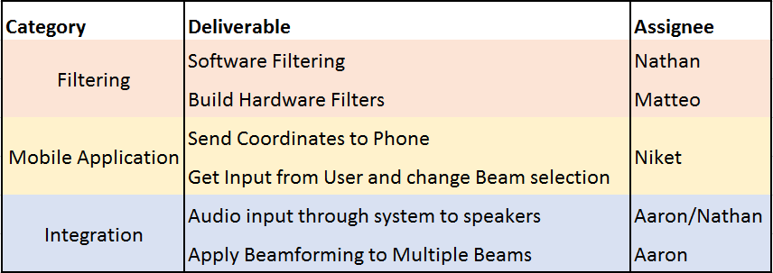
CDR Deliverables
Notes:
For our "Type equation here."

Slide 7
Socket Server
Websockets - Duplex Communication between client and server
Server broadcasts a JSON payload over a Websocket connection
{"targets":[ {"id": 10135,"x_coord": 2.56,"y_coord": 2.34,"muted": true}]}
{"status":[{"id": 10135, "muted": true}]}

Slide 8
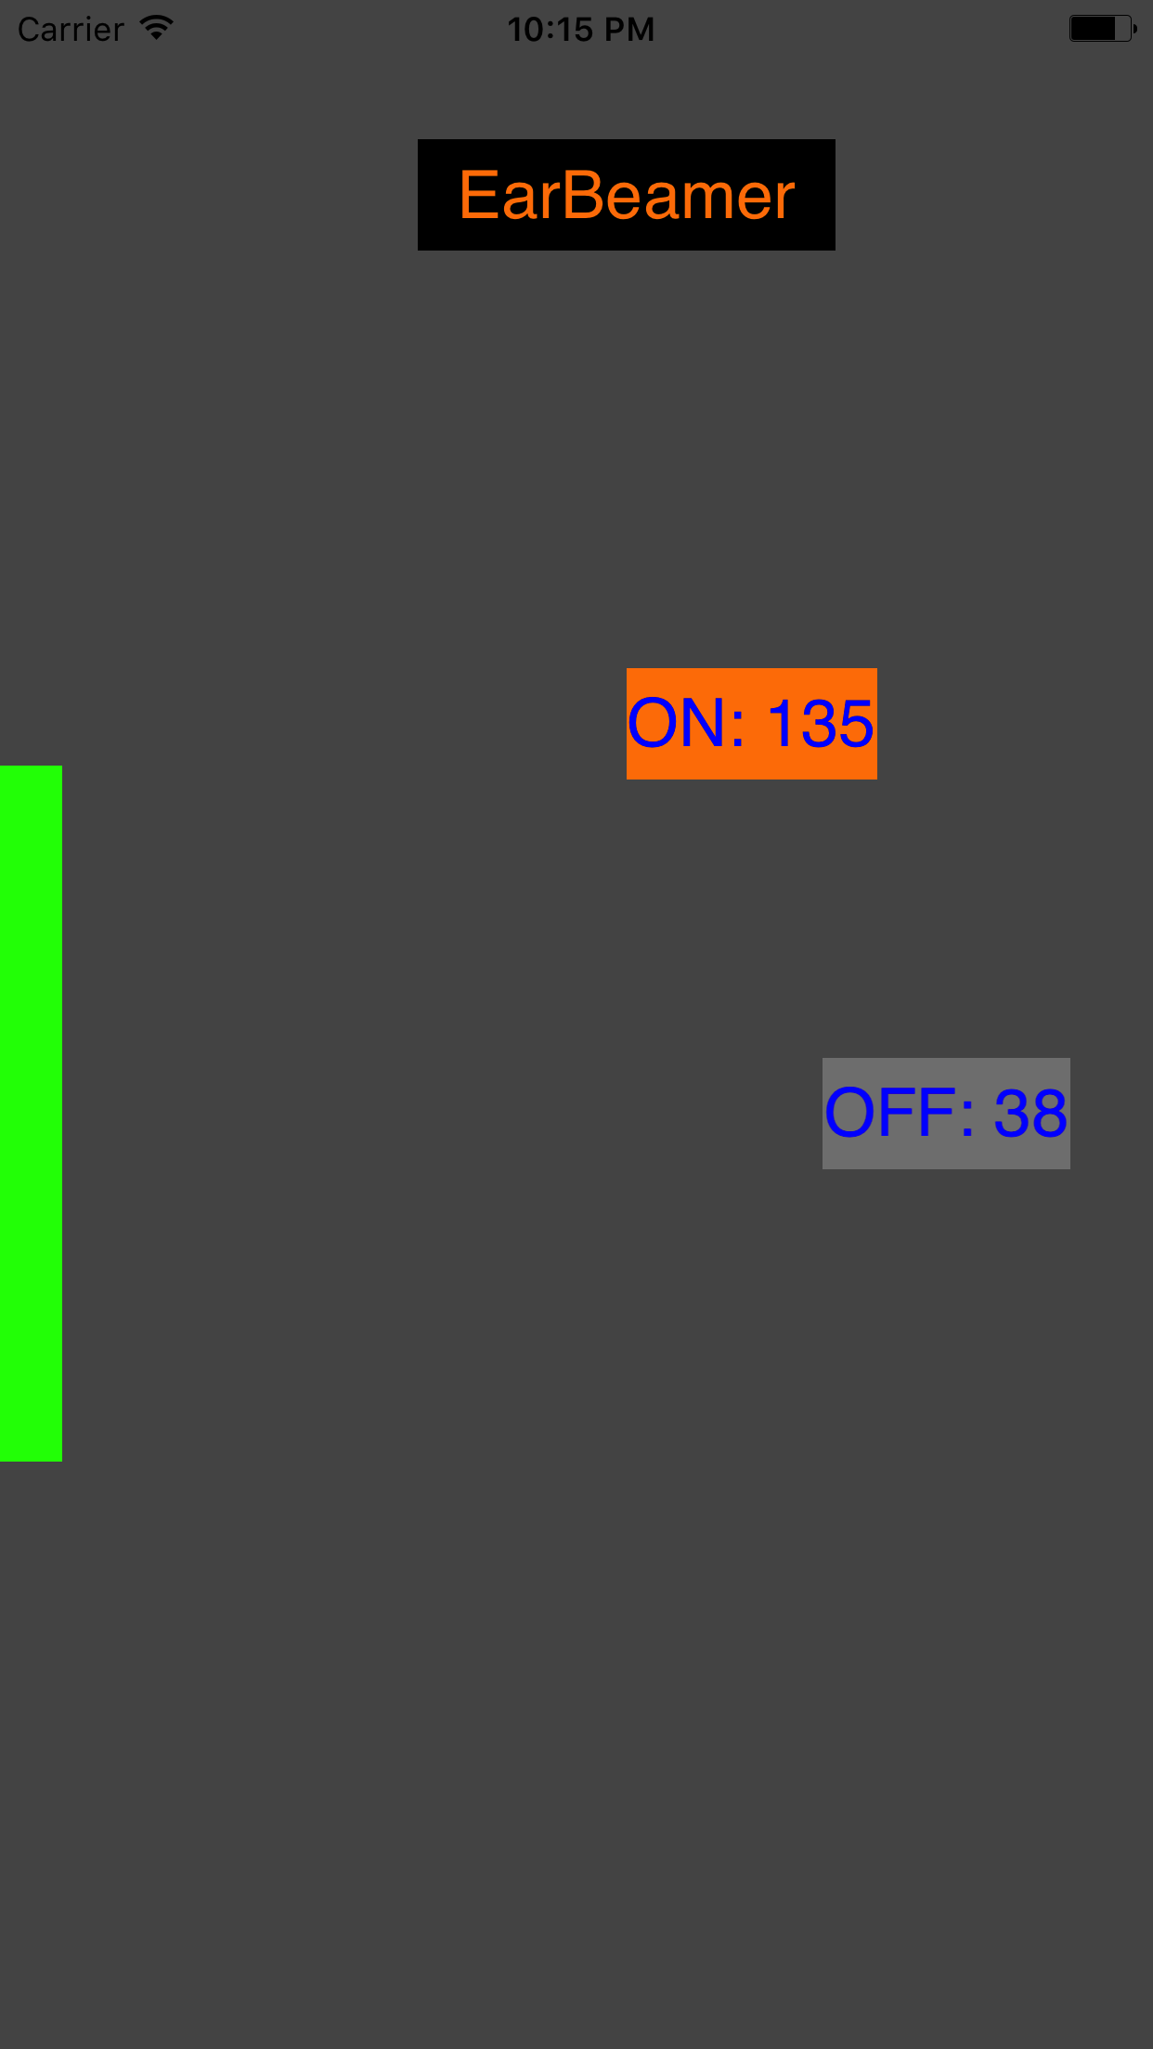
iPhone Application
Asynchronous communication with Processor
WebSocket protocol
Live updates (every second)
Color-coded target status - On/Off
Targets mapped to room

Slide 9
Hardware Filtering
Anti-Aliasing RC low pass filter built at input of microphones
-Cut-Off frequency at 7,000 Hz. R = 20 ohms. C= 1.15uF
Sample rate of 15625 S/s per mic (max of ADC)
Testing:
Used pure tone signal from function generator and recorded attenuation from 1000 Hz to 7000 Hz
Recorded time delay of frequencies from 1000 Hz to 4000 Hz
-Biggest change in group delay is 8.16us

Slide 10
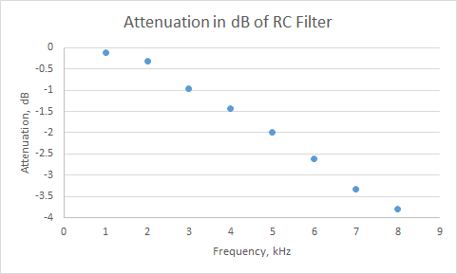
Hardware Filtering

Slide 11
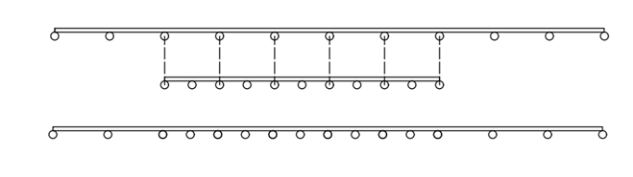
Software Filtering
Subarrays within array target sub-bands of human speech frequencies
14cm
600 - 1200 Hz Octave
1200 - 2400 Hz Octave
Aliasing occurs in beamforming if the microphone distance exceeds λ/2
To avoid, microphones can only process data in given subband

Slide 12
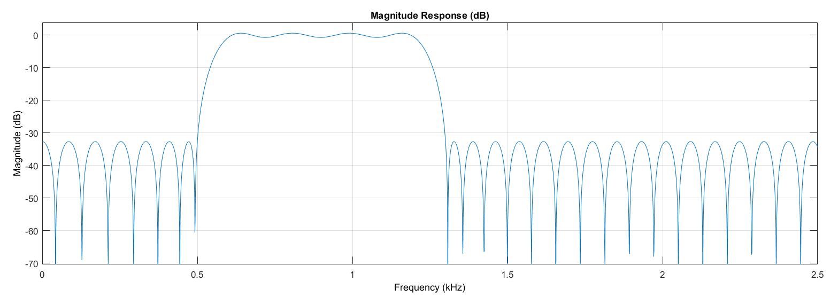
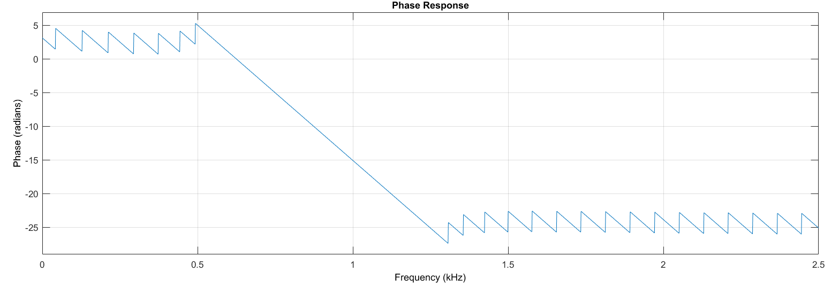
Software Filtering
 | Low Octave | High Octave
Stopband Low | 500 Hz | 1100 Hz
Passband Low | 600 Hz | 1200 Hz
Passband High | 1200 Hz | 2400 Hz
Stopband High | 1300 Hz | 2500 Hz
Transition Bandwidth | 100 Hz | 100 Hz
Filter Order | 200 | 200
Stopband Attenuation | 35 db | 35 db
Requires 120us to process 65 ms of audio

Slide 13
Integration: Audio Datapath

Slide 14
Demo
Two people standing separately have isolated audio
Selecting target with app works
Limitations:
App is in a functional stage, but is not user friendly at the moment
Further beamforming improvements to better isolate others
3 microphones are not functioning, so beamforming should improve when those come in

Slide 15
FDR Goals:
Hardware:
Printed PCB for anti-aliasing filters
Design and print PCB for power supply
Reducing Noise and Improving Performance
Implement Chebyshev Weighting for microphones
Design scenarios to determine experimental performance of beamforming and compare with theoretical MATLAB simulations
Usability
Improve design and user interface of iPhone application
Improve User interface for Windows Application

Slide 16
Demonstration

Slide 17
Questions?

Slide 18
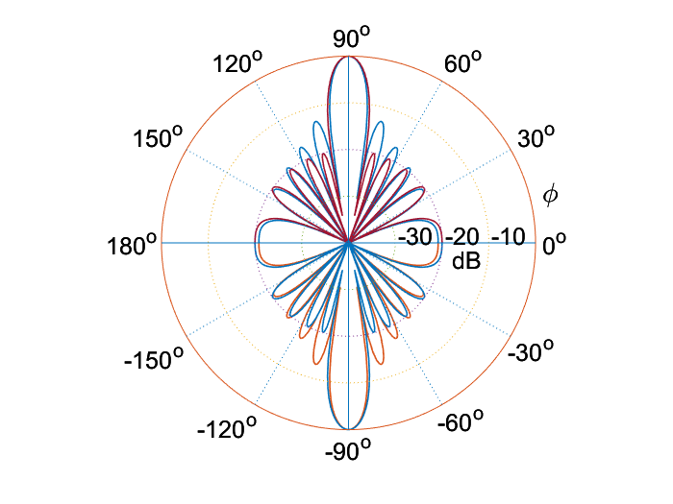
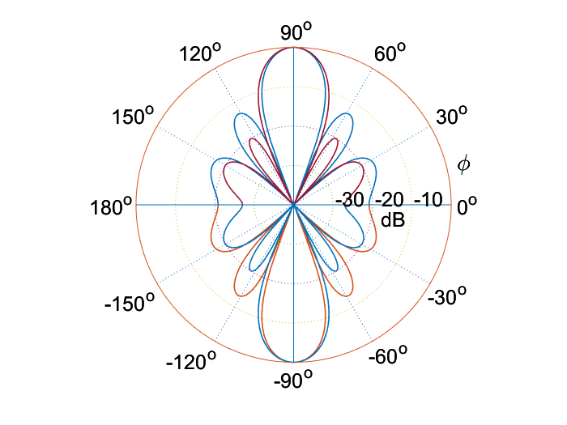
Why do I still hear the other guy? - Side lobes and Microphone Weights
With sound, a 10dB decrease represents a halving of volume
Sidelobes can reach close to -10dB attenuation when mics are uniformly weighted
Can reduce sidelobes, at the cost of beamwidth, using Chebyshev weights
Worst case for our Array, d= 0.25ƛ
Best case for our Array, d= 0.5ƛ

Slide 19
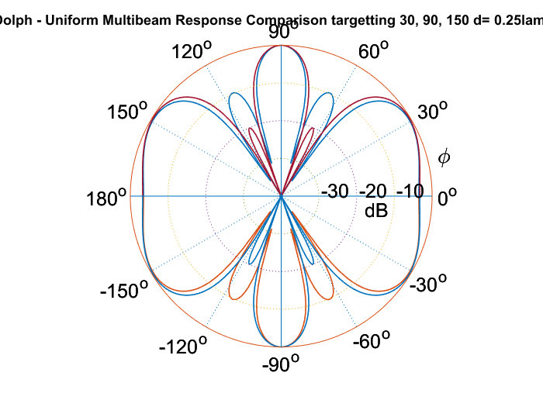
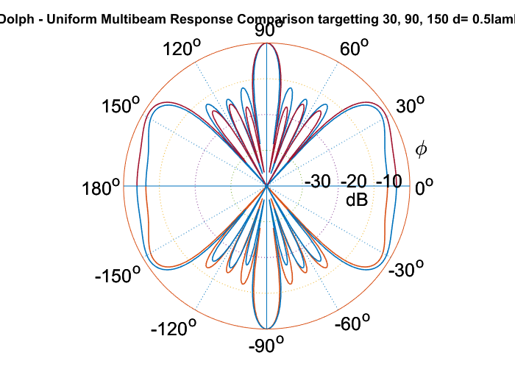
Why do I still hear the other guy? - Side lobes and Microphone Weights
Sidelobes get worse when beamforming is done in parallel
Worst case for our Array, d= 0.25ƛ
Best case for our Array, d= 0.5ƛ

