Slide 1
Preliminary Design Review
Team LOM
October 18, 2016

Slide 2



LOM (Lawn-O-Matic)
Robert Cocomello
ECE
Jeremy Doe
CSE
Jonathan Scibelli
CSE
Ahmet Yanbul
CSE

Slide 3
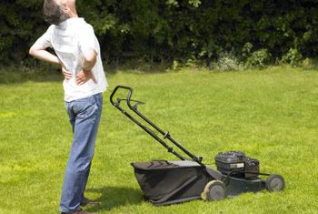
Problem?
People don’t like to mow their lawn
Average American Spends 70hr/yr
Hire a landscaper
~$150/yr to maintain lawn
Notes:
cost of current auto mowers...

Slide 4
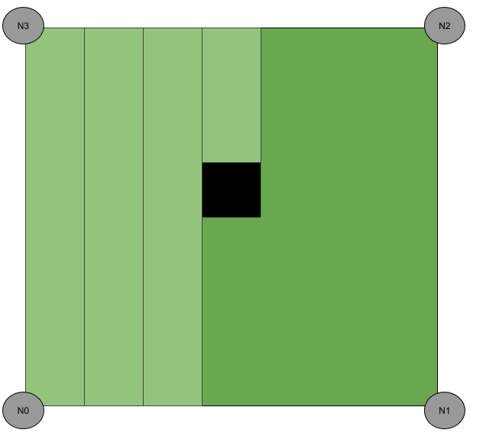
Our Vision

Slide 5
Requirements Analysis: Specifications
Lawn Mower
Stay in boundaries
No unmowed patches
Don’t run out of power
Lawn
Rectangular
Completely level
Obstruction free

Slide 6
Requirements Analysis: Inputs and Outputs
Input(s)
Unmowed lawn
Location of mower
Output(s)
Lawn completely mowed
Direction of mower
New location of mower

Slide 7
Design Alternatives
Infrared sensors to determine location
Corner nodes w/ LEDs
Mower w/ infrared sensors
Wire to detect edge of lawn
Sensor on mower
Detect electromagnetic field
Sensors to detect grass
Ultrasonic
Color sensor

Slide 8
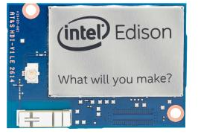
Our Solution: LOM
Controller on lawn mower - Intel Edison
Calculates position
Drives wheels
Ultrasonic transmitter on mower
Continuously send ultrasonic signals
4 Nodes on each corner of lawn
Ultrasonic receivers
Arduino
WiFi
Communication between Edison and nodes

Slide 9
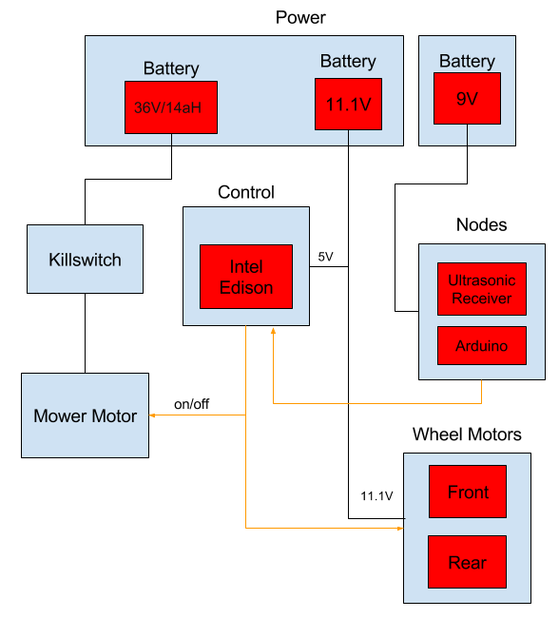
Our Solution: Block Diagram
Wi-Fi

Slide 10
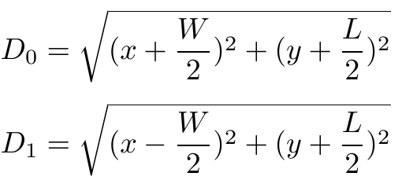
Location
Determined using distance from each Node
6 cases when finding position
D0 = distance from N0
Case 1: N0,N1
N₃
N₂
y
(0,0)
x
N₀
N₁

Slide 11
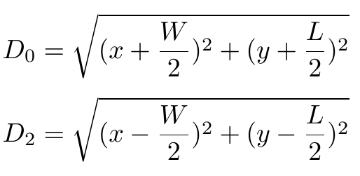
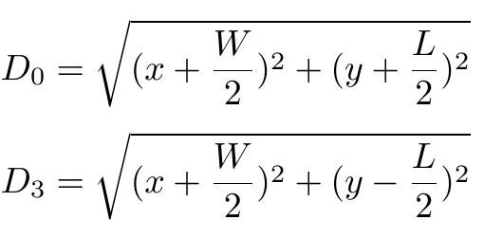
Location
Case 2: N0,N2
N₃
N₂
y
Case 3: N0,N3
(0,0)
x
N₀
N₁

Slide 12
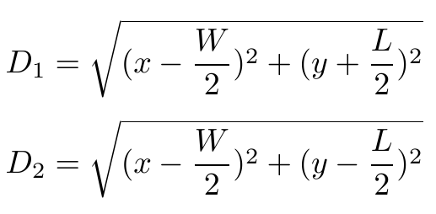
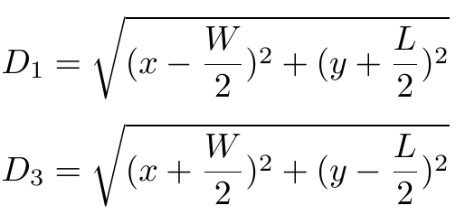
Location
Case 4: N1,N2
N₃
N₂
y
Case 5: N1,N3
(0,0)
x
N₀
N₁

Slide 13
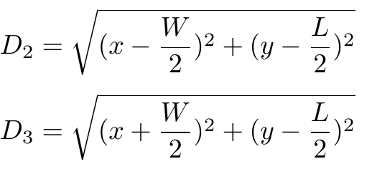
Location
Case 6: N2,N3
N₃
N₂
y
(0,0)
x
N₀
N₁

Slide 14
Sensor Network
Sensor nodes on corners
Determine location of mower
Keep mower within corners
One node determined as “home”
Data Transmission over WiFi
Ultrasonic burst timestamp
Node ID
WiFi 2.4GHz
HTTP POST request
Web server hosted on Intel Edison

Slide 15
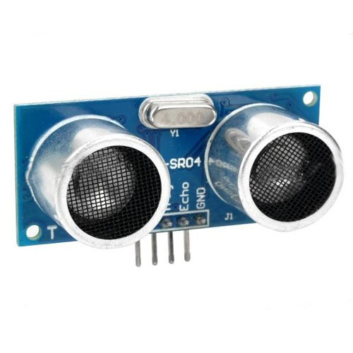
Sensors
Ultrasonic Transmitters
On mower
Transmit to nodes
Determine location of mower
Ultrasonic Receivers
Corner Nodes
Communicate with mower

Slide 16
Sensor Accuracy
Speed of sound = 340.29m/s
Distance = Speed*Time
Time Error (ms) | Distance Error (mm = inches)
.001 | .34029 = 0.0134
.01 | 3.4029 = 0.134
.1 | 34.029 = 1.34
1 | 340.29 = 13.4
10 | 3402.9 = 134.0 = 11.1ft

Slide 17
Power
36V Battery
Power lawn mower motor
11.1V Battery
Power Intel Edison with 5V
Power wheel motors (4)
9V Battery
Power nodes

Slide 18
User Interface and Communication
HTTP POST requests between nodes and mower
Sends time to mower
HTML web server enabled on mower
View progress
Halt mower
Additional configuration and log files
Kill switches

Slide 19
Proposed MDR Deliverables
Demonstration of Location Detection
Ultrasonic frequency enabled Radar system
Multiple radial distance transmissions via nodes
Edison calculations
Small model of working location system
Demonstration of Network Management
Communication via HTTP
Included in small model

Slide 20
Questions?

