Slide 1
Midway Design Review
  Team LOM
  December 8, 2016

Slide 2



Lawn-O-Matic (LOM)
Robert Cocomello
ECE
Jeremy Doe
CSE
Jonathan Scibelli
CSE
Ahmet Yanbul
CSE

Slide 3
Lawn-O-Matic
Problem
  People don’t like to mow their lawn
  Average American Spends 70hr/yr
  Hire a landscaper ~$1800/yr to maintain lawn
Mow Lawn
  Mow entire lawn
  Stay within the boundaries of lawn

Slide 4
System Requirements
Lawn Size
  Mow a lawn up to 20 feet by 20 feet
Accuracy of Location
  Accurate within 6 inches
Charging Time
  Charge Li-Po Battery within 24 hours
Complete lawn without assistance

Slide 5
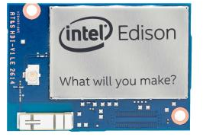
Our Solution: LOM
Controller on lawn mower - Intel Edison
  Calculates position
  Drives wheels
Ultrasonic transmitters on mower
  Periodically sends ultrasonic signals
4 Nodes on each corner of lawn
  Ultrasonic receivers
  Arduino
WiFi
  Communication between Edison and nodes

Slide 6
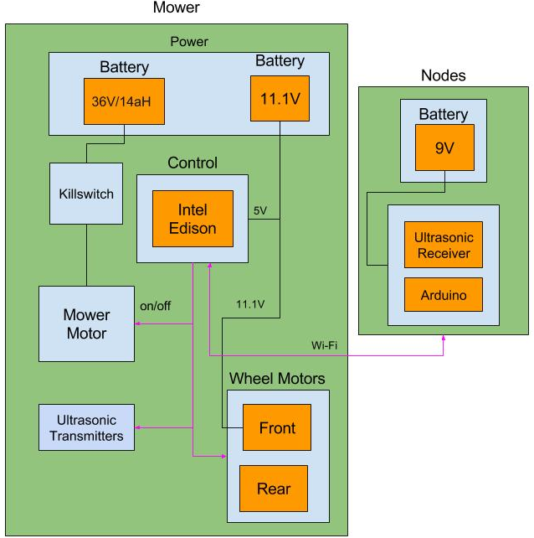
Our Solution: Block Diagram

Slide 7
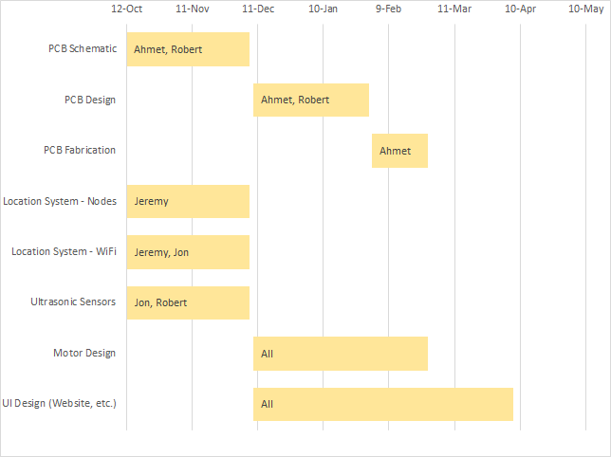
Team Responsibilities

Slide 8
MDR Deliverables
Demonstration of Location Detection
  Ultrasonic frequency enabled Radar system
  Multiple radial distance transmissions via nodes
  Edison calculations
  Small model of working location system
Demonstration of Network Management
  Communication via WiFi
  Included in small model
Design of battery charging circuit

Slide 9
Power
11.1 V 2200mAh LiPo Battery
3 Cells
  Max voltage capacity: 4.2V each
  Max charging current: 2.2A each
Circuit
  Voltage regulator: LM350T
  BJT
    As cells charge, current decreases
  LED
    Turns on when charger connected
    As current decreases, LED turns off
    Off when charging complete

Slide 10
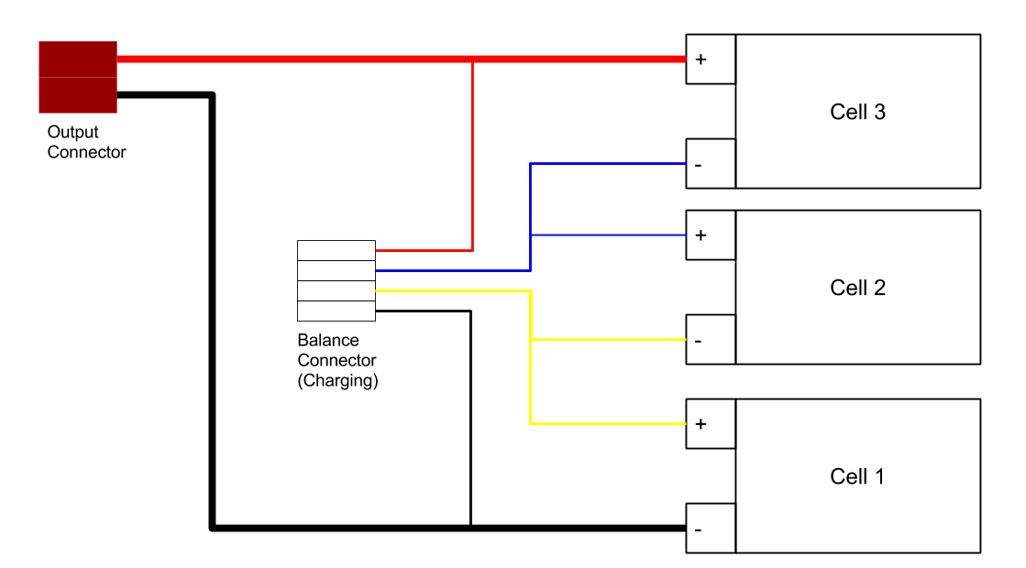
3 Cell Li-Po Battery schematic

Slide 11
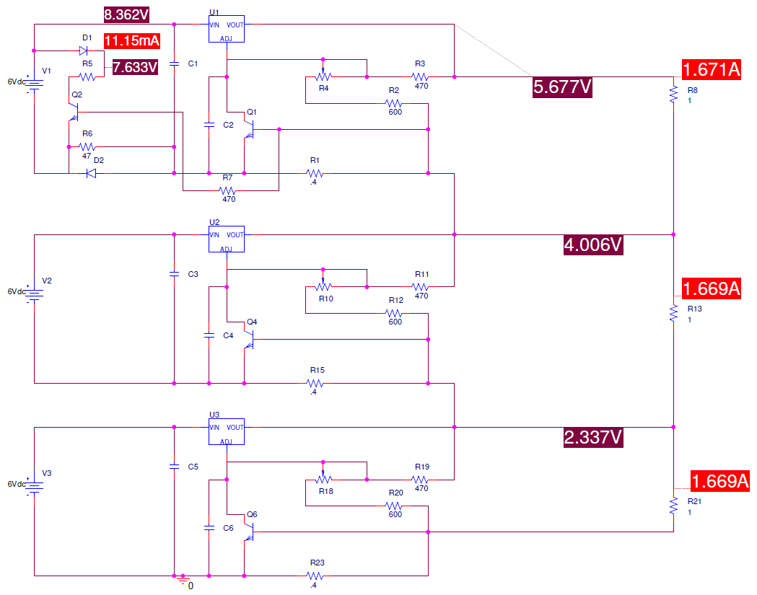
Charging Circuit: Charging

Slide 12
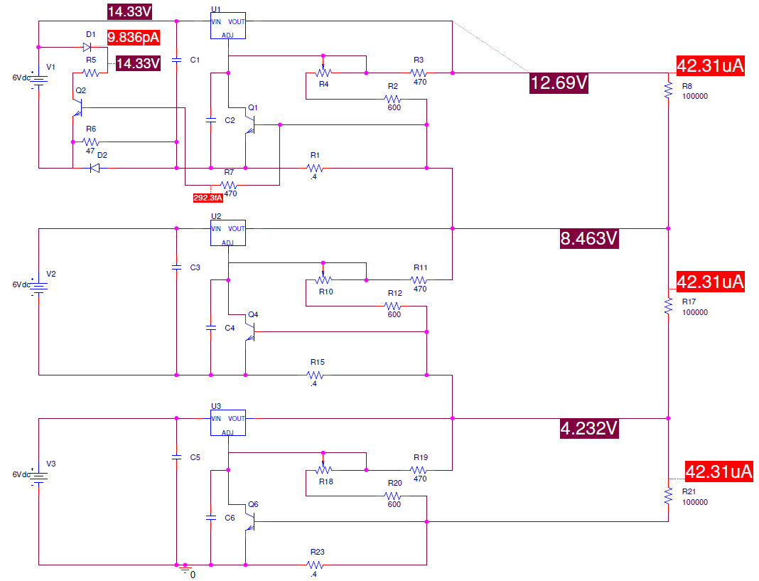
Charging Circuit: Completed

Slide 13
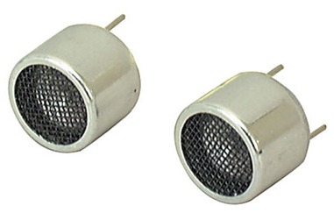
Sensors
Ultrasonic Transmitters
  On mower
  Transmit to nodes
  Determine location of mower
Ultrasonic Receivers
  Corner Nodes
  Communicate with mower

Slide 14
Sensor Network
Sensor nodes on corners
  Determine location of mower
  Keep mower within corners
  One node determined as “home”
Data Transmission over WiFi
  Ultrasonic burst timestamp
  Node ID
WiFi 2.4GHz
  UDP Datagrams
  Web server hosted on Intel Edison

Slide 15
Location Detection
Mower emits ultrasound
  Creates timestamp per transmission
Nodes receive ultrasound
  Create timestamp per received signal
Nodes forward timestamp and ID to Edison
  Process completed over WiFi

Slide 16
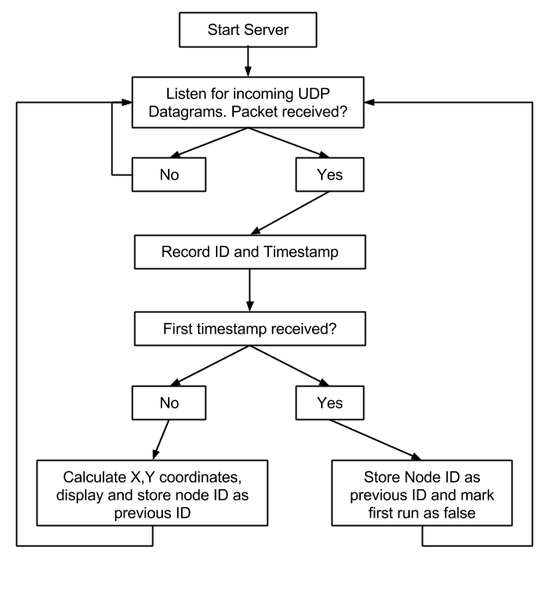
Lawn Mower Control Flowchart (On Edison)

Slide 17
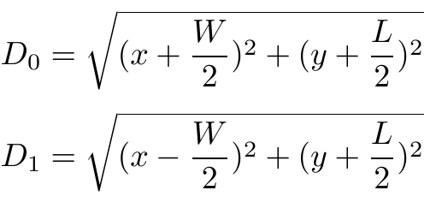
Location
Determined using distance from each Node
6 cases when finding position
  D0 = distance from N0
Case 1: N0,N1
N₃
N₂
y
(0,0)
x
N₀
N₁

Slide 18
Demonstration

Slide 19
Proposed CDR Deliverables
Improved accuracy of location detection - Jeremy Jon
Mower Jon Robert
  Chassis with wheels and motors
  Control motors with Edison
Nodes - Jeremy Ahmet
  Node Housing
Charging - Robert Ahmet
  Completed PCB fabrication

Slide 20
Questions?

