Slide 1
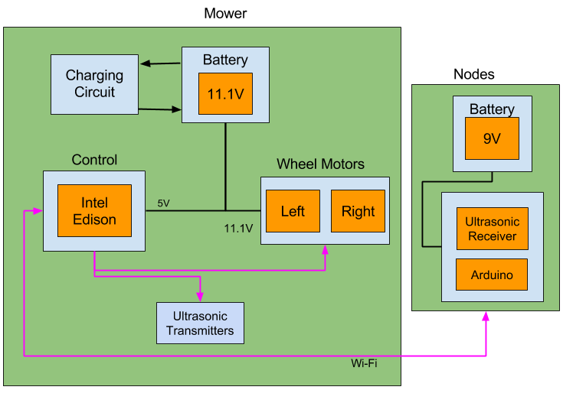
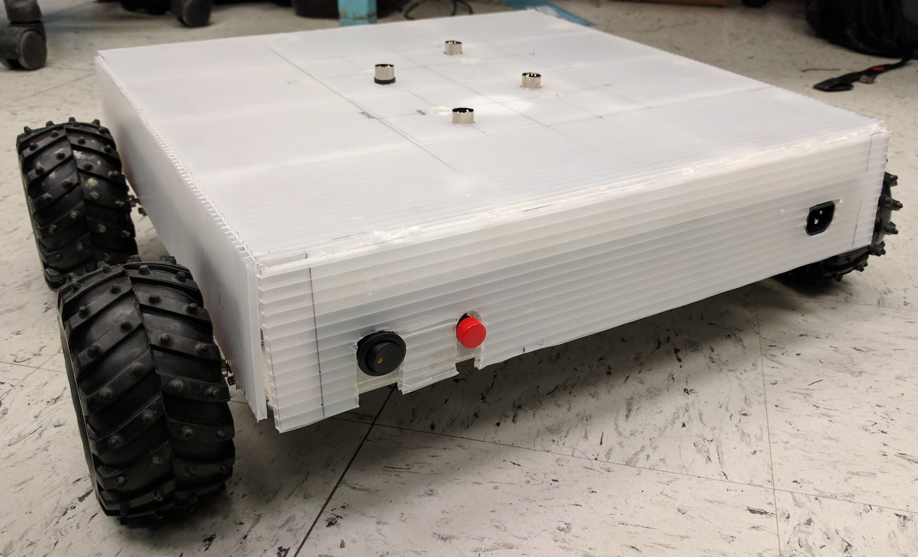
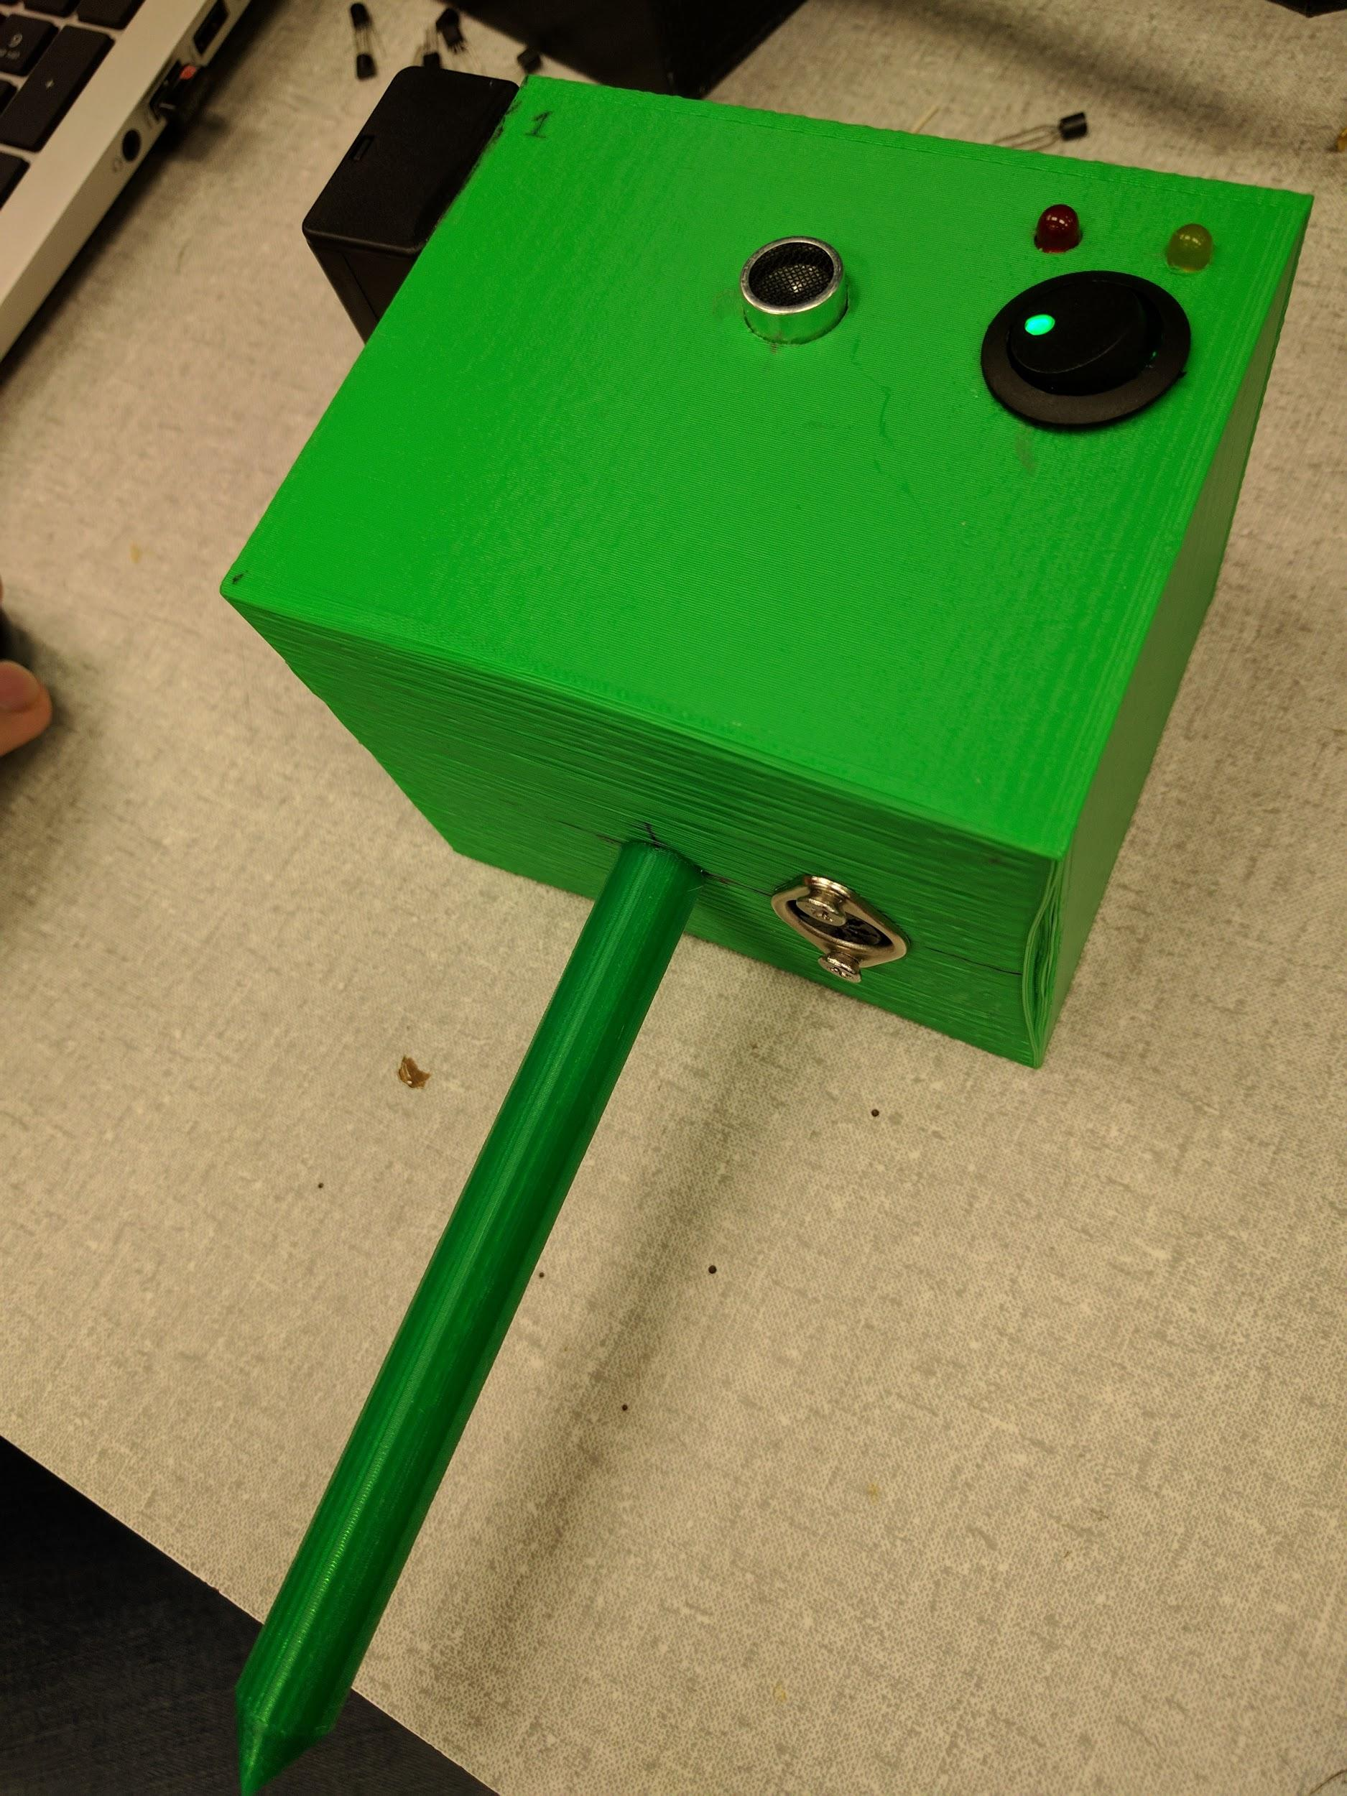
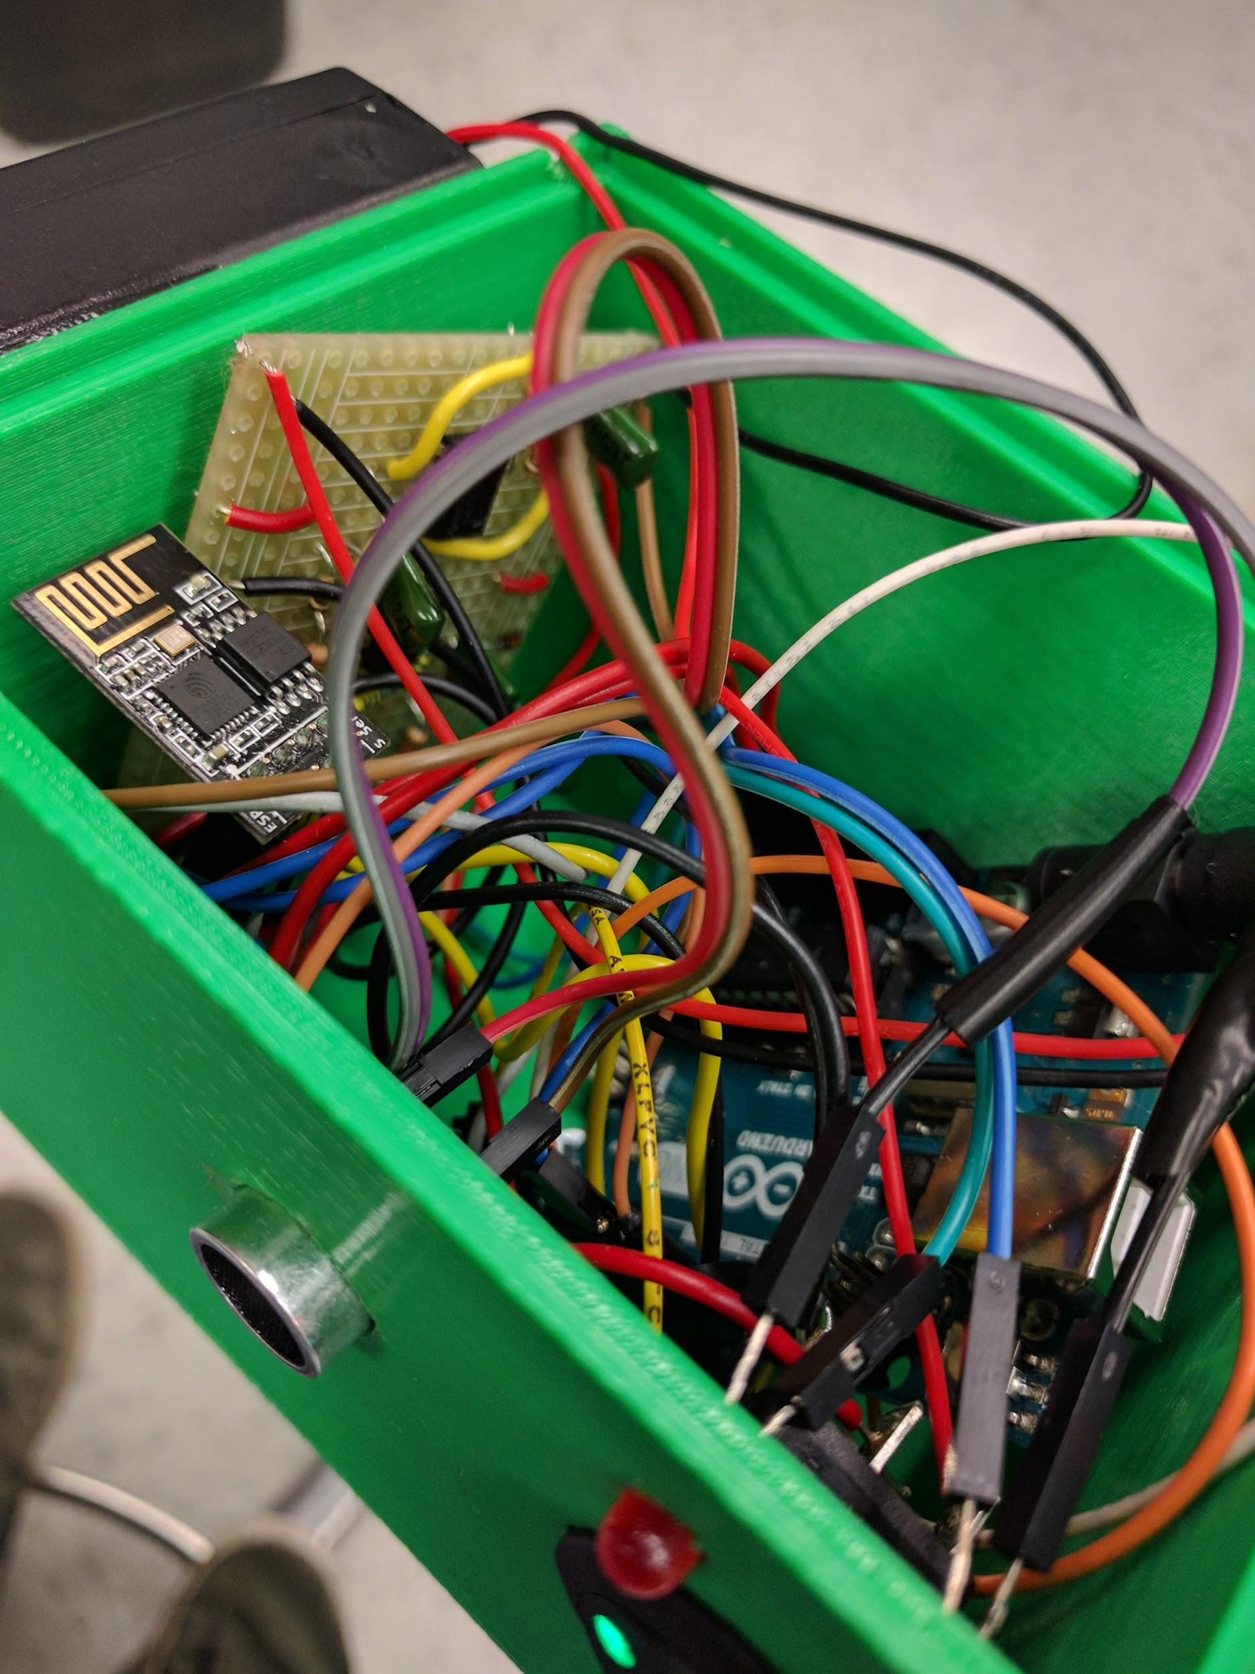
Lawn-O-Matic
Jeremy Doe, Jon Scibelli,
Robert Cocomello, Ahmet Yanbul
Faculty Advisor: Prof. Neal Anderson
Abstract
System Overview
The days of mowing lawns are over with the Lawn-O-Matic! Our Lawn-O-Matic system is a lawnmower that will automatically mow your lawn in the most efficient method possible. How is it so efficient? The Lawn-O-Matic’s smart computer mows a striping pattern similar to a regularly mowed lawn, determining its position while cutting your grass. Our WiFi enabled lawnmower displays its completed progress and current location over a webapp, allowing the user to tackle that leaky faucet in the kitchen as their lawn gets mowed!
Our design is split into two main components: one being the corner nodes and the other being the lawnmower itself. Each node has an ultrasonic receiver which receives an ultrasonic signal from transmitters located on the lawnmower. Timestamps are created by both the nodes upon receiving ultrasound and the mower upon transmitting ultrasounc, and are essential to determining an ultrasound signal’s time in flight. With this, the mower’s position can be found by using a derivation of the distance formula.
System Block Diagram
Lawn Requirements
The Lawn-O-Matic was designed to mow rectangular lawns of sizes up to 20 feet by 20 feet. The desired lawn must not contain objects that pose as an obstacle to the mower. Those include rocks, trees, and other types of stationary hazards. The lawn must also not have any form of a gradient relative to sea level. The Lawn-O-Matic may never be used in wet weather such as rain, hail, or sleet.
Results
We had difficulties adjusting the positioning system for accuracy, however we have shown that we can connect our four nodes to the lawnmower as a centralized system over WiFi and respond to ultrasonic transmission. We also demonstrated that our positioning algorithm is fully functional and can always produce an (x,y) coordinate with the response of two nodes. We completed a fully functional charging PCB, and successfully charged a Li-Po battery from 0% to 100% charge.
Mower: Intel Edison, Ultrasonic Transmitters, Motors and Wheels, 11.1V LiPo Battery, Charging Circuit
Nodes: Arduino, Ultrasonic Receiver, 9V Battery
Mower
The Lawn-O-Matic relies on an Intel Edison microcomputer to determine its position, control the mower’s movements, and host a local webapp. Four ultrasonic transmitters periodically transmit ultrasound as part of the positioning system. The Edison controls the motors using pulse width modulation, and communicates with the four nodes via Wi-Fi. A webapp hosted on the Edison allows for easy setup and realtime progress for the user.
Nodes
Acknowledgements
Four nodes are used to receive the ultrasonic frequency emitted by the lawnmower. Implemented with Arduinos, each node communicates with the mower over WiFi, sending acknowledgments upon receiving an ultrasonic transmission. Together with the operation of four nodes, the mower can find its location within your lawn and mow a striping pattern.
We would like to thank our advisor Neal Anderson for guiding and supporting us over the course of senior design. He has set an example of excellence as a mentor, instructor, and role model.
We would also like to thank Professor Doug Looze, Professor Michael Zink, and Professor Christopher Hollot as evaluators during this project. We are very grateful to all of you.
Finally, we would like to thank Francis Caron for working hard to fulfill our team’s supplies and purchases.
Department of Electrical and Computer Engineering
ECE 415/ECE 416 – SENIOR DESIGN PROJECT 2017
College of Engineering - University of Massachusetts Amherst
SDP17

Slide 2
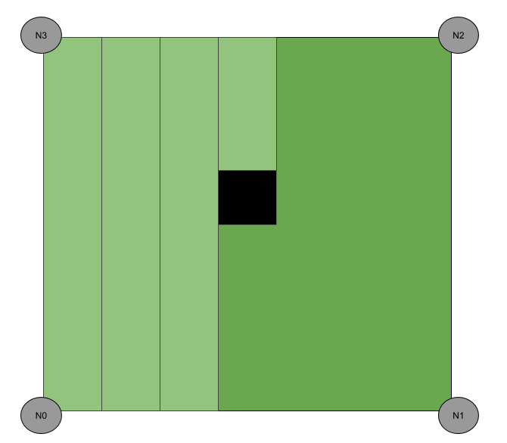
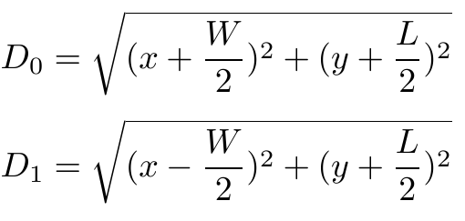
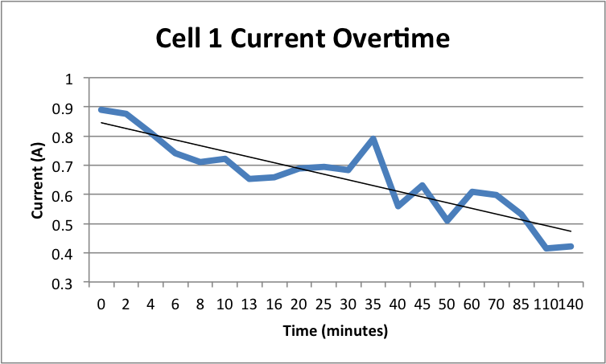
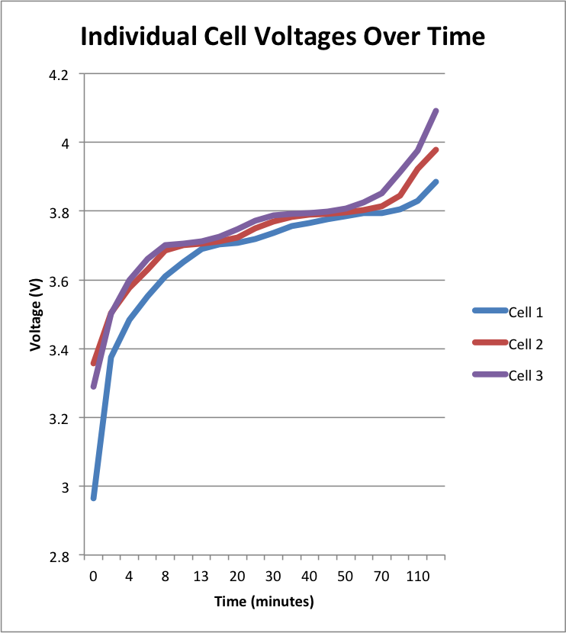
Charging PCB
Specifications
The PCB for our system is a charging circuit for the 11.1V Li-Po battery that powers the Edison and motors in the mower. It charges all three cells up to 4.2V and makes sure the cells do not exceed that limit by using LM350T voltage regulators. As the voltage of a cell approaches 4.2V, the current going into each cell gradually decreases until it is practically zero amps and the cell is fully charged.
Specification | Value
Weight | 7 lbs
Range | 650 square feet
Battery Life | 1 hour 10 minutes
Cost | ~$500
Accuracy | 6 inches
Ultrasonic Positioning
N₃
y
N₂
(0,0)
x
System Sensitivity
N₀
N₁
The speed of sound is affected by temperature and humidity. The adjusted speed of sound due to temperature can be calculated with the below equation:
V = 331m/s + 0.6 m/s/C * T
Below are two error measurements done at two temperatures.
We also discovered the effect of humidity is negligible for our system.
The ultrasonic positioning system is the main input to the lawn mower from the outside world. The mower relies on the positioning system to travel in a straight path, update its job completion, and determine a lawn’s edges. To determine its position, the lawnmower transmits ultrasound and creates a timestamp, then listens over WiFi for a response from two of the four nodes. Upon receiving an ultrasonic pulse, the nodes create and send a timestamp over WiFi for the lawnmower’s computer to compute the ultrasound’s time in flight. If multiplied by the speed of sound, the ultrasound’s time in flight can be converted into a distance, particularly from the lawnmower to the responding node. Together with two responding nodes and a derivation of the distance formula, the lawnmower can determine its exact position within a rectangular lawn. The following equations below are one of four cases the lawnmower may encounter when determining its position. D0 and D1 are the mower’s distances from nodes 0 and 1 respectively, W and L are the lawn’s width and length respectively, and x and y are the mower’s position on a Cartesian plane.
For 70 degrees: V = 331 + 0.6 * 21 = 343.6 |  | For 100 degrees: 331 + 0.6 * 37.7 = 353.6
Time Error (ms) | Distance Error (mm) | Time Error (ms) | Distance Error (mm)
.001 | .34 | .001 | .35
.01 | 3.4 | .01 | 3.5
0.1 | 34 | 0.1 | 3.5
1 | 343 | 1 | 353
10 | 3436 | 10 | 3536
Experiment
We tested the communication between the arduinos on the nodes and the Intel Edison on the lawnmower. Once we could send UDP datagrams over WiFi we were able to successfully send timestamps.
We tested the location algorithm by using fake timestamps and distances to make sure we could actually find the position mathematically.
We designed, built and tested our own ultrasonic transmitter and receiver circuits. Each circuit was first tested separately with ultrasonic range finders and then tested together once we knew they were both working.
After designing and simulating the circuit to charge the Li-Po battery, we tracked the voltage and current over time until the battery was fully charged. The test confirmed the circuit operates as designed.
Cost
Part | Development | Production (1000)
Motor System | $150 | $11.062
Intel Edison | $50 (Previously owned) | $50
Node Housings | $72 | $72
Node Internals | $88 | $88
PCB | $5 | $5
Arduino Block | $14.95 | $12.71
lm350T | $2.61 | $1.11
Resistors | $5.58 | $2.89
Capacitors | $4.50 | $1.30
Transistors | $4.40 | $.93
Circuit Boards | $29.70 | $22.50
AC/DC blocks | $30 | $30
Chassis | $35 | $35
Total | $497.74 | $322.50

