Slide 1
Final Project Review
  Team LOM
  April 21, 2017

Slide 2
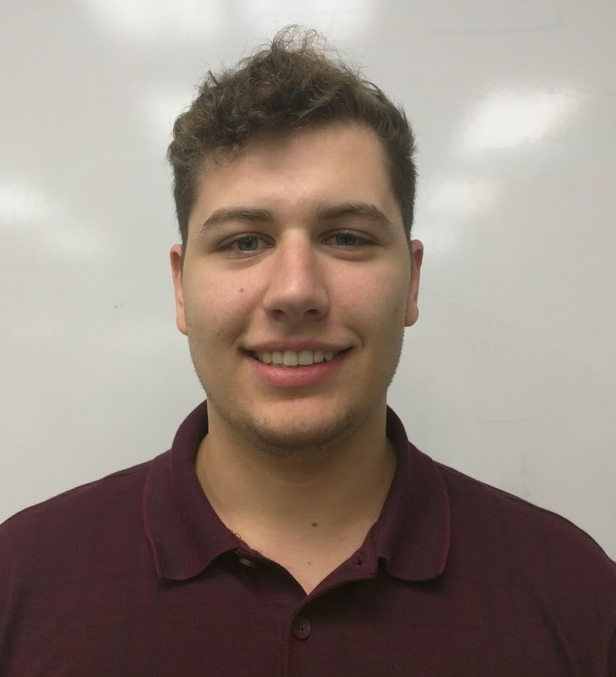


Lawn-O-Matic (LOM)
Robert Cocomello
ECE
Jeremy Doe
CSE
Jonathan Scibelli
CSE
Ahmet Yanbul
CSE

Slide 3
Agenda
Review of Project
FPR Deliverables
Demo

Slide 4
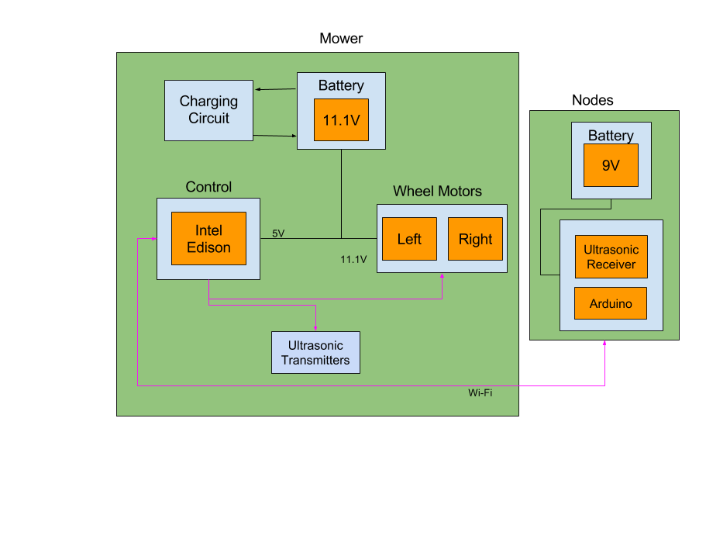
Our Solution: Block Diagram

Slide 5
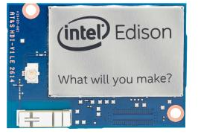
Our Project: LOM
Controller on lawn mower - Intel Edison
  Calculates position
  Drives wheel motors
Ultrasonic transmitters on mower
  Periodically emits ultrasonic signals
4 Nodes on each corner of lawn
  Ultrasonic receivers
  Arduino
WiFi
  Communication between Edison and nodes

Slide 6
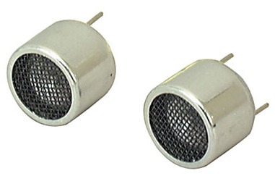
Sensor Network
Transmission nodes on mower
  Emits ultrasonic pulse
  Creates timestamp per transmission
Sensor nodes on corners
  Nodes receive ultrasonic
  Create timestamp per received signal
Data Transmission over WiFi
  Timestamp
  Node ID

Slide 7
Motor Control
Edison writes pulses to the motors to control their speed using PWM.
DRV8835 Dual Motor Driver Carrier
  Rotation direction and speed control
  PWM control
  Left and right control
  Controlled by Edison
DRV8835 chip provides input for direction - forward and backward.

Slide 8
System Specifications
Lawn Size
  Mow a lawn up to 20 feet by 20 feet
Accuracy of Location
  Accurate within 6 inches
Charging Time
  Charge Li-Po Battery within 24 hours

Slide 9
Proposed FPR Deliverables
Mower
  Control motors with Edison
Charging
  Completed PCB fabrication
Web Server on Edison
Ultrasonic positioning system
  Accurate up to 6 inches

Slide 10
Demonstration
Input size
Nodes are placed on mower
Nodes are powered on
  User waits for all four node LEDs to turn on
Mower is powered on
User engages mower motors
  Big red button

