Slide 1
Completed Design Review
  Team LOM
  March 7, 2017

Slide 2
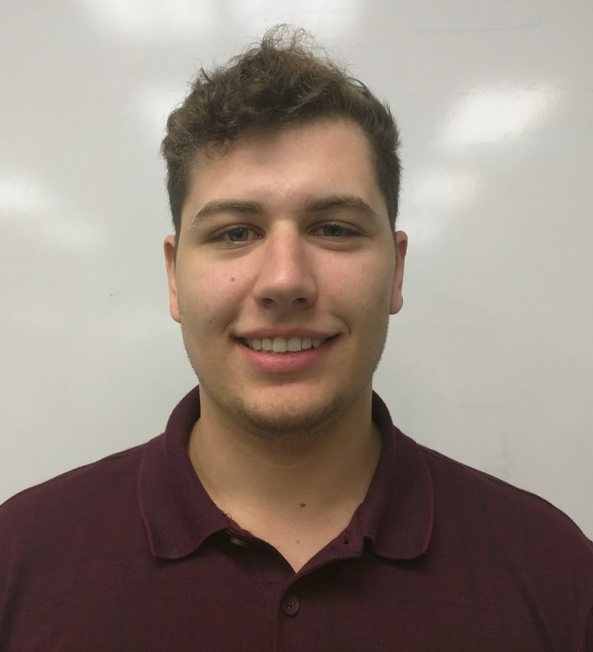


Lawn-O-Matic (LOM)
Robert Cocomello
ECE
Jeremy Doe
CSE
Jonathan Scibelli
CSE
Ahmet Yanbul
CSE

Slide 3
Agenda
Review of Project
CDR Deliverables
Demo
FDR Deliverables

Slide 4
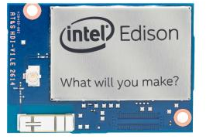
Our Project: LOM
Controller on lawn mower - Intel Edison
  Calculates position
  Drives wheel motors
Ultrasonic transmitters on mower
  Periodically sends ultrasonic signals
4 Nodes on each corner of lawn
  Ultrasonic receivers
  Arduino
WiFi
  Communication between Edison and nodes

Slide 5
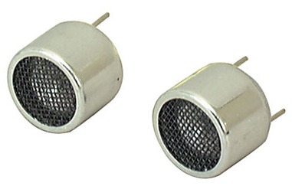
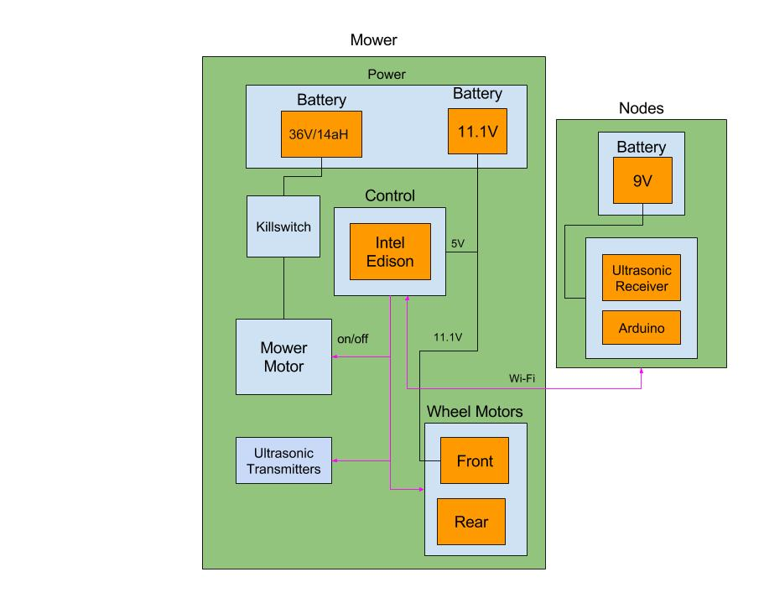
Sensor Network
Sensor nodes on corners
  Determine location of mower
  Keep mower within corners
  One node determined as “home”
Data Transmission over WiFi
  Ultrasonic burst timestamp
  Node ID
WiFi 2.4GHz
  UDP Datagrams

Slide 6
Temperature and Humidity
Humidity can be ignored
  At 100% humidity, sound travels only .35% faster than at 0% humidity.
Temperature in summer typically varies from 70 - 100 degrees F (21 - 37.7 C)
New Speed of Sound Calculation:
V = 331m/s + 0.6 m/s/C * T
Sources: nde-ed.org, Georgia State University Hyperphysics: Speed of Sound in Air
For 70 degrees: V = 331 + 0.6 * 21 = 343.6 |  | For 100 degrees: 331 + 0.6 * 37.7 = 353.6
Time Error (ms) | Distance Error (mm) | Time Error (ms) | Distance Error (mm)
.001 | .34 | .001 | .35
.01 | 3.4 | .01 | 3.5
0.1 | 34 | 0.1 | 3.5
1 | 343 | 1 | 353
10 | 3436 | 10 | 3536

Slide 7
System Requirements
Lawn Size
  Mow a lawn up to 20 feet by 20 feet
Accuracy of Location
  Accurate within 6 inches
Charging Time
  Charge Li-Po Battery within 24 hours
Complete lawn without assistance

Slide 8
Our Solution: Block Diagram

Slide 9
Location Detection
Mower emits ultrasound
  Creates timestamp per transmission
Nodes receive ultrasound
  Create timestamp per received signal
Nodes forward timestamp and ID to Edison
  Process completed over WiFi

Slide 10
CDR Deliverables
Improved accuracy of location detection
Mower
  Chassis with wheels and motors
  Control motors with Edison
Nodes
  Node Housing
Charging
  Completed Circuit Testing
  Completed PCB fabrication

Slide 11
Charging Circuit Demonstration

Slide 12
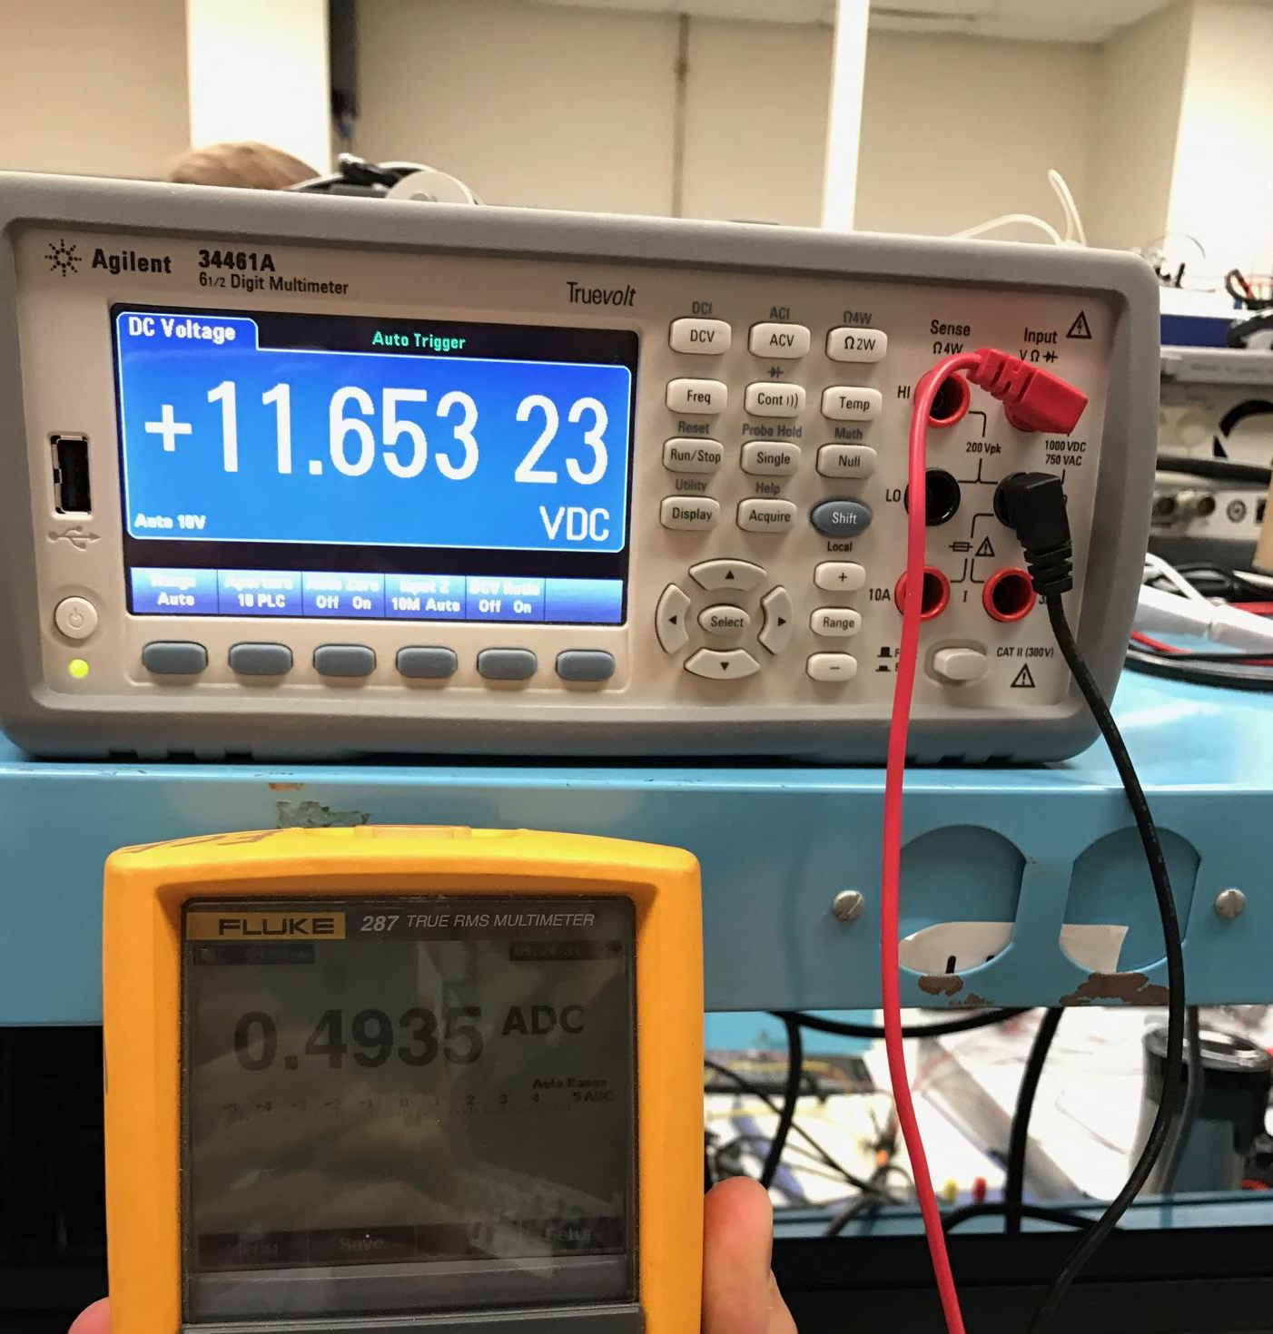
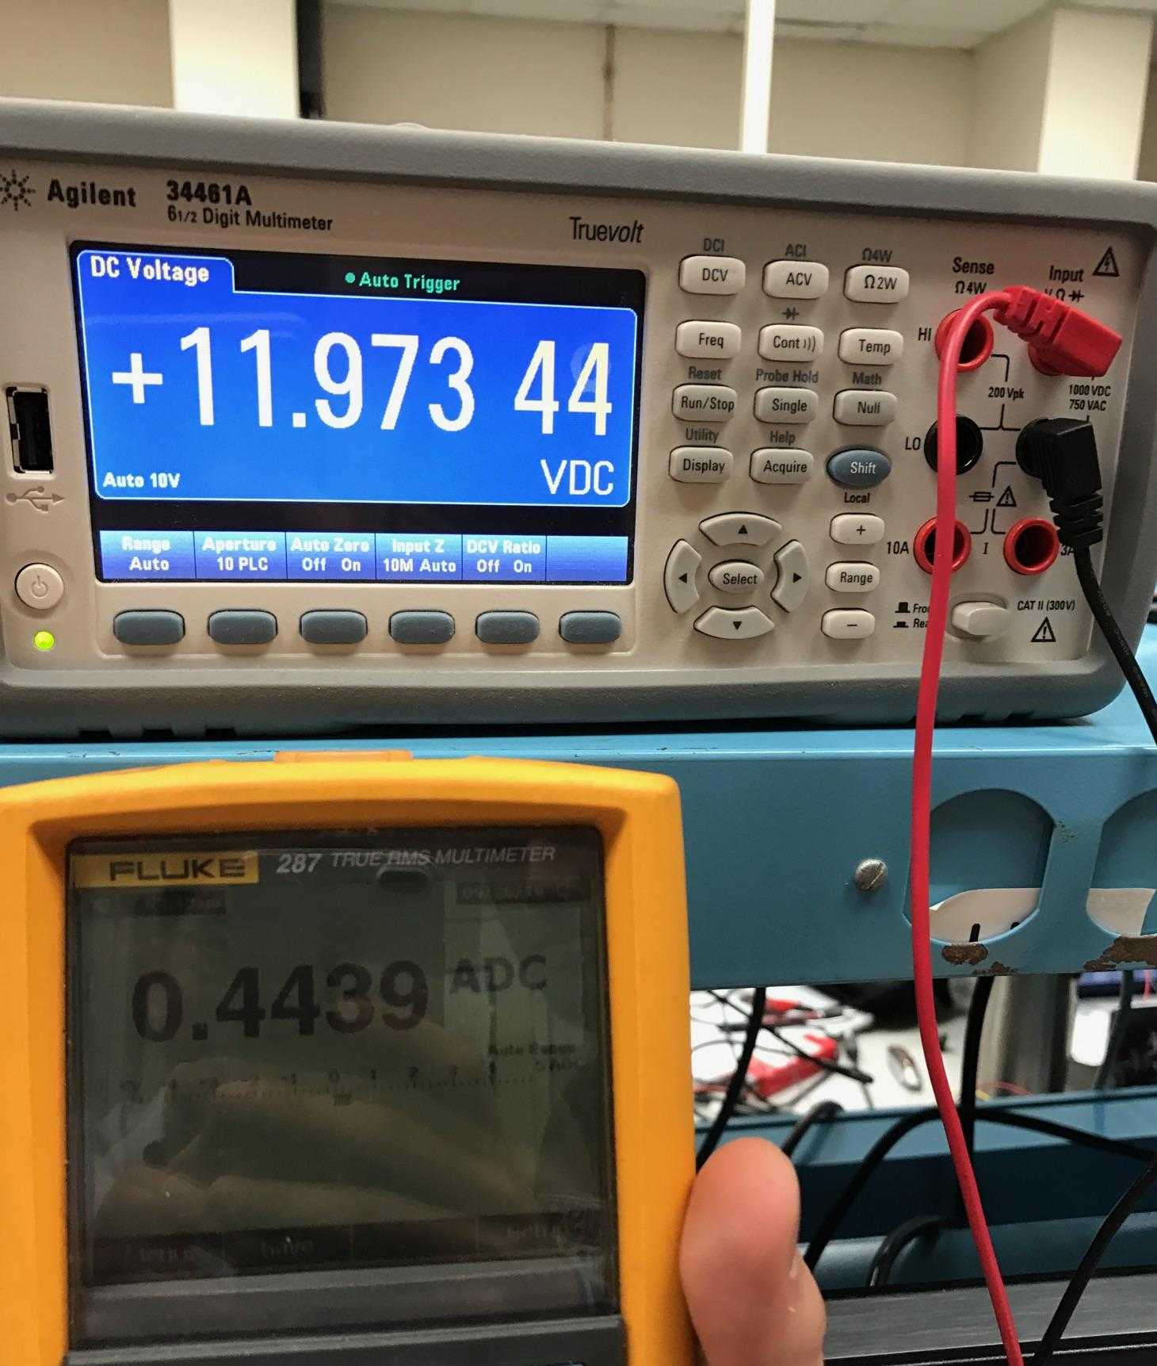
Charging Circuit
11.1 V 2200mAh LiPo Battery
3 Cells
  Max voltage capacity: 4.2V each
  Max charging current: 2.2A each

Slide 13
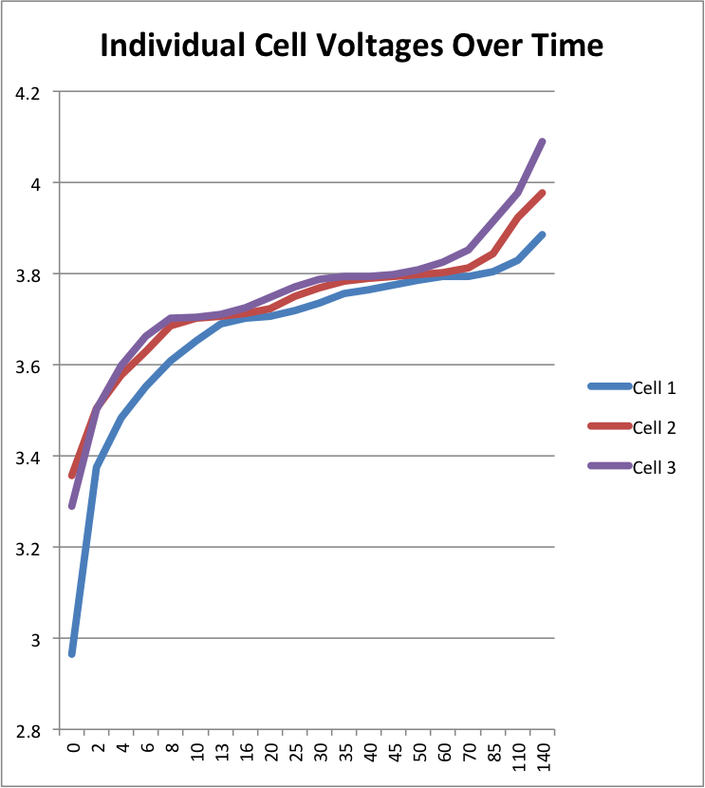
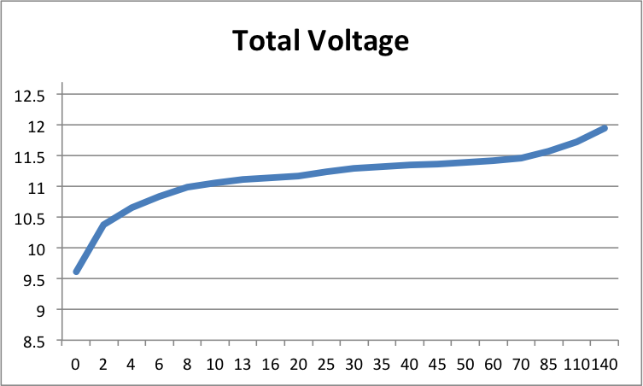
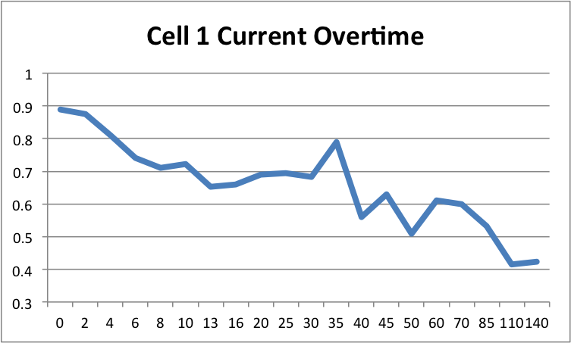
Charging Circuit

Slide 14
Ultrasonic Location System: Intel Edison Problems
Unable to use for our real-time system - OS preemptions create unneeded and unpredictable delays.
Delay is unpredictable due to the C function “usleep.” sleep(5) will delay for at least 5 seconds.
Demonstration

Slide 15
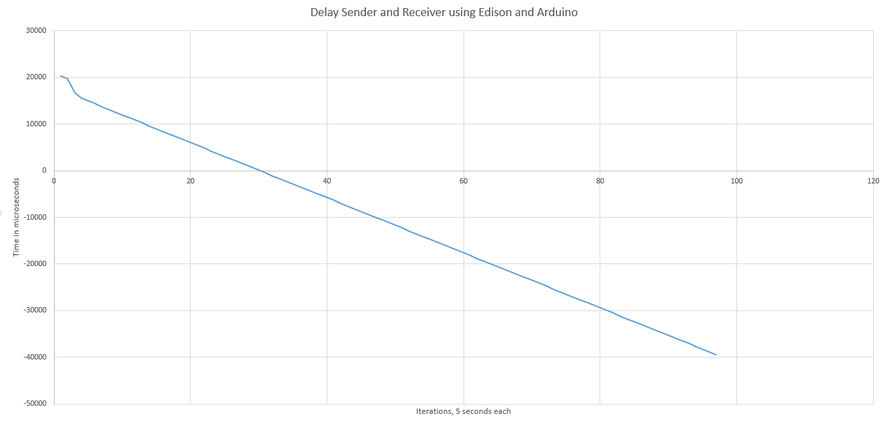
Intel Edison Problems

Slide 16
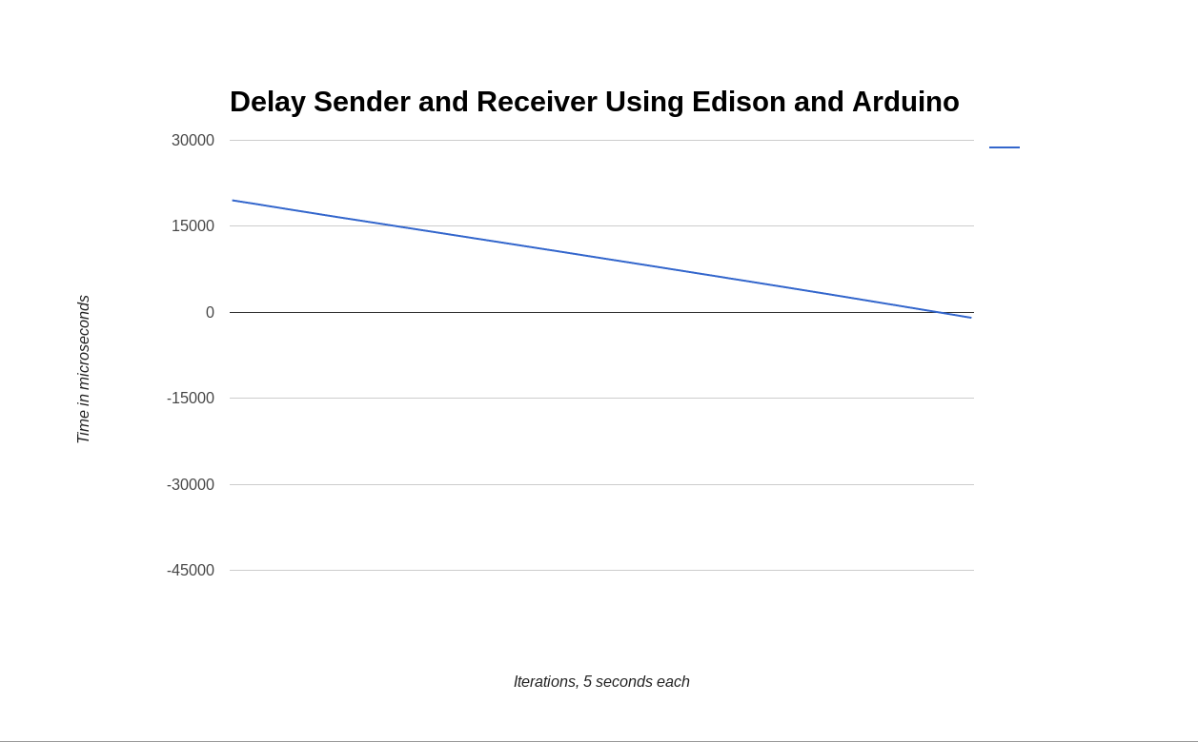
Intel Edison Problems
Same code, different run

Slide 17
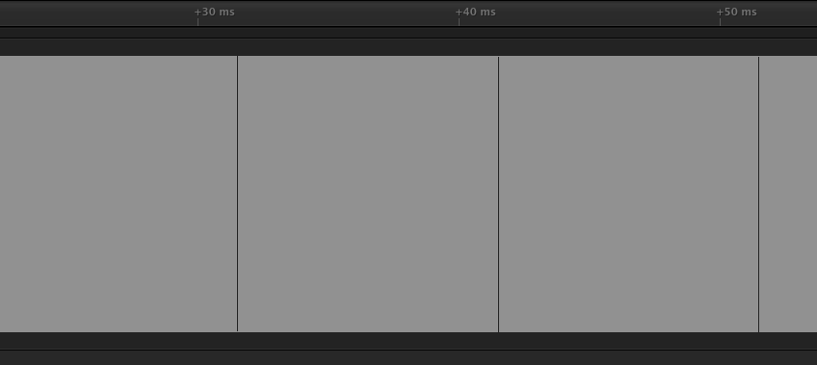
Intel Edison Problems
Gaps represent OS preemptions

Slide 18
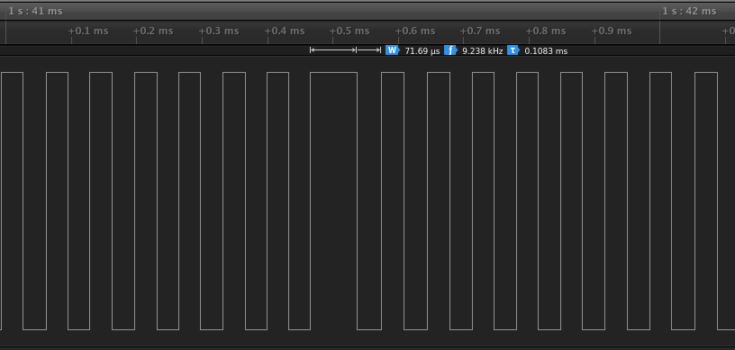
Intel Edison Problems
Zoomed in - Delay unpredictable!

Slide 19
Attempts to Fix
Using memory mapped I/O for GPIO pins
Setting priority of thread
Busy waiting instead of using system sleep calls
Busy waiting is only accurate up to 800ms - we need at most 5 seconds.
Demonstration

Slide 20
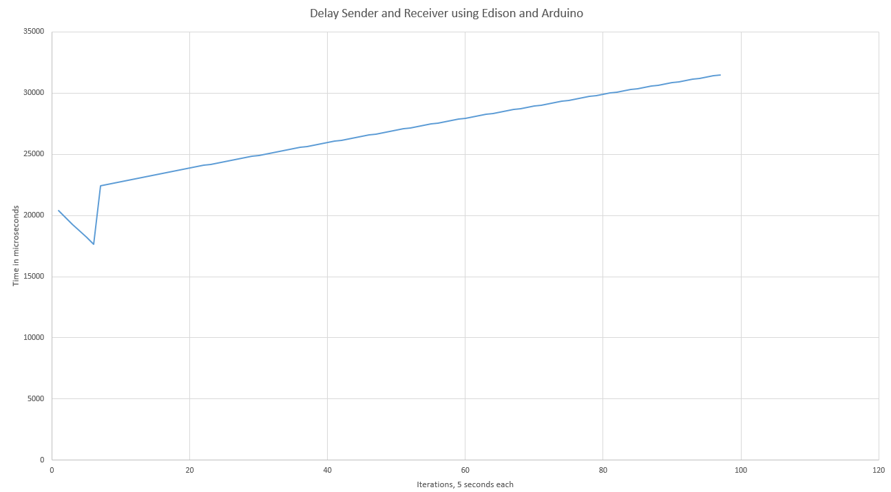
Attempts to Fix

Slide 21
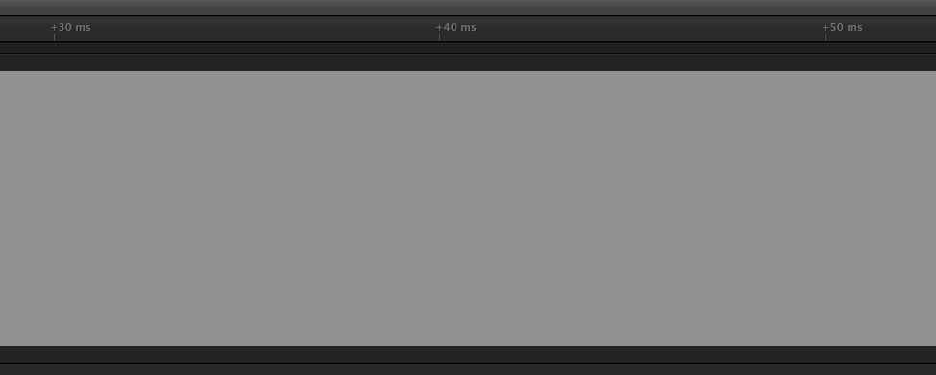
Alternative - Using Two Arduinos
Real-time system - No preemptions!
No use Demonstrating

Slide 22
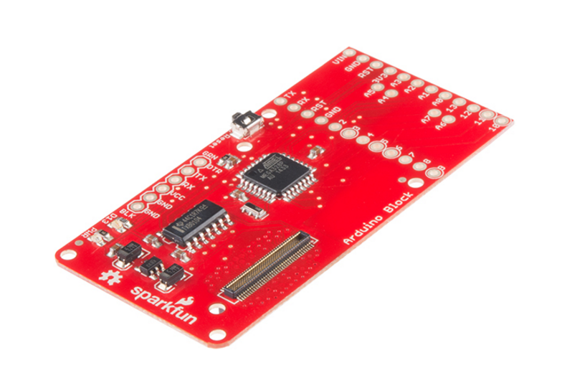
Alternative - Using Two Arduinos
Real-time system - No preemptions!
Arduino Block for Edison
No use Demonstrating

Slide 23
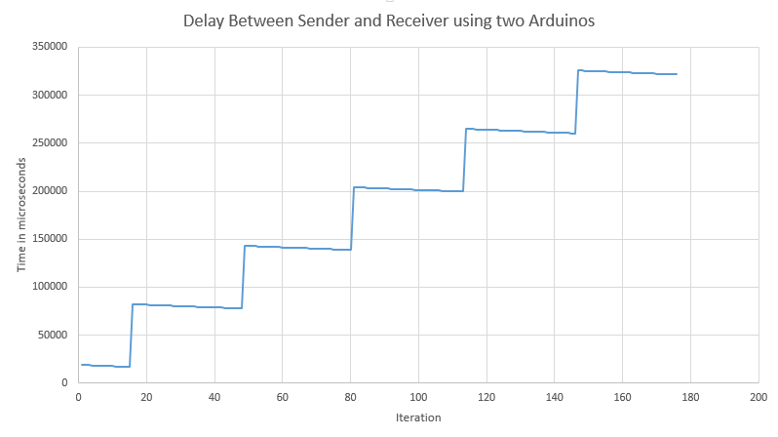
Alternative - Using Two Arduinos

Slide 24
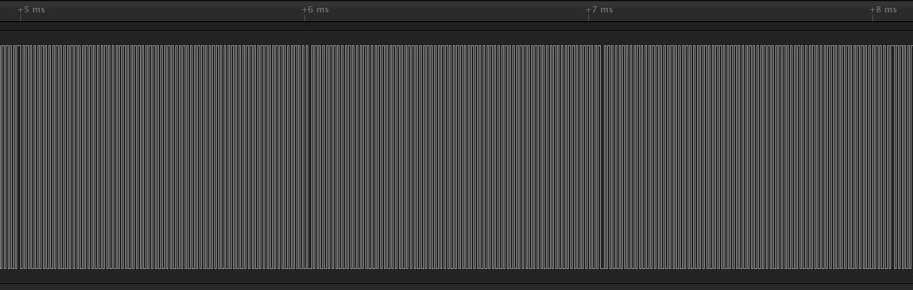
Alternative - Using Two Arduinos
Arduino still has delays every 1.2ms - predictable!

Slide 25
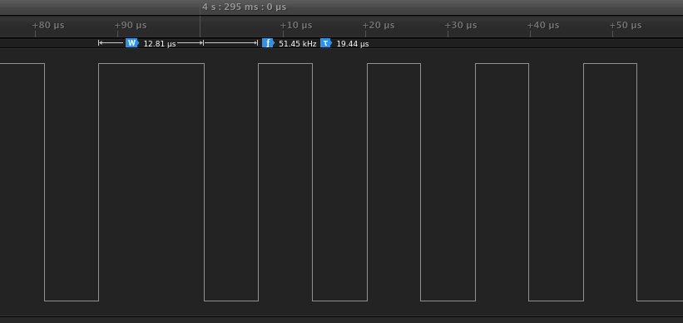
Alternative - Using Two Arduinos
Zoomed in

Slide 26
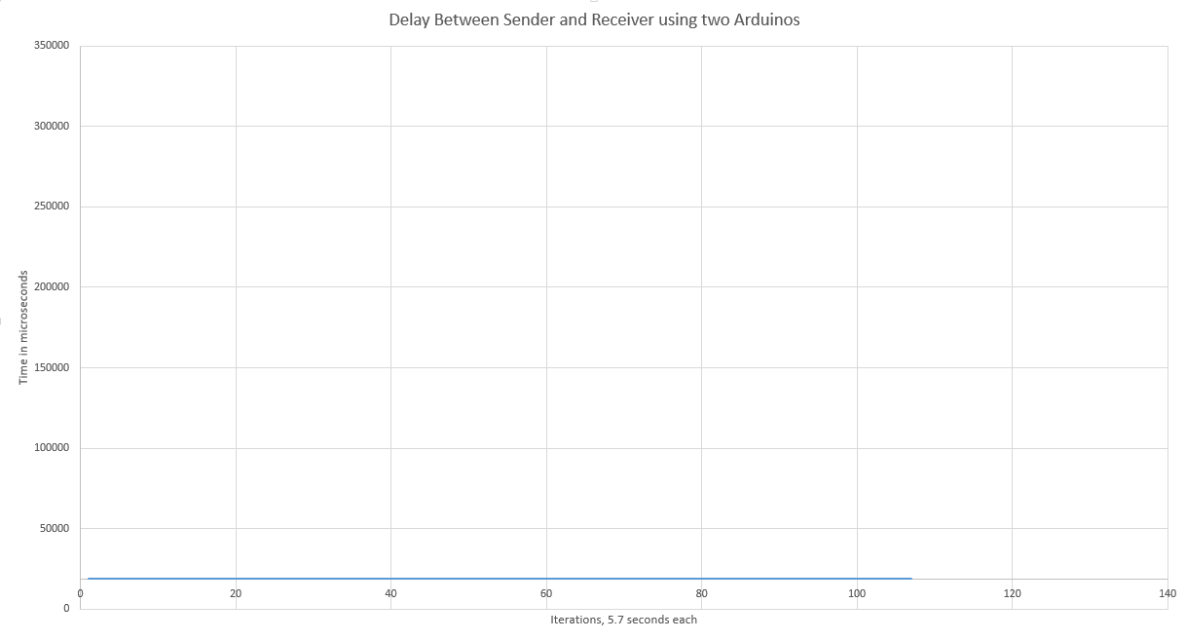
Alternative - Using Two Arduinos
Delay is predictable - we can fix the issue in software.

Slide 27
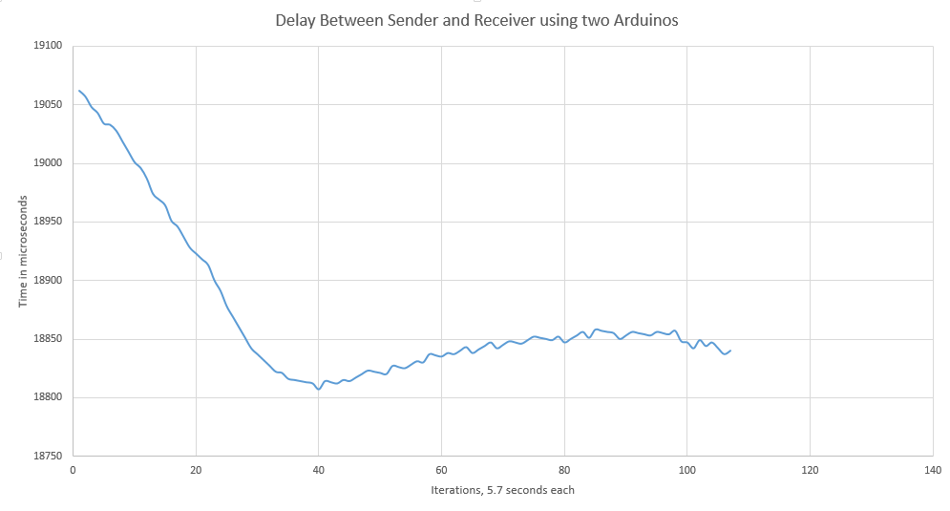
Alternative - Using Two Arduinos
Zoomed in

Slide 28
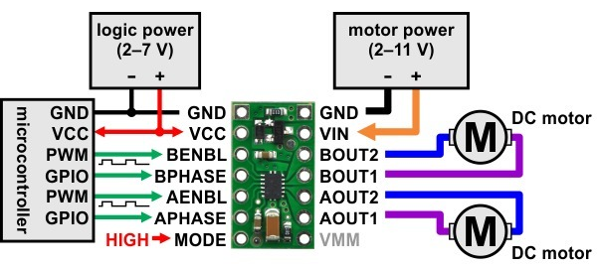
Chassis
4 Motors
  75:1 12V Motor
  1.1A Stall current
  85 oz-in Stall Torque
DRV8835 Dual Motor Driver Carrier
  Rotation direction and speed control
  PWM control
  Left and right control
  Controlled by Edison

Slide 29
Controlling motors with Edison - PWM
Edison writes pulses to the motors to control their speed using PWM.
Period of 50us (20KHz) - writing a 25us pulse will turn on the motors to half speed.
DRV8835 chip provides input for direction - forward and backward.

Slide 30
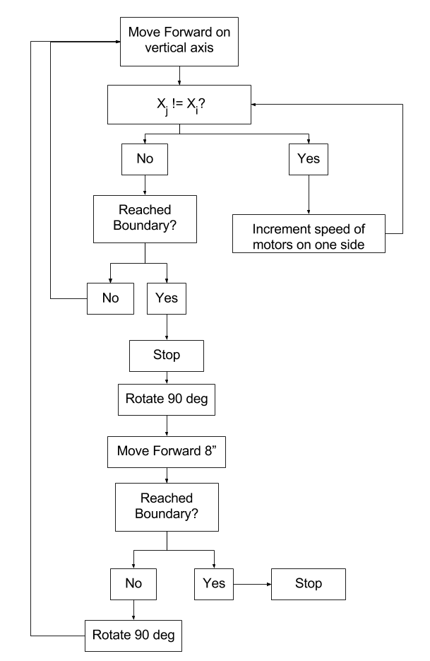
Motor Control Flowchart

Slide 31
Proposed FPR Deliverables
Mower - All
  Control motors with Edison
  Implement Safety Sensors
Charging - Ahmet
  Completed PCB fabrication
Web Server on Edison

Slide 32
Questions?

