Slide 1
Midway Design Review
Team Digiceipt
December 4, 2015
Notes:
‹#›
‹#›
‹#›

Slide 2
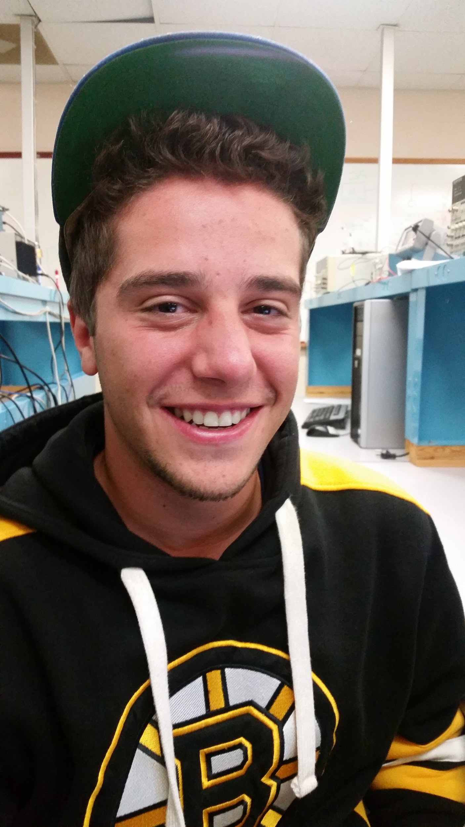
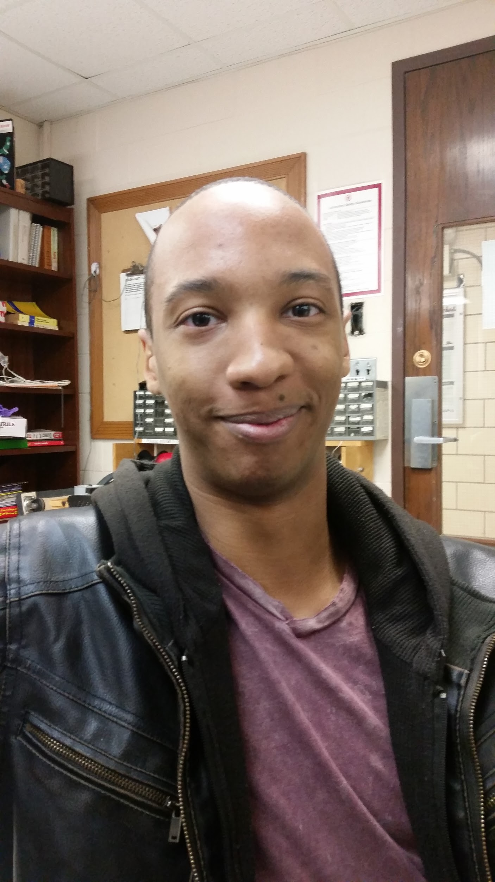
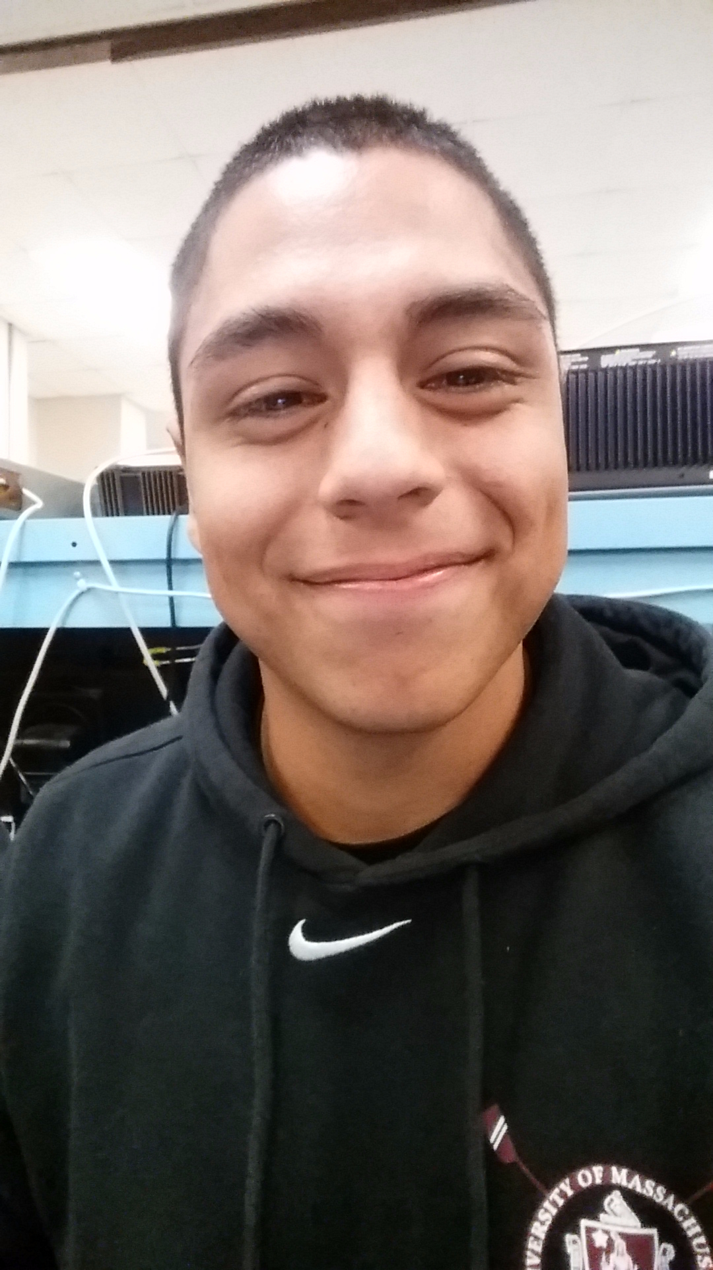
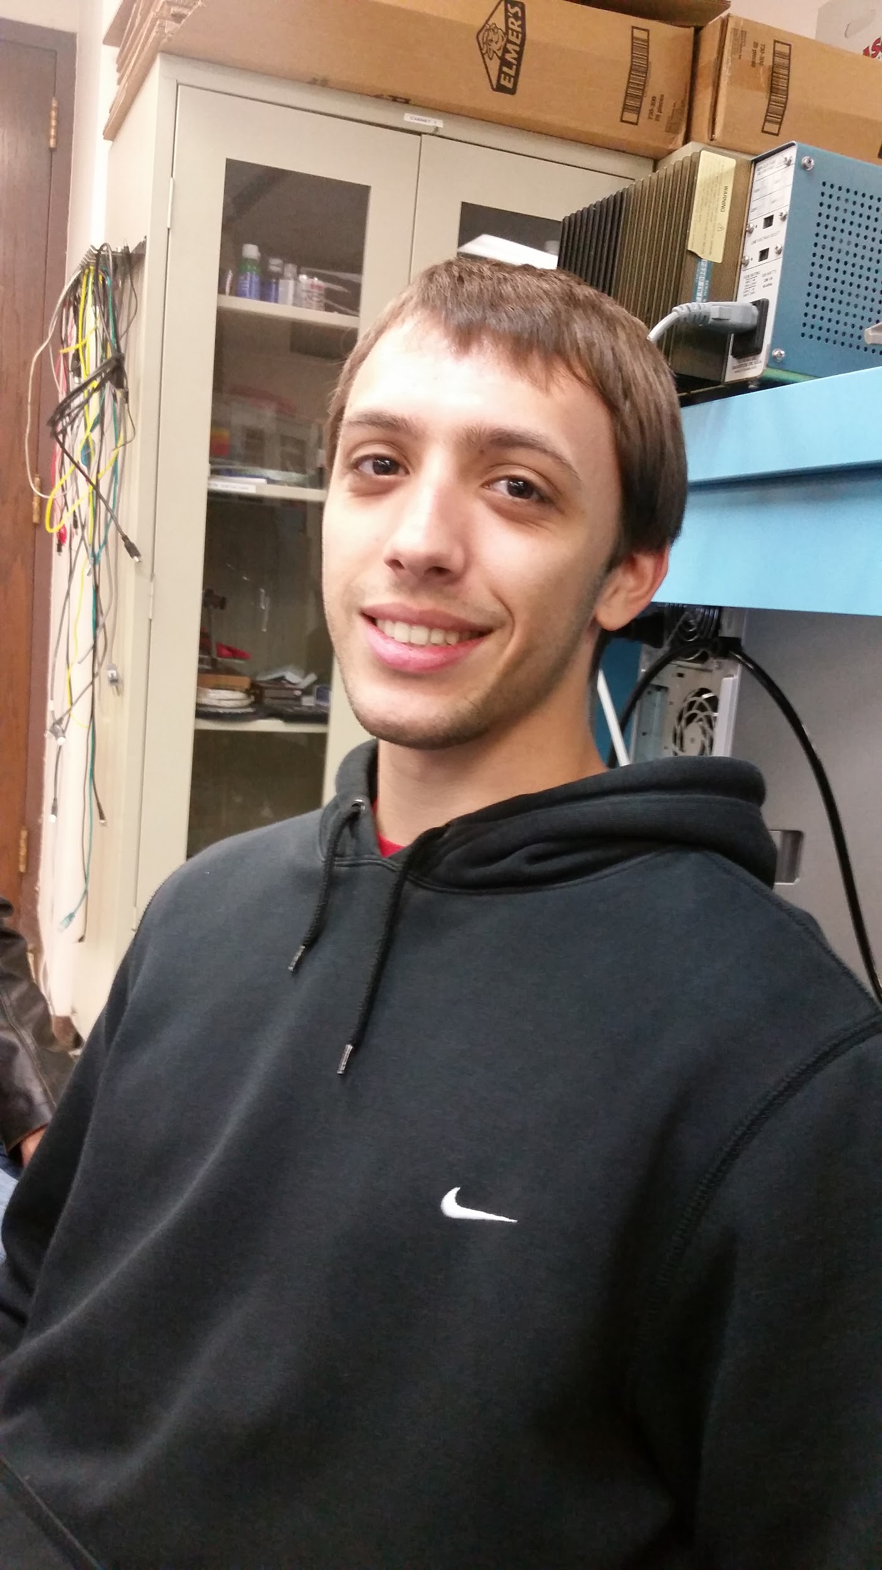
Digiceipt Team Members
George Papageorgiou
EE
Tyler Adams
CSE
Enoc Flores
EE
Edward Townsend
EE

Slide 3
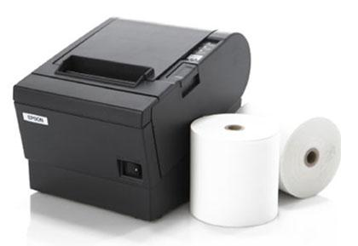
Improving Receipt Systems
Given a paper receipt after every purchase
Receipt can be very long even if you buy one item
Hassle to keep track of
Waste of paper and ink
Potentially dangerous

Slide 4
MDR Goals Reiterated
Scanner interfaces with Raspberry Pi in a way that raw data is transmitted
Raspberry Pi is able to transmit the raw data to NFC transceiver
Transceiver can communicate with Android App and sends raw data via NFC
Android App receives raw data and displays it

Slide 5
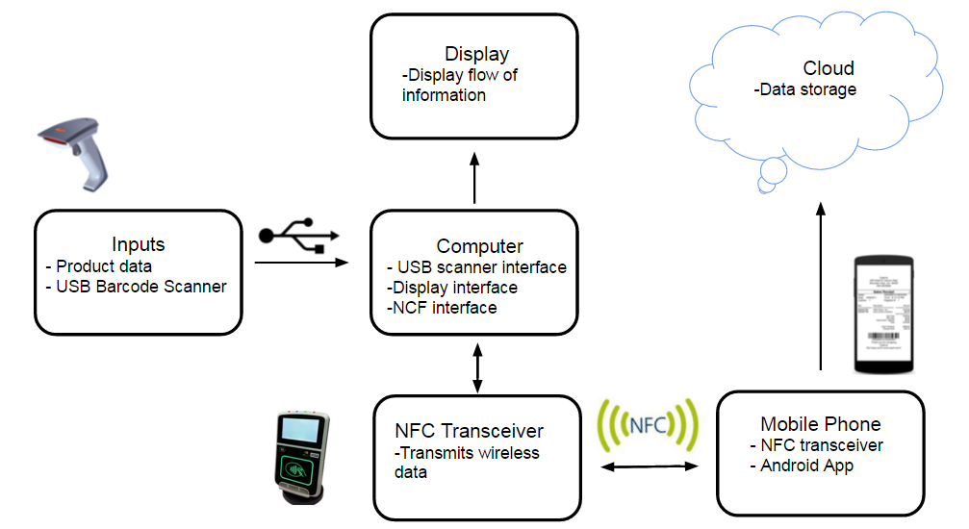
Block Diagram From PDR

Slide 6
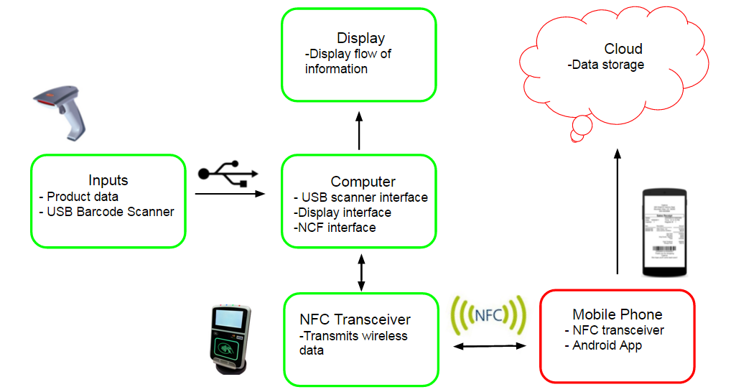
Revised Block Diagram
Eddie/George
Enoc/Tyler
UART

Slide 7
Block 1: Inputs
Researched barcodes and barcode scanners
Ordered USB barcode scanner
Wrote Python script to read to barcode data
Sends data to Raspberry Pi
Researched UPC database API
For CDR:Integrate UPC database to look up scanned items

Slide 8
Block 2: Computer
Ordered and set up Raspberry Pi
Ordered and soldered PN532 NFC Breakout Board
Wired GPIO to interface PN532 with Pi
Wrote program to send data to Android Phone via NFC
For CDR: Transfer additional meta data, store and multiple scans

Slide 9
Block 3: Display Monitor
Ordered HDMI to DVI cord
Ordered mini LCD display to install on Raspberry Pi
Set up Raspberry Pi - Monitor interface
For CDR: Install mini LCD monitor

Slide 10
Block 4: Mobile Phone
Downloaded and configured Android Studio
Configured Android phone for app development and debugging
Researched Android procedures to implement NFC interfaces
Implemented a read and write toggle to debug NFC interactions between phones
For CDR: Receipt storage capabilities, implement cloud, develop UI/UX

Slide 11
MDR Deliverables All Accomplished
Able to input barcode data through scanner to Raspberry Pi B board
Raspberry Pi B board uses Python on NFC Linux libraries to transmit data to NFC chip
Able to transmit data wirelessly through the NFC chip to the Android device
Data transmitted to Android device appears on the app

Slide 12
Proposed CDR Deliverables
Integrate UPC database to look up scanned items
Increase Raspberry Pi data sending capabilities
Install mini LCD monitor
Add receipt storage and retrieval capabilities to Android

