Slide 1

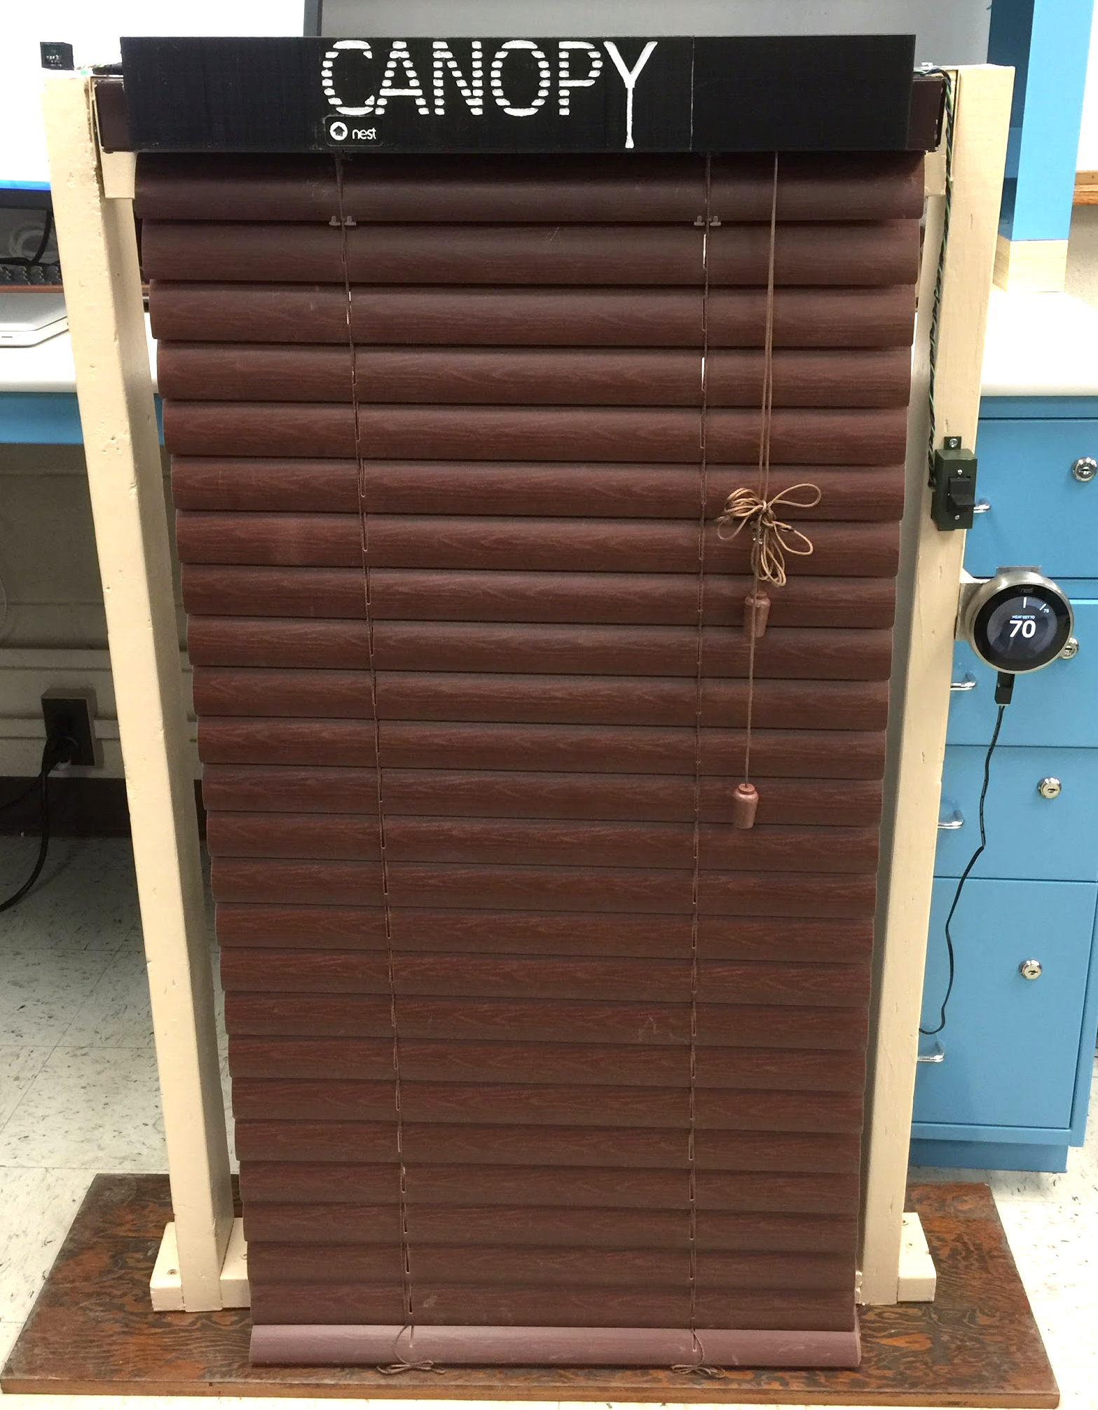
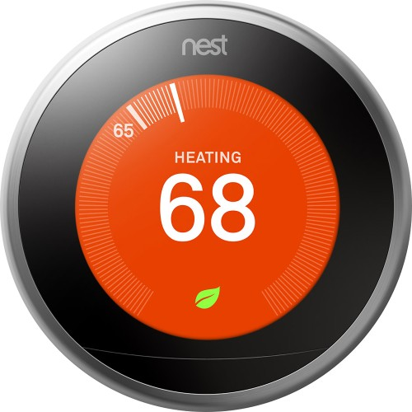






Canopy Automated Shade System
Michael Chapman, John Curci, Justin Thibodeau, Zachary Windoloski
Faculty Advisor: Prof. Csaba Andras-Moritz
Abstract
System Overview
The Canopy automated shade system helps consumers cut down on energy use by controlling the amount of sunlight that enters a home. The system integrates with the Nest thermostat in order to determine whether the home is currently being heated or cooled. This information is combined with input from a light sensor at each shade unit, in order to calculate the angle to set the shade slats. Nest integration allows Canopy to take advantage of Nest’s machine learning, which improves the system’s heating and cooling efficiency. Another major focus of the system is convenience. Through a custom Android application, users can control their shades remotely, and view the light levels at each window equipped with a Canopy shade device. Settings controlled through the app determine the behavior of the shade, and a physical switch allows for direct control.
Users begin by creating a Canopy profile and linking it to a Nest account
The app requests and pushes the user’s home WiFi name and password to the unit, which then connects to the network and begins communicating with AWS
Users define behavior for their shades through the app, setting each shade to be in one of several modes
The control unit uses temperatures from Nest, input from the light sensor, and the specified behavior mode to decide an angle for the shade
The shade actuator adjusts the shade slats to the calculated angle
Block Diagram
AWS
Shade Unit
Nest Cloud
Control Unit
Voltage Regulator
Light Sensor
User Data
Shade Data
WiFi
ADC
Log Amp
Photo
Diode
3.3V
10V
Power Supply
10V
Mobile App
MCU
TX/RX
Shade Actuator
App Backend
UI
Light Sensor - linear response across the spectrum of sunlight
Control Unit - merges light level with temperature and user data to decide behavior
Shade Actuator - adjusts shade slats to correct angle
Mobile Application - allows user to set shade behavior and monitor shade information
Results
Power Consumption
85mW when idle, unchanged during WiFi setup
145mW peak while adjusting shade position
Average power consumption very close to 85mW
Energy Comparison
One shade uses roughly 2Wh/day, operating 24/7
For comparison, a 15W CFL bulb uses 30Wh when used for only 2 hours/day
Comparable to running a 1500W space heater for 5 seconds
An average household may use up to 20 shades, increasing the usage to just 40Wh/day
Specifications
Specification Goal | Implementation
Outdoor Light Level Sensor With ± 50% precision over 0.5-120k lux | BH1620FVC-TR Photodiode
Stable Shade to Internet Communication | IEEE 802.11
Motor Producing > 4 kg*cm | Dynamixel AX-12A
User to Device Communication Security | PSK Encryption
Web Based Data Storage | AWS
Data Integrity & Security | AWS Encrypted Signatures
Continuous Power Source | Standard US 120V Wall AC
Remote Control | Android App
Manual Control | Physical Switch on Device
Acknowledgements
Special thanks to our advisor Csaba Andras-Moritz. Thank you as well to our evaluators T. Baird Soules and Zlatan Aksamija, and to Fran Caron for keeping SDP lab running.
Department of Electrical and Computer Engineering
ECE 415/ECE 416
SENIOR DESIGN PROJECT 2016
College of Engineering - University of Massachusetts Amherst

Slide 2
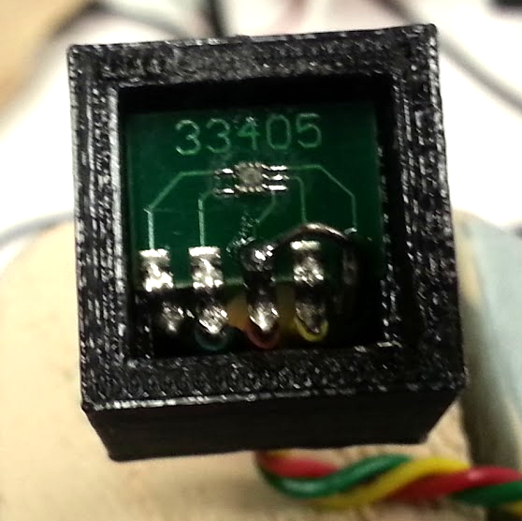
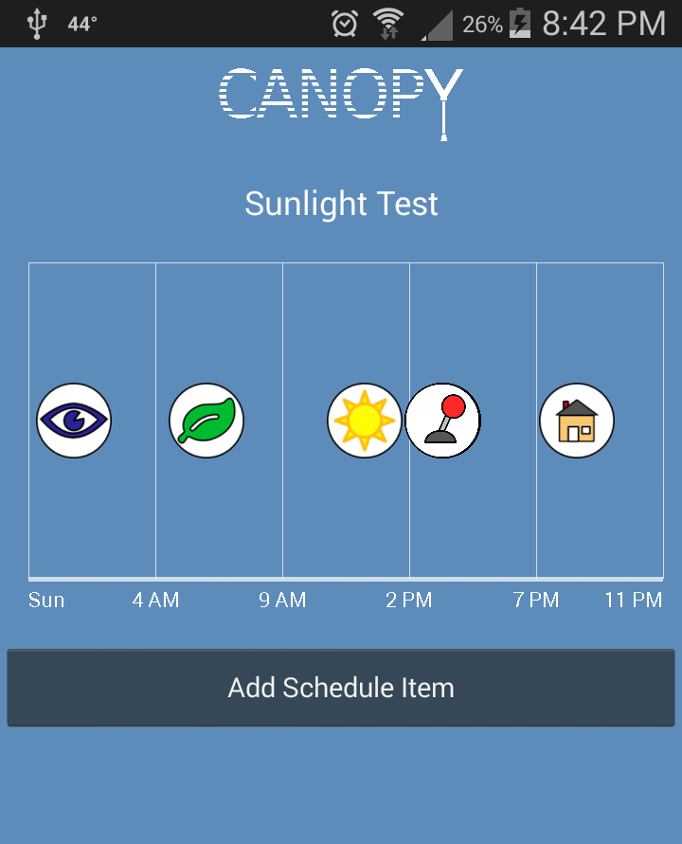
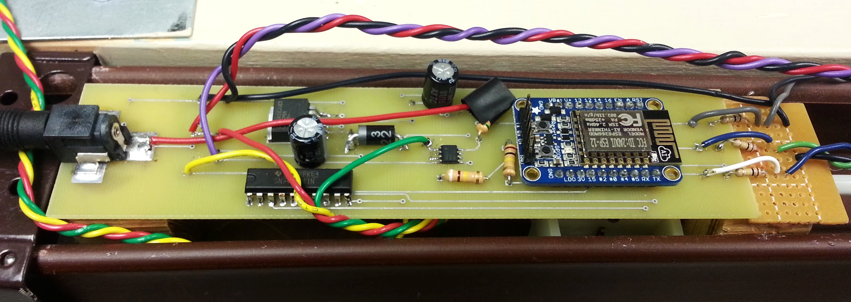
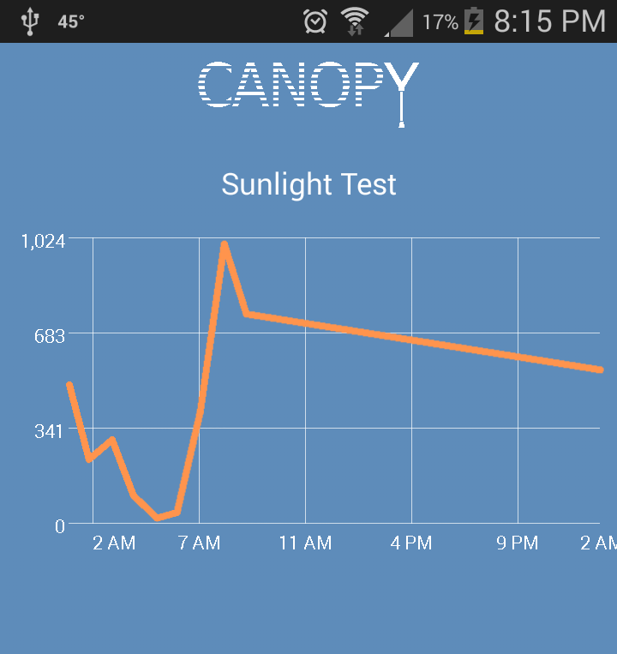
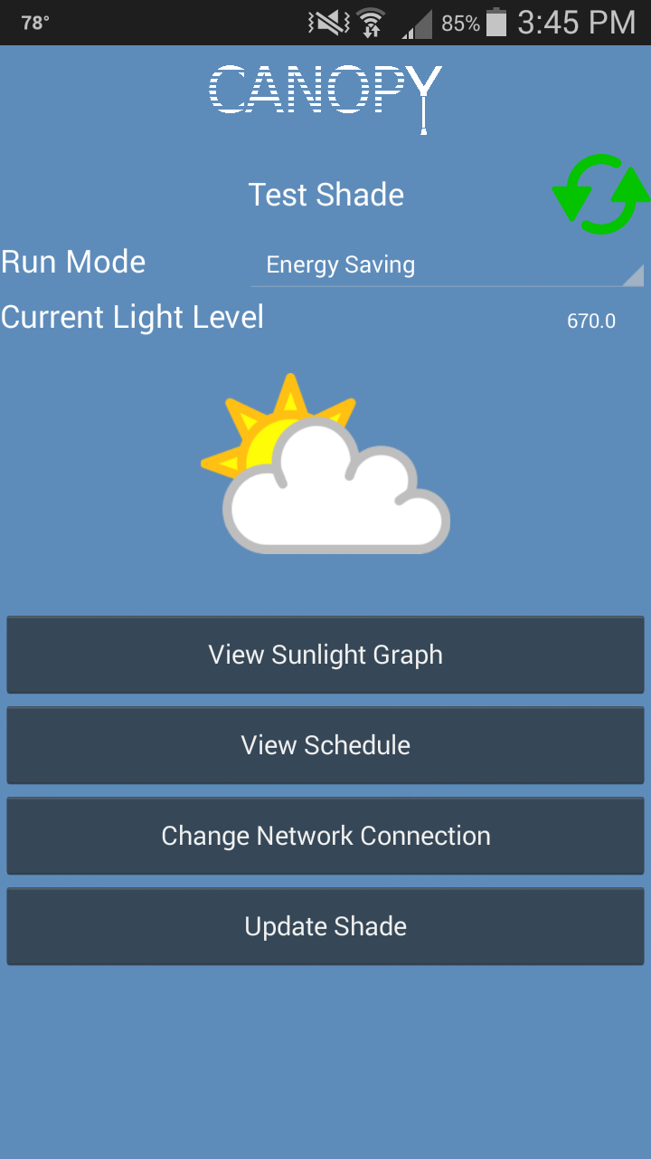
Physical Device
Scheduling
Light Sensor
The light sensor is based on a
BH1620FVC-TR light sensing IC,
providing variable output across
the spectrum of sunlight
The sensor outputs on a logarithmic scale, so the data is passed through a logarithmic amplifier before being sent to the microcontroller
Shade Actuator
The shade slats are moved by a Dynamixel AX-12A Robot Actuator
This servo provides accurate angle control through the use of data packets sent over a half duplex UART connection for control signals rather than a PWM signal
Microcontroller
System processing is done using an Adafruit Huzzah microcontroller
This controller provides sufficient computing power and a WiFi interface with client and access point modes as well as TCP/IP and DNS support
Users have the ability to set a weekly schedule for their shades through the mobile app. A shade will search for the most recent schedule setting, and apply that behavior. Schedules can be set for an individual shade, for all shades in a specific room, or for all shades in a home.
Cloud Storage
AWS DynamoDB is used to store information about users, shades, rooms, and light level readings
Both the app and shade unit push and pull information from DynamoDB
AWS Lambda is used to communicate with the Nest cloud in order to update the temperature information in DynamoDB needed by a shade
Android App
Light Level Visualization
Sunlight levels for each shade are recorded every 30 minutes along with a timestamp
The app displays a graph of these sunlight levels
Android App
Manual Override
The Android application gives the user an interface to the Canopy system. Users can set up shades and have them linked to their Nest account. Users can then customize the shades’ behavior to fit their home’s needs. The application connects with Amazon Web Services to store data.
Canopy App Main Features
User Accounts - Users can only access their own data
Shade Monitoring - Behavior is
set and light levels are viewed
on a per-shade basis
Shade Organization - Shades
are grouped into rooms,
allowing a full room or home
to be controlled together
At any time, the user can manually adjust the shade angle by using the physical switch
The shade will return to automated behavior after an amount of time based on the frequency of overrides
The shade will revert 15 minutes after receiving the first override
If another override is received during this window, the delay increases exponentially up to a full day
This override can also be canceled immediately from within the app
Cost
Development
Production
Part | Price
PCB | $141.51
Motor | $44.90
Adafruit Huzzah | $9.95
Light Sensor | $12.32
Logarithmic Amp | $16.42
Voltage Regulator | $2.76
Power Adaptor | $19.55
Resistors/Capacitors | $1.00
AWS* | $0.00
Case | $53.43
Total | $331.13
Part | Price
PCB | $1.52
Motor | $37.50
Adafruit Huzzah | $7.96
Light Sensor | $6.05
Logarithmic Amp | $9.77
Voltage Regulator | $2.03
Power Adaptor | $11.98
Resistors/Capacitors | $1.00
AWS** | $30.60
Case | $53.43
Total | $179.23
Cost
Behavior Modes
Development
Production
Users can set shade behavior for an individual shade, for all shades in a specific room, or for all shades in a home. We provide the following behavior settings:
Energy Efficiency - open or close shades depending on temperature, light level, and angle of the sun
Preservation - keep shades closed above a certain sunlight threshold to protect sensitive materials
Convenience - shades open between sunrise and sunset, and close at night
Open/Closed - shade stays at open/closed position
Manual - shades only moved by the physical switch
Part | Price
PCB | 33
Motor | 60
Transistor | 2
Total | 101
Part | Price
PCB | 5
Motor | 20
Transistor | 5
Total | 30
* Using AWS Free Tier ** Assuming a 5-year Lifespan

