Slide 1

Preliminary Design Review
Team 18
October XX, 2015
Department of Electrical and Computer Engineering
Advisor: Csaba Andras Moritz
Notes:
Justin

Slide 2

Preliminary Design Review
Justin Thibodeau CSE | Jack Curci EE | Michael Chapman CSE | Zachary Windoloski CSE
Department of Electrical and Computer Engineering
Advisor: Csaba Andras Moritz
Notes:
Justin

Slide 3

Problem
Energy for heating and cooling is expensive
Department of Electrical and Computer Engineering
Notes:
Justin

Slide 4

Individual
Have to pay your electric bill
Annoying and tricky to keep track of all the little things that add to it
Heating and cooling costs big buckaroos (citation needed)
Department of Electrical and Computer Engineering
Notes:
Justin

Slide 5

Community
The community as a whole pays a hidden cost for your energy usage as populations increase and power demand increases
Department of Electrical and Computer Engineering
Notes:
Justin

Slide 6

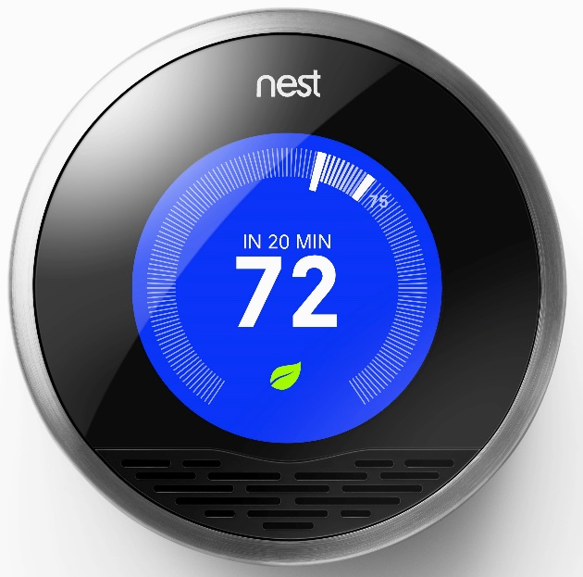
Current Solutions
The Nest thermostat uses machine learning to adapt to your lifestyle and automatically control heating/cooling to reduce energy use
Only has direct control over in-home heating/cooling
Does not take advantage of outside factors like sunlight
Department of Electrical and Computer Engineering
Notes:
Michael

Slide 7

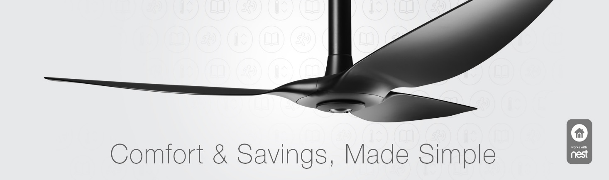
Current Solutions
Big Ass Fans
  Integrates with nest
  Aids in controlling temperature
  Not suitable for every home/building
  Expensive, over $1k for a smart ceiling fan
Department of Electrical and Computer Engineering
Notes:
Michael

Slide 8
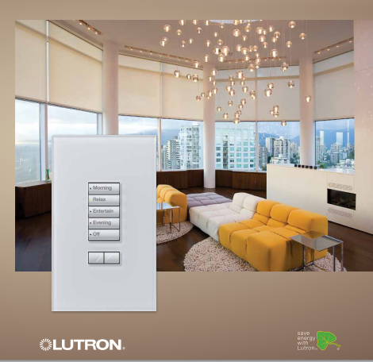
Current Solutions
Lutron Sivoia QS Wireless shading system
  Customized settings
  Provides simple energy savings
    Doesn’t utilize learning algorithms
    Requires user to set their desired behavior (warm/cold) on top of regular thermostat
Department of Electrical and Computer Engineering
Notes:
Michael

Slide 9
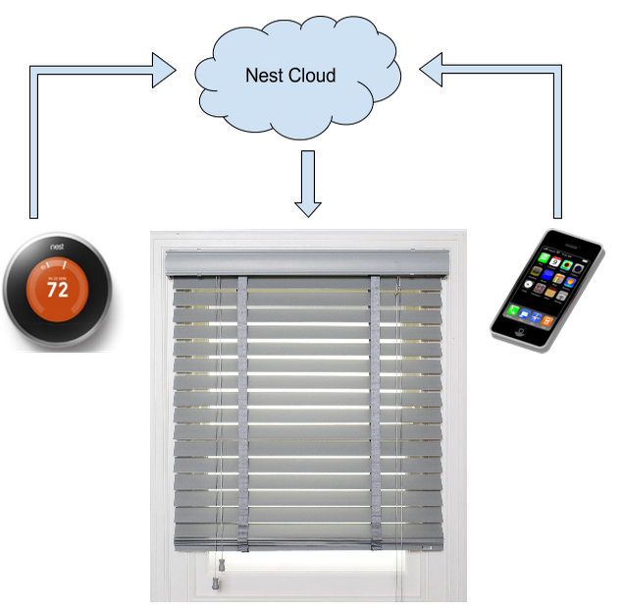
Our Solution
Canopy Blind System
Adjusts blinds to conserve energy, preserve light-sensitive valuables
Integrates with Nest thermostat to determine optimal behavior
Mobile app will allow user to add personalized settings
Department of Electrical and Computer Engineering
Notes:
Zach

Slide 10
Additional Benefit
Preservation of light sensitive valuables
Added layer of security
Convenience
Department of Electrical and Computer Engineering
Notes:
Zach - refactor

Slide 11

Requirements
Help control internal temperature
Save more energy than it uses
Must be able to run continuously or long battery life
Customizable options
Allow for manual control
Department of Electrical and Computer Engineering
Notes:
Zach

Slide 12
System Specifications
Automatic shade actuator
  Allow manual override
WiFi communication with Nest and web server
Mobile phone app
  Profile settings
    Minimal energy usage
    Furniture/Painting preservation
    Custom overrides
React to motion sensor data from other devices
Department of Electrical and Computer Engineering
Notes:
Zach

Slide 13
Alternate Design Decisions
Sensors
Light, temperature, moisture
Power
Solar cells, battery, wall outlet
Communication & Control
WiFi, Bluetooth, RF
Central hub, external server, distributed computation
Department of Electrical and Computer Engineering
Notes:
Jack - refactor

Slide 14
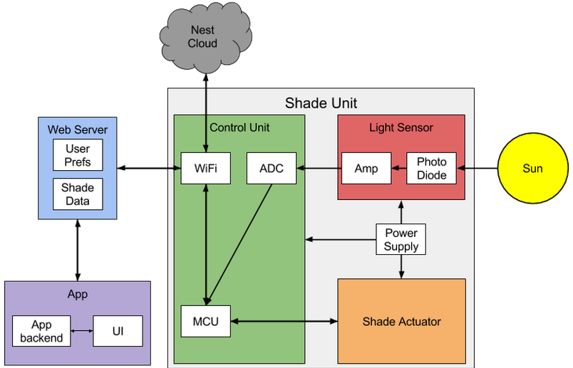
Our Solution: Block Diagram
Department of Electrical and Computer Engineering
Notes:
Jack

Slide 15
Light Sensor
Requirements
Fine-granularity light detection
  Ability to distinguish light level and cloudiness
Implementation
Photodiode light sensor
  Absorption spectrum matched emission spectrum of sunlight
Analog amplification circuit
Output to MCU via ADC
Attached directly to shade unit
Department of Electrical and Computer Engineering
Notes:
Jack

Slide 16
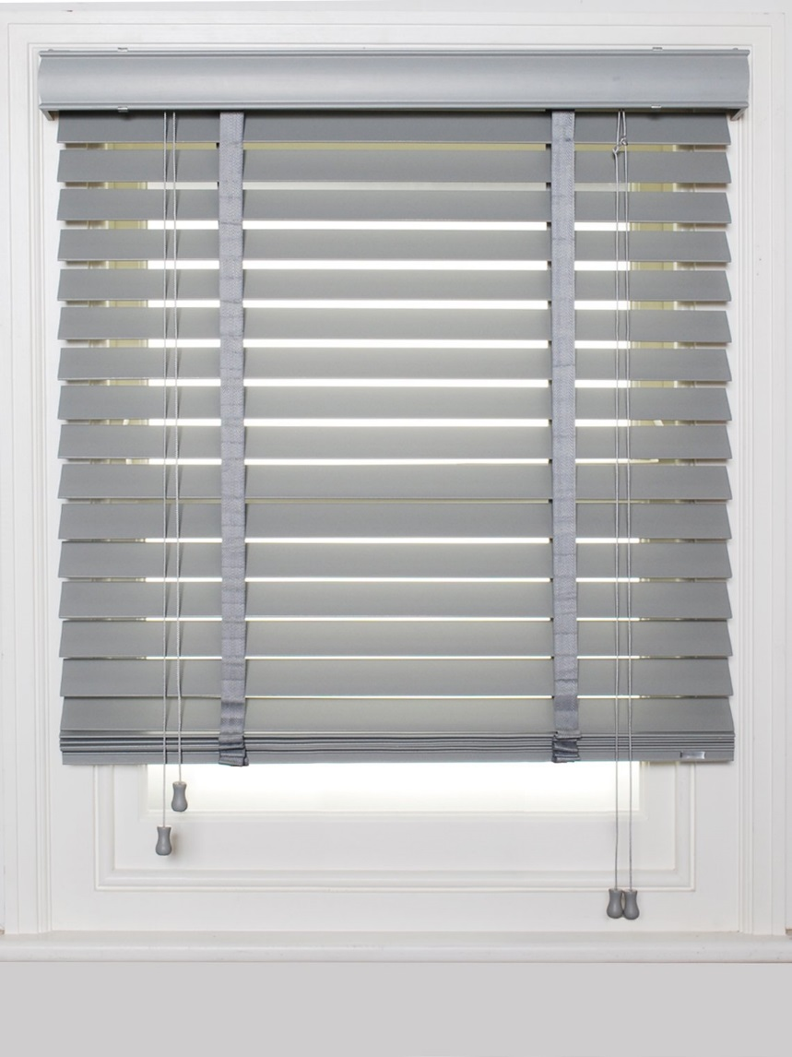
Shade Actuator
Requirements
Roll shade up and down
Allow manual override
Visually inconspicuous
Implementation
Module attached to off the shelf pull shade
Servo motor
Department of Electrical and Computer Engineering
Notes:
Michael

Slide 17

Android App
Requirements
GUI to define settings and display data
Communication with web server
Authenticate users
Implementation
Android based application
RESTful interface to server
Department of Electrical and Computer Engineering
Notes:
Zach

Slide 18

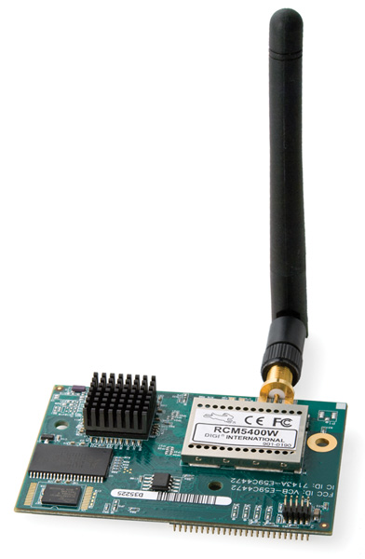
Control
Requirements
Communication with Nest cloud and web server
Shade actuator control based on sensor inputs
Fast response to light level changes
Implementation
Microcontroller with WiFi module
  Nest API
  RESTful interface to server
Wired connection to light sensor and shade actuator
Department of Electrical and Computer Engineering
Notes:
Justin

Slide 19
MDR Deliverables
Working light sensor with ADC → MCU
Shade actuator prototype
  Able to move shade up and down on command
App prototype
  Can send and receive data to web server
  Simplified version on settings
MCU query Nest and web server over WiFi
Department of Electrical and Computer Engineering
Notes:
Justin

Slide 20
Questions
Department of Electrical and Computer Engineering
Notes:
Z

