Slide 1
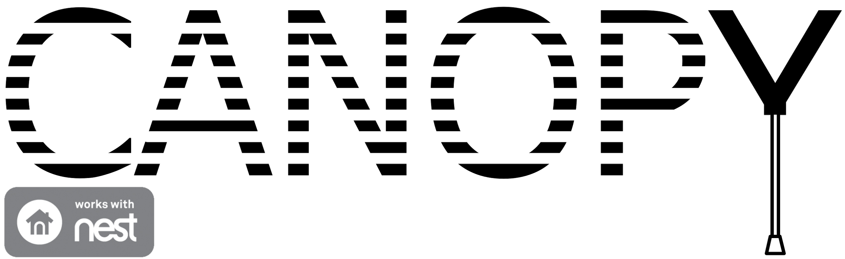
Midway Design Review
Team 18
December 2, 2015
Department of Electrical and Computer Engineering
Advisor: Csaba Andras Moritz

Slide 2



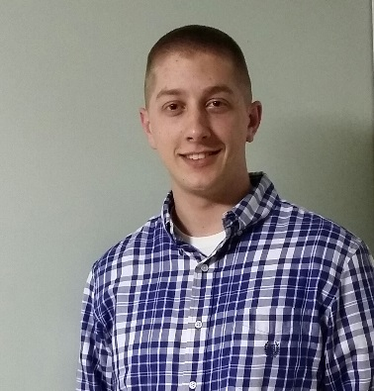
Midway Design Review
Justin Thibodeau CSE | Jack Curci EE | Michael Chapman CSE | Zachary Windoloski CSE
Department of Electrical and Computer Engineering
Advisor: Csaba Andras Moritz

Slide 3
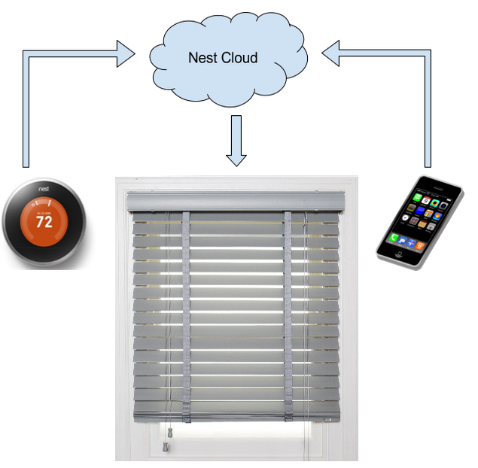
Motivations and Solution
Heating and cooling are expensive
People want ways to automate tasks
Shades help regulate temperature
Nest integration provides intelligent control
App provides convenience
Department of Electrical and Computer Engineering
Notes:
There are two main motivations for this project. The first is the high cost of heating and cooling homes and buildings, and the second is the fact that people often look for ways to automate tedious tasks in order to make their lives easier. To address the high cost of heating and cooling, we proposed as system of automated shades that can help regulate temperature. Furthermore, we decided to integrate our shade system with the Nest thermostat to have more intelligent control. In order to address convenience, our system has an app that allows a user to change their shade settings from anywhere.

Slide 4
Requirements
Improve internal temperature control
Able to run continuously
User definable behavior and scheduling
Easy control through a mobile app
Always allow for manual override
Department of Electrical and Computer Engineering
Notes:
We need the shade to help control internal temperature by properly deciding when to let in sunlight or not. The system must run continuously. We also have to provide different settings for behavior and scheduling on a shade by shade basis, so a user can customize the system to their liking. These settings must be easily controllable in an mobile app. We also must allow for manual override at all times, so if a user wants to adjust the shades themselves they should be able to. Finally, we need our system to save energy associated with heating and cooling of a building.

Slide 5
Design
Nest Cloud
Shade Unit
AWS Database
Control Unit
Light Sensor
Sun
User Data
Shade Data
WiFi
ADC
Amp
Photo
Diode
Power Supply
App
Shade Actuator
tx/rx
App backend
UI
MCU
Department of Electrical and Computer Engineering
Notes:
Shown here is our block diagram, it’s undergone some minor changes since PDR. The core design is the same: the light sensor takes in data from the environment, the control unit communicates with the AWS Database and the Nest Cloud over Wi-Fi and uses that data to control the shade using the actuator. The AWS Database holds user data and data from the shade module, which can be read by the app. The app now communicates with the control unit directly when the system is in access mode, where it is configured and connected to a wireless network.

Slide 6
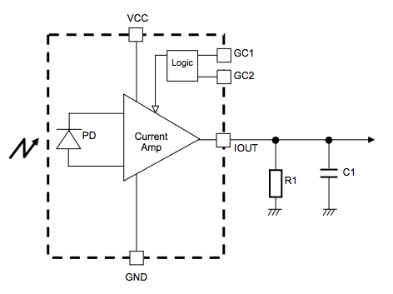
Light Sensor
Requirements
Measure incoming light
Output usable voltage to MCU
Distinct response across wide range
  Brightness levels from <1lx to >100klx
Implementation
Rohm BH1620FVC
  Photodiode based light sensor
  Available characterization across wide range
Logarithmic amplifier to produce usable signal
BH1620FCV
Department of Electrical and Computer Engineering
Notes:
For the light sensor, our initial requirements were that it could measure incoming light, output a usable voltage signal to the microcontroller, and produce a distinct response across a wide range from darkness at less than 1 lux to bright daylight at over 100 thousand lux.
The main challenge in building this sensor was the span of over five orders of magnitude between the smallest and largest signals that we would want to detect.
Our implementation uses the Rohm BH1620 light sensor, which is based around a photodiode sensing element and also includes the amplifier circuit shown here.
The main reason we chose this component was because it came with excellent characterization data showing a linear gain across the full range of brightness that we were interested in.
The output of this sensor still spans five orders of magnitude and is in the form of a current, so we used an IC logarithmic amplifier to produce a useful voltage signal.

Slide 7
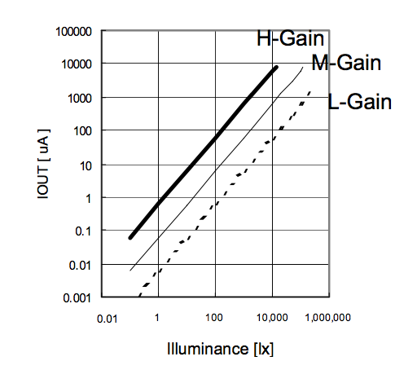
Light Sensor Deliverable
Proposed for MDR
Sensor with voltage output to MCU
Delivered
Outputs light dependent signal
Log amplifier produces usable voltage
Usable resolution at any light level
Output ranging from 0.1V when covered, up to 0.7V in typical indoor light
BH1620FCV
Department of Electrical and Computer Engineering
Notes:
So for MDR we proposed to make a light sensor that would output a usable voltage to our microcontroller.
Our light sensor outputs a light dependent signal, and our log amplifier converts that to a usable voltage. The sensor is able to provide sufficient resolution to be usable across the entire range of light levels that we’re interested in.
And while we haven’t precisely characterized the linearity of the sensor, the device was designed to have a linear response, and the sensing element is highly linear over the range of interest.
Example values for the output are around 0.3V when the sensor is covered, and around 0.7V in typical indoor light

Slide 8
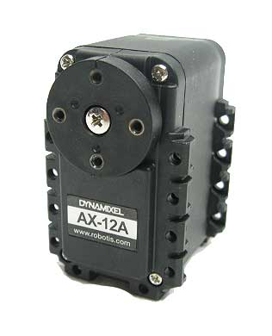
Shade Actuator
Requirements
Adjust shade
Allow manual override
Quiet and inconspicuous
Dynamixel Ax-12a Servo
12kg-cm standing torque
Ability to read data from motor
Easily daisy-chained
Quiet
Department of Electrical and Computer Engineering

Slide 9
Shade Actuator Deliverable
Proposed for MDR
Motor controlling shades from MCU
Delivered
Built wooden frame
Created motor coupler
Motor rotates horizontal blinds
Department of Electrical and Computer Engineering

Slide 10
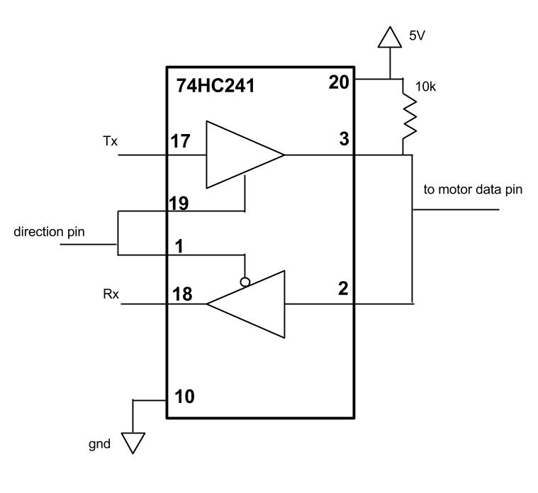
Shade Actuator Next Steps
Reading Data from Motor
Convert full duplex to half duplex
Read temperature, torque
Calibration Options
Proximity sensors inside shade
Physical stop
Manual Override
Buttons on the side of the shade
Department of Electrical and Computer Engineering
Notes:
The communication with the motor happens over a half duplex uart port, which uses the same wire for sending and receiving data. The microcontroller, however, uses full duplex, where separate pins are used for receiving and sending. In order to allow for communication between the mcu and motor, a simple circuit with two tri-state buffers can be used to translate the full duplex of the mcu to the half duplex of the motor. Once this is in place, the motor can send back information about its temperature and torque, which we can use to make our system more robust.
Once that is set up, the next step will be the implementation of calibration, or how we will correct for small errors in position over time. Currently I have two ideas for how that will work. The first involves using proximity sensors placed on the shaft of the motor to tell the motor when it is open or closed. The second option involves placing something on the shaft that will physically stop the motor if it tries to go too far.
Finally, I need to implement manual override. There will be buttons on the side that will allow a user to control the shade.

Slide 11
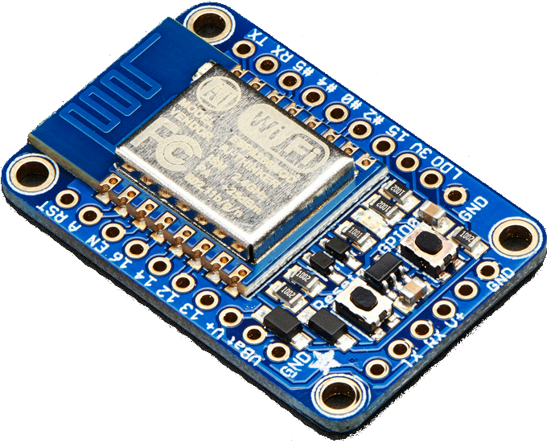
Microcontroller
Requirements
Communicate with Nest cloud and AWS database
Control shade actuator and accept sensor inputs
Fast response to light level changes
Adafruit Huzzah
Can act as access point or connect to a network
Built in MCU that can be programed in Arduino IDE
Low power modes are available with limited WiFi
Watchdog timer can be used to let device sleep when not active
Department of Electrical and Computer Engineering
Notes:
We decided to use the Adafruit Huzzah board as our main microcontroller based on recommendations from Professor Malloch.
This board has a microcontroller and WiFi chip built in, allowing it to easily handle our computations and communication. We can use it as an access point so our users mobile device can directly connect to it in order to set it up on their in-home network. Once this connection is established, it can send and receive requests out to the internet. We are programming it using the arduino IDE and several extra libraries for WiFi communication, encryption, and motor control.

Slide 12

Microcontroller Deliverable
Proposed
Connection to network over WiFi
Database communication
Delivered
Acts as access point on boot, respond to GET and POST to set up network connection
Saves connection data to EEPROM
Communicates with AWS and can push/pull from database with a signature to ensure data integrity
Department of Electrical and Computer Engineering

Slide 13
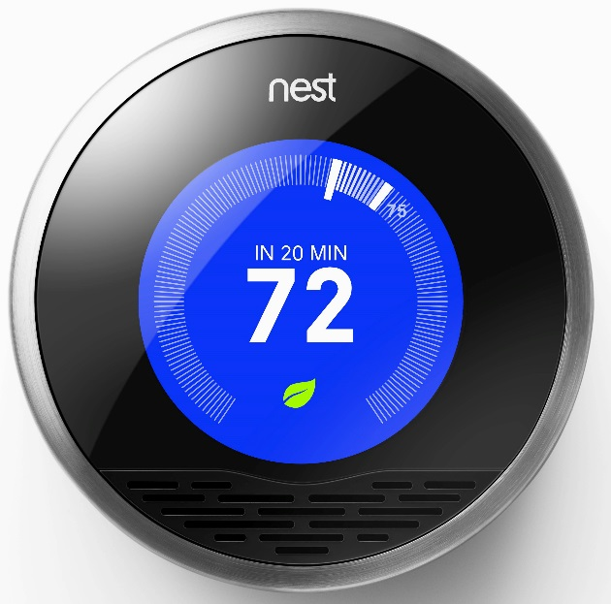
Microcontroller Next Steps
Nest communication
Implement Nest API to access user data and inform behavior
Behavior Algorithm
Efficiency, privacy, and directly set modes
Decide when to return from a user override
Handle schedules
Department of Electrical and Computer Engineering

Slide 14
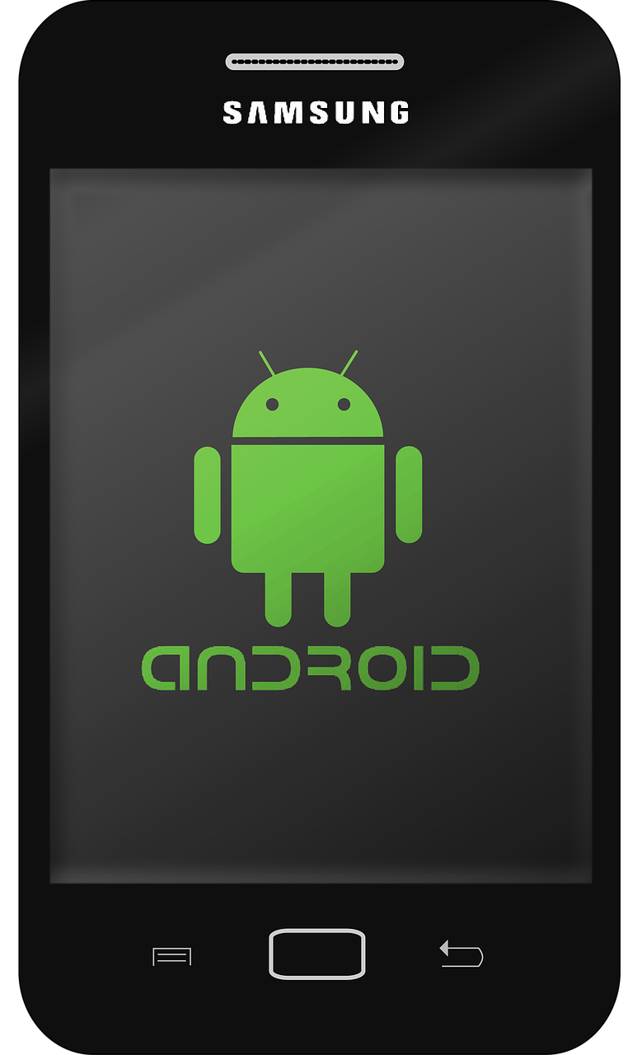
Mobile App
Requirements
Define settings and display data
Communication with database
Authenticate users and maintain security
Android App
Uses Amazon Cognito to manage users
Connects with Amazon's DynamoDB
Department of Electrical and Computer Engineering

Slide 15
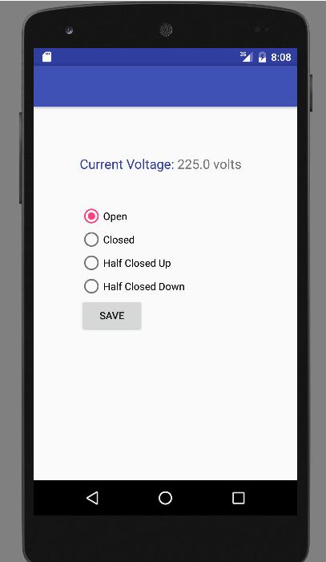
Mobile App Deliverable
Proposed
App that shows AWS integration
Minimal setting functionality
Delivered
Connects to AWS
Can push/pull from database
  Implements Android AsyncTask
Testing done with Android Studio emulator
Working on physical device
Department of Electrical and Computer Engineering

Slide 16
Mobile App Next Steps
A method of adding and organizing multiple shades
In-app setup
  Nest authorization
  Access point setup
Department of Electrical and Computer Engineering

Slide 17
Demo
Department of Electrical and Computer Engineering

Slide 18
CDR Deliverables
Communication with Nest through MCU - Justin
Motor calibration and manual control - Michael
Working power supply - Jack
App supports multiple shades and more settings - Zack
Department of Electrical and Computer Engineering

Slide 19
Questions?
Department of Electrical and Computer Engineering

