Slide 1
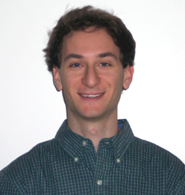
Final Product Review
Justin Thibodeau CSE | Jack Curci EE | Michael Chapman CSE | Zachary Windoloski CSE
Department of Electrical and Computer Engineering
Advisor: Csaba Andras Moritz

Slide 2
System Requirements
Improve internal temperature control
Able to run continuously
User definable behavior and scheduling
Easy control through a mobile app
Always allow for manual override
Department of Electrical and Computer Engineering

Slide 3
Specifications
Outdoor Light Level Sensor With +/-50% precision over 0.5-120,000 lux | BH1620FVC-TR Photodiode
Shade to Internet Communication | IEEE 802.11
Motor Producing ~4 kg*cm | Dynamixel ax-12a
User to Device Communication Security | PSK Encryption
Web Based Data Storage | AWS
Data Security | Encrypted Signatures
Continuous Power Source | Standard US 120V Wall AC
Remote Control | Android App
Manual Control | Physical Switch on Device

Slide 4
Design
Shade Unit
AWS
Control Unit
Light Sensor
Nest Cloud
Voltage Regulator
Sun
User Data
Shade Data
WiFi
ADC
Log Amp
Photo
Diode
10V
3.3V
Power Supply
10V
Android App
Shade Actuator
TX/RX
App backend
UI
MCU
Department of Electrical and Computer Engineering

Slide 5
CDR Review
Full app to database functionality
Nest integration and account linking in App
Manual controls
Power supply and PCB
Department of Electrical and Computer Engineering

Slide 6
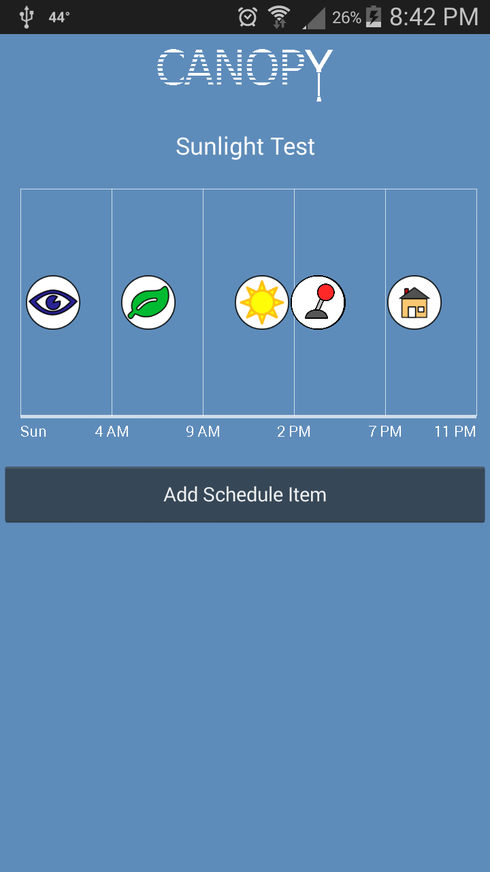
App Finalization
User creation/log-in
Better visualization for schedules
Department of Electrical and Computer Engineering

Slide 7
Device Setup
Finalized shade to network setup
Process is similar to Chromecast
Enter information about new Shade
Enter ID from the physical shade
Select network and enter password
Disconnect from current network
Connect to device’s access point
Push network and hashed password
Reconnect to old network
Check if AWS was updated
Alert user about results
Requires User Input
Runs In Background
Department of Electrical and Computer Engineering

Slide 8
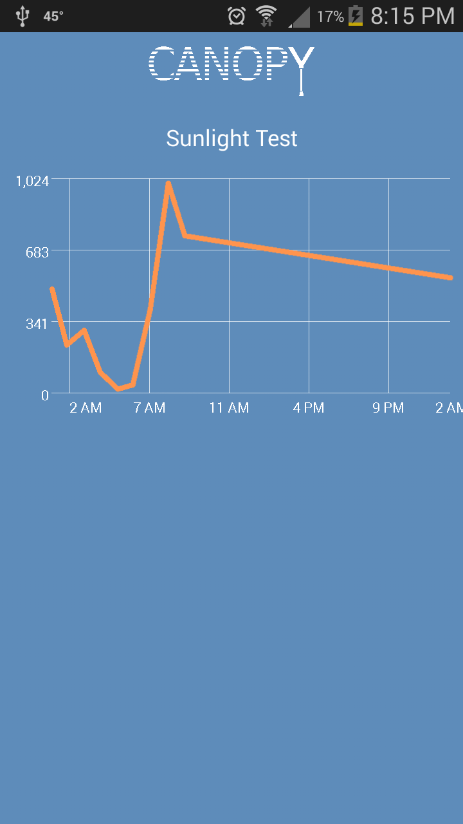
Sunlight Data Visualization
Sunlight levels are being recorded
Update approx. every 15 minutes
The App shows a graph of this data
Department of Electrical and Computer Engineering

Slide 9
Shade Behavior - Energy Efficiency
Energy Efficiency decision based on 3 variables
Sun’s angle of elevation, temperature, and light level
Want house to be warmer: if it’s bright outside, track the sun up to 20 degrees, if it’s dark close the shades to keep in heat
Want house to be colder: if it’s sunny, close the shades, if it’s dark open the shades to let out heat
Department of Electrical and Computer Engineering

Slide 10
Shade Behavior - Energy Efficiency
Convenience - Shades open between sunrise and sunset, calculated using lat/long and time
Preservation - Shades closed above certain light level and at night, open below this light level
Manual
Open/Closed
Department of Electrical and Computer Engineering

Slide 11
Manual Override
Shade will delay for a time before reverting back to behavior
If shade continues to receive overrides, it will lengthen the delay time before reverting back
If no overrides are received, it will shorten this delay period
Currently, minimum delay set to 30 minutes, maximum at 24 hours
Department of Electrical and Computer Engineering

Slide 12
Performance
Power Consumption
Uses 85mW idle, unchanged during WiFi setup
Peak of 145mW while adjusting shade position
Average power consumption very close to 85mW
Energy Comparison
Uses roughly 2Wh/day, operating 24/7
Compare to 30Wh for a 15W CFL bulb, used for 2 hours/day
Comparable to running a 1500W space heater for 5 seconds
Department of Electrical and Computer Engineering

Slide 13
Demo Overview
Full account & shade setup
User creation/login
Link a Nest Account
Create a shade and connect it to a network
Shade behavior modes
Open/Closed
Energy mode - adjust light levels/temperature levels
Manually override, then cancel from within the App
Schedule - create several back to back schedule items
During the demo we will be collecting light levels to show within the App
Department of Electrical and Computer Engineering

Slide 14
Demo
Department of Electrical and Computer Engineering

Slide 15
Questions?
Department of Electrical and Computer Engineering

Slide 16
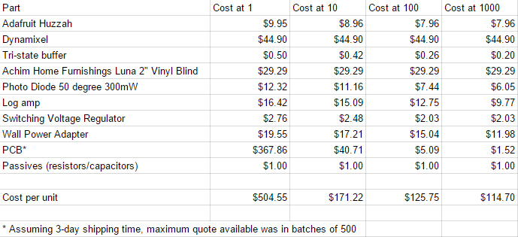
Cost Analysis
Department of Electrical and Computer Engineering

