Slide 1
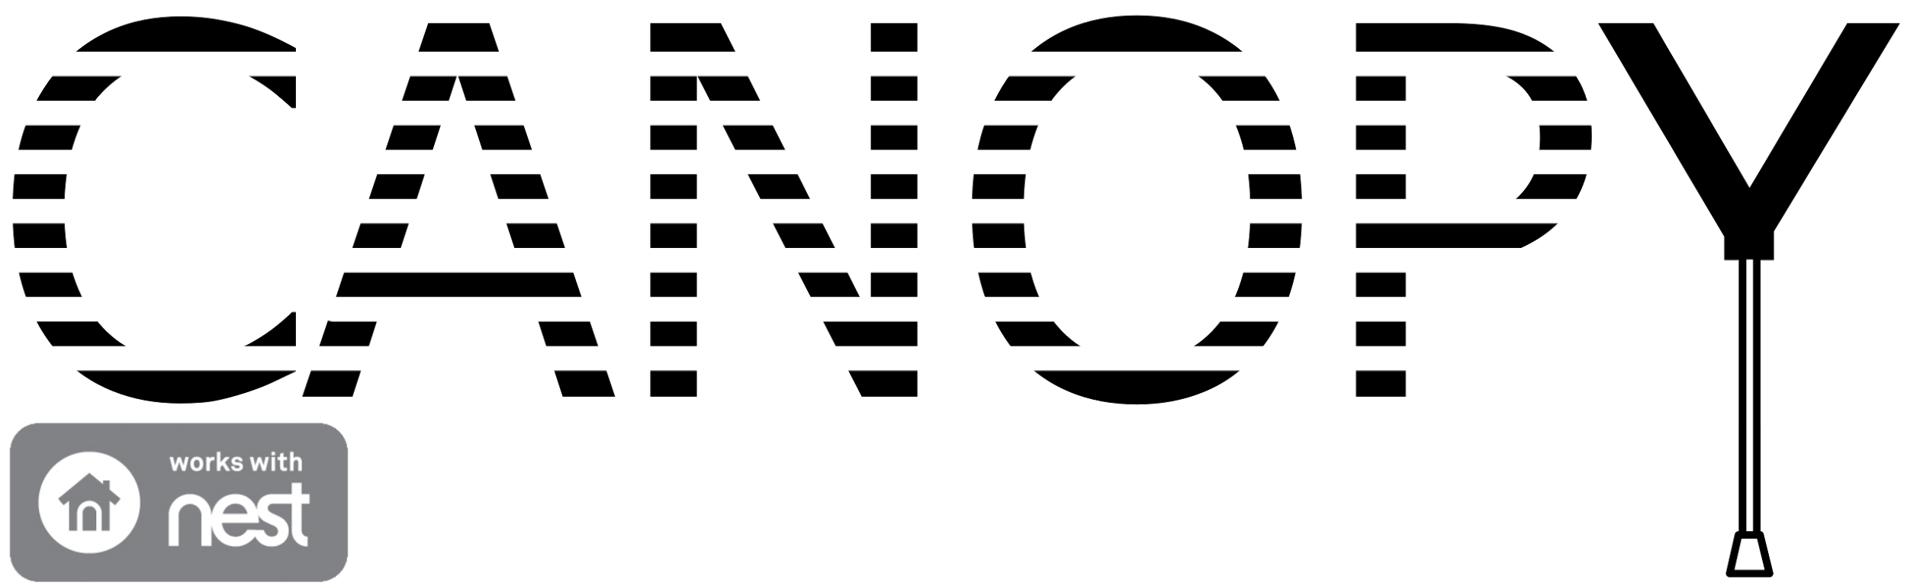




Cumulative Design Review
Justin Thibodeau CSE | Jack Curci EE | Michael Chapman CSE | Zachary Windoloski CSE
Department of Electrical and Computer Engineering
Advisor: Csaba Andras Moritz

Slide 2
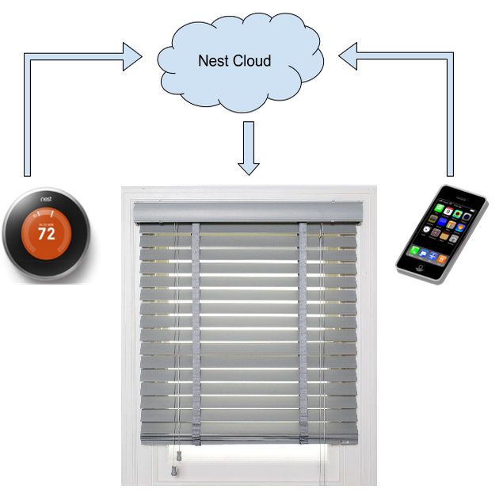
Motivations and Solution
Heating and cooling are expensive
People want ways to automate tasks
Shades help regulate temperature
Nest integration provides intelligent control
App provides convenience
Department of Electrical and Computer Engineering
Notes:
There are two main motivations for this project. The first is the high cost of heating and cooling homes and buildings, and the second is the fact that people often look for ways to automate tedious tasks in order to make their lives easier. To address the high cost of heating and cooling, we proposed as system of automated shades that can help regulate temperature. Furthermore, we decided to integrate our shade system with the Nest thermostat to have more intelligent control. In order to address convenience, our system has an app that allows a user to change their shade settings from anywhere.

Slide 3
Design
Shade Unit
AWS
Control Unit
Light Sensor
Nest Cloud
Voltage Regulator
Sun
User Data
Shade Data
WiFi
ADC
Log Amp
Photo
Diode
10V
3.3V
Power Supply
10V
Android App
Shade Actuator
TX/RX
App backend
UI
MCU
Department of Electrical and Computer Engineering

Slide 4
MDR Review
End to end functionality
Device connects to a network and can communicate with AWS
Motor receives signals from the MCU and can be set to a specific angle
Light sensor detects variable light levels
App can communicate with AWS to push and pull data
Department of Electrical and Computer Engineering

Slide 5
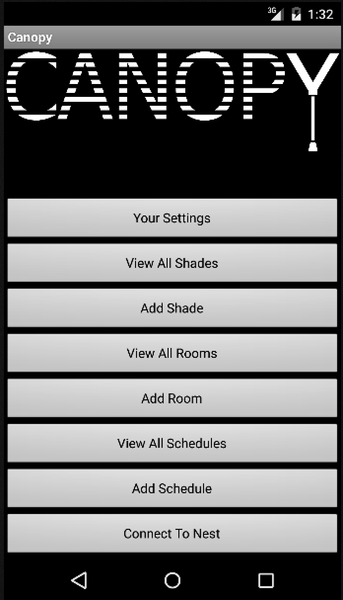
App Changes
Previously app only had single view for one shade
  Only one shade attribute to change
Currently app supports multiple shades, rooms, and schedules
Can create and edit each of those
Each has multiple attributes that can be edited
Schedules link to a user, a user’s room, or a user’s shade
Connects user to Nest (Justin)
Department of Electrical and Computer Engineering

Slide 6
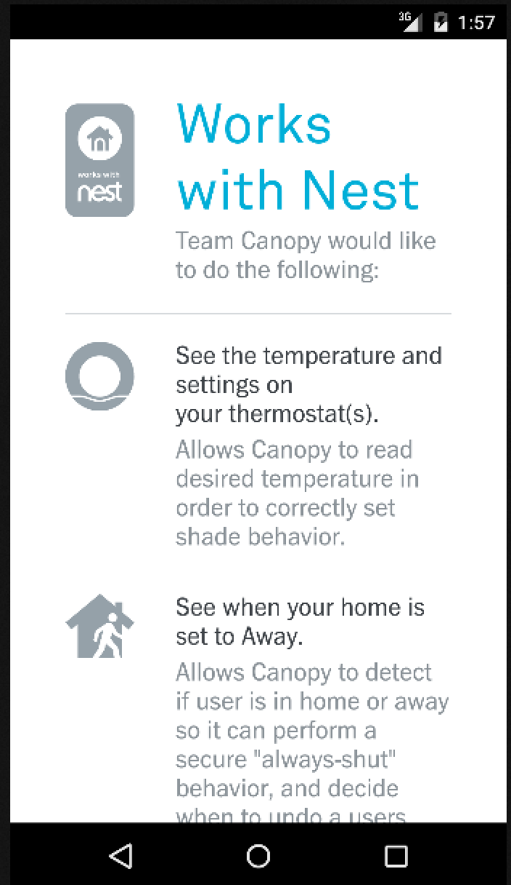
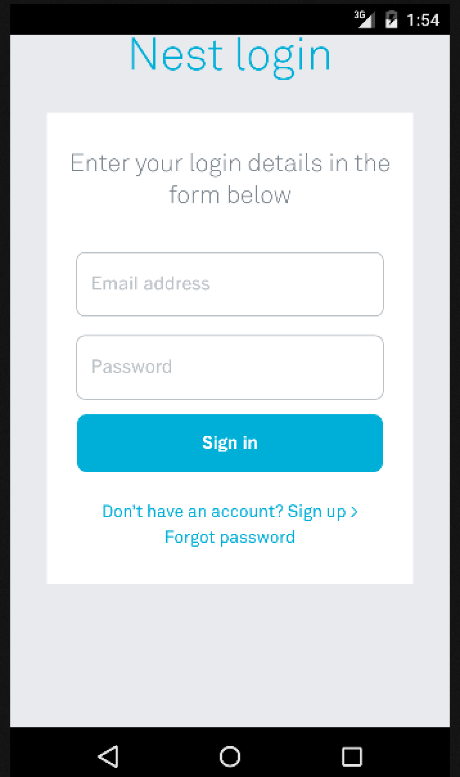
Nest Integration
Nest API allows us to retrieve thermostat data
  Connect to Nest account in app
  Auth token is stored in AWS database
Creating a shade requests list of Nest devices
Department of Electrical and Computer Engineering

Slide 7
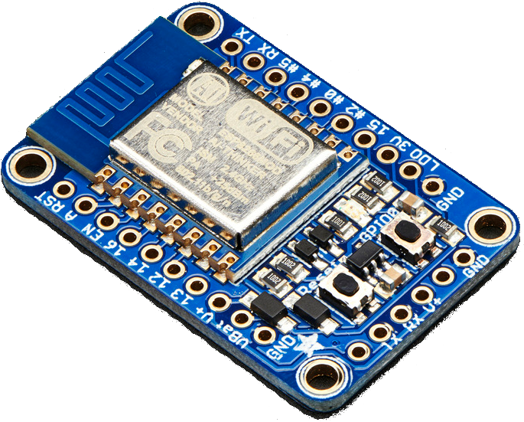


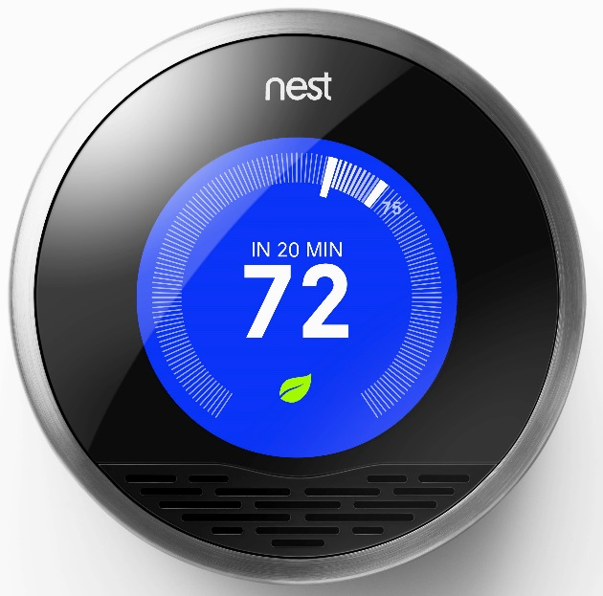

Nest Integration
Canopy device updating a shade in DynamoDB causes Lambda to query Nest for temperatures
Why Lambda?
  Huzzah board has no built-in SSL
  SSL libraries have a large footprint
  Lambda can directly respond to changes in DynamoDB
Department of Electrical and Computer Engineering

Slide 8
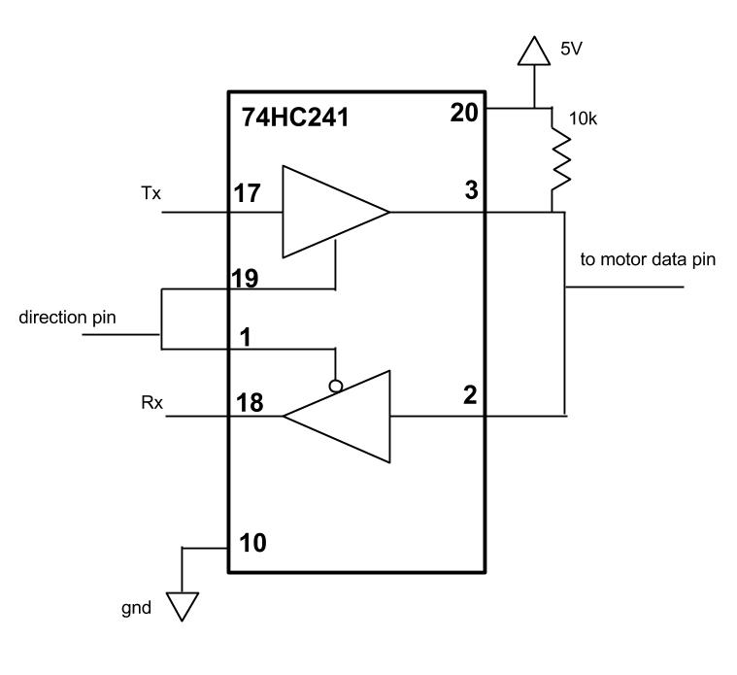
Motor Feedback & Manual Control
Tri-state buffer allows for communication with motor
  Set maximum temperature, voltage, angle of rotation
  Return error if value exceeds max
Buttons allow for manual override
Department of Electrical and Computer Engineering

Slide 9
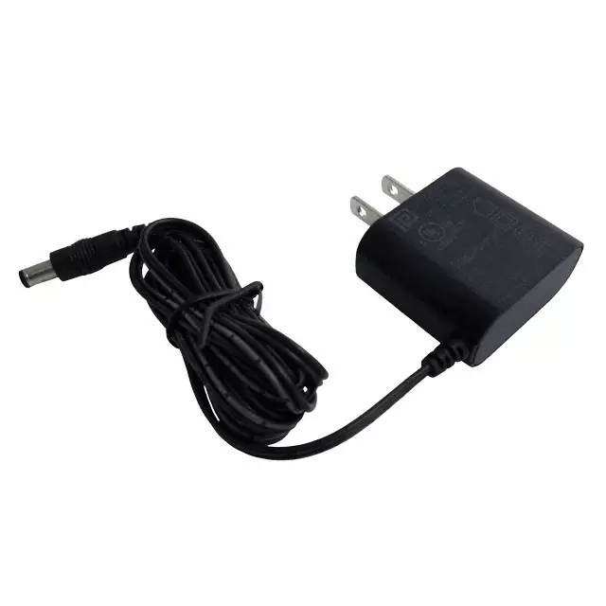
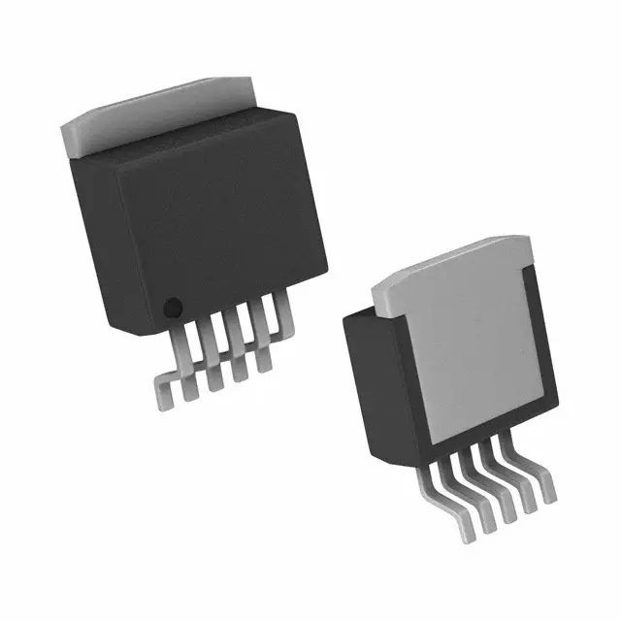
Power Supply and PCB
Power supply uses 10V wall adapter
  Used directly for motor
  10V rail for light sensor circuit
5V level produced using buck regulator
  Used LM2576SX-5.0 regulator
  Supplies Huzzah, tri-state, light sensor
Also created PCB holding all electronics
  Circuit layout using PCB Artist
  Ordered from Advanced Circuits
Department of Electrical and Computer Engineering
Notes:
PSM03A-100-R 10V Power Supply
LM2576SX-5.0 5V Buck Regulator

Slide 10
DEMO
Department of Electrical and Computer Engineering

Slide 11
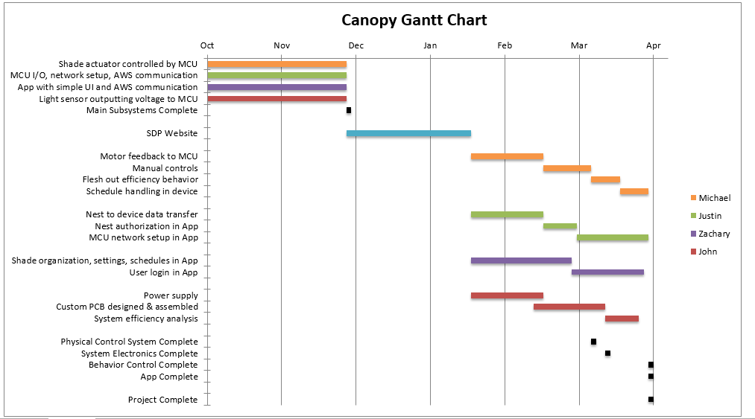
Gantt Chart
Department of Electrical and Computer Engineering

Slide 12
Remaining Work & FPR
Implement User creation and login from the App
App usability
Initial shade connection to the user’s network within the App
Finalized behaviors and schedule handling in device
Efficiency & power analysis
Department of Electrical and Computer Engineering

Slide 13
Questions?
Department of Electrical and Computer Engineering

Slide 14
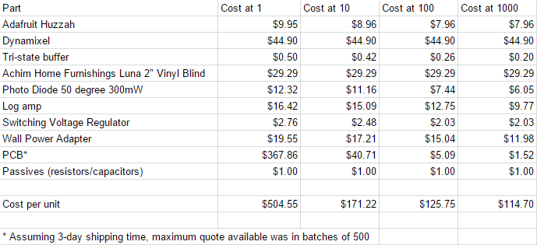
Cost Analysis
Department of Electrical and Computer Engineering

