Slide 1
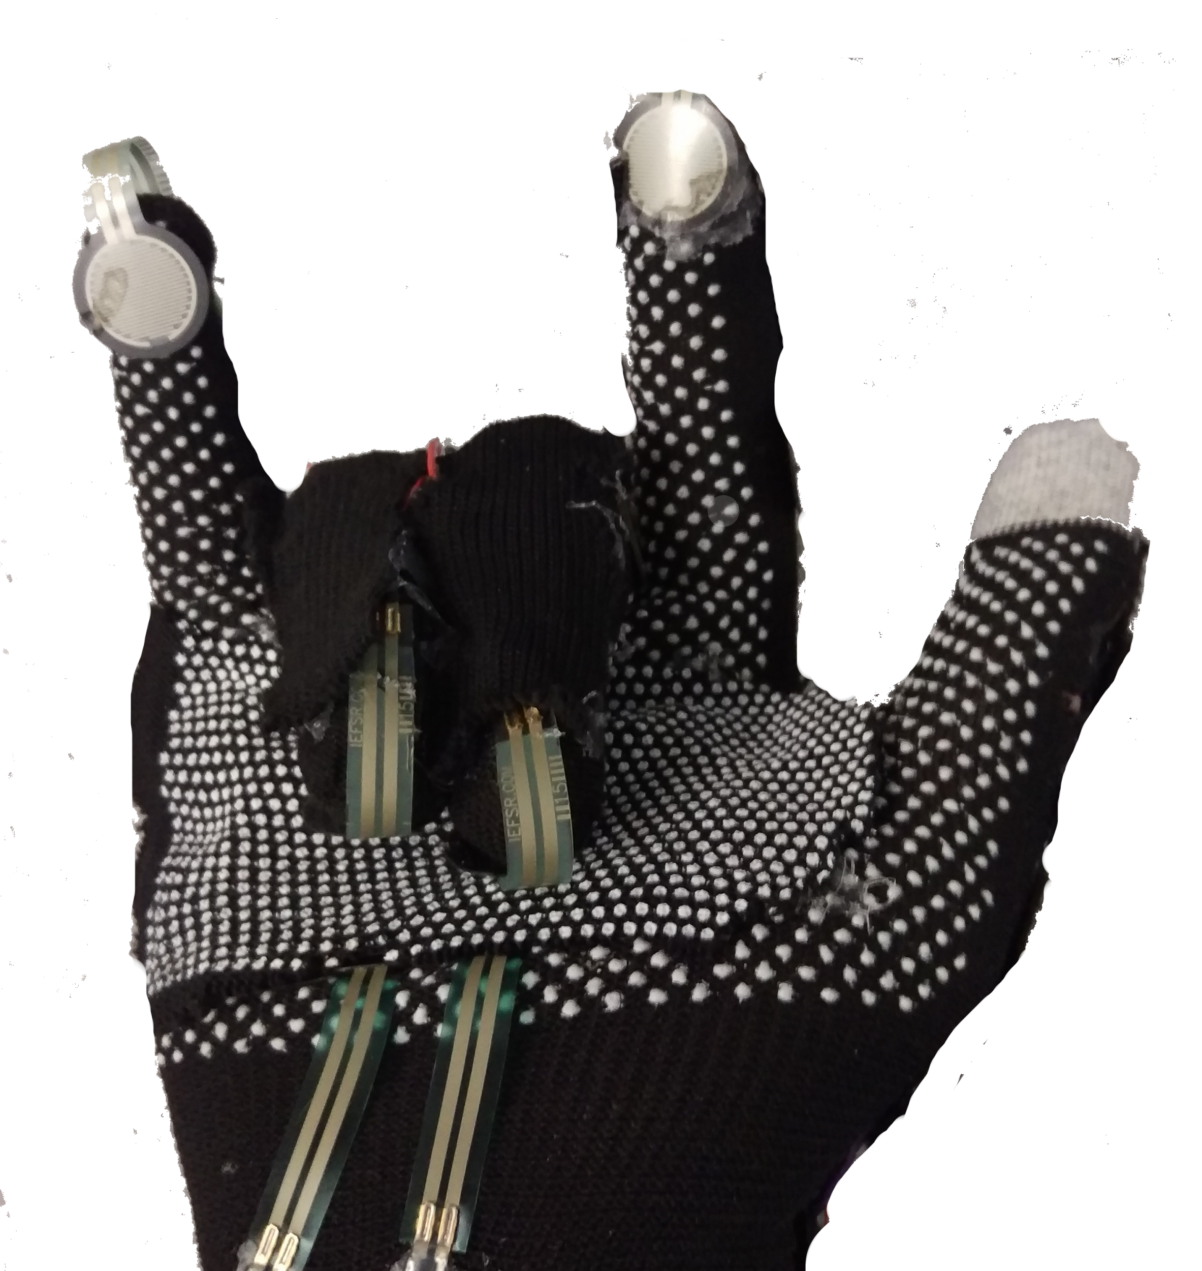
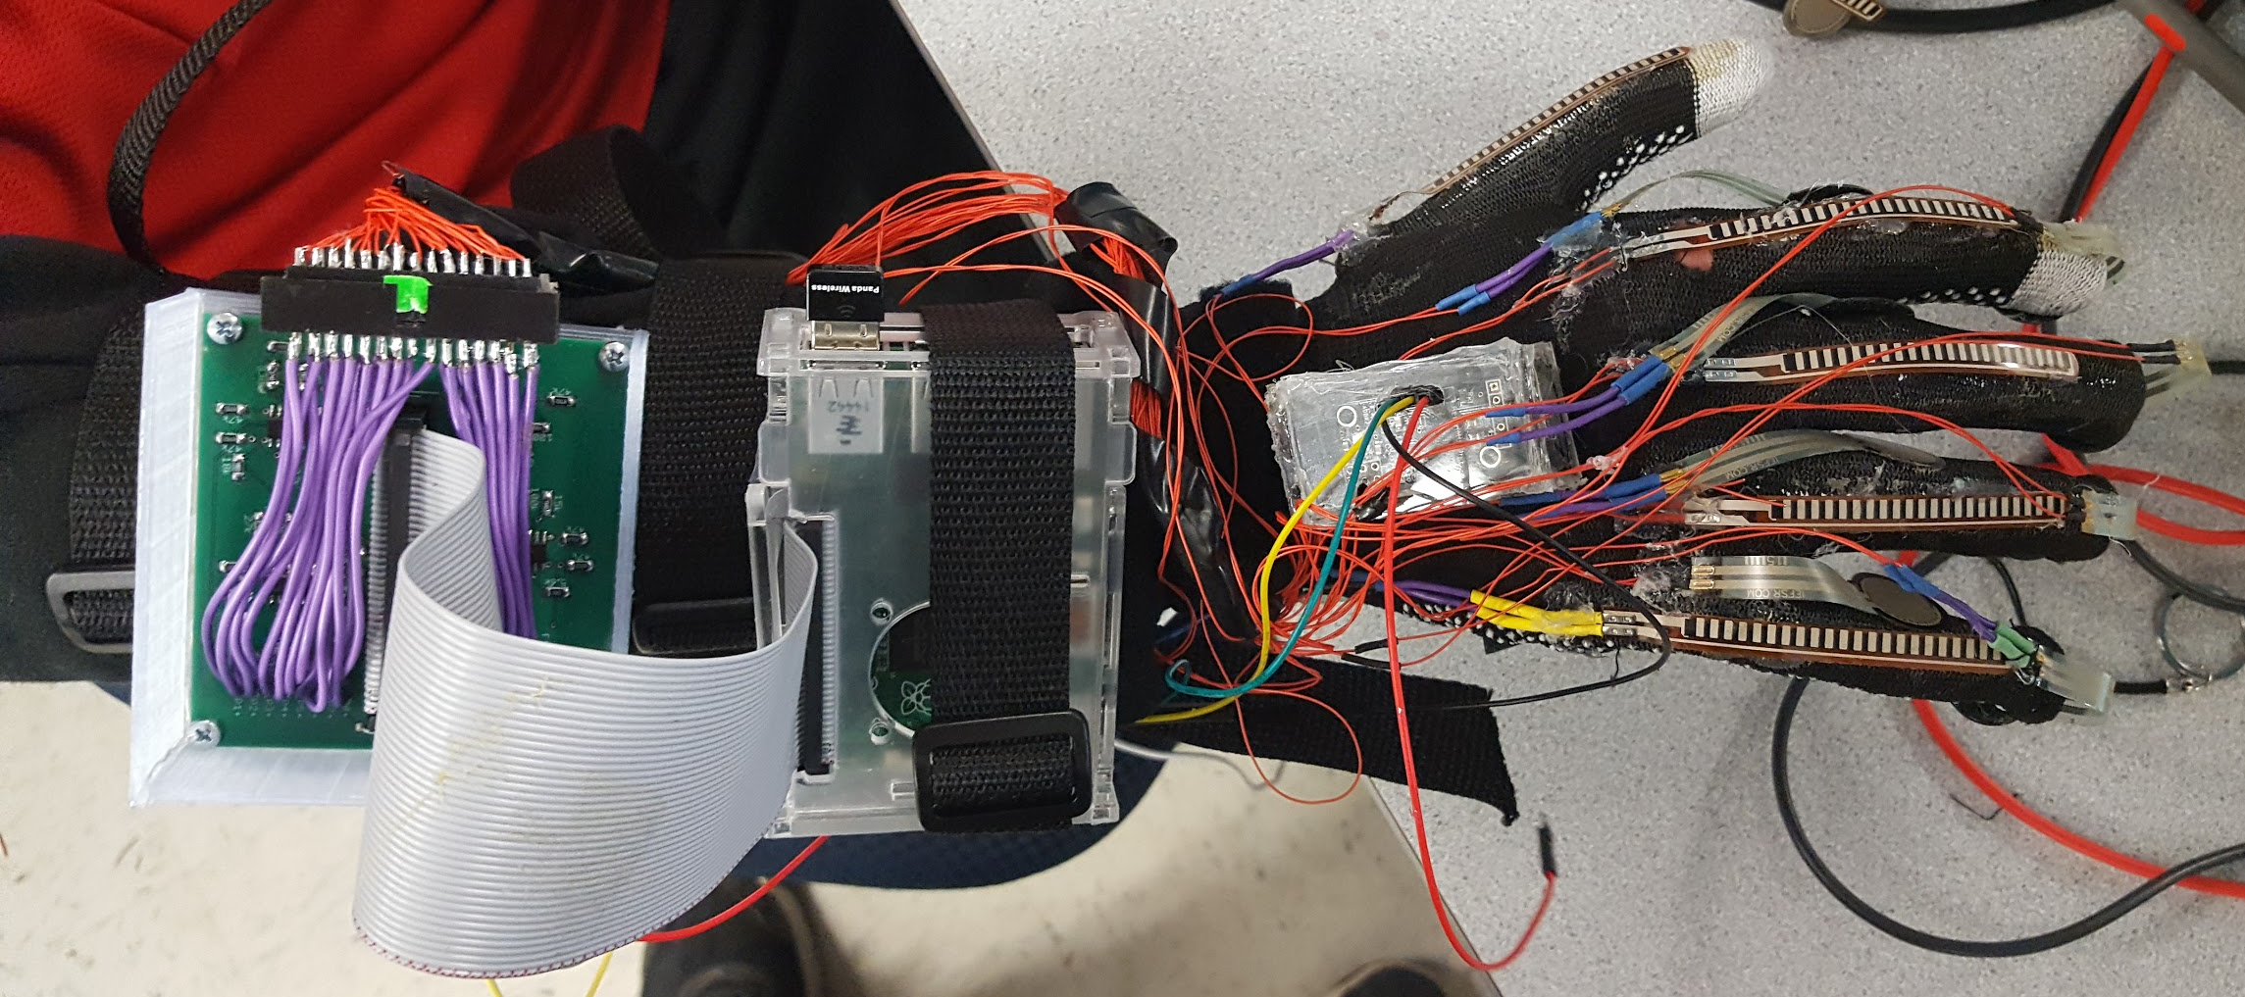
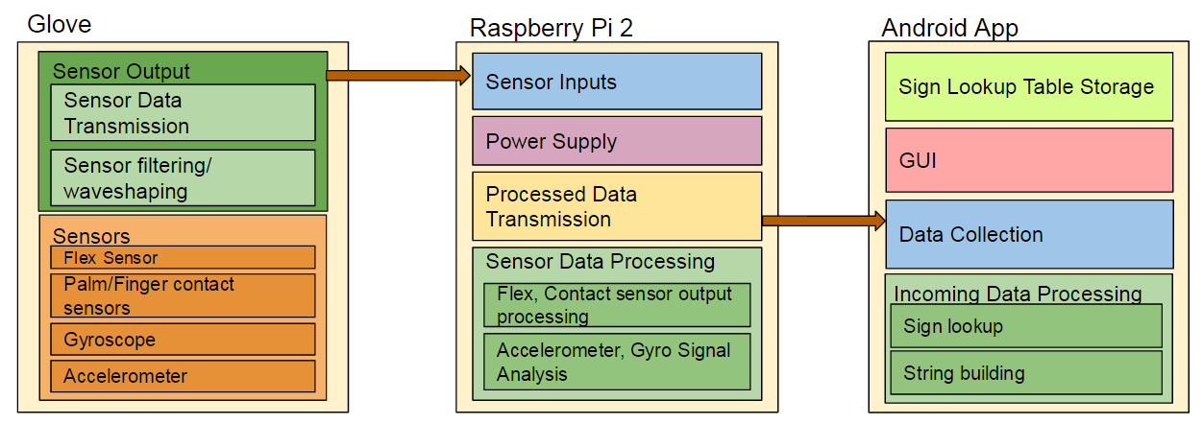




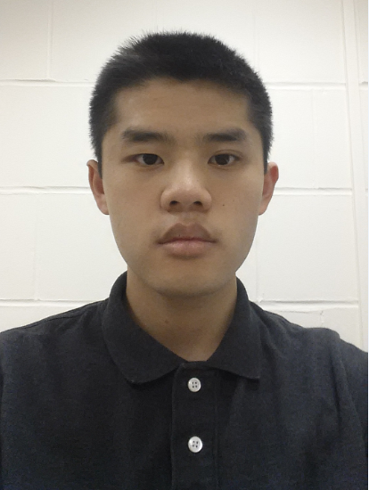

v
SigninGlove
Aaron Gilbert, John Gontowicz, Mathew Lau, Kacey Looney
Faculty Advisor: Prof. Robert Jackson
Abstract
The SigninGlove is a portable American Sign Language translator that would allow the user to communicate with those around them using a wearable glove and their cellphone. The glove contains a variety of sensors that are connected to a Raspberry Pi which wirelessly sends a string to the application that then translates the user’s sign. This would allow a sign language user to be understood in everyday situations that currently lead to miscommunication.
System Overview
The glove is made of five flex sensors and and ten pressure sensors. Each of these sensors are put through a voltage comparator circuit which outputs 0.5 mV when the sensors are not in use and 3.2V when they are in use. The Pi translates a low voltage into a 0 and a high voltage into a one and sends a string of these along with the gyroscope and accelerometer values to the Android application through TCP. The Android app then searches for the string and finds the three most similar strings and displays the results for the user to choose.
Block Diagram
Results
The glove displays the correct translation in one of the three choices 86% of the time. When the sign does not appear in the choices the user has the option to try the sign again or to update the value of the sign to what they are currently signing. The user can also add any signs not currently in the application by completing the sign three times.
Using a variety of sentences, the glove was tested among 15 different people. These people needed to write what they believed the glove was saying as a user signed the test sentences. The user was understood 82% of the time when using the glove. Although the glove did not put sentences in the correct grammatical order, the general point was understood and helped facilitate communication.
The glove contains five flex sensors on each finger and ten pressure sensors throughout the glove. An IMU is used to measure both the angle of the hand and the motion. These values are sent to a raspberry pi that converts the readings to a string that is sent to the android app. The android app then translates this string and displays the translated sign.
Specifications
Specification | Unit of Measure | Target | Actual
Weight | Ounces | <16 | 15
Battery Life | Hours | >4 | 4
Connection Distance | Feet | >10 | 15
Delay | Milliseconds | <500 | ~250
Accuracy | Sign to Word | >75% | ~85%
Cost | Dollars | <500 | 209
Acknowledgement
All those involved in the SigninGlove would like to extend a thank you to Professor Robert Jackson for all his help and advice throughout the project. Professor Jackson helped us keep on track with this project and provided valuable insight throughout the semester. We would like to thank our faculty advisors, Professor Alfred DeFonzo and Professor Lixin Gao, for all of their questions and comments during PDR, MDR, and CDR that helped us look closely at our project and make changes and improvements where needed. Additional thanks to Konner Looney for coming in and testing our glove and giving us feedback on our project.
Team
John Gontowicz
Aaron
Gilbert
Robert Jackson
Kacey
Looney
Mathew
Lau
Department of Electrical and Computer Engineering
ECE 415/ECE 416 – SENIOR DESIGN PROJECT 2016
College of Engineering - University of Massachusetts Amherst
SDP16

Slide 2
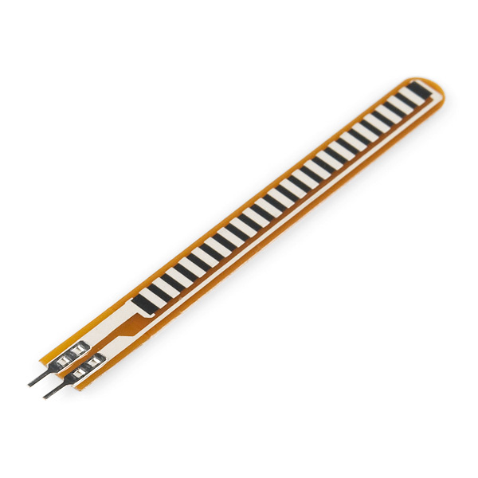
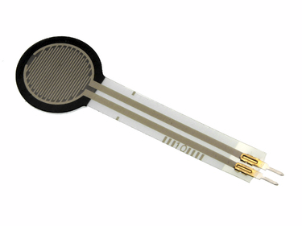
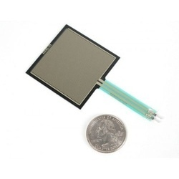
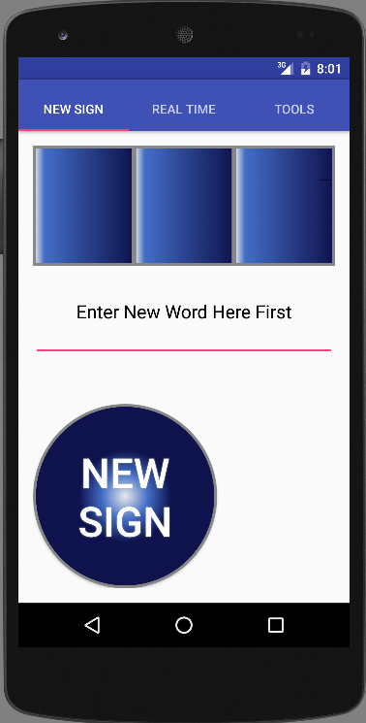
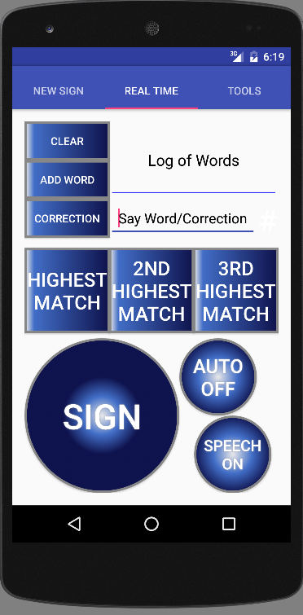
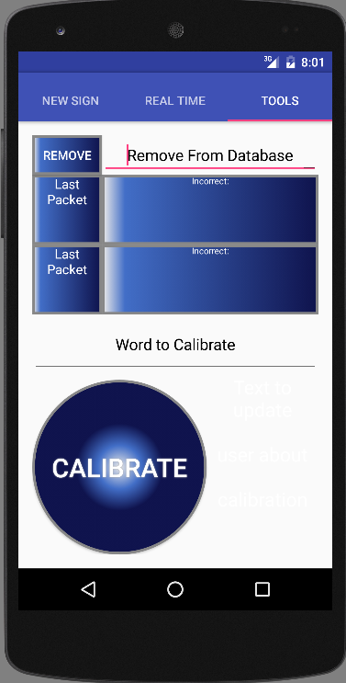
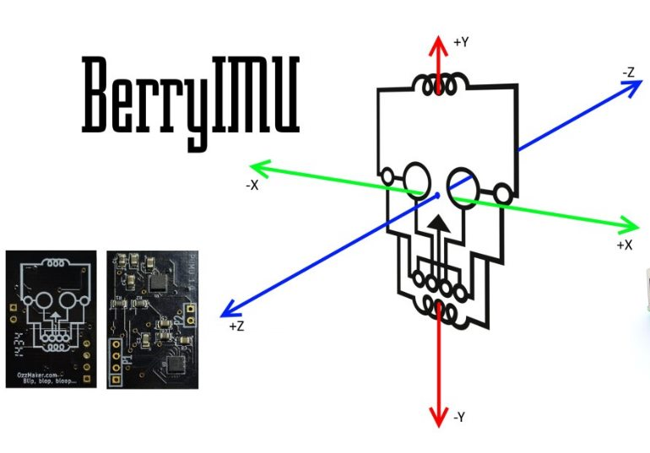
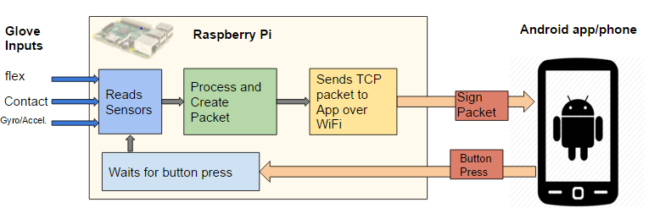
Sensors
Android App
The back of each finger has a 2.2” flex sensor that measures how bent the finger is. The tip of each finger, except for the thumb, has a 0.5” force sensitive resistor. These resistors are also found between each finger. Two square force sensitive resistors are overlapped on the palm as well. Each of these sensors are put through a voltage comparator circuit whose output is fed directly into the Pi. The voltage comparator circuit has an output of 0.5 mV until the sensor is used, then the voltage goes to 3.2V.
The Android app starts by loading the saved database of signs into memory for quicker access. The user then presses the big circular button (“Sign”) to start recording data. Once the user lets go of the button, the data is received from the Pi. Now, the app searches through and calculates the probability for each entry in the database using the algorithm shown below. Lastly, the top three probable results are shown. Some features implemented are adding (three samples taken) and removing signs from the database, word correction, TextToSpeech, calibration, and haptic/visual feedback for deaf people.
BerryIMU
Sign From Database 01111000001111 11110020
Search Algorithm
Sign Sample 01111000001111 11110020
Every Entry Compared
Search Algorithm
1.Different bits calculated (1 if same, else 0)
2. Each bit multiplied by a predetermined weight
3. Sum for probability
4. Return top three signs from database
Highest %
Top Choice Sign
Database of Sign Objects
Sign Object:
Sensor Data
Word
2nd Highest %
2nd Top Choice Match
The BerryIMU is a Gyroscope, Accelerometer, and Magnetometer board that connects to the Raspberry Pi 2 via the I2C bus. The board detects its angular orientation through the gyroscope, and acceleration through the accelerometer. Located on the back of the hand, the chip provides data about position and movement while signing. This allows the Raspberry Pi to differentiate signs that involve different angles and movement.
On the Raspberry Pi, samples of the Accel/Gyro are taken for the duration of the sign movement. After, the minimum and maximum values are determined, and appended to the static sensor values.
3rd Highest %
3rd Highest Match
Cost
Development
Part | Price per Unit | Price
PCB | $38 | $38
Raspberry Pi | $30 | $30
Flex Sensors | $7 | $35
Force Sensitive Resistors - Circle | $7 | $56
Force Sensitive Resistors - Square | $8 | $16
BerryIMU | $34 | $34
Total |  | $209
Raspberry Pi
Production
The system utilizes a Raspberry Pi 2 Model B as an interface between the glove’s sensors and the Android application. Using the GPIO pins, a script running onboard is able to read the values at each sensor, and process the values prior to transmission. The sensor values are expressed in a 22 character string that contains the values of all the sensors together.
The Raspberry Pi is configured to be an access point, which allows the Pi to communicate with the phone over WiFi using TCP. Through this connection, the 22 character string is sent to the App to be interpreted, and
displayed on-screen.
Part | Price per Unit | Price
PCB | $15 | $15
Microcontroller | $8 | $8
Flex Sensors | $6 | $30
Force Sensitive Resistors - Circle | $5 | $40
Force Sensitive Resistors - Square | $6 | $12
Gyro/Accelerometer | $4 | $4
Total |  | $109

