Slide 1
SigninGlove
Midway Design Review
December 03, 2015
SDP 2016
Advisor: Professor Jackson

Slide 2
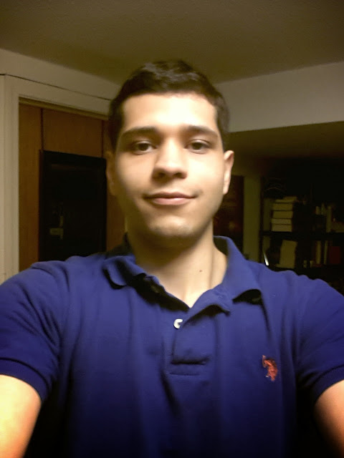
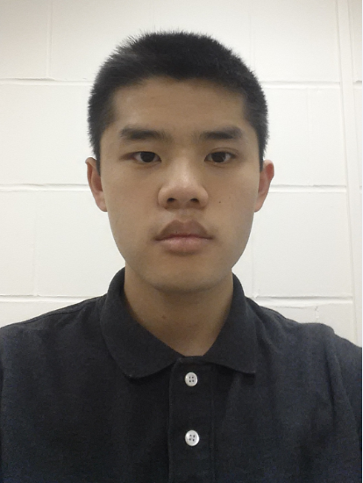
SigninGlove Team
John Gontowicz
Mathew Lau
Aaron Gilbert
Kacey Looney

Slide 3
Sign Language Translation
Need translator
Difficult to communicate
Ordering food, paying at shops, etc.
SigninGlove is a portable translator to be used in everyday situations
Where a translator is not readily available

Slide 4
Our Solution: Block Diagram
Glove
Raspberry Pi 2
Android App
Sensor Data Transmission
Sensor Inputs
Sign Lookup Table Storage
Connect to RPi GPIO
Power Supply
GUI
Sensor filtering/ waveshaping
Processed Data Transmission
Sensors
Data Collection
Send over wireless connection
Flex Sensor
Sensor Data Processing
Palm/Finger contact sensors
Incoming Data Processing
Flex, Contact sensor output processing
Sign lookup
Gyroscope
Accelerometer, Gyro Signal Analysis
Accelerometer
String building

Slide 5
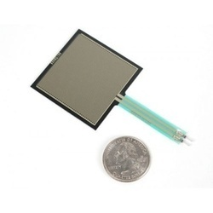
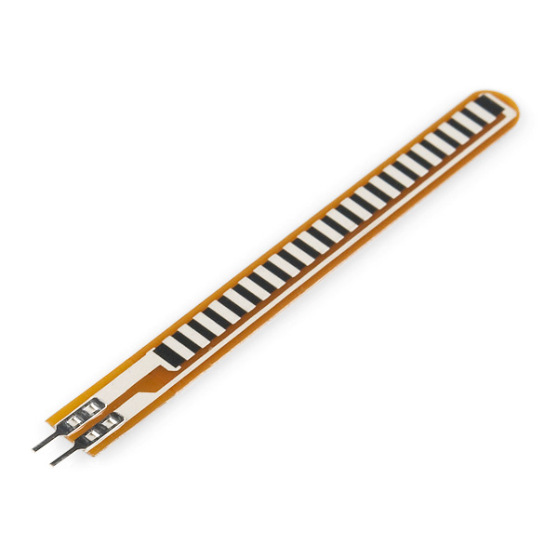
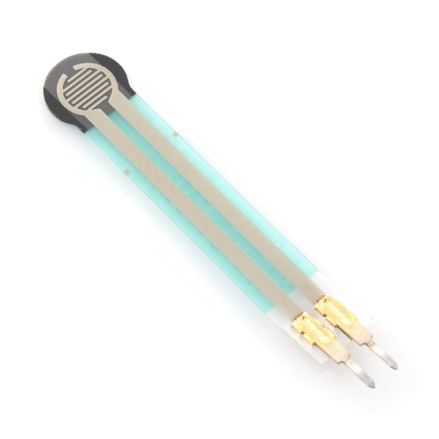
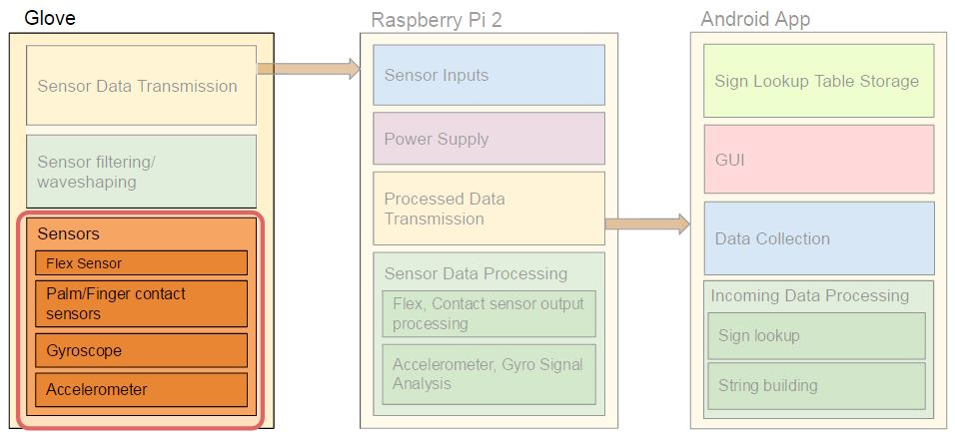
Sensors
Conductive Ink-Based Flex Sensors
Tell if a finger is bent or straight
Force Sensitive Resistor
Tell if pressure is being applied to a point

Slide 6
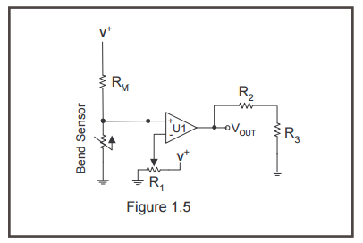
Sensor Outputs
Flex Sensor
Straight (3.2mV): <1.1V
Flexed (3V): >1.1V
Pressure Sensor (Circle)
No Pressure (2.9mV): <2.4V
Pressure (2.9V): >2.4V
Pressure Sensor (Square)
No Pressure (3.1mV): <3.2V
Pressure (3V): >3.2V

Slide 7
Variable Threshold Deflection Switch
Comparator designed for flex and pressure sensors
R1 voltage divider determines voltage input is compared to
Raspberry Pi has a pullup/pulldown network that replaces the function of filters.

Slide 8
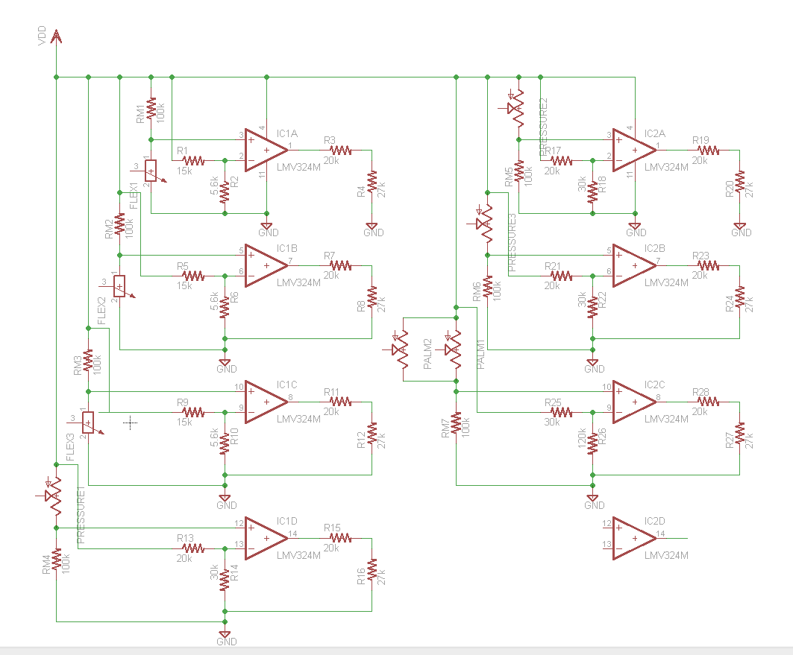
Schematic for all sensors

Slide 9
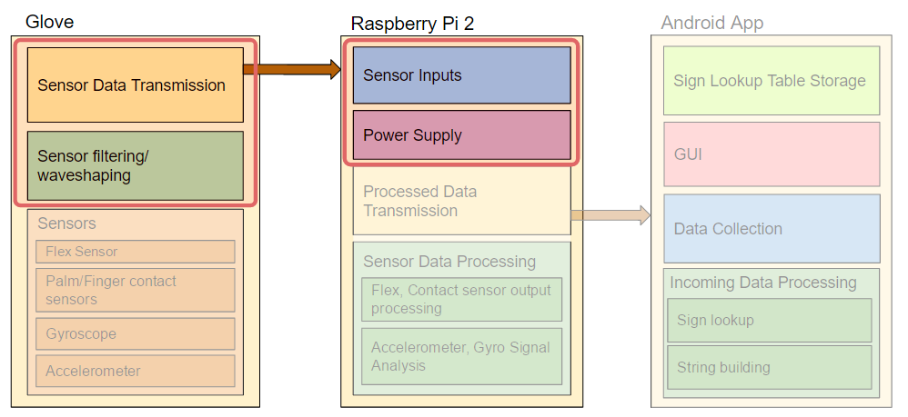
Sensor Power Consumption
Resistor | Resistance | Power (W)
R1 (+) | 15k | 7.13E-04
R1 (G) | 5.6k | 3.26E-04
R2 | 27k | 1.23E-04
R3 | 20k | 9.94E-05
RM | 100k | 1.35E-04
Sensor | 25k-150k | 4.49E-05

Slide 10
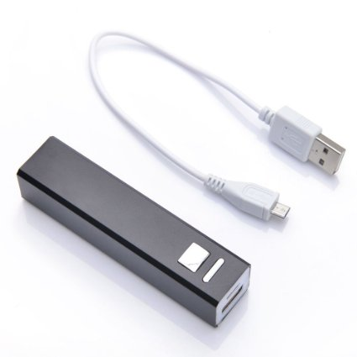
Battery Selection
5V, 2600 mAh=13Wh
Powers Raspberry Pi and Sensors
Half of the power calculated in PDR
Majority of power consumed by Raspberry Pi
Slightly more than 5W, battery would last 2.5 hours

Slide 11
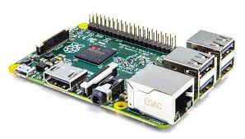
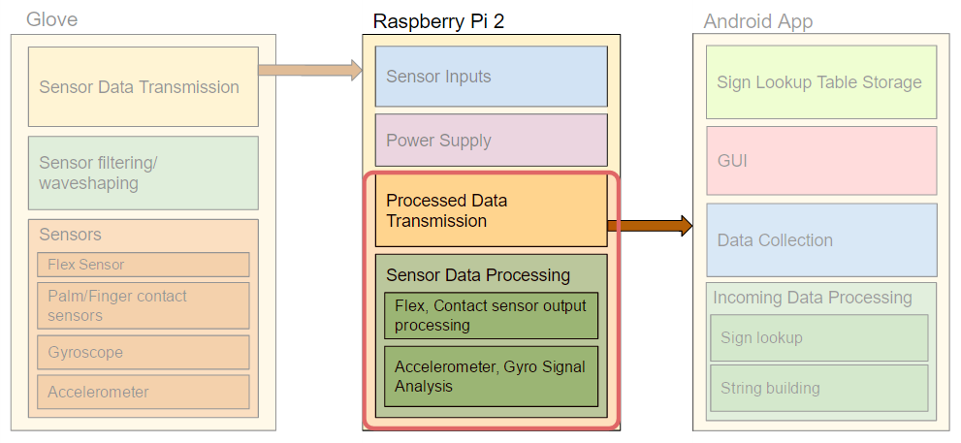
Raspberry Pi -- General Overview
Using Raspberry Pi 2 Model B
1GB RAM
900MHz quad-core ARM CPU
Equipped with wifi networking capabilities
OS: “Raspbian”
Debian Linux designed for RPi
Python Script written for glove

Slide 12
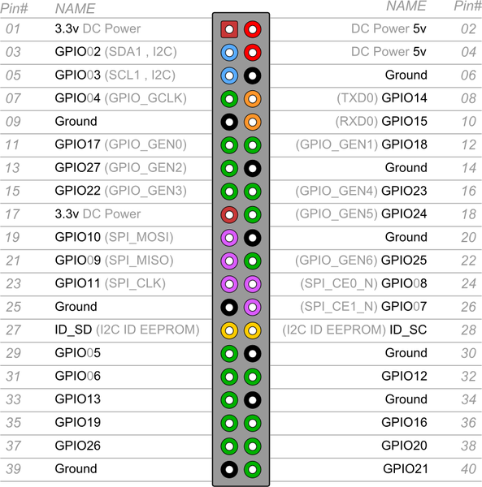
Raspberry Pi - Inputs
Sensors connected to GPIO
Digital inputs
~3.3V → 1
~0V → 0
Read using RPi.GPIO.input(pin#)
Uses internal pulldown/ups for pin connections

Slide 13
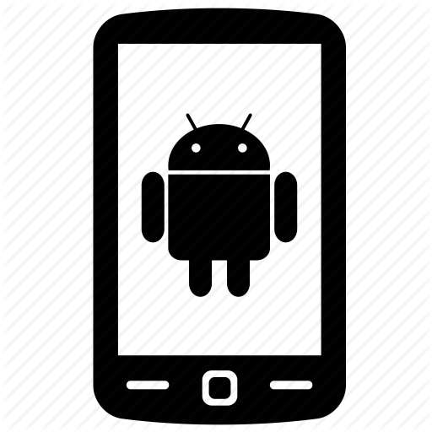
Raspberry Pi - Networking
Using a 2.4Ghz Wireless N WiFi dongle
Configured RPi to act as an Access Point with hosting its own WLAN
Assigns any phone associated to it an IP address via DHCP
Currently broadcasts UDP on port 50000
Phone(s) with App listens on port and receives sign UDP packets
RPi -- 192.168.42.1
Android -- 192.168.42.6
sign_pkt
UDP broadcast
port 50000

Slide 14
Raspberry Pi - Current Functionality
Reads sensor inputs from GPIO pins
Creates 14-bit value from digital inputs
Broadcasts raw 14-bit value over Wifi via UDP
Waits for button input to begin again
Glove
Inputs
Raspberry Pi
Android app/phone
flex
contact
push button
Reads Sensors
Creates Packet/14bit binary value
Sends UDP packet to App over WiFi
sign_pkt
Waits for push button

Slide 15
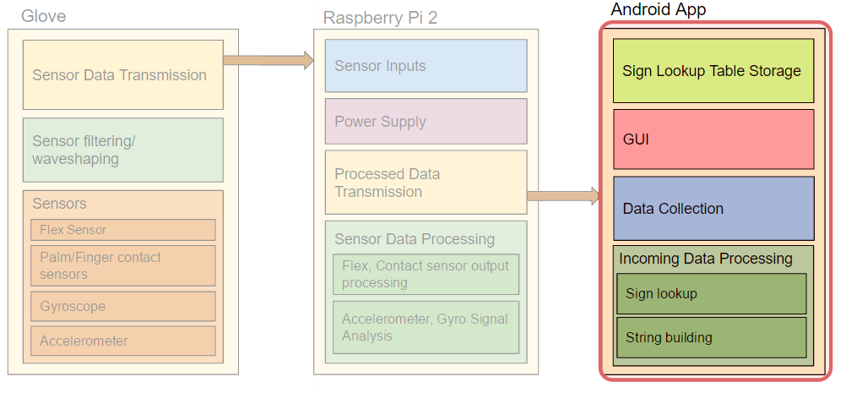
Android App - WIFI
WIFI communication established via built in Datagram API with Raspberry Pi as Access Point
Networking thread saves incoming String until button press to lookup letter
Input String from WIFI sent to lookup algorithm
Version 2 will have protocols for verifying data with checksums and sequence numbers
RPi -- 192.168.42.1
Android -- 192.168.42.6
sign_pkt
UDP broadcast
port 50000

Slide 16
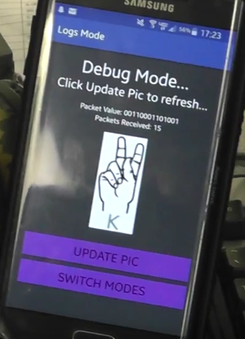
Android App - GUI
Different views for the different modes
Letters displayed with pictures
New Sign Mode
Will add new gesture into table
Real-time
Mode
Displays received letter in real time
Debug Mode
Information on packets received
Button to update packets
Swipe
Swipe

Slide 17
Android App - Tables
Current Tables
Future Table
Input→ Letter Table
Letter→ Picture Table
Input Object → String Table
Key
Value
Key
Value
Key
Value
11110111110001
a
a
a_labelled.png
Static Sensor Data
Gyro
Data
Word
00001000000001
b
b
b_labelled.png
Static Sensor Data
Gyro
Data
...
11111000000000
c
c
c_labelled.png
Static Sensor Data
Gyro
Data
...
...
...
...
...
Static Sensor Data
Gyro
Data
...
App currently uses built in HashMap structures for tables
Graph will be used for sentences

Slide 18
Android App - Lookup Algorithm
Version 2 will implement difference measurement of motion vector
It will then look at new table with objects rather than a string
Lastly, it’ll input words into a graph and return sentences
Input
Letter
Letter
Picture File Name
Picture shown on GUI
Input→ Letter Table
Letter→ Picture Table
Key
Value
Key
Value
11110111110001
a
a
a_labelled.png
00001000000001
b
b
b_labelled.png
11111000000000
c
c
c_labelled.png
...
...
...
...

Slide 19
Proposed MDR deliverables

Slide 20
Proposed MDR deliverables

Slide 21
Proposed MDR deliverables

Slide 22
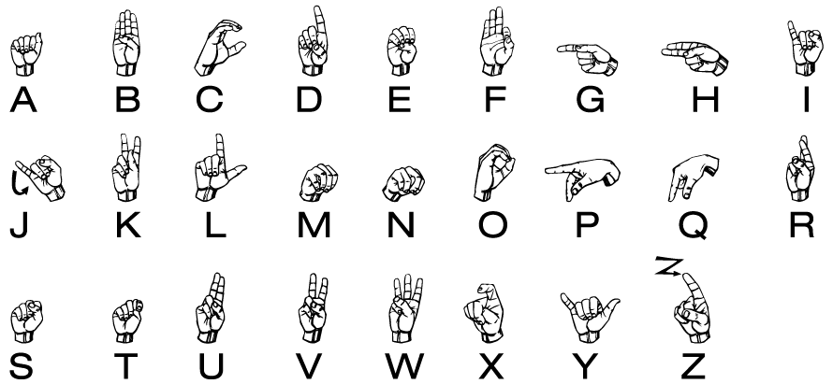
Proposed CDR deliverables
Entire Sign Language Alphabet
Need Gyroscope
Need Accelerometer

Slide 23
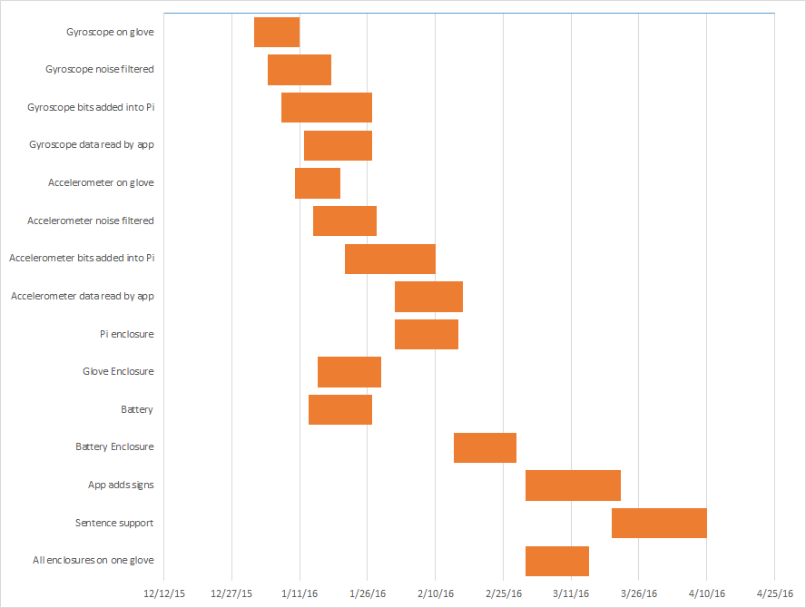
Schedule

Slide 24
Schedule - Mid January
Gyroscope implemented onto glove
Noise filtered out of gyroscope
Raspberry Pi translating gyroscope and adding values onto packets
App translating packets with gyroscope values

Slide 25
Schedule - Mid February
Accelerometer implemented onto glove
Noise filtered out of accelerometer
Battery selected and implemented
Pi translating accelerometer and adding values onto packets
App translating packets with accelerometer values

Slide 26
Schedule - Mid March
App can add signs manually
Refined signal processing for all sensors
Glove enclosure built (Sensors, Pi, and battery)

Slide 27
Schedule - Mid April
App can add sentences
Glove completely portable and finalized
Add prospective features if time permits

Slide 28
Prospective Features
Button to indicate signing a new word on App rather than a hardware button
App will have ability to discern new signs in real-time without the aid of a button
“Shout feature” - All connected phones to Raspberry Pi will receive notification of a new sign if deaf person wants to “shout”
Implement speaker on Raspberry Pi - no App

Slide 29
Demo Day Test
List of sentences commonly used in real world
Test our glove side by side with an interpreter
See how often the glove is understood compared to interpreter
Test both pre-programmed sentences and on the fly sentences

Slide 30
Thank You
Questions?

