Slide 1
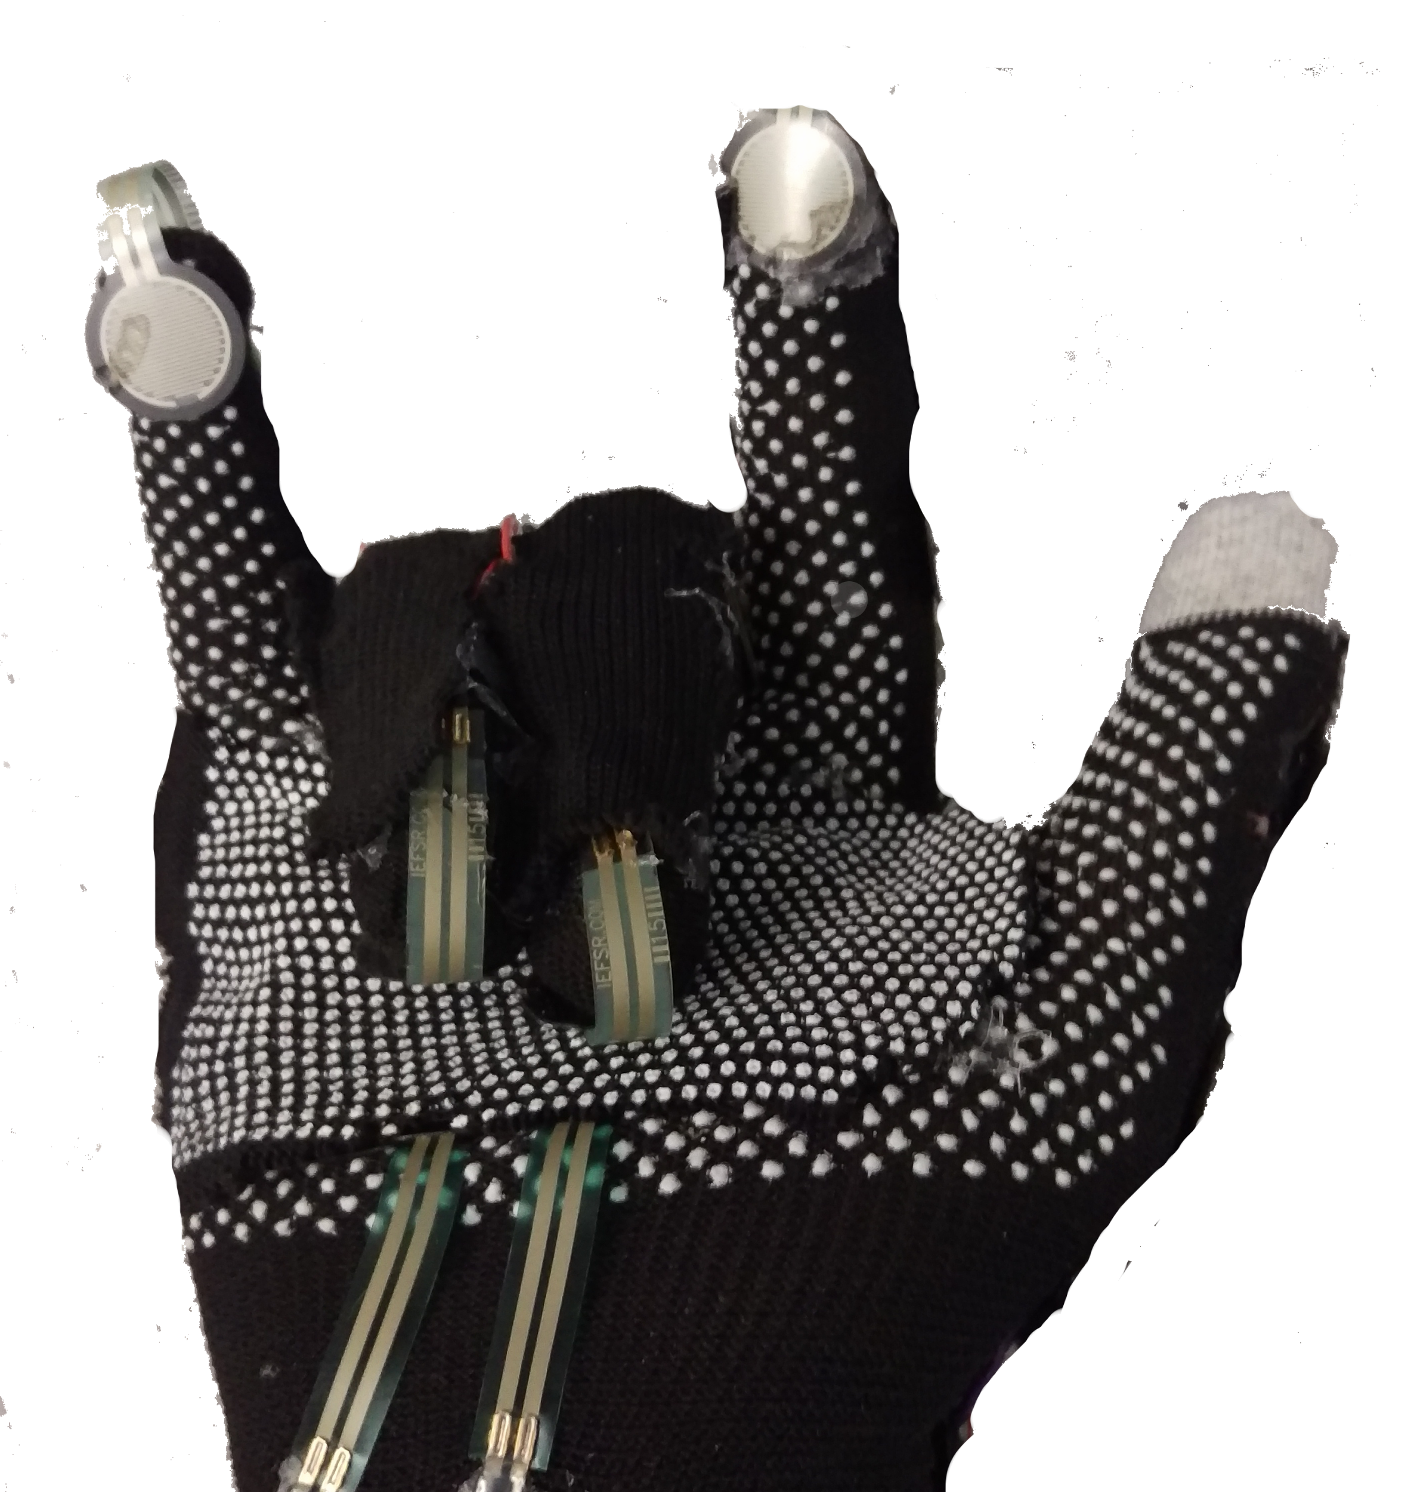
SigninGlove
Final Project Report
April 19, 2016
SDP 2016
Department of Electrical and Computer Engineering
Advisor: Professor Jackson

Slide 2
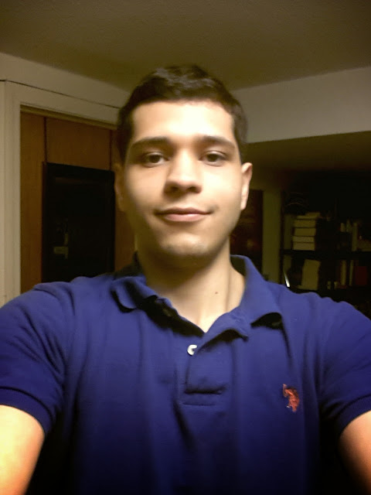
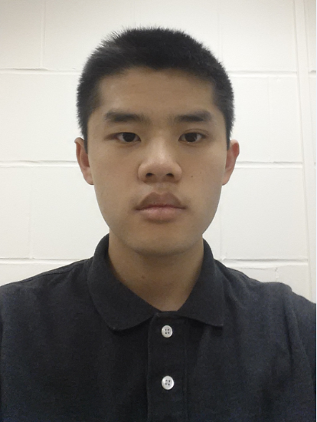
SigninGlove Team
John Gontowicz
Mathew Lau
Aaron Gilbert
Kacey Looney

Slide 3
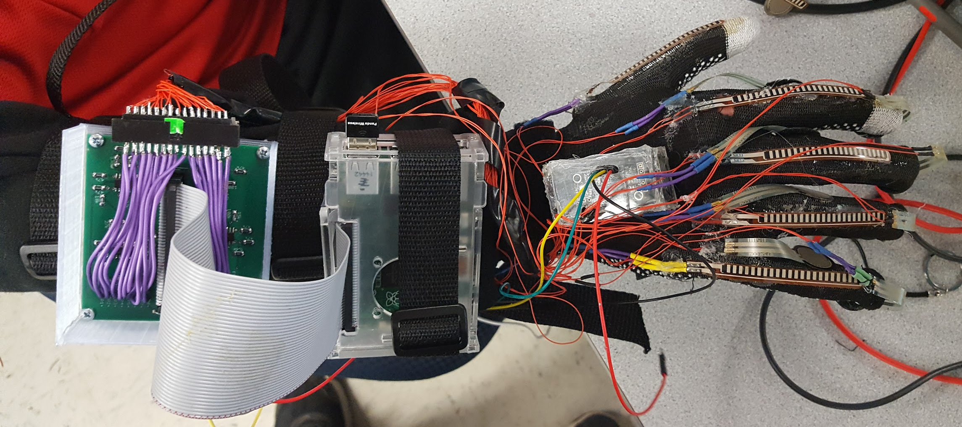
Sign Language Translation
Currently need translator
Difficult to perform everyday activities
Ordering food, paying at shops, etc.
SigninGlove is a portable translator
Especially useful when a translator is not available
Notes:
Kacey:
Currently a deaf person needs a translator to accompany them when they are trying to interact with the hearing world. However in everyday situations, such as going grocery shopping or eating at a restaurant, translators are not available. In these situations there is usually a lot of confusion and misunderstandings occurring between the deaf individual and the hearing person they are trying to communicate with. The SigninGlove would help alleviate these misunderstandings and make it easier for the deaf person to be understood. This would be a great help in situations where a translator is not available.

Slide 4
Our Solution: Block Diagram
Glove
Raspberry Pi 2
Android App
Sensor Data Transmission
Sensor Inputs
Sign Lookup Table Storage
Connect to RPi GPIO
Power Supply
GUI
Sensor filtering/ waveshaping
Processed Data Transmission
Sensors
Data Collection
Send over wireless connection
Flex Sensor
Sensor Data Processing
Palm/Finger contact sensors
Incoming Data Processing
Flex, Contact sensor output processing
Sign lookup
Gyroscope
Accelerometer, Gyro Signal Analysis
Accelerometer
String building

Slide 5
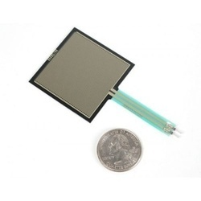
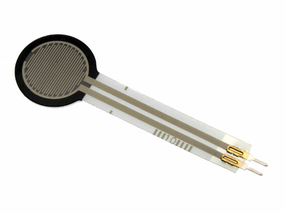
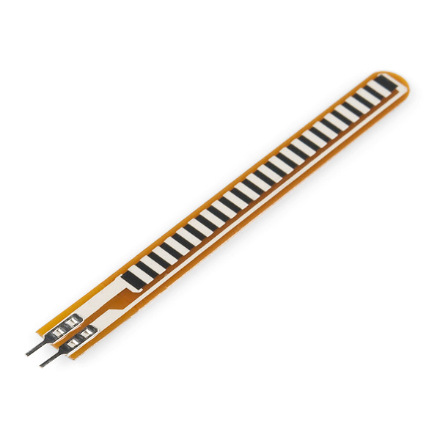
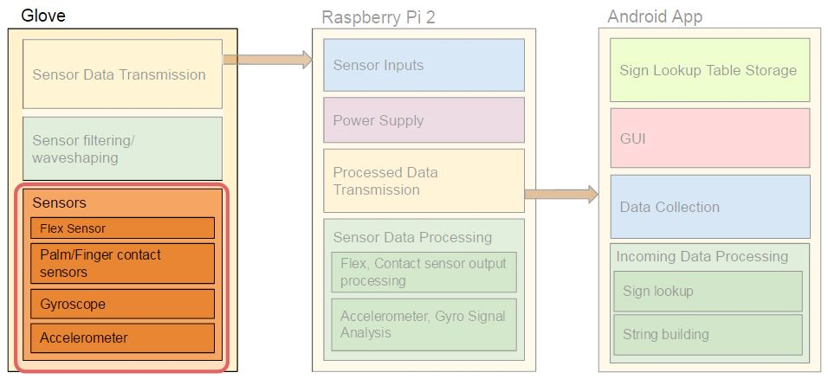
Sensors
Conductive Ink-Based Flex Sensors
0 if straight, 1 if bent
Force Sensitive Resistor
0 if no pressure, 1 if pressure is applied
Notes:
Kacey

Slide 6
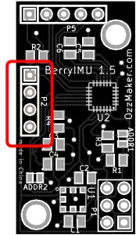
Accelerometer/Gyroscope
Berry IMU
LSM9DS0
3 acceleration channels
2/4/6/8/16 g linear acceleration
3 angular rate channels
245/500/2000 dps angular rate
Notes:
Kacey

Slide 7
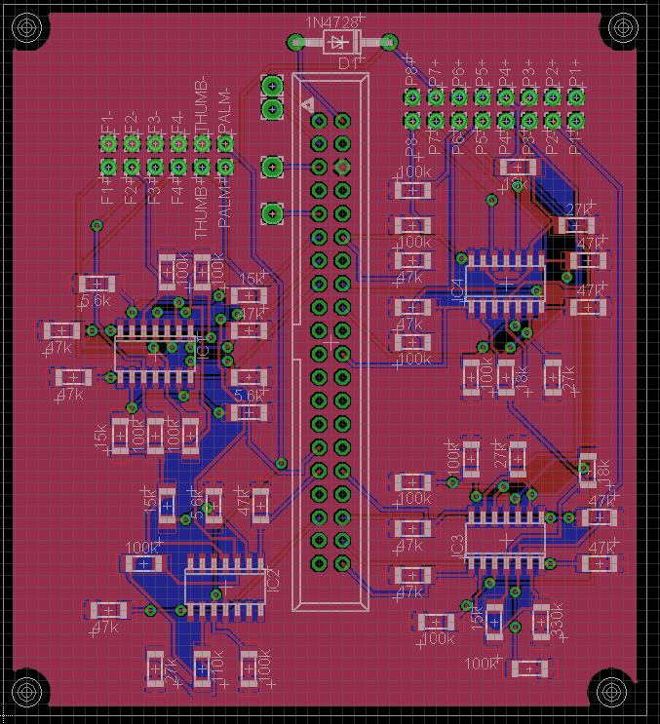
Sensor Integration
2.75x3.05in. 2-layer board
Can easily be made smaller
Majority of space for debugging

Slide 8
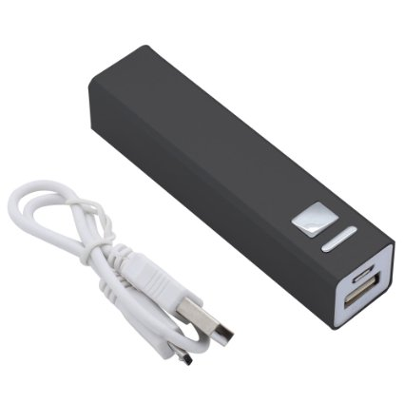
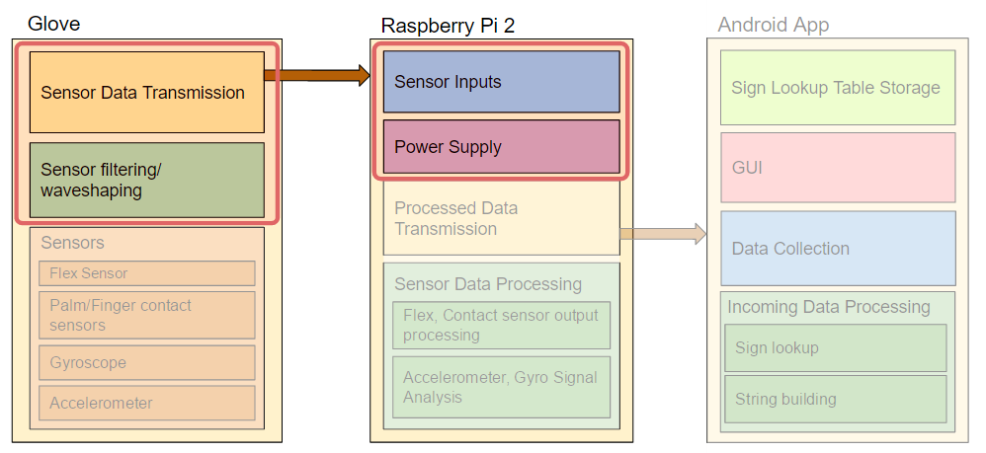
Battery
2600mah USB portable battery
Lasted over two hours of continuous use
Can be exchanged for a Larger battery if needed
Rechargable at any USB outlet or with an adapter
Notes:
Mat

Slide 9
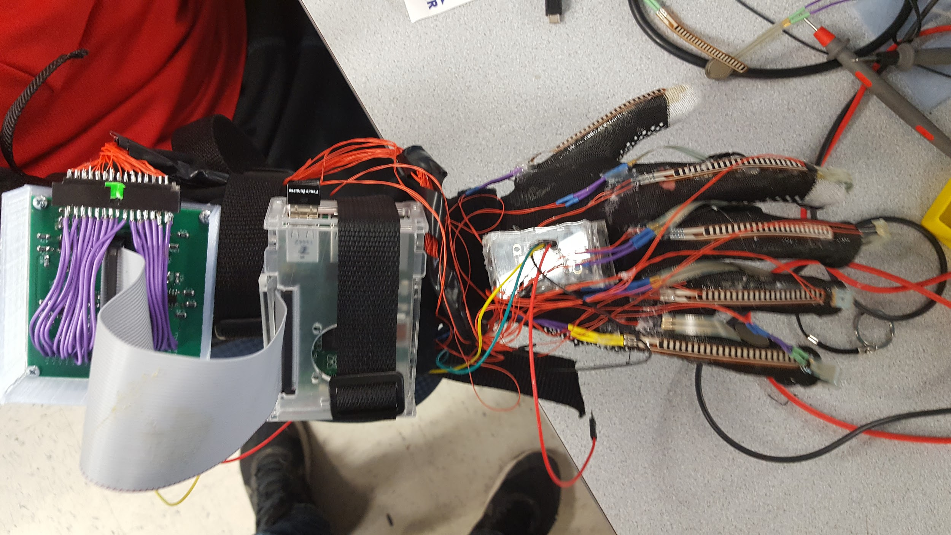
Glove Design
Raspberry Pi
PCB
BerryIMU

Slide 10
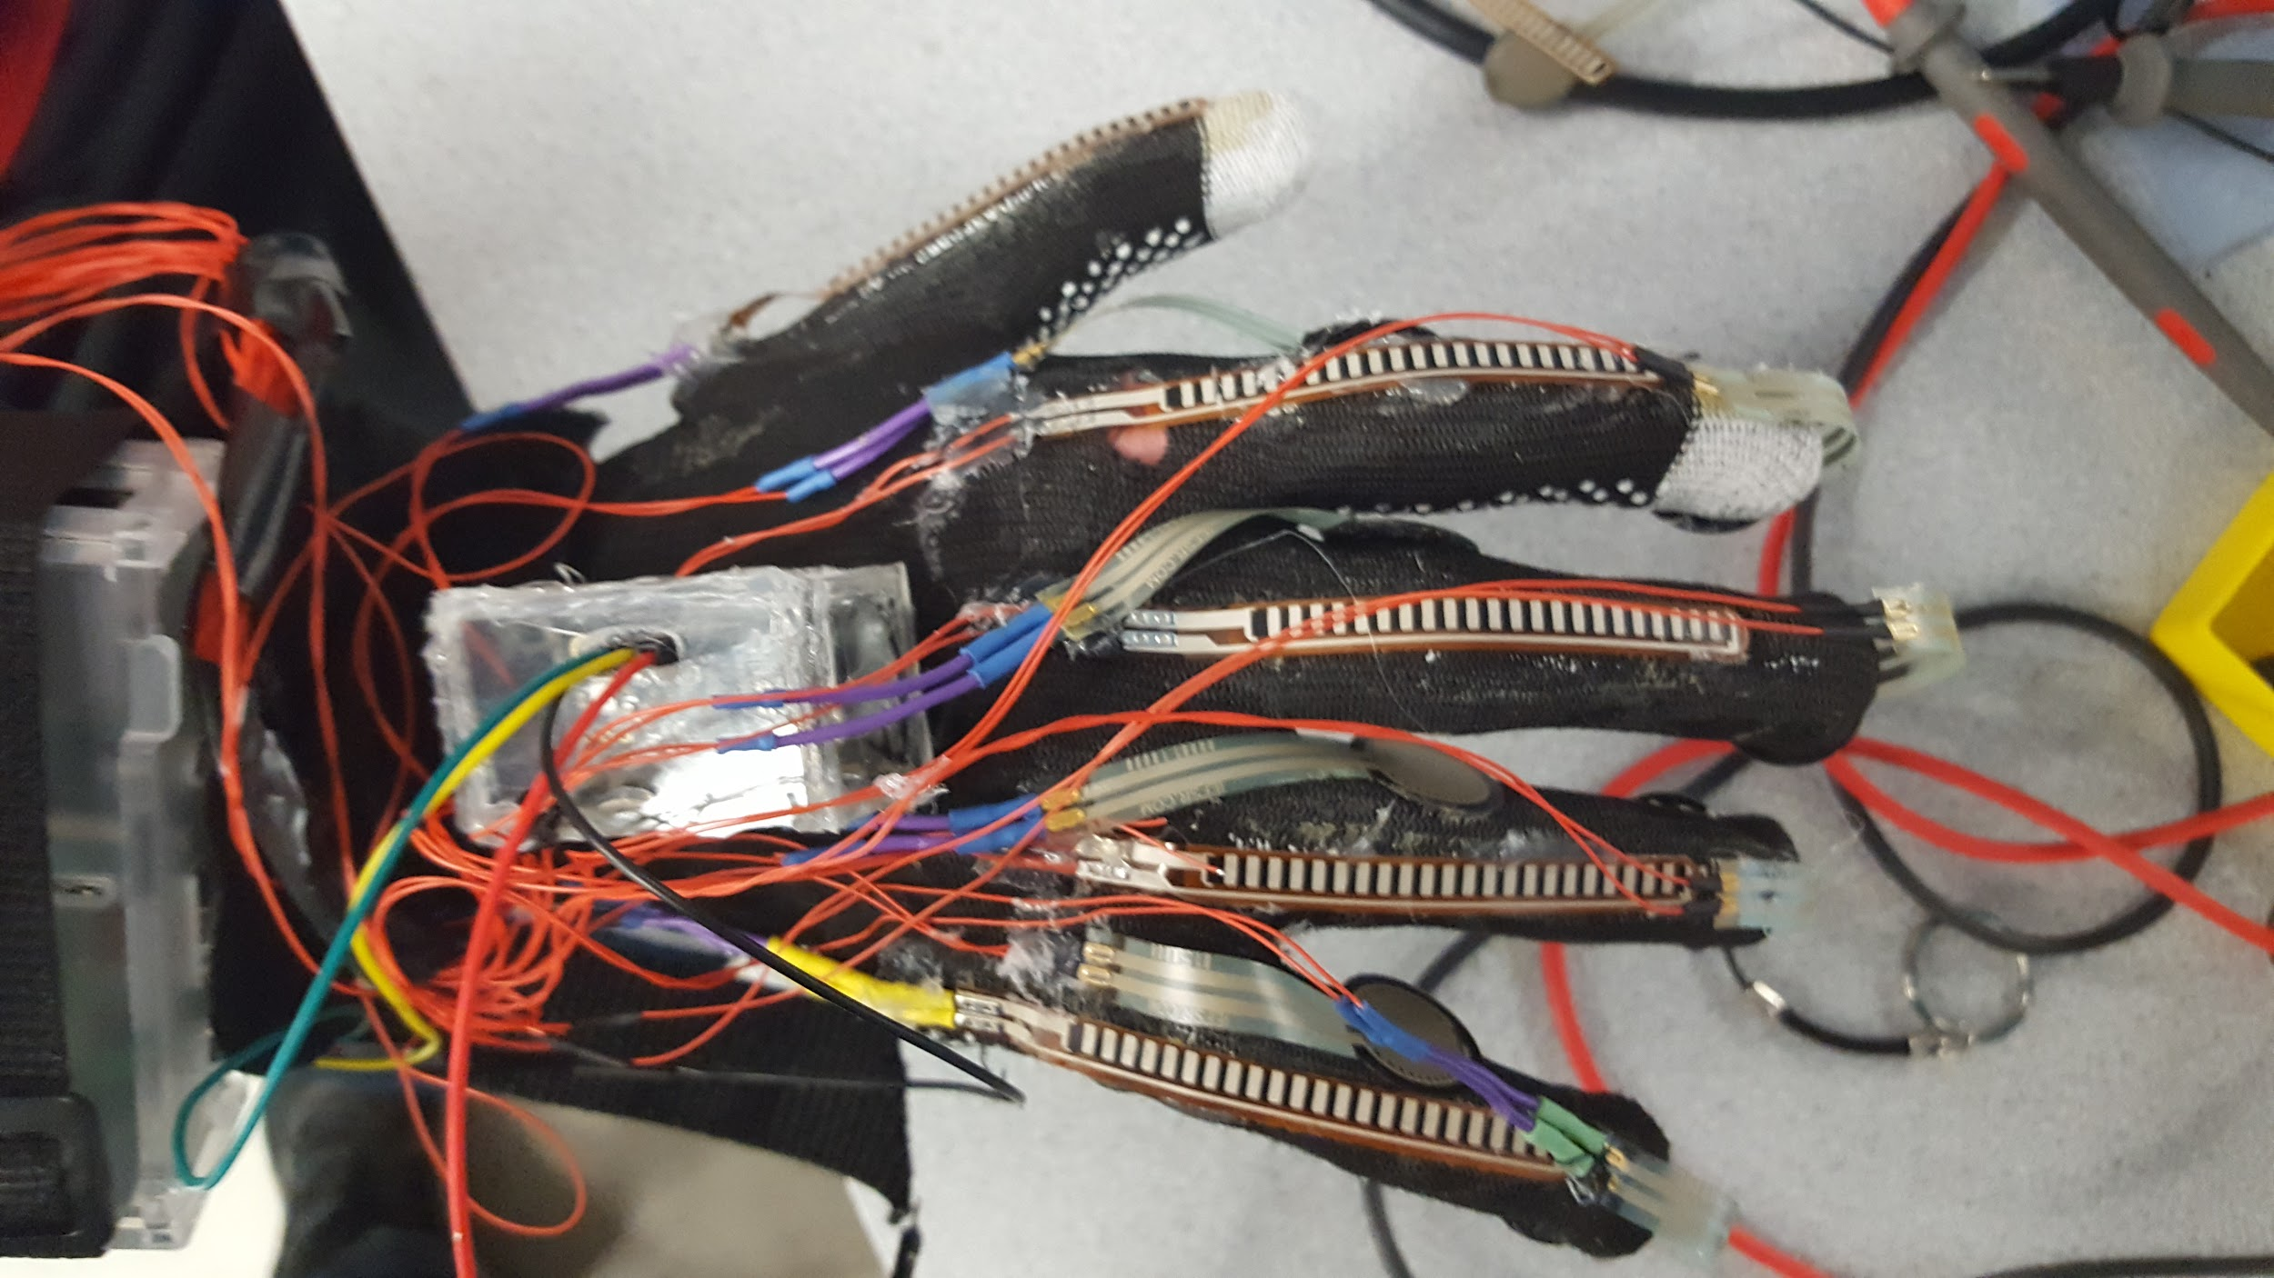
Glove Design
Five flex sensors on each finger
Four force sensitive resistors between each finger

Slide 11
Glove Design
Four force sensitive resistors on each finger tip
Two force sensitive resistors on the palm

Slide 12
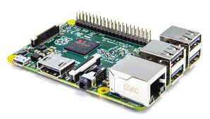
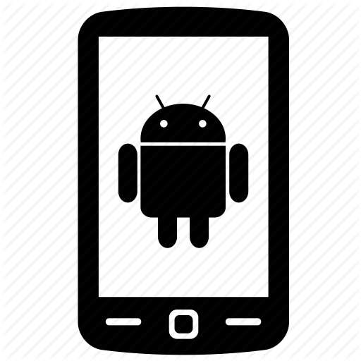
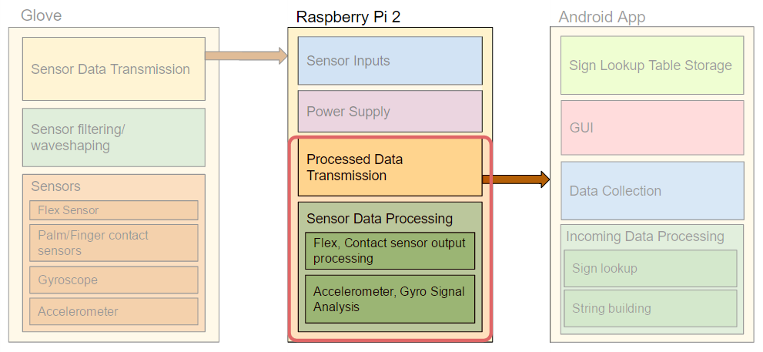
Raspberry Pi -- System Overview
Raspberry Pi acts as an interface between UI and Glove Sensors
User Holds Button, Raspberry Pi generates data associated with sign, sends to App over WiFi
Glove
Inputs
Raspberry Pi
Android app/phone
flex
Read Sensors
Process and Create Packet
Sends TCP packet to App over WiFi
Contact
Sign Packet
Gyro/Accel.
Waits for button presses
Button Press
Notes:
Aaron

Slide 13
Raspberry Pi -- TCP Integration
Data Transmission switched from UDP Broadcast to TCP
Raspberry Pi acts as the TCP server
Enables 2-way communication between RPi and App
Separate thread handles networking, main thread handles sensors and packet construction
Ensures all packets are delivered
RPi -- 192.168.42.1
Android -- 192.168.42.6
TCP Pkt
Notes:
Aaron

Slide 14
Raspberry Pi -- TCP Integration(cont.)
Incoming packets notify Pi about signs being performed
1st Packet: Begin sampling sensors
2nd Packet: Finish sampling sensors
After 2nd packet, RPi constructs sign packet and sends to App
RPi -- 192.168.42.1
Android -- 192.168.42.6
Btn Start
Btn end
Sign Pkt
Notes:
Aaron

Slide 15
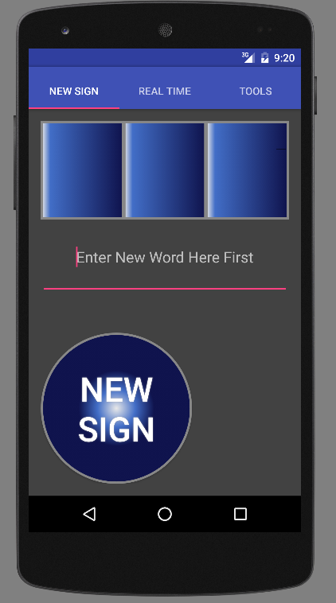
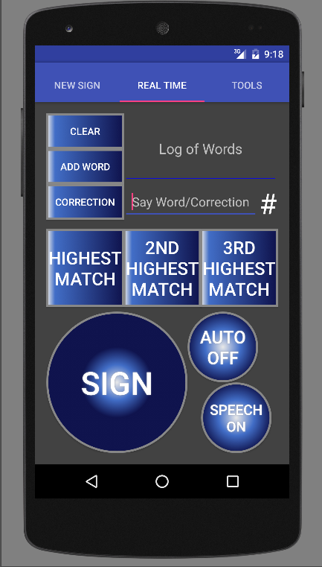
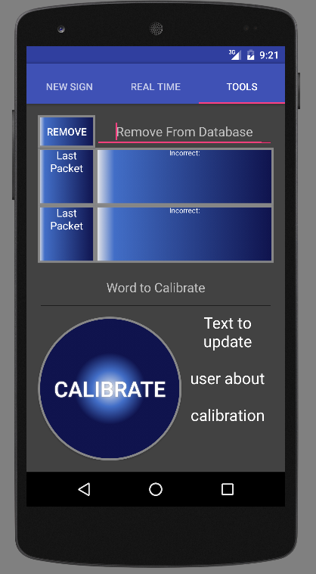
Android App - Overview
RPi -- 192.168.42.1
Android -- 192.168.42.6
TCP
22 char string sent to app via TCP after button release
App decodes into sensor, gyro, accelerometer data
Full database search and top three results shown
User can add new words with multiple samples
TextToSpeech implemented along with control
User can remove words and an Auto Mode was implemented

Slide 16
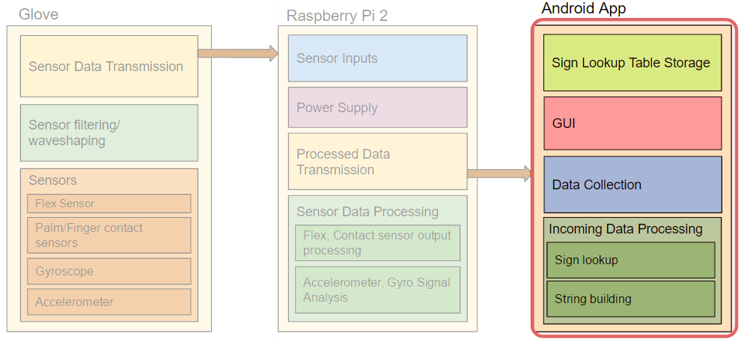
Android App - Real Time Features
Data is recorded on RasPi while “Sign” button is held
Packets transferred using TCP
App displays the top 3 choices
Words are said using TextToSpeech
Features:
Say sentences
Mode to automatically choose highest
Ability to add a correction into database or just add/say a certain word
Notes:
John

Slide 17
Android App - Deaf Friendly
Haptic feedback for button presses
Full control of what words/phrases are spoken with TextToSpeech
Visual cues:
Incrementer of received signs
Modes on buttons’ text
Text in text fields indicate actions taken

Slide 18
Android App - New Sign
User can enter new word in database
Three samples are taken and then averaged before appending
Visual Cues:
New blue text for each sample processed
Text next to button indicating updates

Slide 19
Android App - Tools
Remove word from Database
Shows the last two signs and which sensors were incorrect
Calibration:
Quick way to show what sensor values are incorrect
Future version could enable a change in the search Algorithm with calibration

Slide 20
Android App - Database/Search
Sign From Database 01111000001111 11110020
Sign Sample 01111000001111 11110020
Search Algorithm
Every Entry Compared
Top Choice Sign
Search Algorithm
1.Different bits calculated (1 if same, else 0)
2. Each bit multiplied by a predetermined weight
3. Sum for probability
4. Return top three signs from database
Highest %
Database of Sign Objects
Sign Object:
Sensor Data
Word
2nd Top Choice Match
2nd Highest %
3rd Highest Match
3rd Highest %
Top three probable signs logged after full database search
Search algorithm uses weighted average based on accuracy of sensors

Slide 21
Requirement Specifications
Specification | Unit of Measure | Target | Actual
Weight | Ounces | <16 | 15
Battery Life | Hours | >4 | 4
Connection Distance | Feet | >10 | 15
Delay | Milliseconds | <500 | ~250
Accuracy | Sign to Word | >75% | ~85%
Cost | Dollars | <500 | 204

Slide 22
Cost
Development
Production
Part | Price/Unit | Price
PCB | $38 | $38
Raspberry Pi | $30 | $30
Flex Sensors | $7 | $35
Force Sensitive Resistors - Circle | $7 | $56
Force Sensitive Resistors - Square | $8 | $16
BerryIMU | $34 | $34
Total |  | $209
Part | Price/Unit | Price
PCB | $15 | $15
Microcontroller | $8 | $8
Flex Sensors | $6 | $30
Force Sensitive Resistors - Circle | $5 | $40
Force Sensitive Resistors - Square | $6 | $12
Gyro/Accelerometer | $4 | $4
Total |  | $109
Cost difference comes from lack of circuitry (Op-amps) and non developer parts
PCB is simpler due to only a microcontroller and gyro/accelerometer chip along with battery connection

Slide 23
Reaction

Slide 24
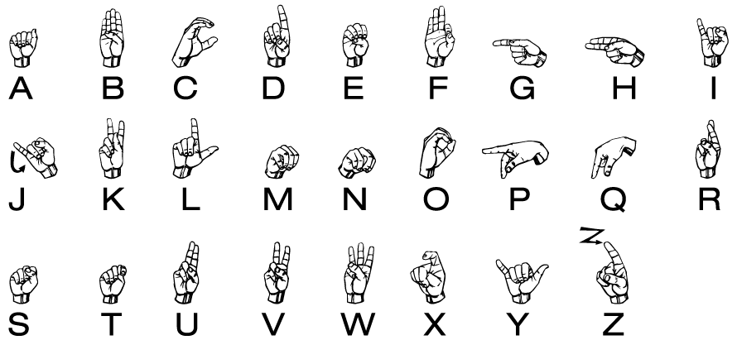
Demo - Alphabet

Slide 25
Demo - Adding Words
1st Sample
2nd Sample
3rd Sample
Text to help user through process

Slide 26
Demo - Signing Words

Slide 27
Demo - Correction

Slide 28
Thank You
Questions?

Slide 29
Sample Turing Test Sentences
Where’s the restroom?
My name is _______.
Yes
No
Can I have a _______? (Ordering)
Hello
Please
Thank you

Slide 30
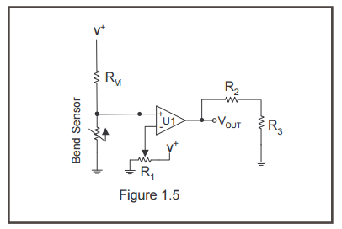
Sensor Outputs
Flex Sensor
Straight (3.2mV): <1.1V
Flexed (3V): >1.1V
Pressure Sensor (Circle)
No Pressure (2.9mV): <2.4V
Pressure (2.9V): >2.4V
Pressure Sensor (Square)
No Pressure (3.1mV): <3.2V
Pressure (3V): >3.2V

Slide 31
Sensor Power Consumption
Resistor | Resistance | Power (W)
R1 (+) | 15k | 7.13E-04
R1 (G) | 5.6k | 3.26E-04
R2 | 27k | 1.23E-04
R3 | 20k | 9.94E-05
RM | 100k | 1.35E-04
Sensor | 25k-150k | 4.49E-05

Slide 32
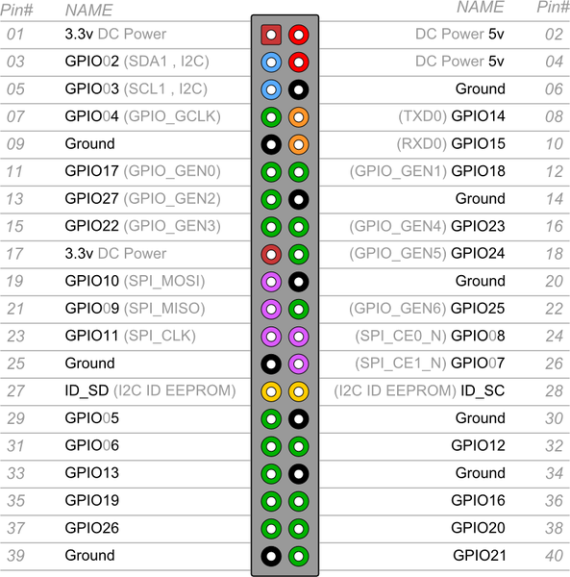
Raspberry Pi - Inputs
Flex Sensors
Contact Sensors
Berry IMU
Sensor Power

Slide 33
Raspberry Pi -- Sensors
Retrieves Binary Flex, Pressure sensor values at beginning
Continuously samples Gyro, Accel while App button being held
After button released, finds sensor extrema
Gyro: possible 0,1 for min and max
Accel: possible 0,1, or 2 for min and max
Example: Gyro Y angle
Example: Accel Y force
max → 2
max angle→ 1
2
1
1
0
min angle→ 0
0
min → 0
Notes:
Aaron

