Slide 1
Cumulative Design Review
S.H.A.R.C.
Simulated Hand and Arm Remote Control
Team 6
Connor Pope, Daniel Sheridan, Derek Caudill, Harrison Shecter
March 4th, 2016

Slide 2
Project Description
Our SDP team is designing and building a system that controls a robotic arm wirelessly using wearable sensors.
The robot arm is an open-source 3D printed design in order to focus our efforts on designing and building the controller
C.P.

Slide 3
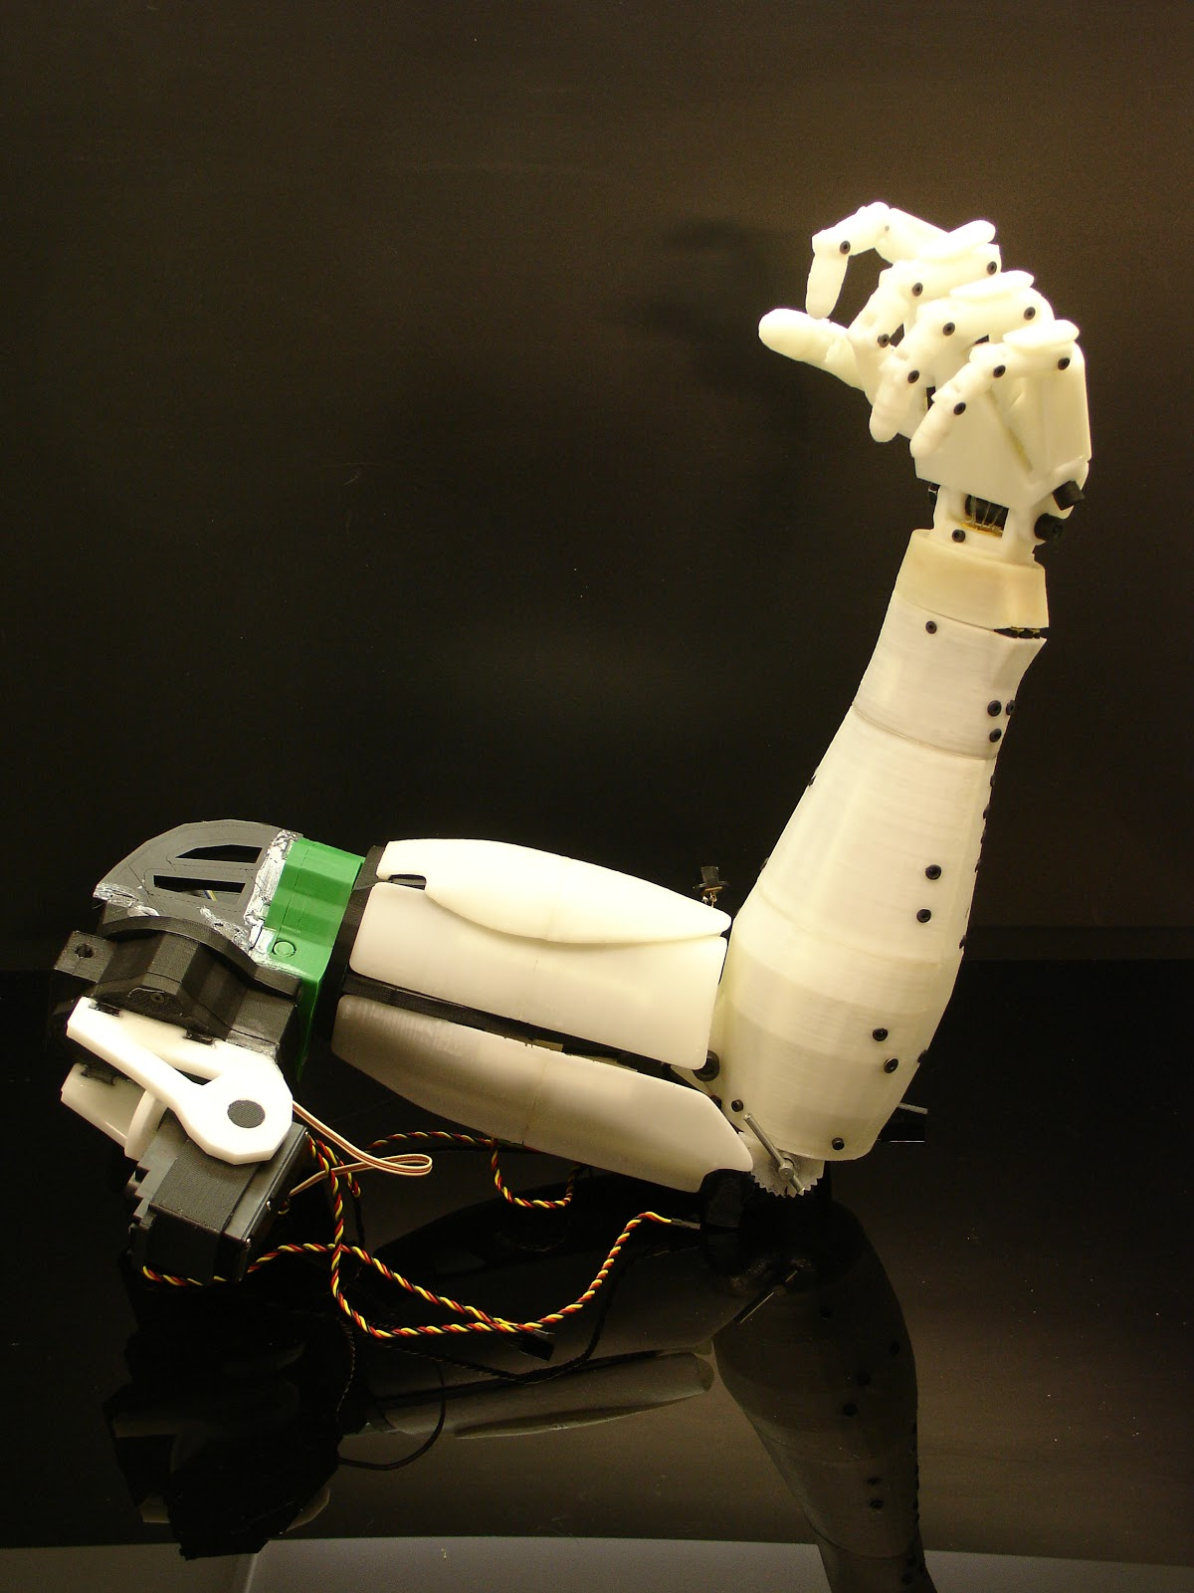
The Arm
InMoov Robot Project
Open source
Directions on how to assemble the arm are provided
All parts and 3D models are given
The entire arm has been assembled, and tested by Connor (No Load Testing)
C.P.

Slide 4
Overall Requirements - Specifications
5 Degree of Freedom Arm movement
Individual finger control
Wireless communication between sensor glove and robot arm
Maximum latency of 500ms
Sensor glove/sleeve can be used by multiple users
Compatibility with Portable Power Supply
C.P.

Slide 5
CDR Deliverables (from MDR)
Derek | ∙ Fully Operational Accel/Gyro Sensor Sleeve Network ∙ I2C Communication to RPI ∙ USB 5V → 3.3V Regulator → Accel/Gyro Units
Dan | ∙ Motion Capture Mode + Replay ∙ Reading Data from Accel/Gyro Sensors ∙ Mapping Accel/Gyro Data to % Duty Cycle Transform Chart
Connor | ∙ Fully Assembled Bicep/Shoulder (Entire Thing) ∙ w/Elbow Actuation x1 D.o.F. ∙ w/Shoulder Actuation x3 D.o.F. ∙ Creation of % Duty Cycle Transformation Chart
Harrison | ∙ Assembled & Tested Regulator PCB’s ∙ Input Voltages; 7V-24V → Output Voltage: 6.5V ∙ Proper Thermal Ventilation (Up to 45A)
All | ∙ Determination of need of feedback sensors on robot arm or not, and how we would implement that.

Slide 6
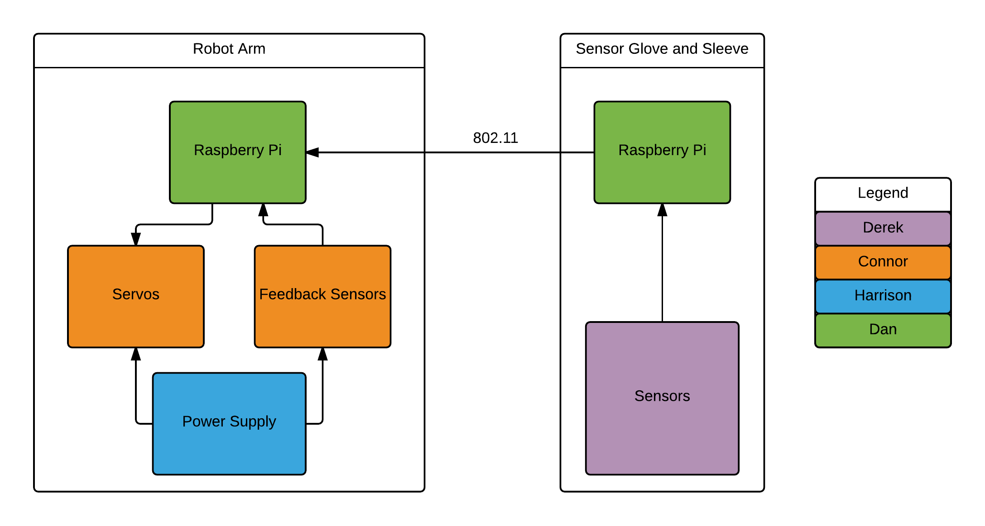
High Level Block Diagram
+
Thermal Sensing
D.S.

Slide 7
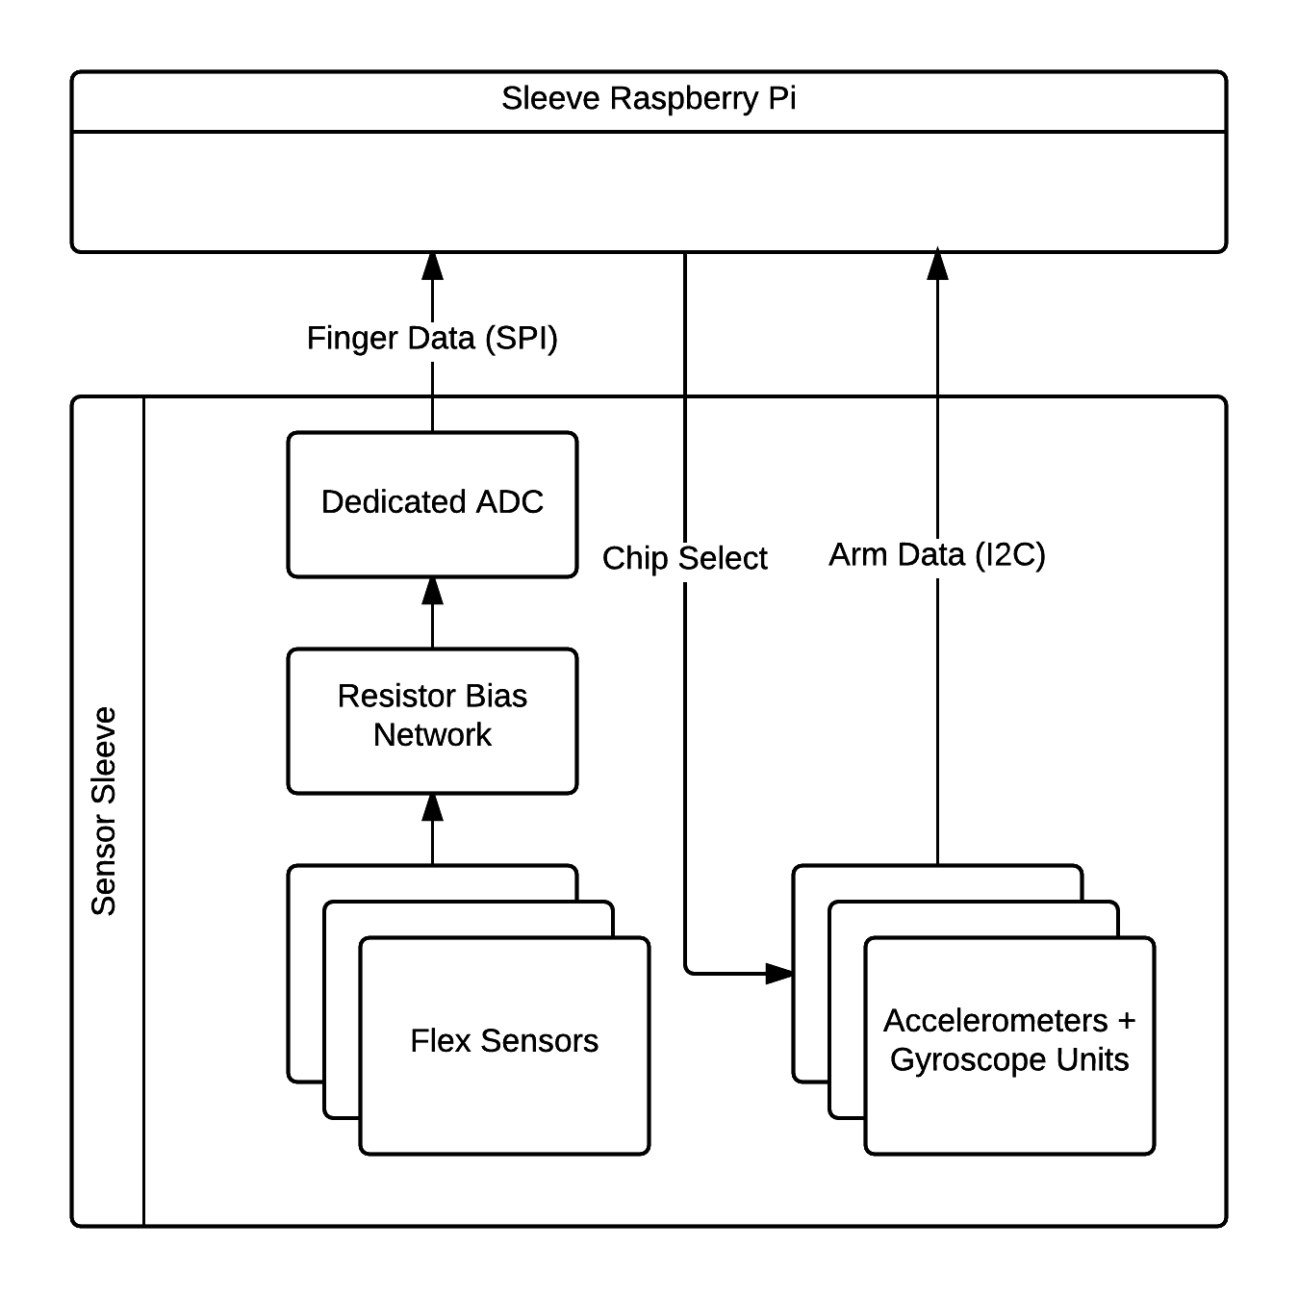
Sleeve & Glove: Sensors - Derek
3.3VDC Linear Regulator
Finger/Elbow flex sensors
DC Bias network
8 Channel 10 Bit ADC
Accelerometer/Gyroscope Inertial Measurement Units (IMU’s)
D.C.

Slide 8
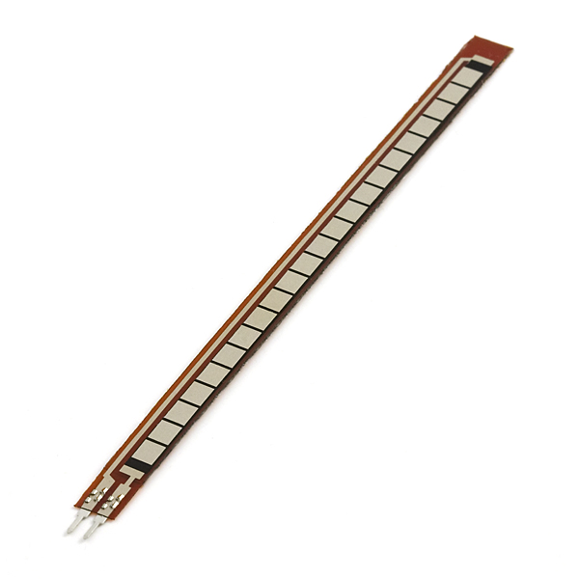
Glove: Sensors - Derek
Flex sensors
Variable Resistance Based off Bend Factor
8kΩ - 23kΩ Range in our System
Voltage Divider with Flex Sensor Created to Measure Finger Movement
Bias Resistor Values Chosen to Maximize Voltage Swing and Resolution
D.C.

Slide 9
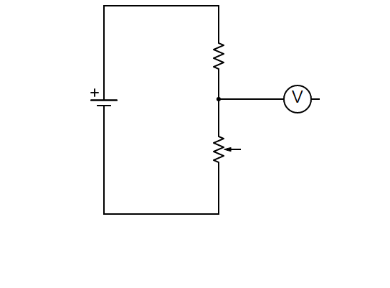
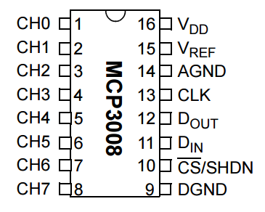
Glove: Sensors - Derek
R_{BIAS}
5V DC - USB ADC Input
R_{FLEX}
Voltage Dividers
Resolution Increased since MDR
8 Channel 10 bit ADC MCP3008
Sensor | Thumb | Pointer | Middle | Ring | Pinky | Elbow
R_{BIAS} | 180kΩ | 150kΩ | 200kΩ | 180kΩ | 200kΩ | 180kΩ
V_{RANGE} | 222-500mV | 325-500mV | 241-500mV | 251-500mV | 230-500mV | 313-500mV
ADC_{RANGE} (V_{REF} = 0.5V) | 455:1023 | 664:1023 | 494:1023 | 514:1023 | 471:1023 | 639:1023
D.C.

Slide 10
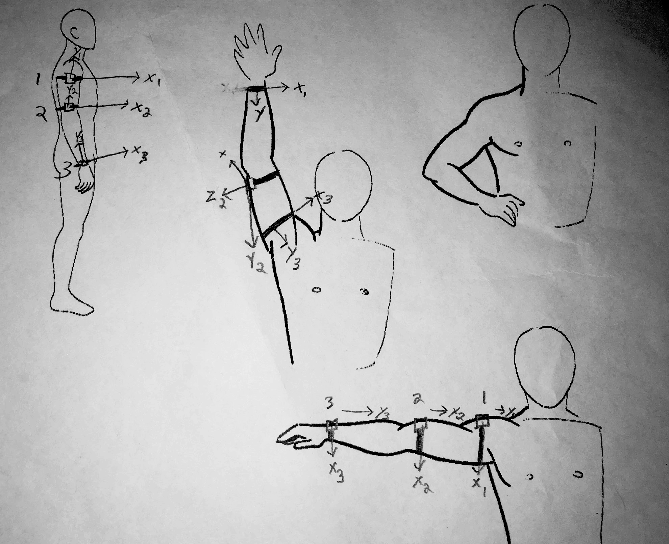
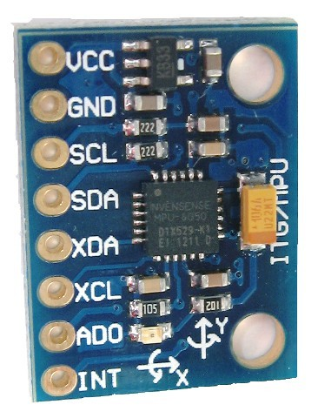
Sleeve: Sensors - Derek
MPU6050 Accelerometer/Gyroscope Units
16 bit resolution per axis
3.3V DC operating voltage (~3.9mA during operation)
I2C interface
Preprocessing/filtering
Sleeve consists of three units to model arm movements/rotations
D.C.

Slide 11
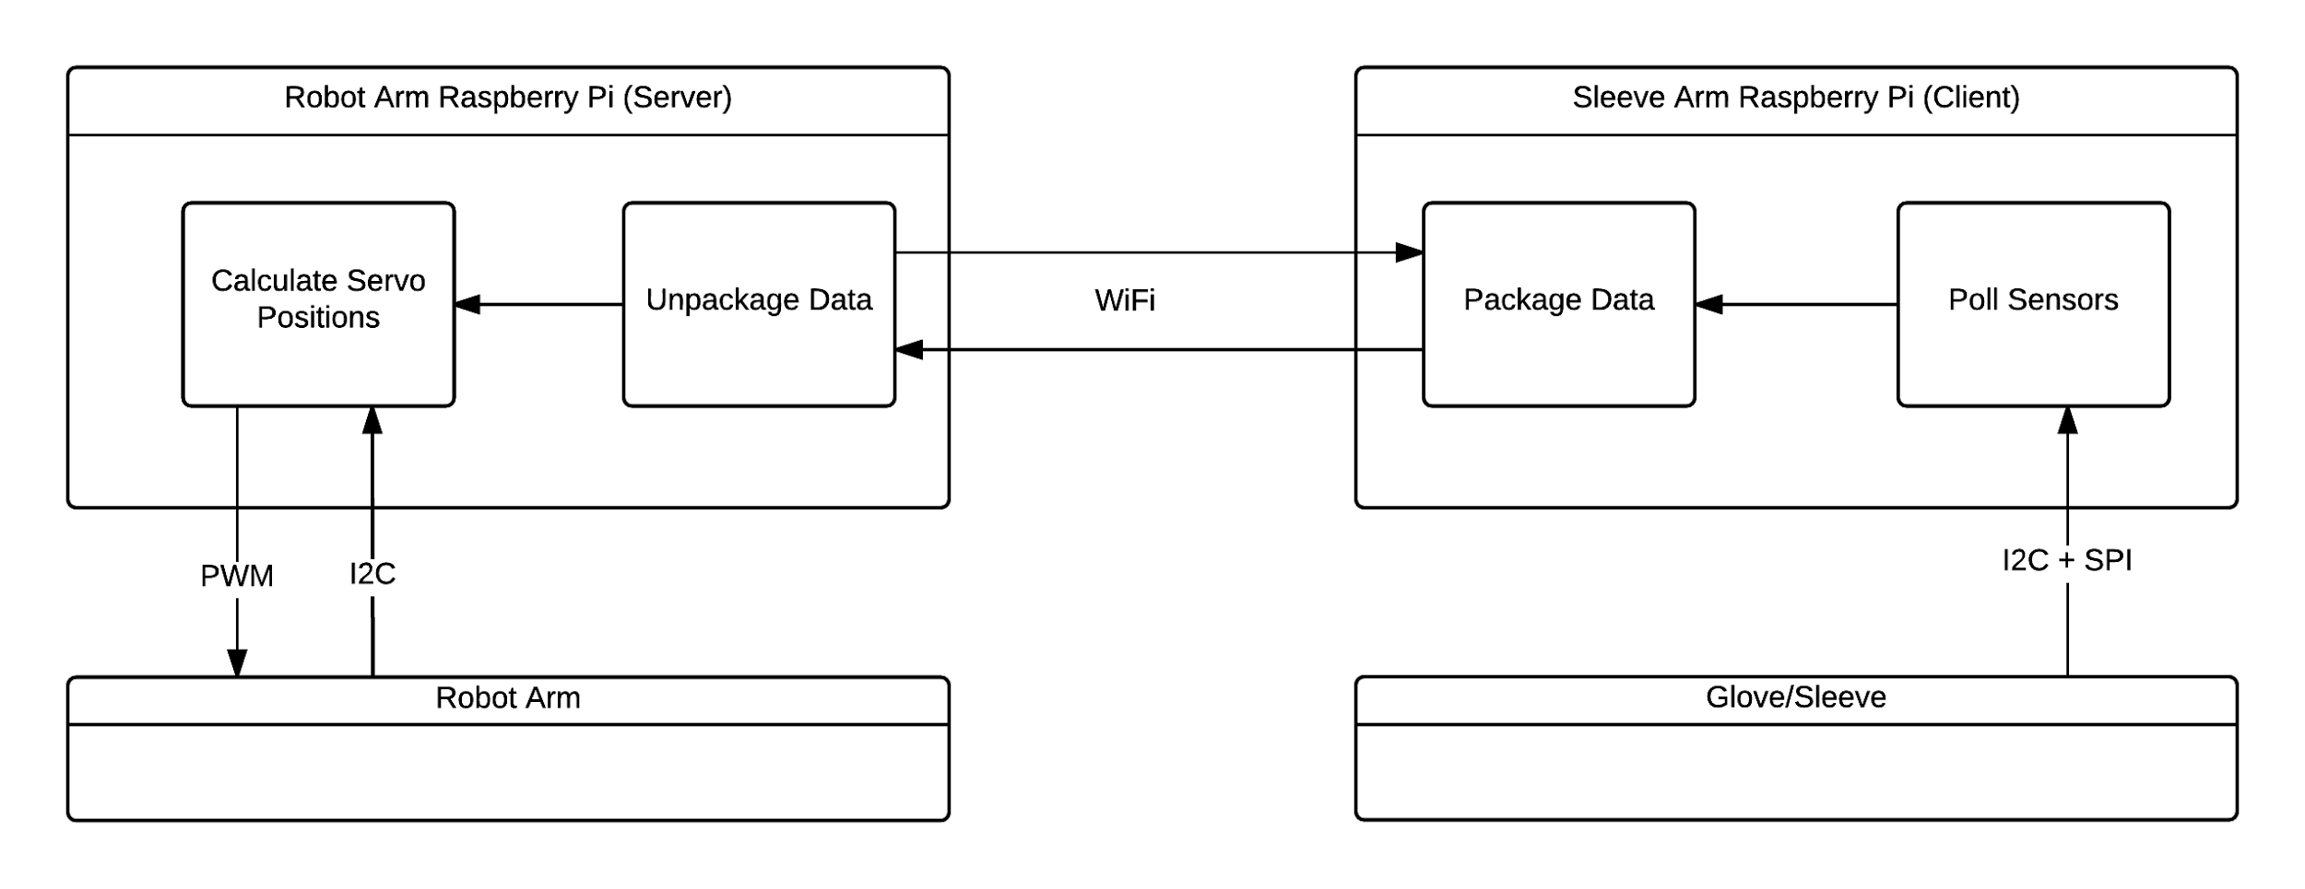
Robot Arm RPi, Robot RPi - Dan
Initial Arm Modeling Completed
Need Some Tweaks for Certain Degrees of Freedom Such as Bicep Rotation
Successfully Reading Data From Sleeve Sensors
Record Mode Completed
D.S.

Slide 12
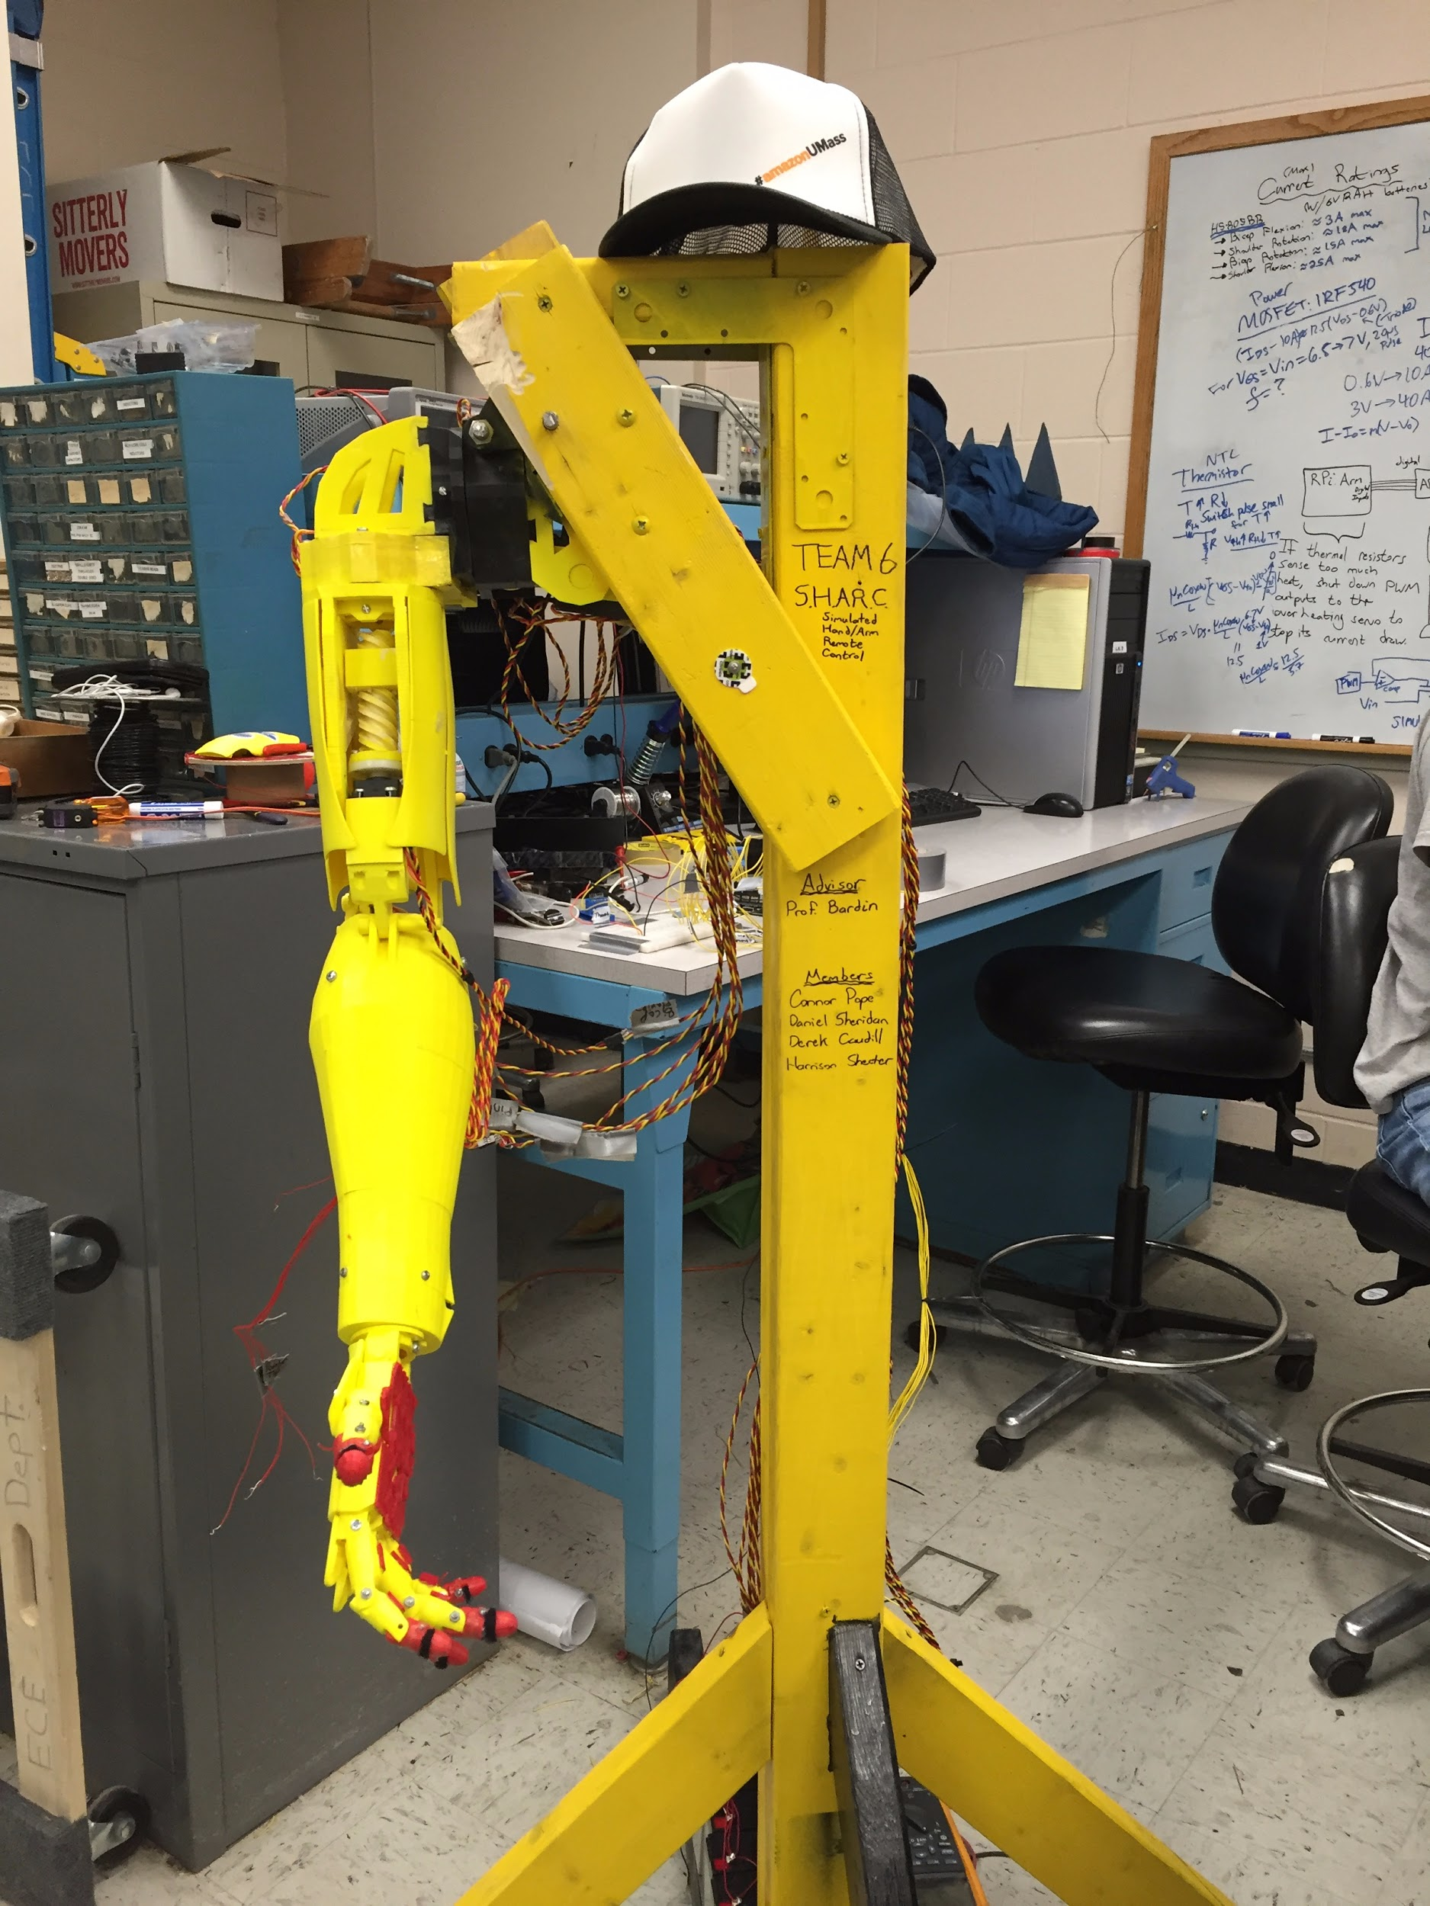
Connor - Fully Assembled Robot Arm
Robot Arm Fully Assembled!
Wooden Arm Support Structure Holds:
Power Supply Batteries
Raspberry Pi
Power/Signal Cables
Pressure Sensing Finger Tips
Finished Duty Cycle Chart Early!
Variable Pressure-Dependent Resistors
Tips are Hinges with Two Copper Pads
Feedback Processed in Raspberry Pi
C.P.

Slide 13
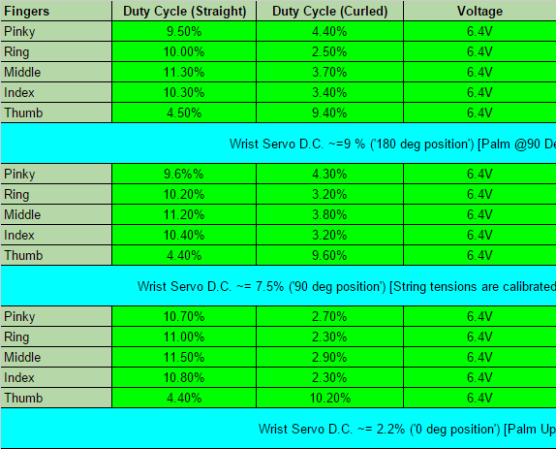
Connor - Duty Cycle Transformation Chart
Finger Transformation Chart
Duty Cycle Logging was Very Important
Moving Beyond Acceptable Range Could Lead to Overheating
Wrist, Bicep & Shoulder Chart
Finger Tip Pressure Chart
C.P.

Slide 14
Power Supply - Harrison
We Encountered Irreparable Issues in the Power Supply Regulator Circuit
Voltage Feedback Network Fell Too Low
Fault Protection Turned On
Could Not Clear Fault Latch
Found Affordable Rechargeable Lead Acid Batteries that made more sense financially
SigmasTek SP6-12HR
6V, 12AH
$7 per Battery
7mOhm Internal Resistance
H.S.

Slide 15
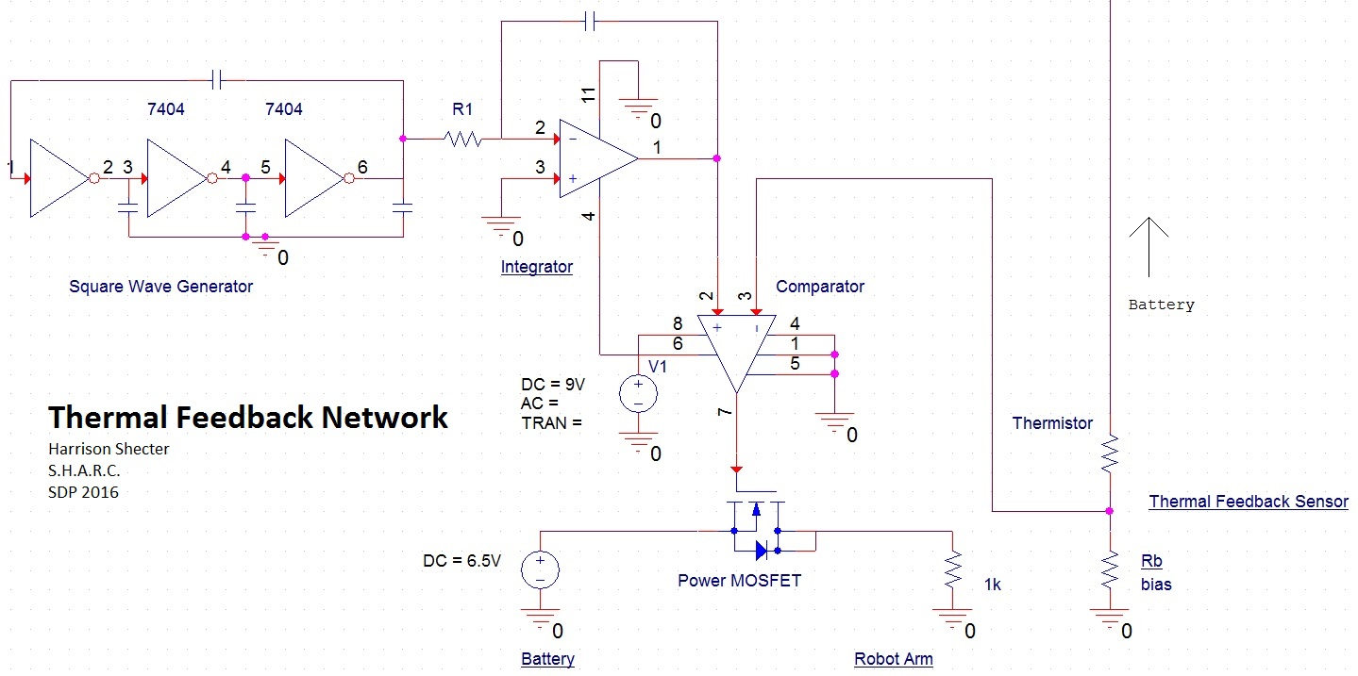
Thermal Feedback Network - Harrison
Power MOSFET:
-IRF540 NMOS
-100V, 28A Rated
-Max Current 10A
At VGS=VDS=6.5V (Battery Voltage)
H.S.

Slide 16
Future Deliverables
Derek | Implementing Flexible, Contained Wiring Harness for Sensors & Glove 3D Printing Casing for Raspberry Pi/ADC Bias Network Updating Sensor Mounting Scheme user independance full range of motion secure connections/circuitry shielding
Dan | Improving Modeling on Arm Movement Calibrating to Match User Better with Arm Interfacing to Controlling Program More Cleanly
Connor | Incorporating Finger Tip Pressure Sensing Feedback RBias Network w/Voltage Division → ADC → Arm RPi → Glove RPi → L.E.D. PWM Controller → Glove L.E.D.s Finger Tip “Stop” Mode: Fingers Stop If Pressure Sensed Maintaining Robot Arm
Harrison | Testing Thermistors and Power MOSFETs Before Building Configuring kHz Range PWM Building Thermal Feedback Network

Slide 17
Challenges Going Forward
Derek:
Ensuring IMU mounts have consistent, rigid orientation
Testing sensor glove/sleeve with multiple users
Assisting with IMU data to servo mapping
Dan:
Coming up with better model for arm movements
Handling feedback data
Connor:
Maintenance of Robot Arm, keep in top shape
Creating a clean pressure sense signal from the fingertips
Harrison:
Testing & Configuring PWM, Thermistors, Power MOSFETs
Integrating Feedback Network Into Completed Arm

Slide 18
Follow us to SDP Lab for DEMO

