Slide 1

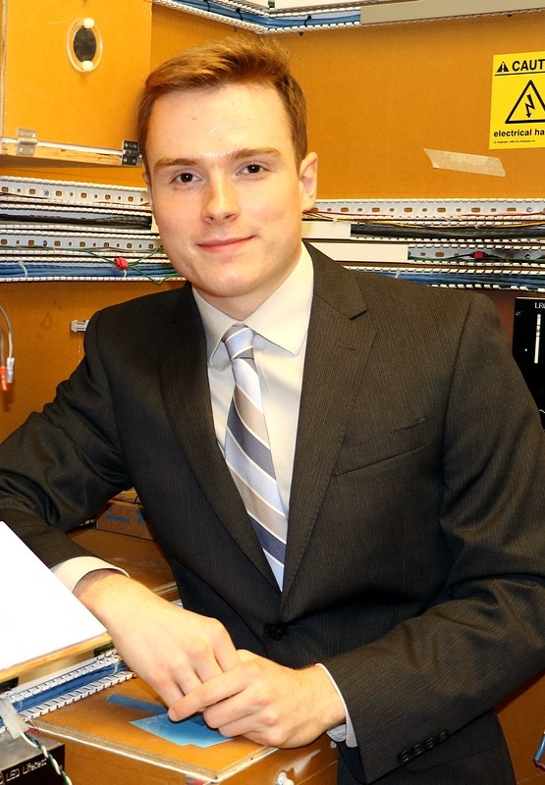


Team Mellon A.D.S.
Preliminary Design Review
Tom Nilsson, ME
Dan Sheahan, ME
October 15th, 2015
Mitchell Dawson, EE
Jessica Ferreira, Nursing
Justin Waller, EE
Notes:
‹#›
‹#›
‹#›

Slide 2
Project Description
Centered around Applewood
  Minimum care assisted living facility
Working through nursing department
Grant funded
Challenges faced at Applewood
  Damage to doors from walkers
  Inconvenience for residence
  Observance of fire codes
  Portable

Slide 3
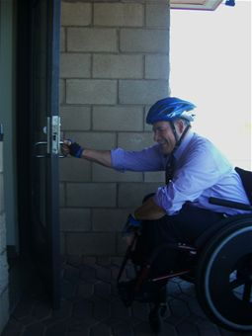
Significance and Societal Impacts
Primary Goal: To assist Elderly Communities in the task of opening and closing of doors while adhering to fire codes and considering customer safety above all.
Secondary Goal: To enhance security for all homes through the use of sensors within the door solution to be integrated into existing home security systems with the option of being an independent security system.
http://www.edwards.af.mil/news/story.asp?id=123278140

Slide 4
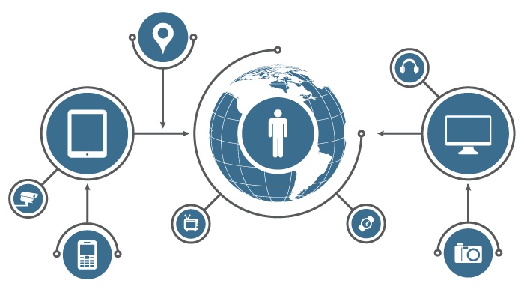
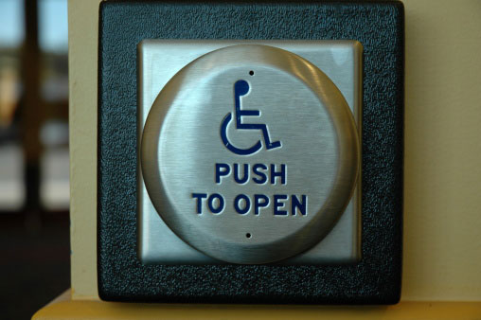
Requirements
Applewood’s Needs
Additional Features
Resident is able to enter their apartment without denting the door
Follows building codes
Fail Safes
Transferable to other doors
Enhanced security features
Scalability
Smart connected system
http://www.accesselevator.net/automatic-door-openers-for-the-handicapped/
http://securityaffairs.co/wordpress/40139/cyber-crime/fbi-internet-of-things.html

Slide 5
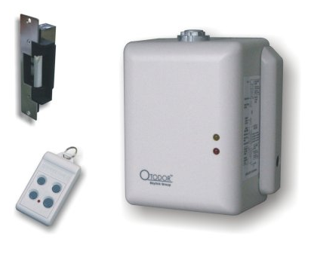
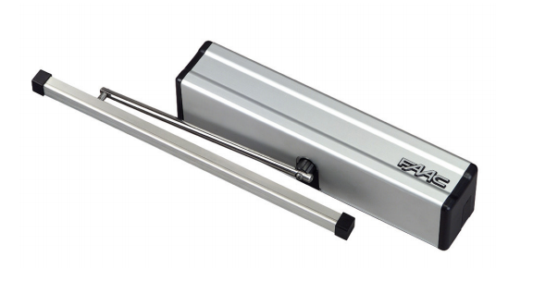
Current Market Products
Skylink Dm-150
http://www.skylinkhome.com/row/products/sdo/dm150.html
FAAC 950 BM
http://www.faacusa.com/uploads/media/950_01.pdf
Opens remotely and closes passively
Can still be opened manually
“Anti-crush” device
Does not unlock the door
No enhanced security features
Remotely opens/closes with a key fob
Unlocks the door on use
Does not passively close
Not upscalable
Poor fail safes

Slide 6
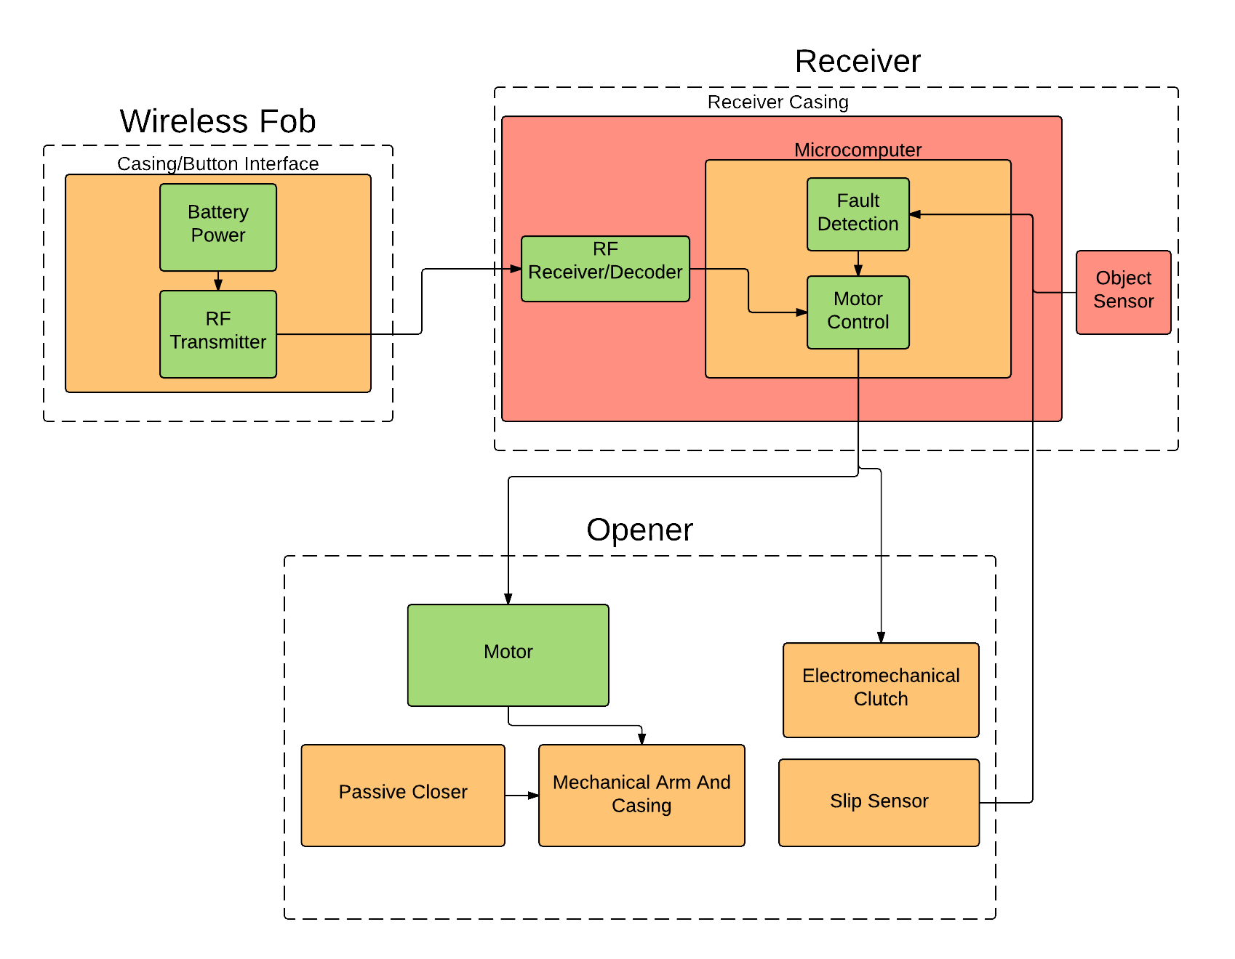
Block Diagram

Slide 7
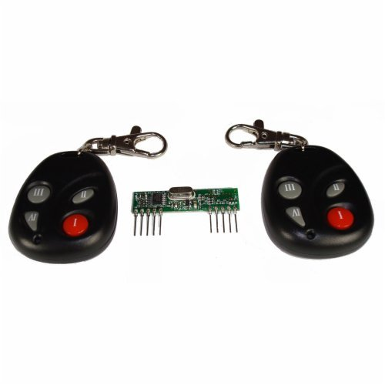
Block 1 (Fob)
RF transmitter and receiver
  Over 530,000 combinations
OEM
~25 Foot range
State Analysis By Raspberry Pi
Alternative
  RFID
  Bluetooth
https://www.alarmgrid.com/products/honeywell-5834-4

Slide 8
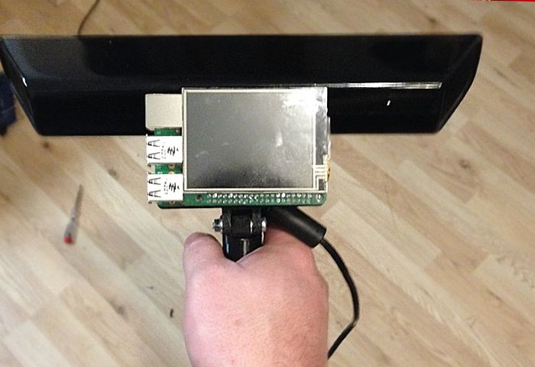
Block 2 (Receiver)
http://www.slashgear.com/raspberry-pi-2-kinect-make-for-a-handy-3d-scanner-06391772/
Consists of 3 Primary Components
RF Receiver and Decoder
  Receives transmitted RF signal and sends to decoder to convert signal from serial to parallel
Microcomputer(Raspberry Pi)
  Processes RF signal
  Controls state of the system
  Accounts for faults
Object Sensor(kinect/IR Beam)
  Ensures customer safety
  Enhances security
    Recognize/record intruders
    Facial recognition and voice command possibilities
    Future mobile device control of the system

Slide 9
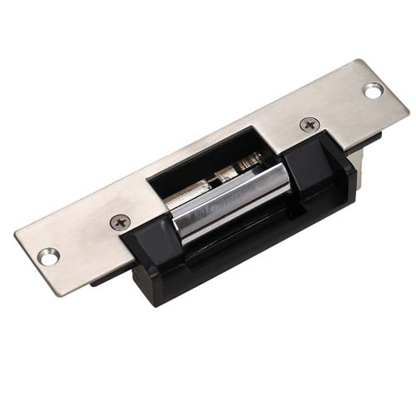
Door Opener
Motor &
Electromechanical Clutch
Passive Closer
Lock Mechanism
Spring
Damper
Electric Strike
Electric Door Lock
Electric Strike
Slip Sensor
Mechanical Arm and Casing
Accelerometer
http://www.safedoormatic.net/Electric-Strike/

Slide 10
MDR Deliverables
Function subsystems
  Functioning fob to microcomputer communication
  Sizing and purchasing of motor and clutch
  Signal processing and motor/clutch control
Return to AppleWood for more detailed analysis of specific client needs
  Door opening closing time
  Tactile response (button sizes and strength required)
  Clearance around door (wiring and portable clamp)
  Finalize power requirements
  Limitations on what we can modify

Slide 11
Questions?

