Slide 1

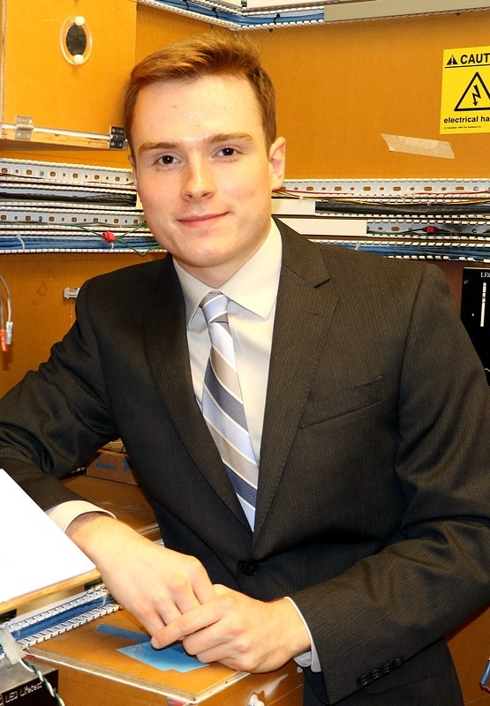


Team Mellon A.D.S.
Midway Design Review (MDR)
Tom Nilsson, ME
Dan Sheahan, ME
December 3rd, 2015
Mitchell Dawson, EE
Jessica Ferreira, Nursing
Justin Waller, EE
Notes:
‹#›
‹#›
‹#›

Slide 2

Introduction
Centered around Applewood
Minimum care assisted living facility
Working through nursing department
Challenges faced at Applewood
Damage to doors from walkers
Inconvenience for residence
Observance of fire codes
Portable

Slide 3
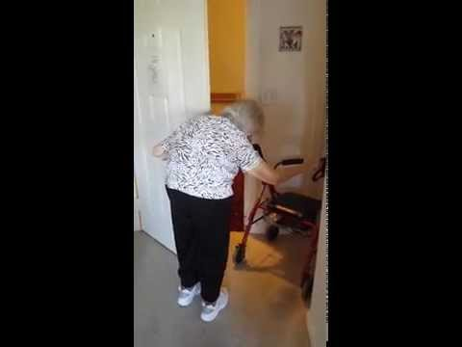
Introduction (Video)

Slide 4
Requirements
Applewood & Resident Needs
Follows building codes
Ergonomic Key Fob
Safety Features
Transferable
Reproducible
Aesthetic
Additional Features
Security & Individuality

Slide 5
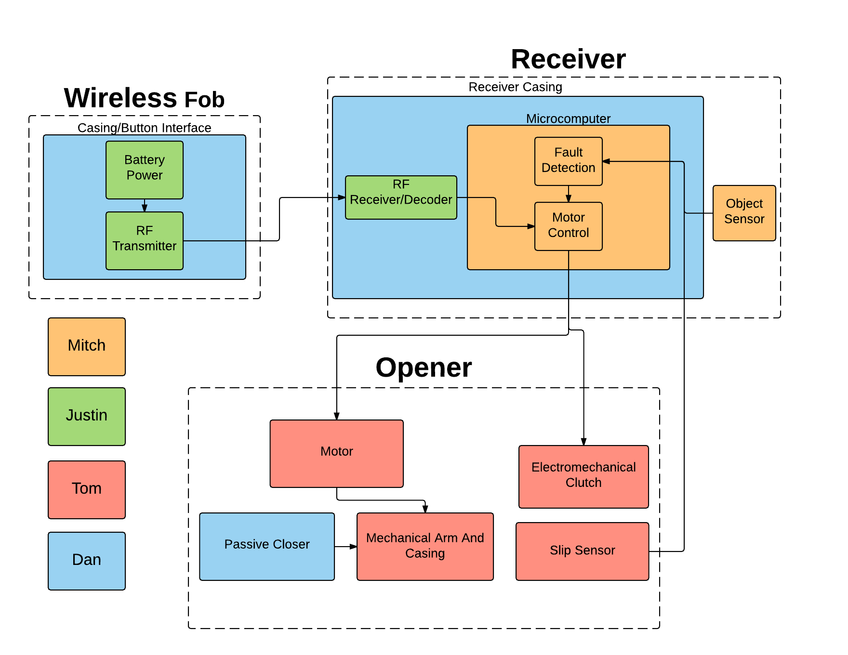
Block Diagram

Slide 6
MDR Deliverables as Stated in PDR
Function subsystems
Functioning fob to microcomputer communication
Sizing and purchasing of motor and clutch
Signal processing and motor/clutch control
Return to AppleWood for more detailed analysis of specific client needs
Door opening closing time
Tactile response (button sizes and strength required)
Clearance around door (wiring and portable clamp)
Finalize power requirements
Limitations on what we can modify

Slide 7
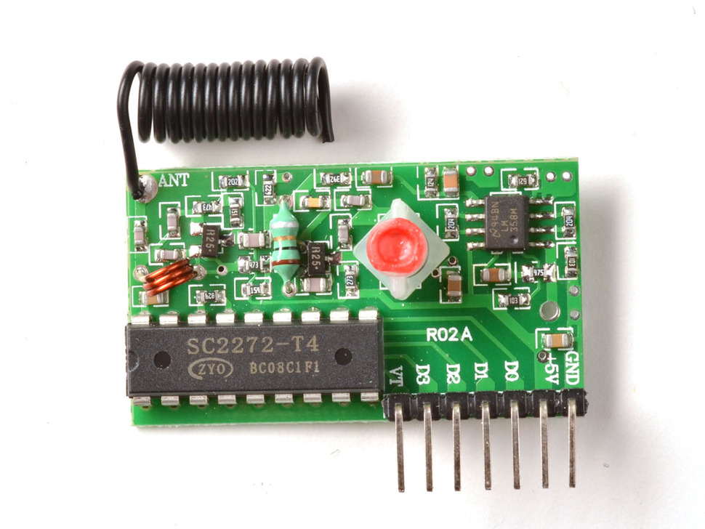
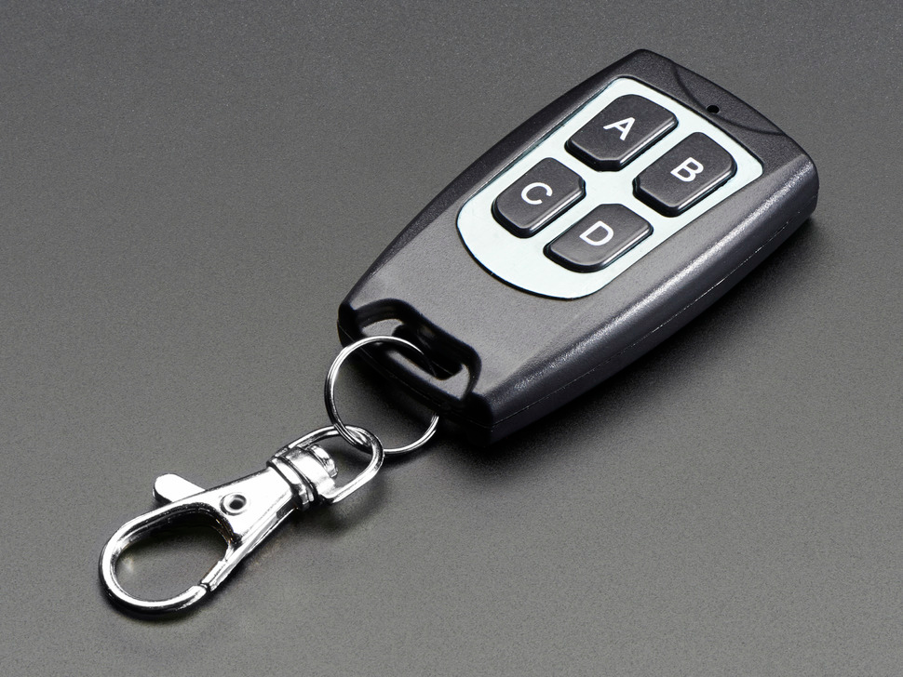
RF Transmitter And Receiver
Transmitter-
Four buttons Functionality
Uses CR2016 batteries
Based off PTC2262
Receiver- Adafruit 1098
Latching type
Based of PTC 2272
Pros
Easy implementation
Easy integration
Cons
Lack of security features

Slide 8
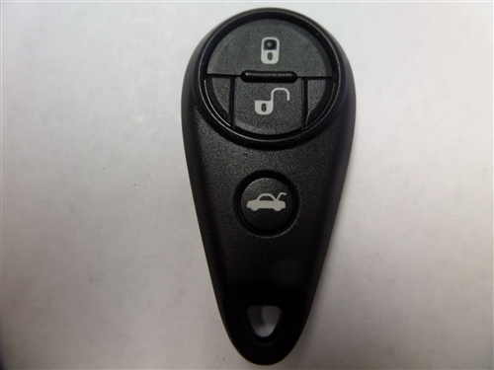
Key Fob Ergonomics
Discoveries:
Hated key fob around her neck
Liked the idea of fob on walker
Mobile enough to reach around the walker
Current Needs for Joan:
Fob clipped onto the walker
Colored Buttons
On & Off button separated
http://www.keylessentryremotefob.com/v/vspfiles/photos/TWB1U819%20SUBARU-2.jpg

Slide 9
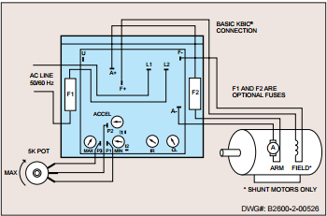
Receiver and Microcomputer
Requirements
Multiple inputs
Controls subsystems
Achieved capabilities
Receives input from transmitter
Motor Control
Still needed
Receive Sensor Inputs
IR/X Beam Sensor
Potentiometer
Clutch Control
State Analysis

Slide 10
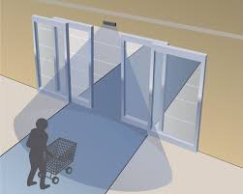
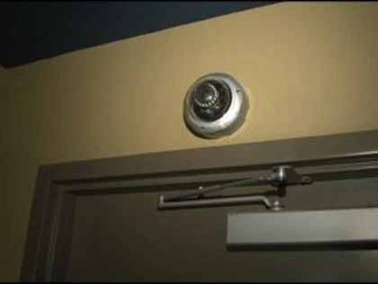
Sensor System
Requirements
Records people entering and leaving
Ensures safety of residents
Implementation
IR/X-beam sensors
Raspberry pi Camera
http://nabcoentrances.com/our-company/news/
http://sacramento.cbslocal.com/2011/01/15/gas-station-bathroom-camera-unnerves-customers/

Slide 11
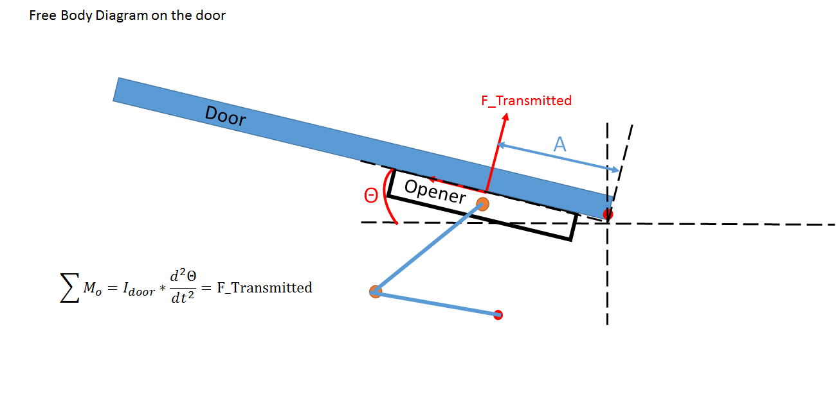
Free Body Diagram on the Door

Slide 12
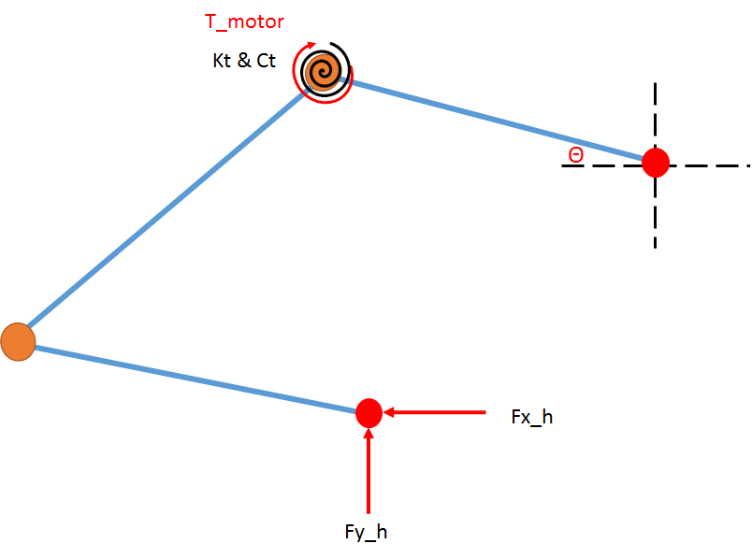
Four-Bar-Linkage

Slide 13
Calculation Results
Component | Calculated Value | Actual Value | Cost ($)
Motor | 0.0027 HP @ 42 lb-in & 4 rpm | 0.033 HP @ 63.6 lb-in & 17.6 rpm | 321
Spring | 10 lb-in/rad | 16 lb-in Max Torque | 53.55
Damper | 22 lb-in-s/rad | ~40 lb-in-s/rad | 37.38

Slide 14
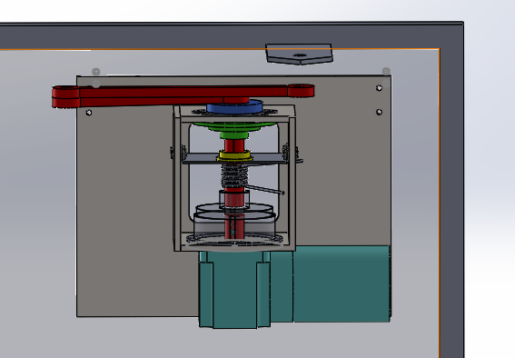
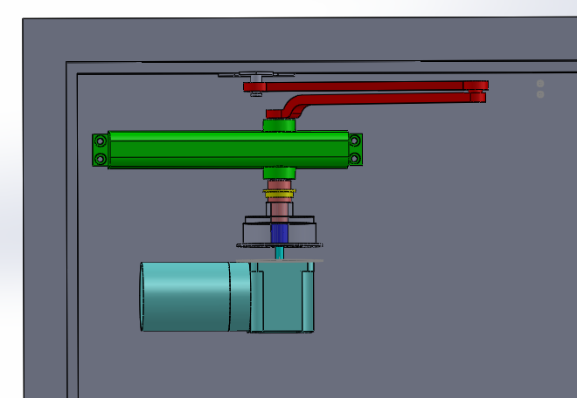
Mechanical Assembly
vs.

Slide 15
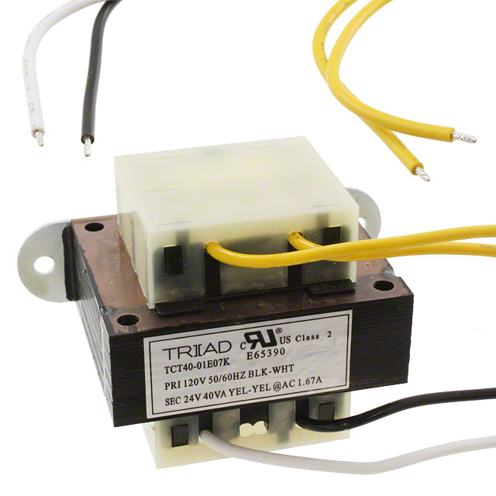
System Power
5VDC | 24VDC | 120VAC
Raspberry Pi RF Receiver | Clutch Driver Clutch | Motor Driver Motor
Triad Magnetics TCT40-01E07K

Slide 16
Team Responsibilities and Schedule
Dan:
Build door frame to test - 1/18
3 key fob prototype tests - 2/26
Justin:
Fully design power system - 2/12
Mitch:
Purchase and integrate sensors - 1/8
Coding and integration of Raspberry pi - 2/19
Tom:
Finish mounting bracket design - 12/18
Purchase all mechanical components - 1/8
Assemble mechanical components - 3/11

Slide 17
CDR Deliverables
Working Prototype
Enhance RF Security
Power Systems
Sensor Control from Microprocessor
Clutch Control
Build Door/Door Frame for Testing
Ergonomic Key Fob
Clutch, Motor, Mounting System Integration
FPR Preparation
Exterior System Finalization
Full Integration with Applewood

Slide 18
Demonstration

Slide 19
Questions?

