Slide 1

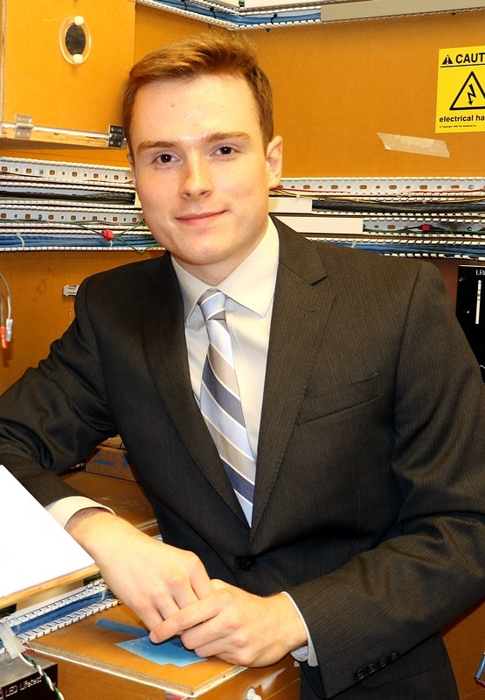


Team Mellon A.D.S.
Final Product Review (FPR)
Tom Nilsson, ME
Dan Sheahan, ME
April 21, 2016
Mitchell Dawson, EE
Jessica Ferreira, Nursing
Justin Waller, EE
Notes:
‹#›
‹#›
‹#›

Slide 2

Introduction
Centered around Applewood
  Minimum care assisted living facility
Working through nursing department
Challenges faced at Applewood
  Damage to doors from walkers
  Inconvenience for residence
  Observance of fire codes
  Portable

Slide 3
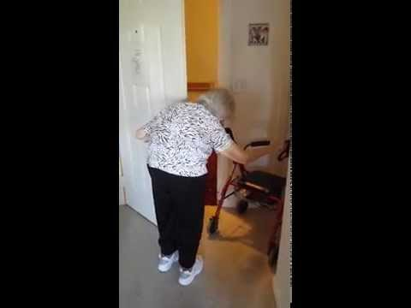
Introduction (Video)

Slide 4
Requirements
Applewood & Resident Needs
Follows building codes
Ergonomic Key Fob
Safety Features
Transferable
Reproducible
Aesthetic
Additional Features
Security & Individuality

Slide 5
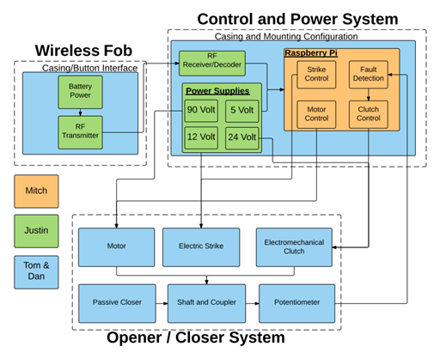
Block Diagram

Slide 6
FPR Deliverables
  Resolved clutch slipping (When outside of electric strike)
  Integrated Potentiometer
  Finalized the packaging
  Electric strike not functional

Slide 7
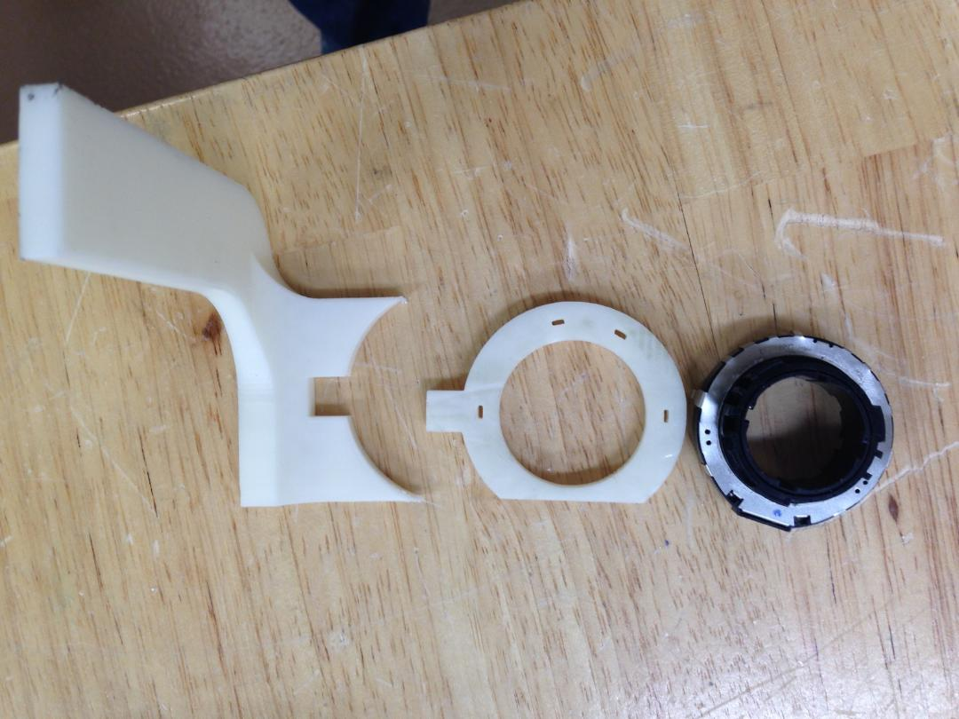
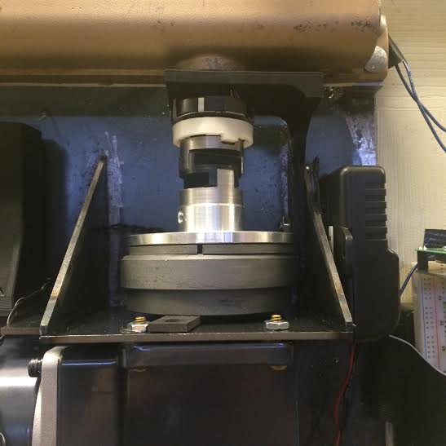
Mechanical Shaft

Slide 8

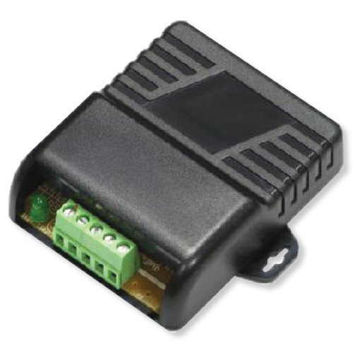
Enhanced RF Security
Seco-Larm SK-919TD1S-UP
Seco-Larm SK-910RBQ

Slide 9
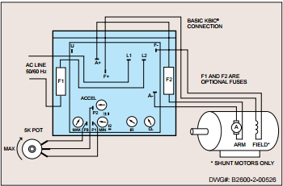
Microcomputer
Requirements
  Multiple inputs
  Controls subsystems
Implementation
  Raspberry Pi Microcomputer
    Controls subsystems
    state Analysis
  Motor Driver PCB
  potentiometer
  Electromagnetic Clutch

Slide 10
Questions?

