Slide 1
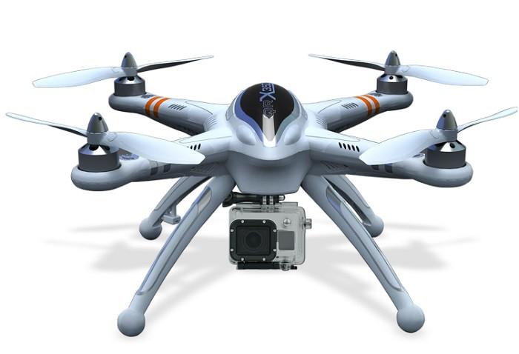
Preliminary Design Review
ASPECTS: Airport Secure Perimeter Control System
Team 2:
Chris Boselli, Sandra McQueen, Jason Danis, Alex Breger
October 22, 2015
Department of Electrical and Computer Engineering Advisor: Professor Looze
Department of Electrical and Computer Engineering Advisor: Professors Looze, Ni
Notes:
1
1
1

Slide 2




The Group
Jason Danis
EE
Alex Breger
EE
Sandra McQueen
EE
Chris Boselli
EE
Advisors: Prof. Looze (ECE), Prof. Ni (CEE), Prof. Collura (CEE)
Department of Electrical and Computer Engineering Advisor: Professors Looze, Ni

Slide 3
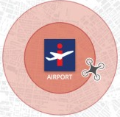
The Problem
“An examination of 891 drone sightings reported to the Federal Aviation Administration over a 17-month period found more than half flew too close to an airport, prompting lawmakers to renew calls to tag the popular remote-controlled aircraft with electronic collars that would keep them away.”
-USA Today, 21 October 2015
Drones flying in the restricted airspace around airports present safety/security problems for the airports
Currently there is no universal means of regulating sUAS operations in this critical 5 mile radius
Department of Electrical and Computer Engineering Advisor: Professor Looze
Department of Electrical and Computer Engineering Advisor: Professors Looze, Ni

Slide 4
How Serious is the Problem?
The number of issued Certificates of Allowance (COA’s) that allow public entities to fly a UAS in civil airspace have dramatically increased over the past few years:
Year | # of COA’s Issued
2009 | 146
2010 | 298
2011 | 313
2012 | 257
2013 | 373
As of Dec. 4, 2013 | 545
These numbers are of course in addition to recreational drones available for public purchase and flight with minimal regulations.
Department of Electrical and Computer Engineering Advisor: Professor Looze
Department of Electrical and Computer Engineering Advisor: Professors Looze, Ni

Slide 5

How Serious is the Problem?
Pilot reports of unmanned aircraft have increased dramatically over the past year, from a total of 238 sightings in all of 2014 to an annual total of more than 650 by August 9 of this year.
From 2010 to 2012 there were 3,070 reported runway incursions out of a total estimated 150 million takeoffs and landings (about 20 for every million) throughout all towered airports in the United States, many of which were caused by drone activity.
Department of Electrical and Computer Engineering Advisor: Professor Looze
Department of Electrical and Computer Engineering Advisor: Professors Looze, Ni

Slide 6
What’s next?
It is one of the FAA’s top priorities to reduce the severity, number, and rate of runway incursions
Senator Schumer (D-N.Y.) introduced proposed amendment into FAA Reauthorization Act requiring all drones to have geo-fencing capabilities
In the future there could be a mandatory firmware upgrade for drone manufacturers requiring geofencing
Department of Electrical and Computer Engineering Advisor: Professor Looze
Department of Electrical and Computer Engineering Advisor: Professors Looze, Ni

Slide 7
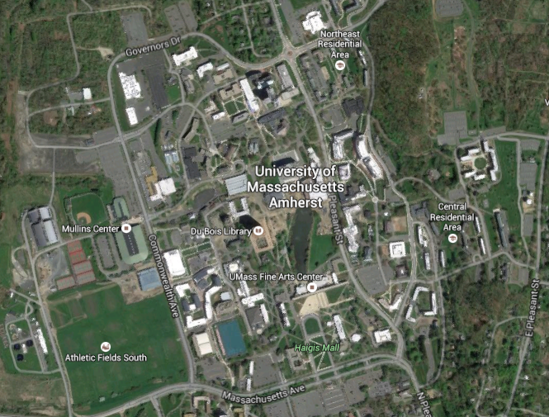
Geofencing
Geofencing is a way of creating virtual geographical boundaries.
The area is defined by a point and a radius.
Used for industrial and marketing applications
Can be paired with hardware and software to simulate a physical barrier
Department of Electrical and Computer Engineering Advisor: Professor Looze
Department of Electrical and Computer Engineering Advisor: Professors Looze, Ni

Slide 8
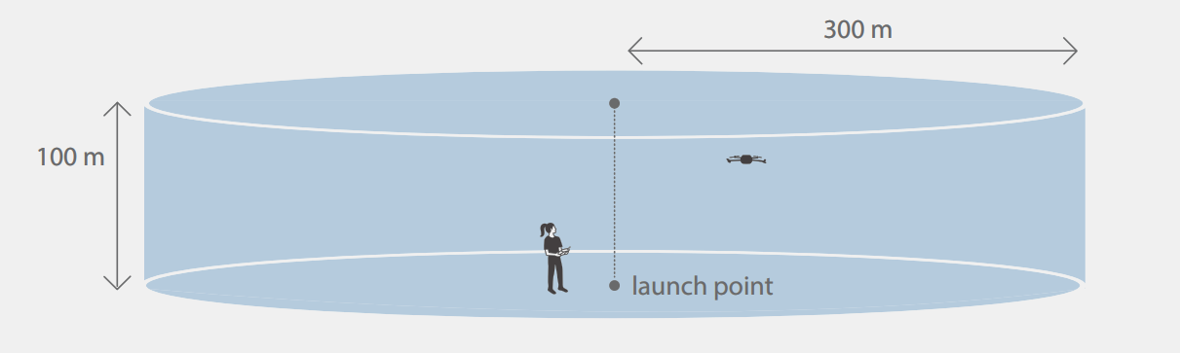
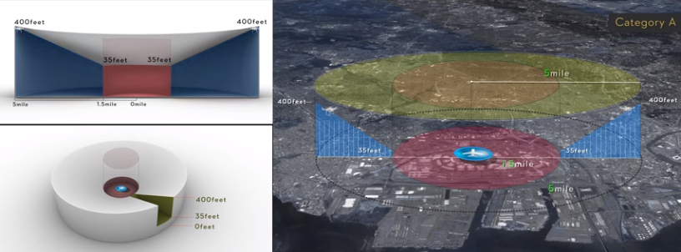
Existing Technology
Flight of the 3DR Iris+ copter is restricted to within a 300 meter radius of the take-off location.
A recent firmware update in DJI Phantom UAVs enforces No Fly Zones around airports.
Our objective is to develop a solution for
universal implementation.
Department of Electrical and Computer Engineering Advisor: Professor Looze
Department of Electrical and Computer Engineering Advisor: Professors Looze, Ni

Slide 9
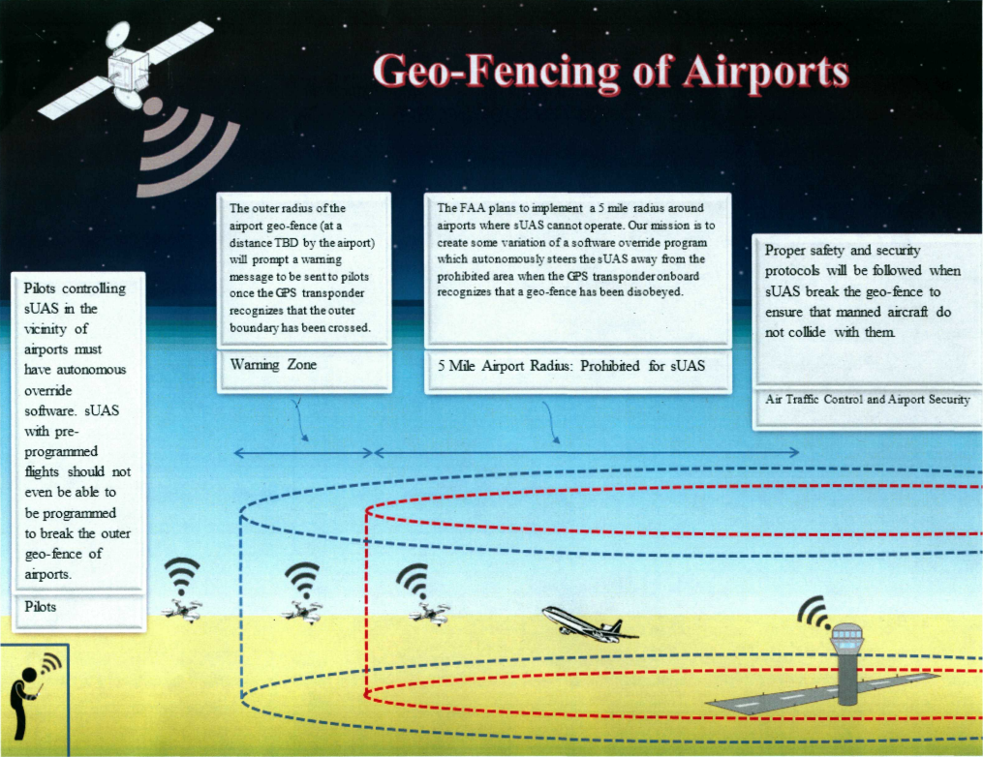
Design Overview
Artist:
Jared Geller
UMass Amherst
CEE Department
Department of Electrical and Computer Engineering Advisor: Professor Looze
Department of Electrical and Computer Engineering Advisor: Professors Looze, Ni

Slide 10
System Requirements
Department of Electrical and Computer Engineering Advisor: Professor Looze
Department of Electrical and Computer Engineering Advisor: Professors Looze, Ni

Slide 11
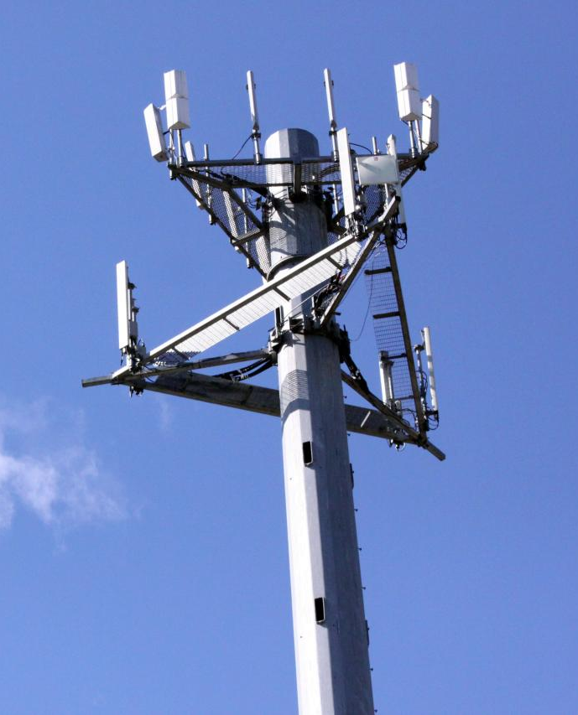
Inputs
GPS data updating multiple times per second
Adafruit Ultimate GPS for pinpointing UAV location, 10 Hz update
Existing cellular infrastructure
Microcontroller communicates with user via 3G/4G antenna
Coordinates of Geofenced zones, retrieved from online database
Printed Circuit Board housing controller
Raspberry Pi receives GPS data, determines proximity to Geofenced area
Department of Electrical and Computer Engineering Advisor: Professor Looze
Department of Electrical and Computer Engineering Advisor: Professors Looze, Ni

Slide 12

Outputs
Alert at user interface allowing >10 seconds advance warning
1000 ft buffer zone
!
WARNING
Stimulation of Auto-Pilot function
Return-to-Launch activated from Raspberry Pi
Safe airspace for passenger and commercial vehicles
Eliminates risk of accidents caused by user error
Your aircraft is approaching Bradley International Airport.
Department of Electrical and Computer Engineering Advisor: Professor Looze
Department of Electrical and Computer Engineering Advisor: Professors Looze, Ni

Slide 13
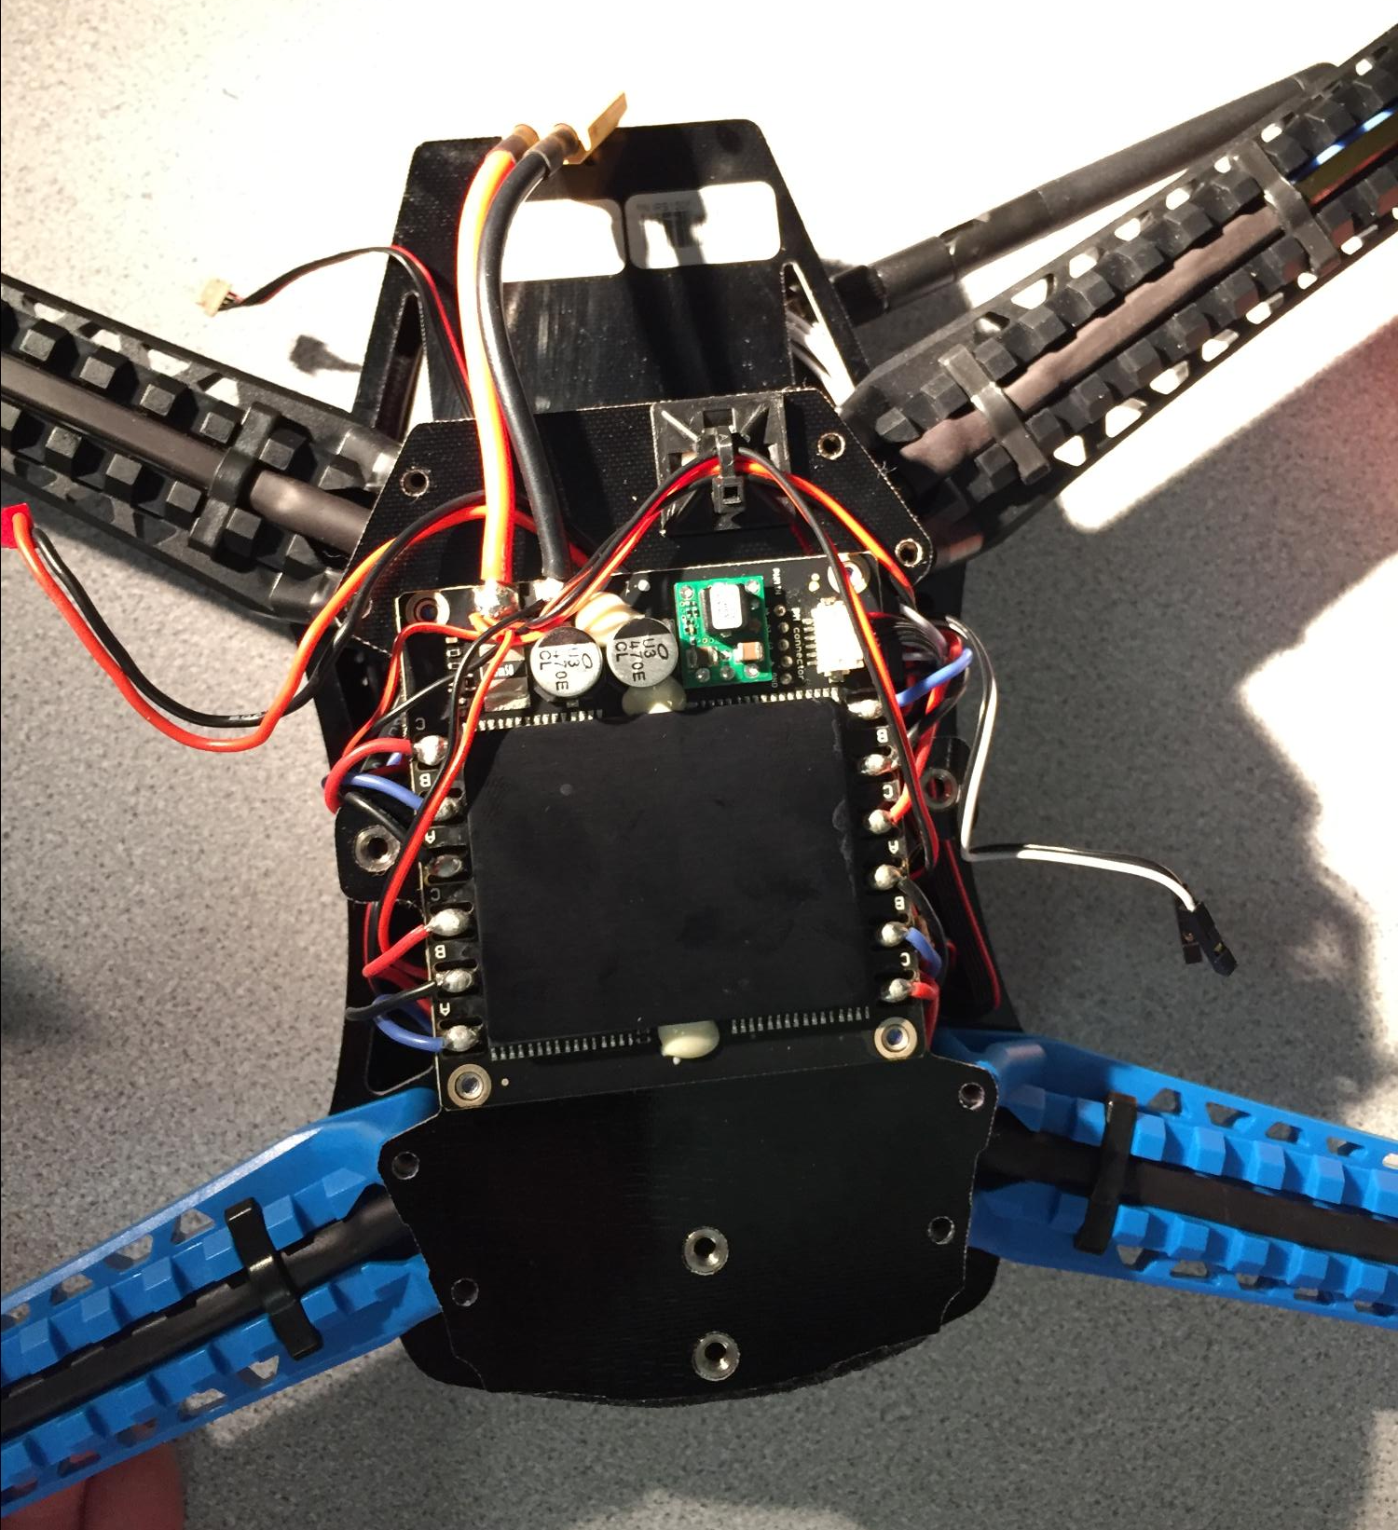
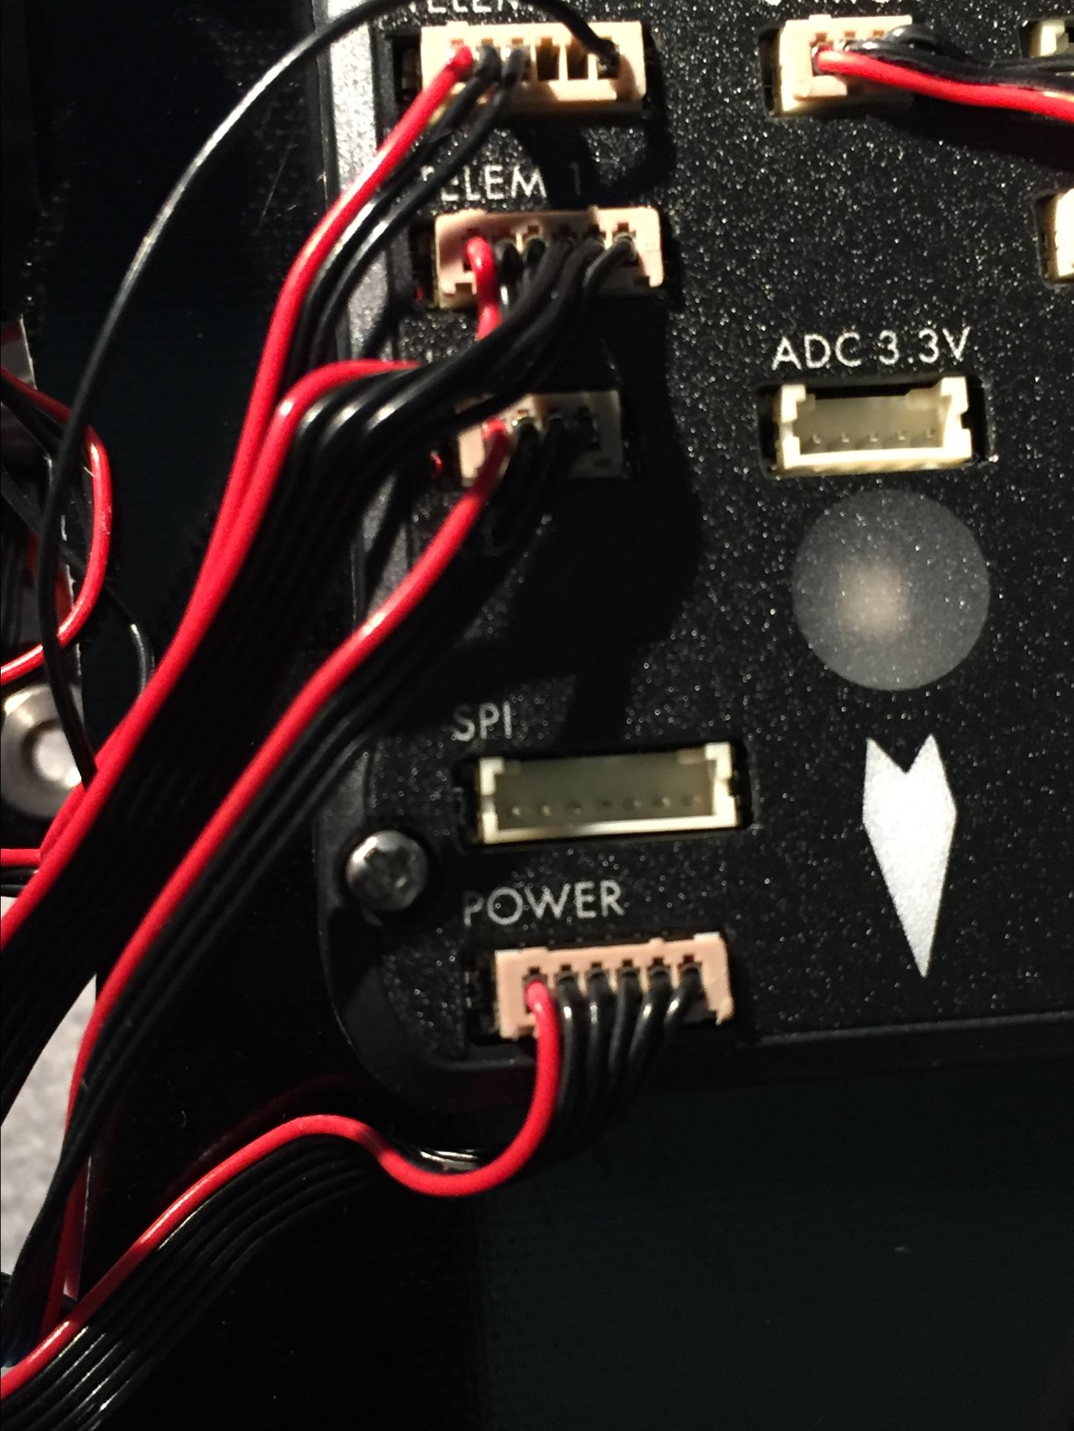
The UAV
Desired quadcopter specifications:
Replaceable battery that allows sufficient flight time between charges
Flight controller with data input port (USB, SPI,...)
Falls within reasonable price range for Proof-of-Concept with lower-end UAVs
Looking inside 3DR’s Iris+ quadcopter
Department of Electrical and Computer Engineering Advisor: Professor Looze
Department of Electrical and Computer Engineering Advisor: Professors Looze, Ni

Slide 14
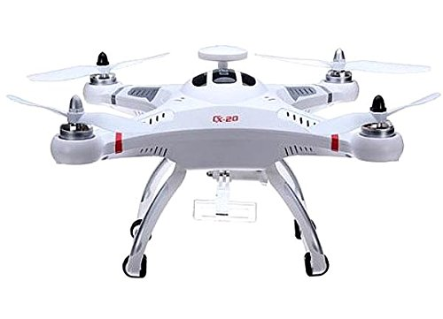
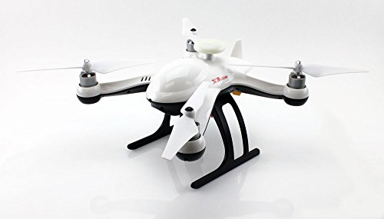
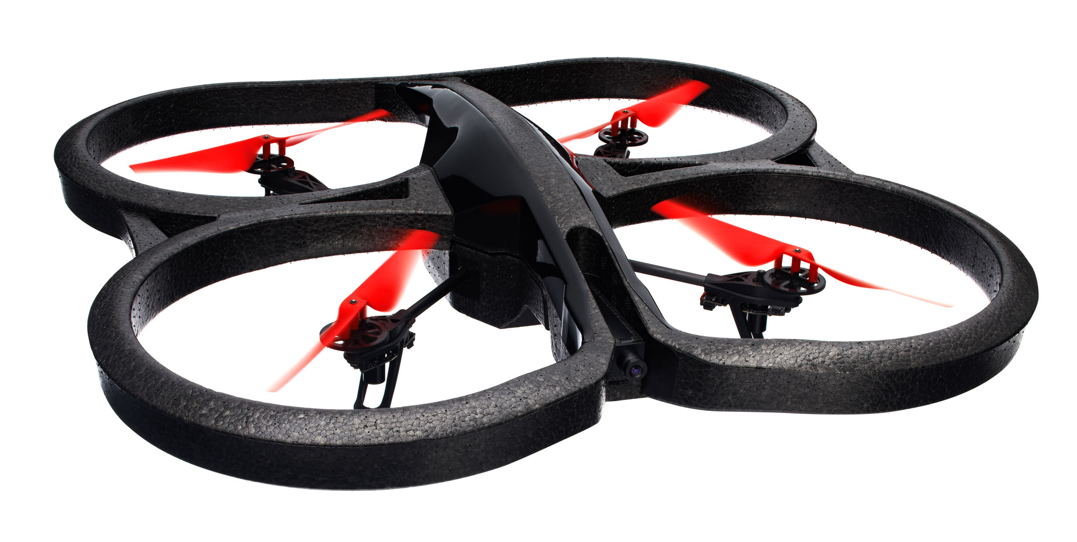
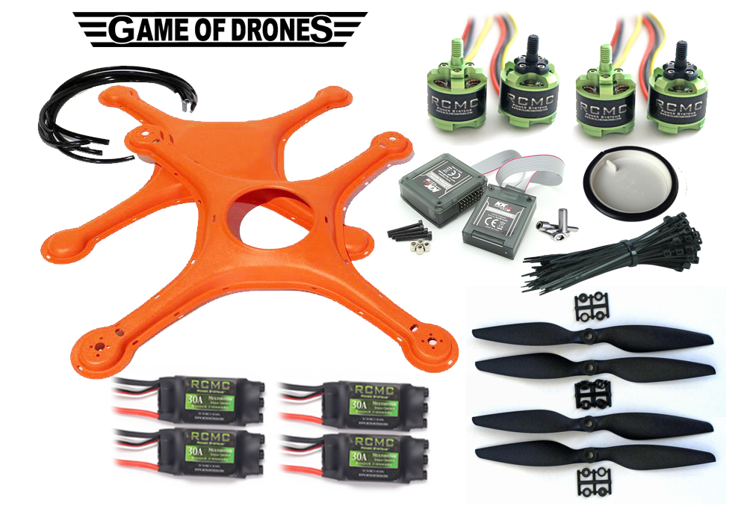
UAV Models
 | Flight Time (minutes) | GPS Enabled | Price (USD)
SeresRoad CXHOBBY CX-20 | 15 | Yes | 320
Storm RC X3 | 12-15 | Yes | 300
Parrot AR Drone 2.0 | 12 | Yes | 349
Custom Arduino-based Quadcopter | ~12 | No | ~400
Department of Electrical and Computer Engineering Advisor: Professor Looze
Department of Electrical and Computer Engineering Advisor: Professors Looze, Ni

Slide 15
High Level Block Diagram
Geofencing Module
(Custom PCB)
Drone I/O Subsystem
Drone Flight Control System
(Already Installed)
Drone Body
Internet
User/Airport Device with Notification App
Department of Electrical and Computer Engineering Advisor: Professor Looze
Department of Electrical and Computer Engineering Advisor: Professors Looze, Ni

Slide 16
Detailed Block Diagram
Our Geofencing Module (PCB enclosure)
Drone IO System (e.g. PX4 or native USB)
Controller (Raspberry Pi)
Wired Drone Interface
USB Power
Geofencing Code
USB
ADS-B Out Subsystem
ADS-B Antenna
Serial Digital In
GPS In Subsystem
3G/4G Out
Flight Code (ArduPilot or existing autopilot software)
GPS Antenna
3G/4G Antenna
Drone Flight Controller
Drone Body
Drone Flight Control System
App Fetch Server (Raspberry Pi)
3G/4G In
User Device Controller
GUI
Server Code
3G/4G Antenna
App Code
Internet
User/Airport Device with Notification App
Department of Electrical and Computer Engineering Advisor: Professor Looze
Department of Electrical and Computer Engineering Advisor: Professors Looze, Ni

Slide 17
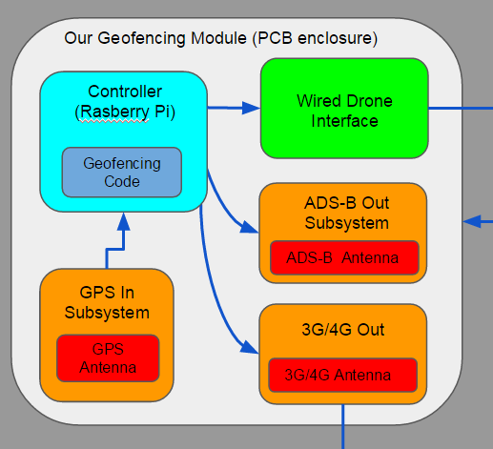
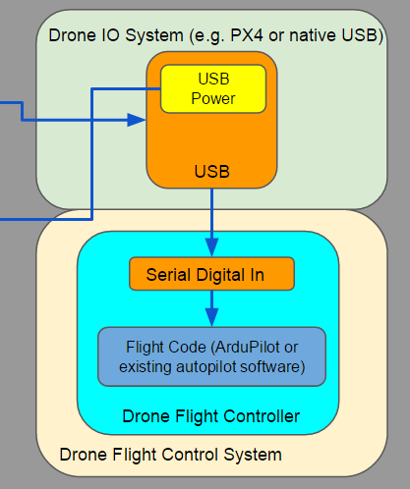
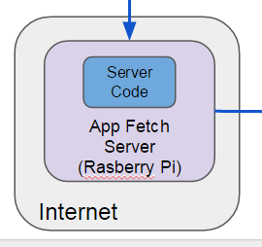
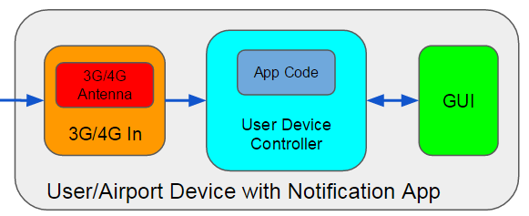
Major Subsystems
Subsystem #1: Installed Geofencing PCB Module
Subystem #2: Drone and I/O
Subsystem #3: App Fetch Server
Subsystem #4: User/Airport Alert Application
Department of Electrical and Computer Engineering Advisor: Professor Looze
Department of Electrical and Computer Engineering Advisor: Professors Looze, Ni

Slide 18
Subsystem #1: Installed Geofencing PCB Module
System #1: Installed Geofencing PCB Module
(1) GPS sensor component w/ antenna
(2) Rasberry-Pi controller component
Geofencing code subcomponent
store geofencing coordinates (cylinder in 3D, circle in 2D)
based on FAA’s 5-mile no-fly radius (the “inner” barrier)
if drone eventually breaches inner barrier →
disable signal sent to drone via drone interface
alert signal sent to app server for airport
store warning coordinates corresponding to our outer warning radius of 5 miles + x (the “outer” barrier)
if drone first breaches outer barrier →
alert sent to app server for drone user
Department of Electrical and Computer Engineering Advisor: Professor Looze
Department of Electrical and Computer Engineering Advisor: Professors Looze, Ni

Slide 19
Subsystem #1: Geofencing PCB Module (con’t)
System #1: Installed Geofencing PCB Module
(3) Wired Drone Interface Component
route signals from controller to drone via wired interface
likely to be USB out from the Rasberry Pi’s perspective
(4) 3G/4G Communications Component
transmit geofencing alerts to app fetch server
(5) ADS-B Out Component (optional)
NextGen communications standard for aeronautics community being implemented by 2020 (most of world)
if we can secure one as donation we can alternatively use it to notify air traffic controllers more directly instead of 3G
Department of Electrical and Computer Engineering Advisor: Professor Looze
Department of Electrical and Computer Engineering Advisor: Professors Looze, Ni

Slide 20
Subsystem #2: Drone and Associated IO System
Two Drone/UAV on-board components:
(1) the flight microcontroller that controls the copter
(2) data-in interface to receive landing override signal from the Geofencing Module when needed
many drone models/kits come with IO chips to enhance connectivity to flight controller with multiple IO interfaces
most (including the models we are looking at) include at least a dedicated USB port
without a dedicated port we would have to hardwire a USB port into the drone’s microcontoller and power rails
Department of Electrical and Computer Engineering Advisor: Professor Looze
Department of Electrical and Computer Engineering Advisor: Professors Looze, Ni

Slide 21
Subsystem #3: App Fetch Server
external linux STP/FTP file server for storing alert data
syncs with User/Airport App to alert them of an outer or inner perimeter breach, respectively
may also alert airport if disable signal fails or is tampered with
Department of Electrical and Computer Engineering Advisor: Professor Looze
Department of Electrical and Computer Engineering Advisor: Professors Looze, Ni

Slide 22
Subsystem #4: User/Airport Alert Application
3G/4G radio on user device fetches alert signals from our Alert Fetch Server
programmed to alert user of an outer perimeter breach (e.g. 500 ft, 1000 ft) away from inner perimeter
programmed to alert airport of inner perimeter breach and drone landing
Installed App Code can be set to sync with Fetch Server at custom interval (battery life vs. response time tradeoff)
sends users GUI an alert when server
Department of Electrical and Computer Engineering Advisor: Professor Looze
Department of Electrical and Computer Engineering Advisor: Professors Looze, Ni

Slide 23
Parts and Estimated Cost List
2 Rasberry Pi (2*$35 = $70)
GPS chip ($30)
USB connector ($5)
3G chip ($30)
3G subscription_pay as we go data ($30)
custom PCB board ($40)
drone ($200-300)
total: $405-505
Department of Electrical and Computer Engineering Advisor: Professor Looze
Department of Electrical and Computer Engineering Advisor: Professors Looze, Ni

Slide 24
Design Alternatives
Software Alternatives: Multiple flight control options to handle a drone
that has entered a geofenced area
Preprogrammed flight path: Directs the flight around the radius
of the geofenced area
Pros
Keeps drones out of restricted airspace
Predictable flight pattern
Cons
No collision detection for oncoming obstacles
Battery life concerns if pilot does not regain control
Department of Electrical and Computer Engineering Advisor: Professor Looze
Department of Electrical and Computer Engineering Advisor: Professors Looze, Ni

Slide 25

Design Alternatives
Hardware Alternatives: Communication between our microcontroller and the onboard microcontroller
Bluetooth
Pros
Reliable
Cheap ($25 - $30)
light weight
Cons
Adds complexity
Less reliable than USB
Department of Electrical and Computer Engineering Advisor: Professor Looze
Department of Electrical and Computer Engineering Advisor: Professors Looze, Ni

Slide 26
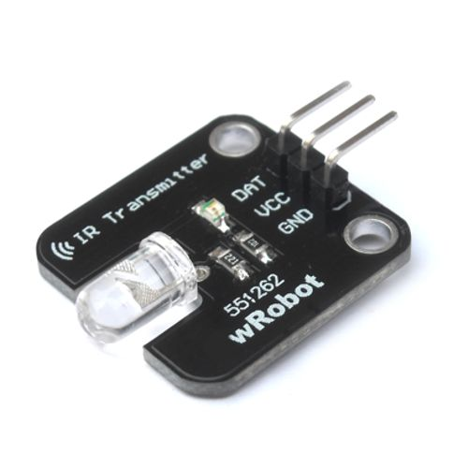
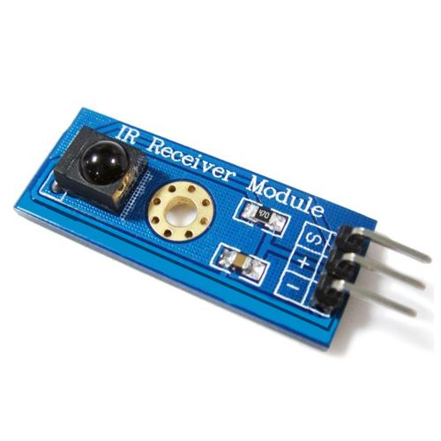
Design Alternatives
Infrared TX/RX
Pros
cheapest wireless solution ($4 - $5)
light weight
simple implementation
Cons
least reliable (IR interference from ambient light)
Department of Electrical and Computer Engineering Advisor: Professor Looze
Department of Electrical and Computer Engineering Advisor: Professors Looze, Ni

Slide 27
Societal Impact
Cost effective, automated solution to the problem at hand
Removes human error from the equation
Able to be implemented on any/all drones if mandatory geofencing regulations do get passed in the future
Applicable to other geofencing scenarios in the future
Department of Electrical and Computer Engineering Advisor: Professor Looze
Department of Electrical and Computer Engineering Advisor: Professors Looze, Ni

Slide 28
Societal Impact - User level
Safe and cost effective
Controlled rotor deceleration
Able to work with controller operated joystick or automated flight path
prevents collisions with airport aircraft
Prevents legal issues between users and FAA
Department of Electrical and Computer Engineering Advisor: Professor Looze

Slide 29

Societal Impact - Airport level
Reduces number of potential runway incursions with sUAS
Greatly reduces equipment damage and maintenance costs
Not the responsibility of airports to handle the problem
Provides an adequate solution at ZERO ADDITIONAL COST TO AIRPORTS
Department of Electrical and Computer Engineering Advisor: Professor Looze

Slide 30
Previous Projects
2014-2015 ACRP University Design Competition for Addressing Airport Needs: Runway safety/incursions/excursions section 1st place winners - Eye in the Sky - Drone Detection & Tracking System
Manufacturers install RFID chip on each individual unit sold
RFID chip number is added to national database
Many RFID tracking systems with individual Adjustable Active RFID Readers responsible for detecting drones in critical airspace set up all around perimeter of 5 mile radius
Range: approximately up to 200-300m each
Cost: ~$700 each
Notifies airport and user when drone enters critical airspace, yet nothing done to remove the threat
Could be a threat if breach was deliberate
Cost of entire system to airport (T.F. Green, RI):
$34,212.56
Department of Electrical and Computer Engineering Advisor: Professor Looze

Slide 31
MDR Deliverables
Demonstration of functioning GPS tracking and data logging
Transmit to microcontroller
Demonstration of interpreting GPS data with microcontroller
Clear of geofenced area?
Quick response
LED indication
Copter assembled/tested
Create app server
Test communication with external device
Department of Electrical and Computer Engineering Advisor: Professor Looze

Slide 32
Sources
<http://www.usatoday.com/story/news/nation/2015/10/21/drone-rulebreaking-geofencing-dianne-feinstein-charles-schumer/74292314/>
<http://www.kgns.tv/home/headlines/Department-of-Homeland-Secuiryt-issues-warning-on-320541622.html>
<http://www.wired.com/2015/02/white-house-drone/>
<https://www.ainonline.com/aviation-news/aerospace/2015-03-13/easa-issues-regulatory-approach-drones-europe>
Department of Electrical and Computer Engineering Advisor: Professor Looze

Slide 33

Questions or Comments?
Department of Electrical and Computer Engineering Advisor: Professor Looze

