Slide 1
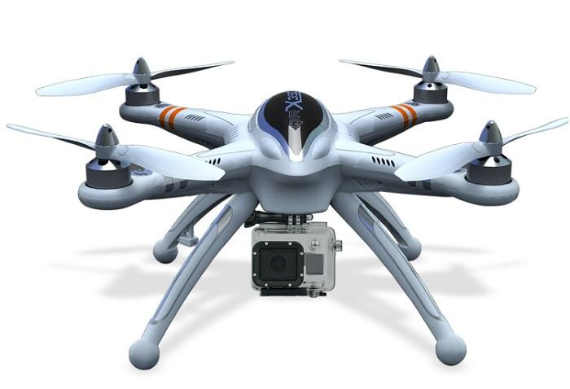
Midway Design Review
ASPECTS: Airport Secure Perimeter Control System
Team 2:
Chris Boselli, Sandra McQueen, Jason Danis, Alex Breger
December 3, 2015
Department of Electrical and Computer Engineering Advisor: Professor Looze
Department of Electrical and Computer Engineering Advisor: Professors Looze, Ni
Notes:
‹#›
‹#›
‹#›

Slide 2
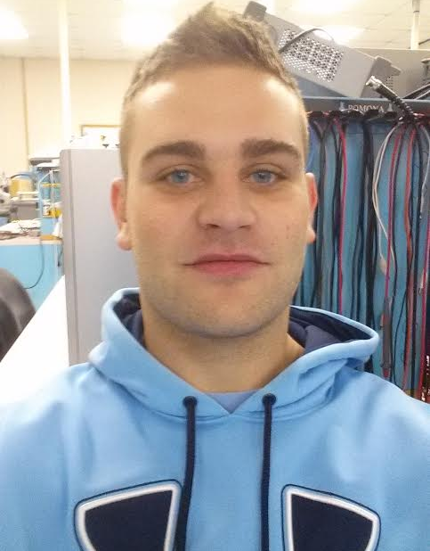
The Group
Jason Danis
EE
Alex Breger
EE
Sandra McQueen
EE
Chris Boselli
EE
Advisors: Prof. Looze (ECE), Prof. Ni (CEE), Prof. Collura (CEE)
Department of Electrical and Computer Engineering Advisor: Professors Looze, Ni

Slide 3
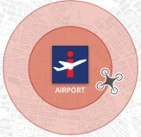
The Problem
“An examination of 891 drone sightings reported to the Federal Aviation Administration over a 17-month period found more than half flew too close to an airport, prompting lawmakers to renew calls to tag the popular remote-controlled aircraft with electronic collars that would keep them away.”
-USA Today, 21 October 2015
Drones flying in the restricted airspace around airports present safety/security problems for the airports
Currently there is no universal means of regulating sUAS operations in this critical 5 mile radius
Department of Electrical and Computer Engineering Advisor: Professor Looze
Department of Electrical and Computer Engineering Advisor: Professors Looze, Ni

Slide 4
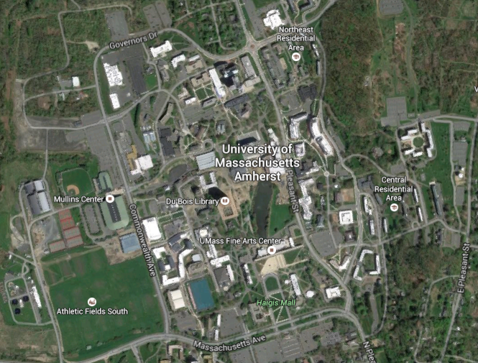
Geofencing
Geofencing is a way of creating virtual geographical boundaries.
The area is defined by a point and a radius.
Used for industrial and marketing applications
Can be paired with hardware and software to simulate a physical barrier
Department of Electrical and Computer Engineering Advisor: Professor Looze
Department of Electrical and Computer Engineering Advisor: Professors Looze, Ni

Slide 5
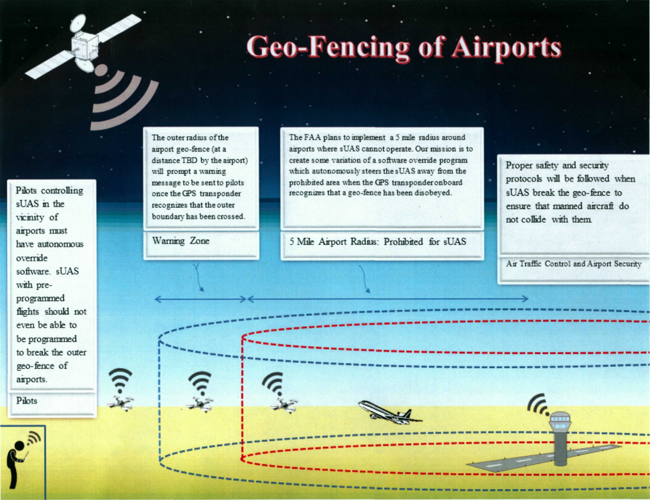
Design Overview
Artist:
Jared Geller
UMass Amherst
CEE Department
Department of Electrical and Computer Engineering Advisor: Professor Looze
Department of Electrical and Computer Engineering Advisor: Professors Looze, Ni

Slide 6
System Requirements
Department of Electrical and Computer Engineering Advisor: Professor Looze
Department of Electrical and Computer Engineering Advisor: Professors Looze, Ni

Slide 7
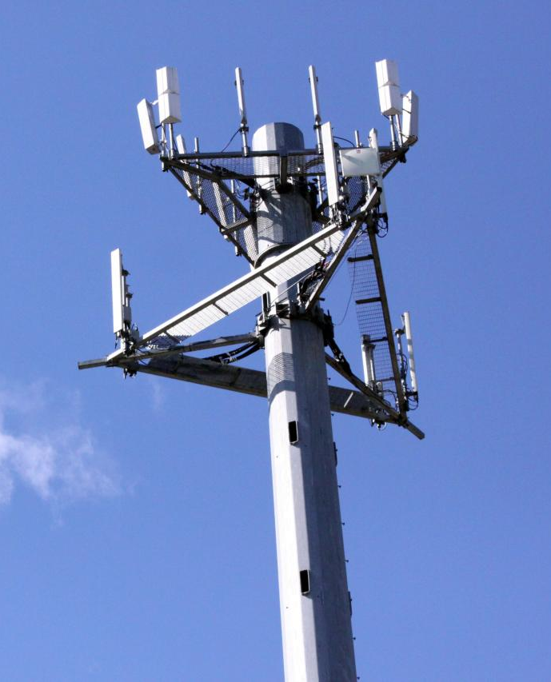
Inputs
GPS data updating multiple times per second
Adafruit FONA for pinpointing UAV location, 2 Hz update
Existing cellular infrastructure
Microcontroller communicates with user via 3G/4G antenna
Coordinates of Geofenced zones, retrieved from online database
Enclosure to house system
Attaches to the drone externally
Department of Electrical and Computer Engineering Advisor: Professor Looze
Department of Electrical and Computer Engineering Advisor: Professors Looze, Ni

Slide 8
Outputs
Alert at user interface allowing >10 seconds advance warning
1000 ft buffer zone
!
WARNING
Eliminates the threat once a breach of the critical airspace has been detected
Automatic Land function activated by Raspberry Pi
Safe airspace for passenger and commercial vehicles
Eliminates risk of accidents caused by user error
Your aircraft is approaching Bradley International Airport.
Department of Electrical and Computer Engineering Advisor: Professor Looze
Department of Electrical and Computer Engineering Advisor: Professors Looze, Ni

Slide 9
High Level Block Diagram
Drone I/O Subsystem
Geofencing Module
(Custom Enclosure)
Drone Flight Control System
(Already Installed)
Drone Body
Internet
User/Airport Notification
Department of Electrical and Computer Engineering Advisor: Professor Looze
Department of Electrical and Computer Engineering Advisor: Professors Looze, Ni

Slide 10
Detailed Block Diagram (Original Solution)
Our Geofencing Module (PCB enclosure)
Drone IO System (e.g. PX4 or native USB)
Controller (Raspberry Pi)
Wired Drone Interface
USB Power
Geofencing Code
USB
ADS-B Out Subsystem
ADS-B Antenna
Serial Digital In
GPS In Subsystem
3G/4G Out
Flight Code (ArduPilot or existing autopilot software)
GPS Antenna
3G/4G Antenna
Drone Flight Controller
Drone Body
Drone Flight Control System
App Fetch Server (Raspberry Pi)
3G/4G In
User Device Controller
GUI
Server Code
3G/4G Antenna
App Code
Internet
User/Airport Device with Notification App
Department of Electrical and Computer Engineering Advisor: Professor Looze
Department of Electrical and Computer Engineering Advisor: Professors Looze, Ni

Slide 11
Detailed Block Diagram (Modified Solution)
Our Geofencing Module (Enclosure)
I/O System
Controller (Raspberry Pi)
Wired Drone Interface
USB Power
USB
Geofencing Code
3G DONGLE
Serial Digital In
GPS Communication
GPS In Subsystem
3G/4G Communication
GPS Antenna
Flight Code (ArduPilot)
3G/4G Antenna
Drone Flight Controller
Drone Body
Drone Flight Control System
Geofencing Coordinate Server (Rasberry Pi)
3G/4G In
User Text Alert
3G/4G Antenna
Airport Email Alert
Internet
User/Airport Notification
Department of Electrical and Computer Engineering Advisor: Professor Looze
Department of Electrical and Computer Engineering Advisor: Professors Looze, Ni

Slide 12
Proposed MDR Deliverables
Demonstration of interpreting GPS data with microcontroller
Clear of geofenced area?
Quick response
LED indication
Demonstration of functioning GPS tracking and data logging
Transmit to microcontroller
Copter assembled/tested
Notification System
3G communication with cell phone
Create app server
Test communication with external device
Department of Electrical and Computer Engineering Advisor: Professor Looze
Department of Electrical and Computer Engineering Advisor: Professors Looze, Ni

Slide 13
Demonstration of Deliverables
Department of Electrical and Computer Engineering Advisor: Professor Looze
Department of Electrical and Computer Engineering Advisor: Professors Looze, Ni

Slide 14
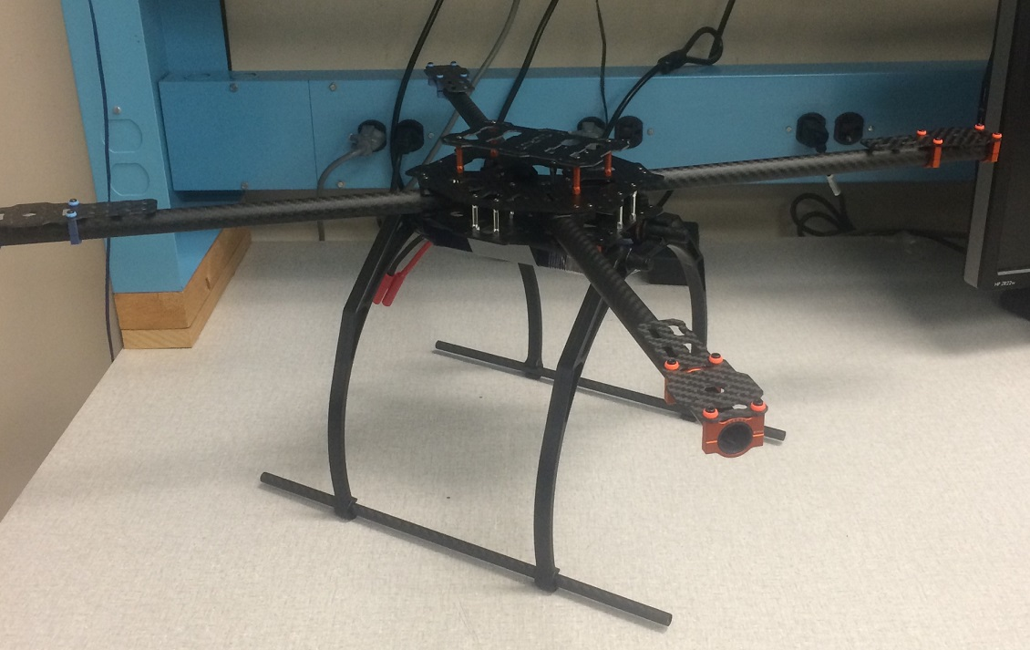
Drone Assembly
Carbon fiber frame fully assembled
Motor mounts and battery mounted in place
Waiting for rest of parts to arrive (ordered 4+ weeks ago)
Department of Electrical and Computer Engineering Advisor: Professor Looze
Department of Electrical and Computer Engineering Advisor: Professors Looze, Ni

Slide 15
GPS Tracking and Data Logging
Our Geofencing Module (Enclosure)
I/O System
Controller (Raspberry Pi)
Wired Drone Interface
USB Power
USB
Geofencing Code
3G DONGLE
Serial Digital In
GPS Communication
GPS Communication
GPS In Subsystem
3G/4G Communication
GPS Antenna
Flight Code (ArduPilot)
GPS Antenna
3G/4G Antenna
Drone Flight Controller
Drone Body
Drone Flight Control System
Geofencing Coordinate Server (Rasberry Pi)
3G/4G In
User Text Alert
3G/4G Antenna
Airport Email Alert
Internet
User/Airport Notification
Department of Electrical and Computer Engineering Advisor: Professor Looze
Department of Electrical and Computer Engineering Advisor: Professors Looze, Ni

Slide 16
GPS Tracking & Data Logging - Overview
Software for receiving satellite information with FONA breakout chip ready and tested
Just need passive antenna (ordered 9 days ago)
Developed algorithm on Raspberry Pi:
Initiates upon startup
Runs continuously in background while Raspberry Pi is on
Does not disrupt regular functionality of Raspberry Pi
Parses GPS In data into comprehensible latitude/longitude coordinates along with other important satellite data (NMEA format)
Longitude and latitude parameters passed into the data interpretation algorithm
Department of Electrical and Computer Engineering Advisor: Professor Looze
Department of Electrical and Computer Engineering Advisor: Professors Looze, Ni

Slide 17
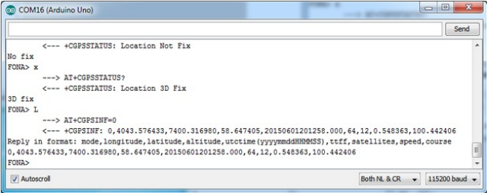
What does the satellite data look like?
NMEA Raw Data Received by FONA chip
Department of Electrical and Computer Engineering Advisor: Professor Looze
Department of Electrical and Computer Engineering Advisor: Professors Looze, Ni

Slide 18
What does the satellite data look like?
NMEA Raw Data Received by FONA chip
Numbers in this line stand for various data associated with the drone
latitude/longitude coordinates
altitude
speed
direction of travel
Department of Electrical and Computer Engineering Advisor: Professor Looze
Department of Electrical and Computer Engineering Advisor: Professors Looze, Ni

Slide 19
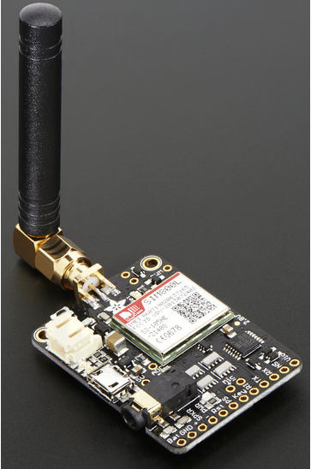
Next Steps
Desired line of data is sent from FONA to on board Raspberry Pi controller through hard wired TX/RX pins
This line must then be parsed so data can be understood and easily accessed by other algorithms through simple commands
Department of Electrical and Computer Engineering Advisor: Professor Looze
Department of Electrical and Computer Engineering Advisor: Professors Looze, Ni

Slide 20
Parsing the Data
Pynmea2
Python library for the NMEA 0183 protocol
Based on “pynmea” written by Becky Lewis
Parses data and into separate data variables that can be called individually
Department of Electrical and Computer Engineering Advisor: Professor Looze
Department of Electrical and Computer Engineering Advisor: Professors Looze, Ni

Slide 21
Summary of Function
The algorithm:
Begins executing at startup and runs in background as an infinite loop
Establishes/verifies communication with FONA
Begins continuously pulling GPS In data
Imports and runs desired data line through Pynmea2
Formats parsed components so each data value can be retrieved individually by other subsystems through simple commands
Logs desired data for later use
Department of Electrical and Computer Engineering Advisor: Professor Looze
Department of Electrical and Computer Engineering Advisor: Professors Looze, Ni

Slide 22
GPS Data interpretation
Our Geofencing Module (Enclosure)
I/O System
Controller (Raspberry Pi)
Wired Drone Interface
USB Power
Geofencing Code
USB
3G DONGLE
Serial Digital In
GPS Communication
3G/4G Communication
GPS In Subsystem
GPS Antenna
3G/4G Antenna
Flight Code (ArduPilot)
Drone Flight Controller
Drone Body
Drone Flight Control System
Geofencing Coordinate Server (Rasberry Pi)
3G/4G In
User Text Alert
3G/4G Antenna
Airport Email Alert
Internet
User/Airport Notification
Department of Electrical and Computer Engineering Advisor: Professor Looze
Department of Electrical and Computer Engineering Advisor: Professors Looze, Ni

Slide 23
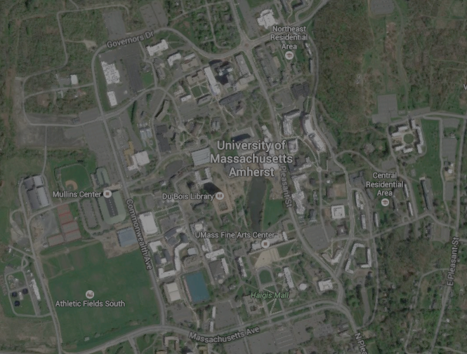
GPS Data Interpretation - Overview
Coded geofencing algorithm to determine if FONA chip is within a specified radius of a fixed location
Raspberry Pi determines if it is inside geofenced area, inside buffer zone, or clear of restricted space
Notification code implemented inside buffer zone
LED indication
Yellow in buffer zone, red in geofenced area
No LEDs when clear of restricted space
Lon
Distance
Lat
Department of Electrical and Computer Engineering Advisor: Professor Looze
Department of Electrical and Computer Engineering Advisor: Professors Looze, Ni

Slide 24
GPS Data Interpretation - Outside Geofence
Department of Electrical and Computer Engineering Advisor: Professors Looze, Ni

Slide 25
GPS Data Interpretation - Buffer Zone
Department of Electrical and Computer Engineering Advisor: Professors Looze, Ni

Slide 26
GPS Data Interpretation - Inside Geofence
Department of Electrical and Computer Engineering Advisor: Professors Looze, Ni

Slide 27
Notification System
Our Geofencing Module (Enclosure)
I/O System
Controller (Raspberry Pi)
Wired Drone Interface
USB Power
USB
Geofencing Code
3G DONGLE
Serial Digital In
GPS Communication
3G/4G Communication
GPS In Subsystem
GPS Antenna
3G/4G Antenna
Flight Code (ArduPilot)
Drone Flight Controller
Drone Body
Drone Flight Control System
Geofencing Coordinate Server (Rasberry Pi)
3G/4G In
User Text Alert
Airport Email Alert
Internet
User/Airport Notification
Department of Electrical and Computer Engineering Advisor: Professor Looze
Department of Electrical and Computer Engineering Advisor: Professors Looze, Ni

Slide 28
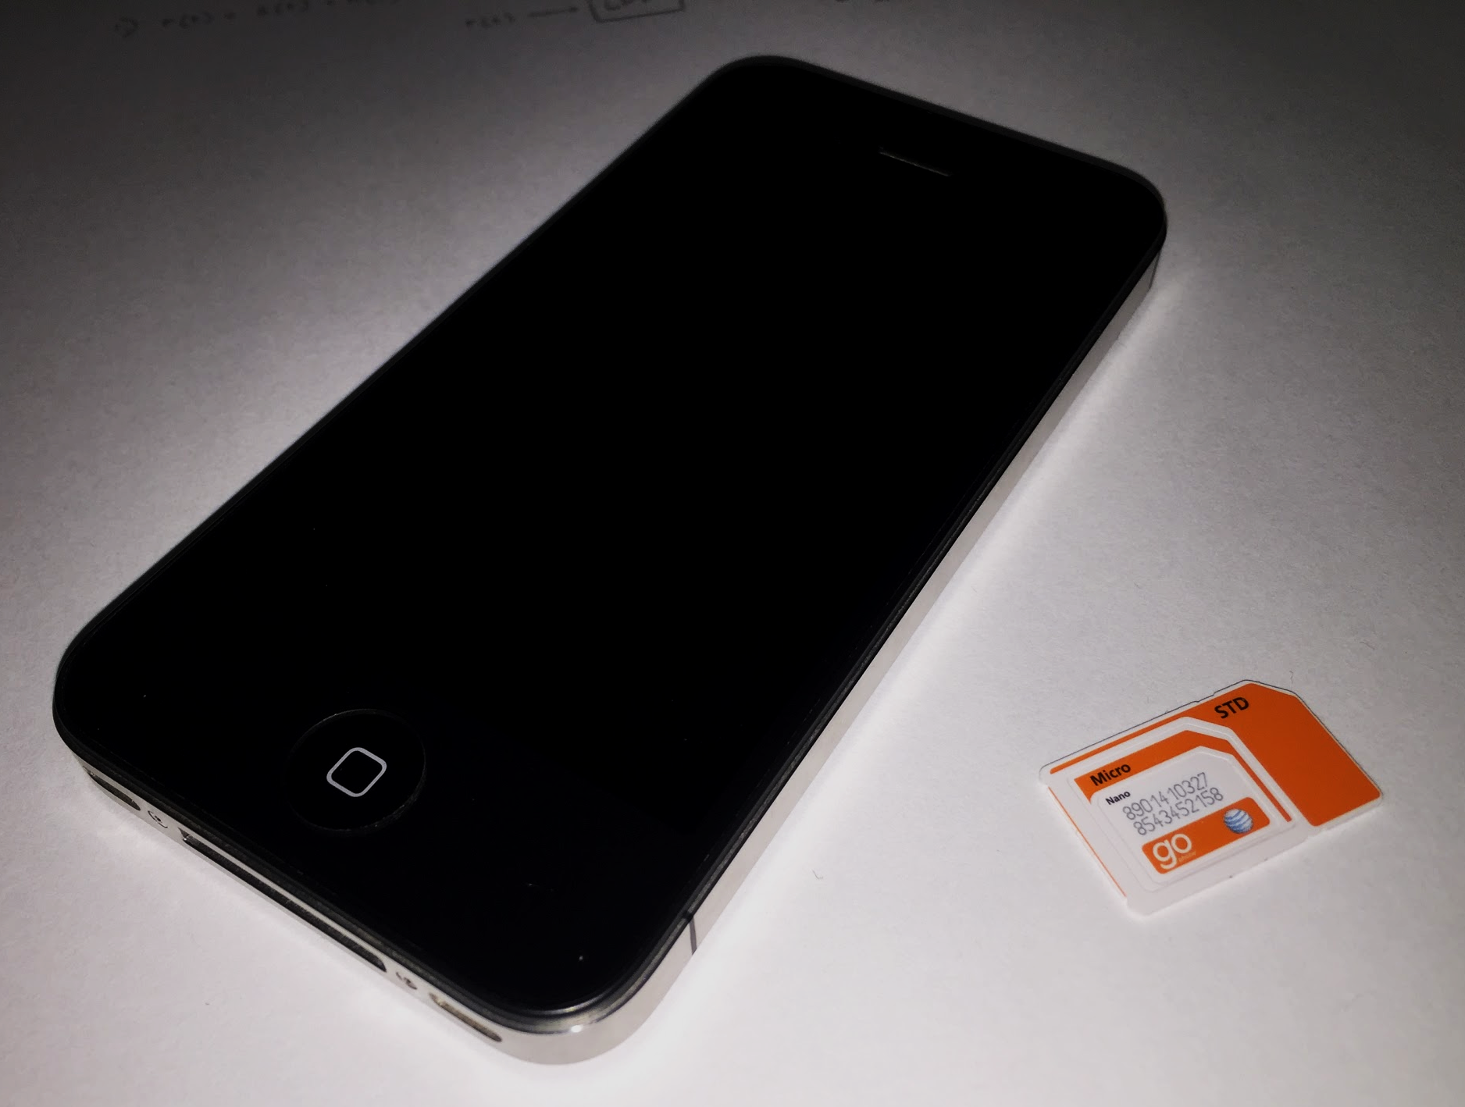
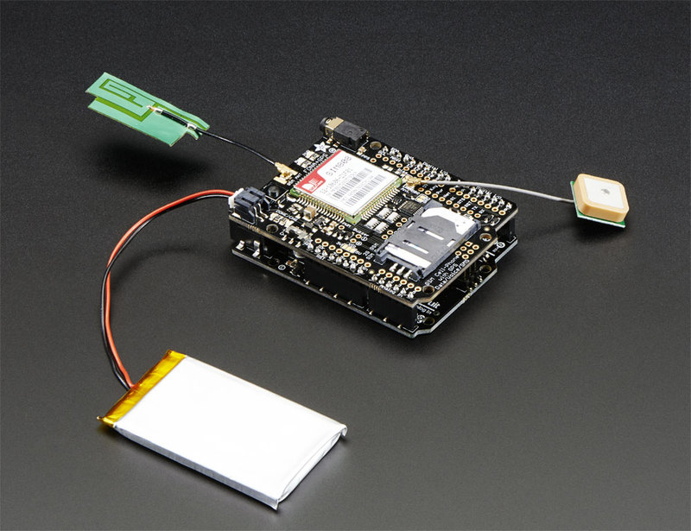
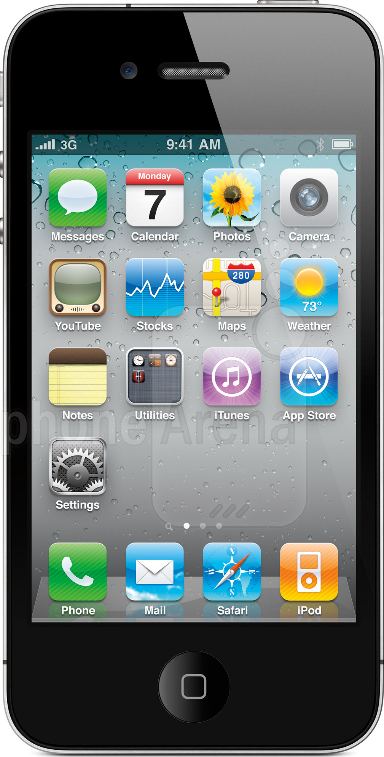
Notification System - Overview
Communication established between Raspberry Pi and FONA
Texting function automated in Python
Initial text message warns user when buffer zone is breached
SMS received within 10 seconds of transmission
Second message notifies user when UAV has been cleared of the buffer zone
AT Command
Pings antenna
Response
Message Sent
Raspberry Pi
FONA 3G Device
GSM Network (AT&T)
Phone
Department of Electrical and Computer Engineering Advisor: Professor Looze
Department of Electrical and Computer Engineering Advisor: Professors Looze, Ni

Slide 29
Notification System
Below: Python script for sending text message
Signal strength in dB (should be 5 or greater)
Above: Minicom terminal displaying the Raspberry Pi/FONA interface
Department of Electrical and Computer Engineering Advisor: Professor Looze
Department of Electrical and Computer Engineering Advisor: Professors Looze, Ni

Slide 30
Geofencing Coordinate Server
Our Geofencing Module (Enclosure)
I/O System
Controller (Raspberry Pi)
Wired Drone Interface
USB Power
USB
Geofencing Code
3G DONGLE
Serial Digital In
GPS Communication
GPS In Subsystem
3G/4G Communication
GPS Antenna
Flight Code (ArduPilot)
3G/4G Antenna
Drone Flight Controller
Drone Body
Drone Flight Control System
Geofencing Coordinate Server (Raspberry Pi)
3G/4G In
User Text Alert
3G/4G Antenna
Airport Email Alert
Internet
User/Airport Notification
Department of Electrical and Computer Engineering Advisor: Professor Looze
Department of Electrical and Computer Engineering Advisor: Professors Looze, Ni

Slide 31
Geofencing Coordinate Server - Overview
Image of Server During Operation
Key Functions of Subsystem:
store geofencing data in .txt files on host FTP file server
dynamically sync files with drone-client at custom intervals
Subsystem Components:
host device: Raspberry Pi Model B+ w/current version of Raspian OS (Linux)
open source GNU vsftp package to enable FTP server functionality on Linux device
data file/s maintained on host in .txt format
client device: 2nd Raspberry Pi on-board geofence module
FTP retrieval script or program executing on client
Desired Qualities of Subsystem:
low-latency communication between client and host
(< 10 seconds sufficient)
drone-client will dynamically receive new coordinate data:
(1) client enters new region
(2) updated coordinate file available
latitude
geofence radius (ft)
longitude
Sample Geofencing
Data File (.txt)
Department of Electrical and Computer Engineering Advisor: Professor Looze
Department of Electrical and Computer Engineering Advisor: Professors Looze, Ni

Slide 32
Geofencing Coordinate Server - Host Configuration
physical host is FTP server running on Raspberry Pi Model B+ (w/Raspian OS)
must install GNU’s official vsftpd protocol for enabling native FTP behavior in Linux
-sudo apt-get install vsftpd
should also edit FTP configuration file ‘/etc/vsftpd.conf’ to enable:
-read permissions (but disable writes)
-auto-run on system startup
identify host device’s IP address:
-enter ifconfig command to check
Host IP address
Linux FTP configuration file
Department of Electrical and Computer Engineering Advisor: Professor Looze
Department of Electrical and Computer Engineering Advisor: Professors Looze, Ni

Slide 33
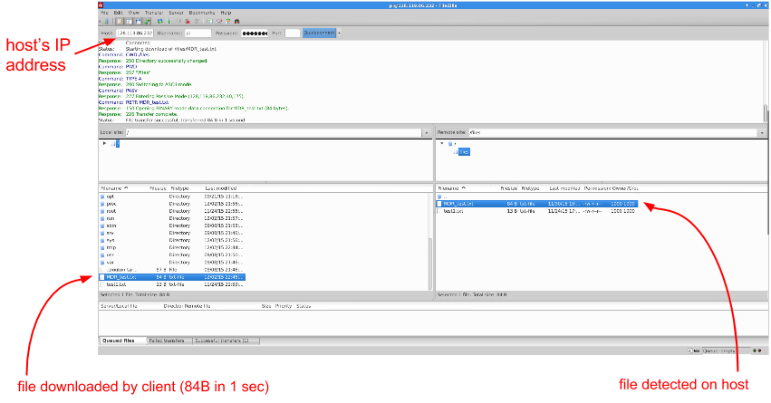
Geofencing Coordinate Server - Client Configuration
physical client is 3G connected Raspberry Pi embedded within drone
client can access FTP server over the Internet to download geofencing data files
on demo day: client will run a Linux script to sync automatically at custom interval
Department of Electrical and Computer Engineering Advisor: Professor Looze
Department of Electrical and Computer Engineering Advisor: Professors Looze, Ni

Slide 34
Team Responsibilities and Schedule
Department of Electrical and Computer Engineering Advisor: Professor Looze
Department of Electrical and Computer Engineering Advisor: Professors Looze, Ni

Slide 35
Team Responsibilities and Schedule
Responsibilities for CDR:
Develop autopilot software for controlled landing at geofence boundary
Establish reliable communication between the Pixhawk and the Raspberry Pi
Responsibilities for Project Completion:
Assist in writing technical Report
Become proficient in piloting the drone for demonstration and testing
Jason Danis
EE
Department of Electrical and Computer Engineering Advisor: Professor Looze
Department of Electrical and Computer Engineering Advisor: Professors Looze, Ni

Slide 36
Team Responsibilities and Schedule
Responsibilities for CDR:
Complete building and testing of drone once hardware is delivered
Develop software to override Pixhawk flight software upon entering critical airspace and execute the self-landing algorithm
Design and 3D print the external enclosure to house the added on-board hardware
Responsibilities for Project Completion:
Assist in final design modifications and testing
Assist in completing the report and preparing the demo
Chris Boselli
EE
Department of Electrical and Computer Engineering Advisor: Professor Looze
Department of Electrical and Computer Engineering Advisor: Professors Looze, Ni

Slide 37
Team Responsibilities and Schedule
Responsibilities for CDR:
Create Python script to provide email notification for airport in addition to user SMS
Establish communication with server to receive data via 3G communication and send to Raspberry Pi
Responsibilities for Project Completion:
Assist in writing final report
Participate in building, testing, and debugging integrated ASPECTS system, both on campus and at Bradley Airport
Sandra McQueen
EE
Department of Electrical and Computer Engineering Advisor: Professor Looze
Department of Electrical and Computer Engineering Advisor: Professors Looze, Ni

Slide 38
Team Responsibilities and Schedule
Responsibilities for CDR:
Develop set of regional databases containing geofencing data for each major commercial/military airport located within region
Configure 3G client to automatically sync with FTP host server at custom intervals using a Linux command line script
Assist in debugging and testing of integrated ASPECTS systems
Responsibilities for Project Completion:
Follow up with Bradley Airport & FAA to conduct live field testing and verify that real-life geofencing database is accurate
Assist in writing final project report
Become proficient in other subsystems in order to assist teammates in debugging and back them up in case of emergency
Alex Breger
EE
Department of Electrical and Computer Engineering Advisor: Professor Looze
Department of Electrical and Computer Engineering Advisor: Professors Looze, Ni

Slide 39
Team Responsibilities and Schedule
Proposed Schedule for the Upcoming Semester:
MDR
CDR
Completion
Drone
assembled
& working
Technical report complete
Demonstrate ability to override Pixhawk
Demo
ready for presentation
Subsystems fully integrated
All final modifications complete
Department of Electrical and Computer Engineering Advisor: Professor Looze
Department of Electrical and Computer Engineering Advisor: Professors Looze, Ni

Slide 40
Estimated Time Spent Coding (hours)
Team Member | Learning Languages | Coding | Debugging | Total
Alex | 10 | 15 | 20 | 45
Christopher | 4 | 12 | 20 | 36
Jason | 4 | 20 | 30 | 54
Sandra | 4 | 15 | 30 | 49
Department of Electrical and Computer Engineering Advisor: Professor Looze
Department of Electrical and Computer Engineering Advisor: Professors Looze, Ni

Slide 41
Estimated Time Spent on Hardware (hours)
Team Member | Building | Testing | Total
Alex | 4 | 15 | 19
Christopher | 10 | 20 | 30
Jason | 2 | 15 | 17
Sandra | 2 | 15 | 17
Department of Electrical and Computer Engineering Advisor: Professor Looze
Department of Electrical and Computer Engineering Advisor: Professors Looze, Ni

Slide 42
Total Hours Spent on Project
Team Member | Total
Alex | 64
Christopher | 66
Jason | 71
Sandra | 66
Department of Electrical and Computer Engineering Advisor: Professor Looze
Department of Electrical and Computer Engineering Advisor: Professors Looze, Ni

Slide 43
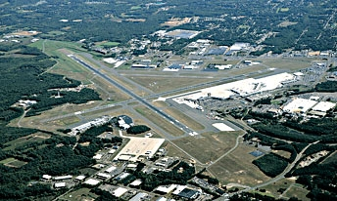
Meeting at Bradley Airport
Consulted with Bradley Ass’t Administrator Benjamin Parish and FAA Air Traffic Manager Ayaz Kagzi
Drones pose a major risk; GeoFencing “solves a significant part of the problem”
Requested a notification to Air Traffic Control via text or email
Data collection helps them to recognize trends and define problems
Department of Electrical and Computer Engineering Advisor: Professor Looze
Department of Electrical and Computer Engineering Advisor: Professors Looze, Ni

Slide 44
Questions or Comments?
Department of Electrical and Computer Engineering Advisor: Professor Looze

