Slide 1
E-PiL
Emergency Personnel Indoor Locator
Mike Anderson
Greg Buitkus
Paul Fallacara
Brett Gavin
Notes:
Mike
Good Morning
We are SDP Team 21 and our project is the E-PiL.
Which stands for Emergency Personnel Indoor Locator.

Slide 2
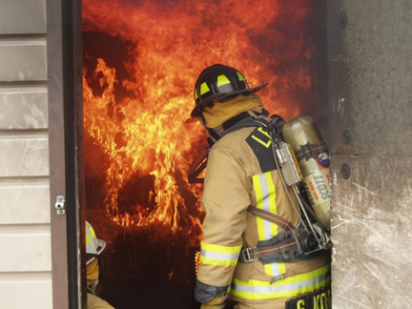
Problem Statement
Problem:
Safety: Emergency personnel can get trapped in hazardous buildings without being able to be located by other units
Accuracy: Modern GPS localization does not work indoors
Temporary: Emergency situations do not allow for pre-setup that current indoor localization systems often use
Notes:
Mike
For emergency personnel,
locating their exact position in hazardous buildings and situations is vital for the safety not just in the surrounding community
but for the personnel providing the safety procedures as well.
Current technology in use is inaccurate which is very lethal to these personnel given all these situations are sporadic and unpredictable.

Slide 3
Team
Mike Anderson- EE
Class of 2015
Greg Buitkus- CSE
Class of 2015
Ramakrishna Janaswamy- Professor
Faculty Advisor
Brett Gavin- CSE
Class of 2015
Paul Fallacara- EE
Class of 2015
Notes:
All

Slide 4
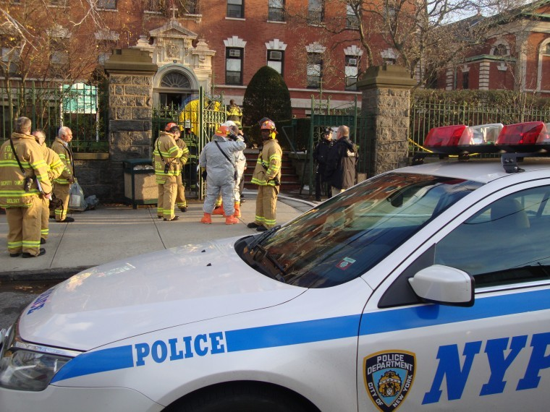
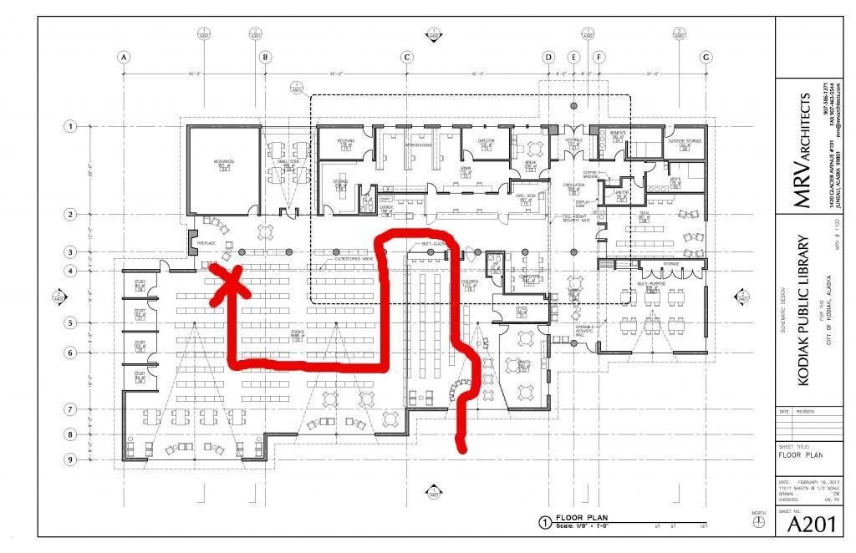
Effect on the Individual
Makes a user trackable in an emergency situation
Will make entering a hazardous building much safer for the user
Notes:
Paul

Slide 5
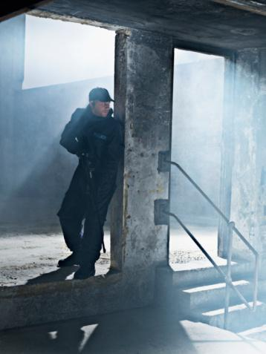
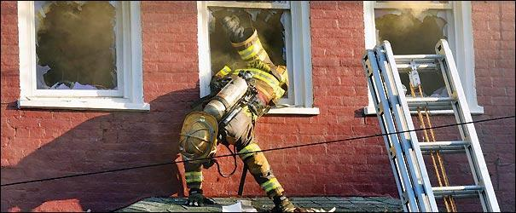
Effect on Group
Team members will be able to locate each other quickly
Rescue injured/unconscious emergency personnel
“Stealth” for police/military
Notes:
Paul

Slide 6
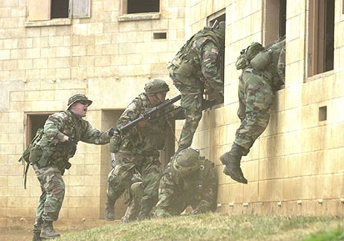
Significance
Invaluable time saved in distress situations:
Every second saved could save a life
Useful in many areas
Emergency Personal: Firefighter, Police, Medical
Military
Notes:
Greg
Indoor location is a tough problem to solve
most solutions require in place systems
solution can be used in emergency situations, no infrastructure is needed
the faster you can get to a person in an emergency situation the better

Slide 7
Requirements Analysis: Specifications
Accurate indoor location data
Does not lose individual due to range limits
Safe to use while working in an emergency situation
Non-inhibiting
Notes:
Greg
no blackouts due to ranging constraints
as easy to use as possible during emergency situations

Slide 8
Inputs and Outputs
Inputs
Accelerometer Data
Gyroscope Data
Altimeter Data
Acoustic Range Data
Bluetooth Beacon Signal Strength
Outputs
Mapping of emergency personnel’s location within the building
Notes:
Brett
Inputs
10 DOF IMU, getting digital accelerometer and gyroscope data in 3 degrees of freedom
IMU also contain an altimeter which we will use to keep track of how high the user is (used to calculate floor)
Ultrasonic sensors will be used to find distance from walls (which will be used to find the users velocity)
2 for each person (1 looking forward, 1 looking to the side)
Bluetooth beacons that the user will put in doorways throughout the house (each user will carry 3 to 4 beacons)
Outputs:
We will display a mapping of the path that the user followed while indoors. This mapping show

Slide 9
Requirement Analysis – Technical Specifications
Power Specifications: Battery life at least 2 hours
Weight Specifications: Less than 5 pounds
Input Specifications:
IMU correctly detects orientation and direction of movement
Ranging data will always be available from either bluetooth beacons or ultrasonic sensors
Output Specifications:
Localization user within 1 meter of accuracy
Accurately recreates the path they took through the building
Path must be displayed in a way that is followable
Real-time output response – Less than 30 second delay
Notes:
Brett
Most situations are resolved in less than a half hour (2 to be safe)
weigh less than a pound in the pack
The inputs to the system
IMU
Ultrasonic
Wifi
Output
localization 1 meter
less than 30 second delay
recreates the path the user took through the building

Slide 10
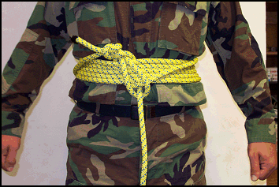
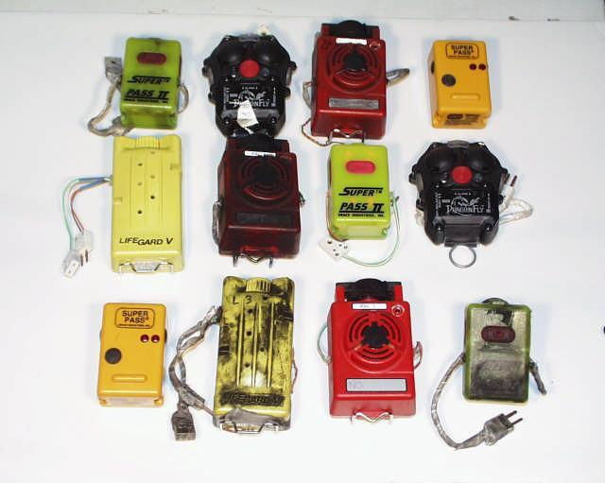
Design Alternatives - Rudimentary
Rope Trail
Pros
Low cost
Easy to follow
Cons
High burning potential
Restrictive(movement, breathing, range, etc)
Easily snagged
PASS (DSU)
Pros
Unrestrictive and small size
Emits loud piercing noise if in distress
Cons
Inaccurate(sound reflects off objects)
Decently expensive(about $500 per unit)
Notes:
Paul

Slide 11
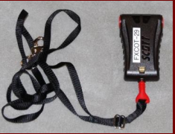
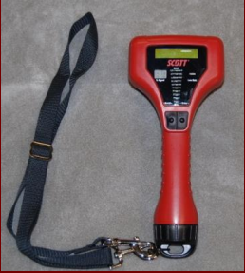
Design Alternatives - Pak-Tracker
Pros
Battery powered (400hrs)
Unrestrictive
Emitted sound frequency increases the closer someone gets to the device
Cons
Need to scroll through ID of each device individually
Only works for range of 300 meters line of sight
Sound travels around objects
Notes:
Mike
As with the devices Paul spoke about, another locating device is the PAK Tracker.
The device functions like a metal detector. When personnel are “downed” or unable to move,
the device emits a loud sound to alert the rest of the team. As other members approach,
the sound increases in frequency. the downside to this device is that you need to scroll through the IDs of each device individually,
which is very inefficient, and the device only works within its range of 300 meters line of sight (can’t recognize signal through walls).

Slide 12
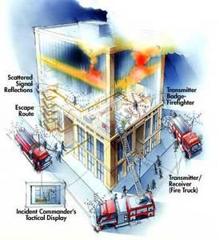
Design Alternatives - RF Triangulation
Pros
Unrestrictive
High accuracy when in sight
Cons
Inaccurate when out of sight
Requires set up before entering the building
Complicated RF systems drives up cost
Notes:
Greg
The drop across the walls of the house is unknown
must set up a bunch of beacons outside

Slide 13
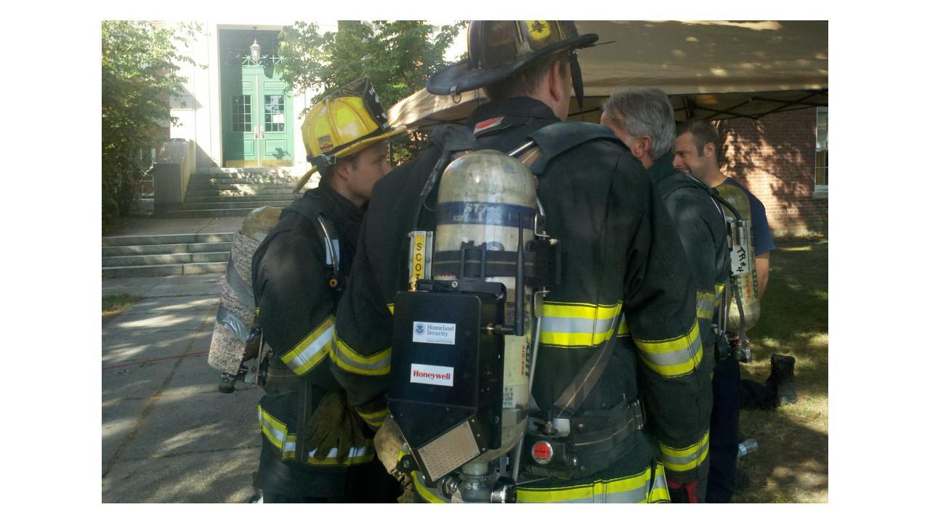
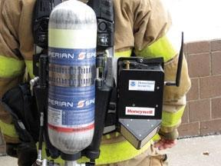
Design Alternatives - GLANSER
Pros
Unrestrictive
Accurate
Cons
Very expensive
$2000-$3000 per unit
Most efficient only when building plans are known and integrated
Incident Commander Unit is connected to the GLANSER network over wifi/ethernet
Notes:
Paul

Slide 14
Our Solution - Block Diagram
Computer
Input To Raspberry Pi
6 DOF IMU
GUI
Range Finder Array
Bluetooth BLE Beacon
Wireless Network
Bluetooth
Input Parsing
Bluetooth Beacon Data
Localization
Cell Phone
Data
Server Metadata Upload
Server
Phone
Notes:
Greg
Using the Raspberry Pi’s GPIO and serial data pins, inputs from the 10 DOF IMU and the Range finders
Using an XBee bluetooth radio this data is sent to the phone that is on the person
The phone also collects the beacon data
all this gets packaged and sent to a server
Server runs the localization algorithm
Sends data to the computer which will display the information in a graphical user interface

Slide 15
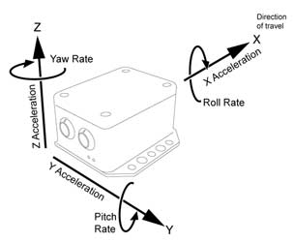
Input Concept – 10 Degree of Freedom IMU
Inertial Measurement Unit reports digital accelerometer, gyroscope and altimeter data
2000 degrees/second gyro resolution
2-16 g selectable accelerometer resolution
170 mm altimeter resolution
Notes:
Paul

Slide 16
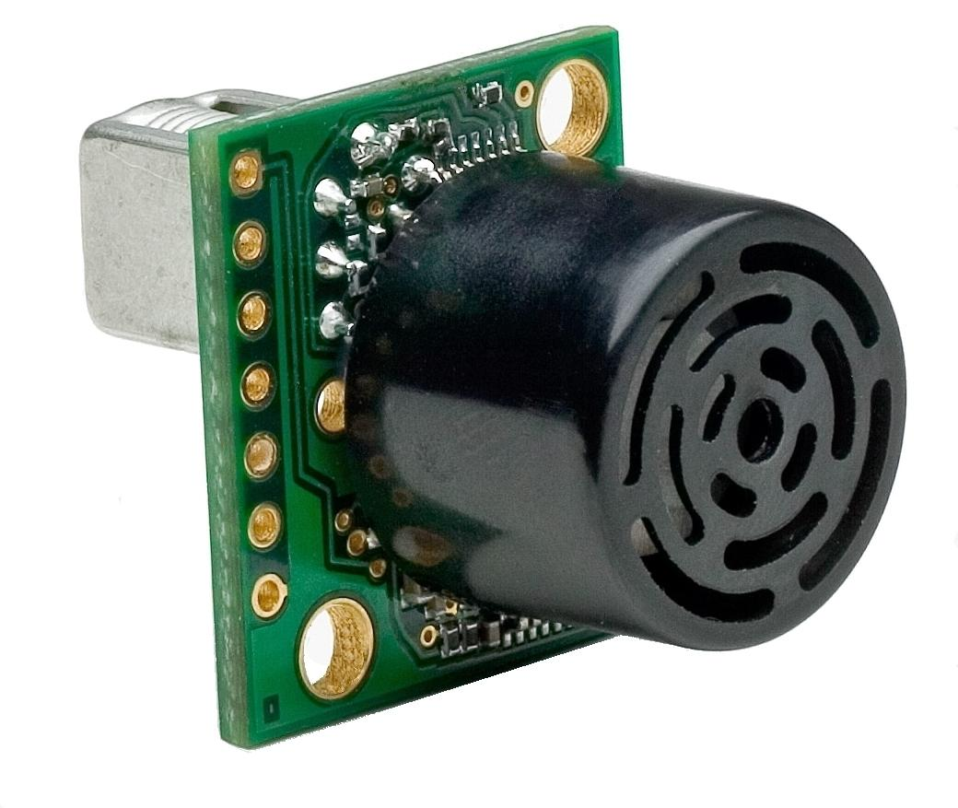
Input Concept – Ultrasonic Range Finder
MB1360 XL-MaxSonar-AEL0 (42kHz Ultrasonic Rangefinder)
Read from all 3 sensor outputs: Analog Voltage, Serial, Analog Envelope
Real-time automatic calibration (voltage, humidity, ambient noise)
Maximum range of 420 inches (35 ft)
Firmware filtering for better noise tolerance and clutter rejection
Resolution of 1 cm
10Hz reading rate
Notes:
Paul

Slide 17
Input Concept – Bluetooth Beacon
Multiple Bluetooth Transmitters
Compact device that emergency personnel will place in the doorways
Strength of signal will allow for an accurate refinement of the location data collected by the IMU
Bluetooth will help to eliminate the error growth issue that using strictly inertial positioning devices create
Notes:
Mike
These compact bluetooth transmitters will be dropped from a backpack by the personnel at every doorway they pass through.
Since each of these transmitters will be in line of sight we can use the signal strength on the phone as ranging data.

Slide 18
Data Delivery Concept - Phone
Android application collects data via Bluetooth and parses information into data structures
Reads the the bluetooth beacons strength of signal
Phone sends metadata to server using TCP/IP connection.
Notes:
Greg
Android app
collects data from raspberry pi
reads bluetooth beacon strength of signal
sends data to server using a TCP/IP connection via wireless data

Slide 19
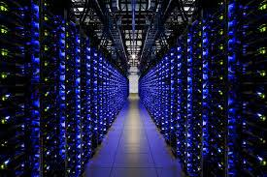
Data Delivery Concept - Server
Server will unpack metadata received from phone
Localization calculation
GUI friendly data will be prepared to be sent
Notes:
Brett
Once all of the input data arrives from the phone, the server will perform localization calculations for the path the user took.
The server will then take the localization data and send it to a computer that is located with a team leader who is tracking the position of the user
The information that the server sends will be easy for the computer with the team lead to display graphically

Slide 20
Localization Concept
Localization - Ultrasonic/IMU
Constantly track users distance from a wall using ultrasonic data
Find the users speed
IMU gyroscopes will give direction
Can tell when user is turning without really moving
Altimeter data will indicate when user goes up or down
Localization - Bluetooth
Use bluetooth signal strength to find distance from known beacons
Useful for when ultrasonic sensors find a “dead zone”
Stops errors from compounding
Notes:
Brett (ultrasonic/imu) & Greg (bluetooth)
Localization Ultrasonic/IMU
-ultrasonic constantly gives information about how far the user is from a wall (can gain user velocity from this)
-gyroscopes in the imu will give information about what direction the users is facing when they move
-altimeter data will allow us to know when the user goes up or down a floor
-using solely this method leads to errors building on themselves, which could result in an end position that is very off, so we also decided to use bluetooth beacons to correct this problem, which greg will talk about now
Bluetooth
Beacons dropped at the doorways
Makes sure line of sight is always true
will help to line up the localization data from the inertial ranginging system
eliminates the largest error in inertial ranging systems of error growing over time

Slide 21
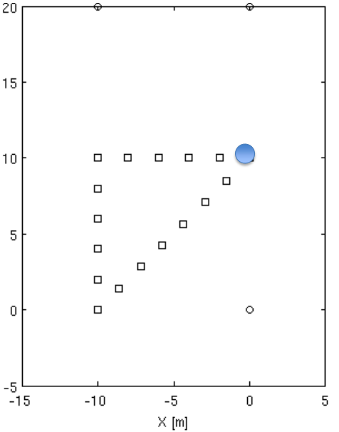
Output Concept
Take collected data and display the path the person took while inside
Display each floor of the building separately
Update the path taken in real time
Displayed path must be easy to follow/reproduce
Notes:
Brett
-Whenever the local computer receives data from the server it will display a data point in the fashion shown in this picture
-Whenever the data received from the server indicates that the user went to a new floor the computer will show a new box used to display the given path the user has taken on that specific floor
-The display will clearly mark where the users path started on a given floor and if necessary where it ended (ie they went up or down a floor)

Slide 22
MDR Deliverables
Input:
Demonstrate (under ideal conditions)
working IMU
functioning ranging from ultrasonics
functioning ranging from bluetooth beacons
Data Delivery:
Bare bones app to collect and send data from Bluetooth
Data from phone to server
Output:
Create a localization algorithm with dummy data
GUI
Notes:
Paul

Slide 23
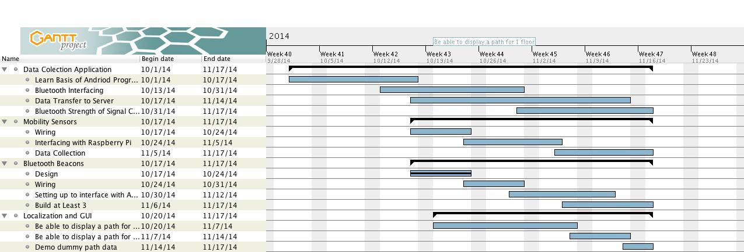
Gantt Chart
Notes:
Mike
This is our timeline of completion by MDR.
This breakdown of each stage within the partitions, show the objectives we plan to complete and when.

Slide 24
Questions?
Notes:
Mike
This is our timeline of completion by MDR.
This breakdown of each stage within the partitions, show the objectives we plan to complete and when.

