Slide 1
E-PiL
Emergency Personnel Indoor Locator
Mike Anderson
Greg Buitkus
Paul Fallacara
Brett Gavin
Notes:
Mike
Good Morning
We are SDP Team 21 and our project is the E-PiL.
Which stands for Emergency Personnel Indoor Locator.

Slide 2
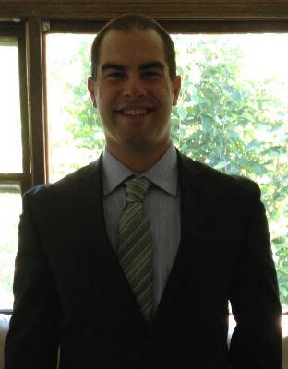

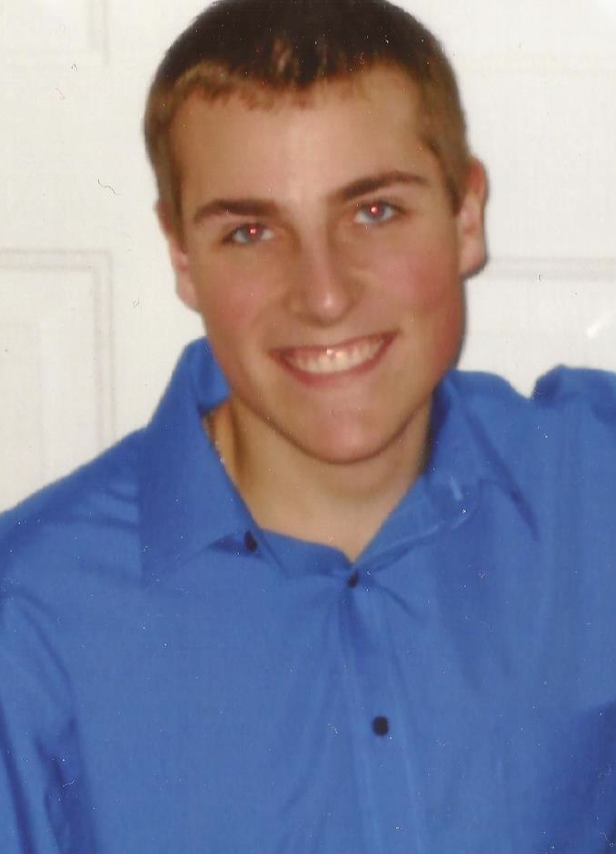
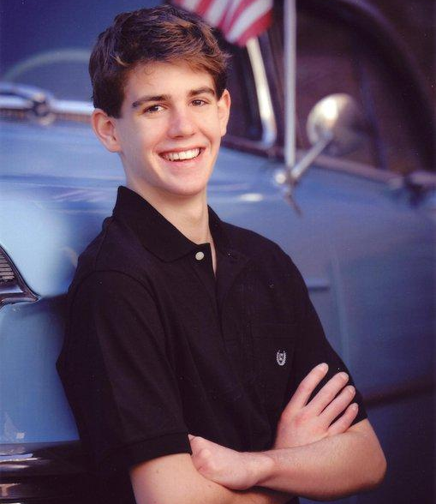
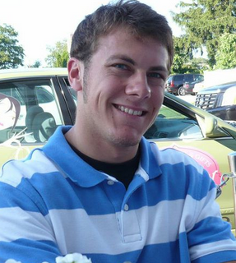
Team
Mike Anderson- EE
Class of 2015
Greg Buitkus- CSE
Class of 2015
Ramakrishna Janaswamy- Professor
Faculty Advisor
Brett Gavin- CSE
Class of 2015
Paul Fallacara- EE
Class of 2015
Notes:
All

Slide 3
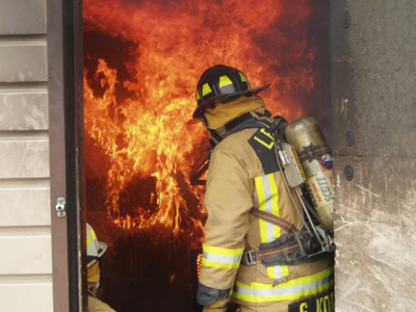
Problem Statement
Problem:
Safety: Emergency personnel can get trapped in hazardous buildings without being able to be located by other units
Accuracy: Modern GPS localization does not work indoors
Temporary: Emergency situations do not allow for pre-setup that current indoor localization systems often use
Notes:
Mike
For emergency personnel,
locating their exact position in hazardous buildings and situations is vital for the safety not just in the surrounding community
but for the personnel providing the safety procedures as well.
Current technology in use is inaccurate which is very lethal to these personnel given all these situations are sporadic and unpredictable.

Slide 4
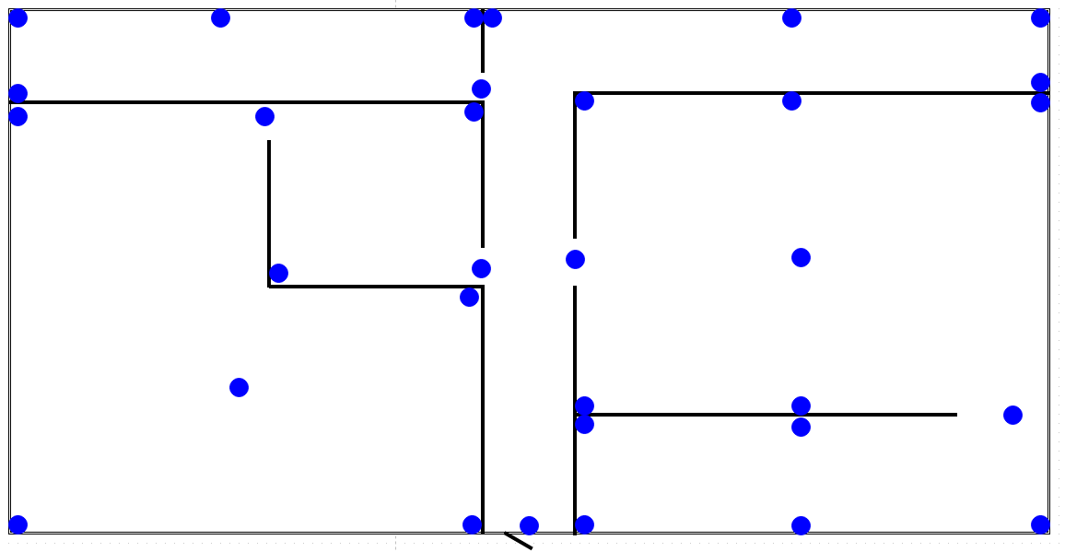
Refined Problem Statement
Create a functioning temporary indoor positioning system
Combining dead-reckoning approach with Bluetooth low energy ranging data
System used in large warehouse or office building settings with blueprints filed
Person will be in sight (4m) of at least 3 beacons at all times using the comprehensive placement application
Notes:
Greg
For emergency personnel,
locating their exact position in hazardous buildings and situations is vital for the safety not just in the surrounding community
but for the personnel providing the safety procedures as well.
Current technology in use is inaccurate which is very lethal to these personnel given all these situations are sporadic and unpredictable.

Slide 5
Updated Requirements
Power Specifications: Battery life at least 2 hours
Weight Specifications: Less than 10 pounds
Input Specifications:
IMU and range finder finds correctly detects orientation and direction of movement
Ranging data will always be available from either bluetooth beacons or ultrasonic sensors
Output Specifications:
Localization will be able to determine what room of a single floor building the user is in
Accurately recreates the path they took through the building
Path must be displayed in a way that is followable
Real-time output response – Less than 30 second delay
Notes:
Brett
Most situations are resolved in less than a half hour (2 to be safe)
weigh less than a pound in the pack
The inputs to the system
IMU
Ultrasonic
Wifi
Output
localization 1 meter
less than 30 second delay
recreates the path the user took through the building

Slide 6
Our Previous Solution:Block Diagram
Computer
Input To Raspberry Pi
6 DOF IMU
GUI
Range Finder Array
Bluetooth BLE Beacon
Wireless Network
Bluetooth
Input Parsing
Bluetooth Beacon Data
Localization
Cell Phone
Data
Server Metadata Upload
Server
Phone
Notes:
Previous: Greg

Slide 7
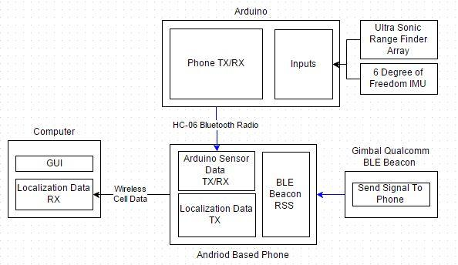
Our Redesigned Solution:Block Diagram
Notes:
Greg
Highlight differences between old and new BD

Slide 8
Proposed MDR Deliverables
Input:
Demonstrate (under ideal conditions)
working IMU
functioning ranging from ultrasonics
functioning ranging from bluetooth beacons
Data Delivery:
Bare bones app to collect and send data from Bluetooth
Data from phone to server
Output:
Create a localization algorithm with dummy data
GUI
Notes:
Paul

Slide 9
Modified MDR Deliverables
Input:
Demonstrate
working IMU
functioning ranging data from ultrasonics
functioning ranging data from bluetooth beacons
Data Delivery:
Bare bones app to collect and send data from Bluetooth
Output:
Create a GUI to display location data
GUI should be able to get dummy data from a server
This simulates getting data from the phone
Notes:
Paul

Slide 10

MDR Deliverables - Android App
App collects and displays incoming sensor data from the arduino.
IMU and Gyro Data displayed in XYZ components
Range finder displayed in centimeters
Separate App Displays RSSI of Bluetooth BLE Beacons
Conflicting accessing to the bluetooth adapter caused issues where the apps could not be integrated
Notes:
Greg

Slide 11
MDR Deliverables - Ultra Sonic/IMU Data
To show that both the ultrasonic range finder and IMU are functioning correctly, both devices are connected to an arduino uno based on their data sheets
The range finder has two ways of connecting: analog and PW
Decided to use analog output because data was more accurate
Displays distance to object in front of it in centimeters
IMU is a combo of an accelerometer and gyroscope
Arduino code was based off of Varesano.net
The accelerometer displays the G force in xyz
gyroscope shows angular velocity in degrees per second in xyz
Notes:
Paul

Slide 12
MDR Deliverables - Bluetooth Ranging Data
The proposed deliverable for functioning ranging data from the beacons was completed.
During testing when the phone’s screen facing away from the beacons, returned better results.
Due to the confined spaces, the inside results were better than the outside results.
As predicted the signal decreases in strength when the beacon is around a corner/out of sight but can still be seen.
Notes:
Mike

Slide 13
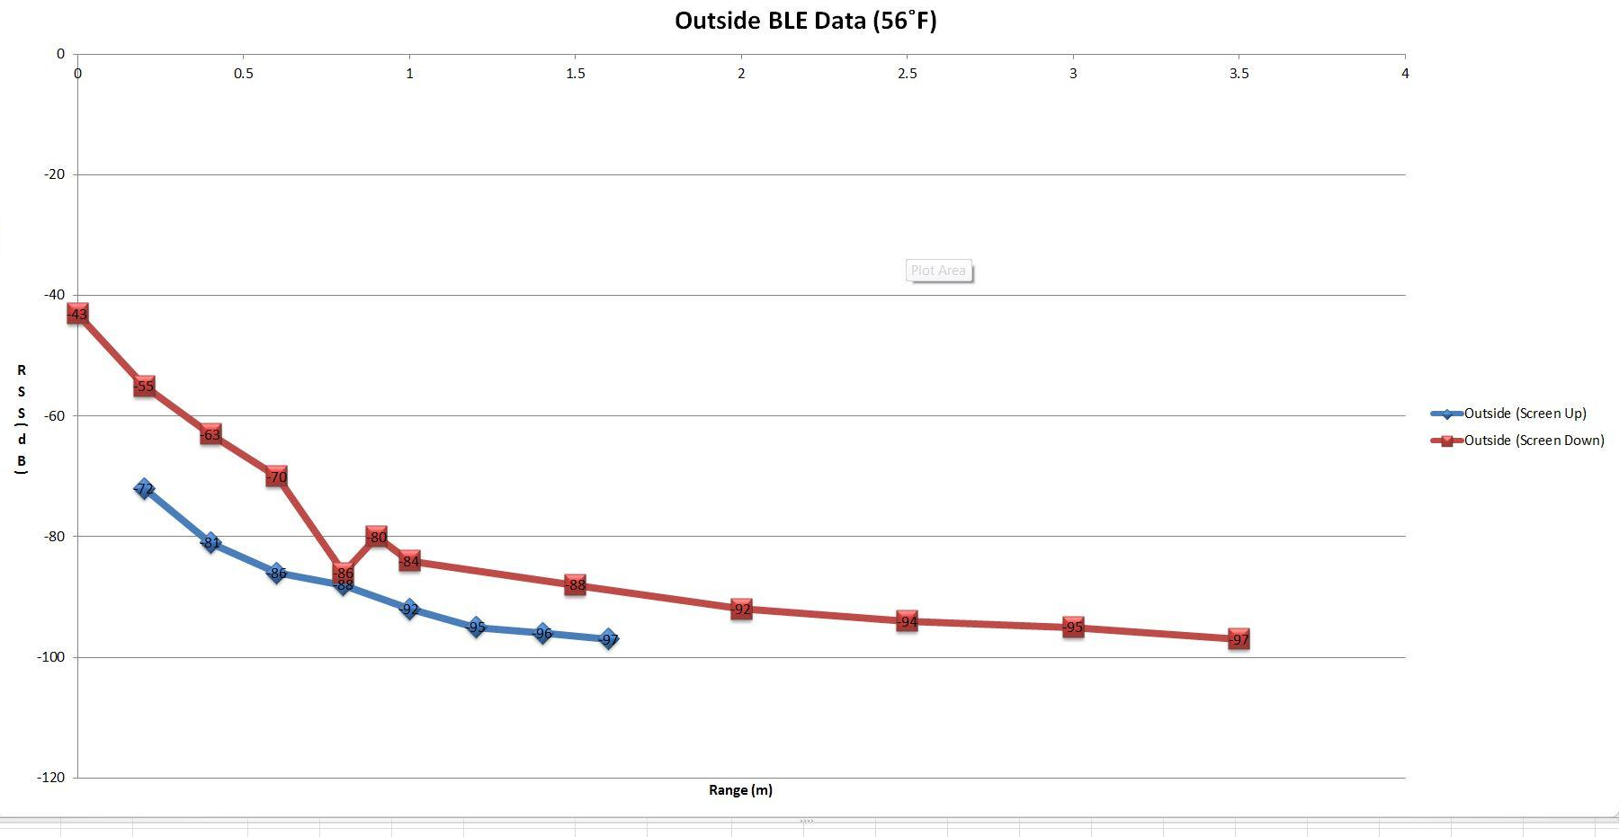
Outside Testing (56˚F)
Notes:
Mike

Slide 14
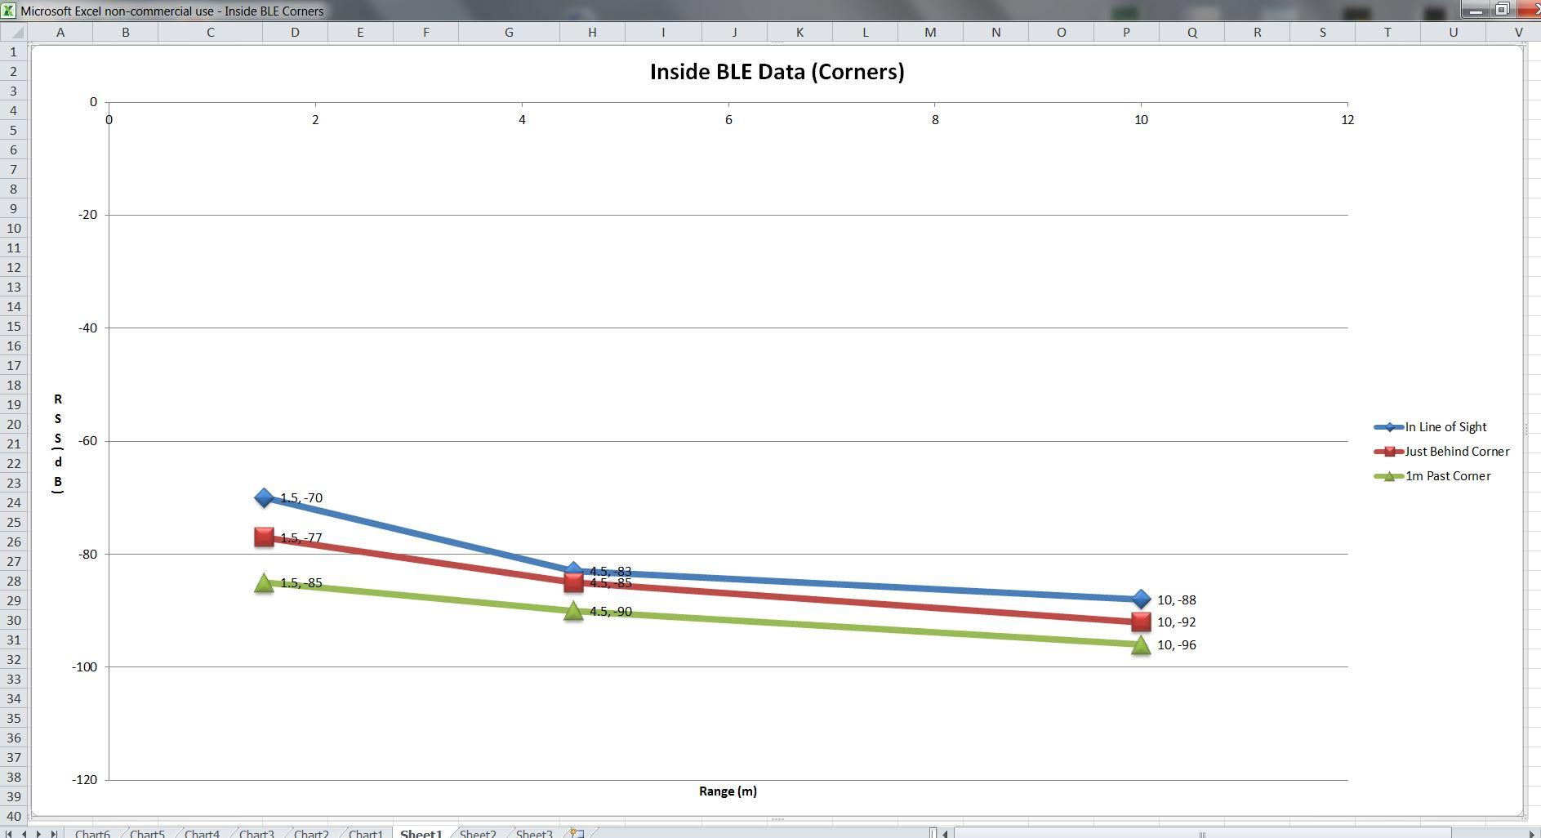
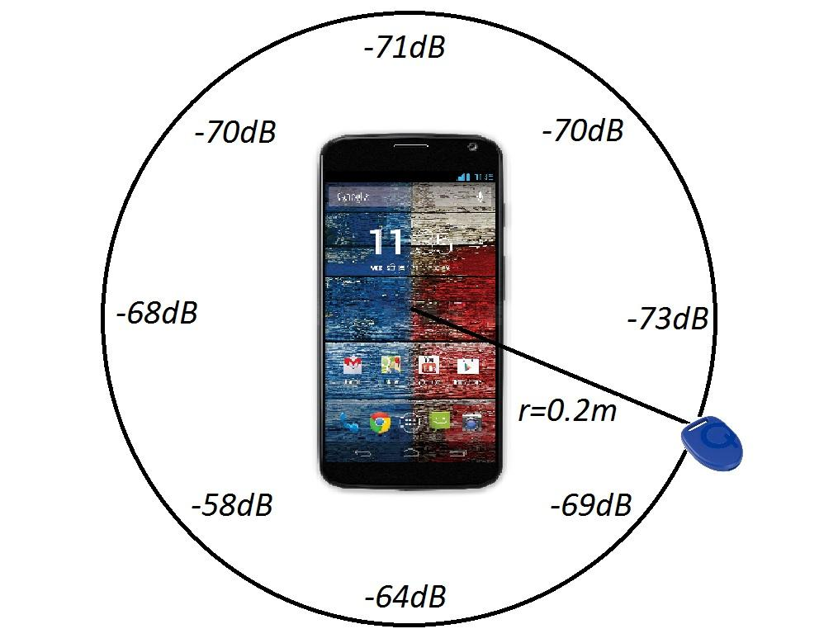
Inside Testing (Corners) & Circumference
Notes:
Mike

Slide 15
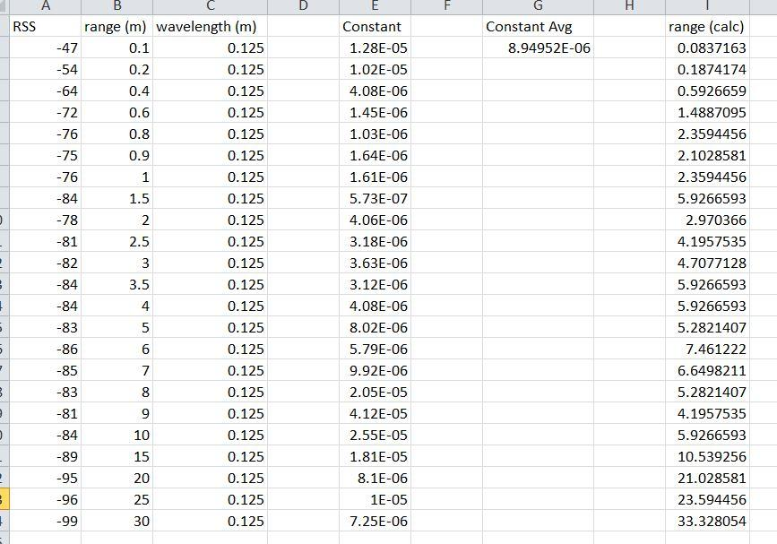
Calculating Range Given Signal Strength
Using the equation:
RSS=10log((gt*gr)/4pi^2)+20log(wavelength/range)
we solve for the signal constants.
Then after taking an average constant, we now use the equation above to solve for ranges given certain RSS data points.
Notes:
Mike

Slide 16
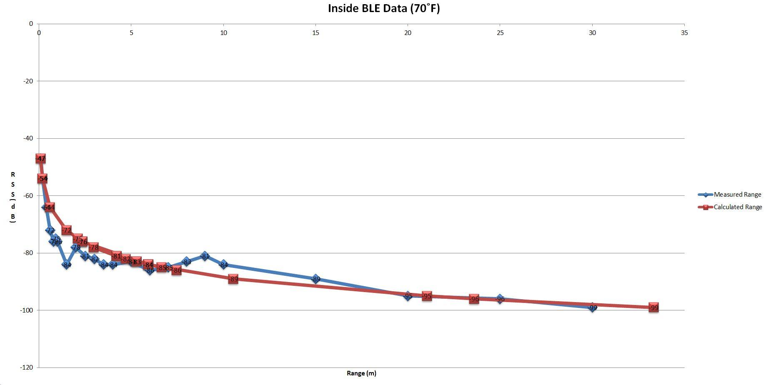
Inside Testing (70˚F)
Notes:
Mike

Slide 17
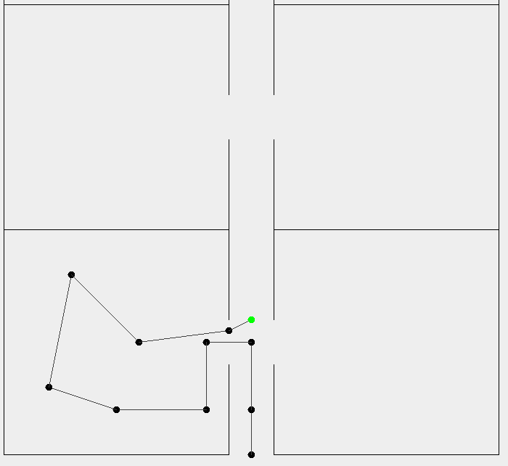
MDR Deliverables - Output GUI
Create Java program to display simulated data
Data can come from 2 sources
Read in from a text file
Get data from a “server”
Simulates data coming from the app
Program designed to easily integrate with app
Notes:
Brett

Slide 18
Live Demos
Range Finder/IMU (communication to app)
Bluetooth Ranging Data (communication to app)
Output GUI
Notes:
All

Slide 19
CDR Deliverables
Brett - Refine output GUI. Read in floor plan from image. Localization algorithm with ideal data
Paul - Integrating two range finders to work together; Integrate all of my portions together(Arduino, IMU, Range Finders, and storage for whole system)
Mike -Power Supply; Work with Greg to refine the BLE data; Work with Greg and Paul to integrate Com Board with Arduino and Android
Greg - Add beacon placement to the app. Combine RSSI and Data collection apps. Work with Brett on localization algorithm
Notes:
All

Slide 20
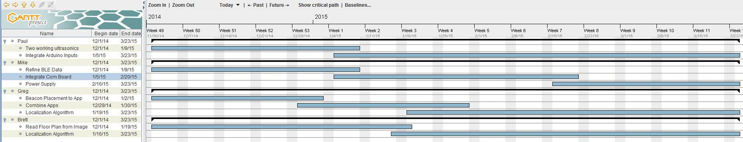
Gantt Chart
Notes:
Brett

